Slide 1
FOR DISCUSSION: InChI JNA/WASM Java+JavaScript Joint Development Proposal
Bob Hanson
St. Olaf College
hansonr@stolaf.edu
March 30, 2025

Slide 2
Original configuration
Different starting points
Two divergent pathways
Independent development
Limited JavaScript dev

Slide 3
Desired configuration
Same starting point
Common IXA-only interface
Simple methods only
No significant changes in Java
Equivalent calls in JavaScript

Slide 4
Preliminary work
No changes were required in inchi-C.
Two methods were added to inchilib simply to round out the options and provide a built-in way to access the InChI version. These included IXA_Builder_GetInchiVersion and IXA_MOL_ReadAuxInfo

Slide 5
Preliminary work
WASM makefile adds IXA methods and renames output to match JNA native registration.
Java2script Eclipse transpiler upgraded to implement “native” methods.
SwingJS runtime adds Clazz._loadWasm, linking Java native methods with WASM exports when native methods are registered in JavaScript

Slide 6
Preliminary work
JNA-InChI adds InchiAPI.java and IXA.java, avoiding all references to C structures.
Adds additional InChI-to-InchiInput flag “fixamide”, which converts inchi-internal N=C-OH (iminol) to HN-C=O (amide) when creating an InchiInput object from an InChI.

Slide 7
Preliminary work
CDK adds SwingJS-j2sExport class CDK.java as well as streamlined InchiGenerator.java and InchiToStructure.java classes functional in Java and JavaScript
OCL configures inchiOCL class to handle all Java and JavaScript calls to InchiAPI

Slide 8
Preliminary work
Website demonstrating using both CDK and OpenChemLib in JavaScript for generating InChI from structures and structures from InChI.
Includes InChI to structure editor, structure editor-to-InChI, CDX and CDXML file dropping, SMILES-to-InChI, MOL file-to-InChI, InChI to PNG, InChI-to-SVG, and OCL molecule-to-CDK molecule.
https://chemapps.stolaf.edu/inchi/cdk-web-demo/

Slide 9
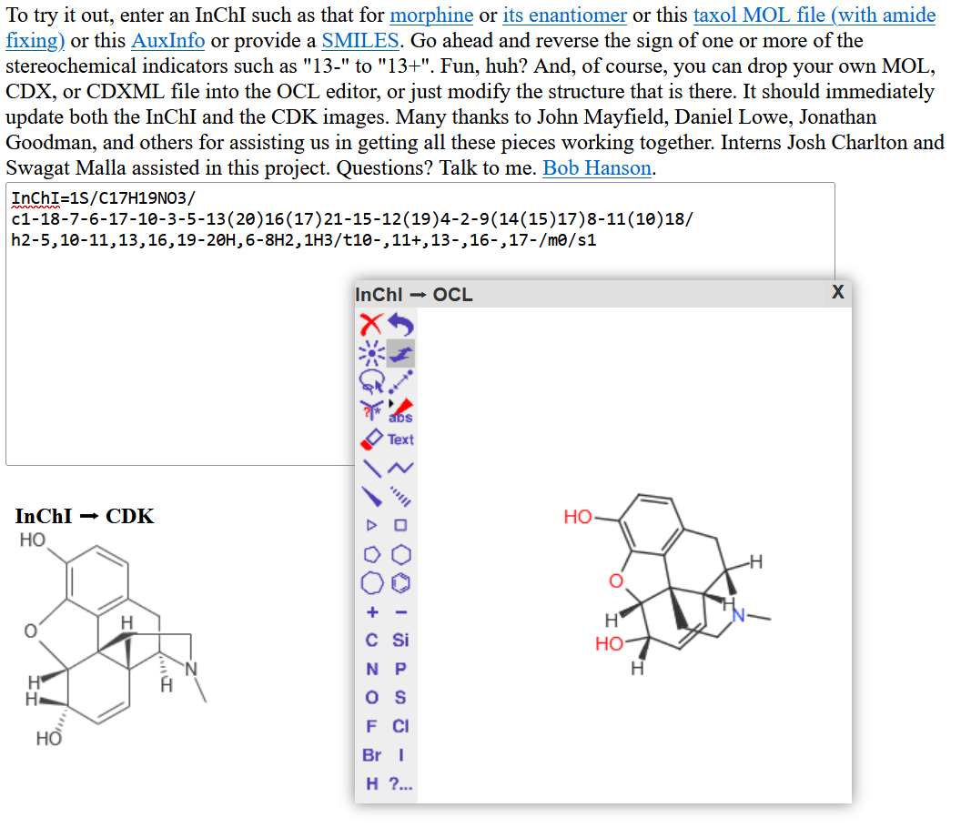

Slide 10
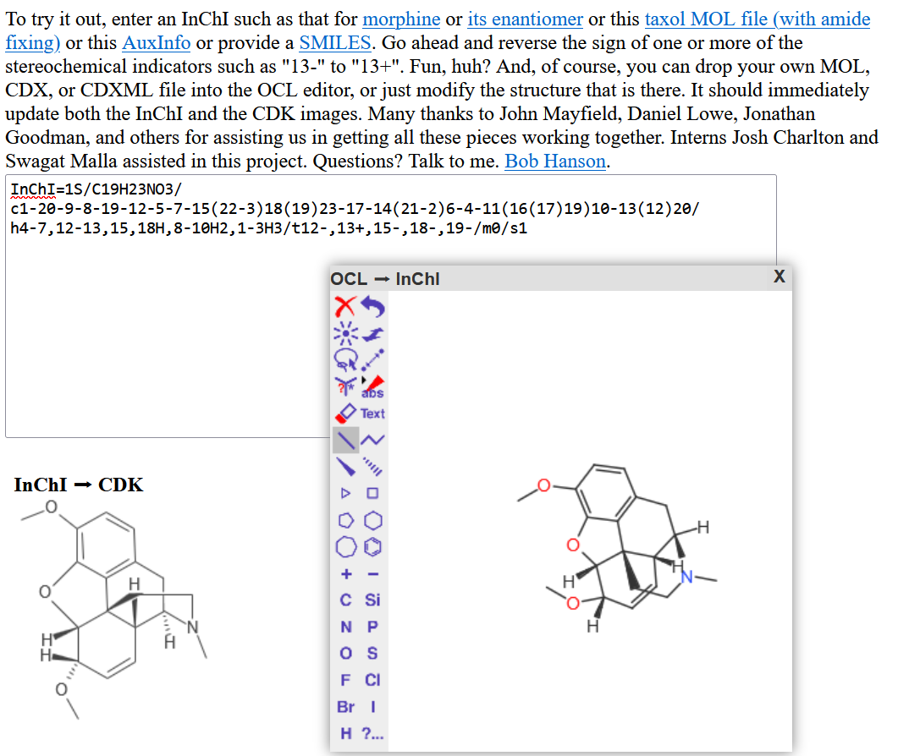

Slide 11
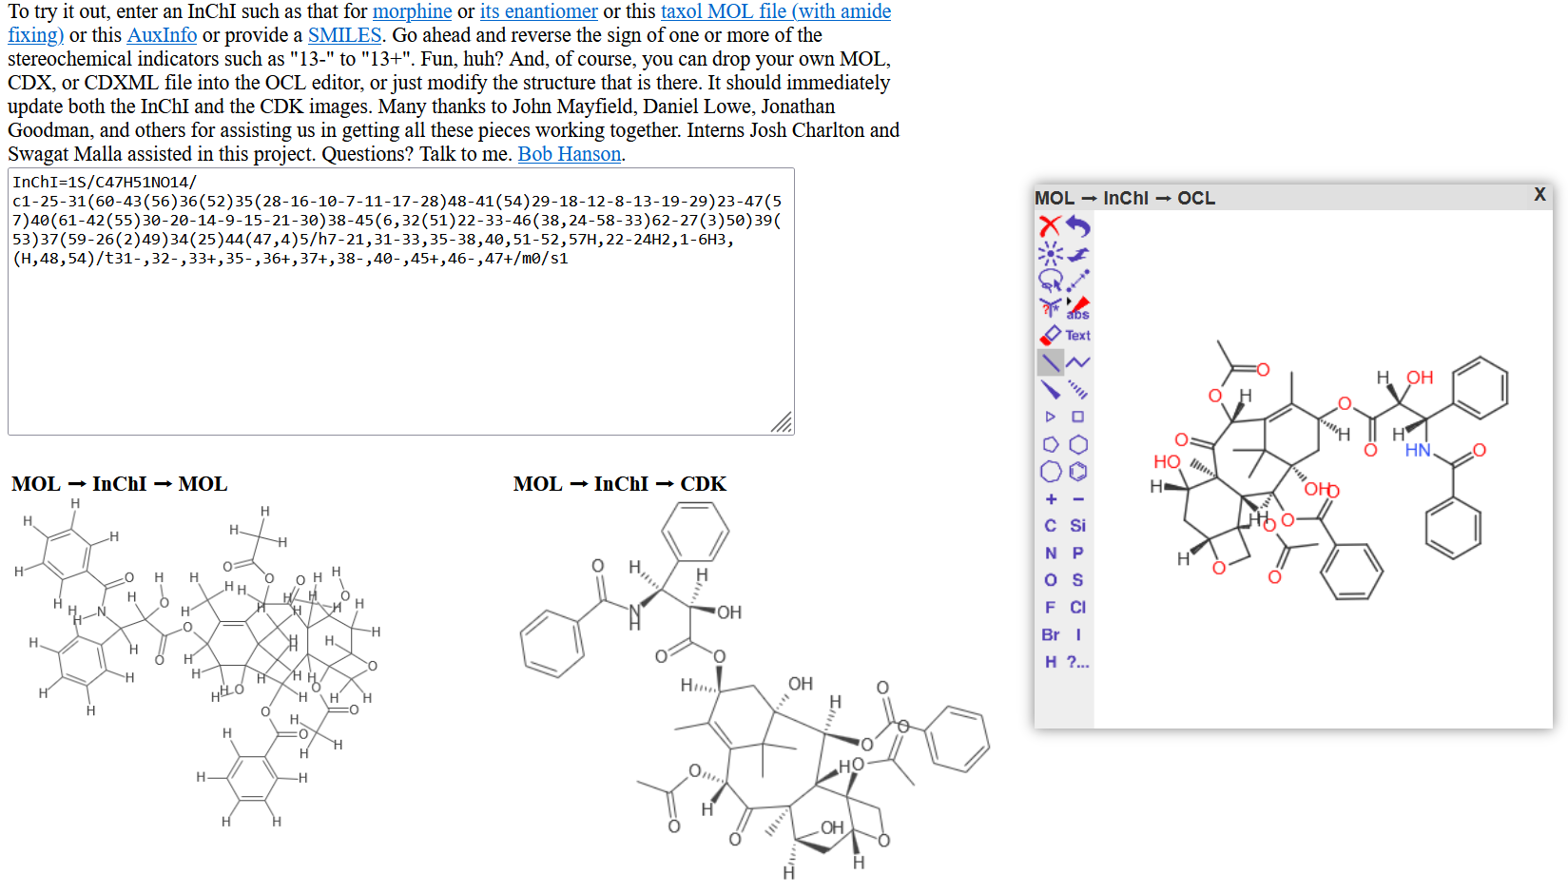

Slide 12
Coding Examples
The following examples use SwingJS. As such, the Java methods map directly to JavaScript functions. All of the functions in bold are written in Java. They are accessed in both Java and JavaScript. For JavaScript apps not using SwingJS, we would provide IXA calls using Emscripten methods cwrap and ccall. (And the apps would be responsible for anything else). But in SwingJS that is already taken care of by the JavaScript version of the native library registration process.
Classes swingjs.CDK and swingjs.OCL are imported in Java as CDK and OCL. In the JavaScript they are script-local references to var CDL = swingjs.CDK and var OCL = swingjs.OCL. These two classes provide equivalent calls in CDK and OCL in both Java and JavaScript for generally useful InChI-related methods. IXA in Java refers (currently) to io.github.dan2097.jnainchi.IXA, and in JavaScript refers to the same, but is also aliased to J2S.wasm.jnainchi.IXA.

Slide 13
Coding examples (InChI-to-image, Java)
BufferedImage inchiToImage(String inchi) {
try {
Pointer hStatus = IXA.IXA_STATUS_Create();
Pointer hMolecule = IXA.IXA_MOL_Create(hStatus);
void IXA.IXA_MOL_ReadInChI(hStatus, hMolecule, inchi);
InchiInput input = CDK.getInchiInputFromMoleculeHandle(hStatus, hMolecule, “fixamide”);
IAtomContainer mol = CDK.getCDKMoleculeFromInchiInput(input);
BufferedImage image = (mol.getAtomCount() == 0 ? null : CDK.getImageFromCDKMolecule(mol));
return image;
} catch (e) {
throw e;
} finally {
IXA.IXA_STATUS_Destroy(hStatus);
IXA.IXA_MOL_Destroy(null, hMolecule);
}
}
Note that all of the IXA method parameters and returns are simple variable types or com.sun.jna.Pointer objects. These are easily handled in JavaScript.

Slide 14
Coding examples (InChI-to-image, JavaScript)
function inchiToImage(inchi, moreOptions) {
try {
var hStatus = IXA.IXA_STATUS_Create();
var hMolecule = IXA.IXA_MOL_Create(hStatus);
IXA.IXA_MOL_ReadInChI(hStatus, hMolecule, inchi);
var input = CDK.getInchiInputFromMoleculeHandle(hStatus, hMolecule, “fixamide”);
var mol = CDK.getCDKMoleculeFromInchiInput(input);
var image = (mol.getAtomCount$() == 0 ? null : CDK.getImageFromCDKMolecule(mol));
return (image == null ? "" : CDK.getDataURIForImage(image);
} catch (e) {
throw e;
} finally {
IXA.IXA_STATUS_Destroy(hStatus);
IXA.IXA_MOL_Destroy(null, hMolecule);
}
}
For JavaScript, in the end we to turn the image into a DataURI in order to display it; this is not necessary in Java.

Slide 15
Coding examples (SwingJS CDK to OCL molecule)
Java:
StereoMolecule cdkToOCLMolecule (IAtomContainer mol) {
InchiInput input = CDK.getInchiInputFromCDKMolecule(mol);
return OCL.getOCLMoleculeFromInchiInput(input);
}
JavaScript (SwingJS):
cdkToOCLMolecule = function(mol) {
var input = CDK.getInchiInputFromCDKMolecule(mol);
return OCL.getOCLMoleculeFromInchiInput(input);
}
These two versions are essentially identical. In both Java and JavaScript, converting simple structures from CDK to and from OCL is just a matter of passing them through InchiInput. One need not actually create the InChI string. No string parsing is required, and no stereochemistry is lost.

Slide 16
Moving Forward
Obviously needs more discussion!
Submit PR requests for InChI, JNA, OCL, and CDK
Proposing two new InChI repositories:
Inchi-API-JNA
Focus on Java, with simple IXA methods only
Inchi-API-WASM
Focus on JavaScript, using simple IXA methods only
Coordinated development
None of this requires the use of SwingJS; we only use that because it also gives us access to OpenChemLib and the CDK in JavaScript.

