Slide 1
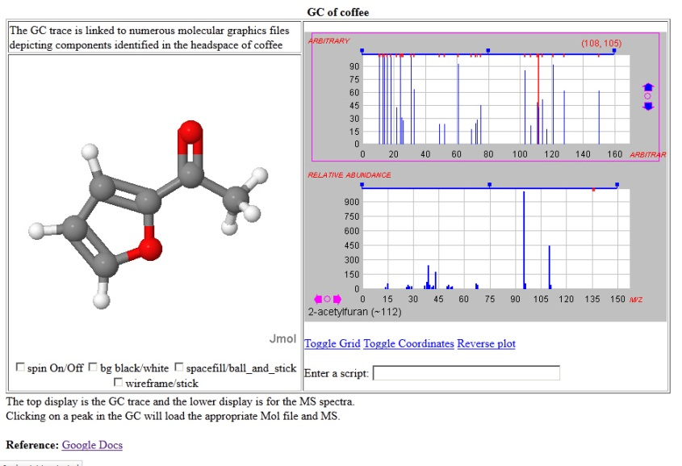
Robert M. Hansonª and Robert J. Lancashire^{b} ª St. Olaf College, Northfield, MN 55057, USA ^{b} The University of the West Indies, Mona Campus, Kingston 7, Jamaica
JCAMP-MOL: A JCAMP-DX extension to allow interactive model/spectrum exploration using Jmol and JSpecView

Slide 2
My Goals Today
Argue for the need of an integrated “package” of molecular and spectral data.
Give a bit of history.
Discuss the proposed extended JCAMP-DX format we call JCAMP-MOL

Slide 3
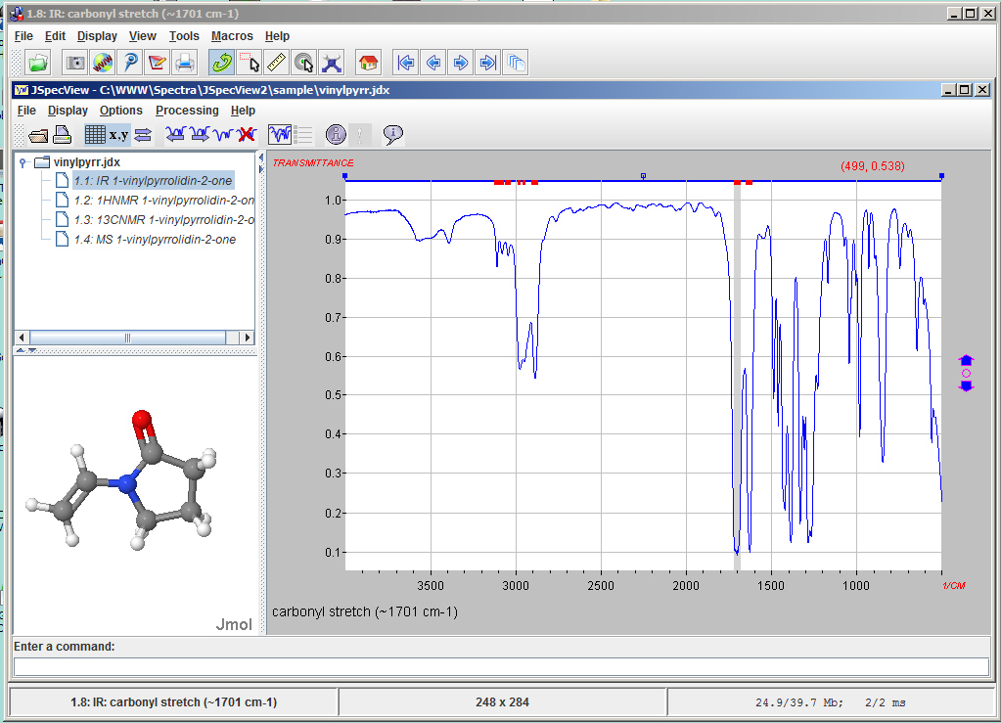
Jmol Application showing JSpecView as a tool - IR
Selecting an annotated peak will load an IR vibrational mode display in Jmol

Slide 4
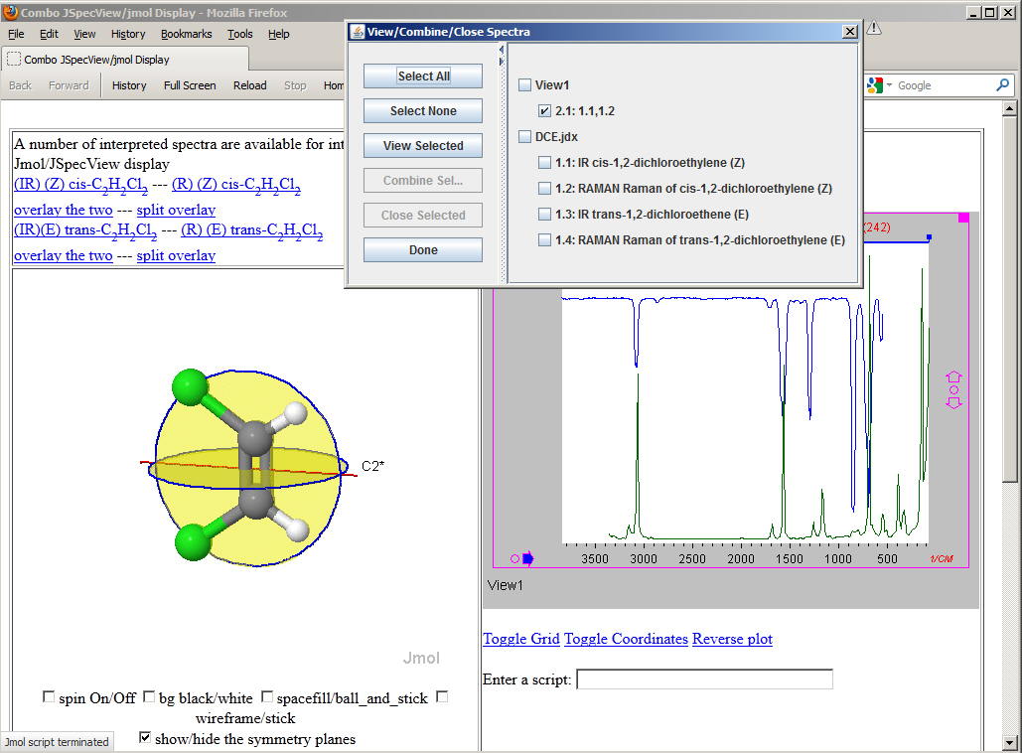
Jmol/JSpecView “applets” – IR and Raman and symmetry

Slide 5
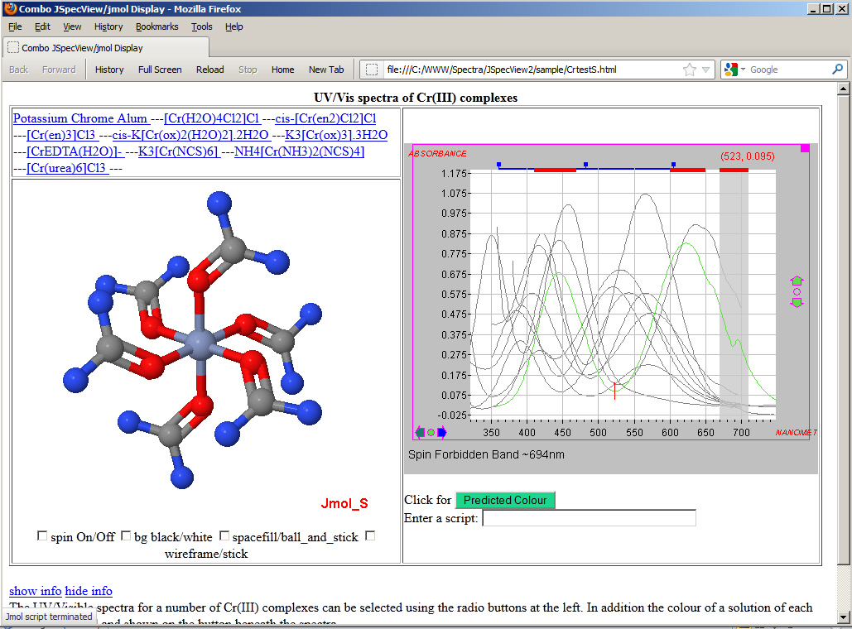
Jmol/JSpecView signed applets showing UV/Vis of Cr(III) spectra

Slide 6
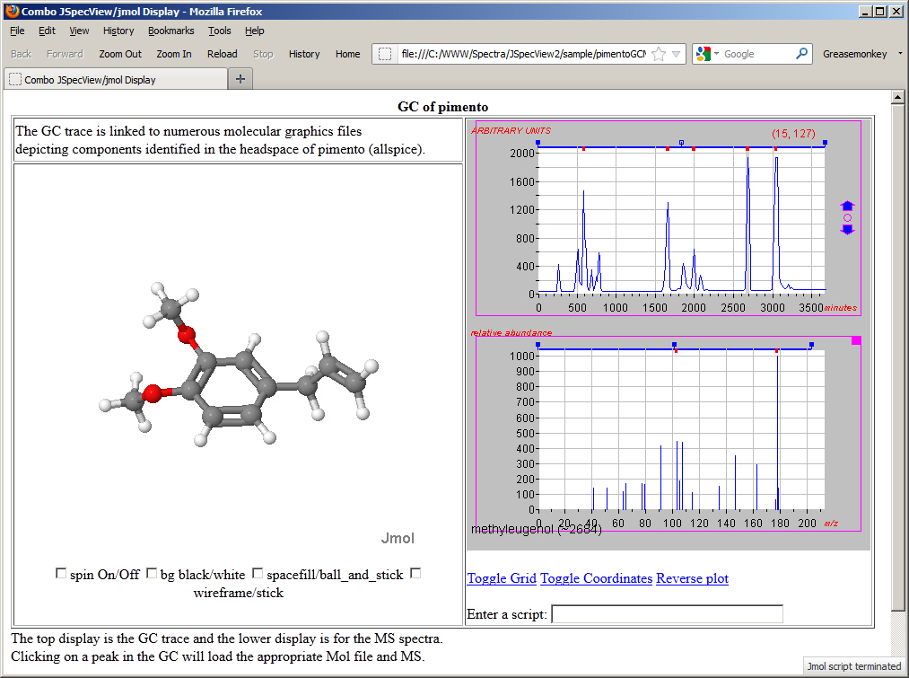
Jmol/JSpecView Applets showing GCMS of pimento

Slide 7
The Argument
Storage: It is desireable to tie together molecular structure and spectral data. It makes sense to have them in the same file.
Exchange: Cloud-based systems work best when a minimum of file transfer occurs.

Slide 8
Possible Options
XML – the original standard for web-based information exchange; easily parsed
JSON – the standard for server API interaction with client JavaScript
JCAMP-DX – a mature standard for instrumental data
Some combination of the above

Slide 9
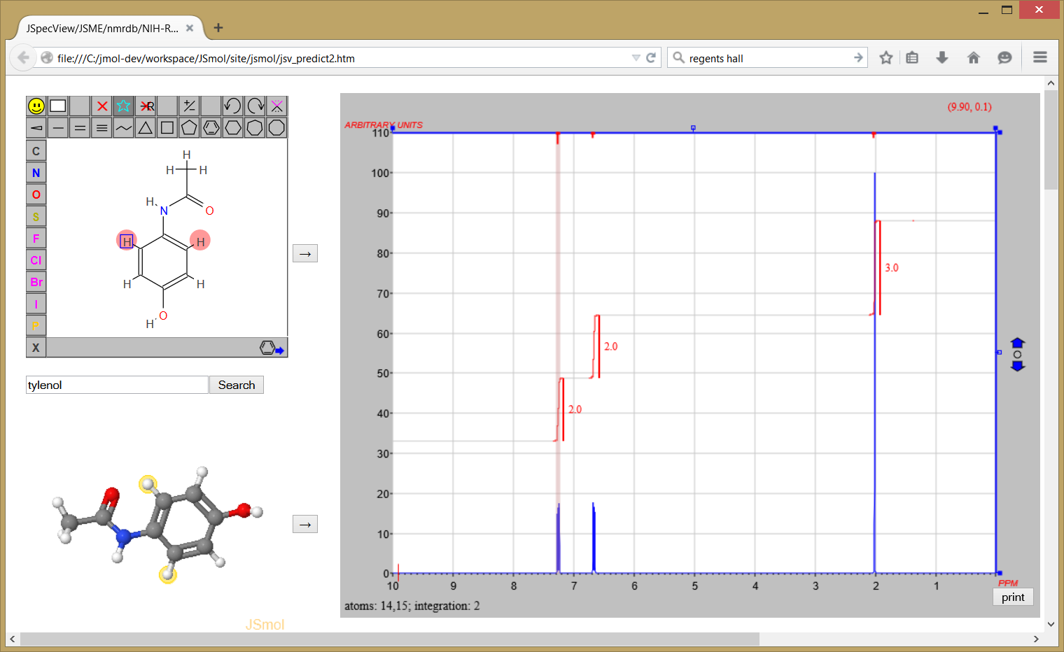
Real-Time NMR spectrum prediction

Slide 10

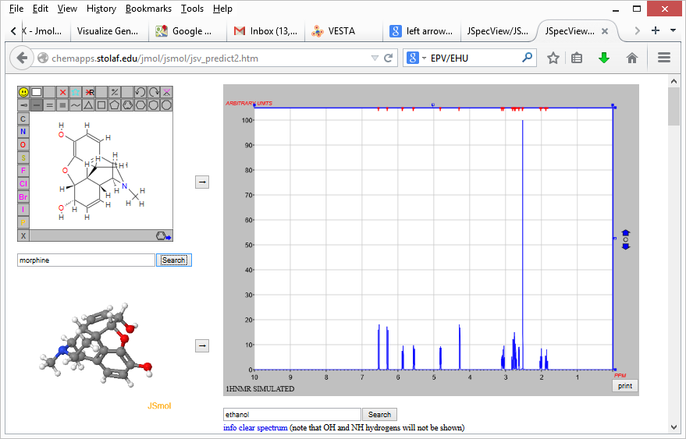
Key point is that all the JCAMP series files are meant for data exchange.
For this purpose, it is critical that we have one file.

Slide 11
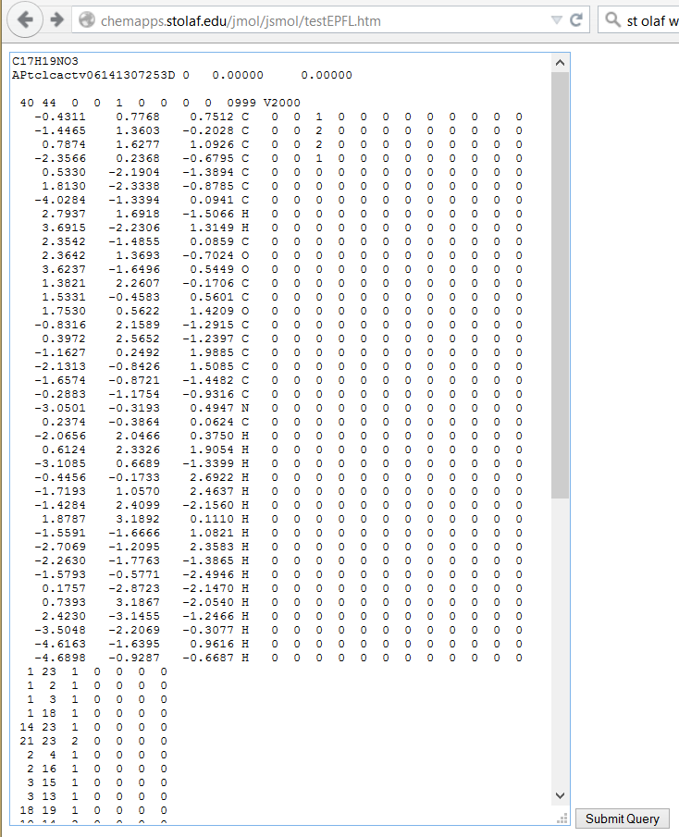
MOL file data

Slide 12
{
"molfile":"C17H19NO3
Actelion Java MolfileCreator 1.0
40 44 0 0 1 0 0 0 0 0999 V2000
-0.4311 0.7768 0.7512 C 0 0 0 0 0 0 0 0 0 0 0 0
-1.4465 1.3603 -0.2028 C 0 0 0 0 0 0 0 0 0 0 0 0
0.7874 1.6277 1.0926 C 0 0 0 0 0 0 0 0 0 0 0 0
-2.3566 0.2368 -0.6795 C 0 0 0 0 0 0 0 0 0 0 0 0
0.5330 -2.1904 -1.3894 C 0 0 0 0 0 0 0 0 0 0 0 0
1.8130 -2.3338 -0.8785 C 0 0 0 0 0 0 0 0 0 0 0 0
-4.0284 -1.3394 0.0941 C 0 0 0 0 0 0 0 0 0 0 0 0
0.2374 -0.3864 0.0624 C 0 0 0 0 0 0 0 0 0 0 0 0
-3.0501 -0.3193 0.4947 N 0 0 0 0 0 0 0 0 0 0 0 0
2.3542 -1.4855 0.0859 C 0 0 0 0 0 0 0 0 0 0 0 0
2.3642 1.3693 -0.7024 O 0 0 0 0 0 0 0 0 0 0 0 0
3.6237 -1.6496 0.5449 O 0 0 0 0 0 0 0 0 0 0 0 0
1.3821 2.2607 -0.1706 C 0 0 0 0 0 0 0 0 0 0 0 0
1.5331 -0.4583 0.5601 C 0 0 0 0 0 0 0 0 0 0 0 0
1.7530 0.5622 1.4209 O 0 0 0 0 0 0 0 0 0 0 0 0
-0.8316 2.1589 -1.2915 C 0 0 0 0 0 0 0 0 0 0 0 0
0.3972 2.5652 -1.2397 C 0 0 0 0 0 0 0 0 0 0 0 0
-1.1627 0.2492 1.9885 C 0 0 0 0 0 0 0 0 0 0 0 0
-2.1313 -0.8426 1.5085 C 0 0 0 0 0 0 0 0 0 0 0 0
-1.6574 -0.8721 -1.4482 C 0 0 0 0 0 0 0 0 0 0 0 0
-0.2883 -1.1754 -0.9316 C 0 0 0 0 0 0 0 0 0 0 0 0
3.6915 -2.2306 1.3149 H 0 0 0 0 0 0 0 0 0 0 0 0
2.7937 1.6918 -1.5066 H 0 0 0 0 0 0 0 0 0 0 0 0
-2.0656 2.0466 0.3750 H 0 0 0 0 0 0 0 0 0 0 0 0
0.6124 2.3326 1.9054 H 0 0 0 0 0 0 0 0 0 0 0 0
...”
MOL file data JSON

Slide 13
{
"molfile":"C17H19NO3...”,
"jcamp":"##TITLE= Maximum beta inter-cluster(0), intra-cluster(0), Cluster size(8)
##JCAMP-DX= 5.00\t$$Hook4 tools, January 22 2015
##OWNER=
##DATATYPE= NMR SPECTRUM
##DATA CLASS= XYDATA
##.OBSERVE FREQUENCY= 400.0
##.OBSERVE NUCLEUS= ^1H
##$DECIM= 0
##$DSPFVS= 0
##$FCOR= 1
##$SW_h= 4000.0
##$SW= 10.0
##$TD= 16384
##$GRPDLY= 0.0
##$BF1= 400.0
##$SFO1= 400.002
##$NUC1= <1H>
##XUNITS=\tPPM
##YUNITS=\tARBITRARY UNITS
##NPOINTS=\t16384
##FIRSTX=\t10.000025000023875
##LASTX=\t-2.4999976125705814E-5
##XFACTOR= 6.103918696209487E-4
##YFACTOR= 1.0
##MAXY= 1.8652532864521182E8
##MINY= 278603.3179195728
##DELTAX= -6.103918696209487E-4
##XYDATA=(X++(Y..Y))
...”
MOL file data JSON

Slide 14
{
"molfile":"C17H19NO3...”,
"jcamp":"##TITLE= Maximum ..”
"signals":[
{"type":"1HNMR",
"atoms":"23",
"xMax":2.64082,
"xMin":2.60318,
"multiplicity":"dd",
"Couplings":[
{"atoms":"25","value":2.36},
{"atoms":"28","value":4.167}
],
"integral":1
},
{"type":"1HNMR",
"atoms":"24",
"xMax":4.29615,
"xMin":4.25585,
"multiplicity":"d",
"Couplings":[
{"atoms":"29","value":7.06}
],
"integral":1
},
...
]
}
MOL file data JSON

Slide 15
JCAMP-DX Origins: IUPAC Subcommittee on Electronic Data Standards
1980s - The first standard by the Joint Committee on Atomic and Molecular Physical Data Exchange (JCAMP-DX) was published for IR.
1990s - Protocols for MS, NMR, IMS, EMR and CD defined and implemented by major instrument manufacturers.

Slide 16
##TITLE= o-eugenol
##JCAMP-DX= 5.01 $$export from JSpecView
##DATA TYPE= INFRARED SPECTRUM
##DATA CLASS= XYDATA
##ORIGIN= Dept of Chem, UWI, JAMAICA
##OWNER= public domain
##LONGDATE= 1997/07/01 09:24:00
##SPECTROMETERDATASYSTEM= PERKIN-ELMER 1000 FT-IR
##INSTRUMENTALPARAMETERS= 4400.00,450.00 cm-1; 16 scans; mode ratio; apod strong
##RESOLUTION= 2
##XUNITS= 1/CM
##YUNITS= TRANSMITTANCE
##XFACTOR= 3.93E-3
##YFACTOR= 9.40262357E-7
##FIRSTX= 470
##FIRSTY= 0.00520004
##LASTX= 4400
##NPOINTS= 3931
##XYDATA= (X++(Y..Y)) 119593E530R12K042n65l78n02q80J885K545o2j634K702r4r43J760J759O29K859A7942 124427B0990L048J89k891K263L362J288K325L237N97l14K891K828O91K043L865D8454 128753E1031K733M305J666K83L802M902J319L048N311J603n35K703K891N122M022I5934
...
1119593H75220
##END=
Header
Data

Slide 17
Advantages of JCAMP-DX
Designed for flexibility/customizable
Wide variety of instrumental techniques
Well-tested; works great
Well-documented
Already readable in Jmol and JSpecView

Slide 18
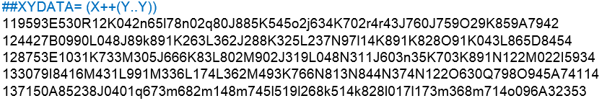
Disadvantages of JCAMP-DX

Slide 19
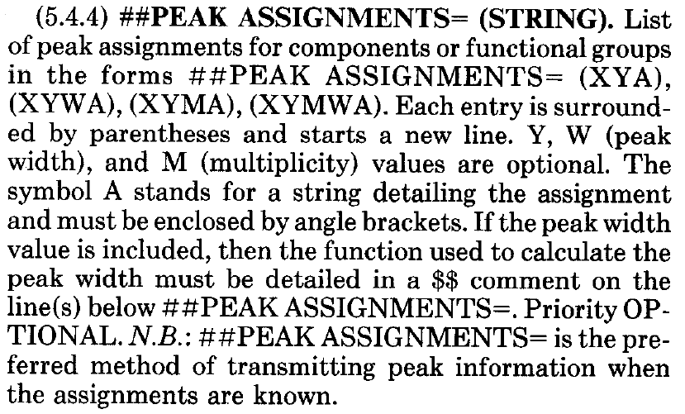
Disadvantages of JCAMP-DX

Slide 20
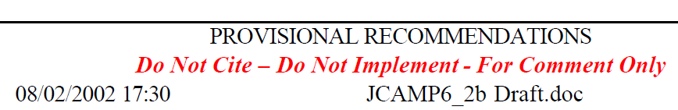
Disadvantages of JCAMP-DX

Slide 21
JCAMP-MOL
The purpose of JCAMP-MOL is to allow for a single file to contain spectral information, model structure information, and model/spectrum correlation information.
The specification describes a simple extension to the JCAMP-DX format using two user-defined-data-labels, ##$MODELS and ##$PEAKS.
The customization can be applied to any JCAMP-DX file, especially BLOCK files that contain multiple spectra of diverse types.

Slide 22
##$MODELS
##$MODELS=
<Models>
<ModelData id="acetophenone" type="MOL">
acetophenone
DSViewer 3D 0
17 17 0 0 0 0 0 0 0 0999 V2000
-1.6931 0.0078 0.0000 C 0 0 0 0 0 0 0 0 0 1
...
M END
</ModelData>
<ModelData id="1" type="XYZVIB" baseModel="acetophenone" vibrationScale=".1">
17
1 Energy: -1454.38826 Freq: 3199.35852
C -1.693100 0.007800 0.000000 -0.000980 0.000120 0.000000
...
17
2 Energy: -1454.38826 Freq: 3191.02824
C -1.693100 0.007800 0.000000 -0.000020 -0.000100 0.000000
...
</ModelData>
</Models>
Multiple embedded structural data
base structure along with any number of additional structures
XML-like compartmentalization

Slide 23
##$PEAKS (IR)
##$PEAKS=
<Peaks type="IR" xUnitsExpected="1/cm" >
<PeakData id="1" title="asymm str of arom CH group (~3100 cm-1)" peakShape="broad" model="1.1" xMax="3121" xMin="3081" />
<PeakData id="2" title="symm str of arom CH group (~3085 cm-1)" peakShape="broad" model="1.2" xMax="3101" xMin="3071" />
<PeakData id="3" title="asymm stretch of CH group (~3060 cm-1)" peakShape="broad" model="1.3" xMax="3077" xMin="3047" />
…
</Peaks>
<PeakData
id="3" unique reference code
title="asymm stretch of CH group (~3060 cm-1)"
peakShape="broad"
model="1.3" refers back to model with id=“1.3”
xMax="3077" range for highlight
xMin="3047"
/>

Slide 24
##$PEAKS (NMR)
##$PEAKS=
<Peaks type="HNMR" xUnitsExpected="ppm" >
<PeakData id="1" title="methyl group ~2.6" peakShape="singlet" model="acetophenone" atoms="15,16,17" xMax="2.7" xMin="2.5" />
<PeakData id="2" title="meta H's ~7.4" peakShape="multiplet" model="acetophenone" atoms="10,11“ xMax="7.5" xMin="7.3" />
<PeakData id="3" title="para H ~7.5" peakShape="multiplet" model="acetophenone" atoms="12" xMax="7.6" xMin="7.4" />
<PeakData id="4" title="ortho H's ~7.9" peakShape="multiplet" model="acetophenone" atoms="8,9" xMax="8.0" xMin="7.9" />
</Peaks>
<PeakData
id="1" unique reference code
title="methyl group ~2.6"
peakShape="singlet"
model="acetophenone" refers model with id=“acetophenone”
atoms="15,16,17" included atoms
xMax="2.7" x-coord range for highlight
xMin="2.5"
/>

Slide 25
##$PEAKS (MS)
##$PEAKS=
<Peaks type="MS" xUnitsExpected="M/Z" >
<PeakData id="1" title="molecular ion (~120)" peakShape="sharp" model="4.1" xMax="121" xMin="119" />
<PeakData id="2" title="fragment 1 (~105)" peakShape="sharp" model="4.2" xMax="106" xMin="104" />
<PeakData id="3" title="fragment 2 (~77)" peakShape="sharp" model="4.3" xMax="78" xMin="76" />
</Peaks>
<PeakData
id="1" unique reference code
title="molecular ion (~120)"
peakShape="sharp"
model=“4.1" refers back to ##$MODELS
xMax=“121" x-coord range
xMin=“119"
/>

Slide 26
Summary – JCAMP-MOL
a simple extension to the proven JCAMP-DX standard
only two custom tags are necessary:
##$MODELS and ##$PEAKS
allows multiple structures and spectra to be stored in the same file, along with correlation data.
flexible – allows a variety of structural data formats
fully implemented in J(S)mol/JSpecView for IR, RAMAN, MS, GC/MS, 1HNMR, and 13CNMR

Slide 27
Acknowledgements
St Olaf College collaborators:
Amanda Leone ‘14
The University of the West Indies, Jamaica and UWI collaborators:
Christopher Muir, Prof. Han Reichgelt,
Debbie Ann Facey, Khari Bryan, Craig Walters
JSME EPFL
Peter Ertl Luc Patiny
Bruno Bienfait
NCI/CADD
Markus Sitzmann
Marc Nicklaus
http://chemapps.stolaf.edu/jmol/docs/misc/Jmol-JSpecView-specs.pdf

Slide 30
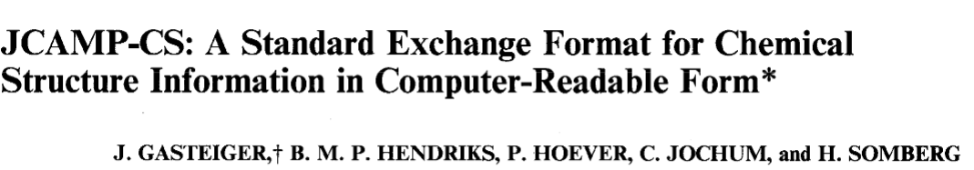
What about JCAMP-CS?
Applied Spectroscopy, Vol. 45, No. 1, 1991

Slide 31
What about JCAMP-CS?
Applied Spectroscopy, Vol. 45, No. 1, 1991
Never implemented (that I know of)
Doesn’t address the correlation issues.

Slide 32
Abstract
JCAMP-MOL is a simple extension to the JCAMP-DX format using two private data-labels, ##$MODELS and ##$PEAKS. These provide 3D Jmol readable models to the spectrum file to allow association of spectral bands with specific IR and RAMAN vibrations, MS fragments, and NMR signals. The purpose of including the JCAMP-MOL extension is to allow for a single file that can be read either by the standalone Jmol application (that now incorporates JSpecView) or by twin Jmol and JSpecView applets on a web page.
From a teaching perspective, the ability to create interactive web based displays that can highlight and hyperlink areas of a spectrum/ molecular display are powerful visual aids for significantly improving characterisation and identification of key spectral features and can simplify interpretation of IR, MS and NMR spectra. Clicking on an atom or selecting an IR/RAMAN vibration in Jmol highlights a band or peak or fragment on the spectrum. Clicking on the spectrum highlights one or more atoms, starts an IR vibration, or displays an MS fragment in Jmol. Examples will be highlighted during the presentation.

