Slide 1
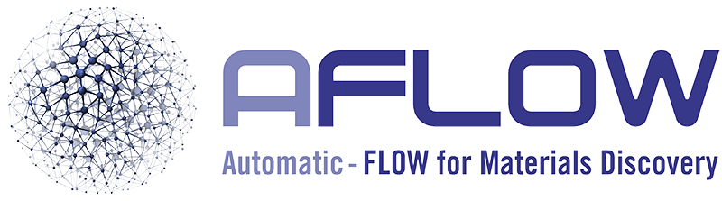

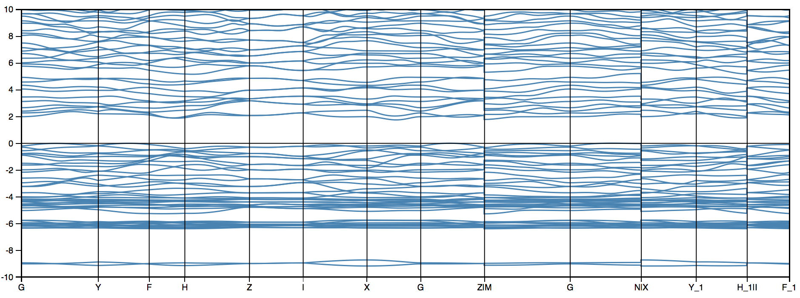
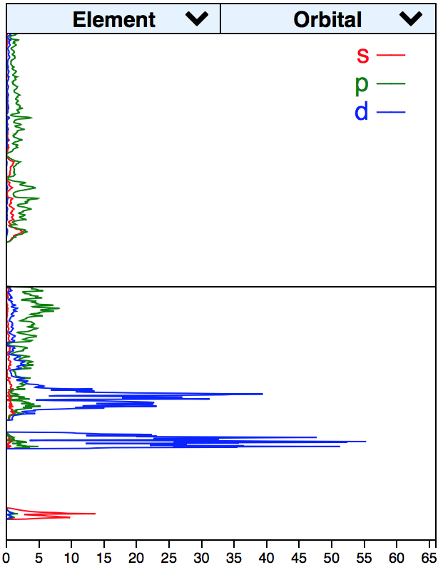
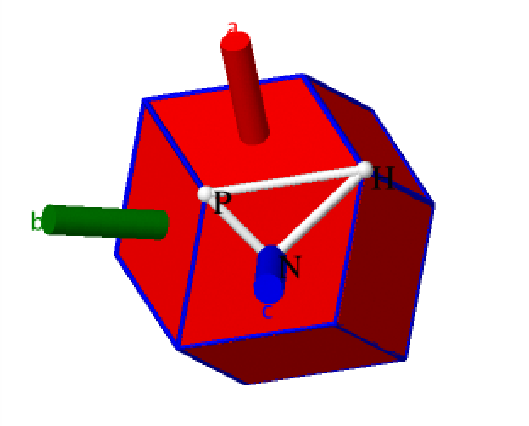
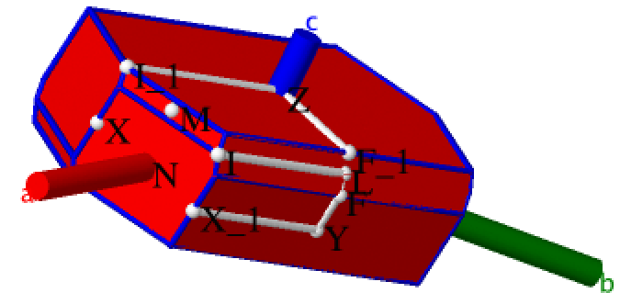


Integrative interactive visualization of crystal structure,
band structure, and Brillouin zone Ben Hinke¹, Matt Van Koevering¹, Robert M. Hanson¹
David Hicks², Jose Plata², Cormac Toher², Corey Oses², Eric Gossett², Stefano Curtarolo²
1) St. Olaf College, 2) Duke Materials Science
Abstract
Results
Accomplishments
The AFLOW library is an open-access database for high throughput ab-initio calculations that serves as a resource for the dissemination and education of material science. Our project aims to use Jmol, a Java-based program for visualization, and D3, a JavaScript-based graphing library, to improve the visualization of AFLOW data and enhance access to information.
The Brillouin zone is a theoretical geometry that is constructed based on the real space lattice structure and transformed into a space referred to as “reciprocal space.” Through Jmol scripting, we expanded the capabilities of Jmol into an effective tool for displaying the Brillouin zone and high points of symmetry called critical points. With Jmol’s improved functionality, we created a website to access and visualize Brillouin zones and band structures for more than 55,000 inorganic crystal structures.
See http://aflowlib.mems.duke.edu/users/jmolers/matt/website to access the graphs and visualizations.
Expanded Jmol capabilities via macro script of functions for direct interaction with the AFLOW API.
Expanded AFLOW API for uncompressed band structure files.
Provided visualization to convey relevant information for experimentalists (band structure, animation features, Brillouin zone, density of states, and crystal structure).
Introduced an effective search engine to filter through the inorganic compounds based on structure classification.
Graphed the band structure and density of states graphs of the crystal structure using D3.
Incorporated JavaScript to improve user interaction capabilities with dynamically modifiable graphs.
Provided visualization of data with filtering capabilities of specific elements and orbitals in the density of states graphs.
Developed methods to utilize the AFLOW JSON interface.
Further developed the algorithms for the production of Brillouin zones and associated high symmetry pathways.
Energy (eV)
Graph 1 (top): The band structure of the crystal, Ag1As1Hg1S3. The domain of the graph illustrates the pathways between the points of high symmetry on the Brillouin zone. The data ranges between -10 eV and 10 eV to better illustrate the band gaps.
Graph 2 (left): The density of states for the crystal, Ag1As1Hg1S3. It has the same -10 eV to 10 eV range as the band structure graph and illustrates the magnitude of the density for various orbital and elemental contribution. There are two dropdown menus that enable the user to filter the data to show specific elements and orbitals of the crystal.
Fig 1: The first Brillouin zone with the white points displaying the k-point position and the lines connecting points representing the pathway for the crystal, Ag16Ca6N1. Not visible, there exists a center point named gamma contributing to the pathways.
Fig 2: The Brillouin zone for the crystal, Ag1Ba1Er1S3. Not every high symmetry point is connected to one another, meaning it is not one continuous path. This causes breaks also displayed in the band structure graph.
Methods
Energy (eV)
Integration of Jmol to interact with the AFLOW API
Construction of a proof of concept website with dynamically modifiable D3 graphs
Generation of high points of symmetry in k-space mapped on a Brillouin zone
Streamline access to compound geometries, k-point data, and band structure data
Uses a brillouin zone algorithm developed at St. Olaf to create the brillouin zone for any crystal structure
Development of the macro AFLOW function aflowCreateBZ to create k-points, pathways and the brillouin zone instantaneously
Graphing band structures and density of states
Integrated D3 functionality to plot data
Incorporated JavaScript code to dynamically modify graphs
Conclusions
Over the course of the summer, we were able to expand Jmol’s functionality to work specifically with Brillouin zone, k-point, and band structure information. Jmol now has the capability to effectively visualize valuable properties of inorganic crystal structures. We successfully incorporated the pathways between critical points on the Brillouin zone into Jmol. The success of this visualization displayed in three-dimensions is a first of its kind in this field. We have also vastly improved the accessibility and visualization of the band structure data by incorporating dynamically changeable graphs and filtration algorithms.
As our project moves forward, we plan to expand the capabilities of our website by adding more user interactivity between the Jmol applets and the graphs. In addition, we are in a position to check our implementation to ensure that it is fully compatible with AFLOW.
Fig 1
Fig 2
References
Acknowledgements
Jmol: an open-source Java viewer for chemical structures in 3D. http://www.jmol.org/
ICSD: Access to all inorganic crystal structure database
http://aflowlib.duke.edu/AFLOWDATA/ICSD_WEB/
Special thanks to the Curtarolo group of Duke University for their continued collaboration, and to the Office of Naval Research for funding our project. This work is an extension of work at St. Olaf carried out by Libby New, Brigette Honaker, Patrik Štefek, and Jacob LaNasa.

