Slide 1
CIF1 to CIF2:
Lessons learned
in the development of Jmol
Robert M. Hanson
St. Olaf College, Northfield, MN
http://www.stolaf.edu/people/hansonr
hansonr@stolaf.edu
MS-107.003.633
24th Congress of the International Union of Crystallography
Hyderabad, India
Aug 27, 2017

Slide 2
Outline
A look at the suite of CIF dictionaries implemented in Jmol
Thoughts on CIF1 and CIF2 syntaxes
Beyond CIF2?

Slide 3
CIF dictionaries
Core dictionary (coreCIF)
Powder diffraction dictionary (pdCIF)
Modulated and composite structures dictionary (msCIF)
Electron density dictionary (rhoCIF)
Twinning dictionary
Magnetic structures dictionary (magCIF)
Image dictionary (imgCIF)
Symmetry dictionary (symCIF)
Macromolecular (and component) dictionary (mmCIF)

Slide 4
CIF dictionaries
Core dictionary (coreCIF)
Powder diffraction dictionary (pdCIF)
Modulated and composite structures dictionary (msCIF)
Electron density dictionary (rhoCIF)
Twinning dictionary
Magnetic structures dictionary (magCIF)
Image dictionary (imgCIF)
Symmetry dictionary (symCIF)
Macromolecular (and composite) dictionary (mmCIF)

Slide 5
CIF dictionaries
Core dictionary (coreCIF)
Powder diffraction dictionary (pdCIF)
Modulated and composite structures dictionary (msCIF)
Electron density dictionary (rhoCIF)
Twinning dictionary
Magnetic structures dictionary (magCIF)
Image dictionary (imgCIF)
Symmetry dictionary (symCIF)
Macromolecular (and composite) dictionary (mmCIF)

Slide 6
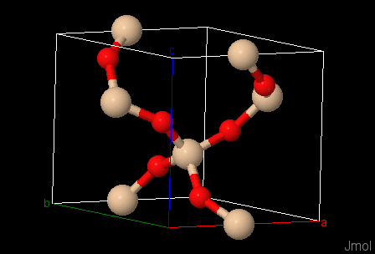
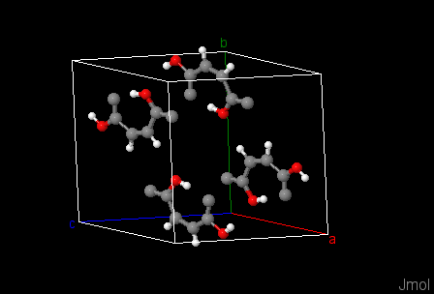
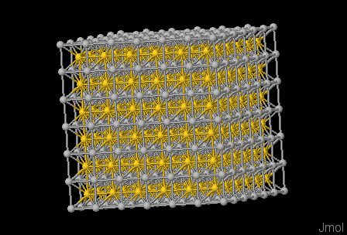
CIF dictionaries - coreCIF
Covers basic small-molecule and traditional crystal structures

Slide 7
CIF dictionaries - coreCIF
Covers basic small-molecule and traditional crystal structures
Publication details (_journal, _publ)
Chemical formula, name (_chemical)
Unit cell information (_cell)
Space group/symmetry information (_space_group, _symmetry)
Atom information (_atom_site)
Bond information (_geom_bond)

Slide 8
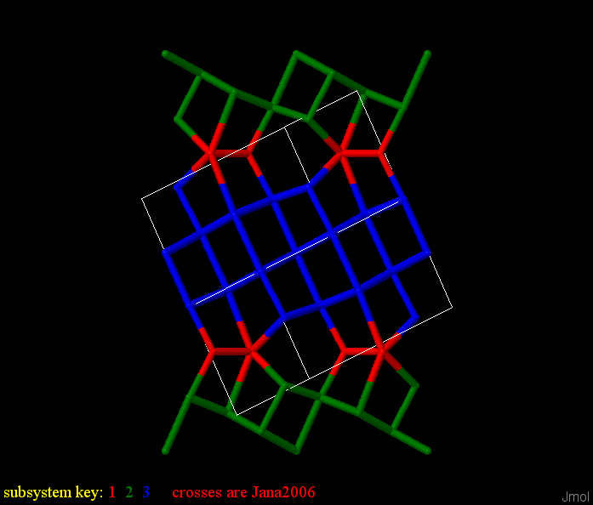
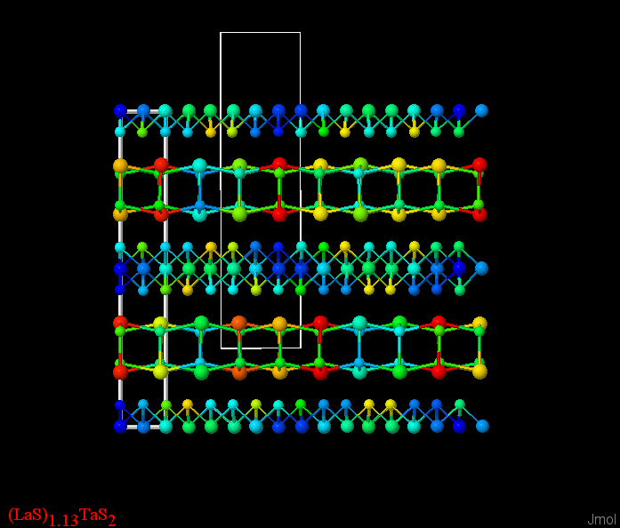
CIF dictionaries - msCIF
Adds 19 additional categories
Provides support for commensurately and incommen-surately modulated structures and composite structures

Slide 9
CIF dictionaries - msCIF
Adds 19 additional categories
Provides support for commensurately and incommen-surately modulated structures and composite structures
Five modulation-related cell categories used by Jmol
cell_modulation_dimension
cell_wave_vectors_number
cell_wave_vector
cell_subsystems_number
cell_subsystem

Slide 10
CIF dictionaries - msCIF
Adds 19 additional categories
Provides support for commensurately and incommen-surately modulated structures and composite structures
Two modulation-related cell categories used by Jmol
space_group_ssg_name
space_group_symop_ssg

Slide 11
CIF dictionaries - msCIF
_space_group_ssg_name_WJJ 'P:P m m m:-1 1 s'
_space_group_ssg_name Pmmn(\a00)00s
loop_
_space_group_symop_ssg_id
_space_group_symop_ssg_operation_algebraic
1 x1,x2,x3,x4
2 x1,-x2,x3,x4
3 1/2+x1,1/2+x2,-x3,1/2+x4
4 1/2+x1,1/2-x2,-x3,1/2+x4
5 1/2-x1,1/2-x2,-x3,1/2-x4
6 1/2-x1,1/2+x2,-x3,1/2-x4
7 -x1,-x2,x3,-x4
8 -x1,x2,x3,-x4

Slide 12
CIF dictionaries - msCIF
Adds 19 additional categories
Provides support for commensurately and incommen-surately modulated structures and composite structures
Seven additional modulation-related atom_site categories:
atom_site_Fourier_wave_vector atom_site_displace_Fourier atom_site_displace_special_func atom_site_occ_Fourier atom_site_occ_special_func
atom_site_U_Fourier atom_site_rot_Fourier * *not implemented in Jmol

Slide 13
CIF dictionaries - msCIF
Adds 19 additional categories
Provides support for commensurately and incommen-surately modulated structures and composite structures
additional modulation-related categories used by Jmol
jana_displace_legendre
jana_occ_legendre
jana_u_legendre

Slide 14
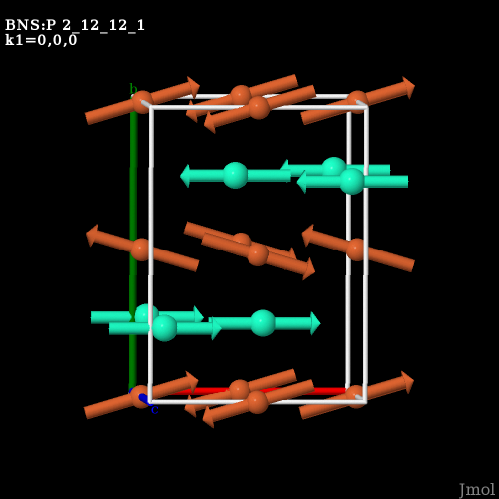
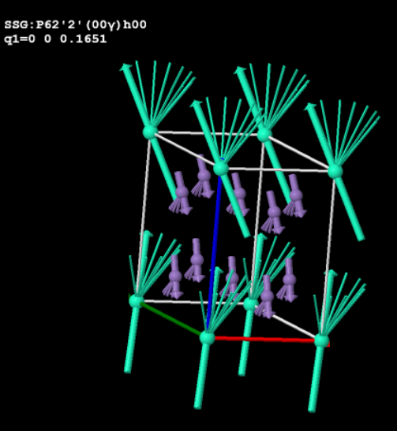
CIF dictionaries - magCIF
Adds 15 magnetic-related categories
Provides support for symmetry involving magnetic moments, including commensurately and incommen-surately modulated structures
http://webbdcrista1.ehu.es/magndata/index.php?index=0.10
index=1.1.10

Slide 15
CIF dictionaries - magCIF
Adds 15 magnetic-related categories
Provides support for symmetry involving magnetic moments, including commensurately and incommen-surately modulated structures
Five magnetic-related categories used by Jmol
space_group_magn space_group_symop_magn_operation space_group_symop_magn_ssg_operation parent_propagation_vector parent_space_group atom_site_moment (includes three ms subcategories)

Slide 16
CIF dictionaries - magCIF
loop_ _space_group_symop_magn_operation.id _space_group_symop_magn_operation.xyz 1 'x+1/2,y+1/2,z,+1' 2 'x+1/2,y+1/2,z,-1’ loop_ _space_group_symop_magn_ssg_operation.id _space_group_symop_magn_ssg_operation.xyz 1 'x1,x2,x3,x4+1/2,-1’ 2 'x1+1/2,x2+1/2,-x3,-x4,-1'

Slide 17
CIF Syntax – CIF1
data_global
_chemical_name Quartz
loop_
_publ_author_name
'Levien L'
'Prewitt C T'
'Weidner D J'
_journal_name_full "American Mineralogist"
_journal_volume 65
_journal_year 1980
_journal_page_first 920
_journal_page_last 930
_publ_section_title
;
Structure and elastic properties of quartz at pressure
P = 1 atm
;

Slide 18
CIF Syntax – CIF1
data_ header
data_global
_chemical_name Quartz
loop_
_publ_author_name
'Levien L'
'Prewitt C T'
'Weidner D J'
_journal_name_full "American Mineralogist"
_journal_volume 65
_journal_year 1980
_journal_page_first 920
_journal_page_last 930
_publ_section_title
;
Structure and elastic properties of quartz at pressure
P = 1 atm
;

Slide 19
CIF Syntax – CIF1
data_ header
data_global
_chemical_name Quartz
loop_
_publ_author_name
'Levien L'
'Prewitt C T'
'Weidner D J'
_journal_name_full "American Mineralogist"
_journal_volume 65
_journal_year 1980
_journal_page_first 920
_journal_page_last 930
_publ_section_title
;
Structure and elastic properties of quartz at pressure
P = 1 atm
;
data item

Slide 20
CIF Syntax – CIF1
data_ header
data_global
_chemical_name Quartz
loop_
_publ_author_name
'Levien L'
'Prewitt C T'
'Weidner D J'
_journal_name_full "American Mineralogist"
_journal_volume 65
_journal_year 1980
_journal_page_first 920
_journal_page_last 930
_publ_section_title
;
Structure and elastic properties of quartz at pressure
P = 1 atm
;
data item
loop structure

Slide 21
CIF Syntax – CIF1
data_ header
data_global
_chemical_name Quartz
loop_
_publ_author_name
'Levien L'
'Prewitt C T'
'Weidner D J'
_journal_name_full "American Mineralogist"
_journal_volume 65
_journal_year 1980
_journal_page_first 920
_journal_page_last 930
_publ_section_title
;
Structure and elastic properties of quartz at pressure
P = 1 atm
;
data item
loop structure
multi-line data value

Slide 22
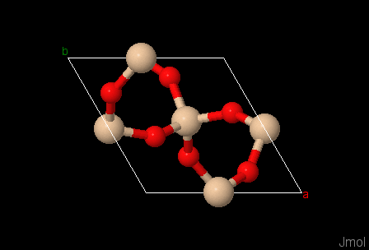
Accessing CIF Data: Symmetry Operators
load quartz.cif packed
show spacegroup
Hermann-Mauguin symbol: P 32 2 1
international table number: 154
crystal class: D3
6 operators from Hall symbol P 32 2" #154:
x,y,z
-y,x-y,z-1/3
…
Hall symbol: P 32 2"
primitive Hall symbol: P 3z2 2"z
lattice type: P: primitive
…

Slide 23
Accessing CIF Data: Symmetry Operators
load quartz.cif packed
show symop 3
3-fold screw axis|translation: 0 0 -1/3

Slide 24
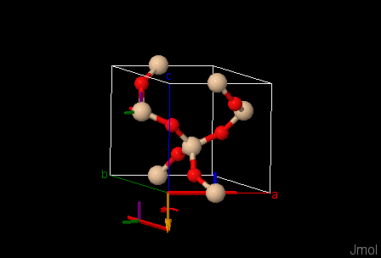
Accessing CIF Data: Symmetry Operators
load quartz.cif packed
draw symop 3

Slide 25
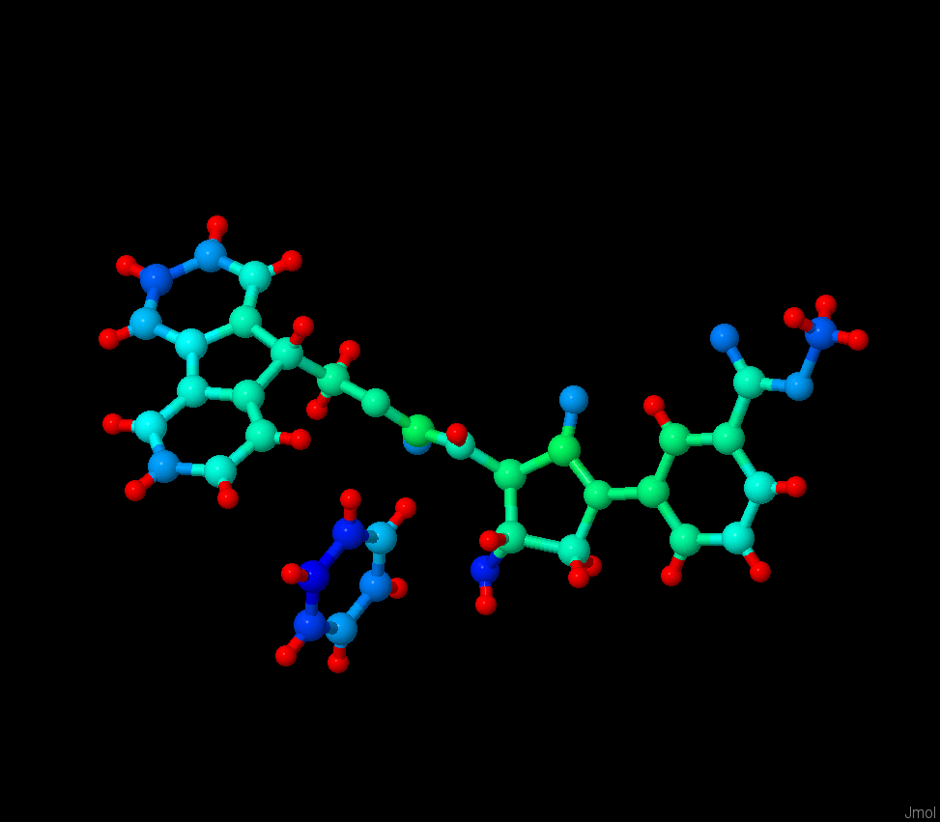
Accessing CIF Data: Atom Site Data
load =cod/1501544
color property adpmax

Slide 26
Accessing CIF Data: Auxiliary Data
print getProperty("fileInfo.models[1]")._publ_author_name
Daniel J. St-Cyr
Thierry Maris
William D. Lubel

Slide 27
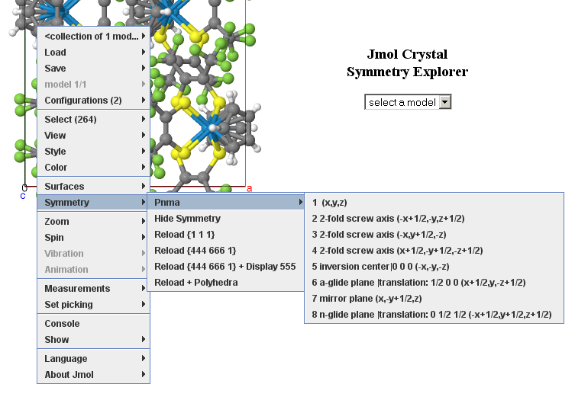
Accessing CIF Data: Putting it all together
Example: Jmol Crystal Symmetry Explorer

Slide 28
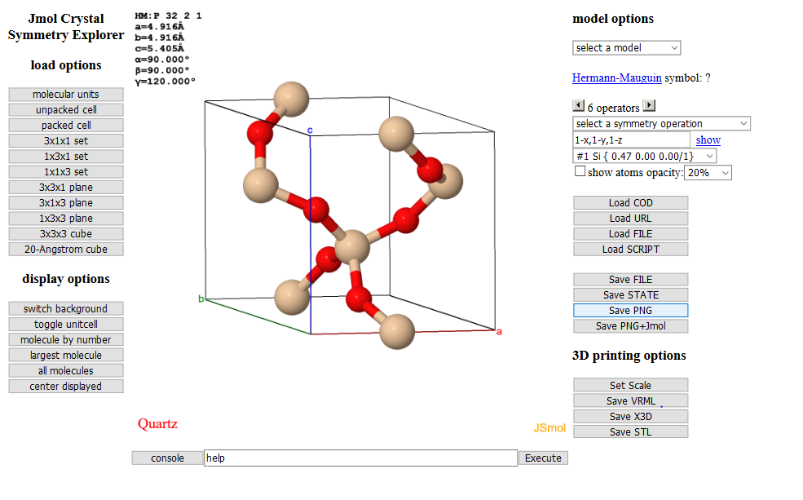
Accessing CIF Data: Putting it all together
Example: Jmol Crystal Symmetry Explorer

Slide 29
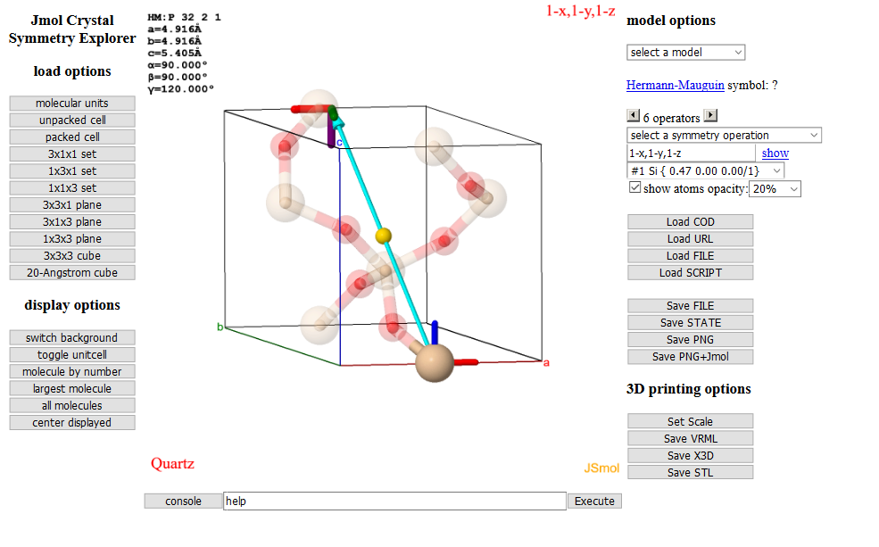
Accessing CIF Data: Putting it all together
Example: Jmol Crystal Symmetry Explorer

Slide 30
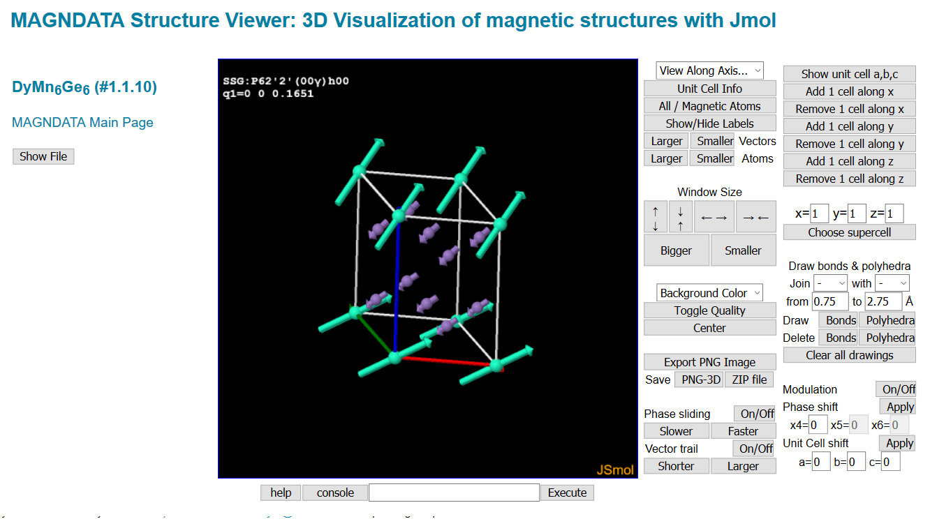
Accessing CIF Data: Putting it all together
Example: Bilbao MAGNDATA server

Slide 31
CIF Syntax – CIF2
3.1. Character set and encoding
- UTF-8
3.2. Whitespace and line termination
- \n, \r, or \r\n
3.3 version "magic number": #\#CIF_2.0
Specification of the Crystallographic Information File format, version 2.0
Herbert J. Bernstein, John C. Bollinger, I. David Brown, Saulius Gražulis, James R. Hester, Brian McMahon, Nick Spadaccini, John D. Westbrook and Simon P. Westrip
http://journals.iucr.org/j/issues/2016/01/00/aj5269

Slide 32
CIF Syntax – CIF2
3.4. Data names, block codes and frame codes
CIF 2.0 defines data name, block code and frame code uniqueness in terms
of the Unicode canonical caseless matching algorithm.
- Comment: I would have preferred if data names were restricted to the simple set:
0-9 A-Z a-z _ . (period)
Q: Was there some reason this was opened up to such a wide variety of data names?
Specification of the Crystallographic Information File format, version 2.0
Herbert J. Bernstein, John C. Bollinger, I. David Brown, Saulius Gražulis, James R. Hester, Brian McMahon, Nick Spadaccini, John D. Westbrook and Simon P. Westrip
http://journals.iucr.org/j/issues/2016/01/00/aj5269

Slide 33
CIF Syntax – CIF2
3.5. Quoted and whitespace-delimited strings
CIF 2.0 ... does not permit quoted data values to embed their delimiter under any
circumstance.
CIF 2.0 excludes these four characters ', ", [, and ] from appearing anywhere in
whitespace-delimited data values.
Specification of the Crystallographic Information File format, version 2.0
Herbert J. Bernstein, John C. Bollinger, I. David Brown, Saulius Gražulis, James R. Hester, Brian McMahon, Nick Spadaccini, John D. Westbrook and Simon P. Westrip
http://journals.iucr.org/j/issues/2016/01/00/aj5269

Slide 34
CIF Syntax – CIF2
3.6. Triple-quoted strings
CIF 2.0 provides a new way to express single- and multi-line data values: triple-quoted strings. A triple-quoted string begins with a delimiter consisting of three apostrophes (''') or three quotation marks ("""), and ends with the next subse-quent appearance of its opening delimiter.
_publ_section_title """ a "clever" trick for an ol’ dog like me """
Specification of the Crystallographic Information File format, version 2.0
Herbert J. Bernstein, John C. Bollinger, I. David Brown, Saulius Gražulis, James R. Hester, Brian McMahon, Nick Spadaccini, John D. Westbrook and Simon P. Westrip
http://journals.iucr.org/j/issues/2016/01/00/aj5269

Slide 35
CIF Syntax – CIF2
3.7. Text fields
[CIF 2.0 adopts] a text prefixing protocol (see §5.2[link]) and [incorporates] a version of the CIF 1.1 line-folding protocol for text fields into the CIF 2.0 specification proper.
_publ_section_title
;title--\
title--Specification of the Crystallographic
title--Information File format,
title--version 2.0
;
Specification of the Crystallographic Information File format, version 2.0
Herbert J. Bernstein, John C. Bollinger, I. David Brown, Saulius Gražulis, James R. Hester, Brian McMahon, Nick Spadaccini, John D. Westbrook and Simon P. Westrip
http://journals.iucr.org/j/issues/2016/01/00/aj5269

Slide 36
CIF Syntax – CIF2
3.8. List data type
The new List data type provided by CIF 2.0 represents, as a single (compound) value, an ordered sequence of values of any type or types.
loop_
_atom_site_Fourier_wave_vector_seq_id
_atom_site_Fourier_wave_vector_x
_atom_site_Fourier_wave_vector_y
_atom_site_Fourier_wave_vector_z
_atom_site_Fourier_wave_vector_q_coeff
1 -0.30000 0.60000 0.00000 [1 1]
2 -0.60000 0.30000 0.00000 [0 1]
3 -0.30000 -0.30000 0.00000 [-1 0]
loop_
_parent_propagation_vector.id
_parent_propagation_vector.kxkykz
k1 [0 0 1]
k2 [0 1 0]
k3 [1 0 0]

Slide 37
CIF Syntax – CIF2
3.9. Table data type
The new Table data type provided by CIF 2.0 represents, as a single (compound) value, an unordered collection of entries representing associations between string keys and data values of any type.
{"symm": "P 4n 2 3 -1n"
'avec': [10.3 0.0 0.0]
'bvec': [0.0 10.3 0.0]
'cvec': [0.0 0.0 10.3]
}

Slide 38
CIF2 implementation in Jmol
Fully implemented in Jmol 14.7.4 (12/2016).
Required one full day (approx.16 hr).

Slide 39
Beyond CIF2: CIF-JSON
A JSON version of CIF2.
Especially designed for JavaScript implementations.
Efficient processing using JSON.parse() or jQuery.getJSON()
Marcin Wojdyr → James Hester
Apr 2017→Forum for CIF software developers cif-developers@iucr.org
May 2017 final draft → COMCIFS
June 2017 approval
http://comcifs.github.io/cif-json

Slide 40
Beyond CIF2: MMTF, binary CIF
MMTF designed at RCSB (https://mmtf.rcsb.org/);
Implemented in Jmol 14.5.4 (Apr 2016)
Binary progressive CIF+MMTF(?) from EBI in the works.

Slide 41
Final Comments
CIF2 is great. Well thought out and well documented. Especially good in terms of using UTF-8 instead of limited idiosyncratic non-Latin characters as well as simpler quoting.
Easy to upgrade already working code. Programmers! You have no excuse not to do that!
It would be good to have more examples that are actual structures, not just nonsense. CIF2 is specified only for magCIF so far (as an option).
CIF-JSON looks promising. Not yet implemented in Jmol, though Jmol can create a JSON version of CIF file data, so a writer, at least, would be relatively easy to write.

Slide 42
Acknowledgments
John Bollinger, Brian McMahon, and the CIF2 authors:
Specification of the Crystallographic Information File format, version 2.0
Herbert J. Bernstein,
John C. Bollinger,
David Brown,
Saulius Gražulis,
James R. Hester,
Brian McMahon,
Nick Spadaccini,
John D. Westbrook,
Simon P. Westrip
http://journals.iucr.org/j/issues/2016/01/00/aj5269

