Slide 1
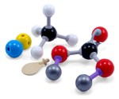
Interactive web-based pointillist visualization of hydrogenic orbitals using Jmol
Robert M. Hanson (St. Olaf College)
Robert Caldwell, Brian Hardock, Pshemak Maslak,
Thomas Stitt, Shane Tully (Penn State)
BCCE 22
Penn State University
Thursday, Aug. 2, 2012
Notes:
Before I say another word, let me point out that what I will be showing you is the work of two undergrads at Penn State – Robert and Brian. Really, I’m just the consultant. Pshemak should be giving this talk, but he skipped town. So here I am!! ☺

Slide 2
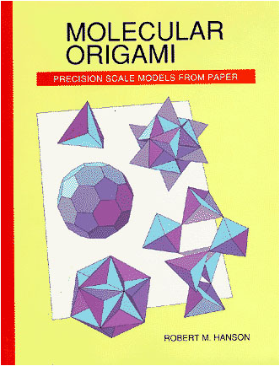
Background: “Molecular Origami”
St. Olaf College Chemistry 123
Start with hand-held models
Develop concepts as needed
http://www.stolaf.edu/people/hansonr/mo
Notes:
Just some background into my involvement – this dates back to the 1990s.

Slide 3
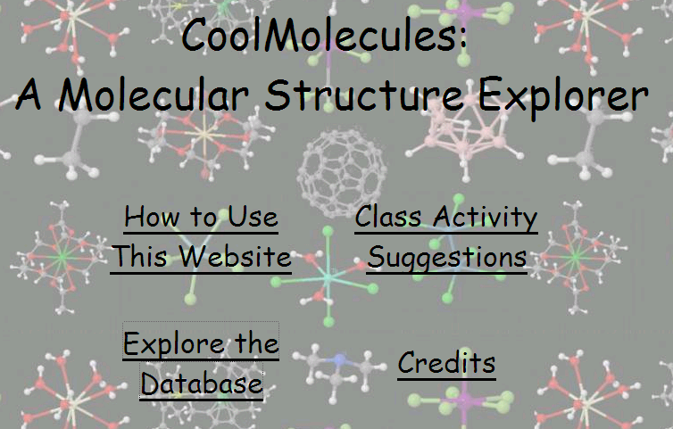
CoolMolecules Project Outcomes: the site
http://www.stolaf.edu/depts/chemistry/mo/struc
Notes:
If you know about Jmol, you probably think of it as a molecule viewer. My involvement with Jmol started with this site…

Slide 4
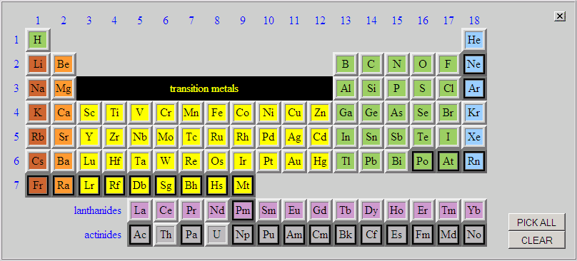
CoolMolecules Project Outcomes: interface
http://www.stolaf.edu/depts/chemistry/mo/struc

Slide 5
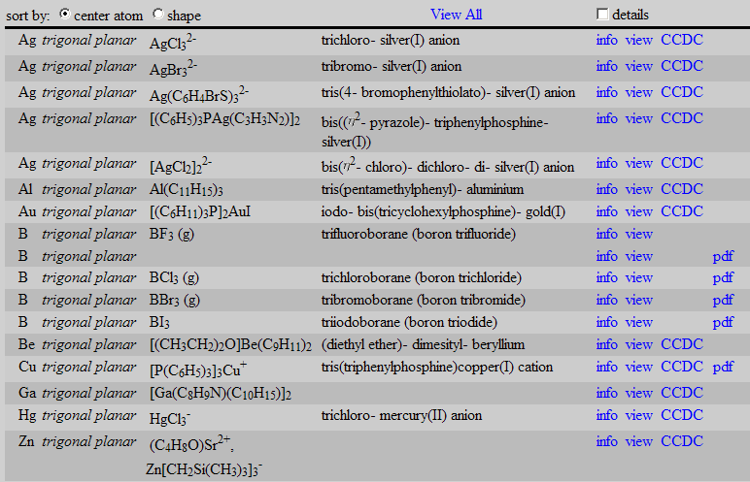
CoolMolecules Search Results: tabulation
http://www.stolaf.edu/depts/chemistry/mo/struc

Slide 6
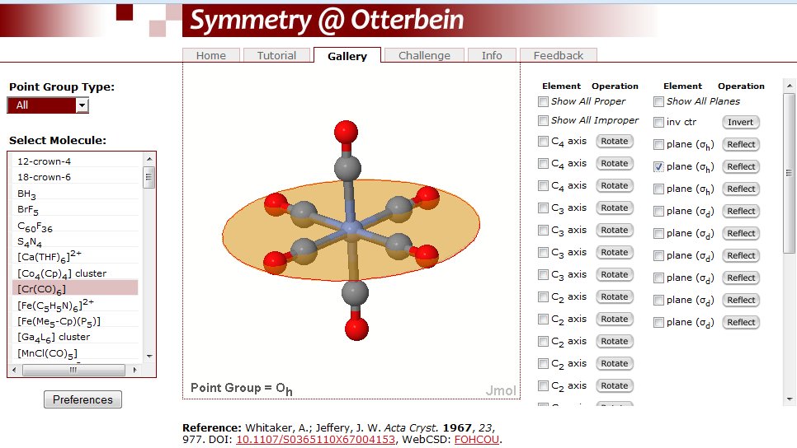
http://symmetry.otterbein.edu/gallery
Notes:
Since then, all sorts of web sites have sprung up around Jmol. Dean Johnston at Otterbein has this great site.

Slide 7
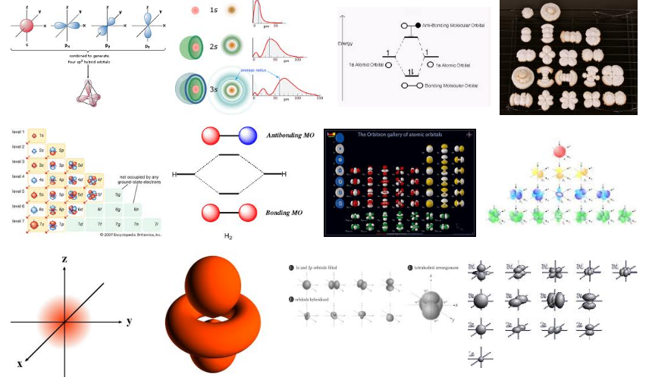

Google: atomic orbital hydrogen
Notes:
A Google search reveals all sorts of (relatively static) depictions of orbitals.

Slide 8
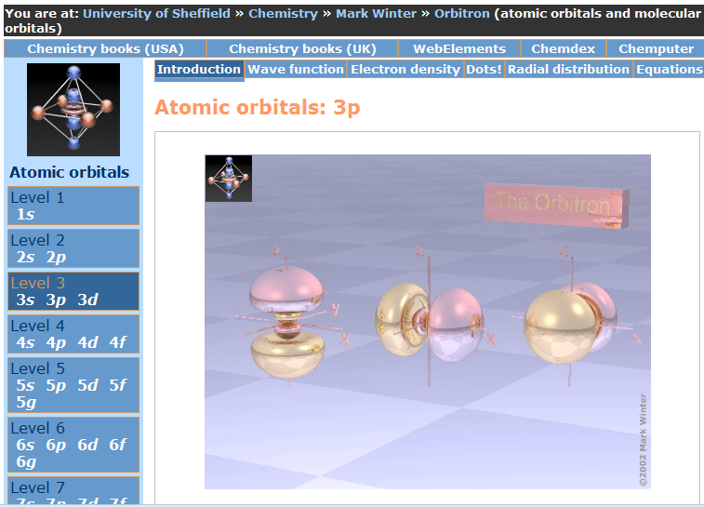
http://winter.group.shef.ac.uk/orbitron
Notes:
Orbitron is fun – sort of a “second-life” approach to visualization.

Slide 9
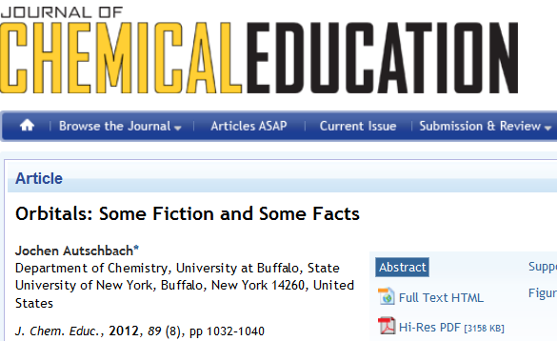
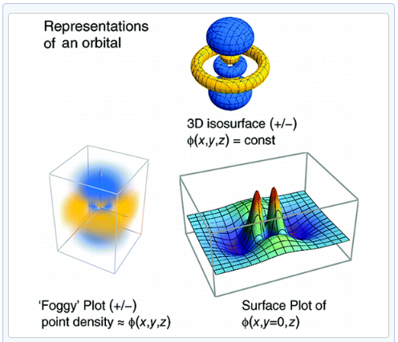
Atomic Orbitals in General Chemistry
Notes:
This recent article makes a good point…

Slide 10
Atomic Orbitals in General Chemistry
“The center of Figure 3 shows what may be called a ‘foggy plot’…. The image conveys the spatial fuzziness of orbitals better than the isosurface plot, and is not as easily mistaken for the aforementioned ‘balloon in which electrons bounce around’.
However, the fuzziness of the plot also makes it less convenient for orbital visualizations in research papers.
The author recommends the juxtaposition of isosurface and
‘foggy’ plots when orbital graphics are first shown to students.”
Notes:
And it’s that juxtaposition that we are trying to achieve here.

Slide 11
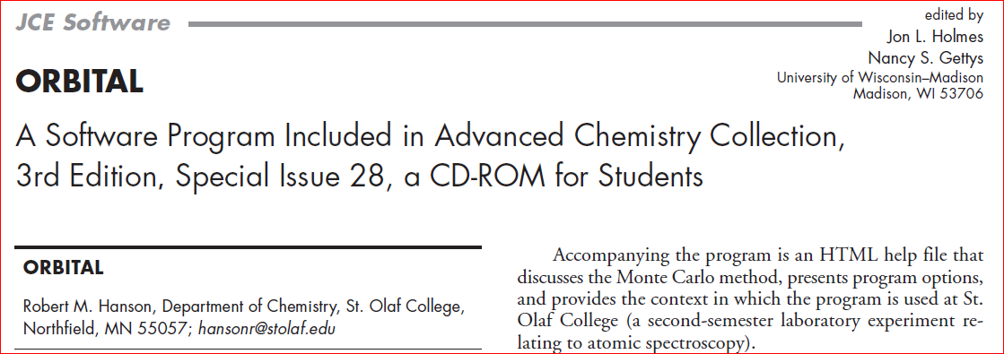
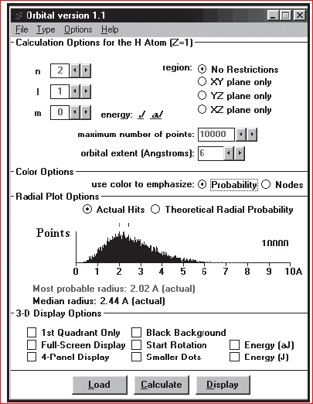
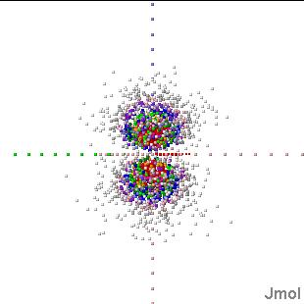
Notes:
Early Visual Basic program that served as the starting point for this work.

Slide 12
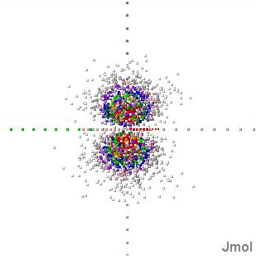
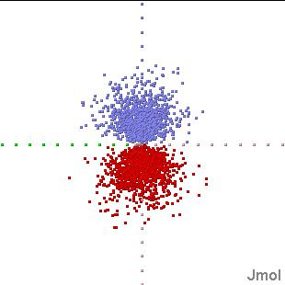
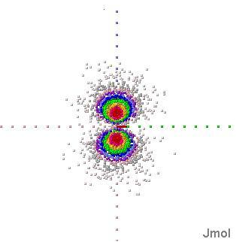
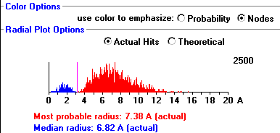
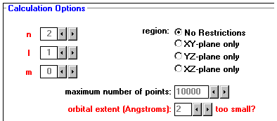
Notes:
… provided a range of visualizations.

Slide 13
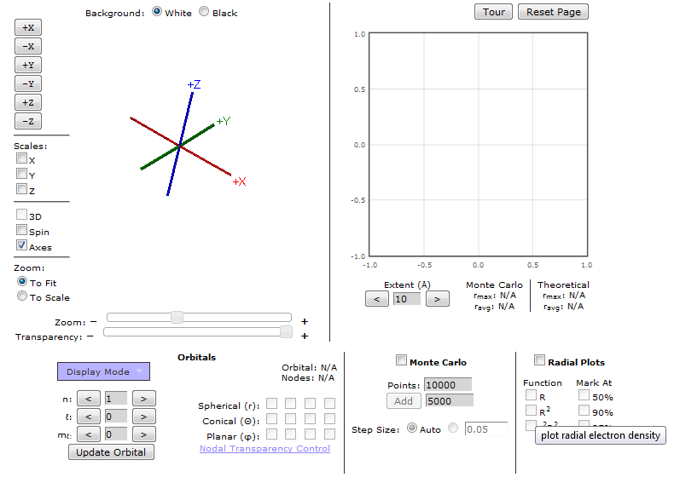
Hydrogenic Orbital Explorer
http://chemapps.stolaf.edu/jmol/orbitals
Notes:
A much more accessible version! The next pages walk us through the possibilities.

Slide 14
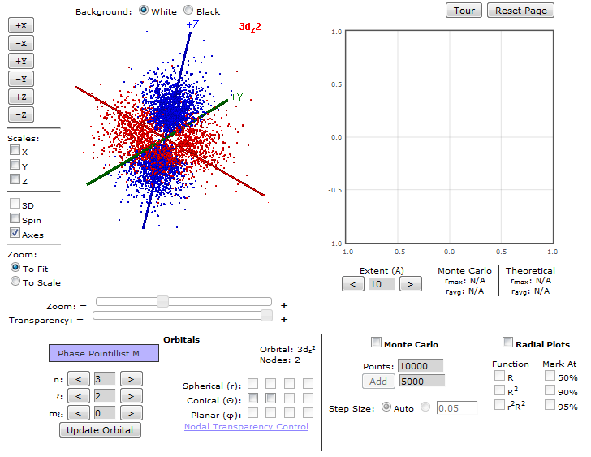
Hydrogenic Orbital Explorer
http://chemapps.stolaf.edu/jmol/orbitals

Slide 15
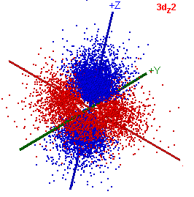
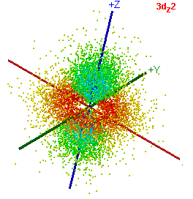
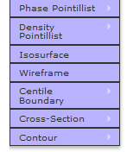
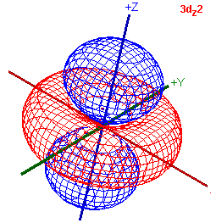
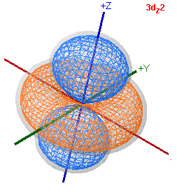
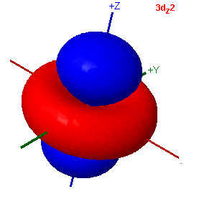
Hydrogenic Orbital Explorer
http://chemapps.stolaf.edu/jmol/orbitals

Slide 16
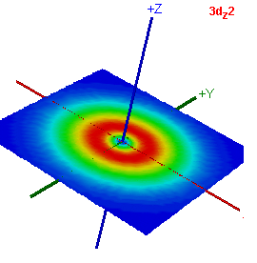
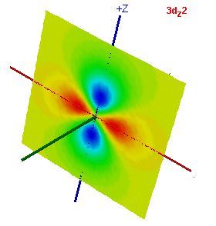
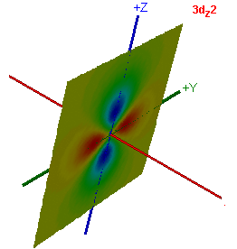
Hydrogenic Orbital Explorer
http://chemapps.stolaf.edu/jmol/orbitals

Slide 17
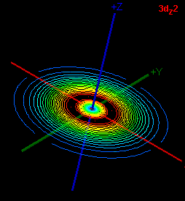
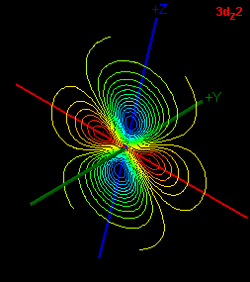
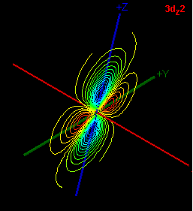
Hydrogenic Orbital Explorer
http://chemapps.stolaf.edu/jmol/orbitals

Slide 18
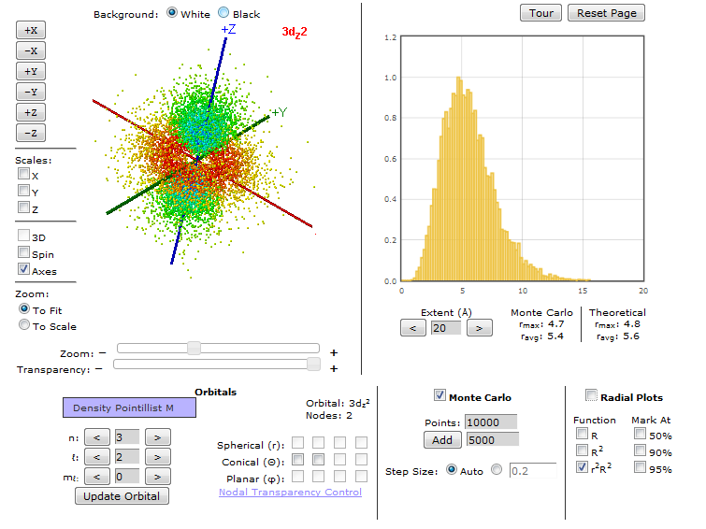
Hydrogenic Orbital Explorer
http://chemapps.stolaf.edu/jmol/orbitals

Slide 19
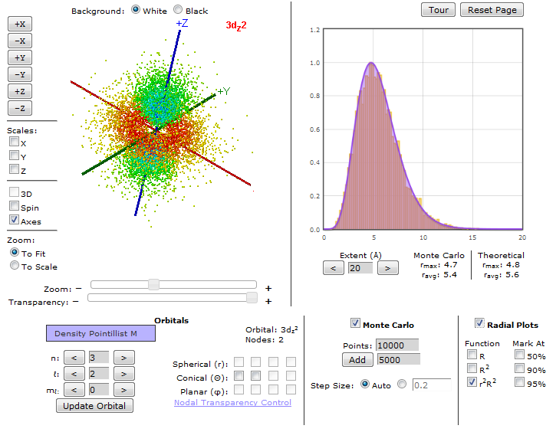
Hydrogenic Orbital Explorer
http://chemapps.stolaf.edu/jmol/orbitals

Slide 20
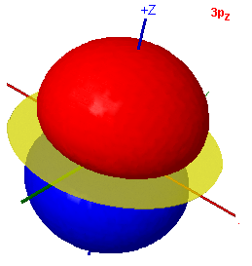
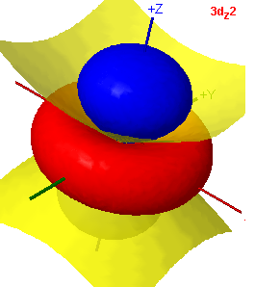
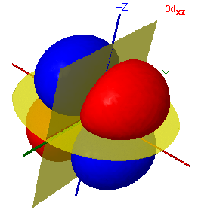
Hydrogenic Orbital Explorer
http://chemapps.stolaf.edu/jmol/orbitals
Notes:
With one minute left of my 15 allotted to the presentation, let me switch to a browser and show you the “tour”
[What followed were 5 minutes of discussion, all very positive.]

