Slide 1
Exploring Crystal Structure, Symmetry, and Energetics
with Jmol
Bob Hanson
St. Olaf College, Northfield, MN
http://www.stolaf.edu/people/hansonr
Crystal Workshop MSSC2013
l'Università di Torino, Italia
2 Sep 2013

Slide 2
Topics for Discussion
general introduction
examples from the web
general capabilities
features specific to crystals
future directions
getting involved
http://jmol.svn.sourceforge.net/viewvc/jmol/trunk/Jmol/jmol-crystal-workshop.ppt

Slide 3
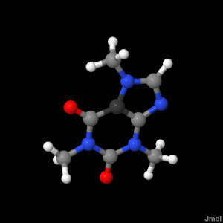
General Introduction to Jmol
Mission: The high-quality, real-time visualization of molecular structure, dynamics, and energetics.
Jmol is:
open source Java
cross-disciplinary
actively being developed
Jmol is not:
a commercial enterprise
a quantum computational package

Slide 4
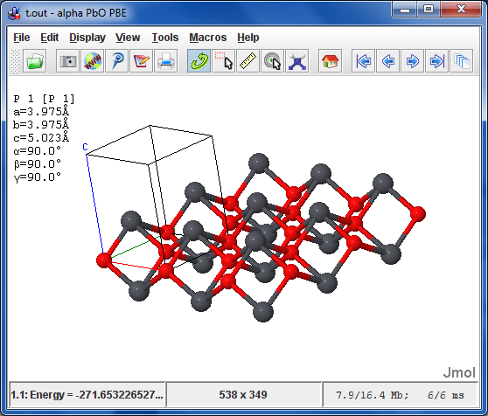
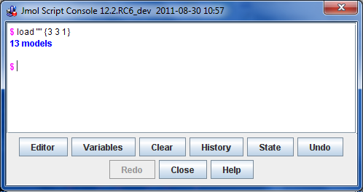
General Introduction to Jmol
Configurations:
Application

Slide 5
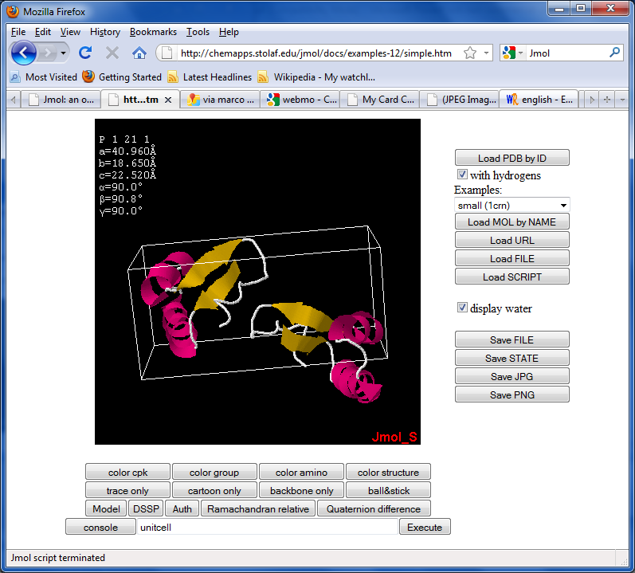
General Introduction to Jmol
Configurations:
Applet
easily added
highly customizable
highly interactive
highly modular
signed or unsigned
in 20 languages

Slide 6
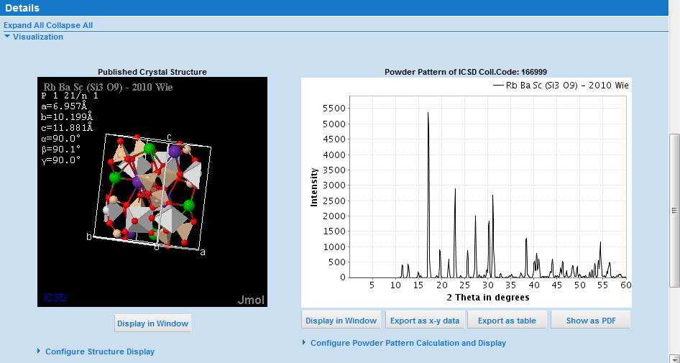
Jmol Examples from the Web
http://www.fiz-karlsruhe.de/icsd_web.html

Slide 7
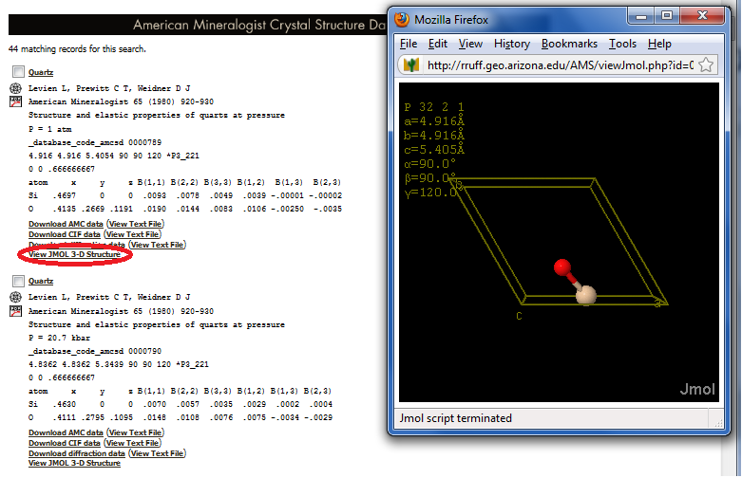
Jmol Examples from the Web
http://rruff.geo.arizona.edu/AMS/amcsd.php

Slide 8
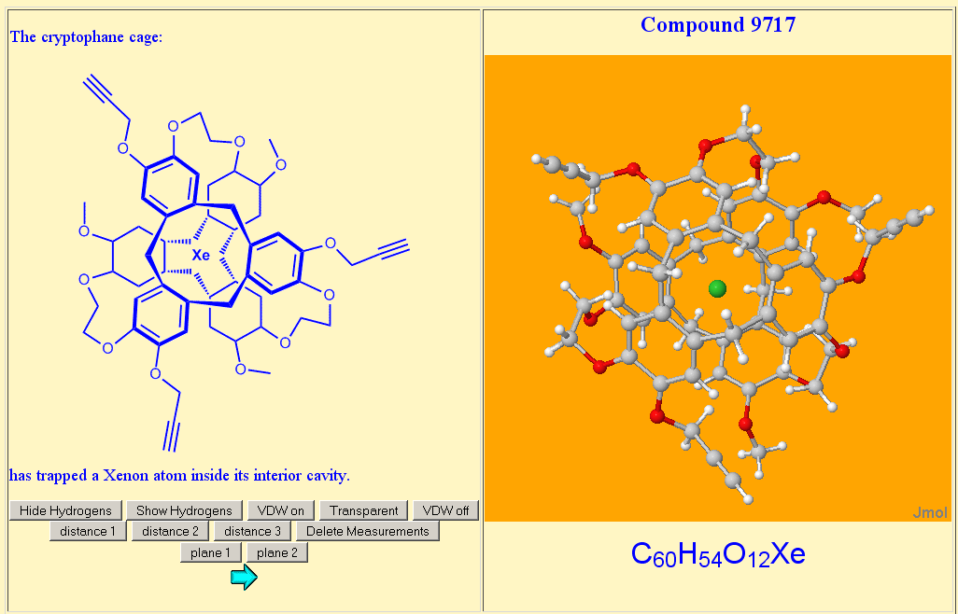
Jmol Examples from the Web
http://macxray.chem.upenn.edu

Slide 9
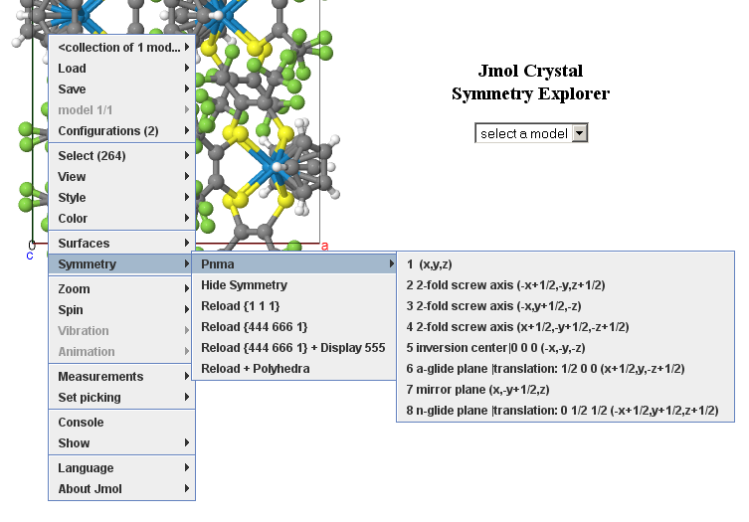
Jmol Examples from the Web
http://chemapps.stolaf.edu/jmol/docs/examples-11/jcse

Slide 10
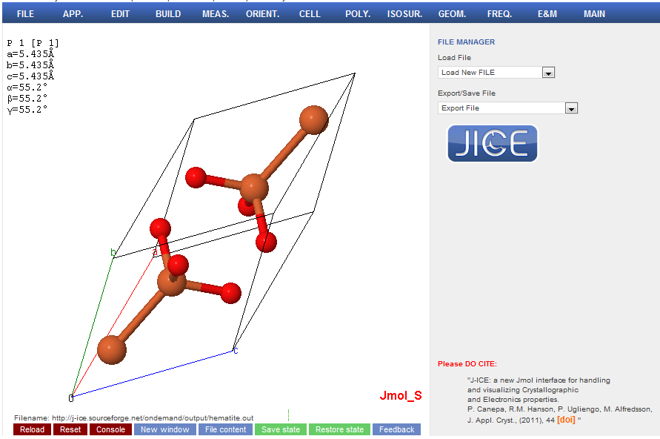
Jmol Examples from the Web
http://j-ice.sourceforge.net/ondemand/

Slide 11
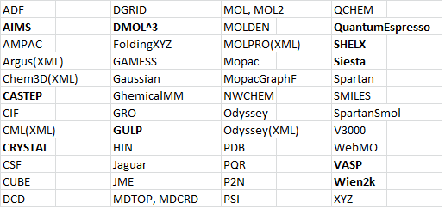
General Capabilities of Jmol
File Loading

Slide 12
General Capabilities of Jmol
File Loading
input configurations
structure optimizations
vibrations
molecular dynamics trajectories
primitive or conventional unit cells
over-ride of file-based unit cells and space groups
biomolecules
multiple files and files with multiple structures

Slide 13
General Capabilities of Jmol
File Loading
directly from:
RCSB/PDB (75,000+ biomolecules)
NIH (250,000+ compounds; infinite IUPAC)
Uppsala Electron Density Server (57,000+ maps)

Slide 14
Try this:
1. Open Jmol application
2. ALT-F M (file…get MOL)
3. Enter in the input box:
1-chlorobutane

Slide 15
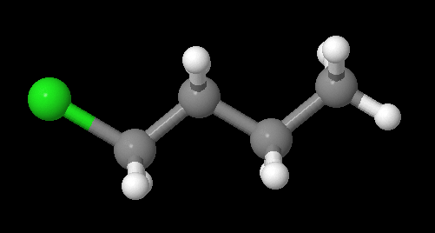
Try this:
1. Open Jmol application
2. ALT-F M (file…get MOL)
3. Enter in the input box:
1-chlorobutane

Slide 16
Using the console. Now try this:
1. ALT-F L (file…Console)
2. Enter in the console:
load $1-chlorobutane

Slide 17
Using the console. Now try this:
1. ALT-F L (file…Console)
2. Enter in the console:
load $1-chlorobutane

Slide 18
But try this:
Enter in the console:
load $1-thiobutane

Slide 19

But try this:
Enter in the console:
load $1-thiobutane // oops! doesn’t work!
apparently the OPSIN program at the server doesn’t recognize “thio”
nothing we can do about that…or is there…

Slide 20
Try this:
load $1-chlorobutane
{_Cl}.element = “S”
calculate hydrogens
minimize

Slide 21
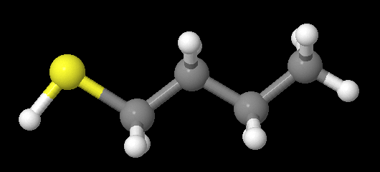
Try this:
load $1-chlorobutane
{_Cl}.element = “S” // “change all chlorines to sulfur”
calculate hydrogens // “add in missing hydrogens”
minimize // “fix the structure”

Slide 22
General Capabilities of Jmol
Scripting
Jmol 12.2 has a rich scripting language that is easily accessed via a console, a pop-up menu, or via an API.
There are nearly 2000 semantic tokens and about 150 commands.
The HELP command accesses the interactive script documentation directly at
http://chemapps.stolaf.edu/jmol/docs

Slide 23
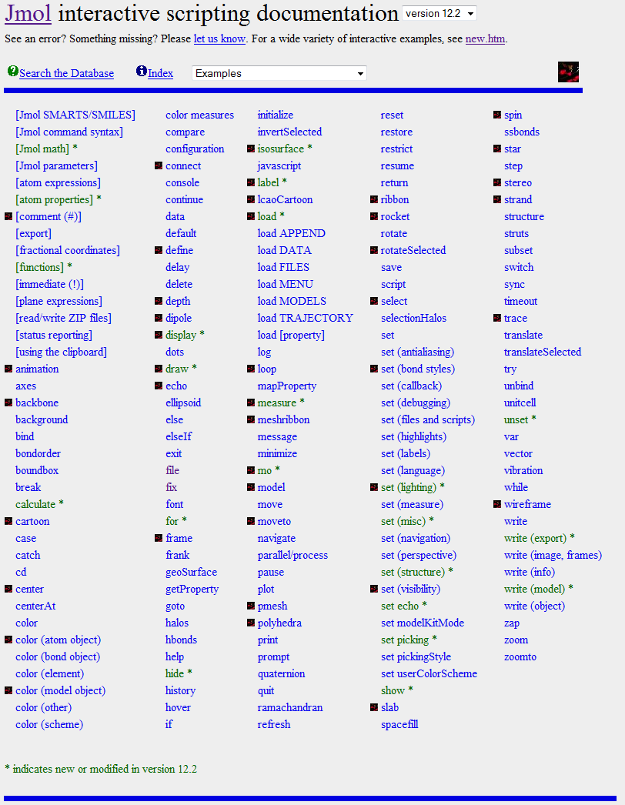


Slide 25
General Capabilities of Jmol
Output/Export Options
Jmol can export a view to several formats, including:
POV-Ray (fancy ray-tracing some people like)
VRML (can be used for 3D-printing)
X3D (XML version of VRML)

Slide 26
General Capabilities of Jmol
Output/Export Options
Structures can be saved in PDB, MOL, and XYZ formats.
Only the selected atoms are written, allowing for creating files that are subsets of the original file.

Slide 27
General Capabilities of Jmol
Output/Export Options
Images can be created in JPG and PNG formats.
A special “PNGJ” format is interesting:
combines an image and a ZIP file
retains the full state of Jmol
includes all files used in the formation of the image
allows dragging the image back into the application to restore the state

Slide 28
General Capabilities of Jmol
Output/Export Options
Jmol can also write a single ZIP file (.JMOL) that contains all files needed to reproduce the exact current state.
The Jmol application includes a “web export” utility that allows relatively novice users to build HTML pages built on standard templates.

Slide 29
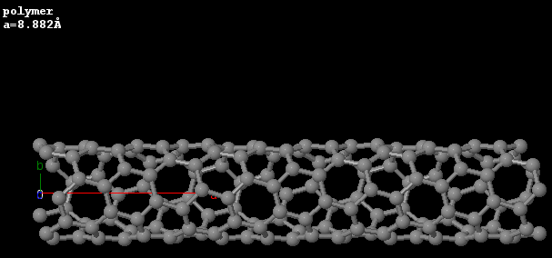
Try this:
load “http://www.theochem.unito.it/crystal_tuto/mssc2008_cd/tutorials/nanotube/output/test_nano03.out” {3 1 1}

Slide 30
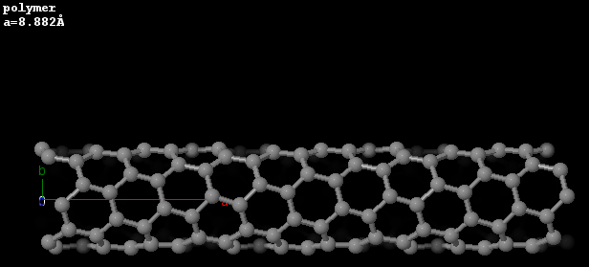
Now add:
set zshade on
set zshadepower 5

Slide 31
Now add:
set zshade on
set zshadepower 5 // removes back side of nanotube

Slide 32
Now save the structure and delete it:
write PNGJ nano.png
zap
Response:
OK PNGJ 47349 C:/jmol-dev/bobtest/nano.png; quality=-1; width=642; height=452

Slide 33
Now, here’s the cool part: Find that image on your computer and drag it back into Jmol or use CTRL-C to clip it from the directory and CTRL-V to paste it into Jmol.
Cool, eh?

Slide 34
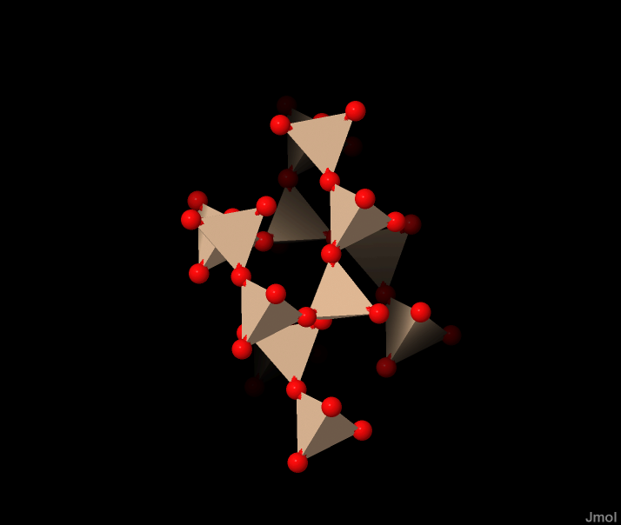
General Capabilities of Jmol
Rendering Options
ball and stick
wireframe
spacefill
dots, stars
polyhedra
thermal ellipsoids
cartoons

Slide 35
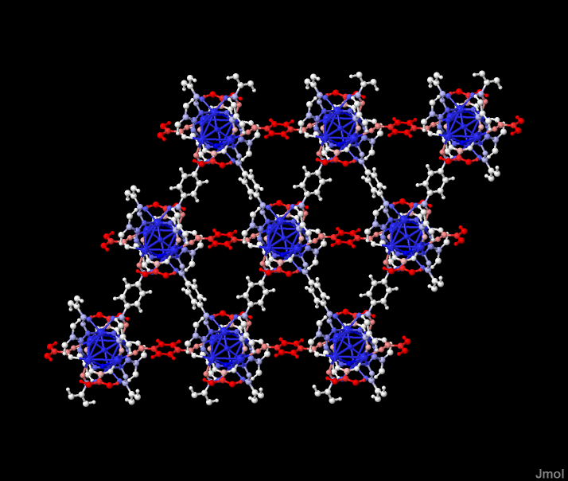
General Capabilities of Jmol
Coloring Options
CPK
custom colors
color by property
{*}.temperature = {*}.vxyz.all
color temperature

Slide 36
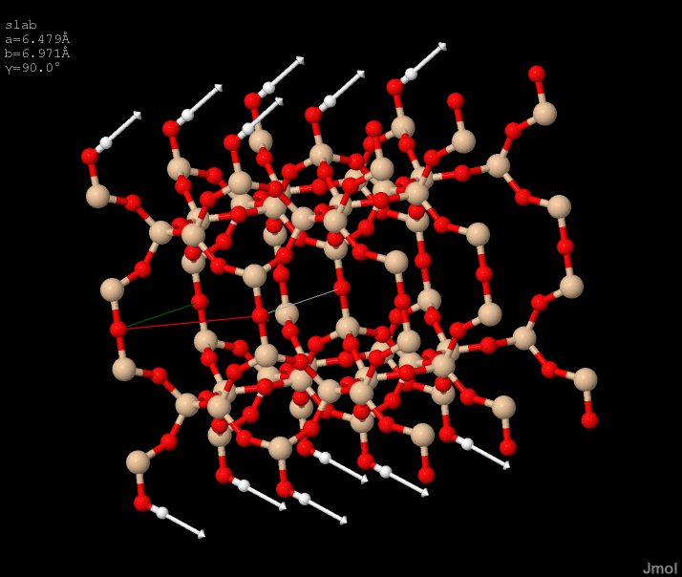
General Capabilities of Jmol
Depicting vibrations
arrows
animation
vectors on

Slide 37
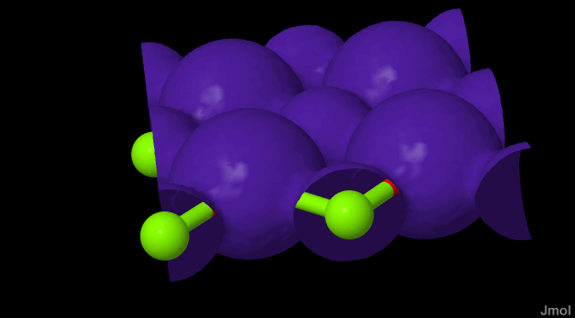
Surface Capabilities of Jmol
Isosurface Creation from Cube Data

Slide 38
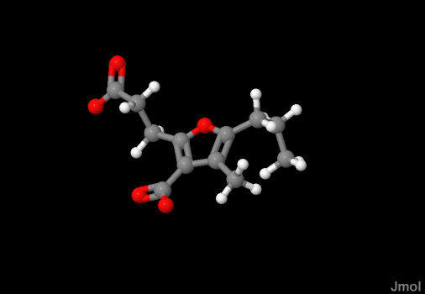
Surface Capabilities of Jmol
Built-in surfaces include Van der Waals and contacts
(this is a ligand in a binding site, actually)

Slide 39
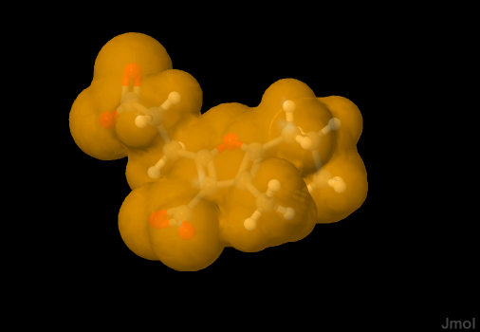
Surface Capabilities of Jmol
Built-in surfaces include Van der Waals and contacts
isosurface select {ligand} only vdw

Slide 40
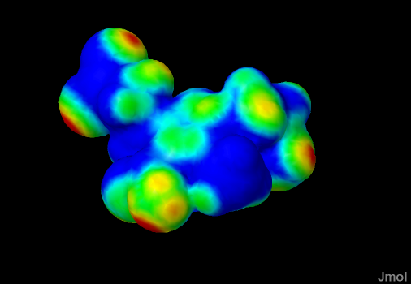
Surface Capabilities of Jmol
Built-in surfaces include Van der Waals and contacts
contact {ligand} surface

Slide 41
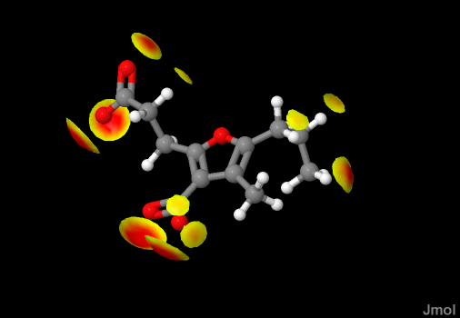
Surface Capabilities of Jmol
Built-in surfaces include Van der Waals and contacts
contact {ligand} trimmed

Slide 42
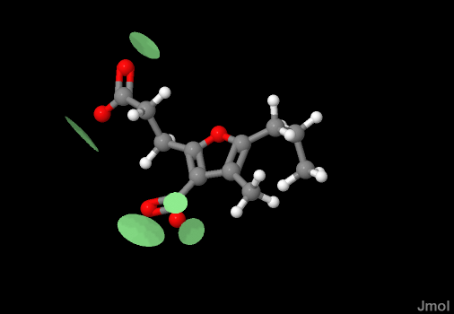
Surface Capabilities of Jmol
Built-in surfaces include Van der Waals, solvent-accessible, solvent-excluded, cavities, and contacts
contact {ligand} hbond

Slide 43

Surface Capabilities of Jmol
Isosurface Creation from Cube Data

Slide 44
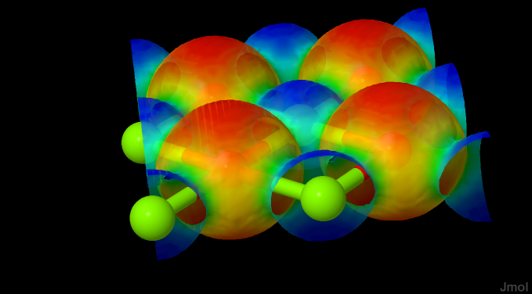
Surface Capabilities of Jmol
Isosurface Creation from Cube Data

Slide 45
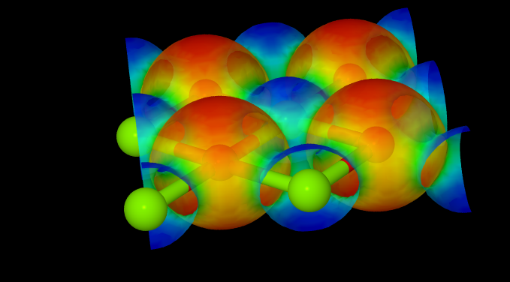
Surface Capabilities of Jmol
Isosurface Creation from Cube Data
(POV-ray output)

Slide 46
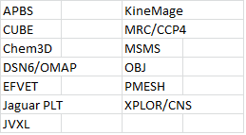
Surface Capabilities of Jmol
Cube/Polygon File Loading

Slide 47
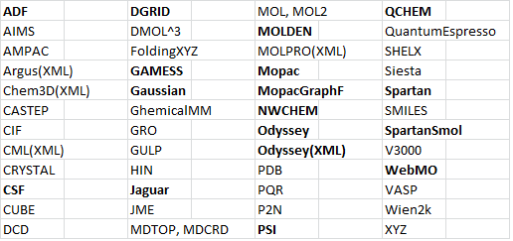
Surface Capabilities of Jmol
Molecular Orbitals -- Basis File Loading

Slide 48
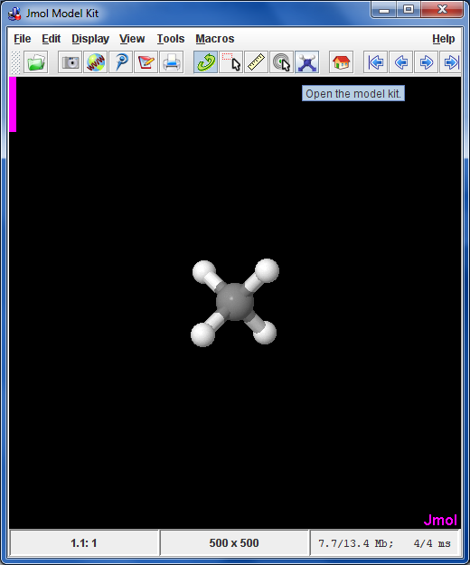
Molecule Building
Jmol’s modelKitMode allows for the creation and modification of models.

Slide 49
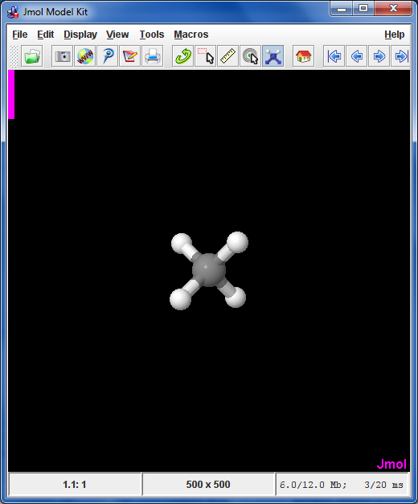
Jmol Virtual Model Kit

Slide 50
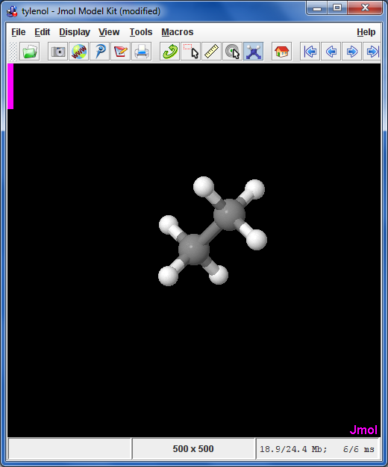
Jmol Virtual Model Kit

Slide 51
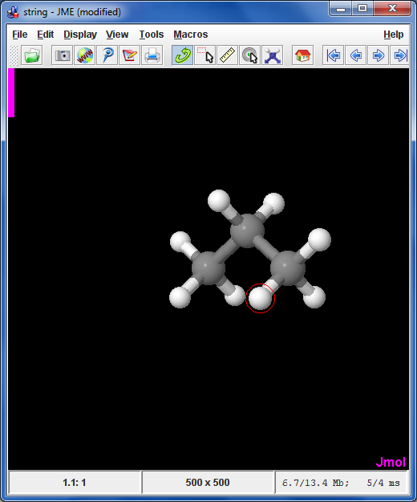
Jmol Virtual Model Kit

Slide 52
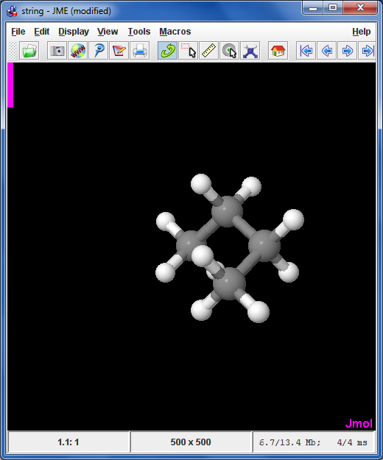
Jmol Virtual Model Kit

Slide 53
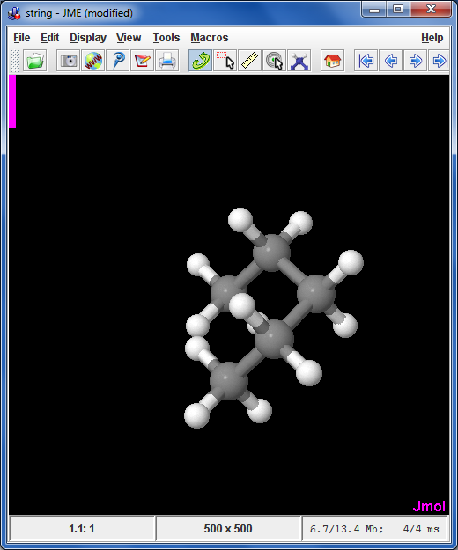
Jmol Virtual Model Kit

Slide 54
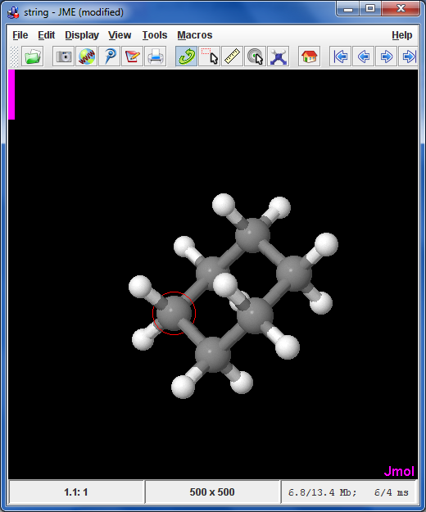
Jmol Virtual Model Kit

Slide 55
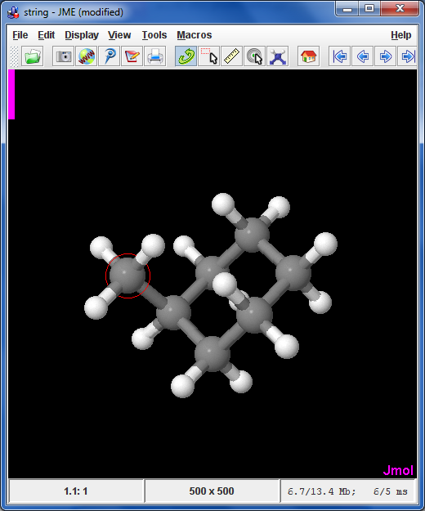
Jmol Virtual Model Kit

Slide 56
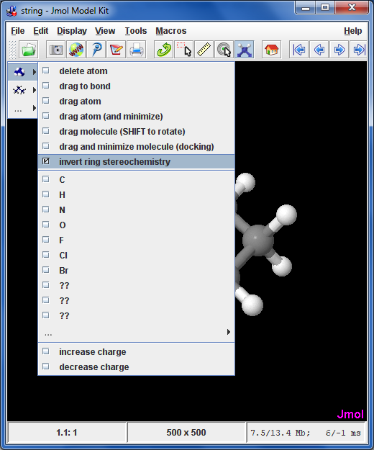
Jmol Virtual Model Kit

Slide 57
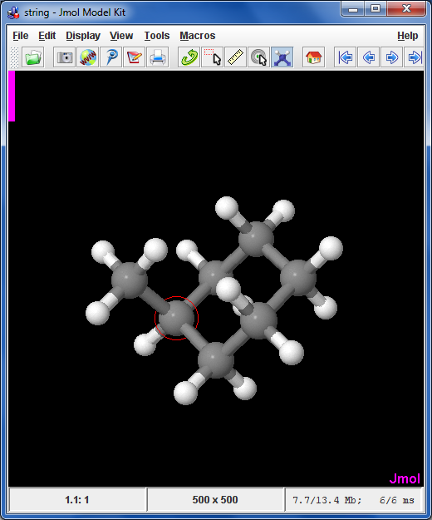
Jmol Virtual Model Kit

Slide 58
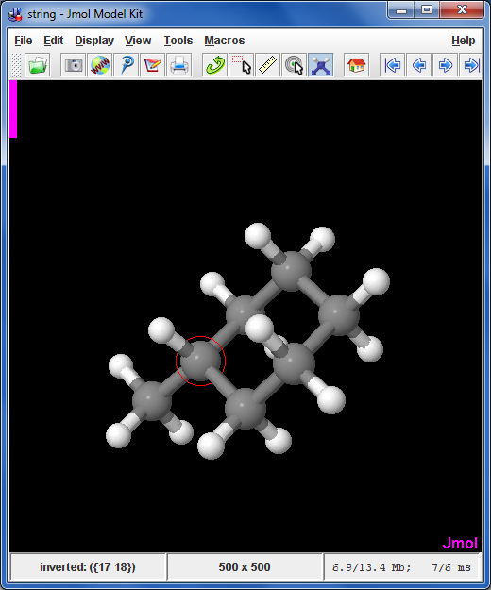
Jmol Virtual Model Kit

Slide 59
Jmol Virtual Model Kit

Slide 60
Jmol Virtual Model Kit

Slide 61
Jmol Virtual Model Kit

Slide 62
Jmol Virtual Model Kit

Slide 63
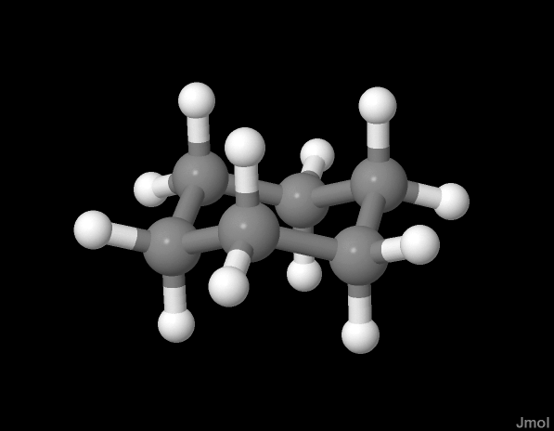
Minimization
Jmol uses the Universal Force Field (UFF) to allow rapid minimization of structures.
You can fix parts of the structure that you don’t want minimized, and you set Jmol to automatically minimize a structure when atoms are moved

Slide 64
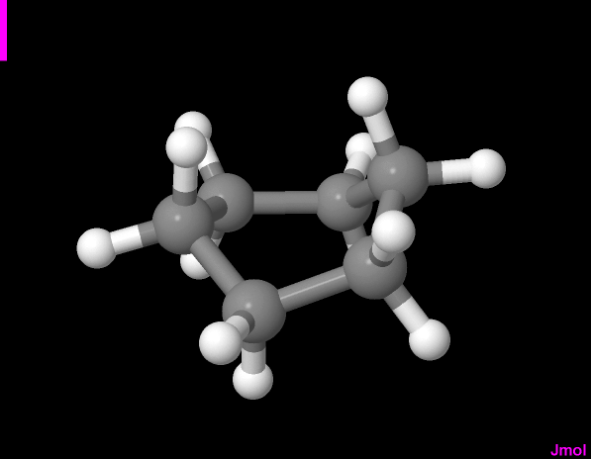
Minimization
Jmol uses the Universal Force Field (UFF) to allow rapid minimization of structures.
You can fix parts of the structure that you don’t want minimized, and you set Jmol to automatically minimize a structure when atoms are moved

Slide 65
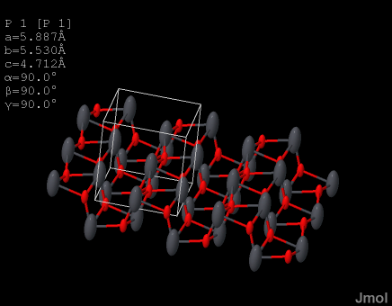
Features Specific to Crystals
space groups
unit cells
slabs and polymers
ellipsoids
Multipole analysis tensors as ellipsoids

Slide 66
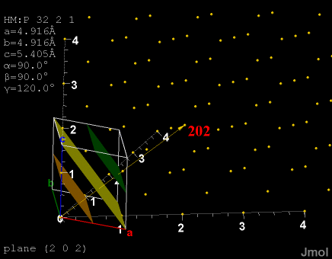
Features Specific to Crystals
space groups
unit cells
slabs and polymers
ellipsoids
Miller planes
http://chemapps.stolaf.edu/jmol/docs/examples-12/hkl.htm

Slide 67
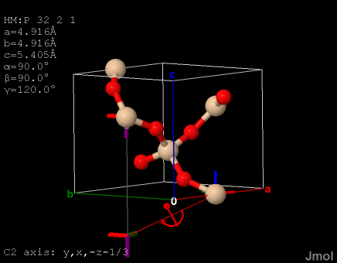
Features Specific to Crystals
space groups
unit cells
slabs and polymers
thermal ellipsoids
Miller planes
operator visualization
http://chemapps.stolaf.edu/jmol/docs/examples-11/jcse

Slide 68
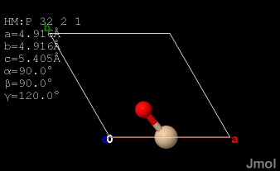
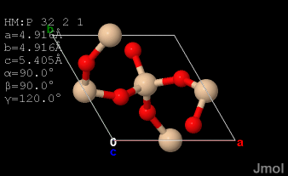
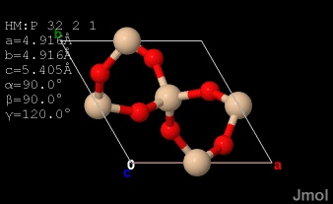
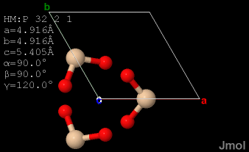
Features Specific to Crystals
load load {1 1 1} / load {555 555 1}
load {1 1 1} packed / load {555 555 -1} load {555 555 0}

Slide 69
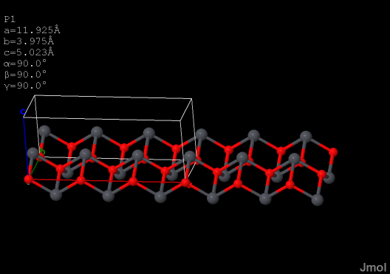
Features Specific to Crystals
load “alpha_PbO.out” {2 2 1} SUPERCELL {3 1 1}

Slide 70
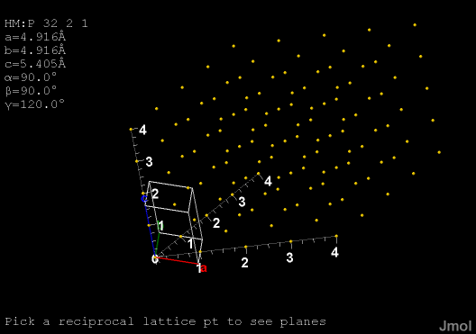
Future Directions for Jmol
reciprocal lattice

Slide 71

Future Directions for Jmol
reciprocal lattice
brillouin zone

Slide 72

Future Directions for Jmol
closer inter-operativity with CRYSTAL

Slide 73

Getting Involved
jmol-users@lists.sourceforge.net
hansonr@stolaf.edu

Slide 74
Thank you!
Special thanks to:
Pieremanuele Canepa
Piero Ugliengo Erik Wyatt (contact command)
Roberto Dovesi
The Jmol user group
The Jmol development team
St. Olaf College
https://sourceforge.net/p/jmol/code/18636/tree/trunk/Jmol/
_documents/jmol-crystal-workshop.ppt

