Slide 1
JSmol: Full-service molecular visualization on the Web
without Java
Robert Hanson, St. Olaf College
Zhou Renjian, unaffiliated, China
Takanori Nakane, Kyoto University
Paul Pillot. l’académie d’Orléans-Tours
246th ACS National Meeting
Indianapolis, Indiana
8 Sep 2013

Slide 2
Today’s Presentation
Background: Jmol-Java and Jmol-Android
Jmol-JSO: Jmol JavaScript Object
WebGL or not WebGL, that was the question
Death of the Java applet
Java2Script to the rescue
Ubiquitous JSmol

Slide 3
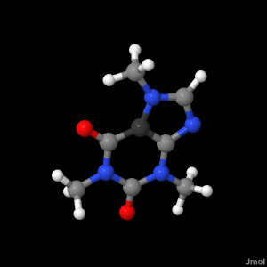
Background: Jmol
Mission: The high-quality, real-time visualization of molecular structure, dynamics, and energetics on all platforms.
Jmol is:
open source Java
cross-disciplinary
actively being developed
Jmol is not:
a commercial enterprise
a quantum computational package

Slide 4
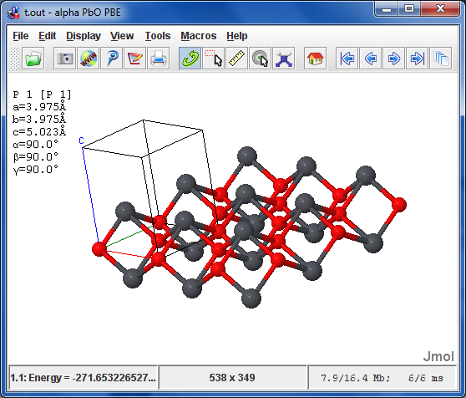
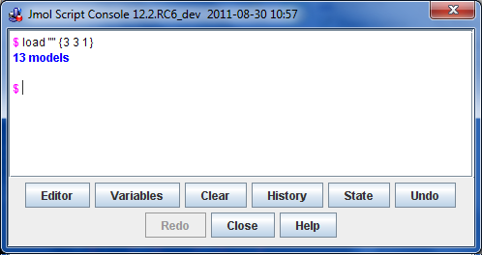
Background: Jmol-Java Application
Configurations:
Application

Slide 5
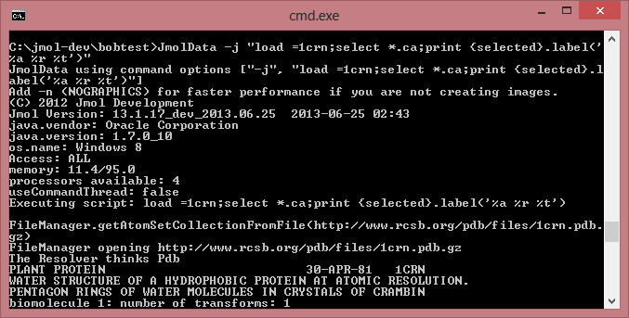
Background: Jmol-Java (JmolData.jar)
Configurations:
Command-line Java application
server-side app
can run
“headless”
automated
workflow
.

Slide 6
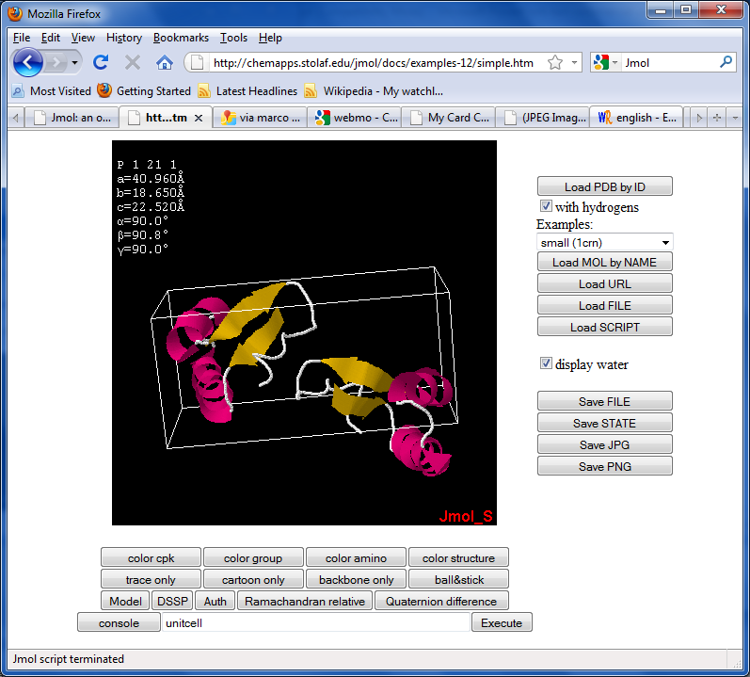
Background: Jmol-Java Applet
Configurations:
Java Applet
easily added
highly customizable
highly interactive
highly modular
signed or unsigned
in 20 languages

Slide 7
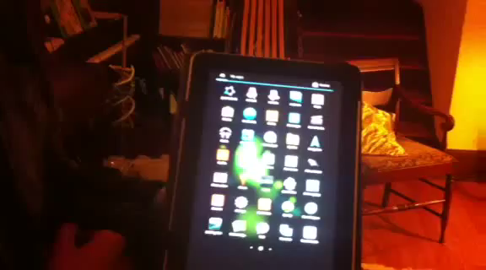
Background: Jmol-Android
Configurations:
Android app
Fall of 2011
An important
experiment in compartmentalization
Core Jmol code isolated; wrapped with a different interface
Utilizes tablet’s gyro for “walk-around” rotation

Slide 8
Jmol-JSO: Jmol JavaScript Object
Jmol = function(){}
Spring of 2012
Utilizes jQuery
Allows modular components
Easy retrofit

Slide 9
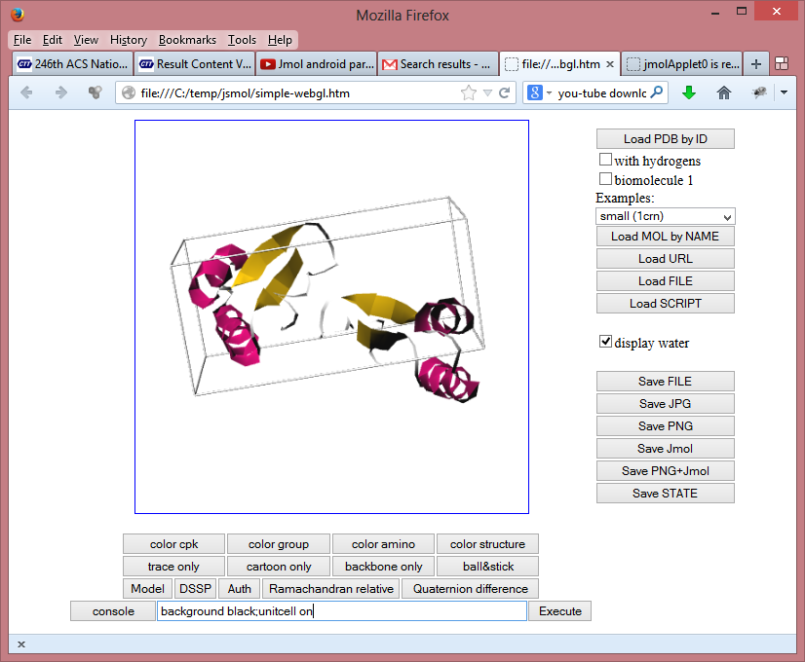
WebGL or not WebGL, that was the question
Extension of
Jmol-Android and Jmol-JSO ideas
Summer of 2012
Early experiments with ChemDoodle and GLmol
Management?
Tablets?
Takanori Nakane http://webglmol.sourceforge.jp/index-en.html

Slide 10
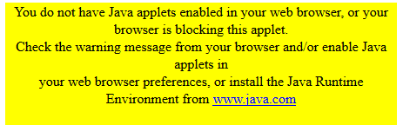
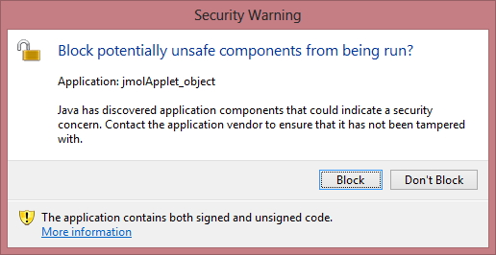
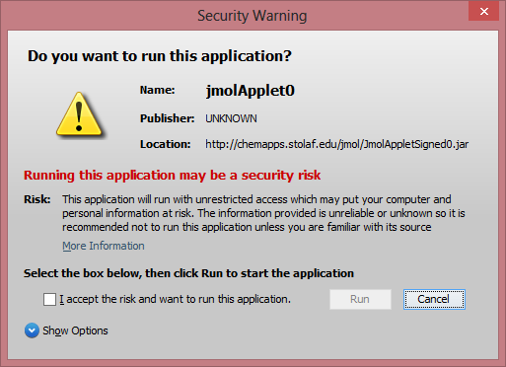
Death of the Java applet
  During the summer of 2012 it became apparent that Java applets were no longer suitable for general web use.

Slide 11
Death of the Java applet
  Jan. 10, 2013
  U.S. Department of Homeland Security suggests:
  Disable Java in web browsers
  This and previous Java vulnerabilities have been widely targeted by attackers, and new Java vulnerabilities are likely to be discovered. To defend against this and future Java vulnerabilities, consider disabling Java in web browsers until adequate updates are available. As with any software, unnecessary features should be disabled or removed as appropriate for your environment.
http://www.us-cert.gov/ncas/alerts/TA13-032A

Slide 12
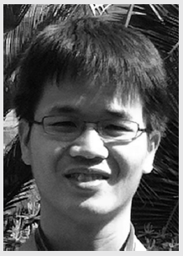
Java2Script to the rescue
Open-Source Plug-In for Eclipse
Fall of 2012
Implementation
Collaborative Development
Java/JavaScript Optimization
Jhou Renjian
http://j2s.sourceforge.net/

Slide 13
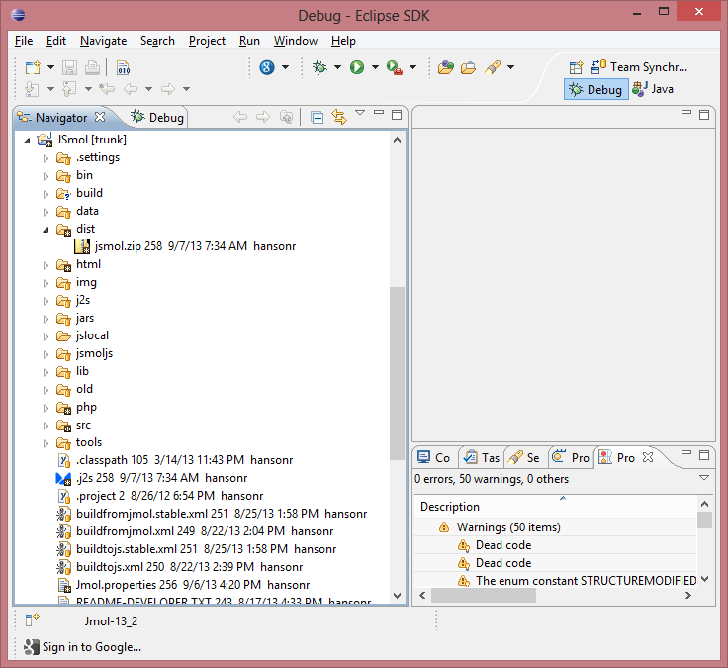
Java2Script to the rescue
All programming still in Java

Slide 14
Java2Script to the rescue
All programming still in Java
Copy Java from Jmol

Slide 15
Java2Script to the rescue
All programming still in Java
Compile JavaScript

Slide 16
Java2Script to the rescue
All programming still in Java
2-minute build to JavaScript!
ZIP file created

Slide 17
Ubiquitous JSmol
Works on all platforms with all major browsers
Windows / Mac / Linux
Firefox / MSIE / Opera / Safari
No Java required
No WebGL required

Slide 18
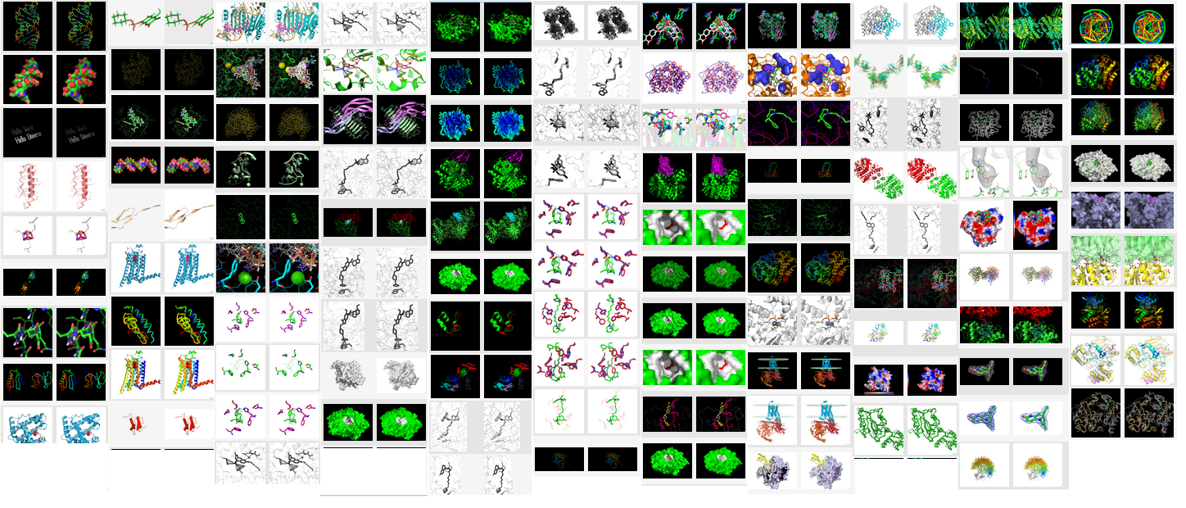
Ubiquitous JSmol
Reads over 60 file model file formats, including PyMOL PSE
Jaim Prilusky http://ispcsrv.weizmann.ac.il/a2jmolb/browse

Slide 19
Ubiquitous JSmol
Reads and writes Jmol states:
Jmol SPT files (state with file references)
Jmol ZIP files (comprehensive state)
Jmol Scene files (Proteopedia)
Jmol JVXL files (surfaces)
PNGJ images (image + zip)

Slide 20
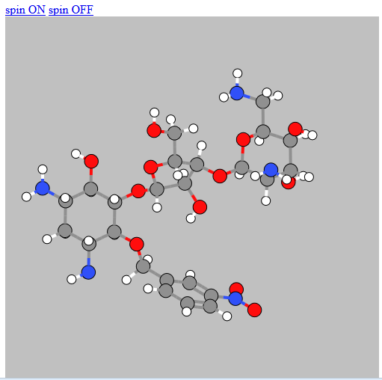
Ubiquitous JSmol
“JSmol-Lite”
40K download
(requires jQuery)
135K download
(includes jQuery)
clean, simple rendering
no surfaces
nearly instantaneous
minimal scripting
http://chemapps.stolaf.edu/jmol/jsmol/lite4.htm

Slide 21
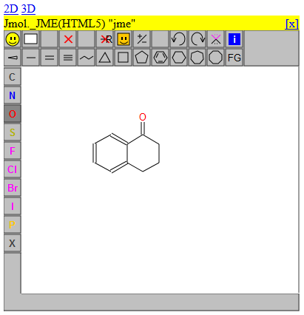
Ubiquitous JSmol
Implements JSME
2D → 3D
3D → 2D

Slide 22
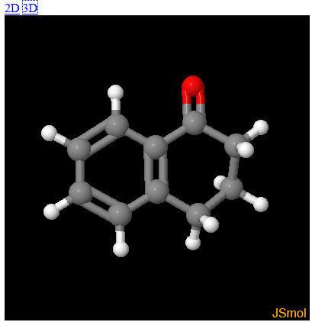
Ubiquitous JSmol
Implements JSME
2D → 3D
3D → 2D

Slide 23
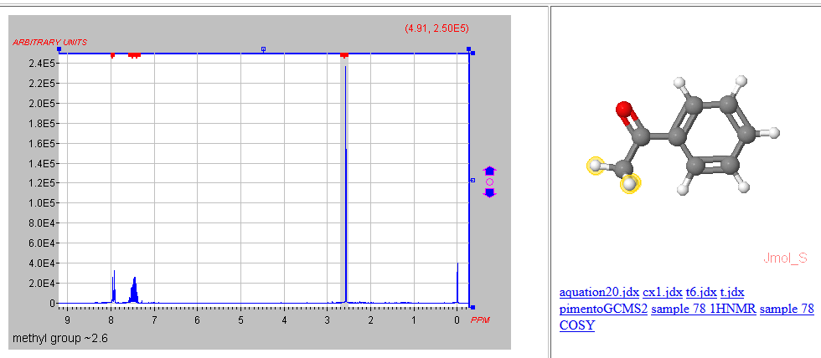
Ubiquitous JSmol
Works with JSpecView (Java applet)
Jaim Prilusky http://ispcsrv.weizmann.ac.il/a2jmolb/browse

Slide 24
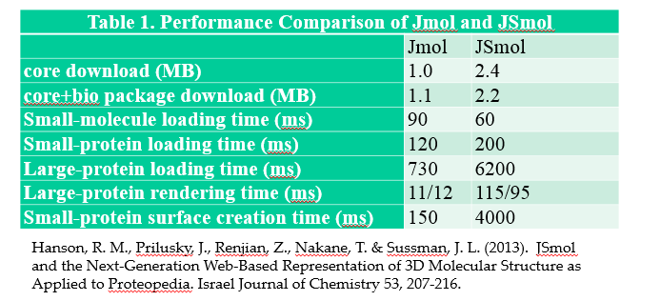
Ubiquitous JSmol
Comparisons to Jmol

Slide 25
Ubiquitous JSmol
set platformSpeed [1-8]
Up to 30x speed increase while rotating or zooming
value >= enables
8 antialiasDisplay (and thus, all features)
7 translucency
6 meshes (contact, draw, isosurface, MO, pmesh, lcaocartoon, CGO)
5 cartoons, rockets, trace, ribbon
4 geosurfaces
3 ellipsoids
2 wireframe and balls
1 none of the above (same as "set wireframeRotation off")
0 [reserved for "auto"]

Slide 26
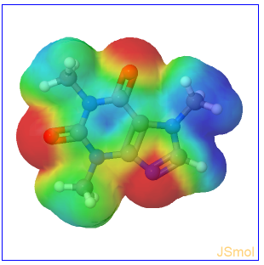
Ubiquitous JSmol
Isosurface cache
Small surfaces are no problem
Larger surfaces best precalculated and saved as JVXL files

Slide 27
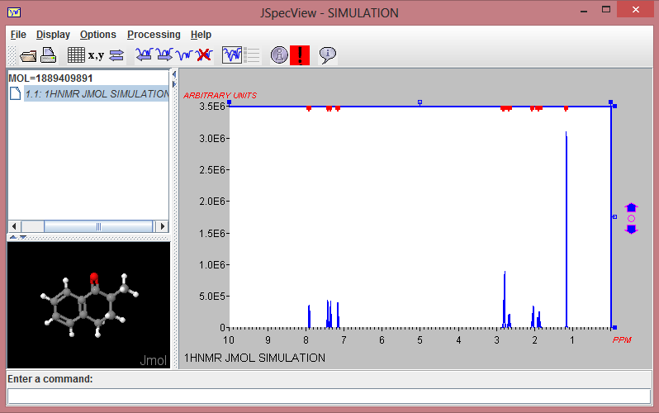
JSmol – what’s next
Display of simulated spectra (working in Jmol app)

Slide 28
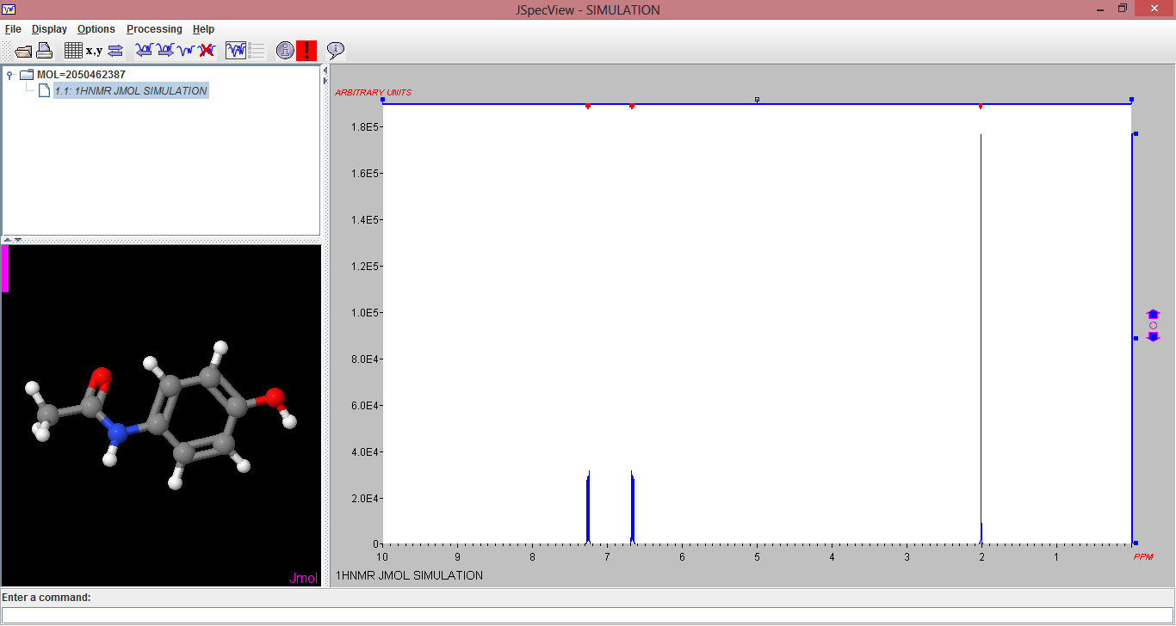
JSmol – next project
Display of simulated spectra (working in Jmol app)

Slide 29
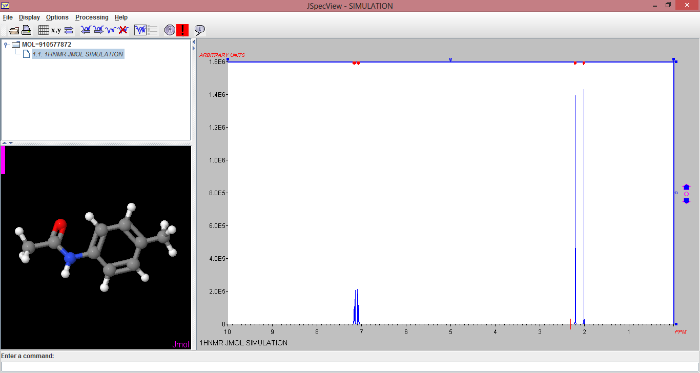
Ubiquitous JSmol – future plans
Display of simulated spectra (working in Jmol app)

Slide 30
Thank you!
Special thanks to:
Jeff Lang, David Martinsen, Evan Bolton (kick in the butt)
Duncan Blue (Java2Script optimization testing)
Jaim Prilusky (PyMOL PSE reader testing)
Peter Ertl (JSME)
Luc Patiny (nmrdb web service API)
The Jmol user group
The Jmol development team
St. Olaf College

