Slide 1
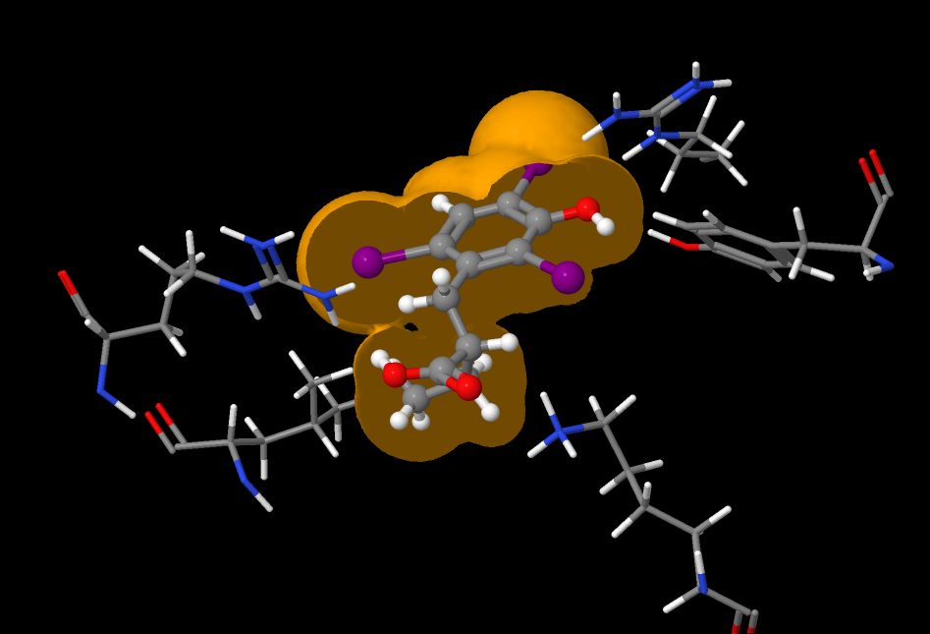
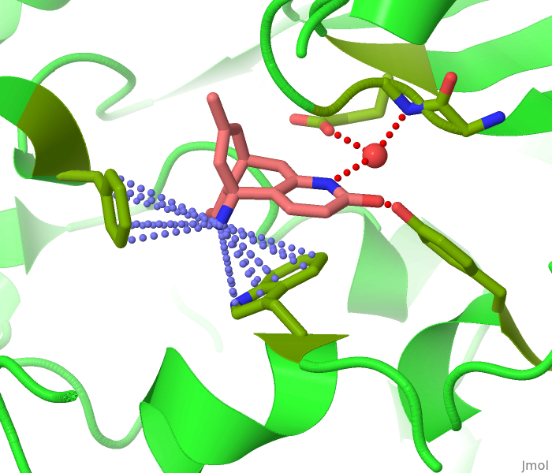
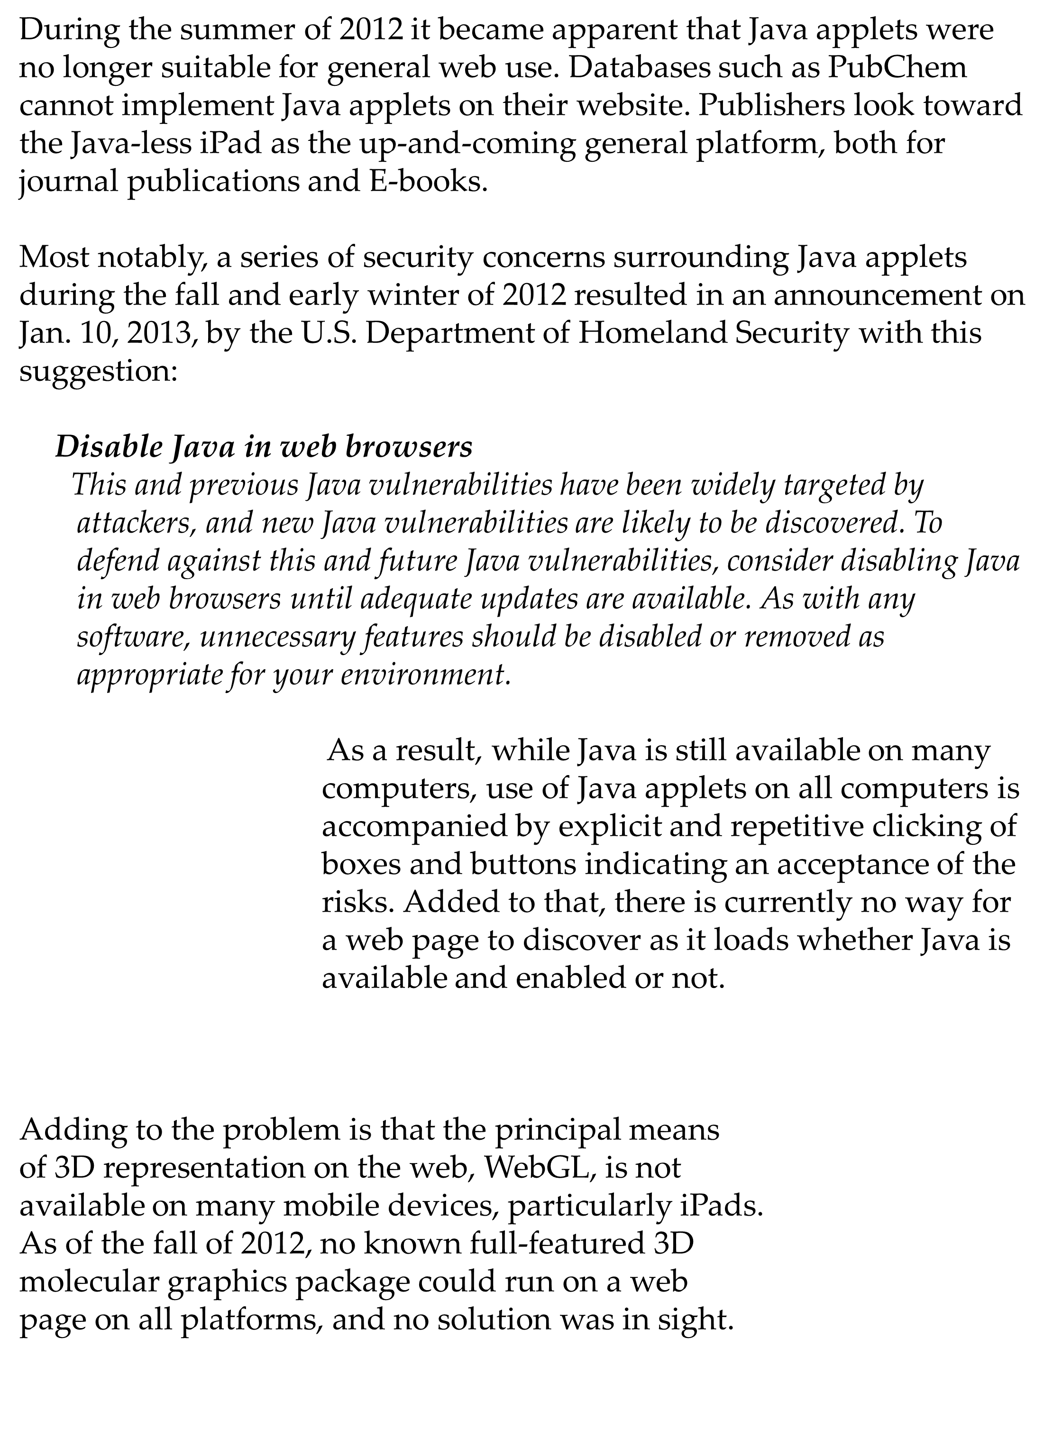
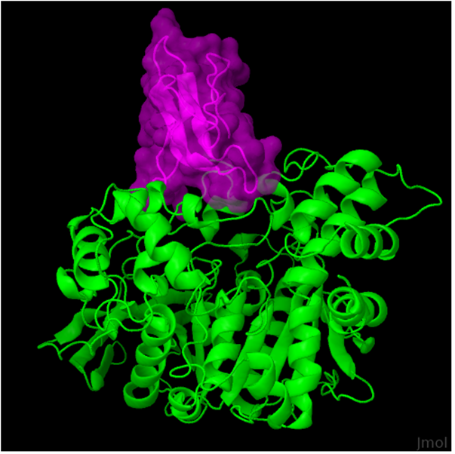
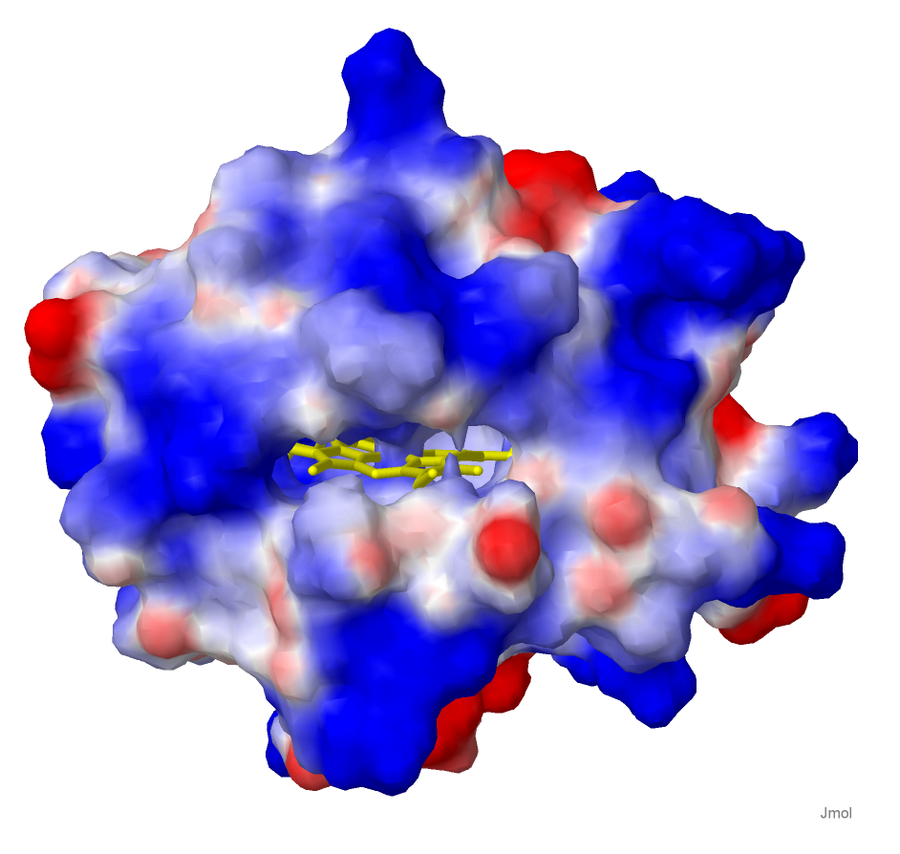
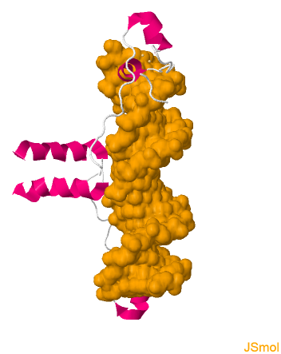
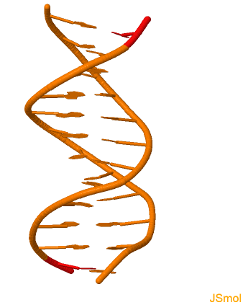
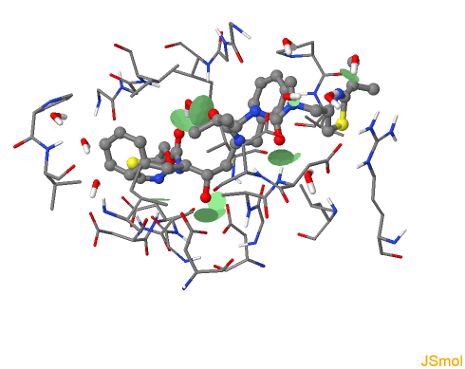
JSmol: Full-Service Molecular Visualization
On the Web Without Java
Robert M. Hanson Jhou Renjian
St. Olaf College, Northfield, Minnesota Shanghai, China
Gordon Research Conference on Visualization In Science & Education
Bryant University, July 21-26, 2013
Abstract
The Solution – Jmol Becomes JSmol
Results
We have recently ported the Java-based Jmol applet to pure JavaScript.
The implementation, JSmol (JSmol.sourceforge.net), reproduces all of the functionality of Jmol/Java, but with no Java. In this poster I describe the problem and its solution, and compare the look and feel of Jmol and JSmol. For small systems, JSmol proves to be an excellent solution; for larger systems, especially those involving surface creation, time will tell.
We needed a solution that:
(a) allowed automated translation from Java to JavaScript,
(b) would perform at an acceptable level, and
(c) could be easily maintained (not a wholly new development
thread).
In September of 2012 a candidate appeared in the form of an open-source Eclipse plug-in called “Java2Script” written by Jhou Renjian, among others. Largely untested, Java2Script initially proved incapable of handling the complexity of the task. But with some modification and a few key design changes from both sides of the Pacific, by October the Java2Script solution was able to satisfy both conditions (a) and (c). Conversion of Java to JavaScript is simply the press of a button and takes only seconds. This allows continued development in Java, with conversion to JavaScript only at the end of the process. Thus, there is still one and only one development thread, and the standard Java options (applet, stand-alone application, and server-side app) are all still present.
Performance (b) then became the issue. Initial results were discouraging because the differences between Java and JavaScript are substantial. Over the course of October – December, 2012, however, significant optimization of Jmol’s Java code – specifically with JavaScript implementation in mind – ultimately proved successful.
Surfaces proved especially difficult to produce in JavaScript. The solution there relies on findings presented at the 2007 Gordon Visualization Conference – the creation and use of “JVXL” surfaces – and also recent work packaging Jmol states into PNG images (“PNGJ” files). Together, these two solutions make it possible to deliver complex surfaces over the web in real time – even with pure JavaScript.
When surfaces are required, the idea is to convert them to JVXL format, save the converted surface along with the input data file in a PNGJ file, and load that into Jmol instead of the original file. All this is done with a couple of simple commands in Jmol:
(initially, using Jmol.jar)
load t.pse filter “DOCACHE”
write PNGJ t.png
(later, on the web)
load t.png
Table 1. Performance Comparison of Jmol and JSmol
 | Jmol | JSmol
Core download (MB) | 1.1 | 2.3
Core+bio package download (MB) | 1.2 | 2.5
Small-molecule loading time (ms) | 90 | 60
Small-protein loading time (ms) | 120 | 140
Large-protein loading time (ms) | 730 | 2600
Large-protein rendering time (ms) | 12 | 95
Small-protein surface creation time (ms) PyMOL session file loading (ms) | 150 96 | 1250 950
The Problem
Hanson, R. M., Prilusky, J., Renjian, Z., Nakane, T. & Sussman, J. L. (2013). JSmol and the Next-Generation Web-Based Representation of 3D Molecular Structure as Applied to Proteopedia. Israel Journal of Chemistry 53, 207-216.
Table 2. Overall Performance PSE vs. PNGJ (Java/HTML5)
 | PSE | PNGJ
File size (MB) | 3.0 | 0.8
Loading time (s) | 5.0/ 49.0 | 1.1/ 15.8
Table 3. Solvent-Excluded Surface PSE vs. PNGJ (Java/HTML5)
 | PSE | PNGJ
File size (MB) | 5.2 | 0.7
Isosurface creation (s) | 16.0/ 295.0 | 0.1/ 5.4
a
b
c
Conclusions
d
For the most part, code transfer and file loading time is not an issue. For small systems, JSmol is a perfect solution. However, JavaScript is slower than Java, and for large systems or complex surfaces, performance suffers. For solvent-excluded surfaces in particular, it is important to prepare the surface in JVXL format using Java first (or on the server), rather than have JavaScript do the surface calculation itself.

