Slide 1
Generics
Generic Programming in Java

Slide 2
Outline
History and theory
Generic type parameter
Generic Interface , Class and method
Bounded type parameter
Inheritance with generic classes
Overriding with generic classes
Restriction and Limitations
Conclusion

Slide 3
History
Generic types were introduced in J2SE 5.0 in 2004
Additional type safety
Reduced the need for casting
Pre-generics code example:
List v = new ArrayList();
v.add(“test”);
Integer i = (Integer) v.get(0); // Run-time error
Post-generics:
List<String> v = new ArrayList<String>();
v.add(“test”);
Integer I = v.get(0); // Compile-time error

Slide 4
Why Generics method ?
Generic methods allow you to create algorithms that apply to a wide variety of types.
For example, how many sorting algorithms do you need ?
Sort a list of integers
Sort a list of dates
Sort a list of strings
What do these all have in common ?
"Get your data structures correct first, and the rest of the program will write itself." - David Jones

Slide 5
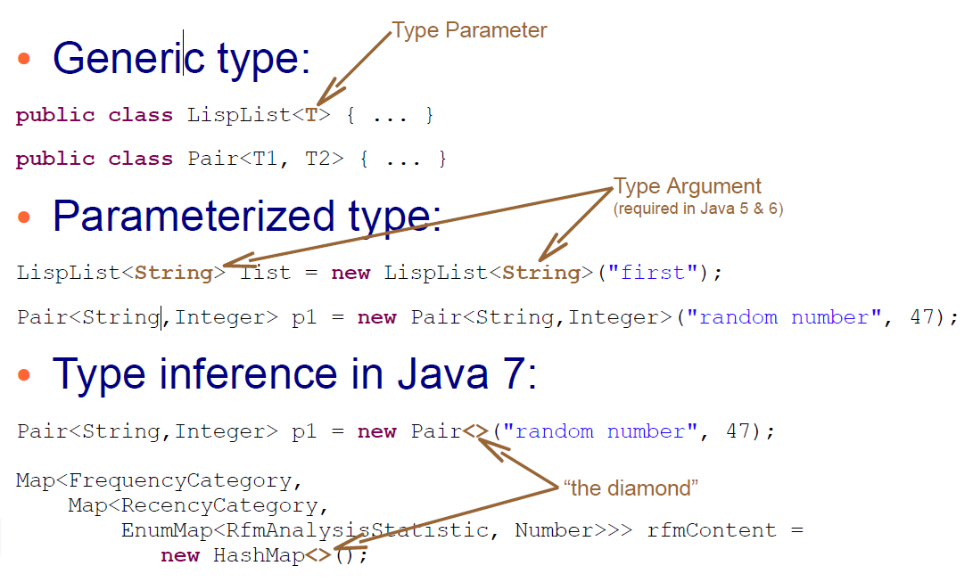
Terminology

Slide 6
Theory
Primitives cannot be type parameters
List<int> numbers; // illegal
Generics are a compile-time feature
At run-time type variables (ex. T become Object)
This is called erasure
Public class LispList<T> { Public class LispList {
private T item; private Object item;
private LispList<T> next; private LispList next;
public T first() {…} public Object first() {…}
// etc… // etc…
} }

Slide 7
Generics type parameter
Classes and methods can have a type parameter
A type parameter can have any reference type (i.e., any class type) plugged in for the type parameter. (T → Object and any subclasses)
When a specific type is plugged in, this produces a specific class type or method (ex. If We use T as Integer then String class are not allowed)
Traditionally, a single uppercase letter is used for a type parameter, but any non-keyword identifier may be used.
E for element
K for a map key
V for a map value
T, U for data types

Slide 8
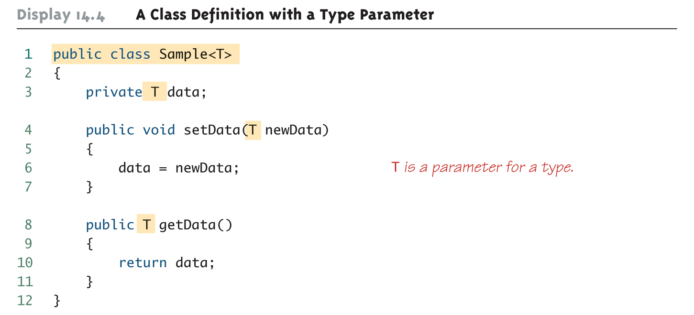
A class definition with a type parameter

Slide 9
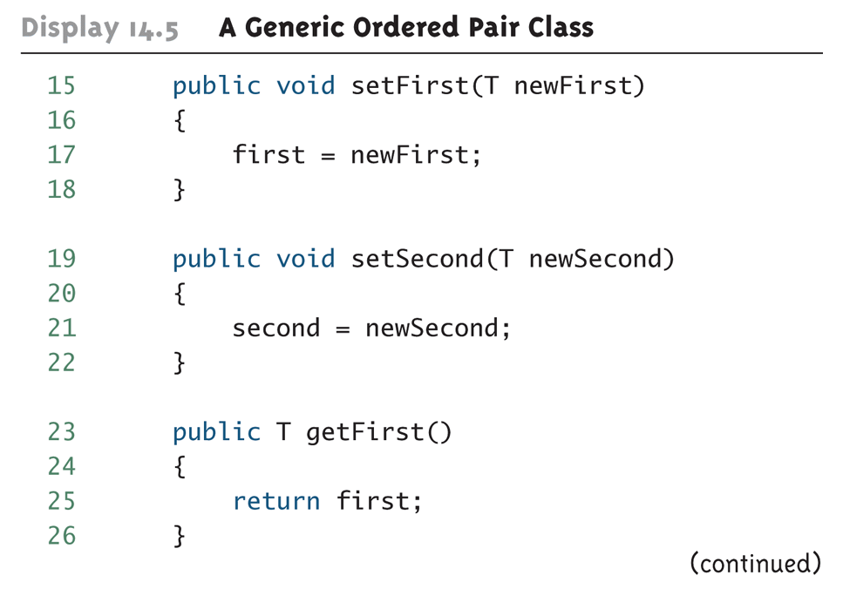
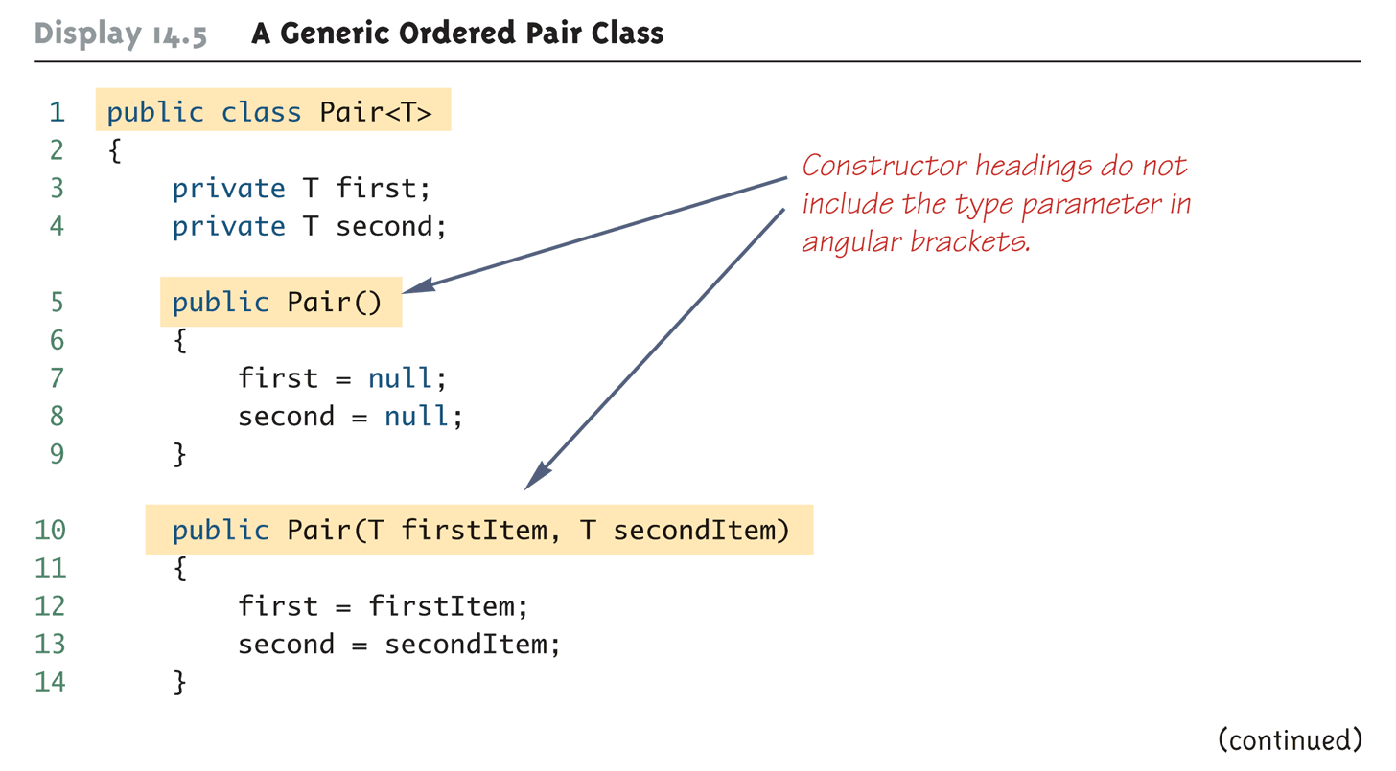
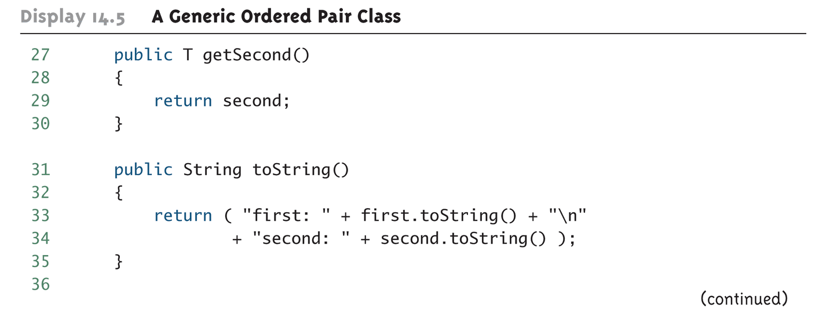
A Generic Pair Class
2
1
3

Slide 10
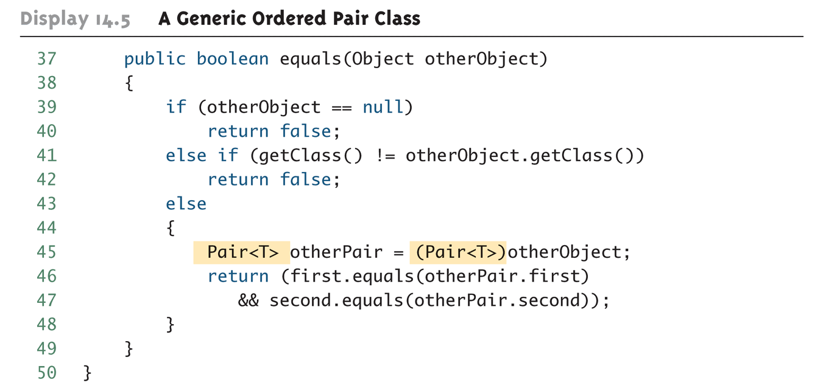
A Generic Pair Class (cont’d)

Slide 11
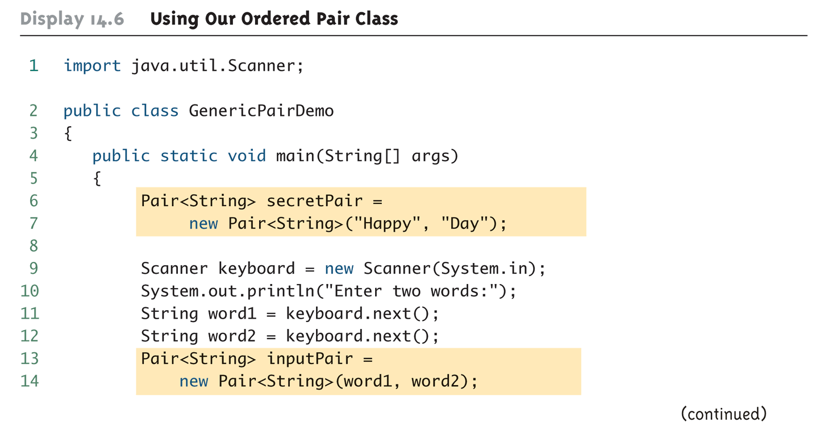
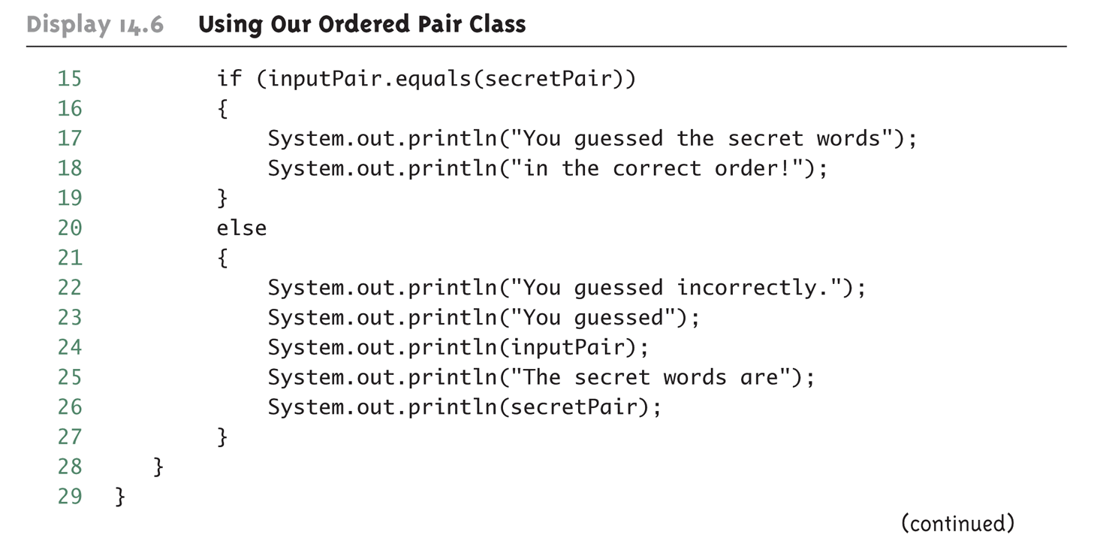
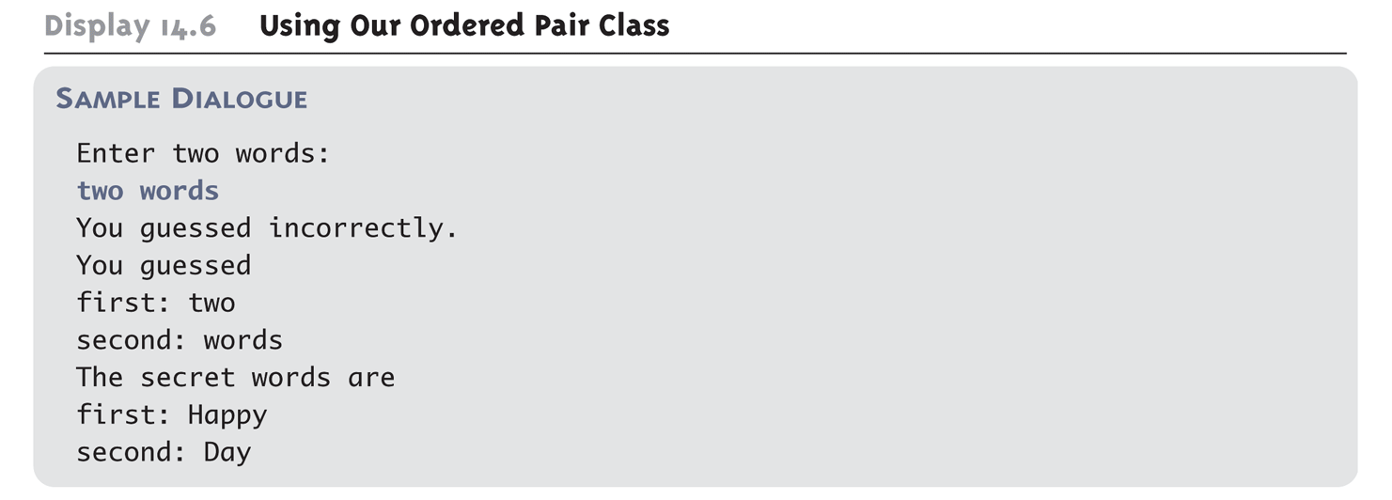
A Generic Pair Class (cont’d)
1
2
3

Slide 12
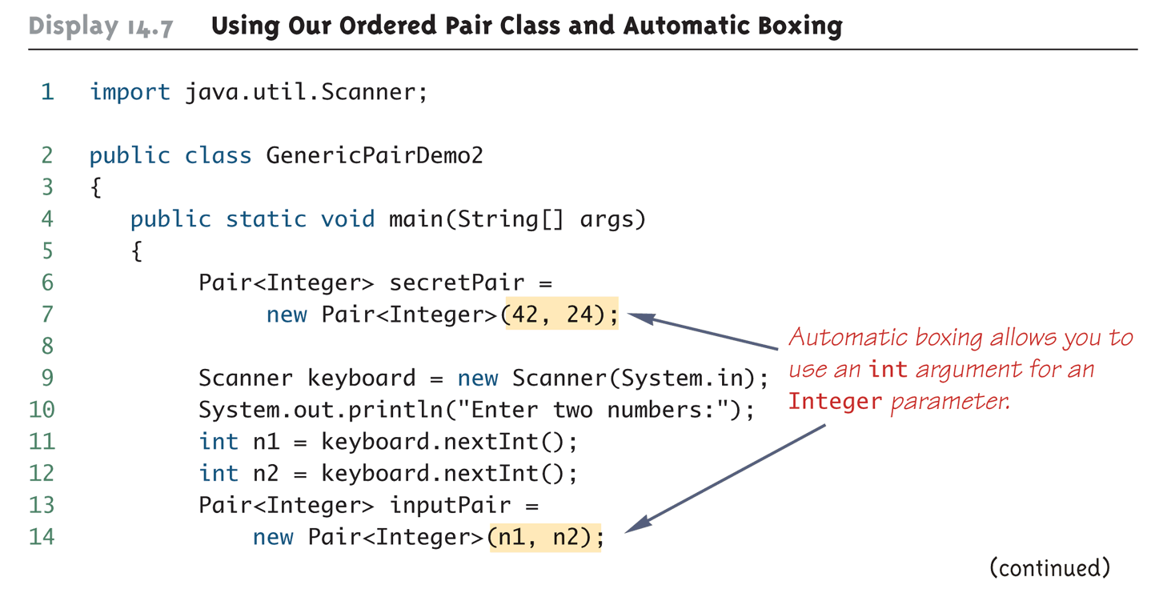
Generic Pair class and Automatic Boxing

Slide 13
A Class Definition Can Have More Than One Type Parameter
A generic class definition can have any number of type parameters
Multiple type parameters are listed in angular brackets just as in the single type parameter case, but are separated by commas

Slide 14
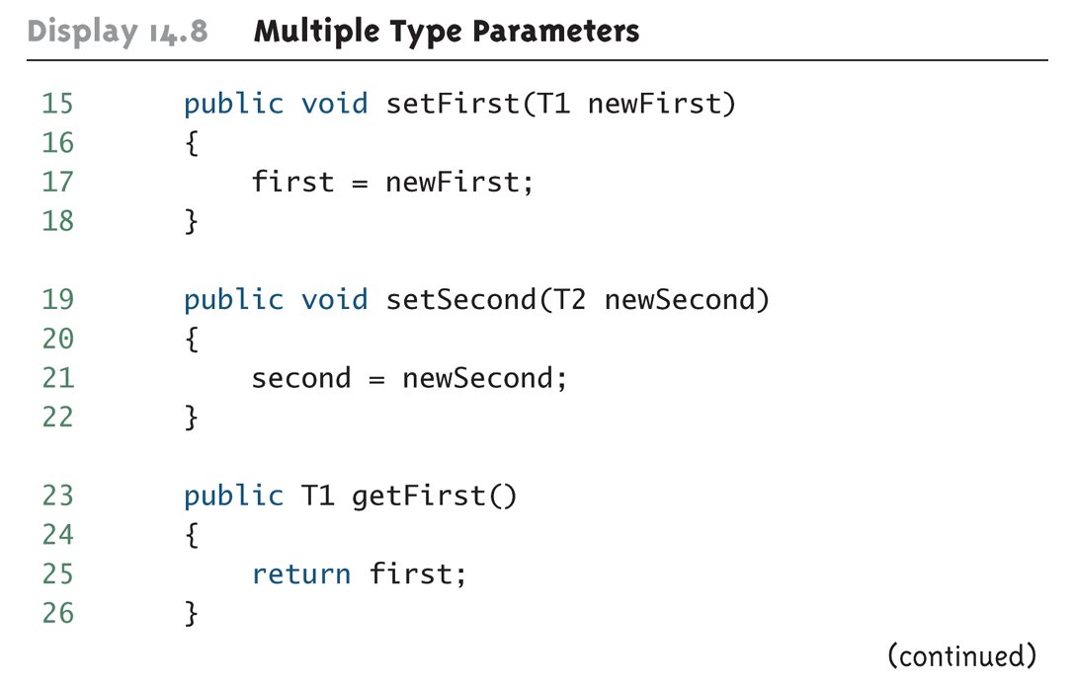
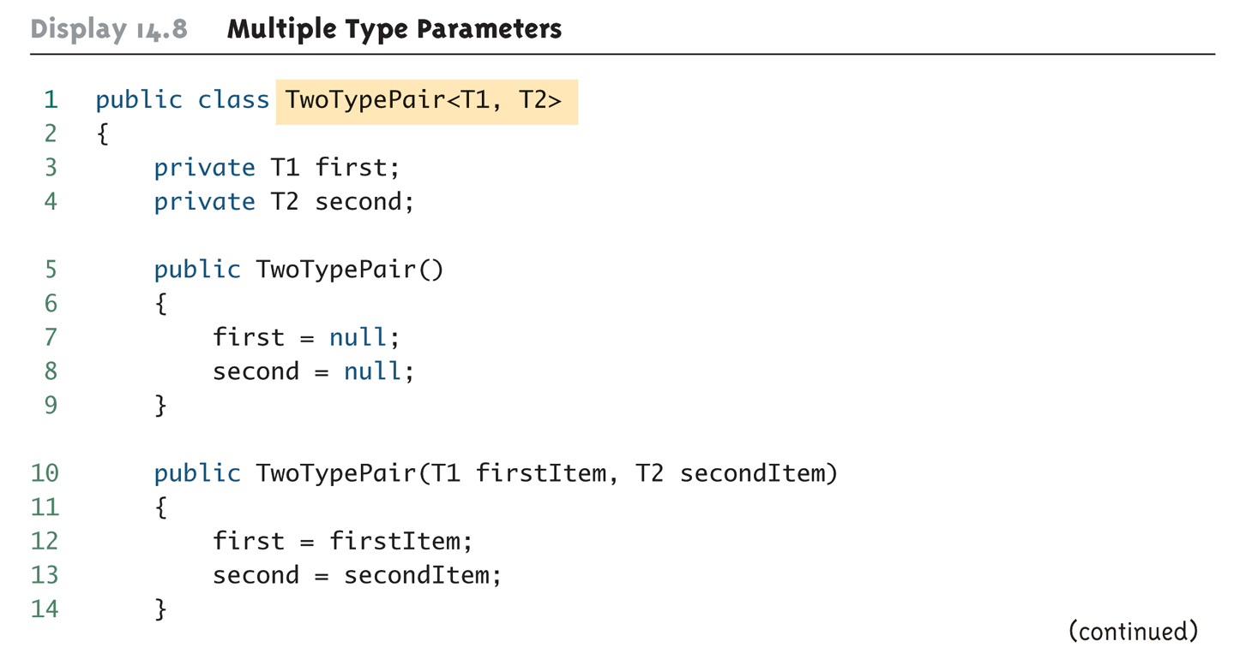
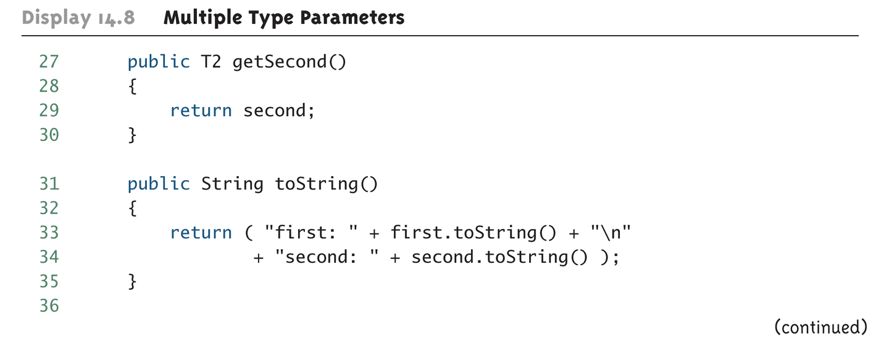
Multiple Type Parameters
2
1
3

Slide 15
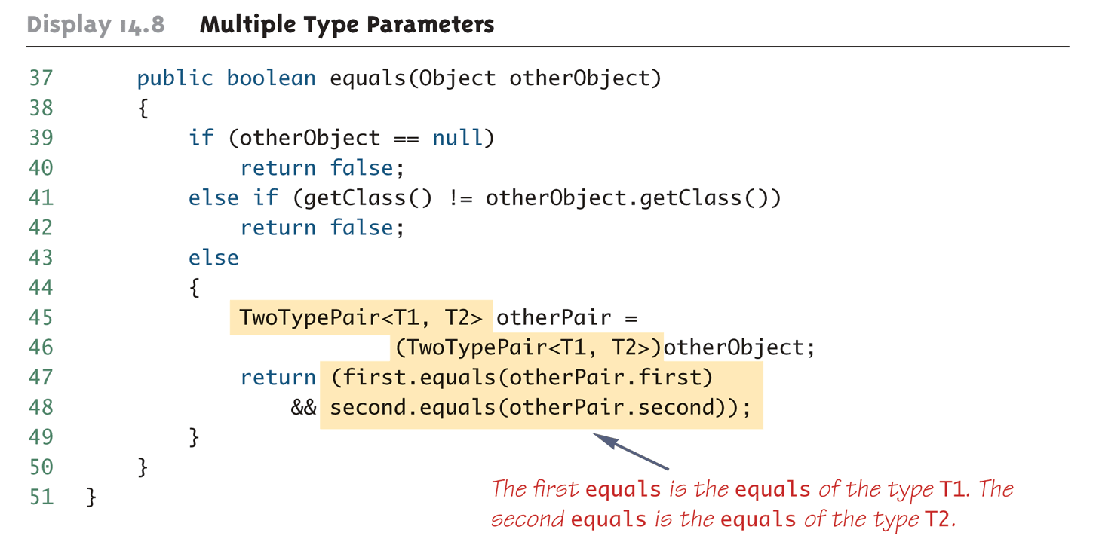
Multiple Type Parameters (cont’d)

Slide 16
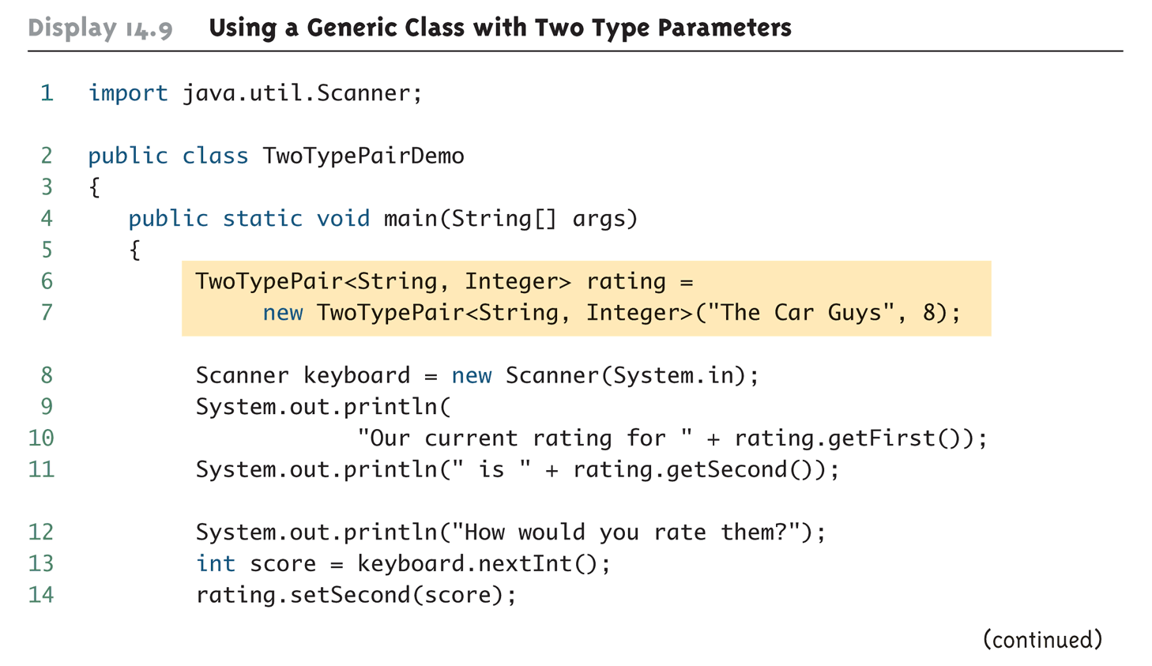
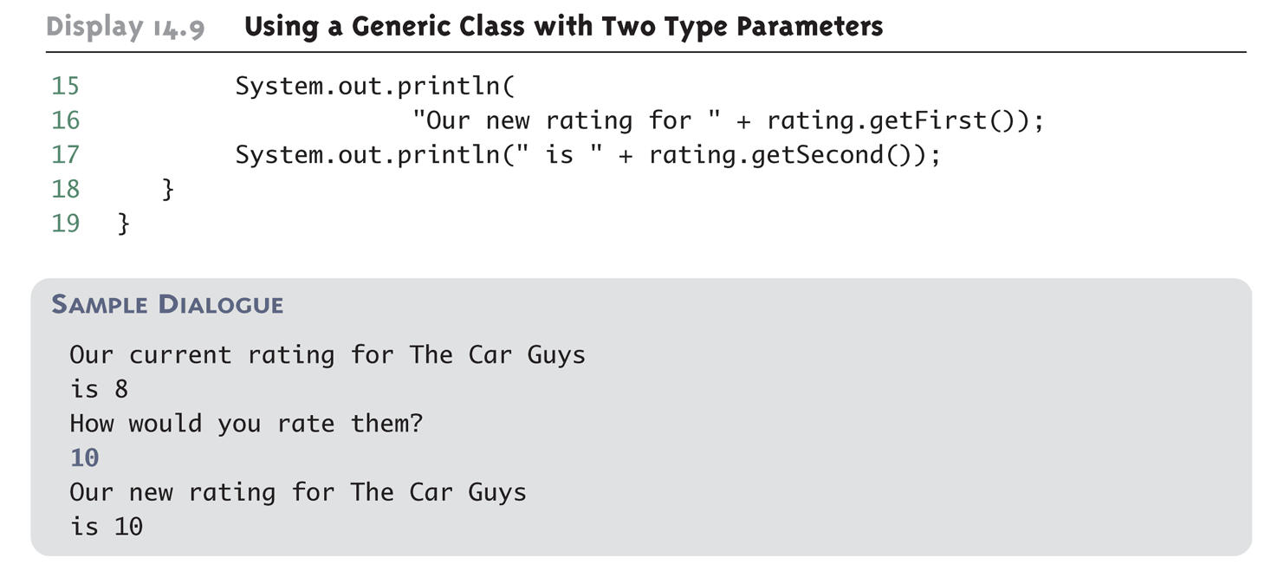
Multiple Type Parameters (cont’d)

Slide 17
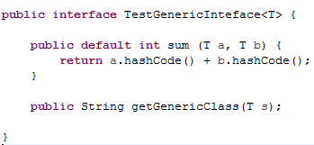
Generic Interfaces
An interface can have one or more type parameters
The details and notation are the same as they are for classes with type parameters

Slide 18
Generic Methods
When a generic class is defined, the type parameter can be used in the definitions of the methods for that generic class
In addition, a generic method can be defined that has its own type parameter that is not the type parameter of any class
A generic method can be a member of an ordinary class or a member of a generic class that has some other type parameter
The type parameter of a generic method is local to that method, not to the class

Slide 19
Generic Methods (cont’d)
The type parameter must be placed (in angular brackets) after all the modifiers, and before the returned type
public static <T> T genMethod(T[] a)
When one of these generic methods is invoked, the method name is prefaced with the type to be plugged in, enclosed in angular brackets
String s = NonG.<String>genMethod(c);

Slide 20
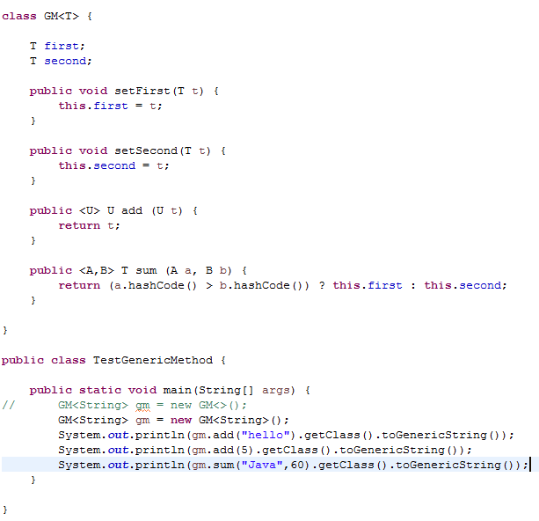
Generic Methods (cont’d)

Slide 21
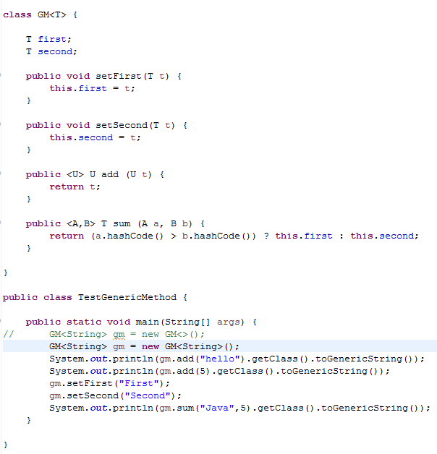
Generic Methods (cont’d)
public final class java.lang.String
public final class java.lang.Integer
public final class java.lang.String

Slide 22
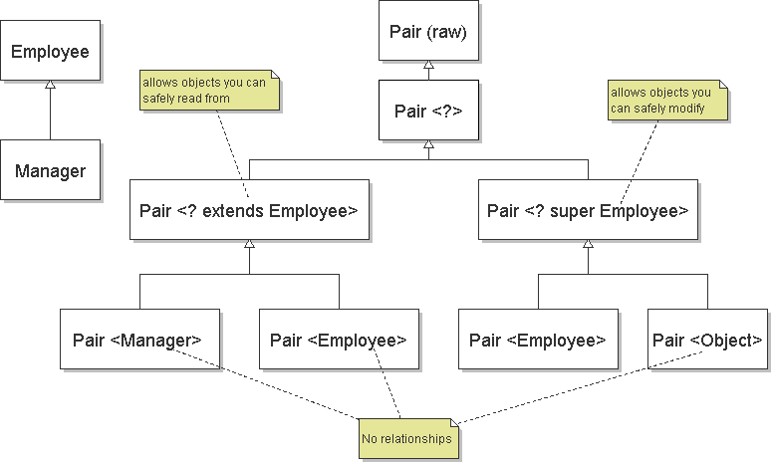
Bounded Type Parameter

Slide 23
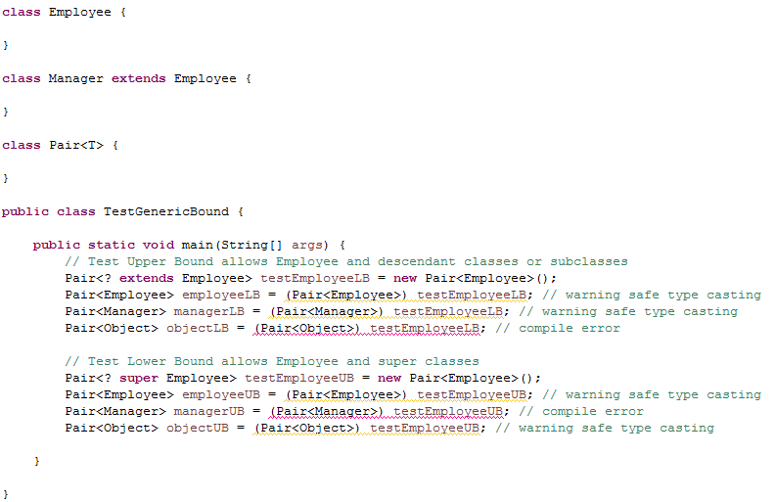
Bounded Type Parameter Example

Slide 24
Inheritance with Generic Classes
A generic class can be defined as a derived class of an ordinary class or of another generic class
Given two classes: A and B, and given G: a generic class, there is no relationship between G<A> and G<B>
This is true regardless of the relationship between class A and B, e.g., if class B is a subclass of class A

Slide 25
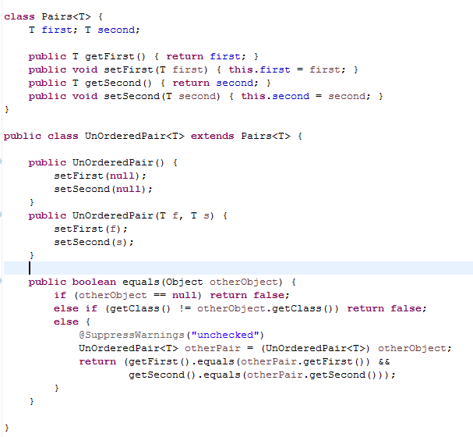
Inheritance with Generic Classes (Cont’d)

Slide 26
Overriding of methods of generic type
consider a generic class with a non-final method:
to override such type-erased methods, the compiler must generate extra bridge methods:

Slide 27
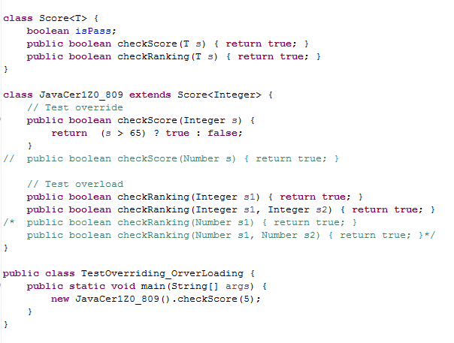
Overriding of methods of generic type example
public boolean checkScore(Object s) {
}

Slide 28
Overloading where type erasure will leave the parameters with the same type is not allowed:
class Test { // List<String> and List<Integer> // will be converted to List at runtime public void method(List<String> list) { } public void method(List<Integer> list) { } }

Slide 29
Restriction and Limitations

Slide 30
A Generic Constructor Name Has No Type Parameter
Although the class name in a parameterized class definition has a type parameter attached, the type parameter is not used in the heading of the constructor definition
public Pair<T>() // illegal
A constructor can use the type parameter as the type for a parameter of the constructor, but in this case, the angular brackets are not used
public Pair(T first, T second)
However, when a generic class is instantiated, the angular brackets are used
Pair<String> pair =
new Pair<String>("Happy", "Day");

Slide 31
A Type Parameter Cannot Be Used Everywhere a Type Name Can Be Used
In particular, the type parameter cannot be used in simple expressions using new to create a new object
For instance, the type parameter cannot be used as a constructor name or like a constructor:
T object = new T();
T[] a = new T[10];

Slide 32
An Instantiation of a Generic Class Cannot be an Array Base Type
Arrays such as the following are illegal:
Pair<String>[] a =
new Pair<String>[10]; // compile error
Although this is a reasonable thing to want to do, it is not allowed given the way that Java implements generic classes

Slide 33
Static fields and static method with type parameters are not allowed
static fields and static methods with type parameters are not allowed
class Singleton <T> {
private static T singleOne; // ERROR
since after type erasure, one class and one shared static field for all instantiations and their objects

Slide 34
Wildcard type (?) cannot be used as a declared type of any variables
Pair<String> pair = new Pair<?>(); // Compile error

Slide 35
Generic types list
These types can be made generic:
Classes
Interfaces
Inner classes, etc.
These java types may not be generic:
Anonymous inner classes
Exceptions
Enums

Slide 36
A Generic Class Cannot Be an Exception Class
It is not permitted to create a generic class with Exception, Error, Throwable, or any descendent class of Throwable
A generic class cannot be created whose objects are throwable
public class GEx<T> extends Exception // error
The above example will generate a compiler error message
However, you can use a type parameter in a throws clause:
class Test<T extends Exception> {
public void method() throws T { } // OK
}

Slide 37
Conclusion
Generics are a mechanism for type checking at compile-time.
The process of replacing all references to generic types at runtime with an Object type is called type erasure.
A generic class used without a generic type argument (like List list = null;) aka a raw type.
The diamond operator (<>) can be used to simplify the use of generics when the type can be inferred by the compiler.
It's possible to define a generic class or interface by declaring a type parameter next to the class or interface name.
We can also declare type parameters in any method, specifying the type before the method return type (in contrast to classes, which declare it after the class name).
The unbounded wildcard type (<?>) means that the type of the list is unknown so that it can match ANY type. This also means that for example, List<?> is a supertype of any List type (like List<Integer> or List<Float>).
The upper-bounded wildcard (? extends T) means that you can assign either T or a subclass of T.
The lower-bounded wildcard (? super T) means that you can assign either T or a superclass of T.

