Slide 1
Assertions
Program Correctness

Slide 2
Outline
Assertions
Using Exception Handling or Assertions?
Conclusion

Slide 3
Assertions
Java statement
enables you to assert an assumption about your program.
An assertion contains a Boolean expression that should be true during program execution.
Assertions can be used to assure program correctness and avoid logic errors.

Slide 4
Declaring Assertions
An assertion is declared using the new Java keyword assert in JDK 1.4 as follows:
assert booleanExpressionIsFalse; if (booleanExpressionIsFalse) throw new AssertionError();
assert booleanExpressionIsFalse : detailMessage; if (booleanExpressionIsFalse) throw new AssertionError(detailMessage);
where assertion is a Boolean expression and detailMessage is a primitive-type or an Object value.

Slide 5
Which constructor is used?
assert assertion;
the no-arg constructor of AssertionError is used.
assert assertion : detailMessage;
an appropriate AssertionError constructor is used to match the data type of the message.
Since AssertionError is a subclass of Error, when an assertion becomes false, the program displays a message on the console and exits.

Slide 6
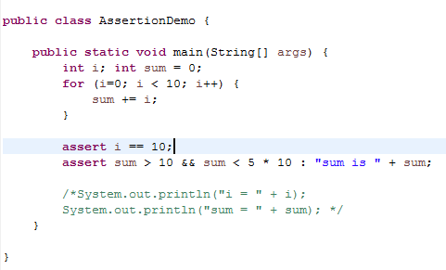
Executing Assertions Example

Slide 7
Compiling Programs with Assertions
Since assert is a new Java keyword introduced in JDK 1.4, you have to compile the program using a JDK 1.4 compiler. Furthermore, you need to include the switch –source 1.4 in the compiler command as follows:
javac –source 1.4 AssertionDemo.java

Slide 8
Executing Assertions
When Java executes the assertion statement:
the boolean assertion is evaluated
If it is false, an AssertionError will be thrown.
AssertionError class constructors:
no-arg constructor
seven overloaded single-argument constructors of type
int,
long,
float,
double,
boolean,
char,
and Object.

Slide 9
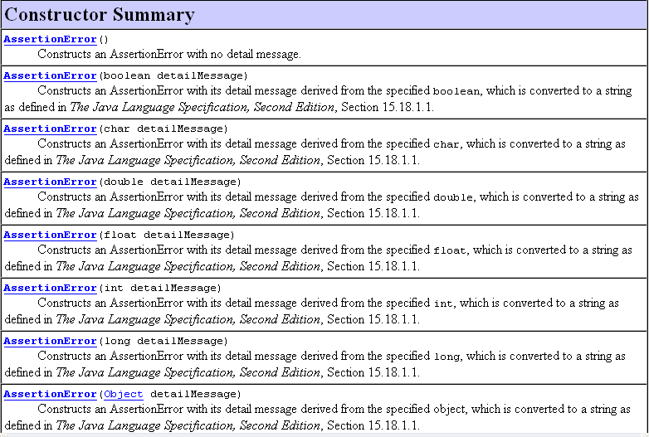

Slide 10
Running Programs with Assertions
By default, the assertions are disabled at runtime. To enable it, use the switch –enableassertions, or –ea for short, as follows:
java –ea AssertionDemo
Assertions can be selectively enabled or disabled at class level or package level. The disable switch is –disableassertions or –da for short. For example, the following command enables assertions in package package1 and disables assertions in class Class1.
java –ea:package1 –da:Class1 AssertionDemo
If assertions are enabled and the boolean expression is true, nothing happens.
If assertions are enabled and the boolean expression is false, an AssertionError is thrown.
If assertions are disabled, no matter the outcome of the boolean expression, assertions are ignored.

Slide 11
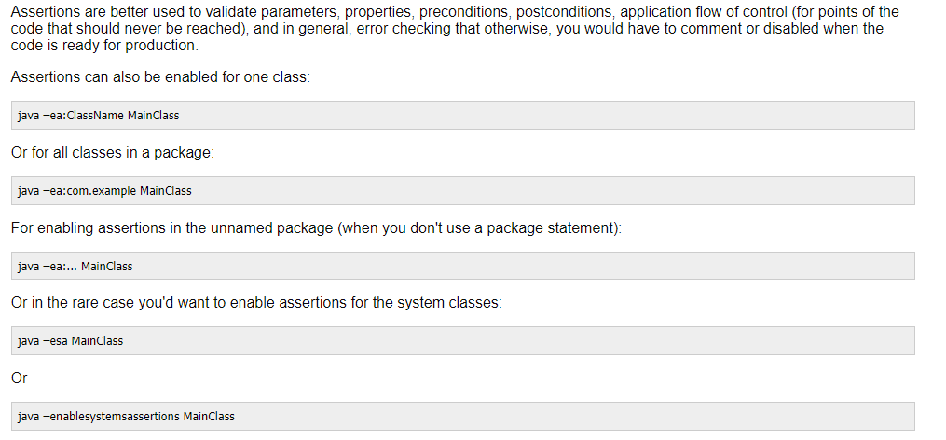
Enable Assertion (single instance)

Slide 12
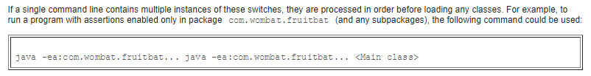
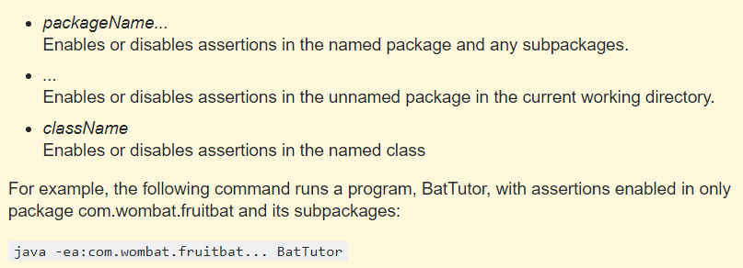
Enable Assertion (multiple instance)

Slide 13
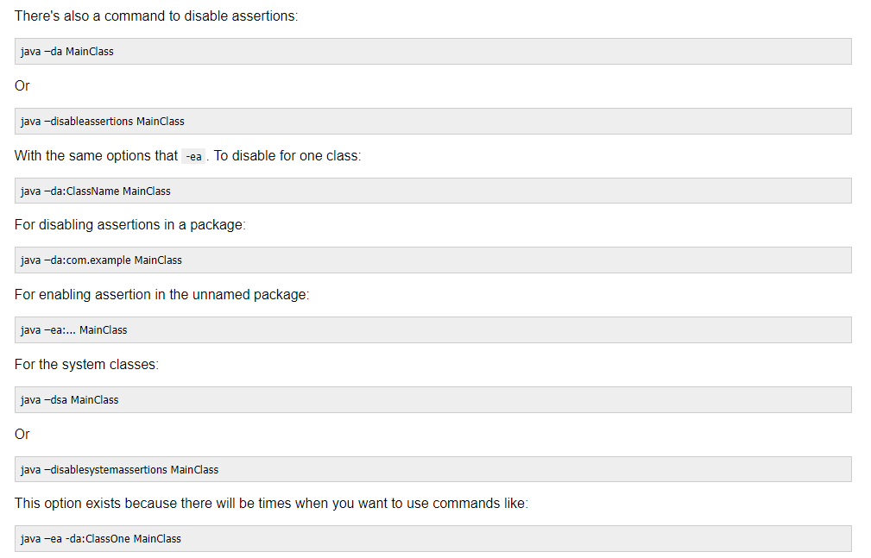
Disable Assertion

Slide 14
Using Exception Handling or Assertions?
Assertion should not be used to replace exception handling.
Exception handling deals with unusual circumstances during program execution.
Assertions are to assure the correctness of the program.
Exception handling addresses robustness and assertion addresses correctness.
Like exception handling, assertions are not used for normal tests, but for internal consistency and validity checks. Assertions are checked at runtime and can be turned on or off at startup time.

Slide 15
Using Exception Handling or Assertions?
Do not use assertions for argument checking in public methods.
Valid arguments that may be passed to a public method are considered to be part of the method’s contract.
The contract must always be obeyed whether assertions are enabled or disabled.
public void setRadius(double newRadius) {
assert newRadius >= 0;
radius = newRadius;
}// improper
public void setRadius(double newRadius) {
if (newRadius >=0)
radius = newRadius;
else
throw new IllegalArgumentException(
“Radius cannot be negative’);
}

Slide 16
Using Exception Handling or Assertions?
Use assertions to reaffirm assumptions.
This gives you more confidence to assure correctness of the program.
A common use of assertions is to replace assumptions with assertions in the code.

Slide 17
Using Exception Handling or Assertions?
Another good use of assertions is place assertions in a switch statement without a default case.
switch (month) {
case 1: ... ; break;
case 2: ... ; break;
...
case 12: ... ; break;
default: assert false : "Invalid month: " + month
}

Slide 18
Conclusion
An assertion is a statement used to check if something is true and helps you to detect errors in a program.
Assertion should not be used to replace exception handling.
An assert statement has the following syntax:
assert booleanExpressionIfFalse;
assert booleanExpressionIfFalse: "Message about the error";
If the boolean expression of the assert statement evaluates to false, the program will throw a java.lang.AssertionError and terminate.
By default, assertions are disabled. You can use the command-line arguments –ea (for enabling assertions) and –da (for disabling assertions) with other options for classes, packages, and system classes when running the program.

