Slide 1

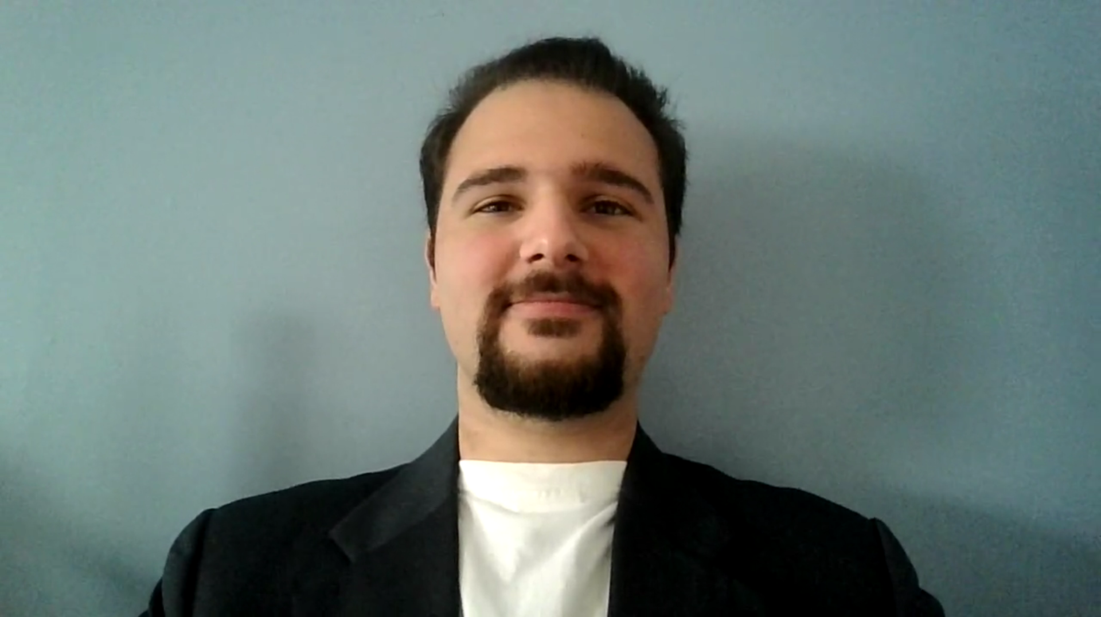
Game Engine Design & Implementation: Assignment 1 INFR 3110U
Farhan Irani
100748418

