Slide 1
Colors

Slide 2
MetBrewer
https://github.com/BlakeRMills/MetBrewer
This project gives some color palette suggestions
Some color schemes are color-blind friendly
Maybe worth to consider when publishing with custom colors figures/images
A Matlab version of the function have been written

Slide 3
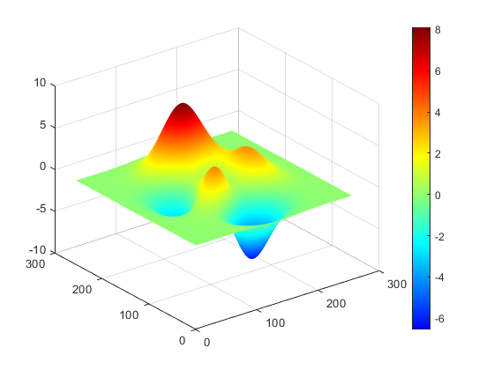
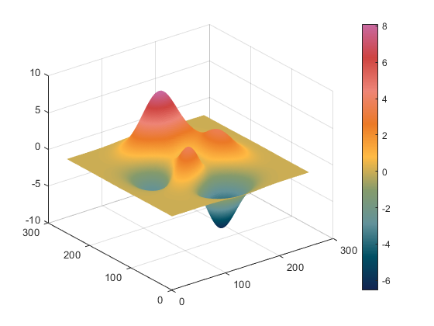
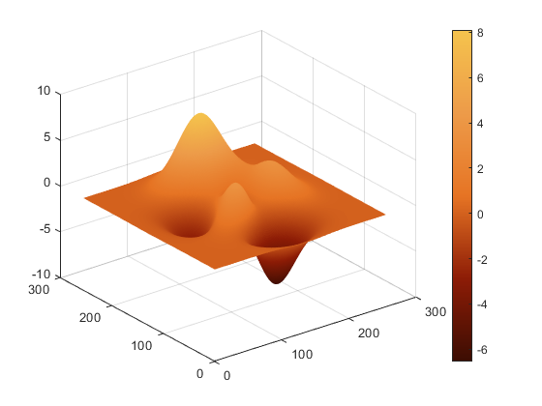
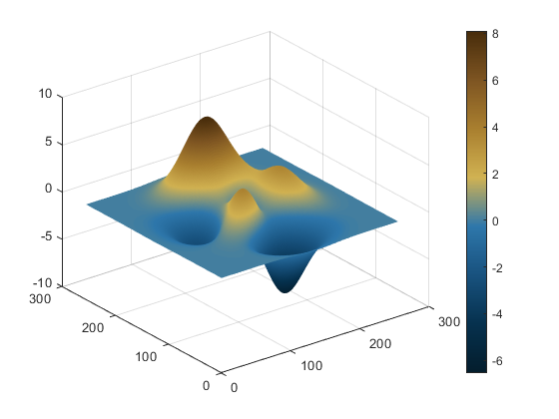
Color palette examples
Jet (default)
Cross
Greek
Ingres

Slide 4
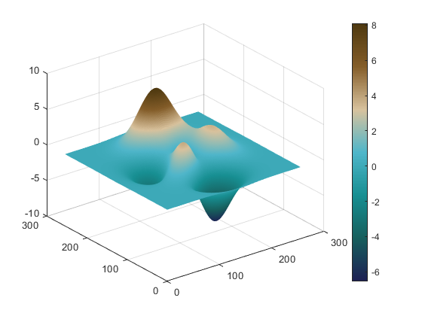
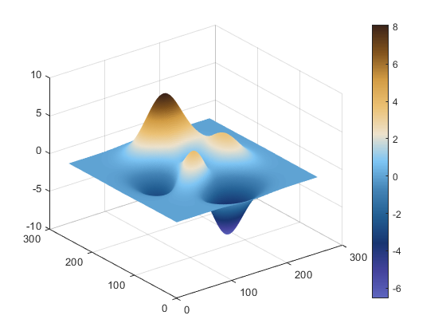
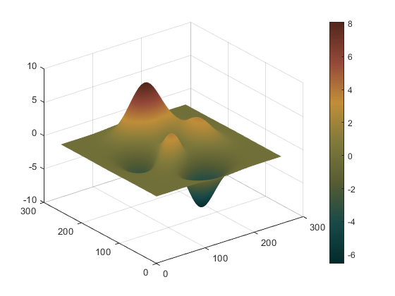
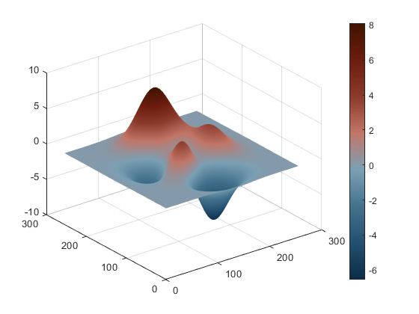
Color palette examples (cont.)
Isfahan1
Manet
Nattier
Troy

Slide 5
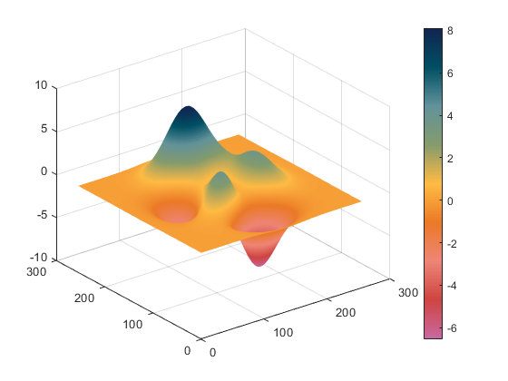
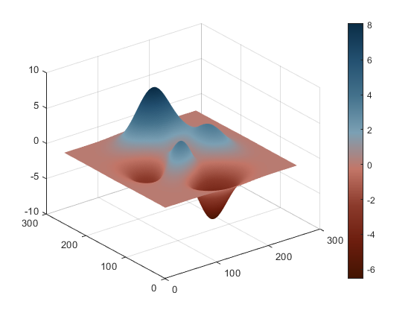
Inversion of colormap
Cross
Cross Inverted
Troy
Troy Inverted

Slide 6

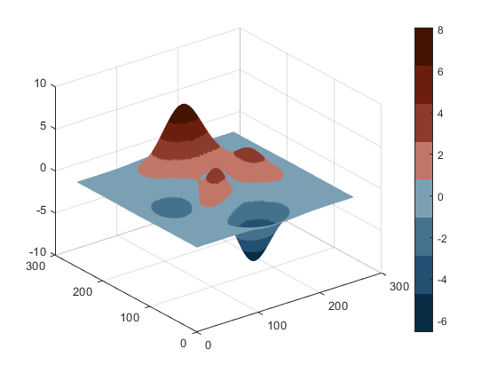
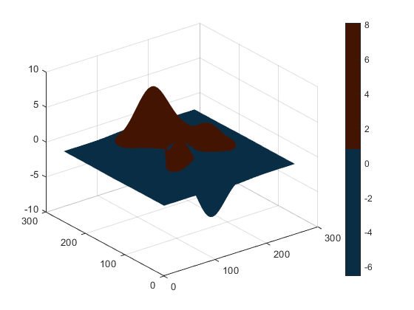
Discretization level of colormap
256 levels, (default)
32 levels
8 levels
2 levels

Slide 7
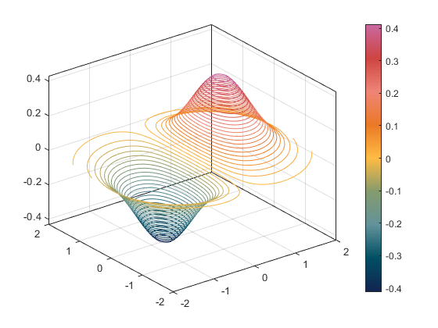
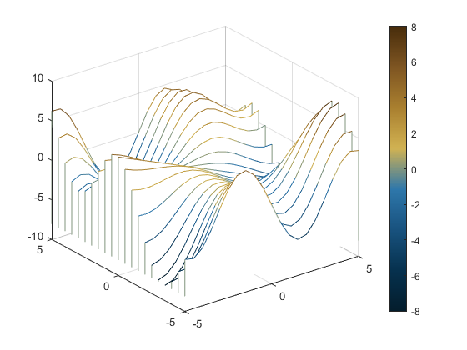
Examples of application
3D contour map
Waterfall graph
2D image
Scatter plot

