Slide 1


Sources of phylogenetic signal and ‘noise’ in complex genomic datasets
Dr. Robert Literman
NSF Postdoctoral Fellow, University of Rhode Island
Dr. Rachel Schwartz
Principal Investigator, University of Rhode Island

Slide 2
Acknowledgements
NSF Postdoctoral Fellowship in Biology (1812201)
College of the Environment and Life Sciences
Department of Biological Sciences

Slide 3



Trees Matter
A
B
C
D
E
F
D
A
B
C
D
E
F
C
D
A
B
E
F
C
A
B
E
F
Notes:
https://www.publicdomainpictures.net/en/view-image.php?image=117683&picture=black-butterfly

Slide 4
What do we need to build a tree?
Sufficient variation …
… among orthologous features.

Slide 5
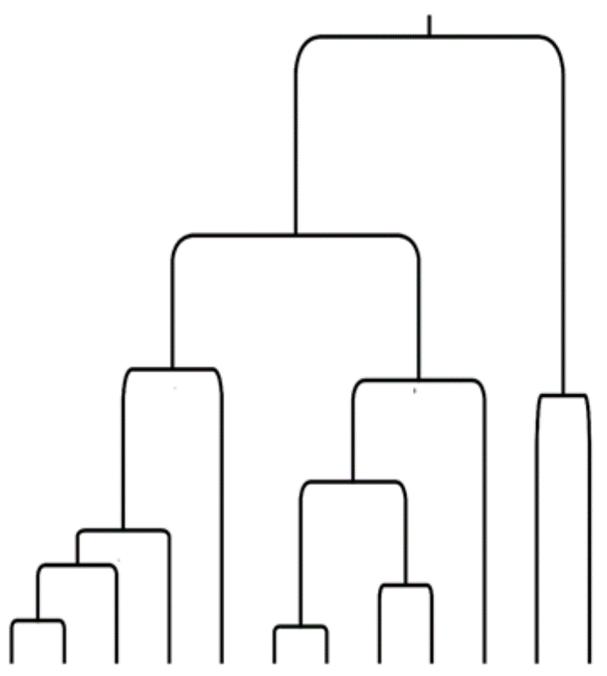
Coding
Coding
Introns
Intergenic
Slow
Medium
Fast
Recent
Older
Phylogenetic Power

Slide 6
Taxonomic Phylogenetic Signal
A
A
A
A
T
T

Slide 7
Non-taxonomic Phylogenetic Signal
A
T
A
A
T
A
Sources of non-taxonomic
signal include:
Convergent evolution
Homoplasy
Incomplete lineage sorting

Slide 8
What do we need to build a tree?
Sufficient variation …
… among orthologous features.

Slide 9
From genes to genomes
Genome-scale data is becoming more accessible
Hundreds to thousands of loci in a single analysis
Alignment based
Ultra-conserved elements
Targeted sequencing
Goal: Overwhelm the diffuse non-taxonomic signal by maximizing specific taxonomic signal

Slide 10
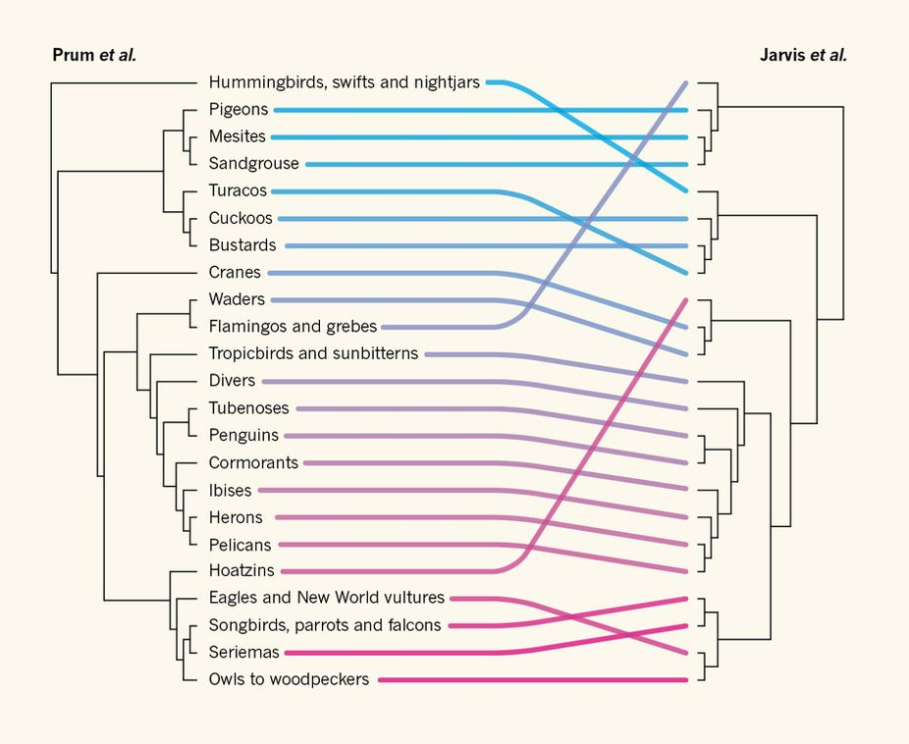
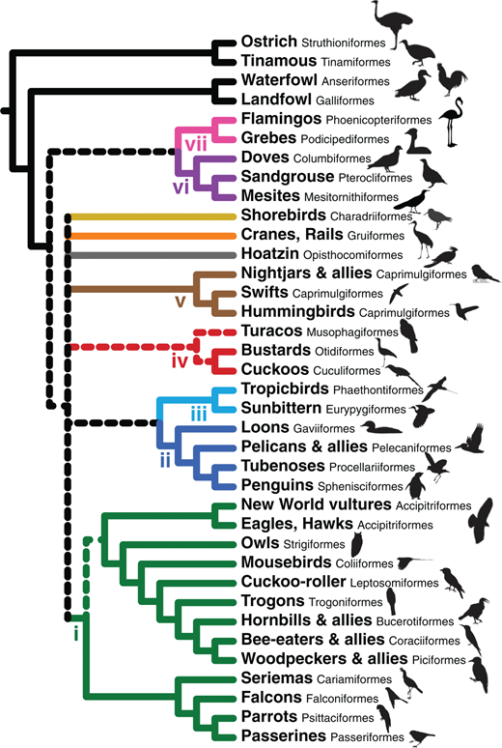
Genome scale data contains complex signal
Gavin H. Thomas 2015 (Nature)
Reddy, et al. 2017 (Sys. Bio)
Notes:
If “all” is not the answer, we need to start thinking about “which”, but what should we pick?

Slide 11
Major Questions
How is taxonomic and non-taxonomic signal distributed among genomic subsets?
Do genomic subsets vary in their ability to resolve nodes of different ages?

Slide 12
Research Approach
Choose focal clades with:
- Well-established species relationships
- Existing reference genome information for one taxa

Slide 13
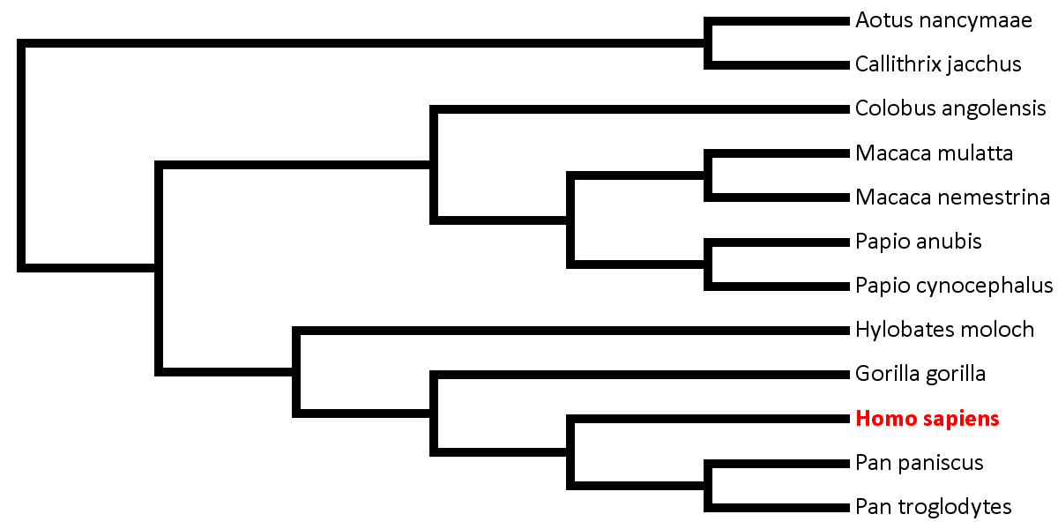









Silhouettes from PhyloPic.org

Slide 14
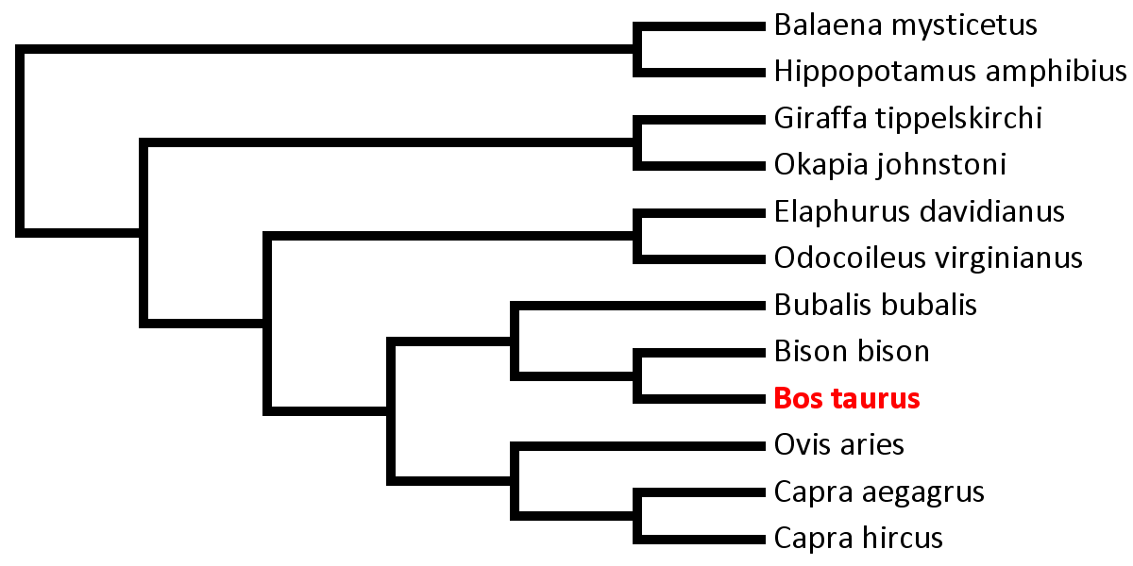







Silhouettes from PhyloPic.org

Slide 15
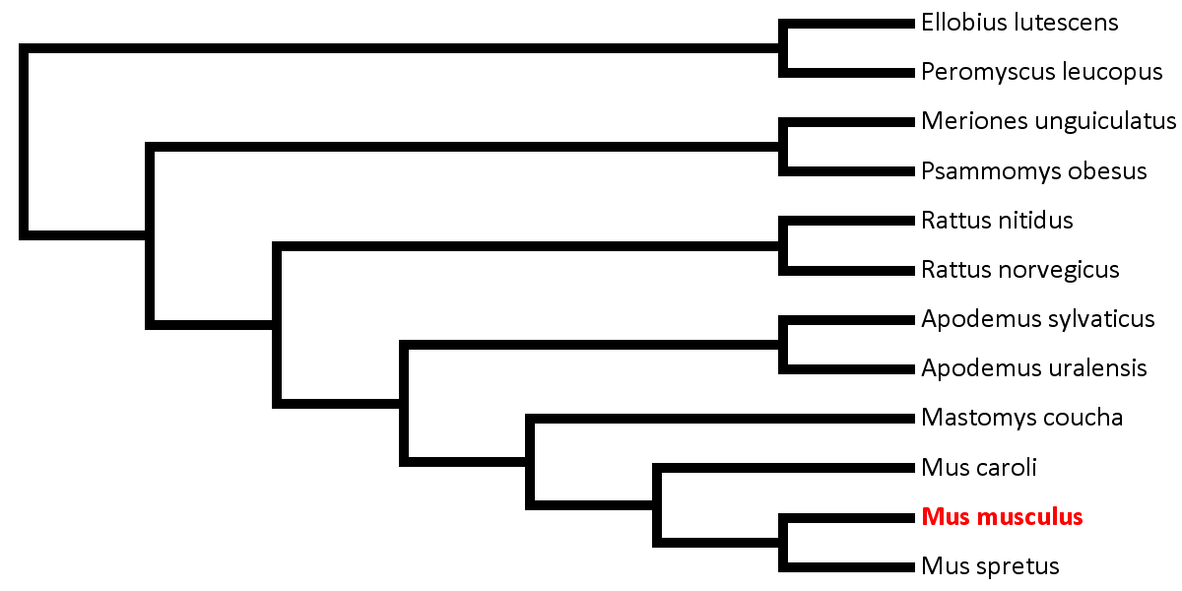
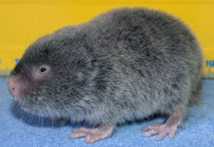
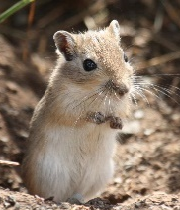
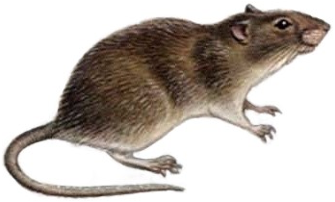


Ellobius: http://www.ecosystema.ru/08nature/photo/img/03009166.jpg
Meriones: https://upload.wikimedia.org/wikipedia/commons/9/9c/Meriones_unguiculatus_%28wild%29.jpg
Rattus: https://upload.wikimedia.org/wikipedia/commons/3/34/Rattus_norvegicus_%28white_background%29.png
Apodemus: https://previews.123rf.com/images/creativenature/creativenature1309/creativenature130900043/22242317-field-mouse-apodemus-sylvaticus-on-the-forest-floor-in-it-s-natural-habitat.jpg
Mus: https://previews.123rf.com/images/icefront/icefront1309/icefront130900089/22099698-house-mouse-standing-on-rear-feet-mus-musculus.jpg
Notes:
Ellobius: http://www.ecosystema.ru/08nature/photo/img/03009166.jpg
Meriones: https://upload.wikimedia.org/wikipedia/commons/9/9c/Meriones_unguiculatus_%28wild%29.jpg
Rattus: https://upload.wikimedia.org/wikipedia/commons/3/34/Rattus_norvegicus_%28white_background%29.png
Apodemus: https://previews.123rf.com/images/creativenature/creativenature1309/creativenature130900043/22242317-field-mouse-apodemus-sylvaticus-on-the-forest-floor-in-it-s-natural-habitat.jpg
Mus: https://previews.123rf.com/images/icefront/icefront1309/icefront130900089/22099698-house-mouse-standing-on-rear-feet-mus-musculus.jpg

Slide 16
Research Approach
Identify orthologs and informative sites from raw NGS data using SISRS

Slide 17
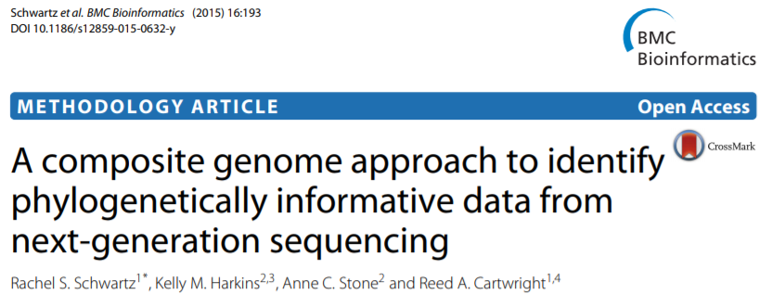
SISRS Pipeline

Slide 20
Composite Genome

Slide 21
Composite Genome

Slide 22


Unannotated Markers

Slide 23
SISRS Filtering
SISRS filters all sites down to only those that:
Have clear data for every species (no missing data)
Vary among species (no invariant sites)
Do not vary within any taxon (no hypervariable sites)
Have only two possible bases

Slide 24
Research Approach
Uniquely map composite scaffolds to reference genome
CDS
Noncoding Genes
5’ UTR
smRNA
Pseudogenes
3’ UTR
lncRNA
Intergenic/Other
Intronic
Not present in Bos taurus reference genome

Slide 25
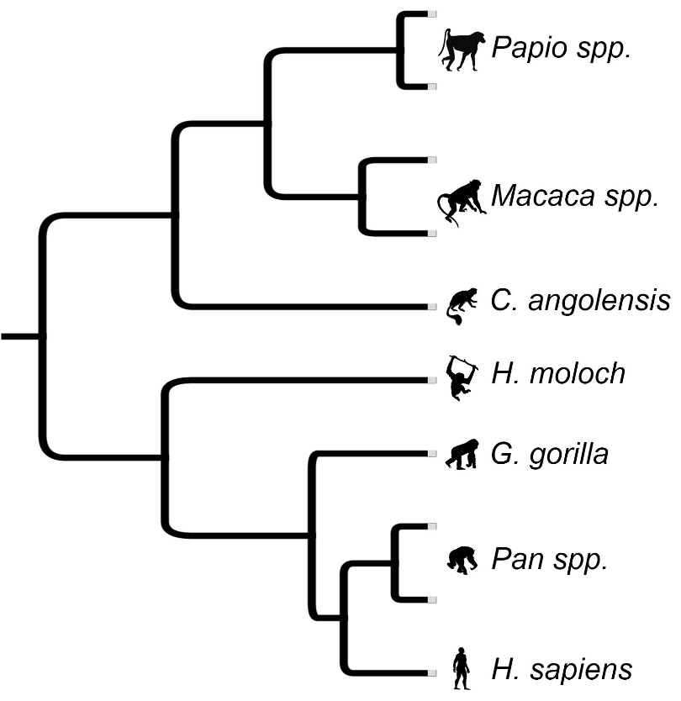
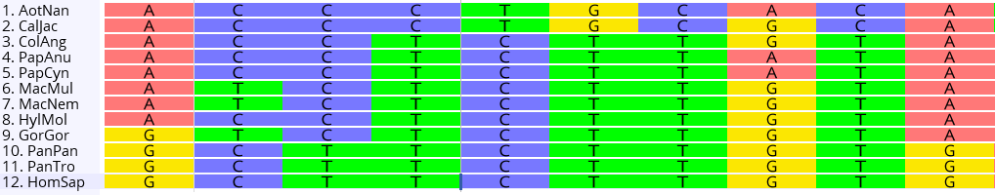
Research Approach
Assign phylogenetic signal to each site

Slide 26
Research Approach
Assign phylogenetic signal to each site
Taxonomic Signal

Slide 27
Research Approach
Assign phylogenetic signal to each site
Non-Taxonomic Signal

Slide 28
Research Approach
Assign phylogenetic signal to each site
Taxonomic Signal

Slide 29
Results

Slide 30



SISRS sites contained mostly taxonomic signal
Rodents
3M Sites
78% Taxonomic
Pecora
10M Sites
84% Taxonomic
Primates
11.5M Sites
90% Taxonomic

Slide 31


Annotation | Primates | Pecora | Rodents
3' UTR | 177,037 | 38,788 | 128,916
5' UTR | 24,173 | 5,322 | 19,157
CDS | 94,306 | 156,346 | 284,903
Intergenic | 4,471,169 | 6,625,459 | 1,258,262
Intronic | 5,481,429 | 3,253,771 | 1,289,450
lncRNA | 4,119,353 | - | 886,271
Noncoding Genes | 18,708 | - | 14,074
Pseudogene | 64,884 | 318 | 7,475
smRNA | 1,171 | 508 | 690
Annotation | Primates | Pecora | Rodents
3' UTR | 177,037 | 38,788 | 128,916
5' UTR | 24,173 | 5,322 | 19,157
CDS | 94,306 | 156,346 | 284,903
Intergenic | 4,471,169 | 6,625,459 | 1,258,262
Intronic | 5,481,429 | 3,253,771 | 1,289,450
lncRNA | 4,119,353 | - | 886,271
Noncoding Genes | 18,708 | - | 14,074
Pseudogene | 64,884 | 318 | 7,475
smRNA | 1,171 | 508 | 690

Slide 32
SISRS sites were largely non-coding
Intron + Intergenic + lncRNA | CDS
88% | 7.30%
97%
98%
Intron + Intergenic + lncRNA | CDS
Intron + Intergenic + lncRNA | CDS
88%
Intron + Intergenic + lncRNA | CDS
88%
97%
Intron + Intergenic + lncRNA | CDS
88%
97%
98%
Intron + Intergenic + lncRNA | CDS
88% | 7.30%
97% | 0.65%
98%
Intron + Intergenic + lncRNA | CDS
88% | 7.30%
97% | 0.65%
98% | 1.50%

Slide 33
Results – Historical Signal
Do taxonomic:non-taxonomic ratios vary among genomic subsets?

Slide 34
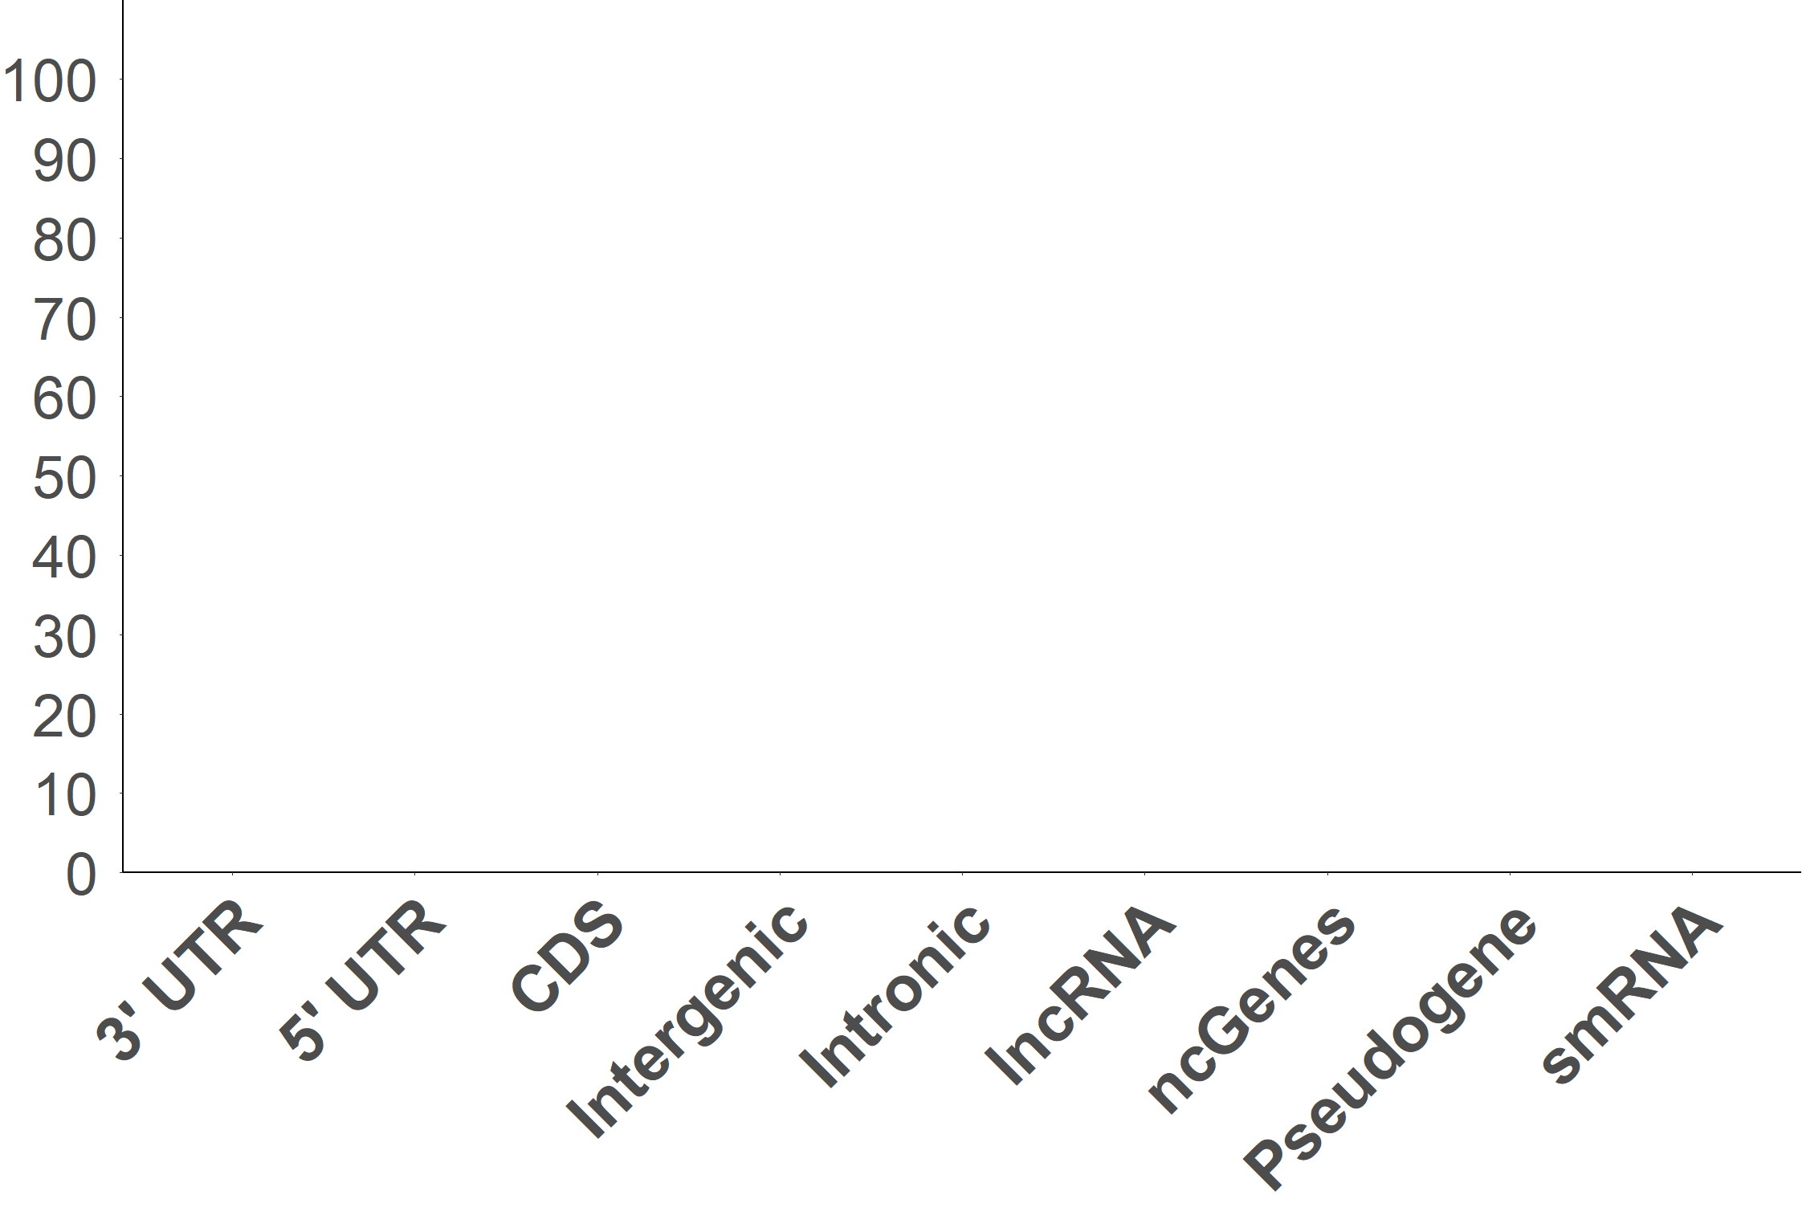
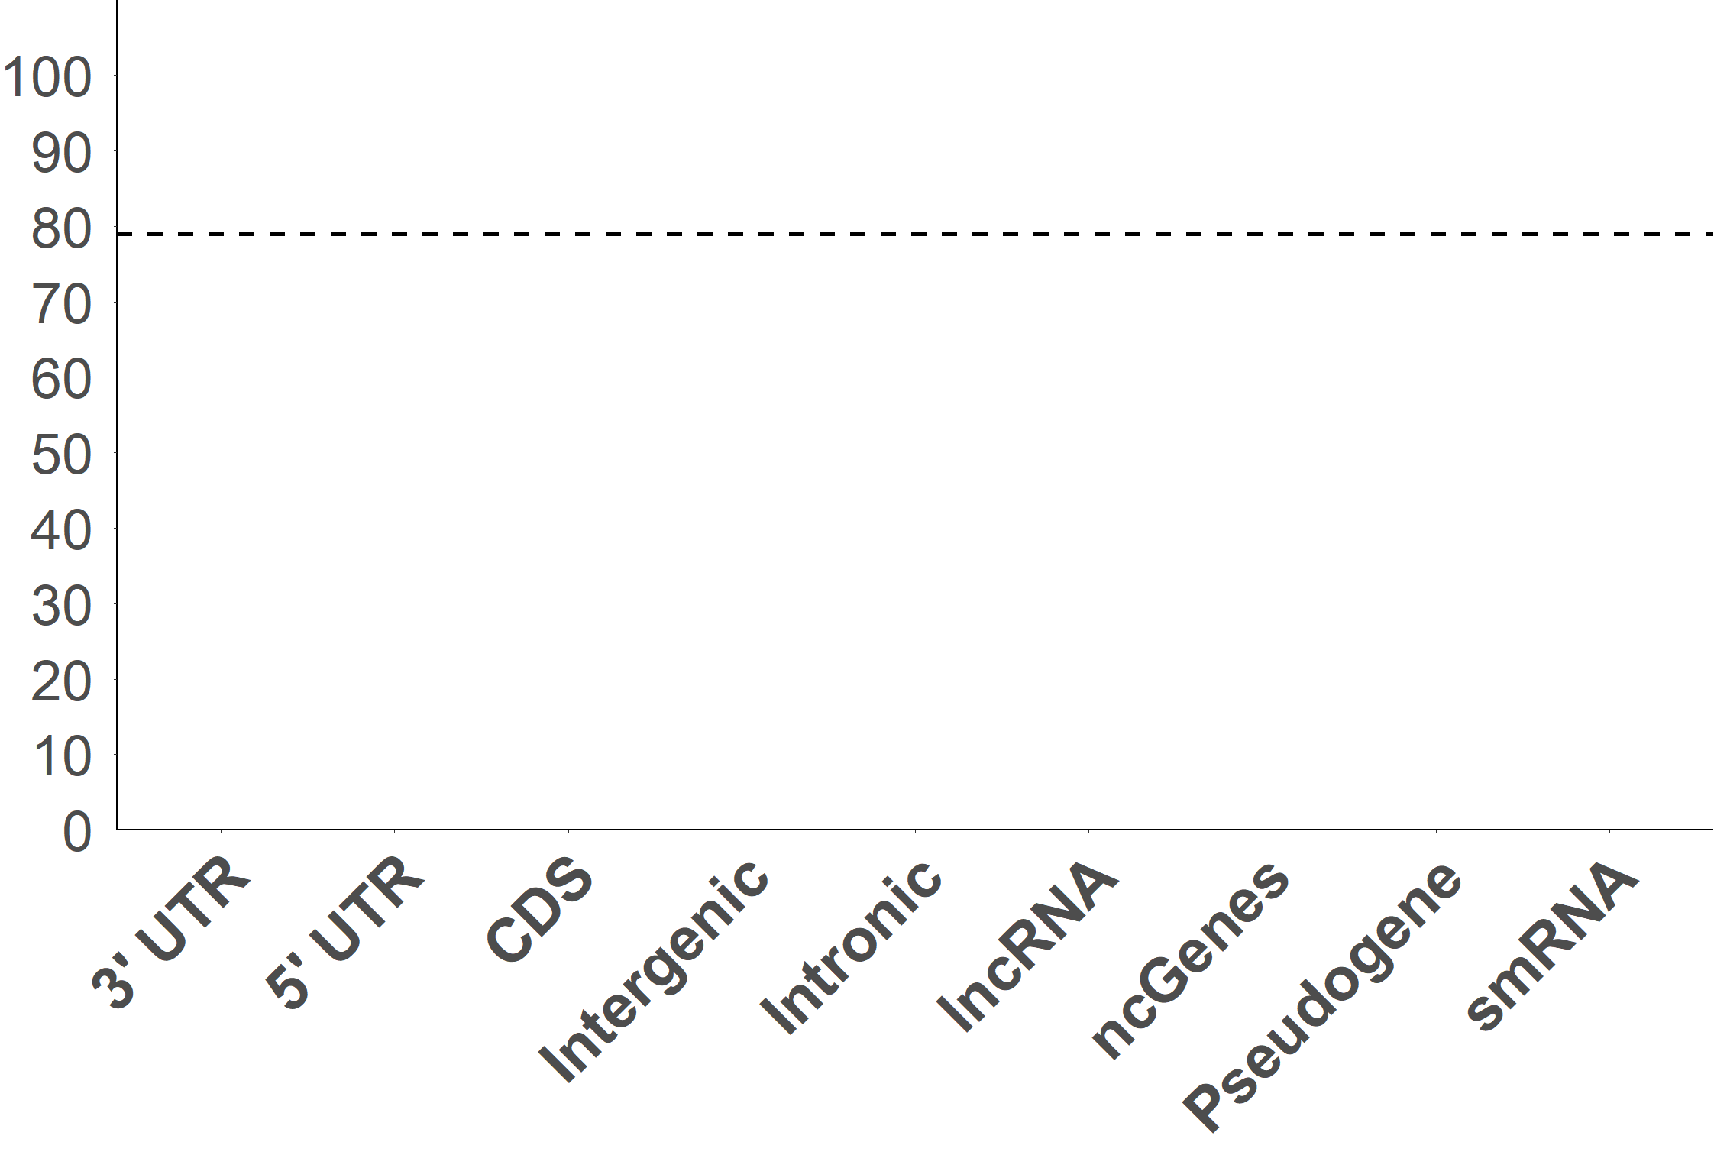
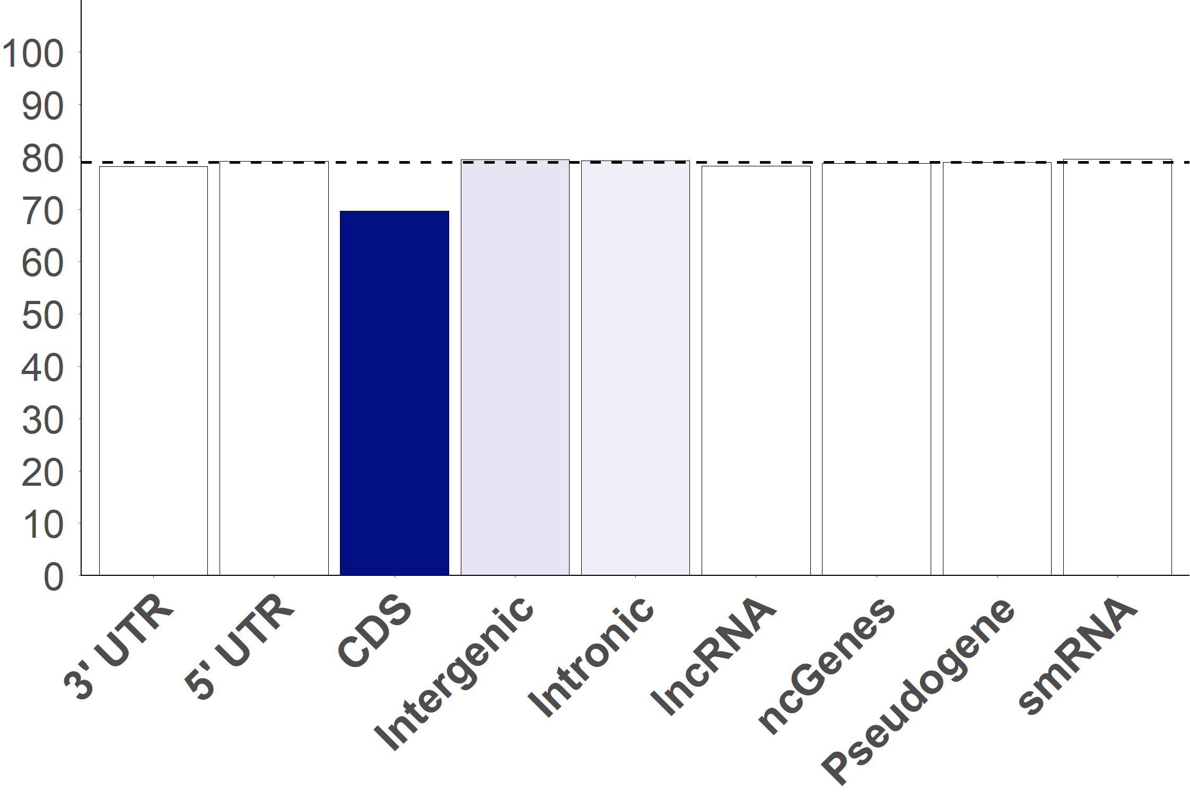

Overall Median: 78.9%
CDS: 69.7%*
Percent Accurate Splits (%)
* Significant at adjusted α=0.05

Slide 35
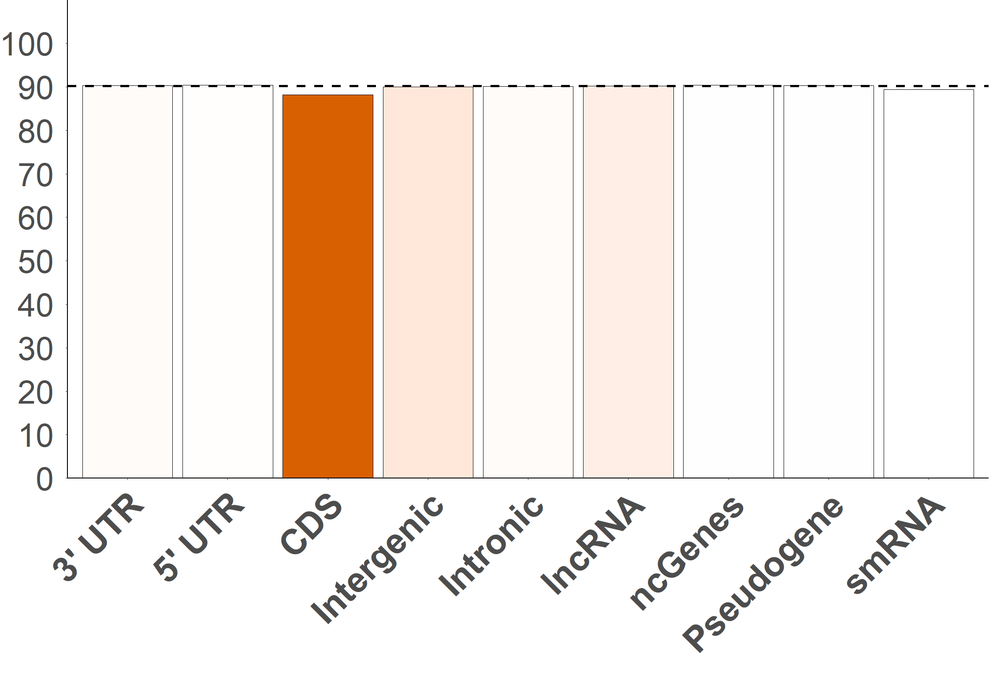


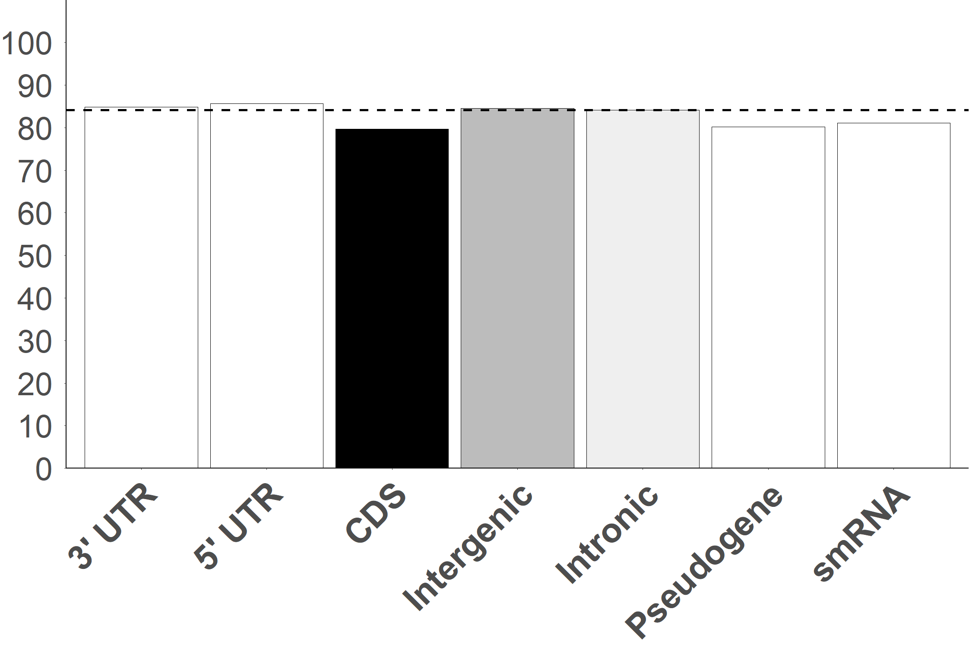

Coding sites provided the largest percentage of non-taxonomic signal
Percent Concordance
CDS | Non-CDS | ΔCDS
69.7% | 79.1% | -9.4%*
79.7% | 84.3% | -4.6%*
88.2% | 90.2% | -2.0%*
* Significant at adjusted α=0.05

Slide 36
Results – Time-Dependent Signal
Do genomic subsets vary in their ability to resolve older and more recent splits?

Slide 37
Node Ages
~5 – 23MYA
~2 – 20MYA
~4 – 25MYA
% Signal from Subset
Age of Node in Tree (MYA)

Slide 38
Non-Significant Slope
Subset informativeness not
impacted by node age
Negative Slope
Subset more informative
at YOUNGER nodes
% Signal from Subset
Positive Slope
Subset more informative
at OLDER nodes
Age of Node in Tree (MYA)

Slide 39
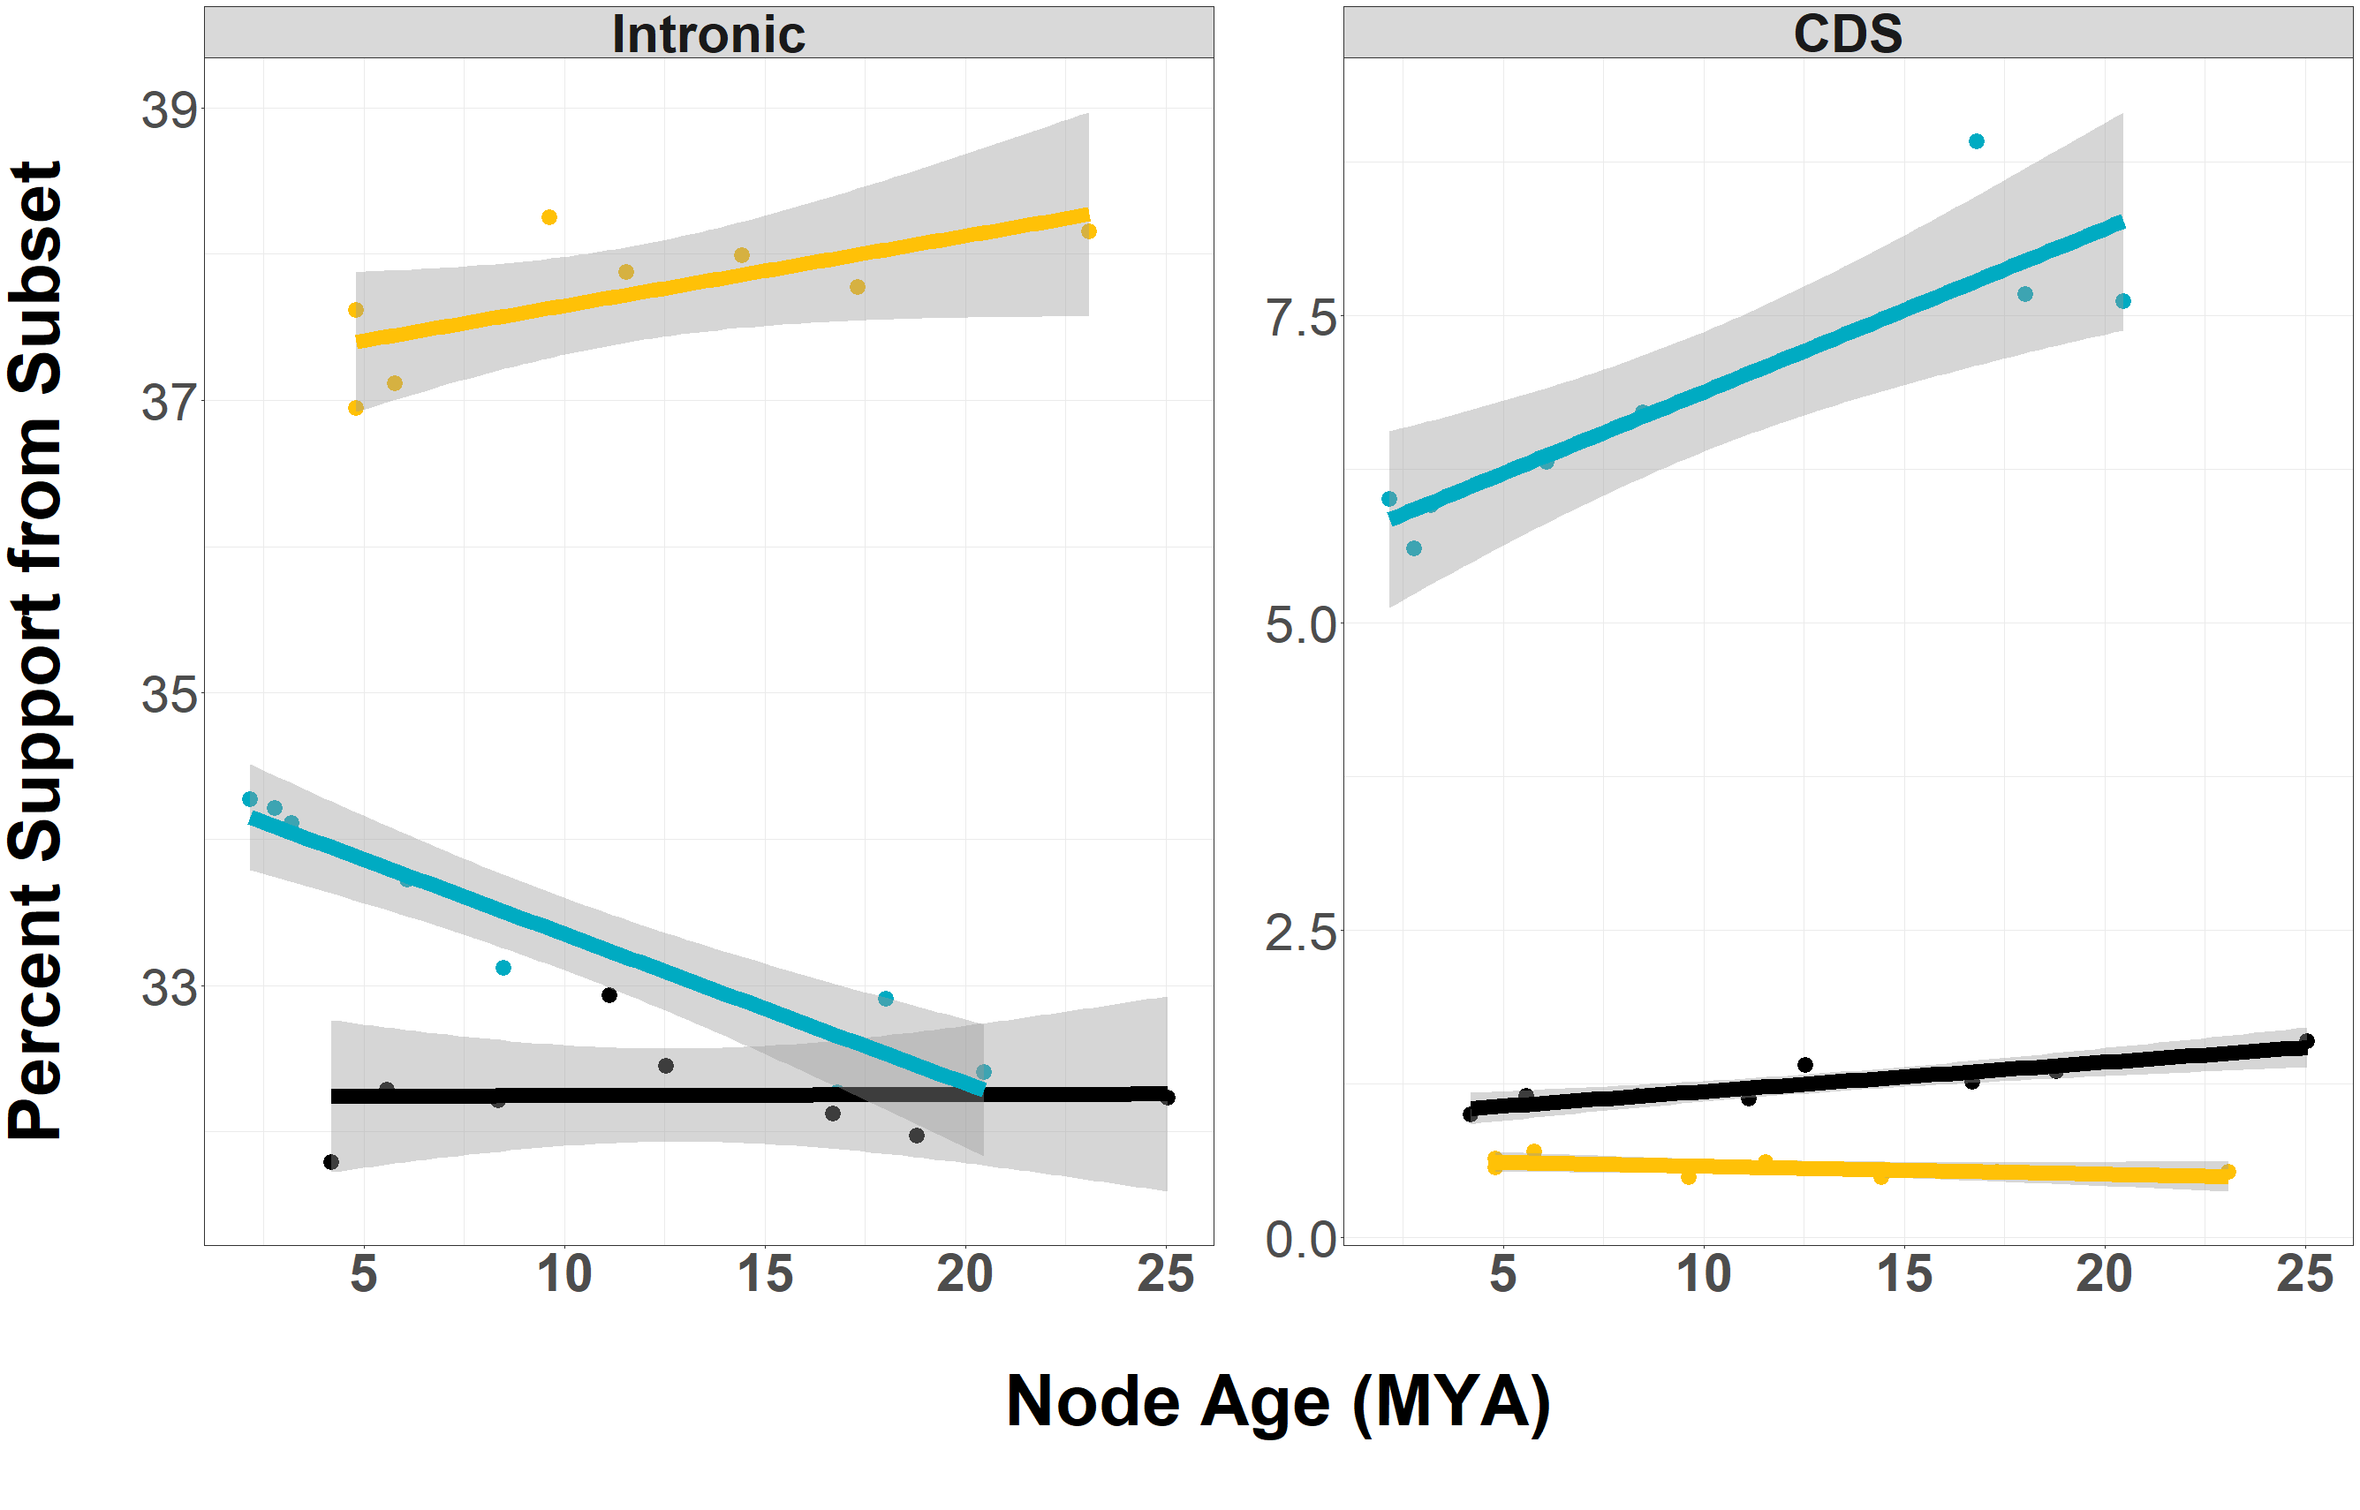


Rodents: +0.13% / MY
Rodents: -0.10% / MY
Pecora: +0.02% / MY
0

Slide 40
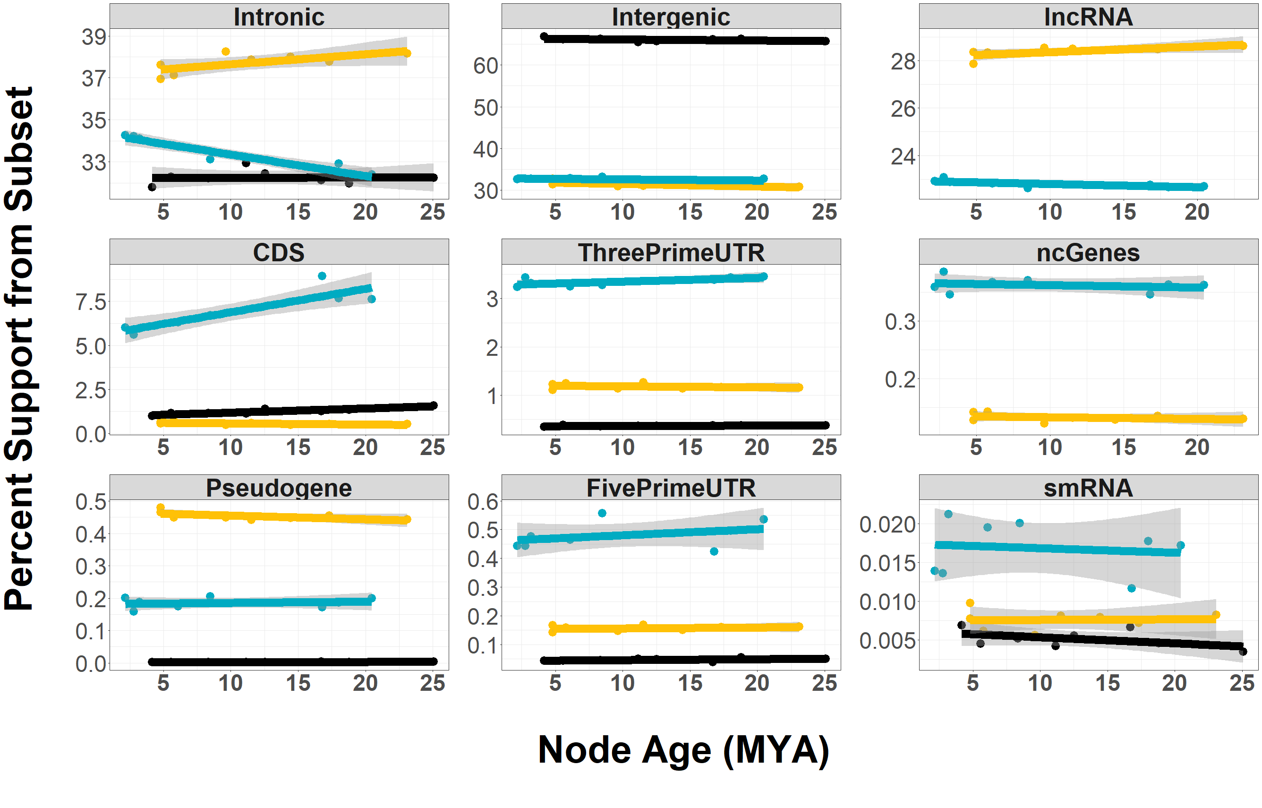
Δ Signal Over Time
Consistent Signal

Slide 42
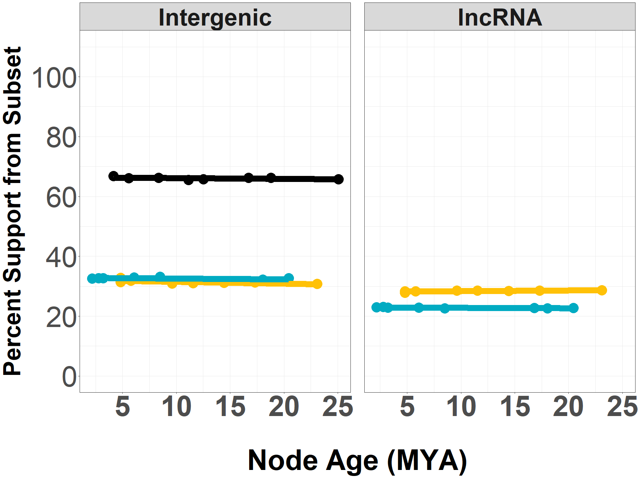
lncRNA data included in analysis

Slide 43
Conclusions
Annotation-free ortholog identification pipeline allows genome-wide analyses in the absence of an existing reference genome
SISRS reduces data size while enriching the ratio of taxonomic:non-taxonomic signal

Slide 44
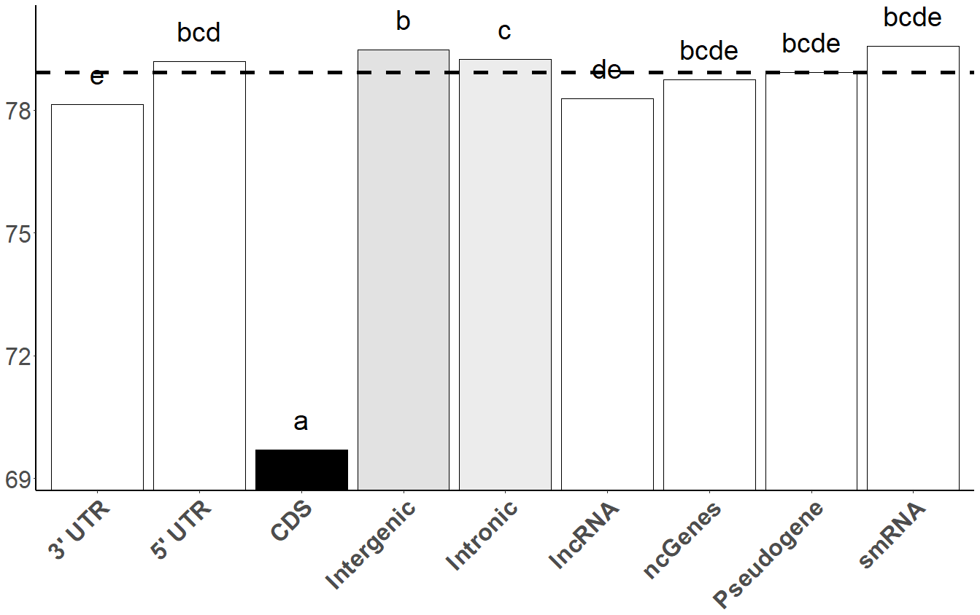
Conclusions
Coding regions carried significantly more non-taxonomic signal when compared to most other subsets
Intronic, lncRNA, and Intergenic regions made up between 88% - 98% of identified SISRS sites

Slide 45
Conclusions
Most genomic subsets saw little change in phylogenetic utility over a 2-25MY timescale
Δ Signal Over Time
Consistent Signal

Slide 46
Future Directions
If you have NGS data, please try SISRS!
https://github.com/SchwartzLabURI/SISRS
Expanding SISRS functions to move from descriptive to interrogative experiments
Diving deeper in the sources of non-historical signal

Slide 47



Thank You!
@BobLiterman
Literman@uri.edu
GitHub Code
SchwartzLabURI/SISRS
Thanks to Devin McConnell

Slide 48
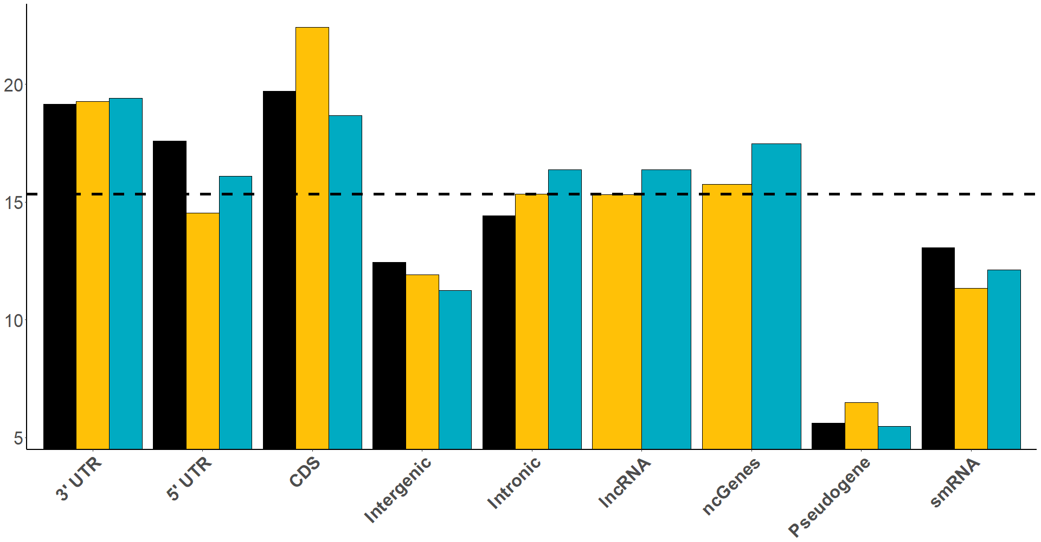
Assembly
(% Ref)

Slide 49
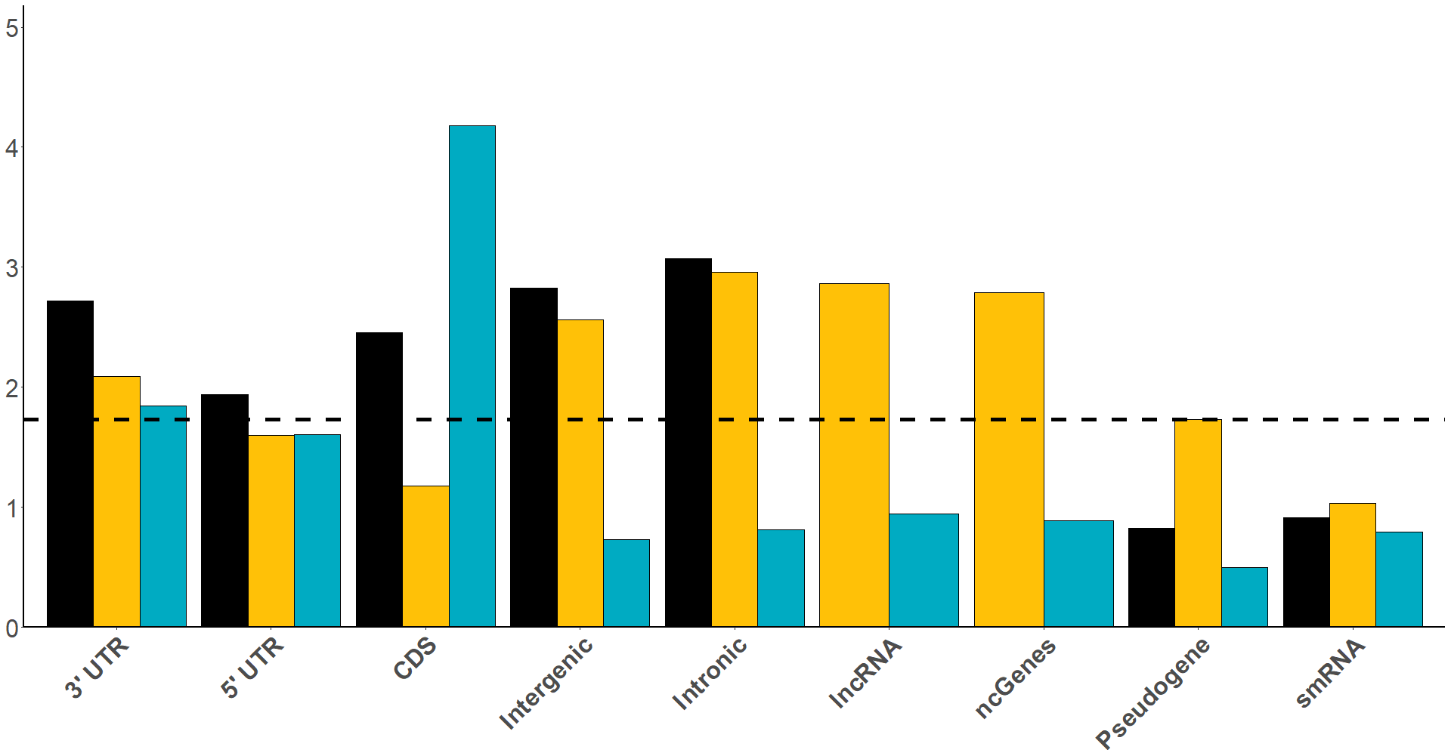
SISRS
(% Composite)

Slide 50
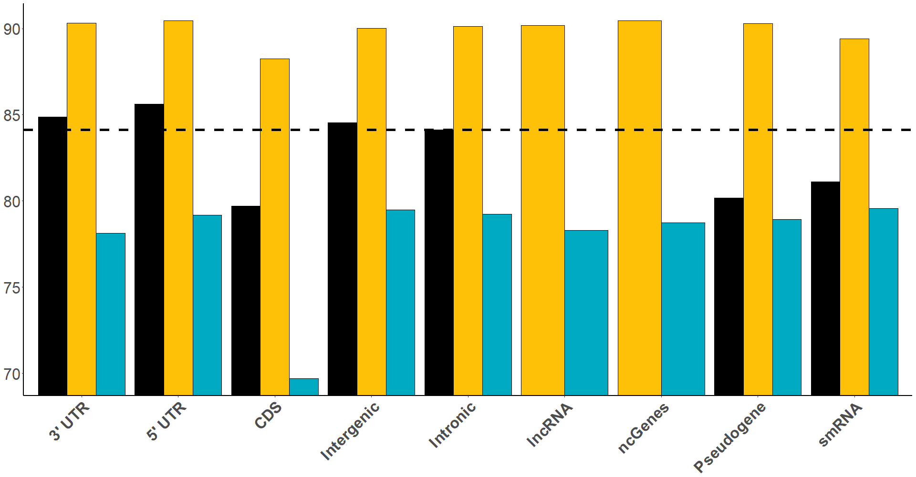
Concordance (% Good)

Slide 51
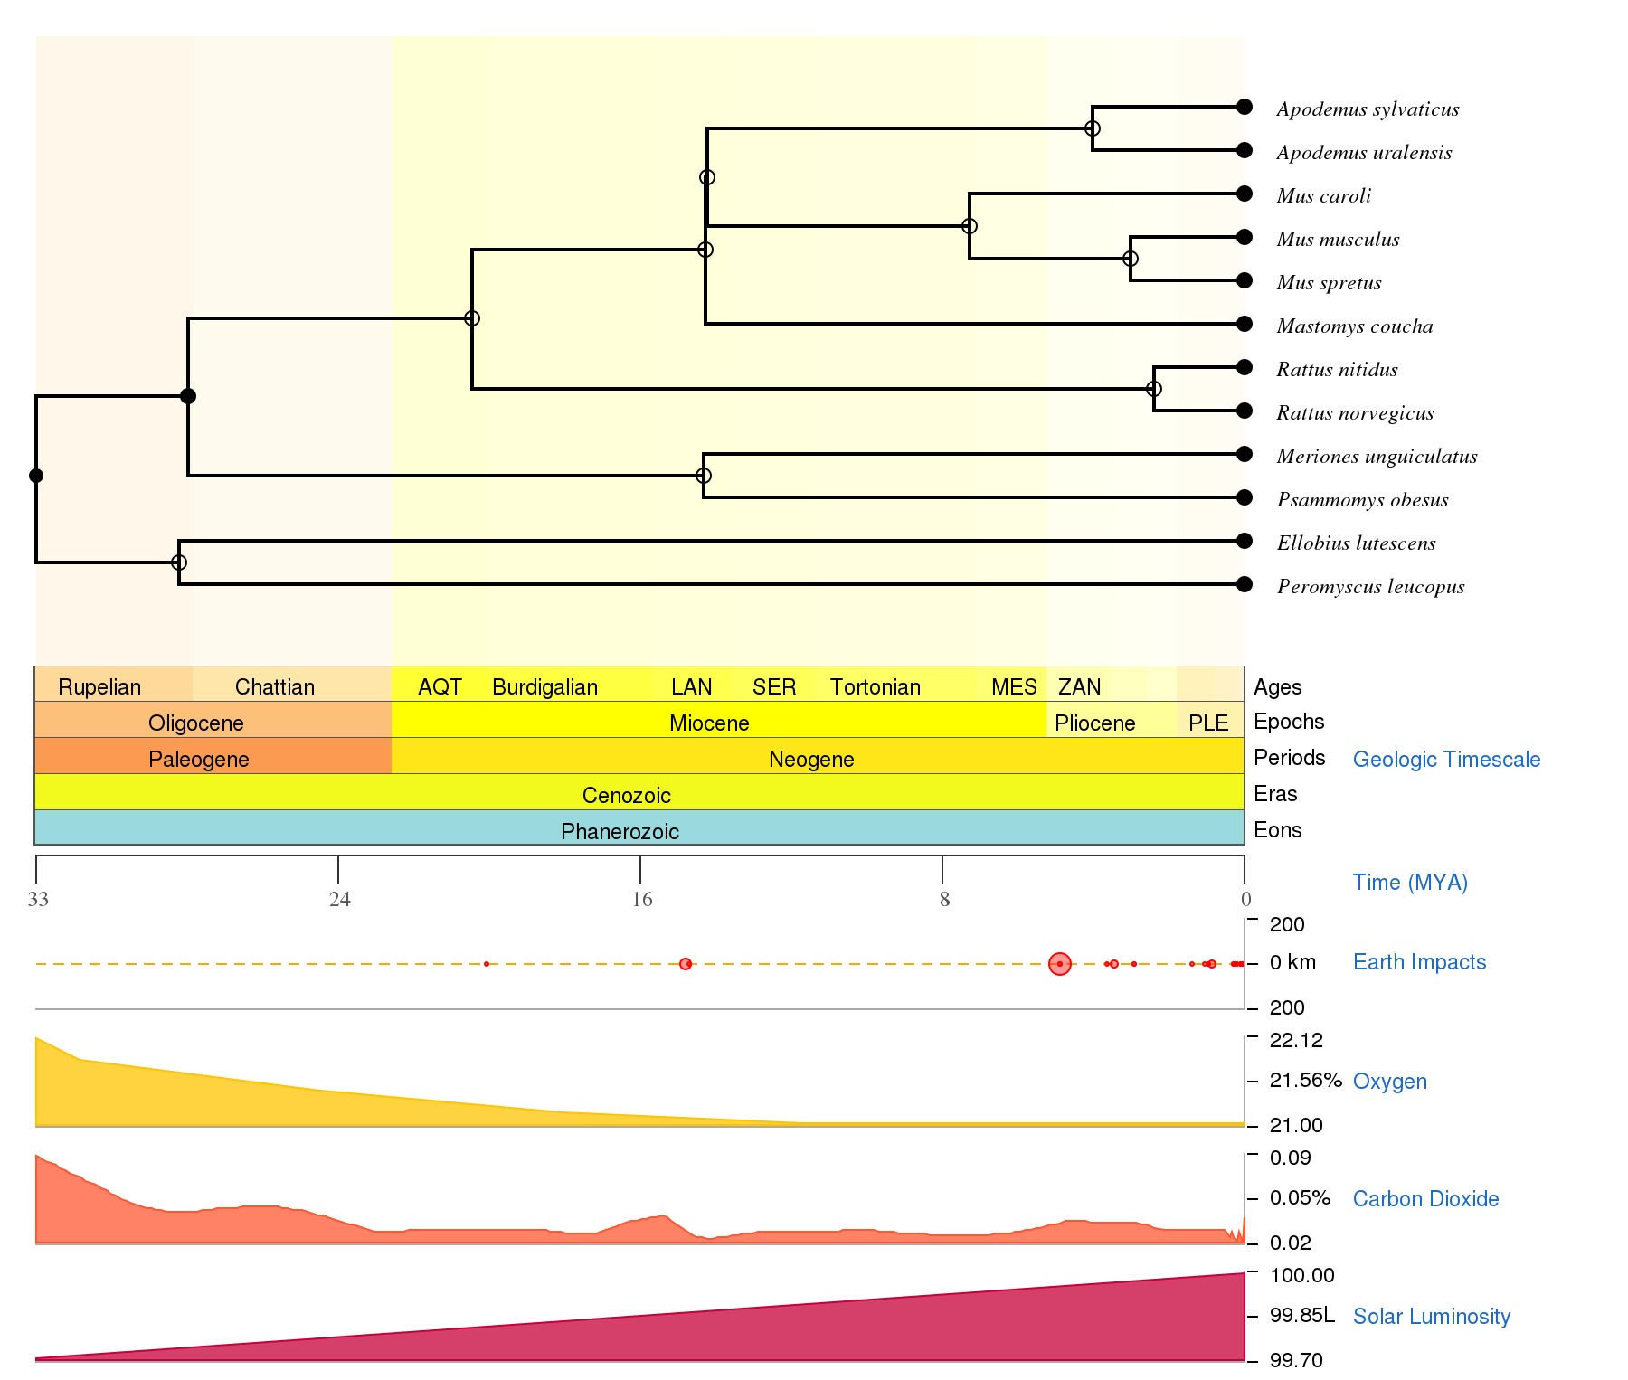
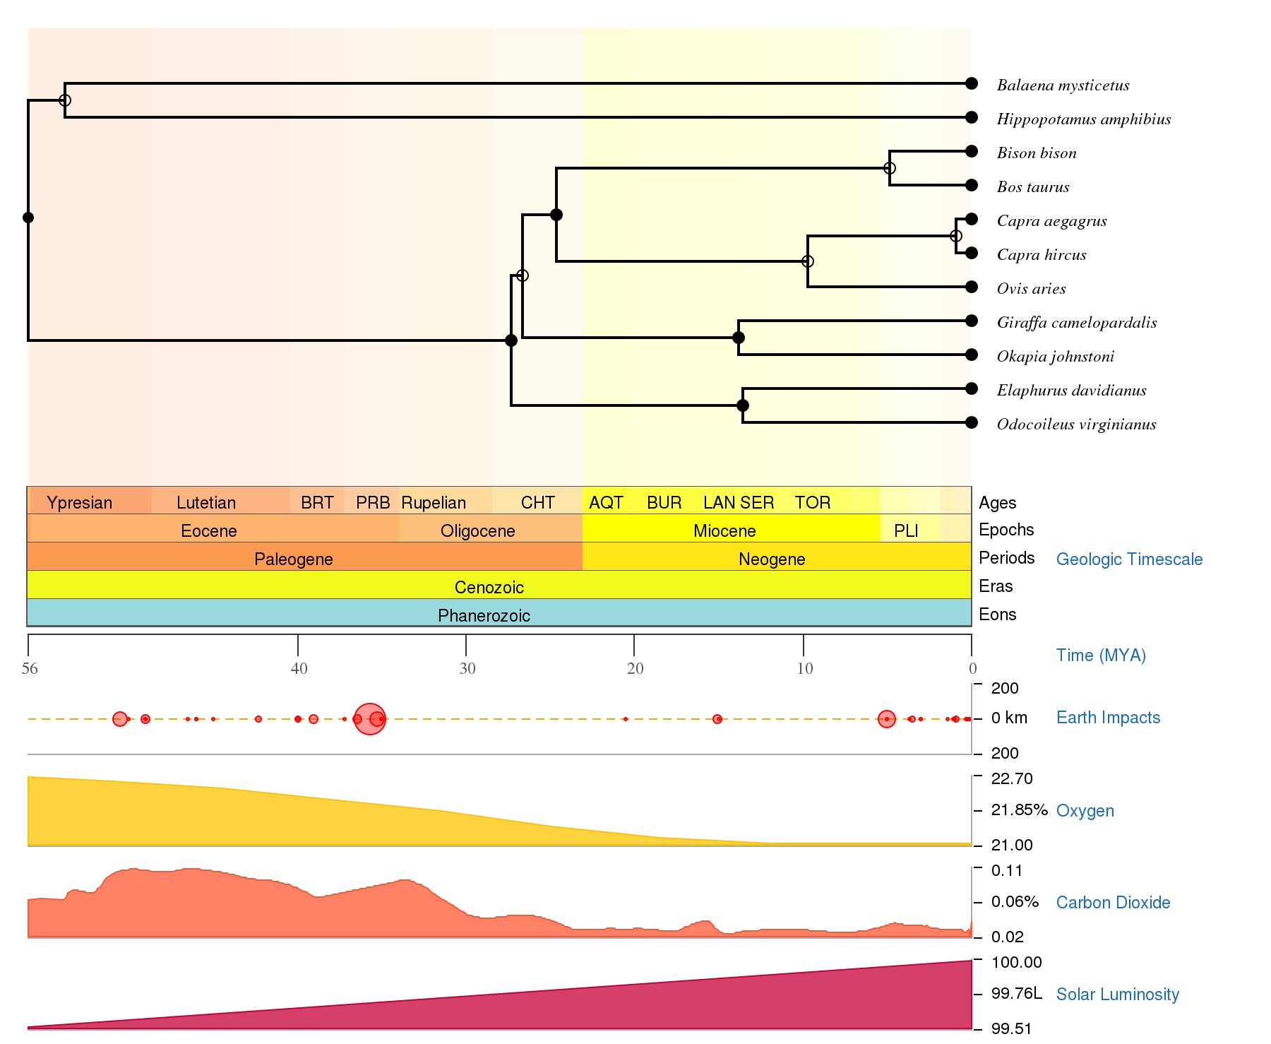
11th most common ‘bad split’
Apo+Mus: 14K sites
Mus+Mas: 27K sites
34% ‘Bad’
#1 most common ‘bad split’
Deer Outgroup: 61K sites
Giraffidae Outgroup: 172K sites
26% ‘Bad’

