Slide 1
CS 427/527
Computer Security
Project #2
Public-key encryption
Spring 2015
Sarah Mocas

Slide 2
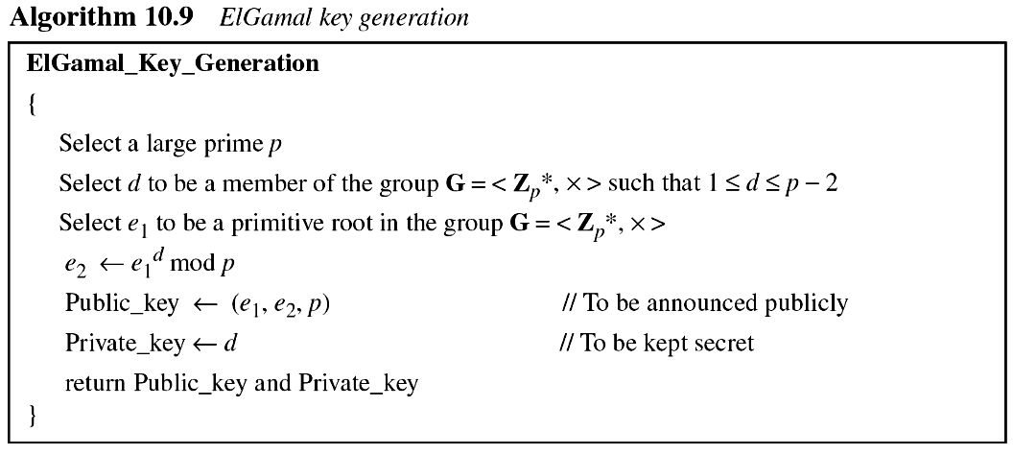
Project 2 - CRYPTOSYSTEM
A primitive root is a number whose powers successively generate all the elements mod p
Key set up
Just means in {1, …, p-2}
Just means in {1, …, p-1}
This system is using a primitive root (generator) for prime p. Given a prime p, there is no known fast algorithm to find a primitive root g for p.

Slide 3
Algorithm to generate a k-bit safe prime p so that 2 is a generator for mod p
1. Do the following:
  Select a random (k-1)-bit prime q (Rabin-Miller), so that q mod 12 = 5
  Compute p := 2q + 1, and test whether p is prime (using, the Rabin-Miller test)
2. Repeat Step 1 until p is prime
Now finish key generation …
2
2

Slide 4
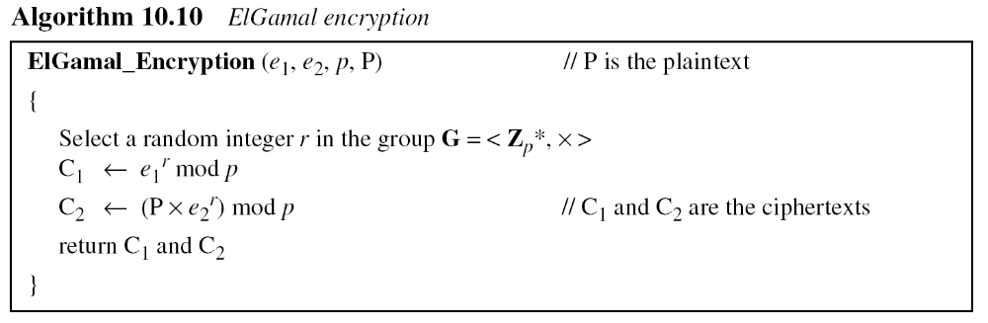
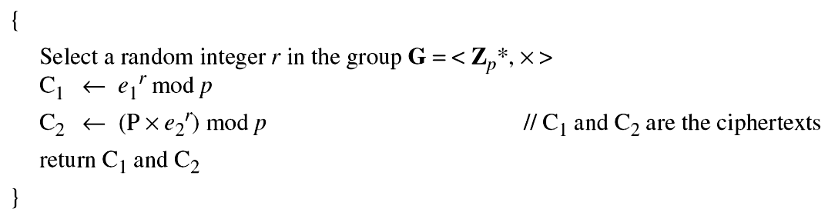
Project 2 - CRYPTOSYSTEM
P = plaintext and |P| < p
e₁ = 2
Encryption
Just means in {1, …, p-1}
P is the plaintext message
A unique random r must be used each time, otherwise the result is insecure

Slide 5
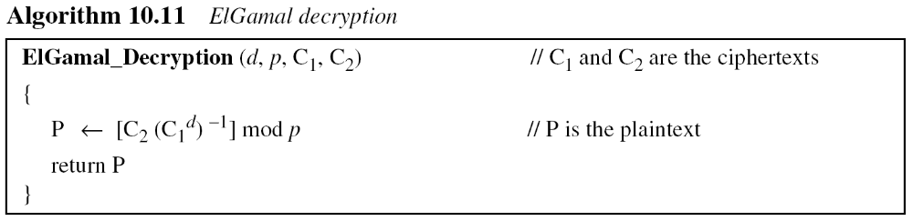
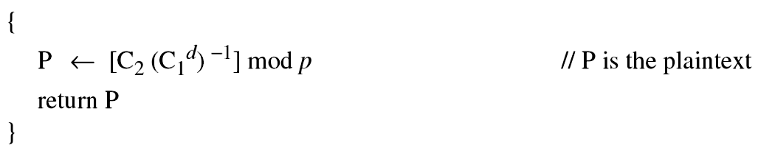
Project 2 - CRYPTOSYSTEM
Decryption
C₁, C₂ = ciphertext
Instead of using P = [C₂ (C₁^{d})⁻¹] mod p for decryption, we can avoid the calculation of the multiplicative inverse and use
P = [C₂ C₁^{p−1−d} ] mod p
Since d ≤ p-2 then ((p − 1) − d) > 0

Slide 6
Project 2 - CRYPTOSYSTEM
Instead of using P = [C₂ (C₁^{d})⁻¹] mod p for decryption, we can avoid the calculation of the multiplicative inverse and use
P = [C₂ C₁^{p−1−d} ] mod p
The inverse of C₁^{d} is a value so that
1 ≡ [C₁^{d} (C₁^{d})⁻¹] mod p
In this case
1 ≡ [C₁^{d} (C₁^{p−1−d})] mod p
since
[C₁^{d} ^{+ p−1−d}] mod p
1 ≡ C₁ ^{p−1} mod p
Fermat’s Little Theorem
a^{p-1} ≡ 1(mod p)
where p is prime, gcd(a, p)=1

Slide 7
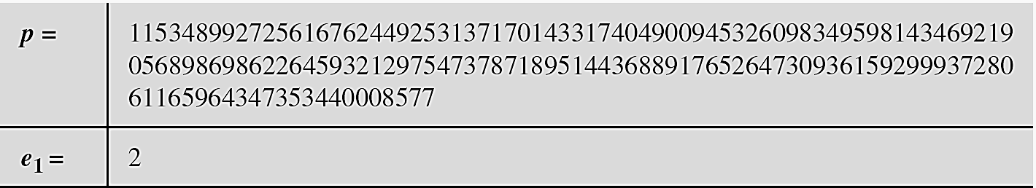
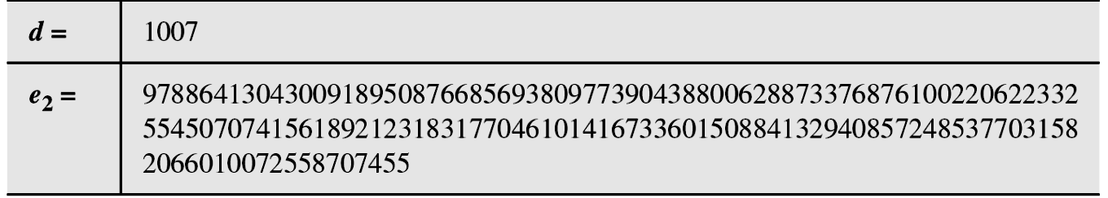
Example
Bob uses a random integer of 512 bits. The integer p is a 155-digit number (the ideal is 300 digits). Bob then chooses e₁, d, and calculates e₂, as shown below:
e₁∈ {1, …, p-1}
d∈ {1, …, p-2}
e₂ = e₁^{d} mod p

Slide 8
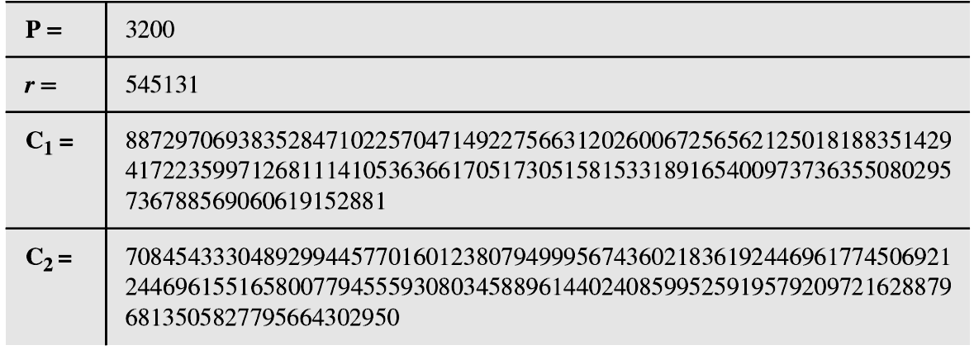
Example
Alice has the plaintext P = 3200 to send to Bob. She chooses
r = 545131, calculates C₁ and C₂, and sends them to Bob.
Alice calculates C₁= e₁^{r} mod p and C₂ = (P∙e₂^{r}) mod p
Bob calculates P = C₂((C₁)^{d})⁻¹ mod p = 3200 mod p

Slide 9
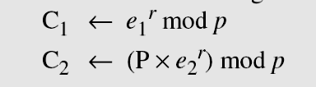
Why This Works
Encryption is probabilistic, since r is randomly picked for each new ciphertext – r masks
  a single plaintext can be encrypted to many possible ciphertexts, with the consequence that a general encryption produces a 2 to1 expansion in size from plaintext to ciphertext.
Encryption requires two exponentiations
  exponentiations are independent of the message and can be computed ahead of time
Decryption only requires one exponentiation

Slide 10
Why This Works
Encrypt P as a pair of integers (C₁,C₂) where
  Chose random integer r
  C₁ = e₁^{r} mod p
  C₂ = P∙e₂^{r} mod p
  Return (C₁,C₂)
Decrypt the message by
  P = [C₂ (C₁^{d} )⁻¹ ] mod p
  = [(P∙e₂^{r} mod p)((e₁^{r} mod p)^{d} )⁻¹] mod p
  = [(((P mod p)(e₂^{r} mod p)) mod p)((e₁^{r} mod p)^{d} )⁻¹] mod p
  = [P∙((e₁^{d} mod p)^{r} mod p)((e₁^{r} mod p)^{d} )⁻¹] mod p
  = [P∙((e₁rd mod p)∙(e₁rd mod p)⁻¹] mod p
= [P∙((e₁rd mod p)∙(e₁rd mod p)⁻¹) mod p] mod p
= [P∙1] mod p = P
Facts:
e₂ = e₁^{d} mod p
P = P mod p, P < p
1 ≡ a∙a⁻¹ mod p

Slide 11
Finding a Primitive Root
C₁= e₁^{r} mod p where e₁ is a primitive root for mod p
No simple general formula to compute primitive roots modulo n is known.
What the algorithm that you can use does is, assume 2 is the primitive root and then it finds a good prime p
RFC 4419, SSH DH Group Exchange, March 2006
Appendix A: Generation of Safe Primes
The "Handbook of Applied Cryptography" [MENEZES] lists the following algorithm to generate a k-bit safe prime p. It has been modified so that 2 is a generator for mod p.

Slide 12
Finding a Primitive Root
Algorithm to generate a k-bit safe prime p so that 2 is a generator for mod p
1. Do the following:
  Select a random (k-1)-bit prime q (Rabin-Miller), so that q mod 12 = 5
  Compute p := 2q + 1, and test whether p is prime (using, the Rabin-Miller test)
2. Repeat Step 1 until p is prime
http://www.ietf.org/rfc/rfc4419.txt
Note: 2q = p -1 which is Φ(p) so 2 and q are the prime factor of Φ(p).

Slide 13
Project 2 – What do you need to code?
Miller-Rabin, to test primes
Square and Multiply to do fast modulo exponentiation
Use a decent pseudo random number generator

Slide 14
Project 2 - Primitive roots
A good source: http://en.wikipedia.org/wiki/Primitive_root_modulo_n
Martin's ... primitive roots – Wikipedia (sequence A001122 in OEIS)
A calculator of primitive roots modulo p is located here.
This site has a primitive root calculator applet.

