Slide 1
Project 1
E14086020 洪緯宸

Slide 2
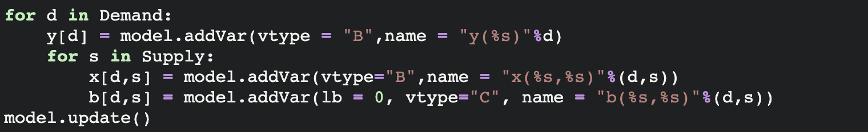
Setting Variables
x: variable set represent if the No.d car park into the No.s parking lot, so it is a boolean variable, if No.d car park in No.s parking lot, then x[d,s]=1
Y: variable set represent the penalty decision variable. If No.d car not park in the lot, then y[d] = 1
b: variable set represent the benefit (penalty/R) that each car “d” park in parking lot “s”, we will obtain. ie. b[d,s] = penalty[d]/distance[location_d[d],location_s[s]

Slide 3
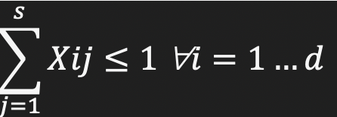
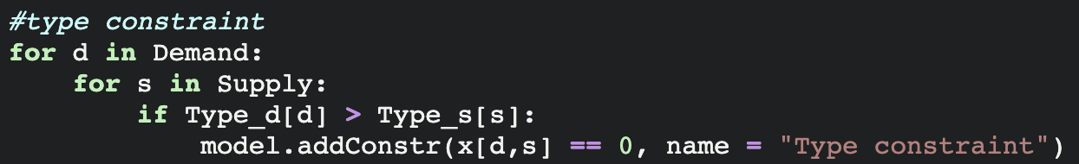
Adding constraint
Adding constraint on one car can at most park in one parking lot
Time complexity : O(n)
Adding constraint on type demand if car_type > supply_type, then x[d,s] ==0
Time complexity : O(n*m)

Slide 4
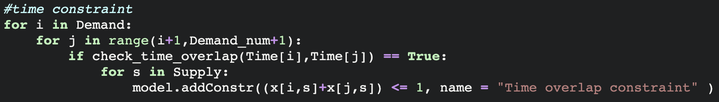
Adding constraint
Adding constraint on time, compare every pair of demand check if the time overlap. If overlapping, then add constraint that two car can’t park in the same lot
Time complexity : O(n^2)

Slide 5
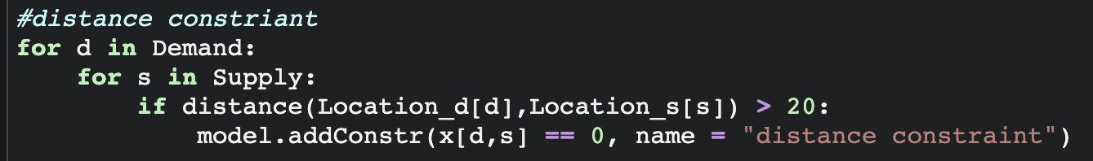
Adding constraint
Constraint on distance : loop over each car to every supply, if the distance is greater than the R, then add the constraint that Xij =0

Slide 6
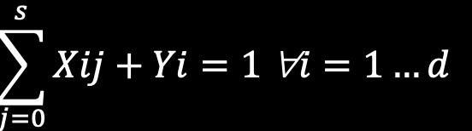
Setting variable constraint
Setting variable Y[d] opposite from whether the car park or not, so if the car is parked, the penalty variable Y[d] = 0
Time complexity = O(n)

Slide 7
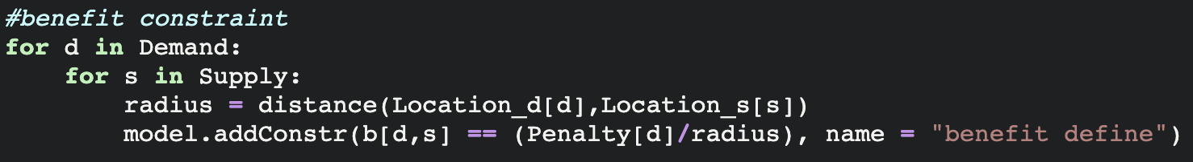
Setting variable constraint
Adding constraint on benefit variables
Bij = penalty[d] / radius

Slide 8
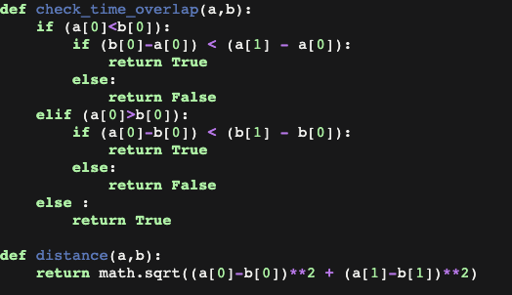
Function setting
Check if each car time overlap
Calculate the distance

Slide 9
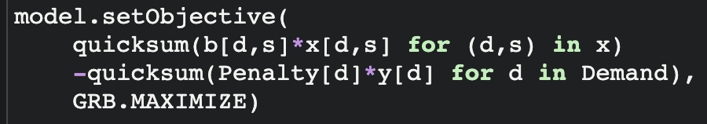

Setting objective
Maximize

Slide 10
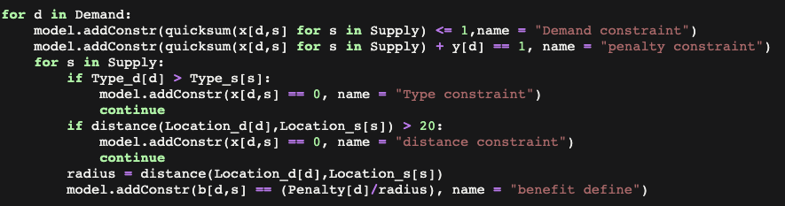
Optimize setting constraint
Observing the constraint above we can combine each other together
Cause comparing type is the simplest so we put in the first place. If the type doesn’t match, we don’t need to compare location and add the benefit. By doing so we can save lots of time, cause calculate distance cause lots of time

Slide 11
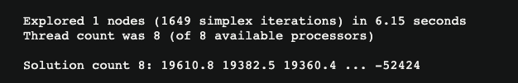

Comparing the before and after optimize
Before
After
Decrease the time by (6.15-5.53)/6.15 = 10%
Not enough!!
The most time consume is in comparing time, cause it time complexity is O(n^2) on demand if the demand increase the time comsume will be square.

Slide 12
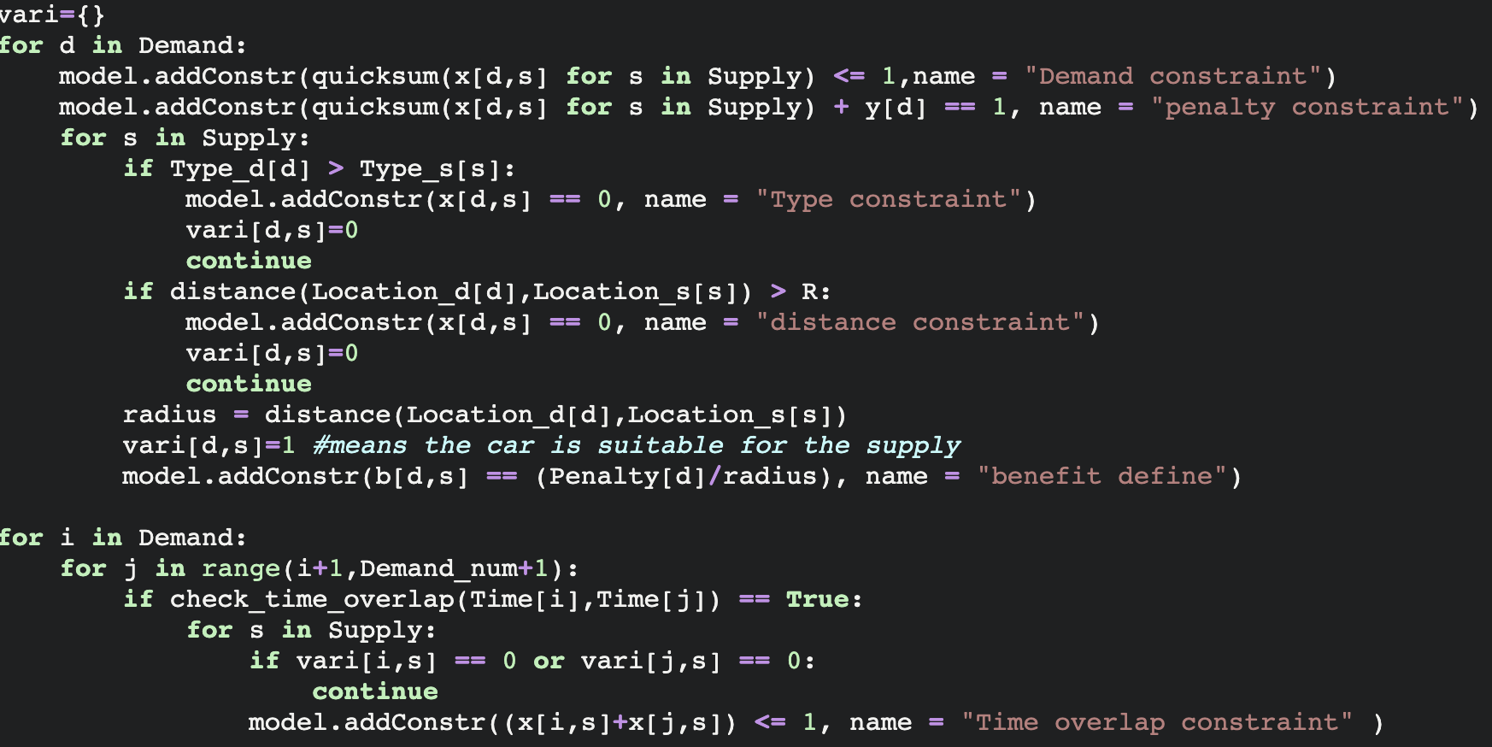
Optimize the time constraint

Slide 13

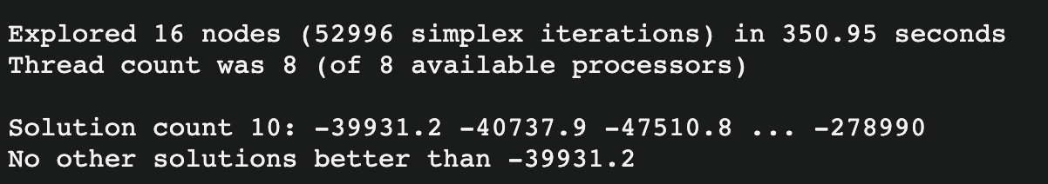
Optimize time constraint explain & compare
By add a variable array to record if the car is suitable for the supply, and check the array when adding the time constraint, I optimize the program by (6.15-1.36)/6.15 = 77.8%
When solving the biggest data demand = 1000 supply = 200 it takes less less 5 mins, before optimizing I can’t even run this file

