Slide 1

NHibernate 101
NHibernate basics for beginners

Slide 2
MARQUEE SPONSOR

Slide 3
PLATINUM SPONSOR

Slide 4

PLATINUM SPONSOR

Slide 5

GOLD SPONSOR

Slide 6

GOLD SPONSOR

Slide 7

GOLD SPONSOR

Slide 8
GOLD SPONSOR

Slide 9

GOLD SPONSOR

Slide 10

GOLD SPONSOR

Slide 11



SILVER SPONSORS

Slide 12
About the speaker
Bob Palmer
Architect, software developer, and technology junkie.
I write code and build stuff (mostly web stuff, sometimes robots.)
Senior ALM Consultant, http://InCycleSoftware.com
Blog: http://TechnocratusRex.com
Twitter: @BobKnowsCodeFu
Email: rbpalmer2222@gmail.com
Code (including this presentation) http://github.com/BobPalmer

Slide 13


Slide 14

Notes:
- New talk (Beta version) – Feedback is appreciated!

Slide 15

Notes:
We’ll be leaving the dogma at the door, not getting into EF4 v NH3.2, other ORMs, etc
Since folks are here, assumed that they want to dig into NH

Slide 16

Notes:
Will be going through at a pretty high velocity as there is a lot to cover.

Slide 17
Our Agenda:
Why ORMs are awesome and save you time
Our demo data for today (dinosaurs and lasers are involved).
Lots of examples
Some basic crud operations (add, query, edit, delete)
Using Repositories
Many to Many and Many to One relationships
Lazy Loading
Dealing with Select N+1
Final words, quick troubleshooting tips, and resources
All code (including the full sample site) is up on GitHub!

Slide 18

Why ORMs?
Notes:
Reality is that none of us became software developers to do plumbing.
You could start with working with datasets and datatables, but that’s evil.
Eventually will have to have data shaped differently
Lots of left hand right hand code
All of us have built Data Access layers…
ORMs come in to help us get rid of a lot of that basic plumbing.

Slide 19

Why ORMs?
LOL With teh ORMs I will never have to write SQL ever again!
OMG Generated TSQL is teh sux and will crash our server!
Notes:
Be Pragmatic
You still need to know SQL!
100% chance that a skilled DBA can write, for any single transaction, a much more performant query.
But an ORM will, 90% of the time, write much better SQL than you could write. And 100% that it will be better than your home-grown data access layer.

Slide 20
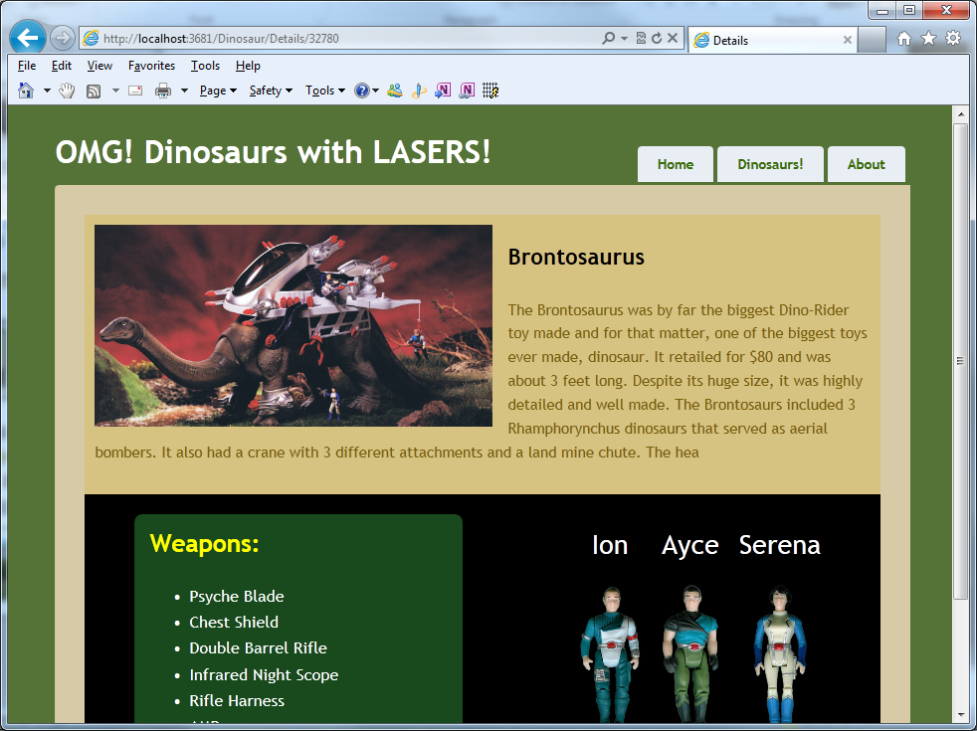
Our demo MVC Site

Slide 21
Our Demo Data as Objects
Category
Category
Dinosaur
Rider
Rider
Weapons
List<String>

Slide 22
Our Demo as Tables
Categories
1:*
Dinosaur
Categories
1:*
Dinosaurs
1:*
1:*
Riders
DinoWeapons

Slide 23

Enough slides – Let’s code!

Slide 24
Wrapping up…
Troubleshooting mapping issues (aka ‘No Persister Found’)
Did you name the file *.hbm.xml?
Did you select ‘Embedded Resource’ in the file properties?
Did you include your <Mapping> tag in App.config?
Are you being sure to not swallow exceptions?
Did you look at the InnerException?
Resources:
http://nhforge.com
http://ayende.com/blog/tags/nhibernate
http://fluentnhibernate.org/
Book: Nhibernate in Action (version 2.x but still good)

