Slide 1
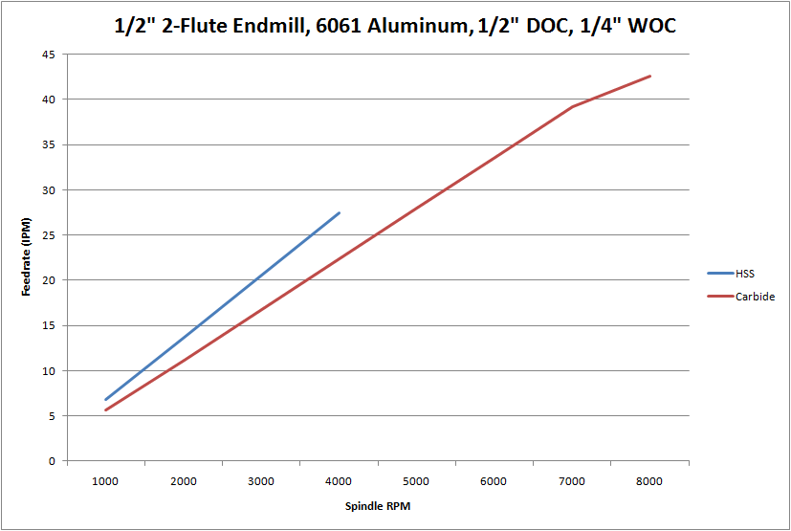
HSS
Carbide

