Slide 1
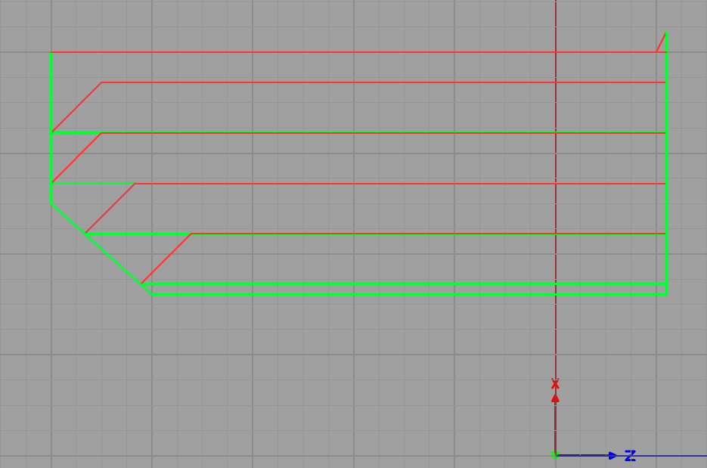
Cycle ends at Start
Position when G71 called
Rough Amt
“U” Word
Retract
“R” Word
45 degrees
Last Pass
Follows
Profile

