Slide 1
Course Notes for
CS1520
Programming Languages
Part C
By
John C. Ramirez
Department of Computer Science
University of Pittsburgh

Slide 2
These notes are intended for use by students in CS1520 at the University of Pittsburgh and no one else
These notes are provided free of charge and may not be sold in any shape or form
Material from these notes is obtained from various sources, including, but not limited to, the following:
  http://docs.jquery.com/Main_Page
  http://www.w3schools.com/jquery/default.asp
  http://jqfundamentals.com/
  Programming the World Wide Web, multiple editions, by Robert Sebesta (AW)

Slide 3
Lecture 1: Intro to JQuery
What is JQuery?
  Not actually a language in and of itself
  Rather, it is large library of Javascript code designed to make access and updates via DOM much simpler than with straight Javascript
  Everything it does we could do without it, but it does make a lot of what we do easier
    You will use JQuery in Assignment 4

Slide 4
Lecture 1: JQuery Library
How to include / access JQuery?
  We can download the library locally and include the file
    <script src = ”http://localhost/localJQuery.js"></script>
    Where localJQuery.js is our local copy of the library
    We can find JQuery library at:
      http://jquery.com/download/
  There are different versions
    Newer versions are not compatible with older IE
    Like all languages / APIs / libraries, JQuery changes over time

Slide 5
Lecture 1: JQuery Initialization
JQuery depends on the DOM being ready for access
  We do not want to use it until the page has been completely loaded
  Once this has occurred we can use JQuery to access parts of our document (in various ways) and to manipulate them (also in various ways)

Slide 6
Lecture 1: JQuery Initializtion
    A good way to make sure the DOM is ready before using JQuery is to put our JQuery access statements into a callback function:
    <script>
$(document).ready(function(){
// Rest of our JQuery code here will
// execute when “ready” occurs
});
</script>
    Note the syntax
      Most JQuery commands are going to be prefixed by $
      This is (more or less) a function in the JQuery library that parses the rest of the data and invokes the appropriate function based on the command

Slide 7
Lecture 1: JQuery Initialization
    We will be able to do a LOT of things with this, all utilizing a fairly simple, consistent syntax
    In the case of the ready() function, we are associating a function that contains the rest of our code with the ready event
    The ready event fires when the DOM is ready, and the function is called
    We can have a lot of code in the function body, including assignments of callbacks to events, etc.
      We are setting up our document here, and waiting for events to occur

Slide 8
Lecture 1: Selection
      Ex: Set an onclick callback to a button
      Ex: Assign style to some text
      Ex: Append text to an element
    In order to do the above we must be able to select elements / items in our document
  There are MANY ways of selection in JQuery
  Let’s look at a few of them:
    Selecting by TAG name:
      $(“tagname”)
      Returns an array of tags that match tagname
    Selecting by ID:
      $(“#theid”)
      Returns element with id equal to theid

Slide 9
Lecture 1: Selection
    Selection by CSS class:
      $(“.className”)
      Returns an array of elements with class .className
    Selection by odd / even:
      $(“element:odd”)
      Returns array of items matching element with odd index values (with indices starting at 0)
    Selection by index:
      $(“element:eq(2)”)
      $(“element:lt(4)”)
      $(“element:gt(1)”)
      Returns elements specified by index (eq = equal, lt = less than, gt = greater than)
    Plus MANY MANY MORE

Slide 10
Lecture 1: Selection
    We can even use selectors to find nested elements in a very intuitive way
      $(“outerElement innerElement”)
      This can be handy when we have several elements of the same type but we want to only modify nested elements within a certain one
      $(“element#id”)
      This allows us to match a specific element with a specific id
    Let’s look at a simple example
      See jqex1.html
    For more on selection see:
      http://www.w3schools.com/jquery/jquery_ref_selectors.asp
      http://api.jquery.com/category/selectors/
    COOOOOOLNESS!!

Slide 11
Lecture 1: Modifying Elements
  In the first example, we already saw how we can modify selected elements
    Basically, once an element has been selected we can do whatever we want to it
    Some examples:
      $(selector).css()
        Update the CSS of the selected element(s)
      $(selector).append()
      $(selector).addClass()
      $(selector).attr()
      …
        Many DOM methods to update properties of the element
        See: http://www.w3schools.com/jquery/jquery_ref_html.asp

Slide 12
Lecture 1: Modifying Elements
      $(selector).hide()
      $(selector).show()
        …
        Methods to change appearance of elements
        See: http://www.w3schools.com/jquery/jquery_ref_effects.asp
      $(selector).bind()
      $(selector).click()
      $(selector).focus()
      $(selector).mouseover()
        …
        Methods to deal with events and event handling
        See: http://www.w3schools.com/jquery/jquery_ref_events.asp
    We will look at some of these in more detail
      Others you will need to look up at your leisure

Slide 13
Lecture 1: Modifying Elements
  Note: Just as in most situations, there is often more than one way of doing things with JQuery
    Sometimes, one approach may be better than another, but in other situations they are just different
    Don’t assume the way I present something is the only way to do it
      Or even necessarily the best way!

Slide 14
Lecture 1: Modifying Elements
  Problem: We would like to iterate through the rows of a table and add a button to each row
    We want a click of the button to toggle a class assignment to the row
  Solution:
    First we need to figure out how to iterate through the rows
    We then must add a new button to each row
    We must then add a click event handler to each new button

Slide 15
Lecture 1: Modifying Elements
  JQuery has the each() iterator
    It iterates through each matched element in a selector, executing a callback function for each
      The callback function receives two arguments, the current matched element and the current index (starting at 0)
    Note: The notion of iteration is common and we have seen it already in Java and PHP
      The difference with this iterator is the way the code is executed – as a function call for each element
    We can use a selector to get the rows of the table and then use each() to access each one in turn

Slide 16
Lecture 1: Modifying Elements
  We can use the append() function
    This allows us to add arbitrary text / html to an element
    We can add an input button to the current row
  There are a couple of ways we can do this
    We can “hard code” the onclick attribute to a callback function that will toggle the class
    We can access the button using JQuery immediately after adding it and use the click() function to assign the callback function
  See jqex2.html and jqex2b.html

Slide 17
Lecture 2: Modifying Elements
  Problem: We would like the font size of our document to automatically adjust as we increase or decrease the window width
  Solution:
    We need to detect the width of the document
    We need to calculate a font size based on that width
    We need to recognize a resize event and call a function to update the font size

Slide 18
Lecture 2: Modifying Elements
  We can use the width() function to find out the width of the document
  There are several ways ways that we can do this
    Depends on how we are actually storing / keeping the font
    CSS allows for many different font metrics
      pt (points)
      px (pixels)
      em (ems)
      % (percent of the default size for the browser)
        For scaling it is probably better to use em or %
        If you need a fixed size, you can use pt or px

Slide 19
Lecture 2: Modifying Elements
    See:
      http://www.w3.org/Style/Examples/007/units.en.html
      http://kyleschaeffer.com/best-practices/css-font-size-em-vs-px-vs-pt-vs/
    In any case, we can calculate a new font size based on the relative width of the resized window vs. that of the original
  JQuery has a resize() function that takes a callback for the resize event
    We simply put code into this function that we want to execute each time the window is resized
  See jqex3.html and jqex3b.html

Slide 20
Lecture 2: Modifying Elements
Problem: We want to show the user a list of items and have him/her rank them by the order they are chosen
  They will then be placed into a new list showing the ranking
Solution:
  Iterate through list, attaching on click event handler
  Handler will remove list item from an unordered list and add it to an ordered list

Slide 21
Lecture 2: Modifying Elements
  We can again use the each() function to iterate through all <li> elements in an unordered list
    To each we assign a callback function for the click() event
    For a bit of added style we also use the hover() function to update the style when the mouse is over the element
  For the current <li> element, we simply remove() it from the unordered list and append it to an ordered list (<ol>)

Slide 22
Lecture 2: Modifying Elements
    We also handle some special cases:
      Initially there is NO ordered list, so for the first element selected we must create the <ol>
      After all items have been moved, the old <ul> is empty, so we remove that
  See jqex4.html
  Yes, this is some neat stuff!

Slide 23
Lecture 2: AJAX
JQuery has a lot of AJAX convenience functions
    See: http://api.jquery.com/category/ajax/
  They allow the full AJAX capabilities
    As if you were using XMLHttpRequest directly
  They also allow some “shorthand” access
  Let’s look at a few functions
    $.ajax()
      Most general ajax() function
      Has options to more or less do whatever you want
        Headers, callbacks, cache, etc

Slide 24
Lecture 2: AJAX
  However, in many cases we use a specific variation of an AJAX call
  JQuery has some predefined variations that are very convenient
    .load()
      This is actually a function that is called from a matched / selected element
      It makes an AJAX call to update the selected element’s data from a server
      Ex:
      $(“#theTable tr”).load(‘url’);
        Will get the file from ‘url’ (which could be the result of a script) and load it into the selected table row
        We can also put in a callback function but it is not required

Slide 25
Lecture 2: AJAX
    .get(), .post()
      Make AJAX requests with the stated default way of passing parameters
      Both can supply options to the server
    Many other functions are available to specific options
  AJAX return data:
    Cool thing in JQuery:
      Default is Intelligent Guess
        Not a scientific theory!
        JQuery looks at the header / format of the returned document and makes its judgment about the type
        Automatically parses it based on that guess

Slide 26
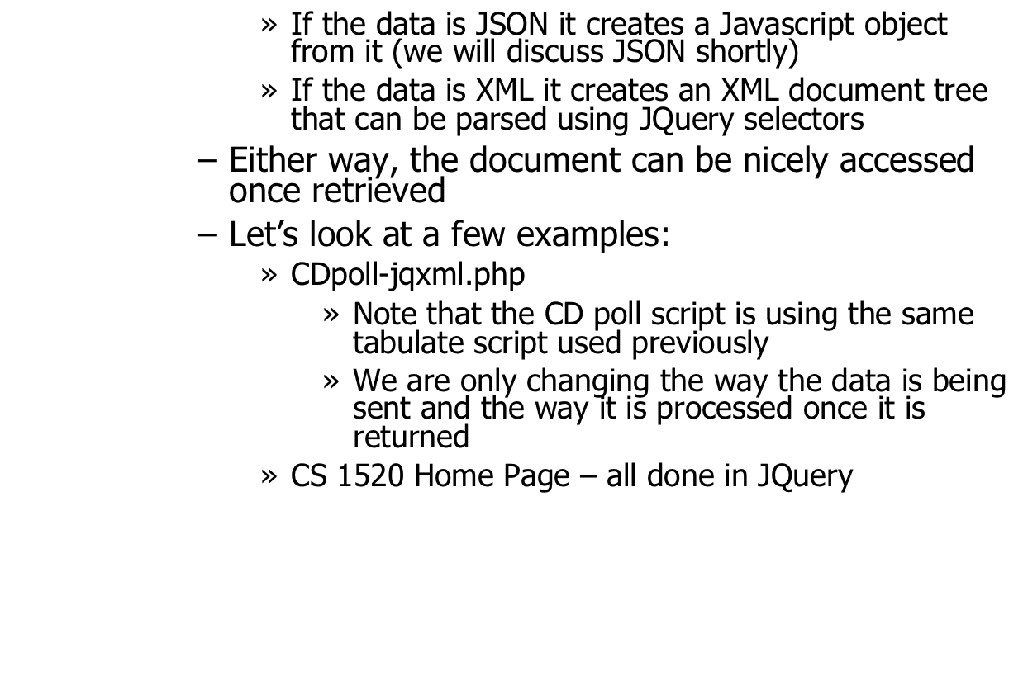
Lecture 2: AJAX

