Slide 1
Progress

Slide 2
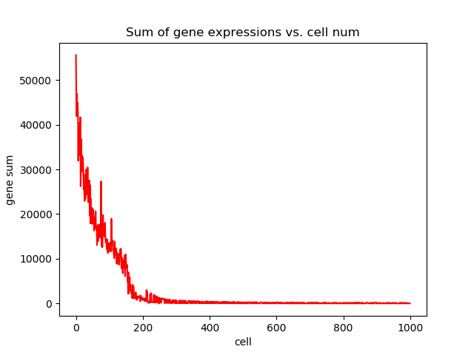
data

Slide 3
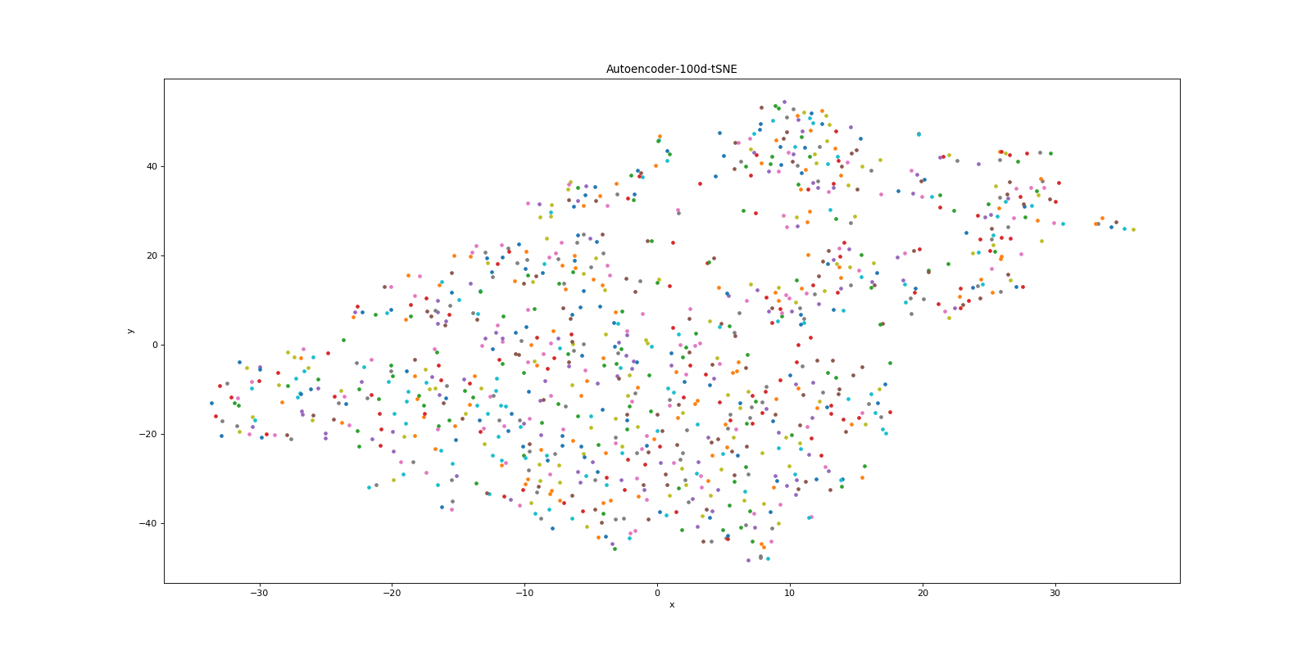

Slide 4
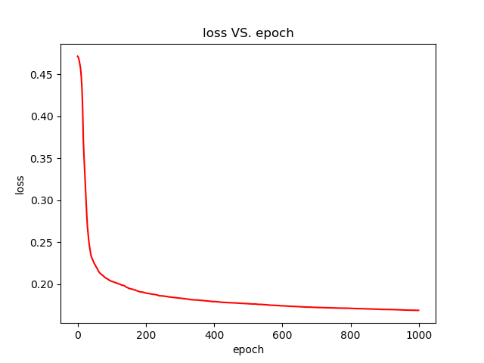

Slide 5
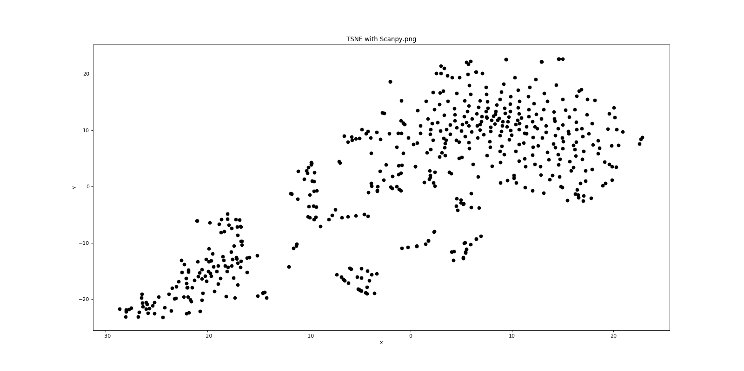
Min_cells=50 Min_Gene=100

Slide 6
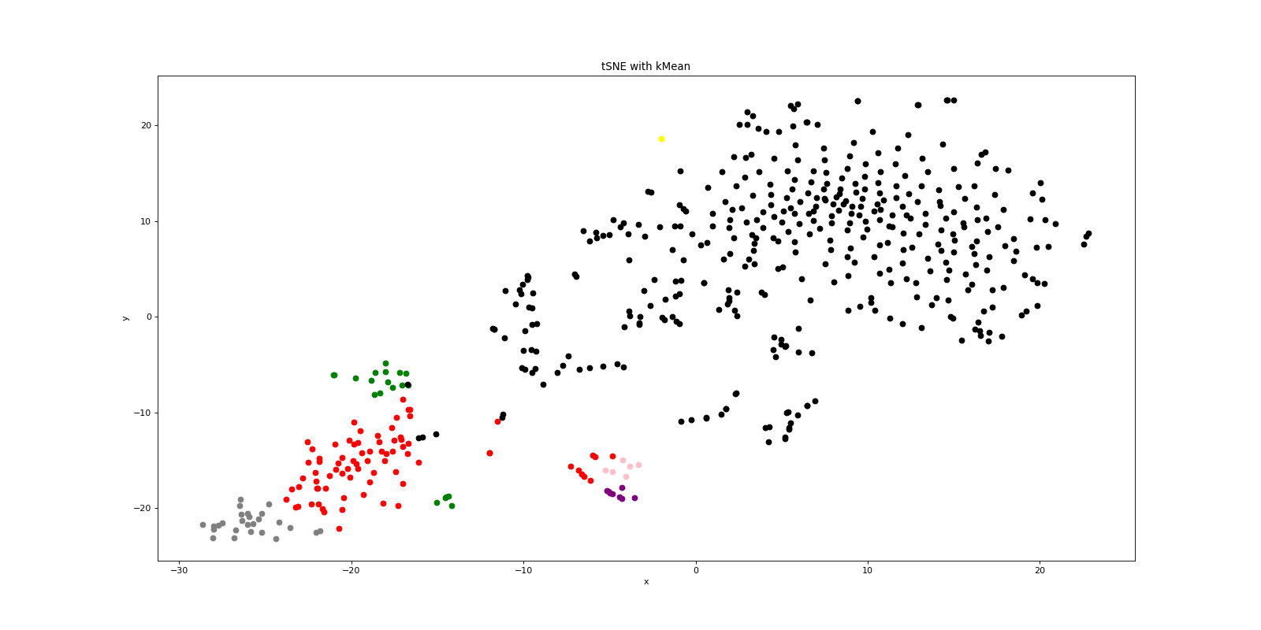
K-mean: k=7

Slide 7
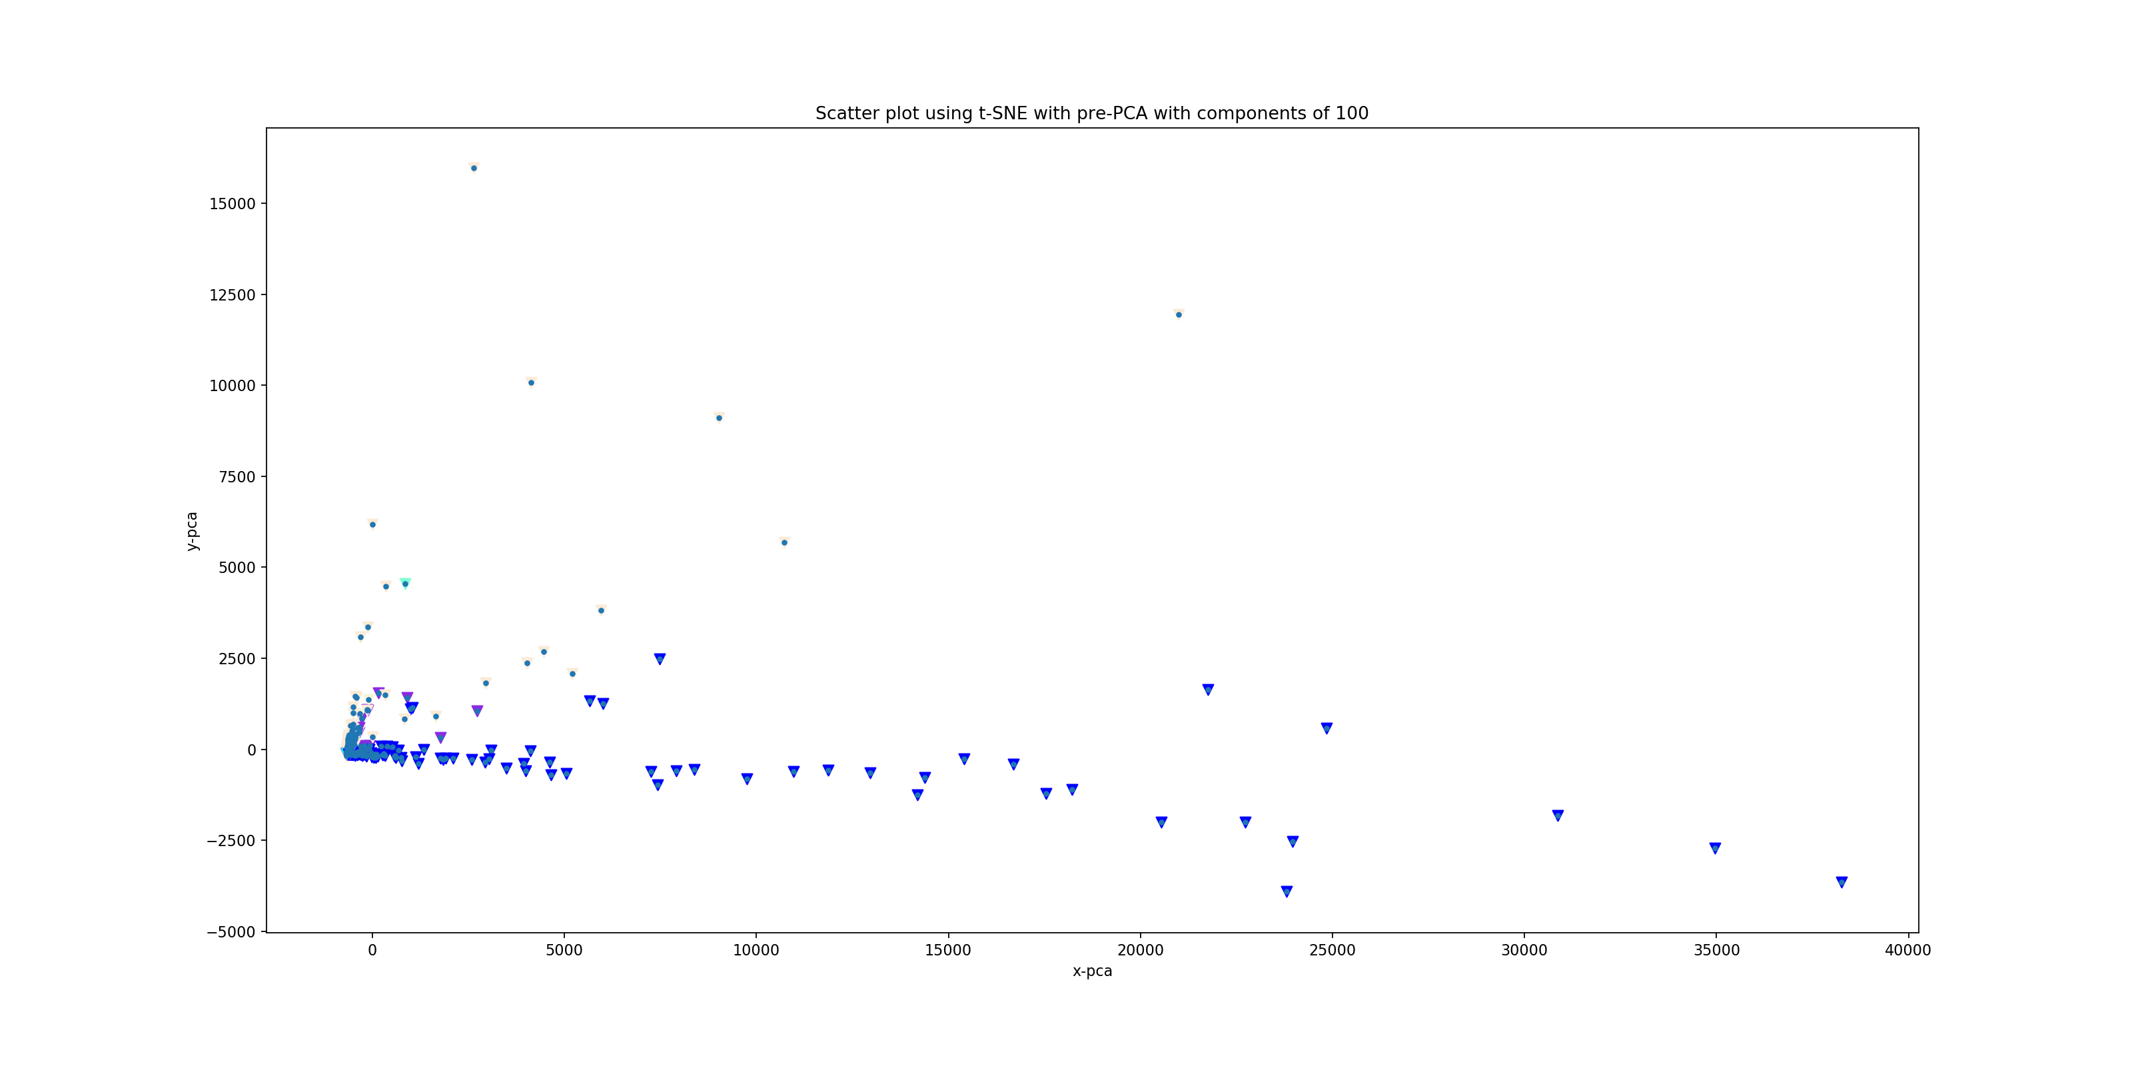
PCA_hierarchal_11clusters(cosine)

Slide 8
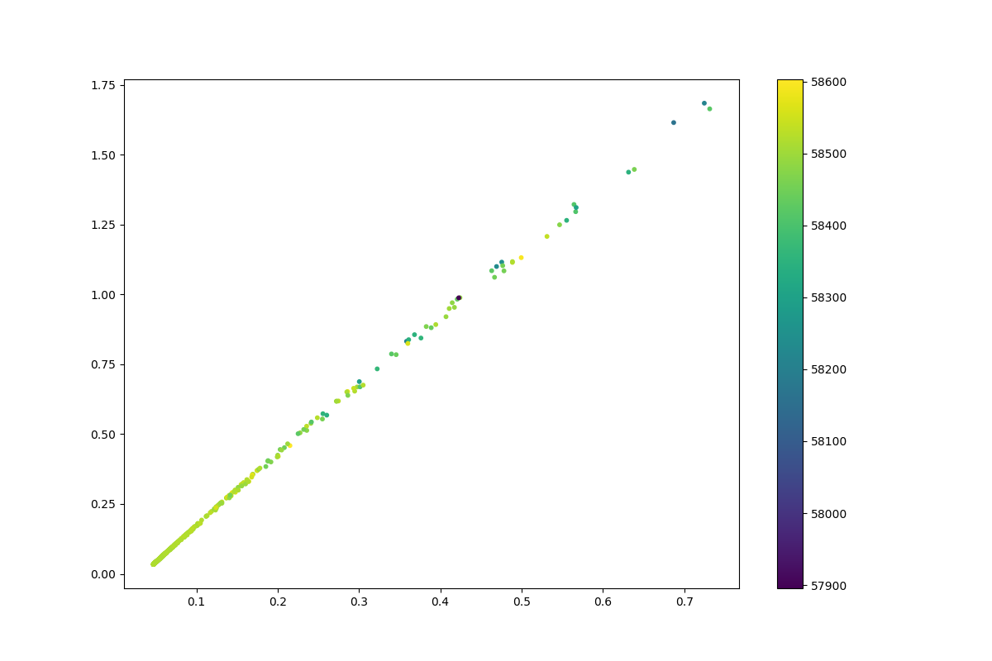
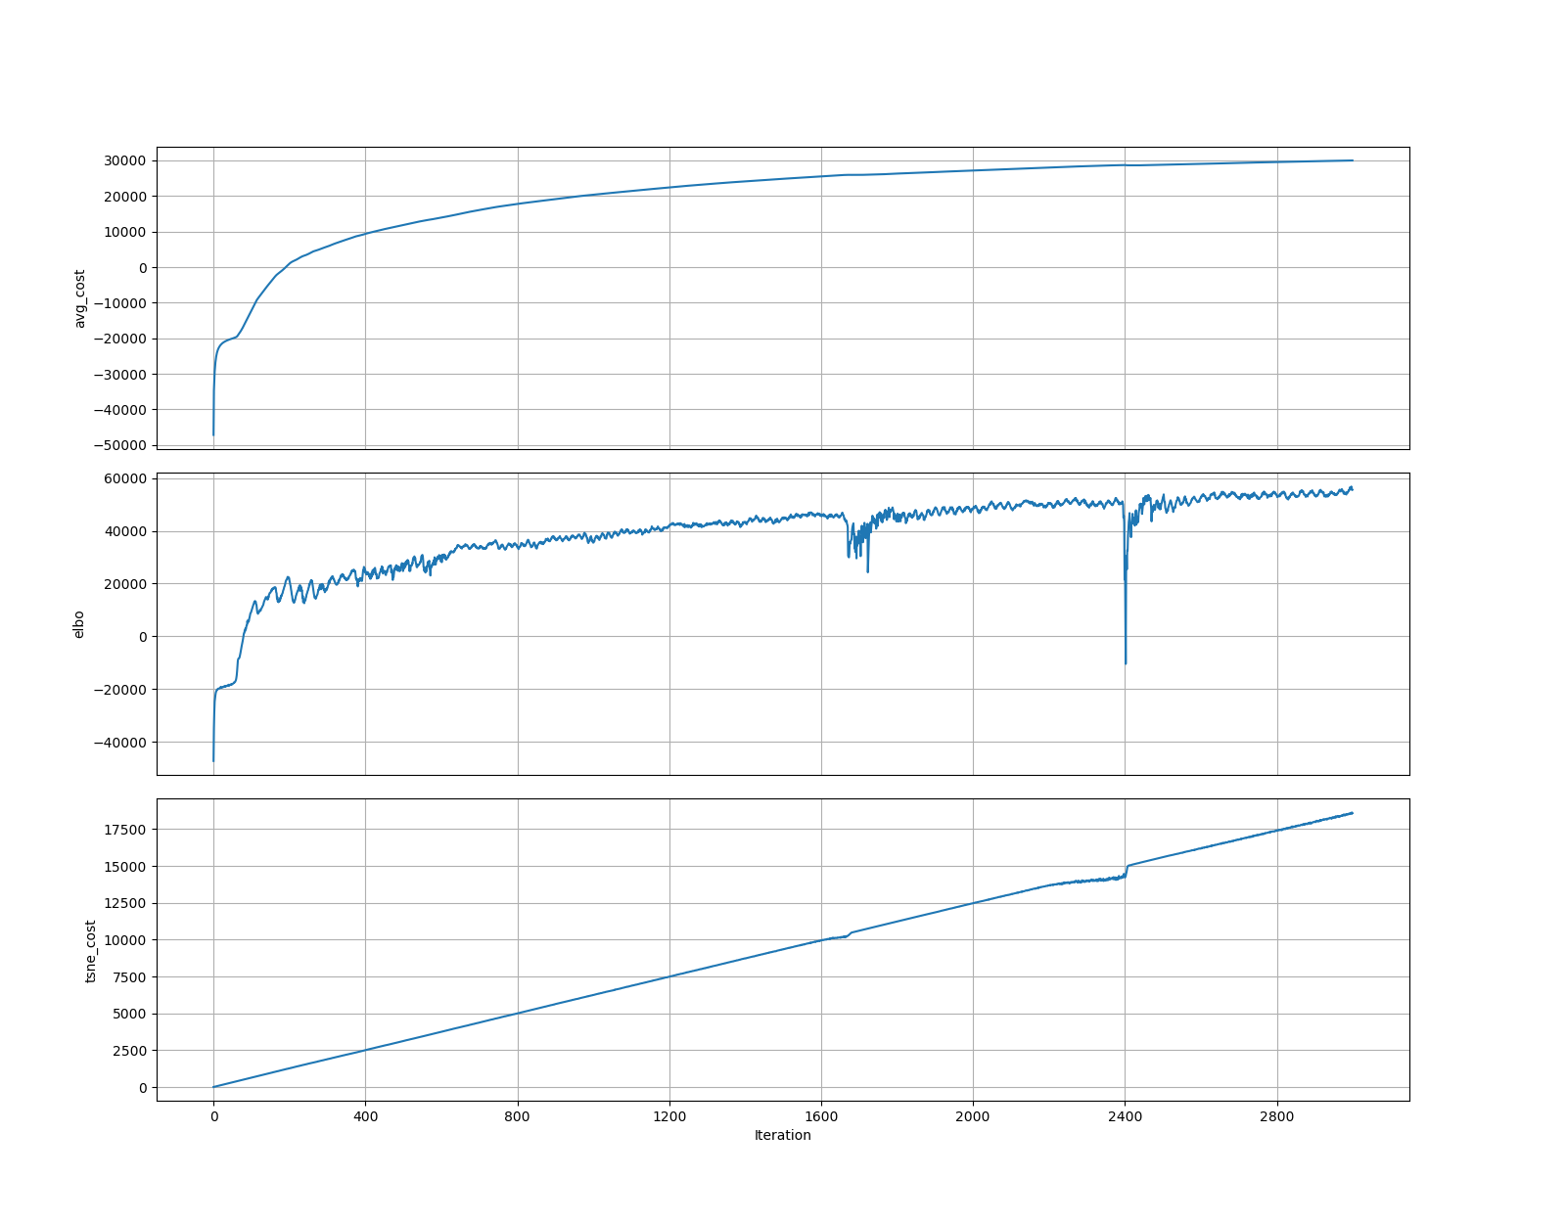
perplexity_10_regularizer_0.001_batch_size_512_learning_rate_0.01_latent_dimension_2_activation_ELU_seed_1_iter_3000_log_likelihood

Slide 9
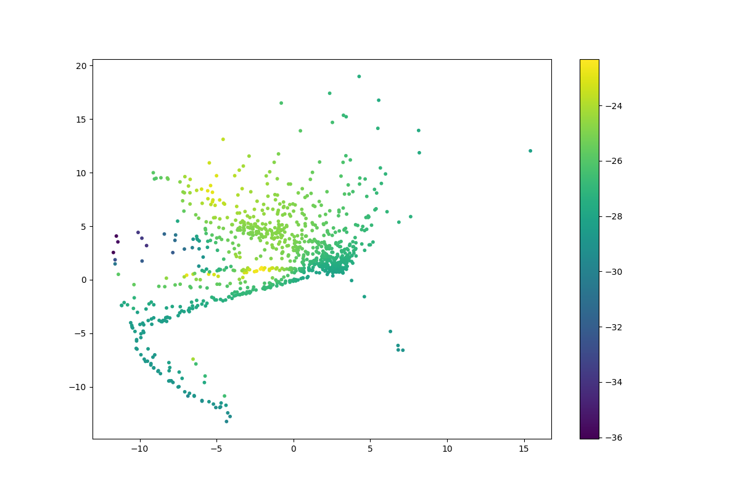
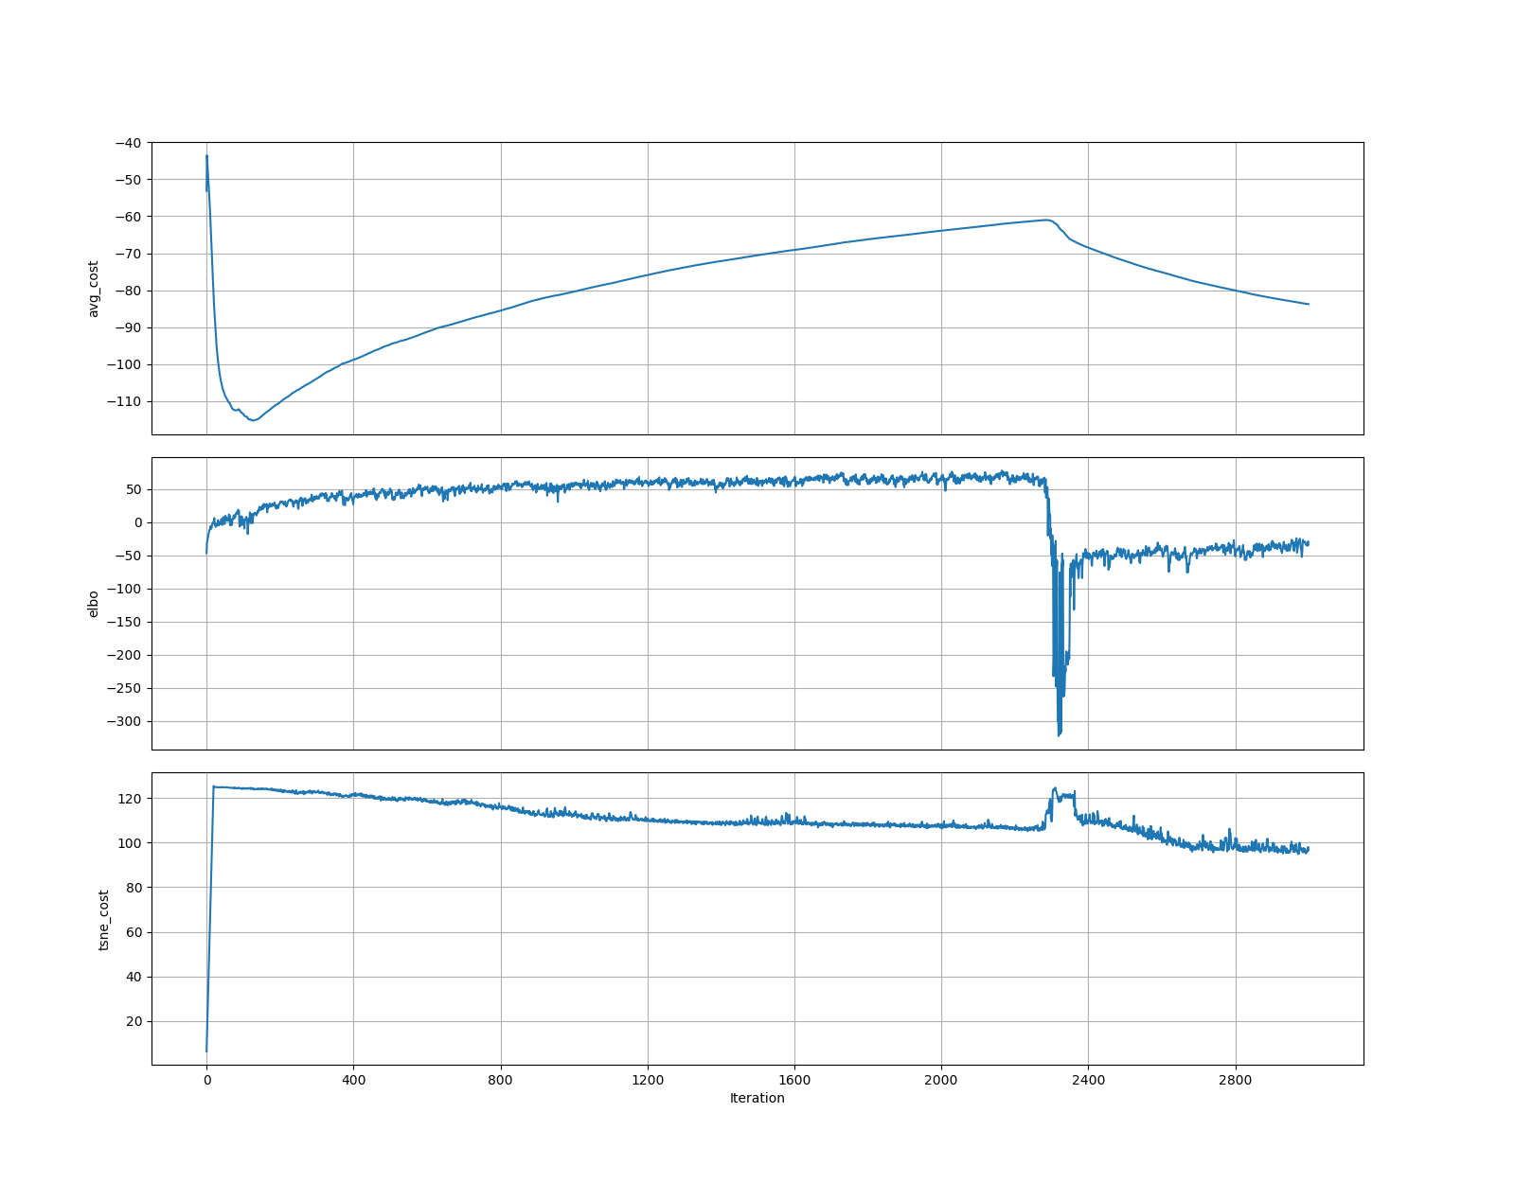
perplexity_10_regularizer_0.001_batch_size_512_learning_rate_0.01_latent_dimension_2_activation_ELU_seed_1_iter_3000_log_likelihood

Slide 10
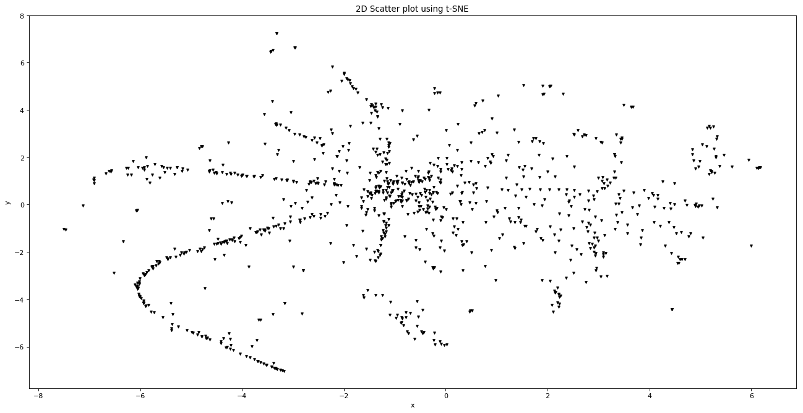
tSNE2D

Slide 11
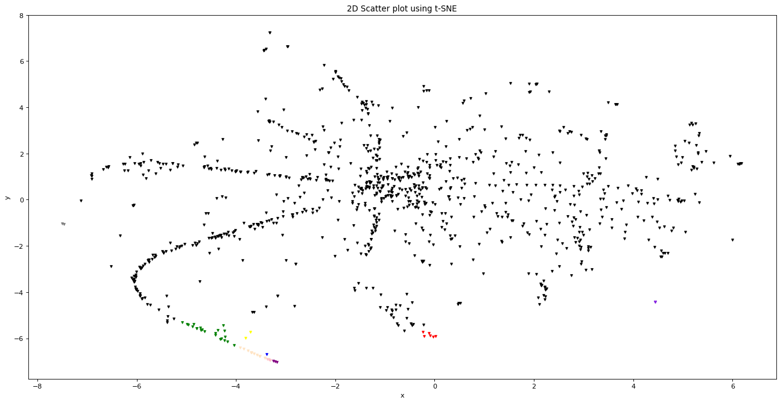
tSNE2D_hierarchal_11clusters(euclidean)

Slide 12
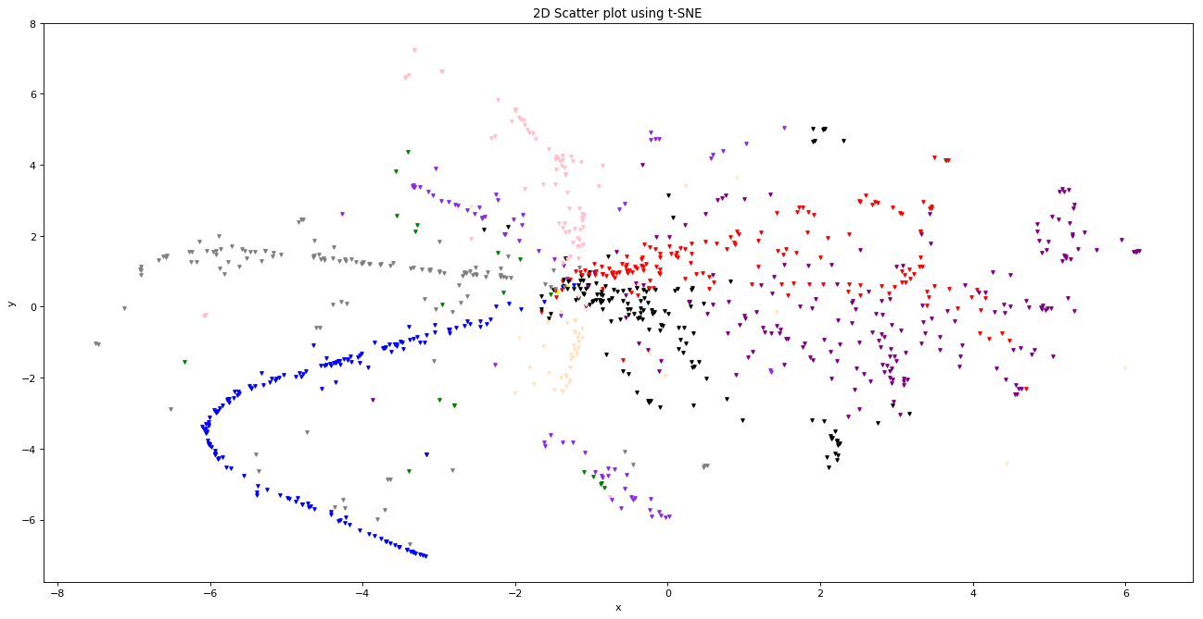
tSNE2D_hierarchal_11clusters(cosine)

Slide 13
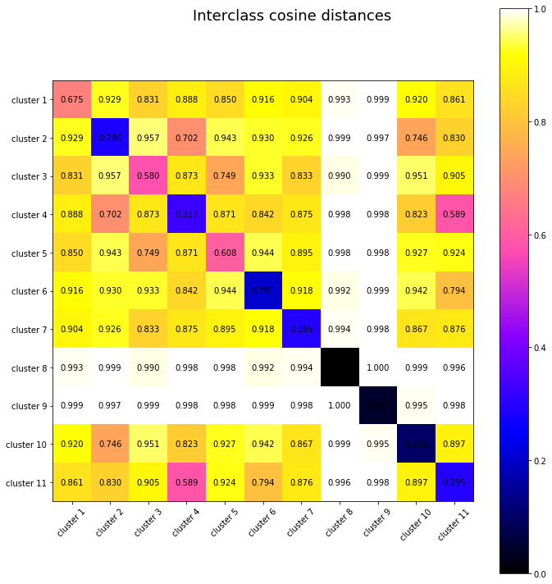
PairwiseSilhouetteCoefficient_hierarchal_11clusters

Slide 14
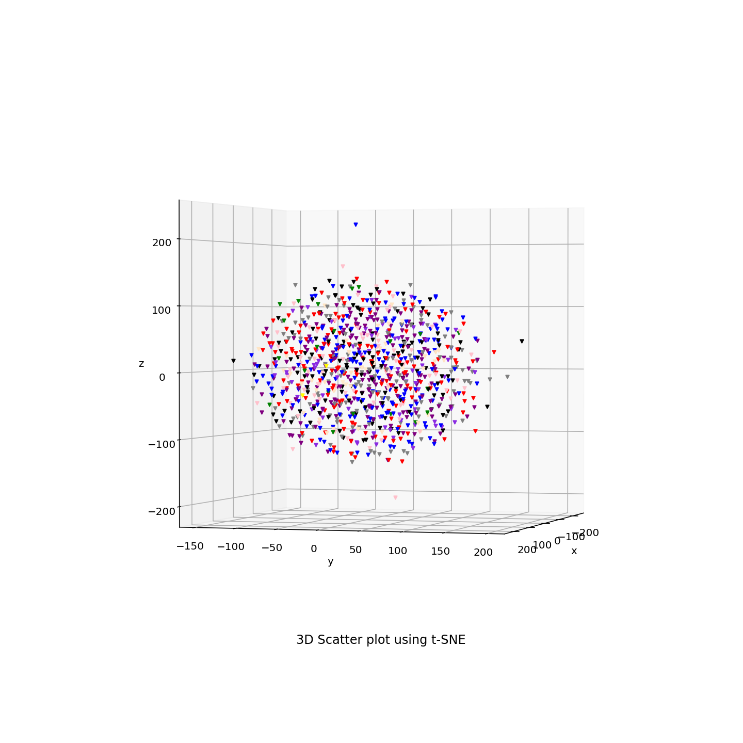
tSNE3D_hierarchal_11clusters(cosine)

