Slide 1
Progress

Slide 2
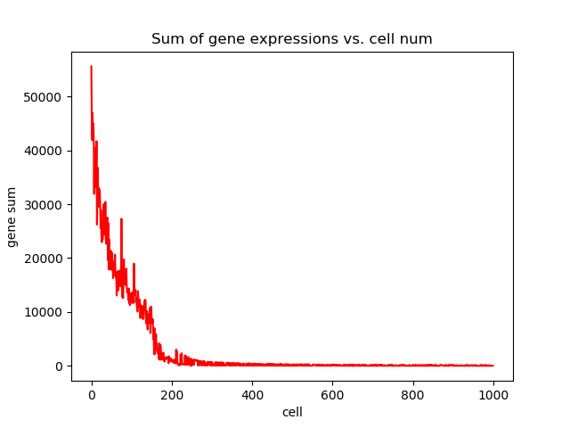
Data: Airway

Slide 3
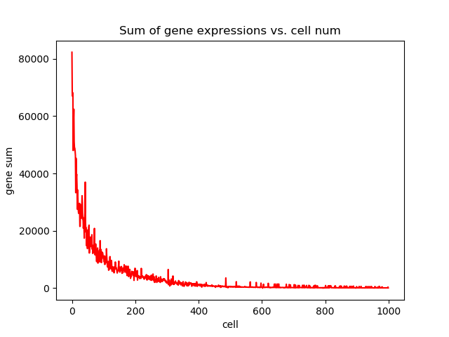
Data: Gland

Slide 4
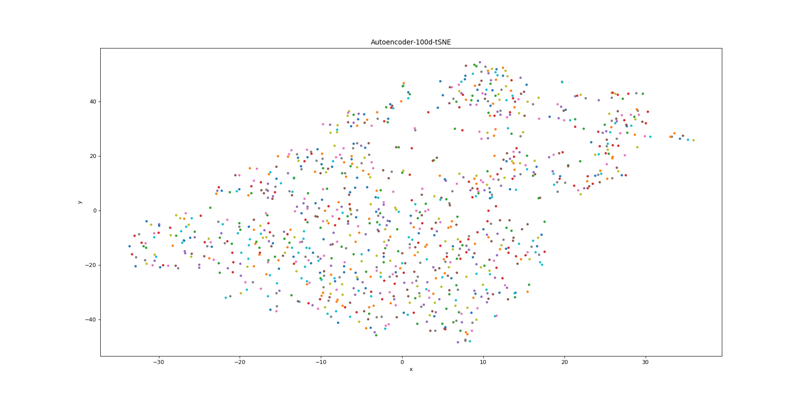

Slide 5
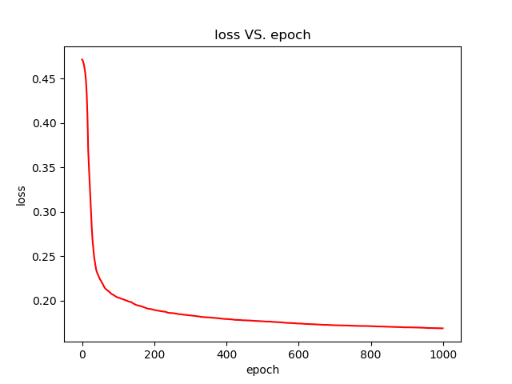

Slide 6
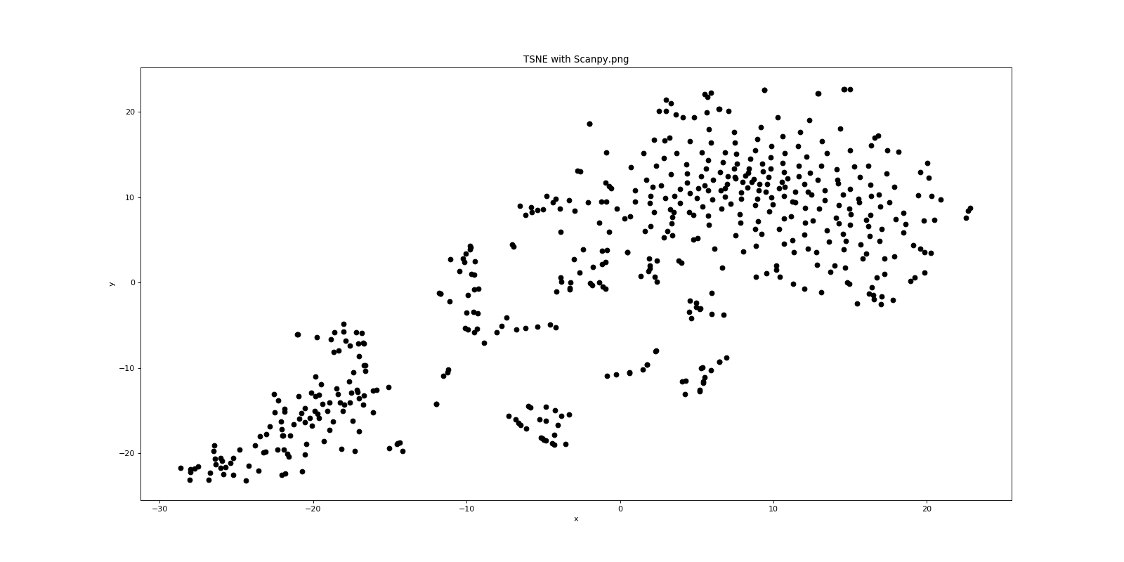
Airway: Min_cells=50 Min_Gene=100

Slide 7
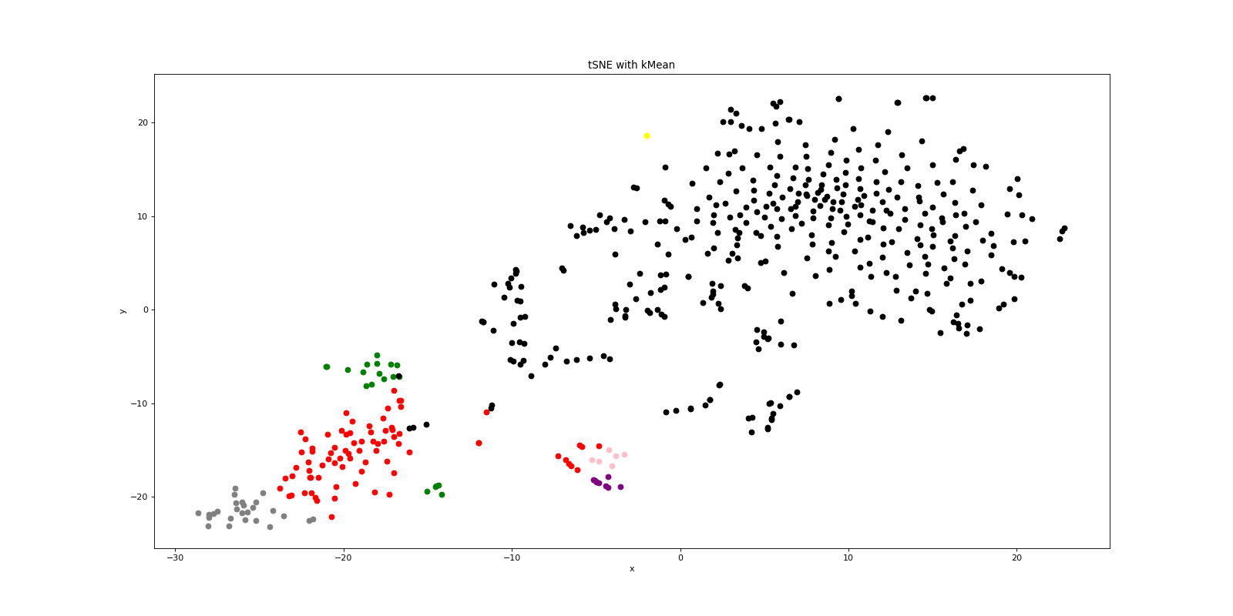
Airway: K-mean: k=7

Slide 8
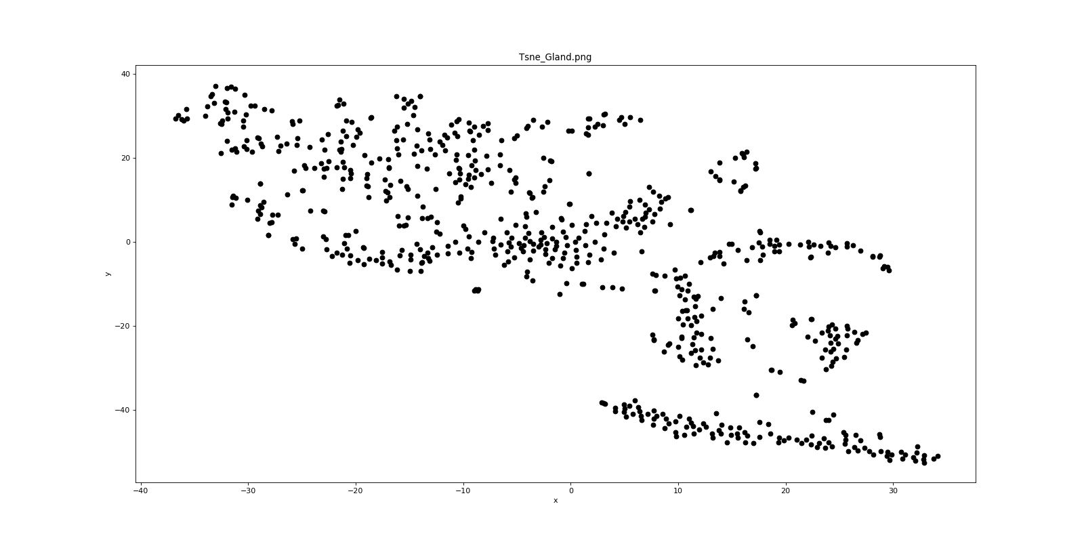
Gland: Tsne

Slide 9
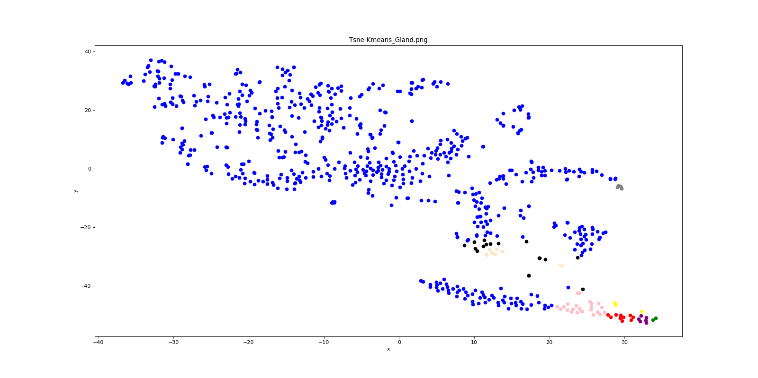
Gland: K-means k=10

Slide 10
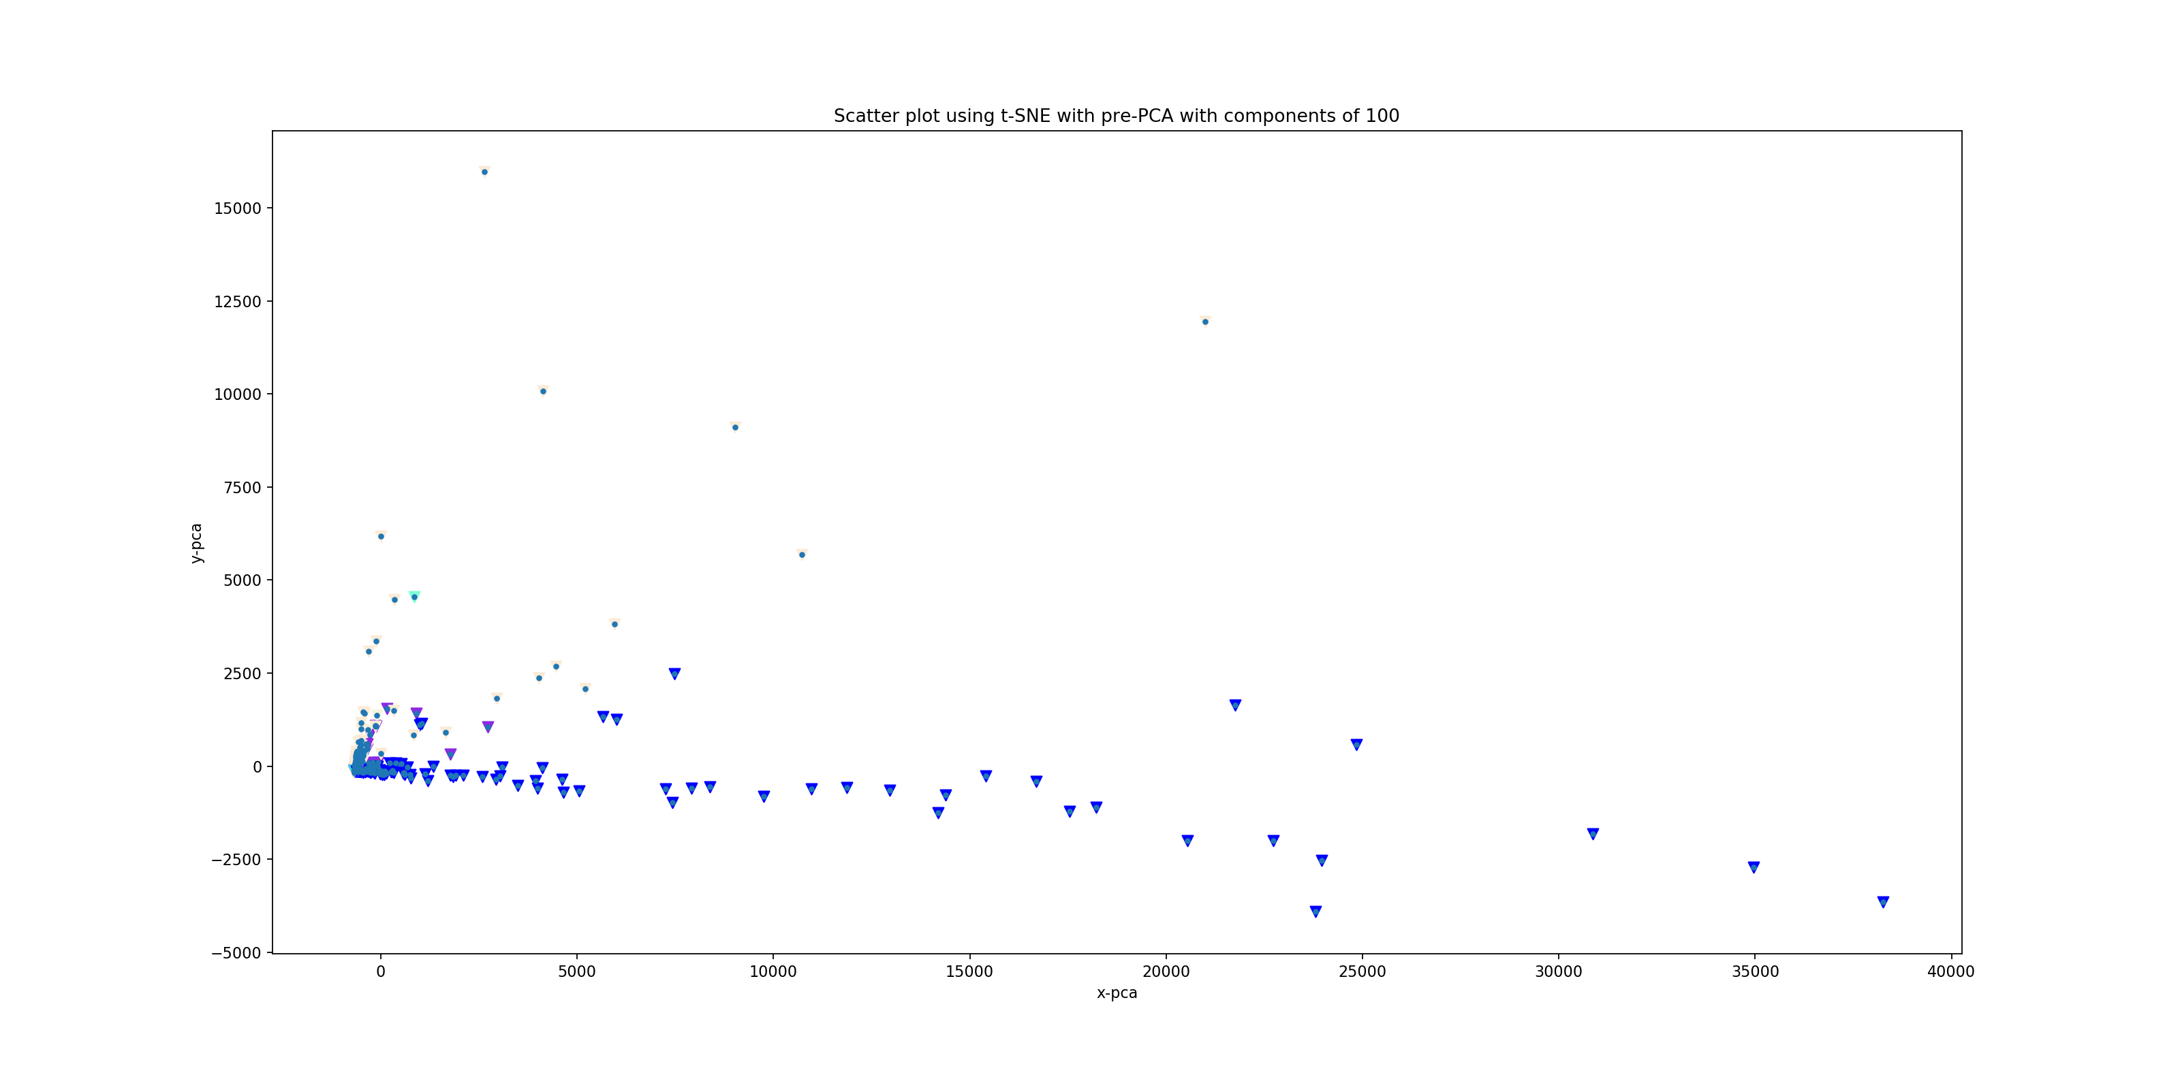
PCA_hierarchal_11clusters(cosine)

Slide 11
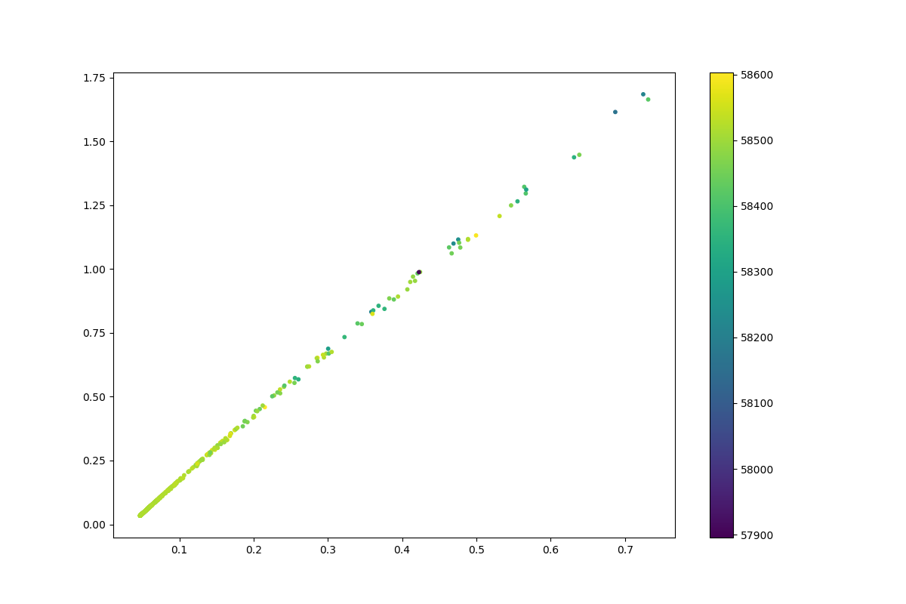
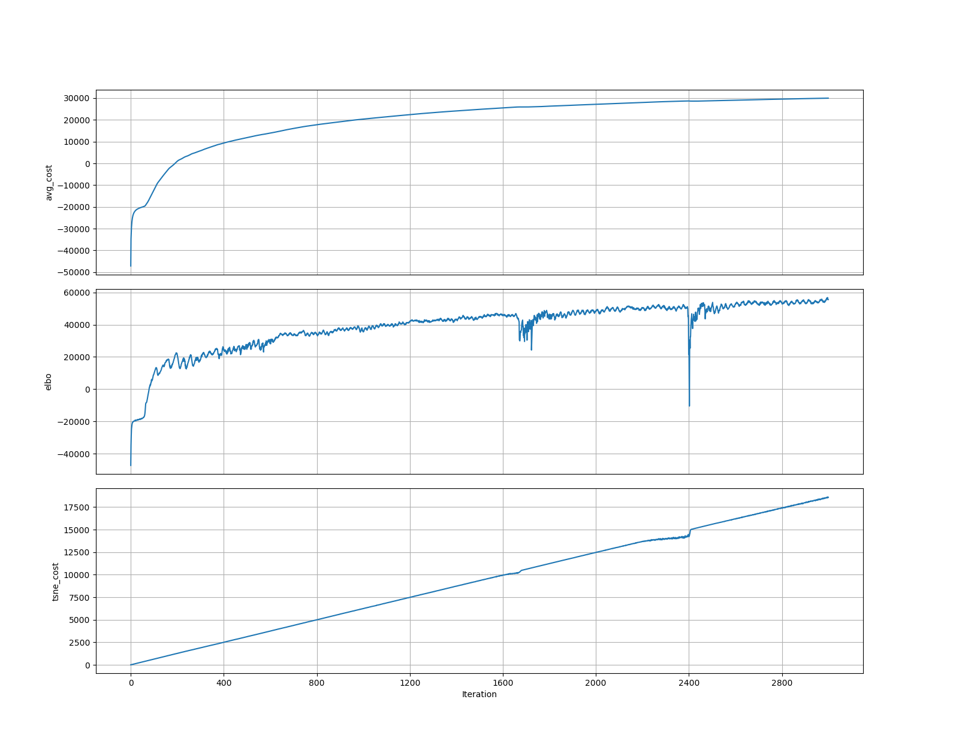
perplexity_10_regularizer_0.001_batch_size_512_learning_rate_0.01_latent_dimension_2_activation_ELU_seed_1_iter_3000_log_likelihood

Slide 12
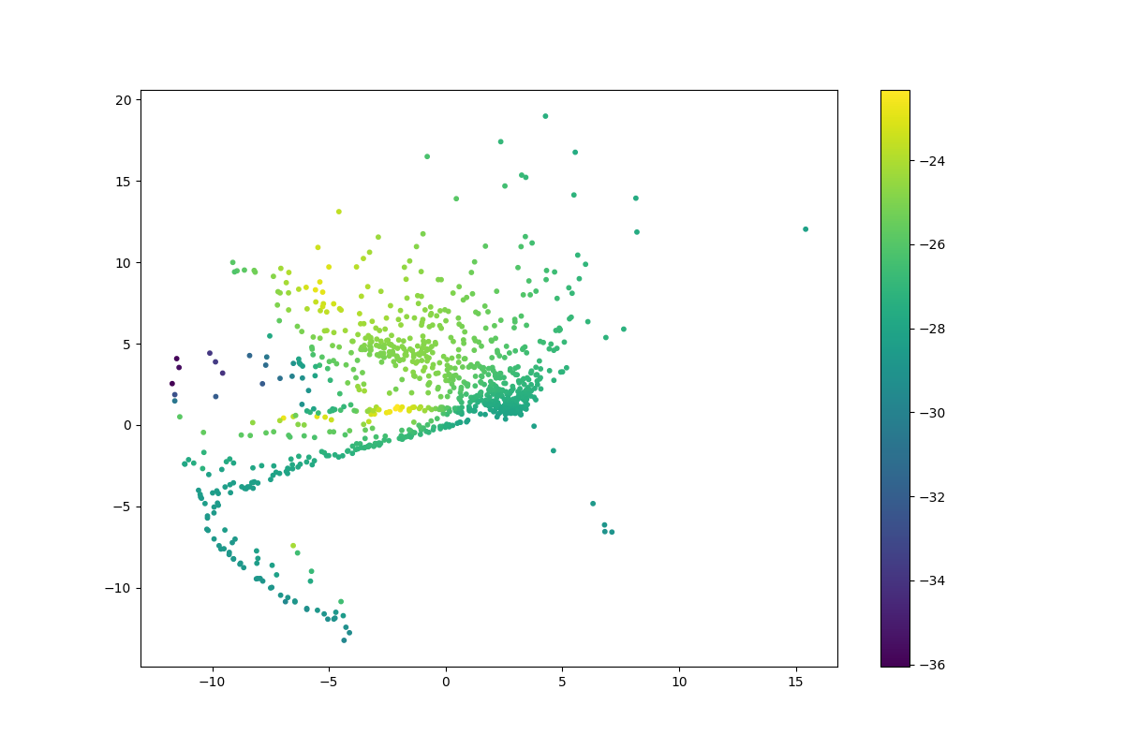
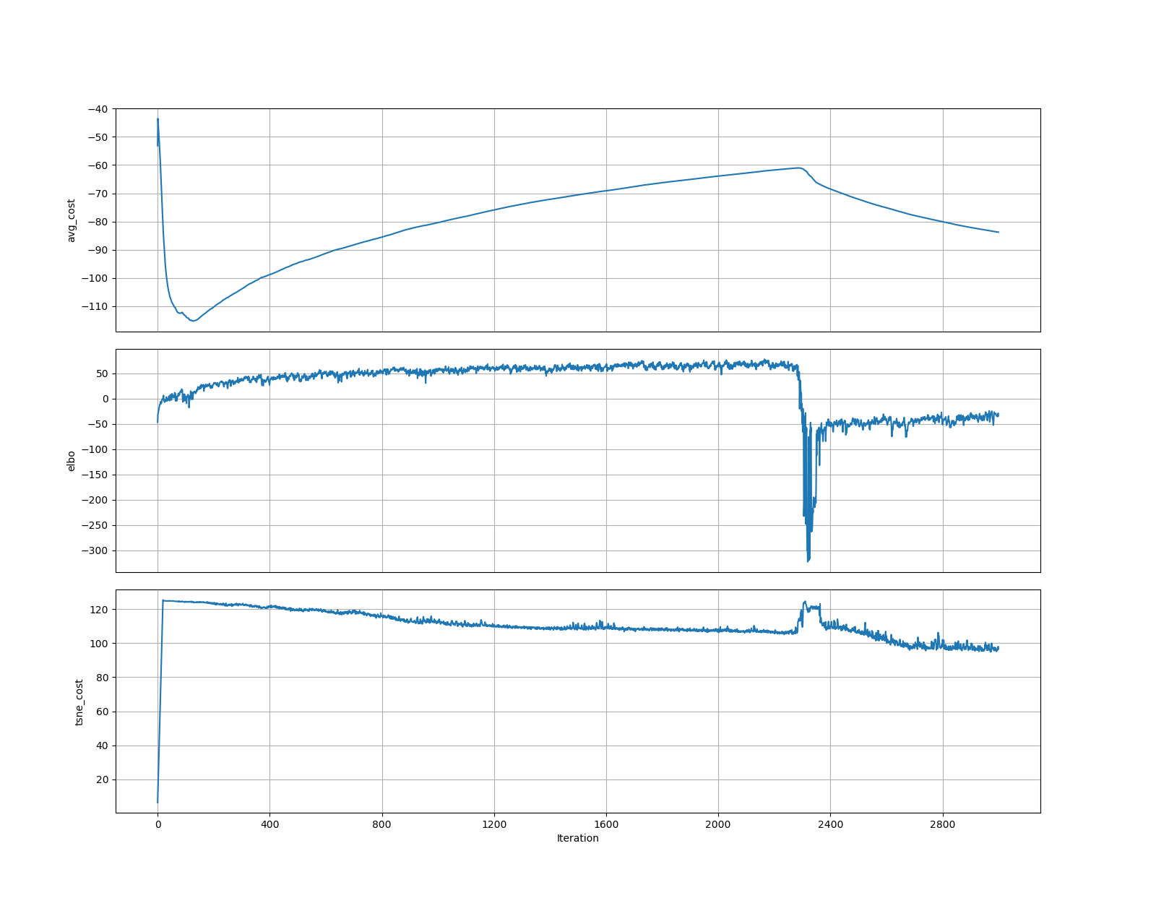
perplexity_10_regularizer_0.001_batch_size_512_learning_rate_0.01_latent_dimension_2_activation_ELU_seed_1_iter_3000_log_likelihood

Slide 13
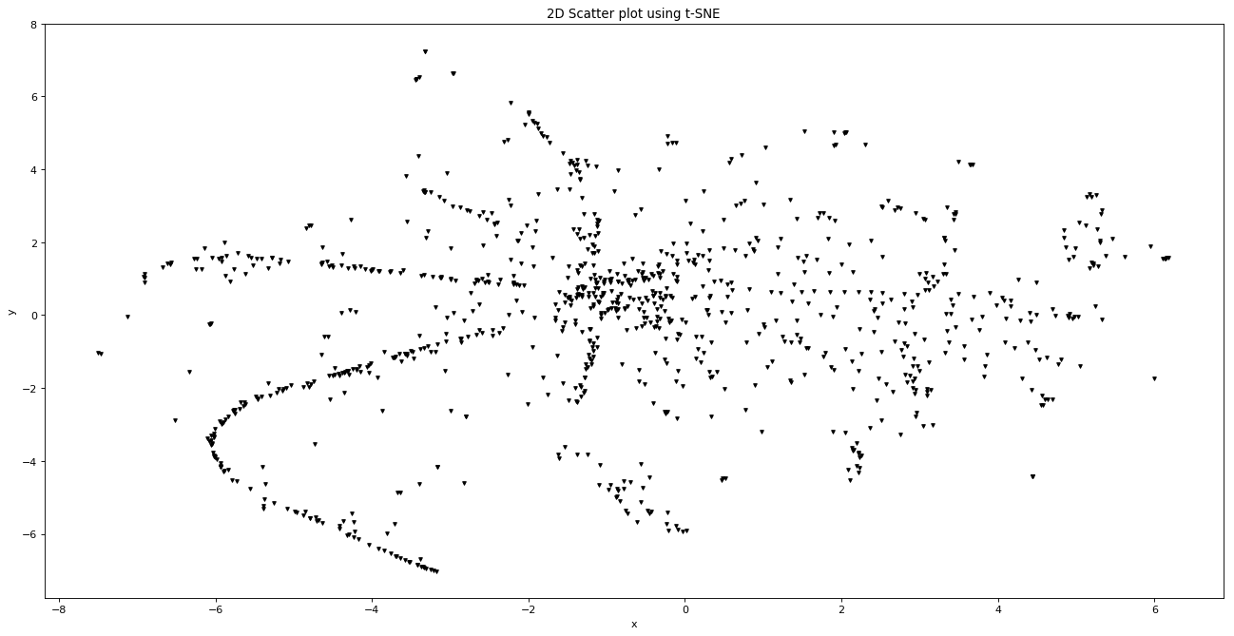
tSNE2D

Slide 14
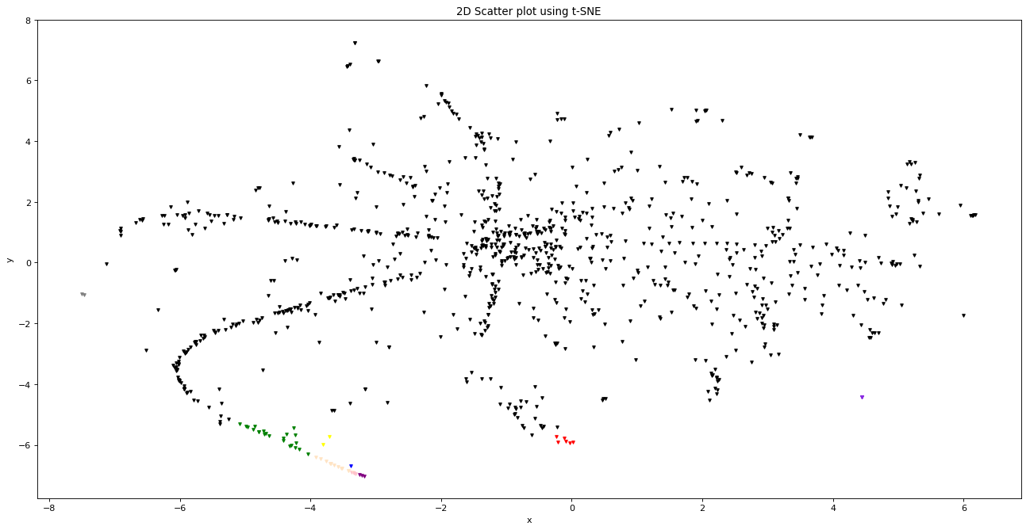
tSNE2D_hierarchal_11clusters(euclidean)

Slide 15
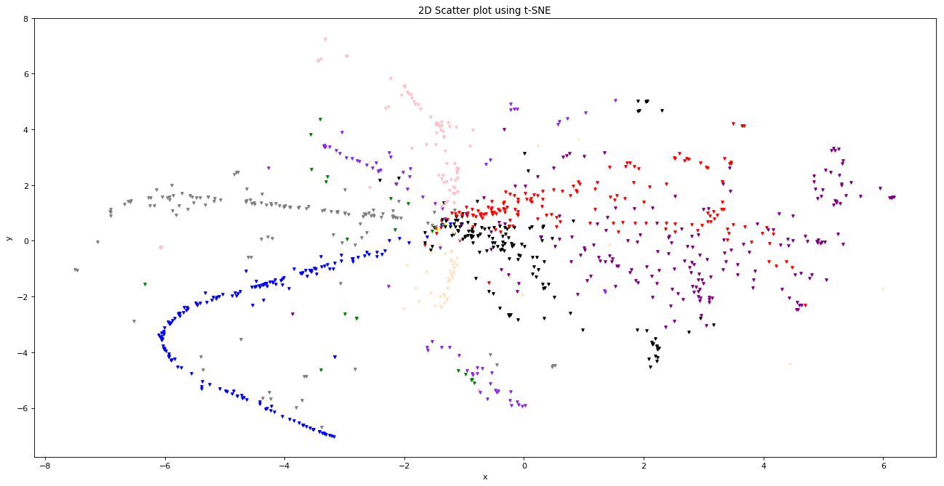
tSNE2D_hierarchal_11clusters(cosine)

Slide 16
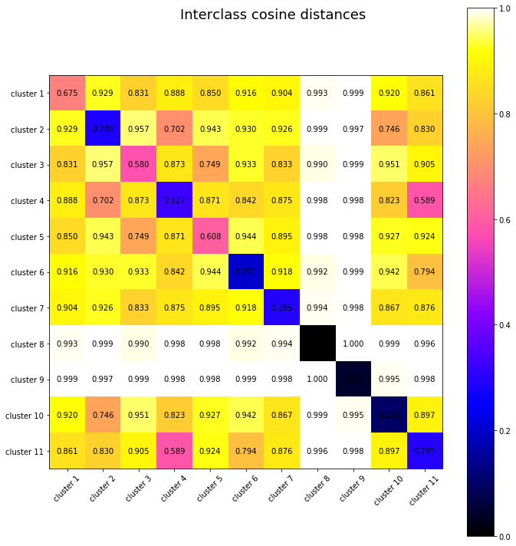
PairwiseSilhouetteCoefficient_hierarchal_11clusters

Slide 17
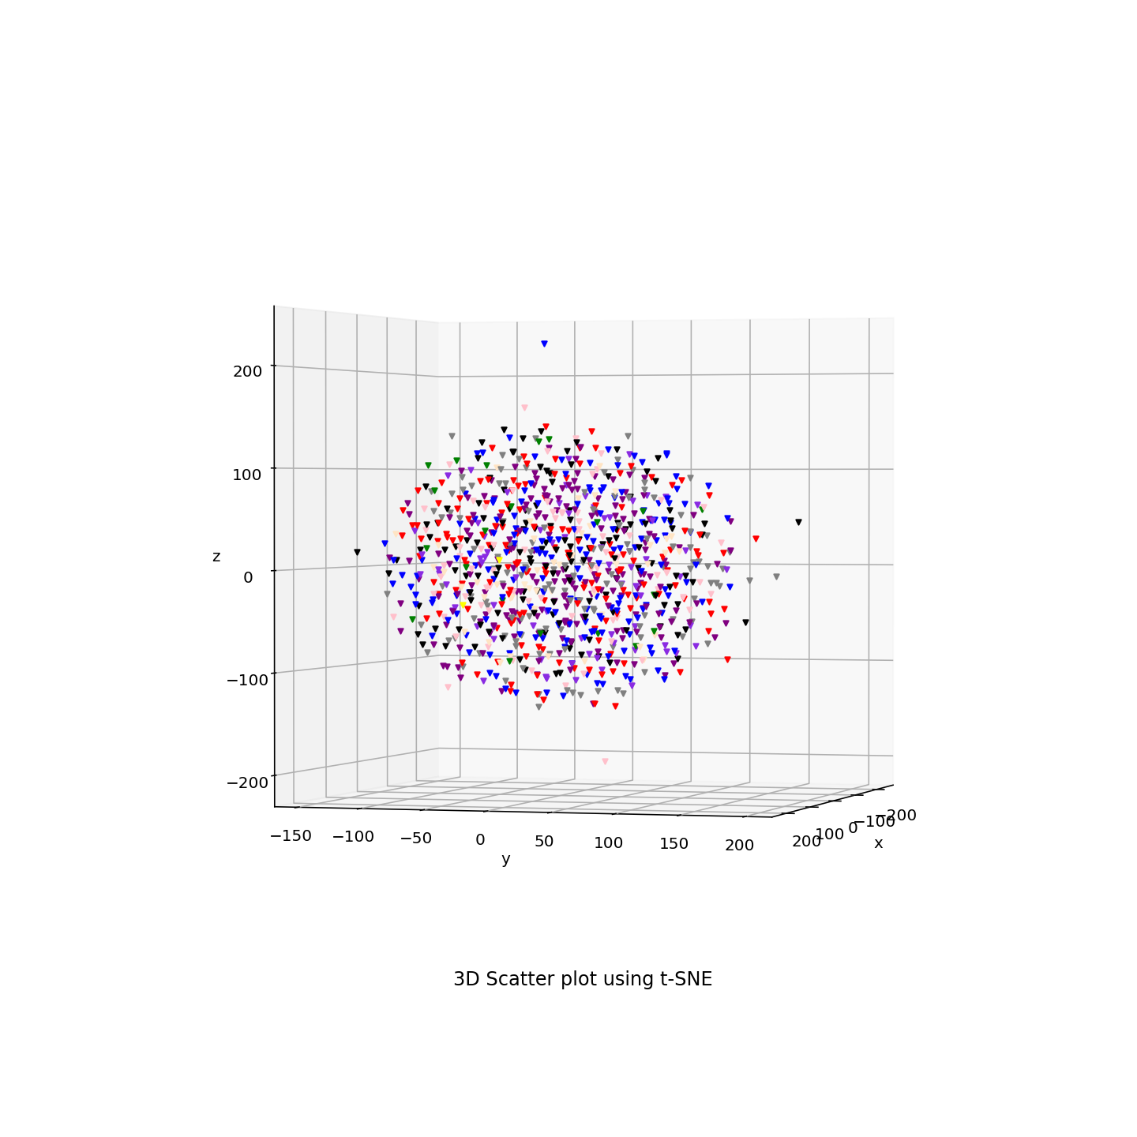
tSNE3D_hierarchal_11clusters(cosine)

