Slide 1
Option Pricing Using UKF & Reservoir Computing
Author: Ziyang Ding
May 20, 2020

Slide 2
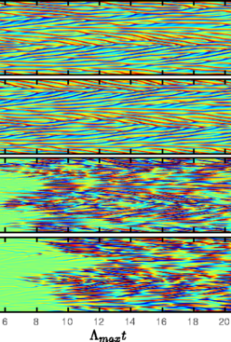
Reservoir Computing (ESN: Echo State NN)
Reservoir Computing methods have shown significant power in numerically learning chaotic dynamic system.
Echo State Neural Network is one of the reservoir computing method that had been previously used for Stock Price modeling.
It has a very LARGE randomly initialized latent state transition that generate myriad different possible dynamics.
Has only been studied under deterministic context rather than in a Bayesian framework. Therefore, none has studied using ESN as dynamic model within a Kalman Filter.

Slide 3
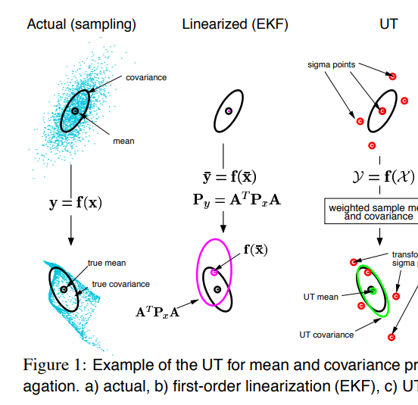
UKF (Unscented Kalman Filter
Different from EKF, UKF uses unscented transform to replace Taylor expansion for better transformed distribution approximation, which is still Gaussian
Unscented Transform has shown capable of achieving 3rd order Taylor expansion approximation accuracy.

Slide 4
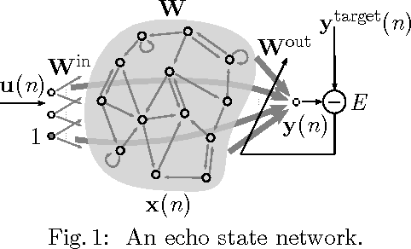
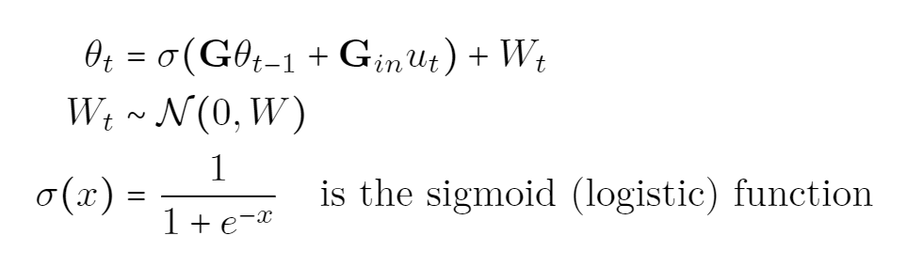
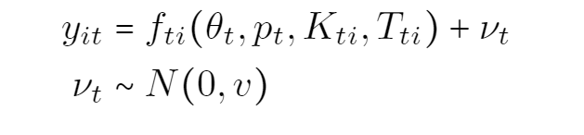
Model
Just like the GARCH(1,1) EKF that I did in for final project, this research uses ESN(Echo State NN) to replace GARCH(1,1); And it uses UKF to replace EKF.
State transition (ESN)
Observation Black Scholes

Slide 5
Parameter Inference
Parameter to infer (G, G_in, W, v)
This time, I must use EM algorithm, as conjugacy is impossible to find (Distribution on sparse matrix with spectral radius < 1, involves too many random matrix theory which is impractical)

Slide 6
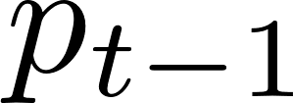
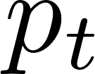
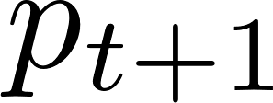
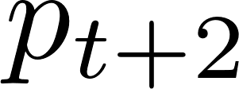
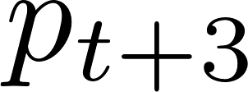
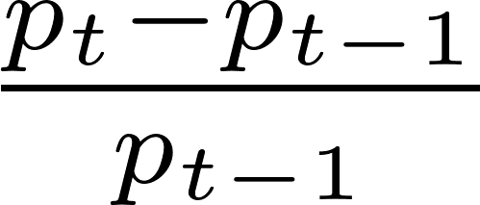
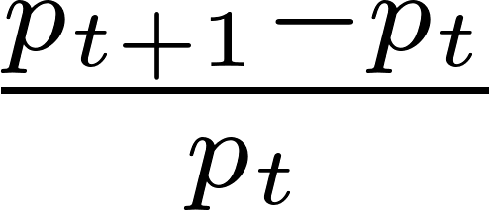
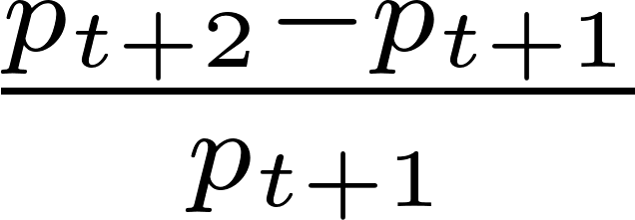
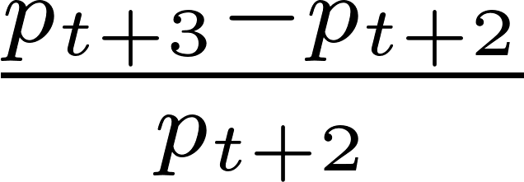

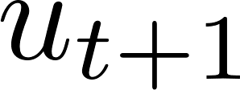
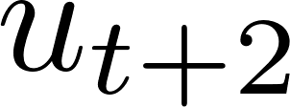
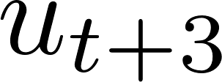
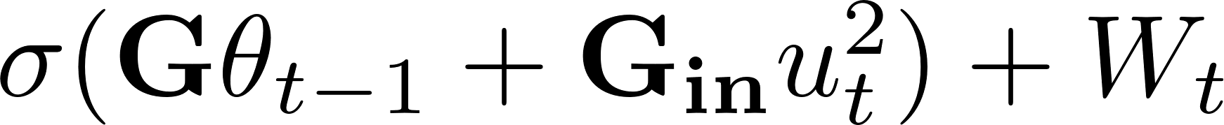
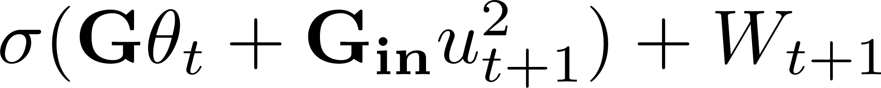
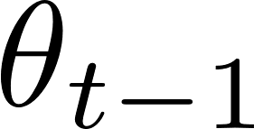
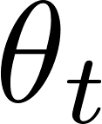
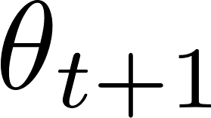
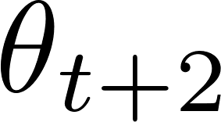
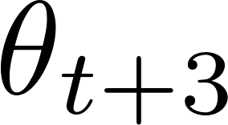
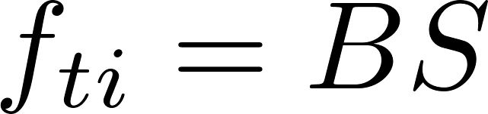
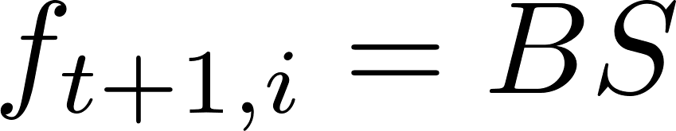
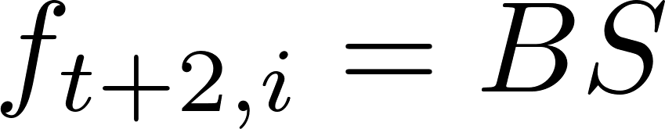
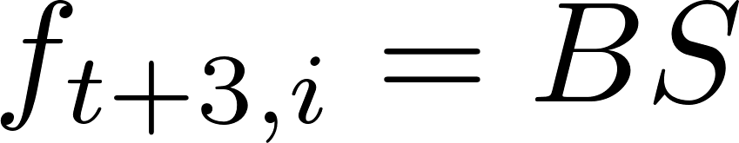
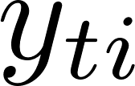
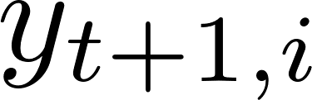
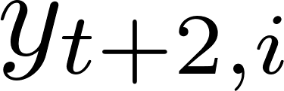
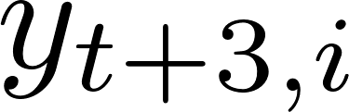
Model Illustration

Slide 7
Current Progress
In the past one week, I finished:
Developing all the derivation and theory
Wrote out about 8-9 pages of Latex research specific
Finished first round of literature review
Finishing all the python code
Currently, I am:
Finishing some bugs in my code
Countering a computation instability problem

