Slide 1
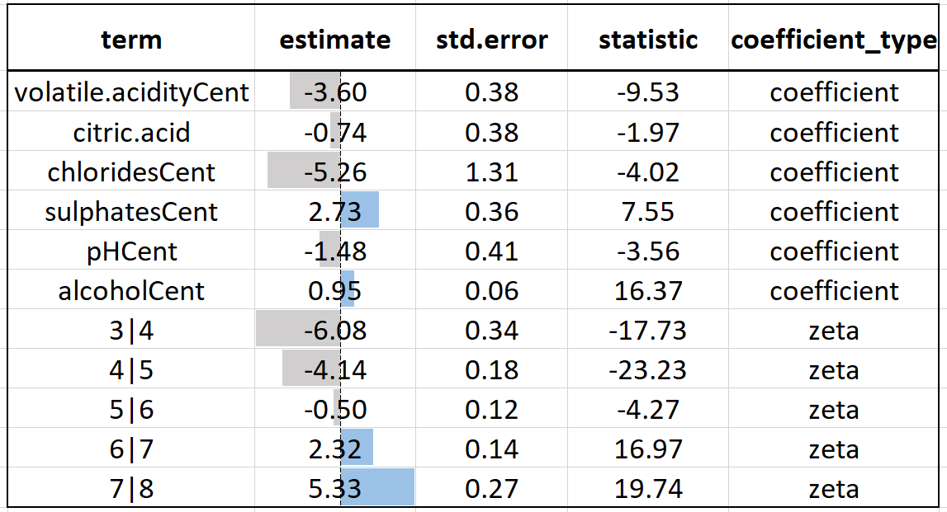
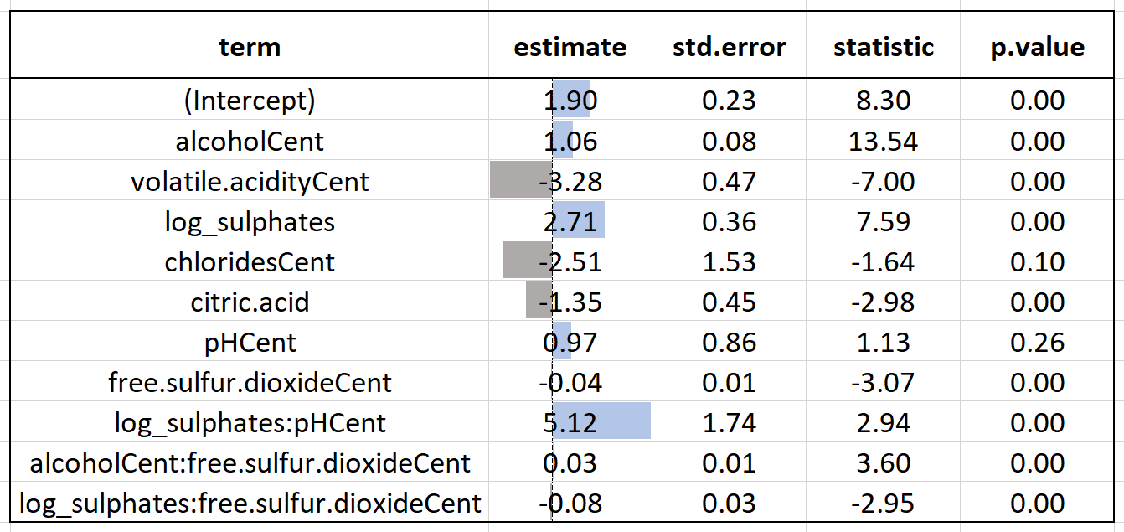
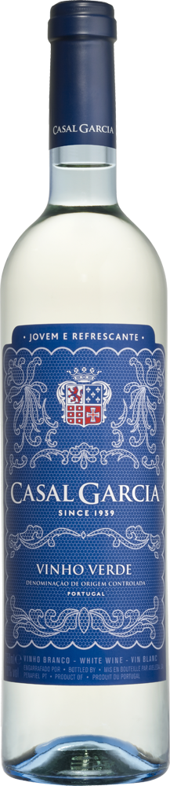
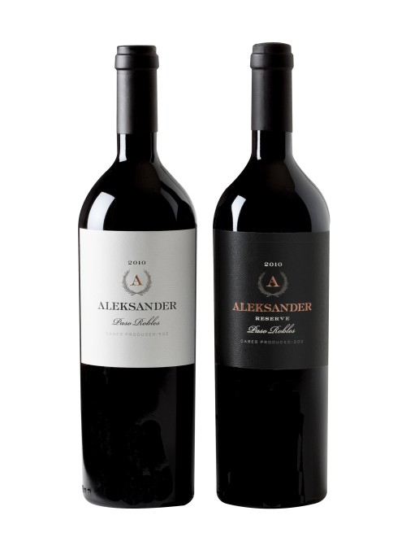
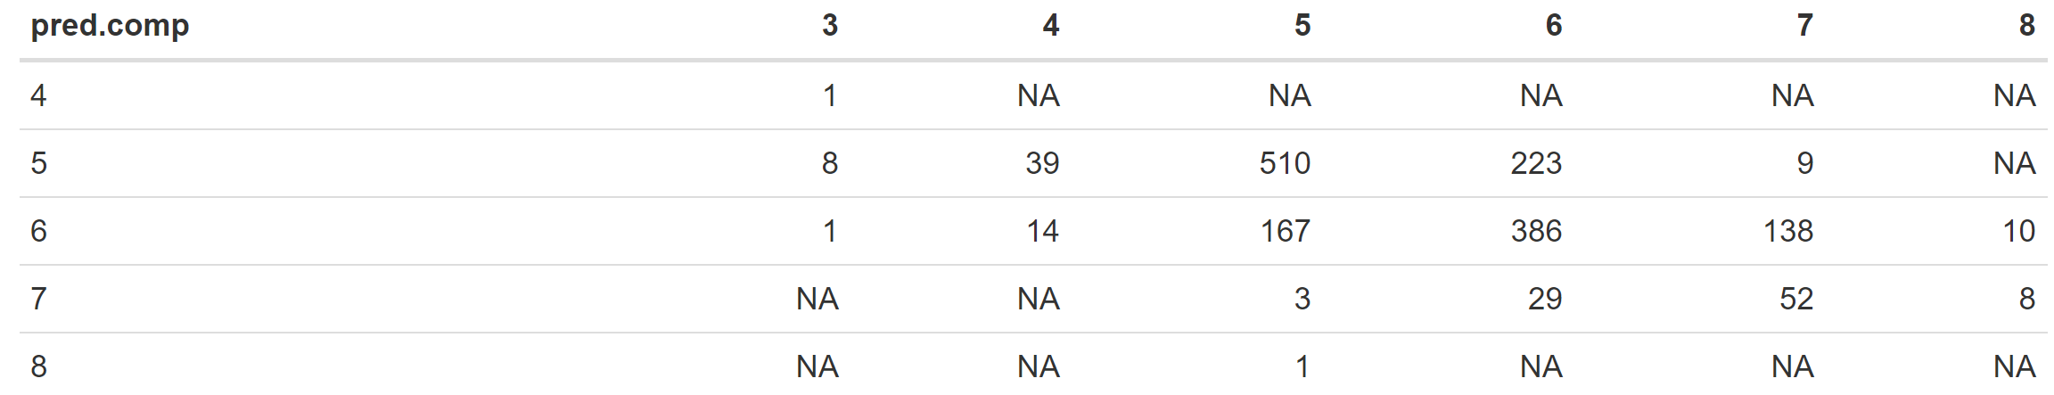
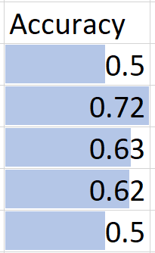
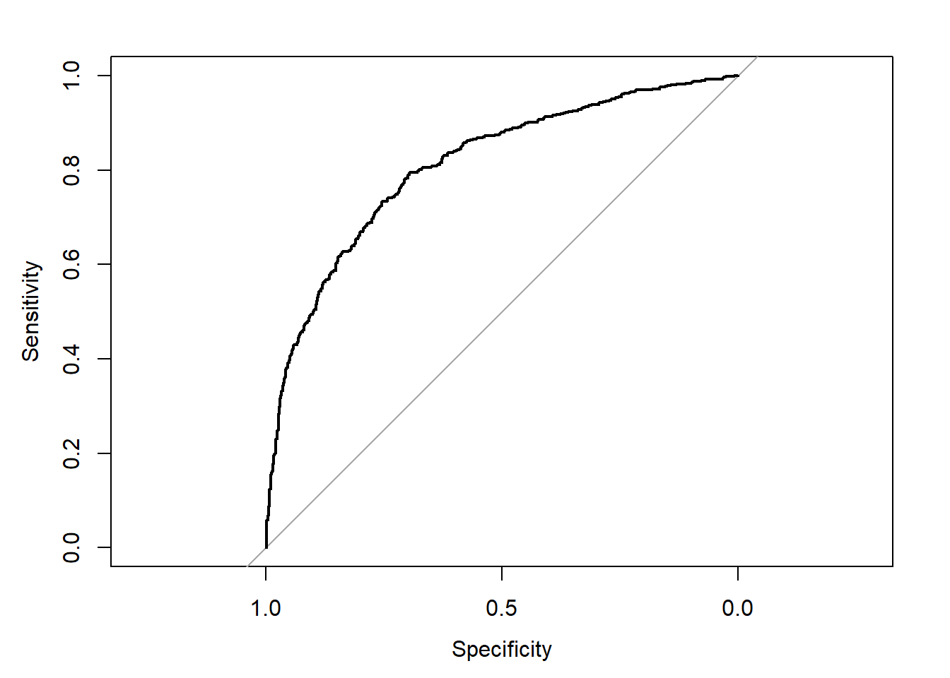
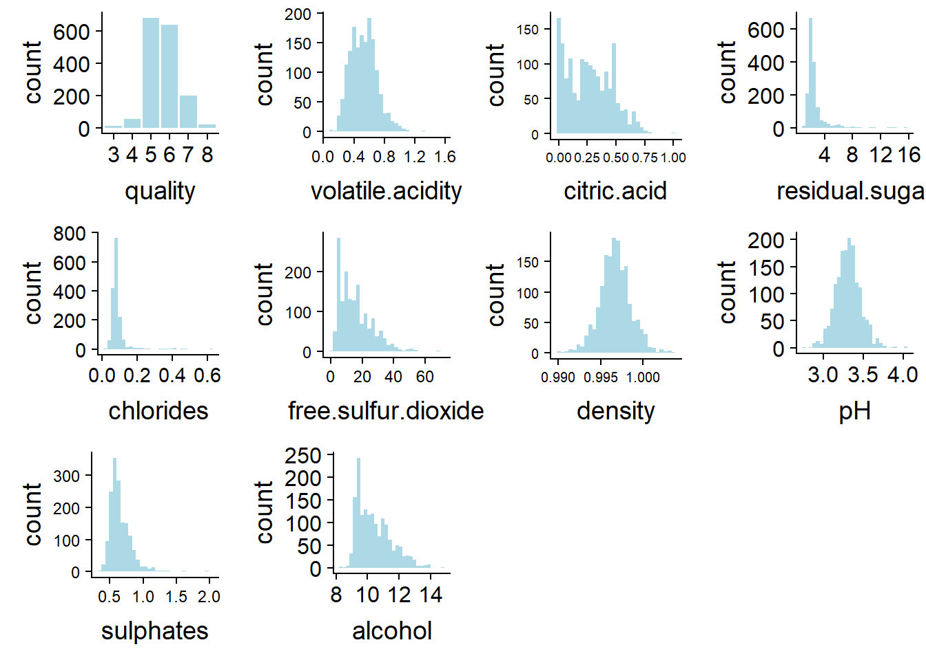
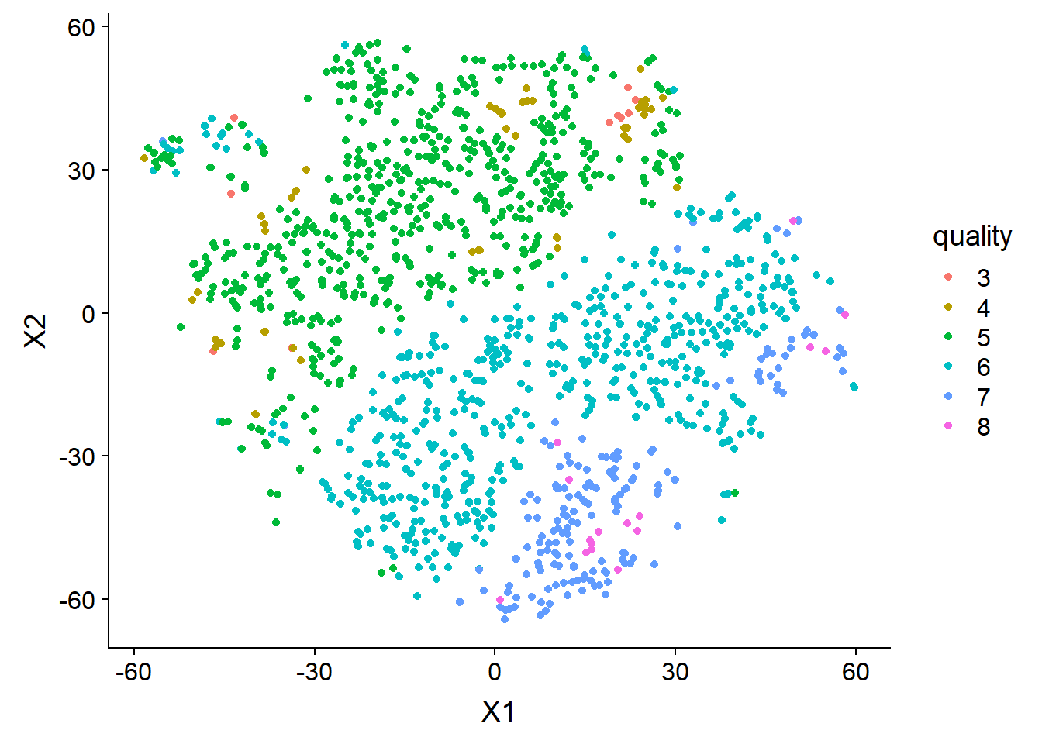
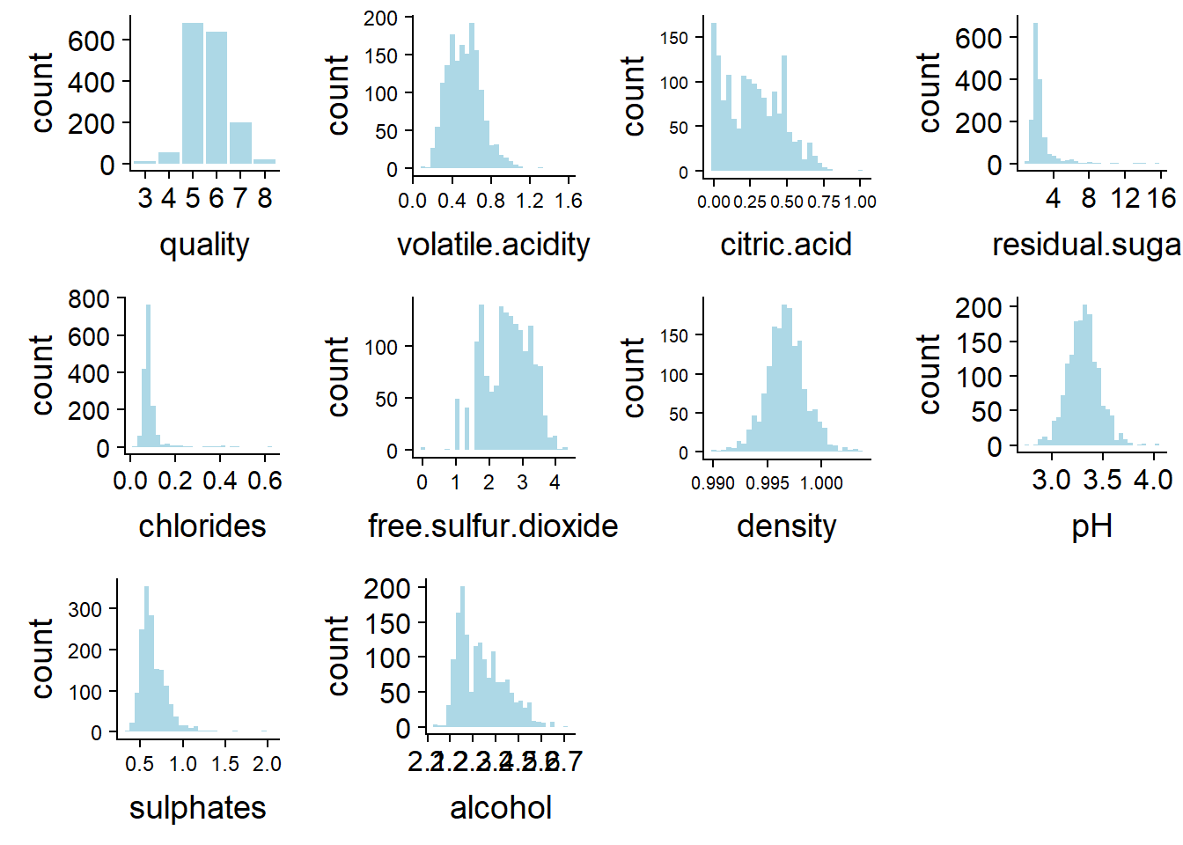
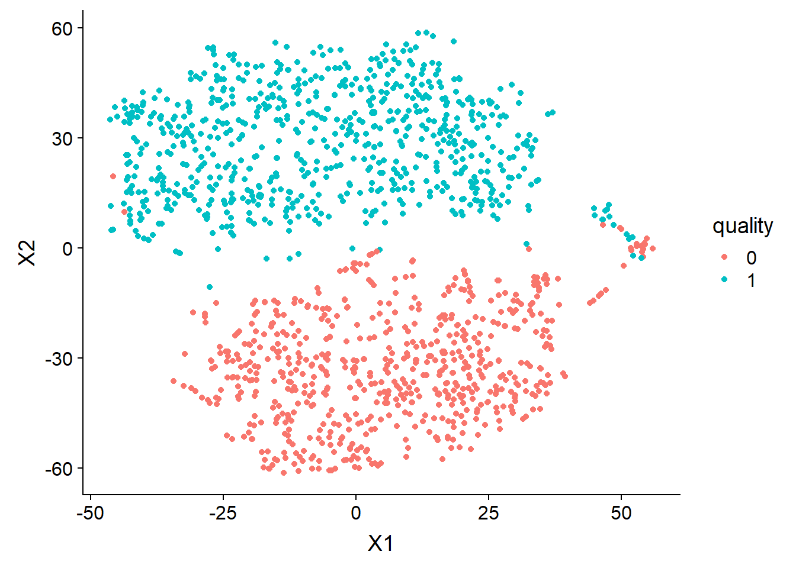
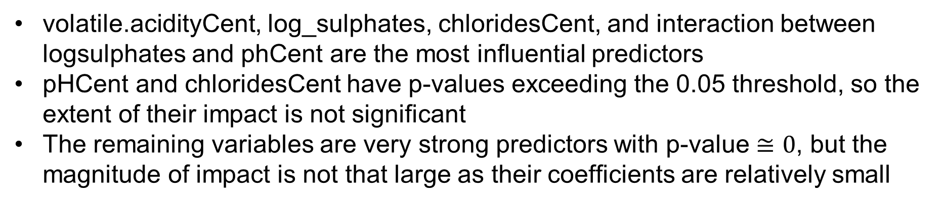
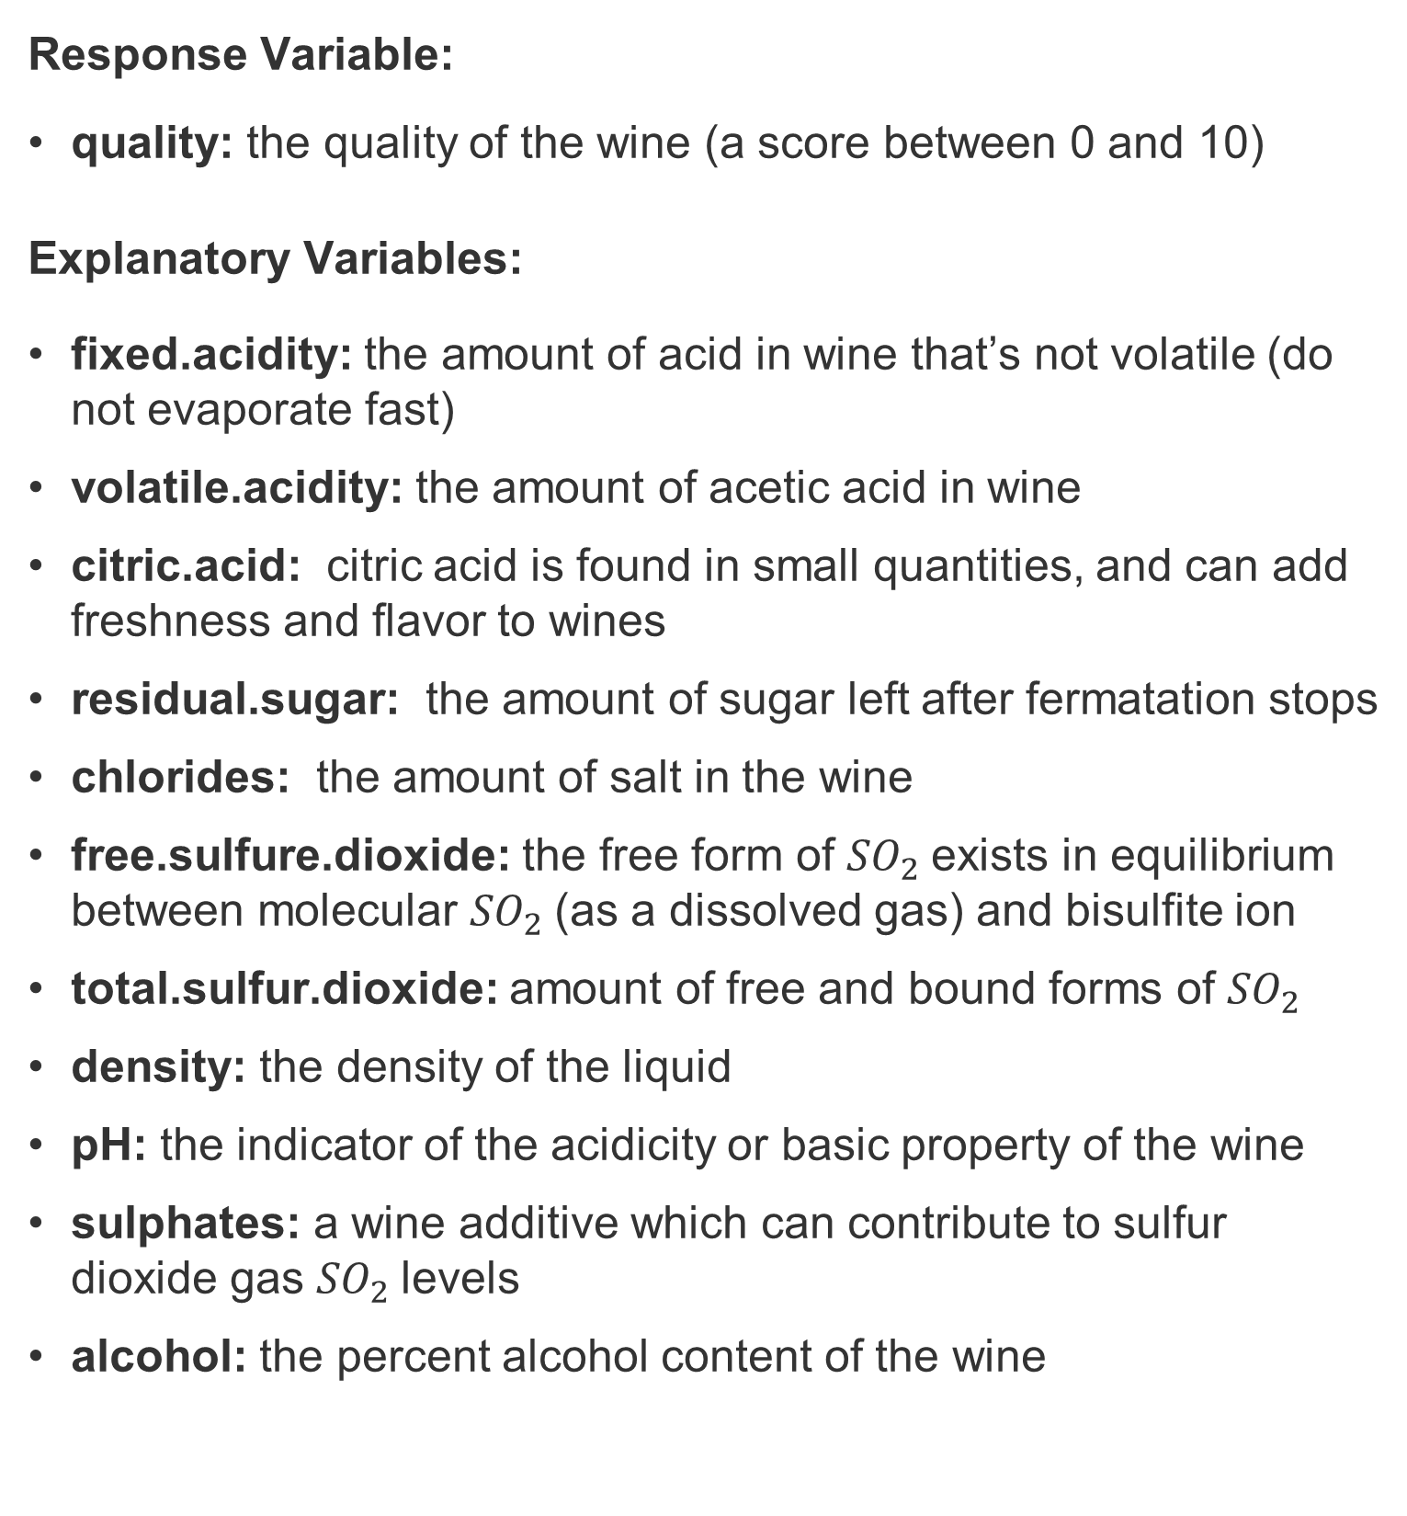
O
rdinal Regression Model Detail
Modeling Wine Quality by Data Mining from Physicochemical Properties
L
ogistic Regression Model Detail
Bob Ding, Lynn Fan, Alice Jiang
Dec. 15th, 2018
What Makes a Good Glass of Wine
Project Goal: Explanation.
To identify variables that are important in explaining variation in the response.
We are interested in researching what factors contribute to the quality of wine for different types of red vinho verde from Portugal.
What makes a good glass of wine? How do wine experts evaluate whether a wine satiates human palettes? We picked red vinho verde from Portugal as the wine of interest for our research. The data set in this research was used to predict the quality of wine for future wine certification, complementary to human wine tasters, in the paper we cited. We believe that this data set can also be used to analyze what chemical factors are attributable to the final rating of wine on a scale of 0 to 10. Understanding what makes a good wine may shed light on future directions for chemical methods that could improve/preserve wine quality.
ChloridesCent, Volatile.acidity, sulphatesCent are very significant and influential predictors
Model meets all assumptions in statistics are big and p-values are small
volatile.acidityCent, log_sulphates, chloridesCent, and interaction between logsulphates and phCent are the most influential predictors
pHCent and chloridesCent have p-values exceeding the 0.05 threshold, so the extent of their impact is not significant
The remaining variables are very strong predictors with p-value $≅0$, but the magnitude of impact is not that large as their coefficients are relatively small
Why Proportional Odds & Logistic Regression Model
O
rdinal Regression Model Output
Proportional odds model gives more specific quality level interpretation, which is more informative for professionals in the wine industry.
Logistic regression indicates whether the wine is ‘good’ or ‘bad’. This simple and straightforward information is more useful for potential customers,
L
ogistic Regression Model Output
Proportional Odds
for the professionals
Logistic Regression
for the consumers
Data Explanations & Explorations
Model not predicting quality = 1, 2, 3, 9,10 as no (few) raw data available
Model not predicting well at quality = 4, 8 because of dominance
Model predicting well at quality = 5, 6, 7, as bigger data size available
Overall accuracy: 59.47%; Class 5 accuracy: 72.23%
Response Variable:
quality: the quality of the wine (a score between 0 and 10)
Explanatory Variables:
fixed.acidity: the amount of acid in wine that’s not volatile (do not evaporate fast)
volatile.acidity: the amount of acetic acid in wine
citric.acid: citric acid is found in small quantities, and can add freshness and flavor to wines
residual.sugar: the amount of sugar left after fermatation stops
chlorides: the amount of salt in the wine
free.sulfure.dioxide: the free form of ${SO}_{2}$exists in equilibrium between molecular ${SO}_{2}$(as a dissolved gas) and bisulfite ion
total.sulfur.dioxide: amount of free and bound forms of ${SO}_{2}$
density: the density of the liquid
pH: the indicator of the acidicity or basic property of the wine
sulphates: a wine additive which can contribute to sulfur dioxide gas ${SO}_{2}$levels
alcohol: the percent alcohol content of the wine
From the ROC curve and AUC calculation, we can see the curve is close to the top left corner, area = 0.81.
This shows that the logistic model can distinguish between good and not good quality, so this is a pretty good model.
Most variables are normally distributed
residual.sugar, chlorides, and sulphates are slightly skewed to the right
free.sulfur.dioxide and alcohol have an obvious rightly skewed distribution
citric.acid at first appears to have a bimodal distribution, because there are some wines with zero citric acid. Based on data definition, we know it is possible for wines to have citric acid of 0.
The variables in yellow plots are logged sulphates; log transformation is used to improve model fit
Data dominance in class 5, 6. This explains why prediction at 5, 6 is better
Overall, the dataset is a good dataset for the ordinary regression model, as the data structure suggests
O
rdinal Regression Model Inference
The t-SNE plot shows that the logistic regression the raw dataset has been a good model in differentiating good and bad wine
Conclusions
Limitations
Alcohol level, acetic acid level, and sulfate level are the strongest explaining variables for quality with largest magnitude of test statistic.
During the modeling process, we tried to log transform sulfate level as we discovered nonrandom patterns in binned residual plot for sulphatesCent, but they still exist after log transformations. We believe that the patterns are partly caused by mid-quality wines dominating the model.
The model makes valuable predictions for mid-quality wines as the accuracy rate exceeds 70% for quality=5, 6 and 7. As they are the most common occurring quality for vinho verde, professionals might find this model useful.
Our project goal is explanation: to identify the chemical factors that make significant contribution to the quality of wine
As quality is an ordinal variable, we used logistic regression model and ordinal logistic regresison model for our research, serving customers and wine professionals, respectively
Two models lead to the same conclusion, that for vinho verde wine produced in Portugal, alcohol level, acetic acid level, and sulfate level are very strong explaining factors
Citric acid level and free sulfur dioxide level also contribute to the variation in quality, though not as influential
The sample data has wine with quality mostly ranging from 4 to 7. For future uses, it is very important not to extrapolate beyond this quality range, or the model will not give reliable explanations
In both models, there are some slightly non-random patterns for the binned residual plots for a few variables, which requires care and possible future analysis – we did not conduct further improvements as they are beyond our knowledge learned in class
Model should also be tested on larger and more comprehensive datasets and more chemical factors can be included for future modeling
L
ogistic Regression Model Inference
Alcohol level indicates fermentation process. So it has positive effect.
Sulfates help preserve freshness. So it has positive effect.
Volatile acetic acid leads to a sour taste of vinegar, so it has a negative coefficient.
The assumptions are met except a few observations with high leverage, but they have low Cook’s distance values, so they do not have a big impact on the predicting power of model.
Alcohol
Volatile acetic acid
Sulfate
References:
Vinho Verde. (2018, September 20). Retrieved from https://en.wikipedia.org/wiki/Vinho_Verde
Cortez, P., Cerdeira, A., Almeida, F., Matos, T., & Reis, J. (2009). Modeling wine preferences by data mining from physicochemical properties. Decision Support Systems,47(4), 547-553. doi:10.1016/j.dss.2009.05.016
Alcohol
Volatile acetic acid
Sulfate
Alcohol
Volatile acetic acid
Sulfate

