Slide 1
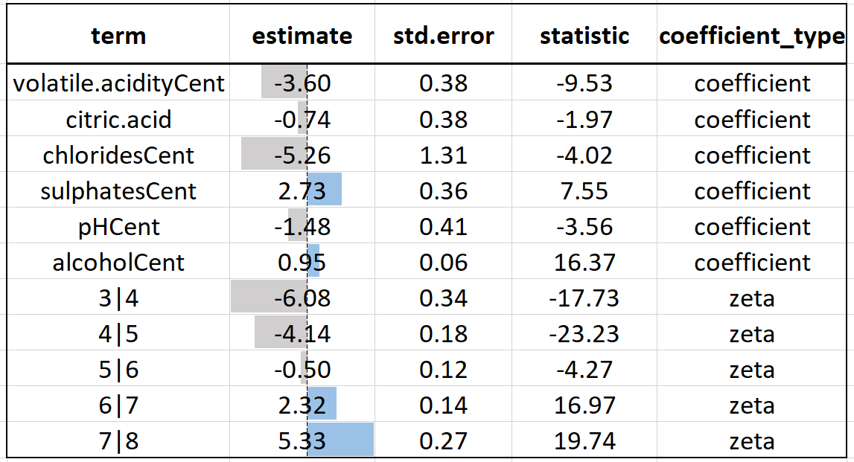
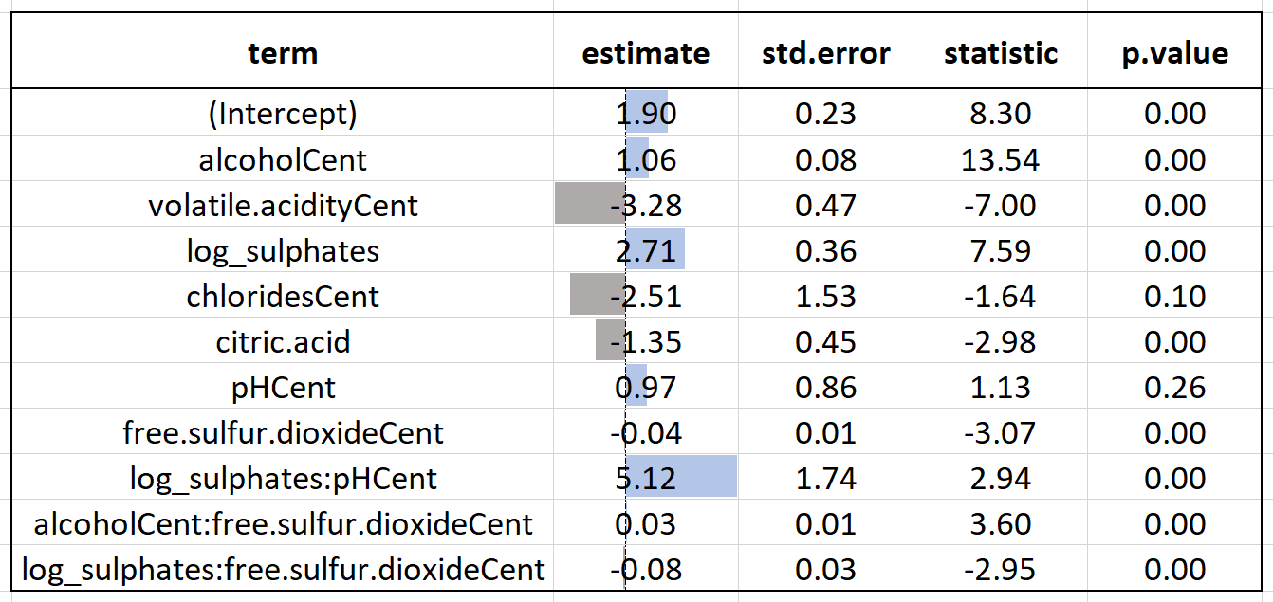
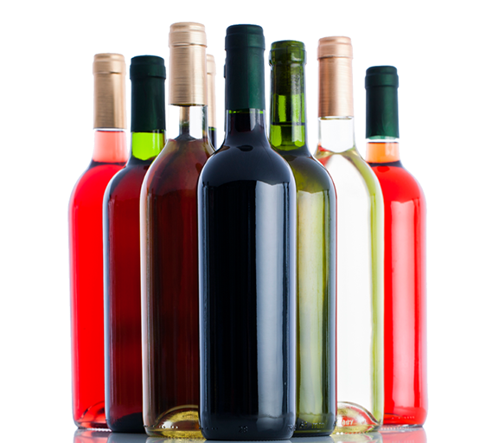
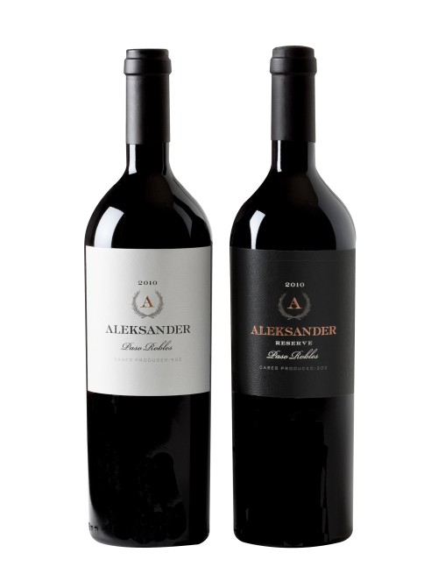
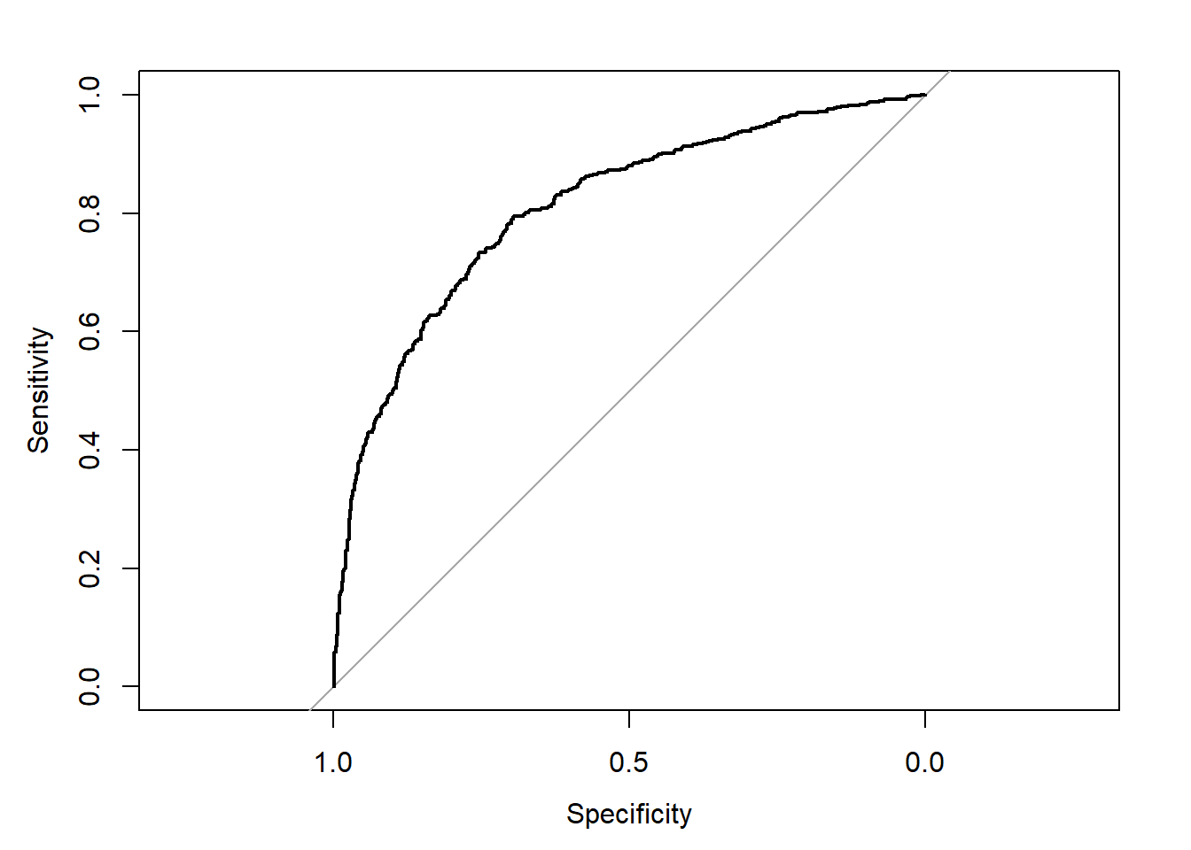
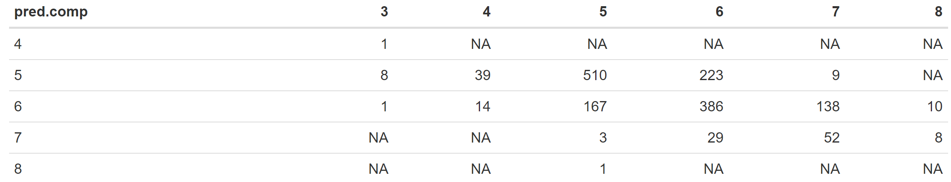
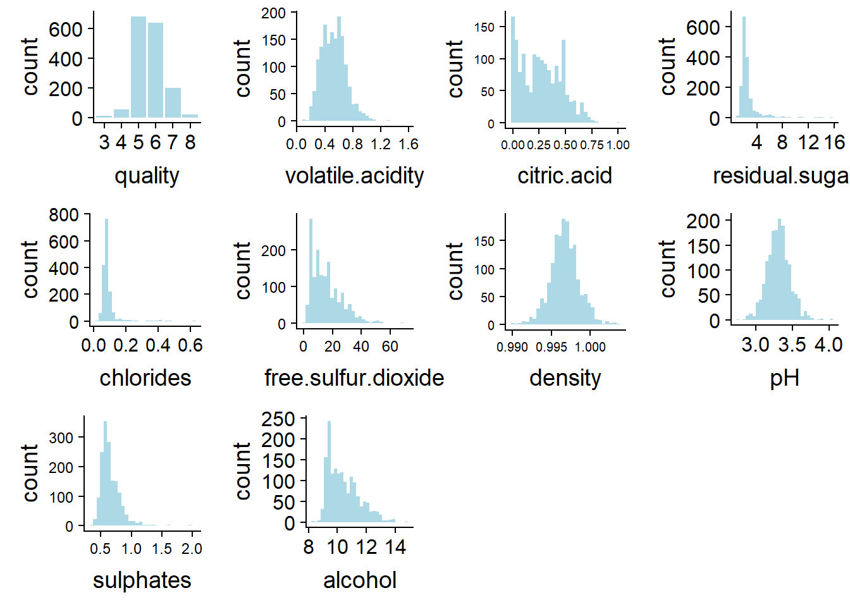
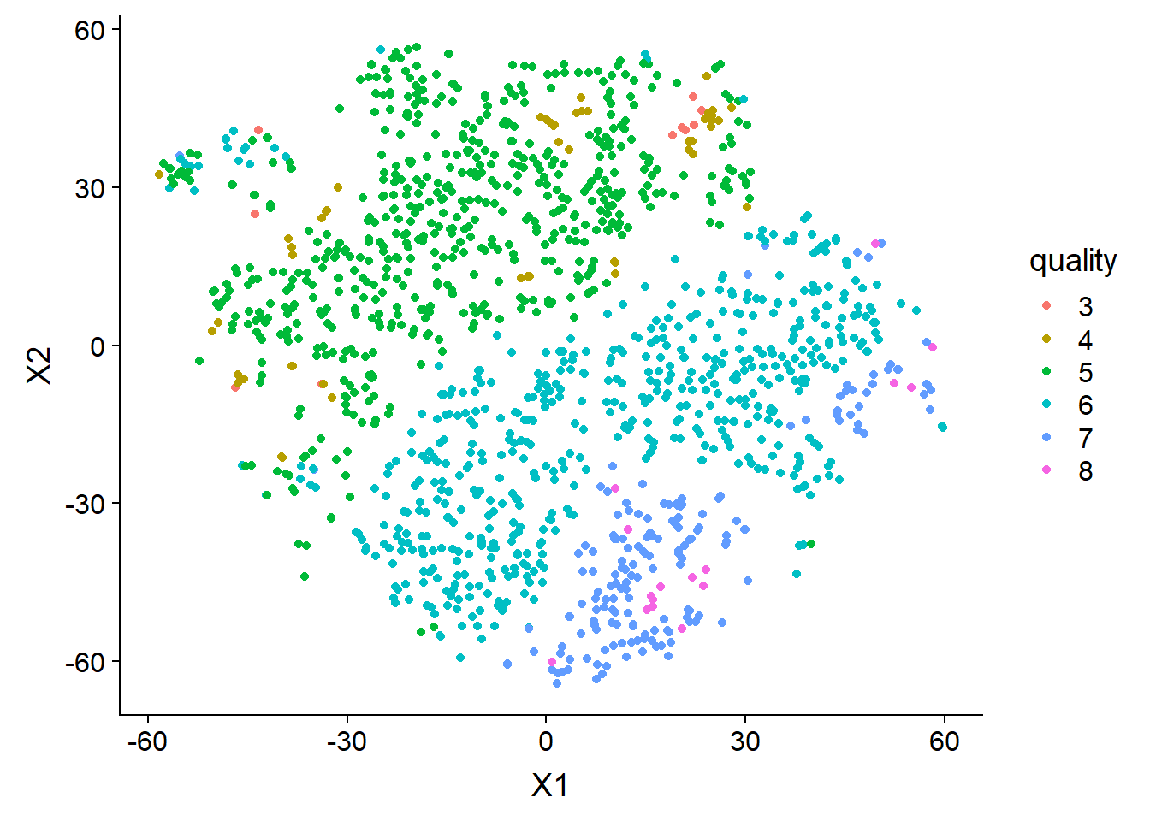
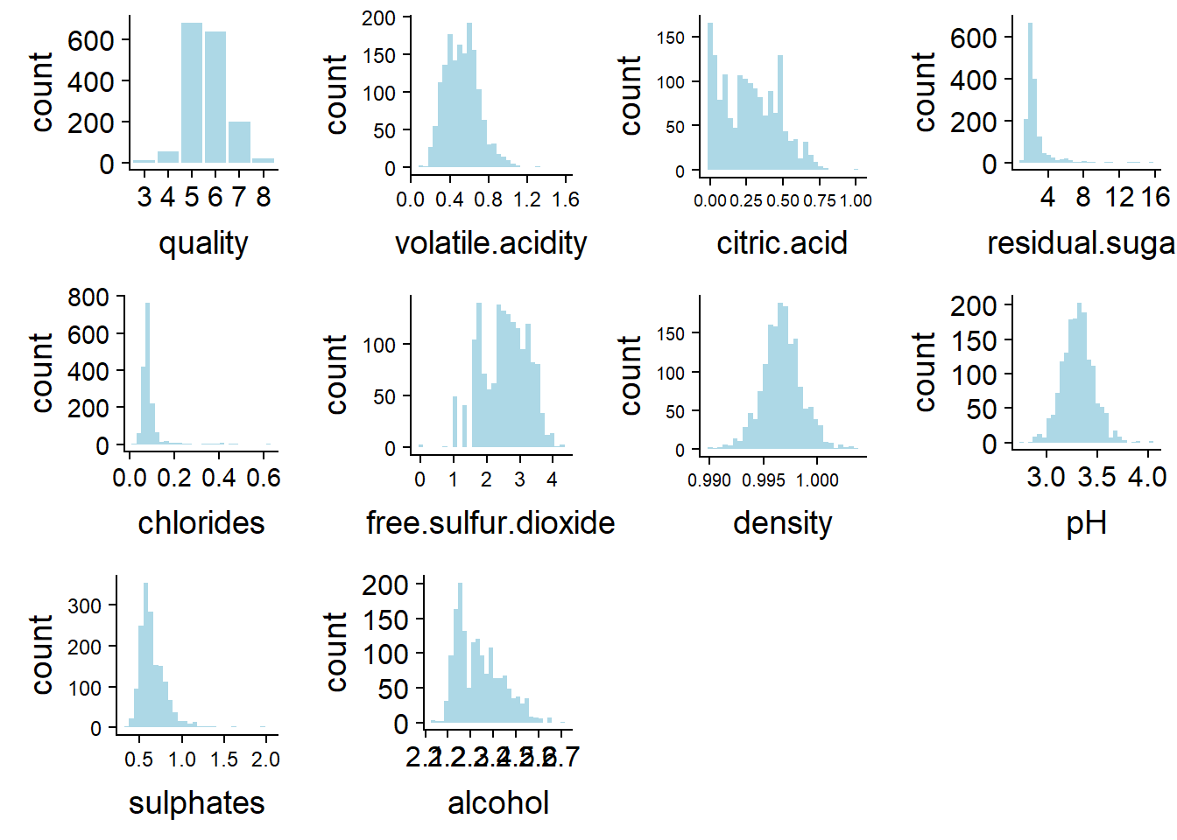
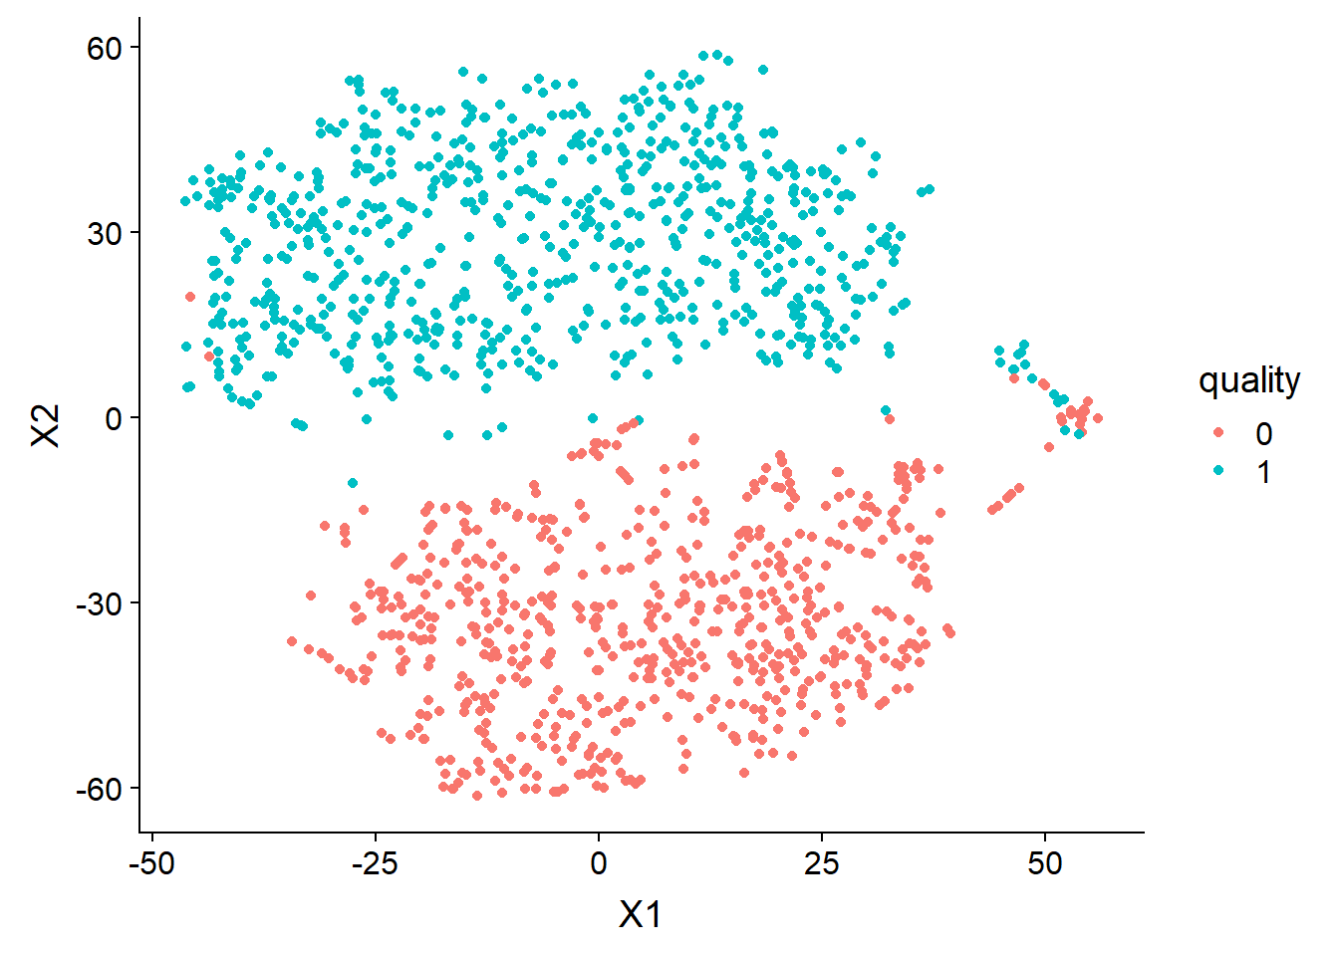
O
rdinal Regression Model Detail
Modeling wine preferences by data mining from physicochemical properties
L
ogistic Regression Model Detail
Bob Ding, Lynn Fan, Alice Jiang
Dec. 2nd, 2018
Introduction
Project Goal: Explanation.
To identify variables that are important in explaining variation in the response.
We are interested in researching what factors contribute to the quality of wine for different types of red vinho verde from Portugal
Wine, as a popular consumer good, originated by ancient civilizations. We are very curious about how these human experts tell the differences in quality for different wines and hope to explain the relationship between chemical tests and human palettes. Quality standards might vary dramatically for different wines, and we picked red vinho verde from Portugal to conduct our research, as Portugal is a large wine exporting country, and vinho verde is getting more and more popular. The data set in this research was used to predict quality of wine for future wine certification, complementary to human wine tasters, in the paper we cited (Modeling wine preferences by data mining from physicochemical properties). We believe that this dataset can also be used to analyze what chemical factors are attributable to the final rating of wine (measured by the variable quality). If we can understand how chemical factors affect the wine quality, it may shed light on future R&D directions for chemical methods that could improve/preserve wine quality.
ChloridesCent, Volatile.acidity, sulphatesCent are very significant and influential predictors
Model meets all assumptions in statistics are big and p-values are small
Volatile.acidityCent, log_sulphates, chloridesCent, and free.sulfur.dioxideCent are most influential predictors
pHCent p-value is bigger than the 0.05 threshold, so the validity of its influence is doubtful
All other predictors are very significant with p-value = 0, even their effect on the wine quality might be small and trivial
Regression Methods
For the purpose of explaining wine quality in meeting the needs of wine-professionals’ and common folks’ level, we ran proportional odds model, giving more specified quality levels, and logistic regression, indicating whether the wine is good enough.
L
ogistic Regression Model Output
O
rdinal Regression Model Output
Proportional Odds
for the professionals
Logistic Regression
for the common
Data & Data Exploration
Response Variable:
quality: the quality of the wine (a score between 0 and 10)
Explanatory Variables:
fixed.acidity: (g(tartaric acid)/dm3) the amount of acid in wine that’s not volatile (do not evaporate fast)
volatile.acidity: (g(acetic acid)/dm3) the amount of acetic acid in wine; at high levels can lead to an unpleasant and vinegar taste in wines
citric.acid: (g/dm3) citric acid is found in small quantities, and can add freshness and flavor to wines
residual.sugar: (g/dm3) the amount of sugar left after fermatation stops; generally greater than 1 gram/liter in wines and wines with greater than 45 grams/liter are considered sweet
chlorides: (g(sodium chloride)/dm3) the amount of salt in the wine
free.sulfure.dioxide: (mg/dm3) the free form of S02S02 exists in equilibrium between molecular S02S02 (as a dissolved gas) and bisulfite ion
total.sulfur.dioxide: (mg/dm3) amount of free and bound forms of S02S02; at free S02S02 concentration over 50ppm, S02S02 becomes evident in the smell and taste of the wine
density: (g/cm3) the density of the liquid, which is close to the density of water depending on the percent alcohol and sugar content in the wine
pH: the indicator of the acidicity or basic property of the wine on a scale from 0 (very acidic) to 14 (very basic)
sulphates: (g(potassium sulphate)/dm3)a wine additive which can contribute to sulfur dioxide gas S02S02 levels
alcohol: (vol. the percent alcohol content of the wine
Model not predicting quality = 1, 2, 9,10
Overall accuracy: 60%
Very good job in prediction at quality = 5, 6
From the ROC curve and AUC calculation, we can see the curve is fairly close to the top left corner (area under the curve is close to 1).
This shows that the logistic model is able to distinguish between good and not good quality, so this is a pretty good model.
We can see that free.sulfur.dioxide and alcohol have an obvious rightly skewed distribution. residual.sugar, cholorides, and sulphates also have a slightly rightward skewedness. citric.acid at first appears to have a bimodal distribution, but this is because there are some wines with zero citric acid, so we see a spike at 0 in the histogram. Based on the data definition, we know it is possible for wines to have citric acid of 0. The distribution of citric acid is overall fairly symmetric. All other variables: quality, volatile.acidity, density, and pH are unimodal and fairly symmetric.
Notice that now free.sulfur.dioxide,and alcohol is logged
Dominance in class 5, 6. Explaining why prediction at 5, 6 is good

