Slide 1
Trading the AI Ecosystem, Long and Short
Situational Humility: a regime signal plus a memory-vs-hyperscaler spread
Awareness tells you what is happening. Humility sizes the bet.
Midterm · Applied Financial Technology · Charlotte Roth, Matthew Ivancic, Tom Dickson
Buyers
Clouds
Chips
Memory
Data centers
Notes:
TIMING: with the motivation slide (2) and the five stress-test slides (15-19) the full deck runs about 15-16 minutes, so skip slides 9 and 12 by default to stay under the 15-minute limit. For about 12 minutes, also skip slide 21; for about 10 minutes, also skip slides 18 and 19. Show the backup slide (23) only if asked. Open: Our strategy trades the companies around the AI build-out. It is always invested in single stocks, it can go short when the trend turns, and right now the AI group is in a sharp sell-off, so we can show how it is positioned today.

Slide 2
Motivation: Large IPOs can affect companies already trading
Evidence from prior IPOs
Why others react
Why we explored AI
Hsu et al. (2010) find that listed industry competitors averaged −0.82% abnormal returns around large IPO completions.*
An IPO can strengthen a company’s competitive position, putting pressure on existing rivals.
Anthropic’s IPO motivated us to explore connected public companies and whether their relationships and trends offer trading opportunities.
Situational Humility · AI ecosystem long/short · Midterm *Hsu, Reed & Rocholl (2010), “The New Game in Town: Competitive Effects of IPOs,” Table III
2
Notes:
Big IPOs move the companies around them. Hsu, Reed and Rocholl studied 134 large IPOs from 1980 to 2001. Listed industry rivals lost about 0.8 percent over the 10 trading days either side of the IPO's completion, because a newly public competitor is stronger and better funded. The paper is about rivals, not suppliers, so it does not tell us the sign of the effect on our names. It told us where to look, not what to bet. Anthropic's IPO made us ask which public companies are tied to it, and whether those links create trading opportunities. We focused on the supply chain, where the links are strongest: the clouds that host Claude, the chips it runs on, and the memory and data-center companies behind them.

Slide 3
AI spending moves through a chain, and the stocks in it move together
1
2
3
4
5
Customers
Clouds
Chips
Memory
Data centers
Companies buying Claude and other AI models
AMZN GOOGL MSFT META ORCL IBM
NVDA AVGO AMD
MU WDC STX SNDK
DELL ANET VRT EQIX CEG
Not traded
Our core idea
Start date: November 22, 2022, the week before ChatGPT launched.
The question: which parts of the chain lead, and which break first?
Situational Humility · AI ecosystem long/short · Midterm
3
Notes:
ChatGPT launched on November 30, 2022. Our backtests start the week before, on November 22, so they cover the whole AI trade. The thesis: AI spending ripples through a supply chain, and the stocks in that chain are connected. When one part moves the others tend to follow, and the strength of memory relative to the buyers tells us where the cycle is.

Slide 4
Anthropic's S-1 shows where the money flows
3
4
Demand > compute
cloud platforms
chip families
the bottleneck
Claude is sold through AWS, Google Cloud and Azure, with a joint go-to-market on each.
Trained and served on AWS Trainium, Google TPUs, NVIDIA GPUs and AMD GPUs. Broadcom is a named supplier.
The S-1 says customer demand exceeds available compute, and data-center partners such as Fluidstack build capacity.
Source: Anthropic, PBC, Form S-1/A.
Situational Humility · AI ecosystem long/short · Midterm
4
Notes:
We built the universe from Anthropic's S-1. Claude runs on all three major clouds. It trains and serves on four chip families. It buys from Broadcom and relies on data-center partners. The S-1 also says customer demand exceeds available compute: compute is the bottleneck, so the suppliers of compute are where we look.

Slide 5
Eighteen stocks in four groups
Hyperscalers
Chips
Memory
Infrastructure
The buyers of compute
The compute itself
Our core idea
The data-center build
Amazon
Google
Microsoft
Meta
Oracle
IBM
NVIDIA
Broadcom
AMD
Micron
Western Digital
Seagate
SanDisk
Dell
Arista
Vertiv
Equinix
Constellation
Chosen with hindsight: all 18 are survivors of the AI run-up.
Situational Humility · AI ecosystem long/short · Midterm
5
Notes:
Eighteen names in four groups. Hyperscalers are the buyers. Chips. Memory, our core idea: Micron, Western Digital, Seagate and SanDisk. And infrastructure. We chose these knowing how the story played out, so we will be upfront that the list has hindsight in it.

Slide 6
Situational Humility runs two strategies side by side, half the capital each
1
SLEEVE 1 · 50% OF CAPITAL
2
SLEEVE 2 · 50% OF CAPITAL
Regime
Memory spread
Is the AI basket trending up or down? Net long when it is, net short when it is not.
Is memory beating the cloud buyers? Long memory and short hyperscalers when it is. Reverse when it is not.
Always invested in single stocks. SPY is used only to cancel market risk.
Situational Humility · AI ecosystem long/short · Midterm
6
Notes:
Half the capital runs on a regime signal: is the AI basket trending up or down. The other half bets on a relationship: memory against the buyers. Everything is single stocks; the only SPY position is a small one that cancels market exposure from the spread.

Slide 7
Regime sleeve: three tests set how long or short we are
1
The 18-stock basket is above its 50-day average
2
The basket is above its 100-day average
3
More than half of the stocks are above their own 50-day averages
Scales in steps: it usually moves one level at a time, though one sharp day can flip all three tests.
Situational Humility · AI ecosystem long/short · Midterm
7
Notes:
We build an equal-weight index of the 18 stocks and ask three questions. Above its 50-day average? Above its 100-day average? Are more than half of the stocks above their own 50-day averages? All three yes: fully net long. All three no: fully net short. In between it holds a partial position, so it usually moves one step at a time, although one sharp day can flip all three tests at once.

Slide 8
Spread sleeve: memory leads the cloud buyers, until its trend breaks
Ratio above its 100-day average
Long memory, short hyperscalers. Below it, the reverse.
Sized to a 15% volatility target
The position shrinks when the spread gets wild.
SPY cancels market exposure
So the sleeve bets on the relationship, not the market.
Situational Humility · AI ecosystem long/short · Midterm
8
Notes:
When memory stocks are outperforming the hyperscalers and that trend is up, we go long memory and short the hyperscalers. When the trend turns, we reverse. Memory is the most sensitive part of the chain to AI capital spending. We size the sleeve to a 15% volatility target so it cannot dominate, and use a small SPY position to cancel its market exposure. Note the line: the ratio fell below its average this autumn.

Slide 9
We tested about 80 ideas, and most of them failed
Idea | What happened | Verdict
Momentum ranking: long winners, short losers | Lost 16–30% in the 2022 bear market | Dropped
Hyperscalers lead chips by two days | Lost 37% in 2021 and again in 2022 | Dropped
Memory against every other stock | Lost money in the first half of the window | Dropped
Hold the basket overnight only, gate by day | Strong returns, but lost 38% in 2022 (offline) | Dropped
Gated long-only basket (P1) | Highest return, but beta 1.4: not a hedge | Alternative
Regime + memory spread (Situational Humility) | Shallow drawdown, beta 0.1, shorts when the trend breaks | Selected
Situational Humility · AI ecosystem long/short · Midterm
9
Notes:
We started with about 80 rule variations and kept a record of every one. Momentum rankings lost money in the 2022 bear. A rule that bets the hyperscalers lead the chip stocks by two days lost 37% in a year. Holding the basket overnight only looked great until 2022. Situational Humility survived because it combines two things that worked in different periods and is built to lose less when the group falls. (Skip this slide for an 8-minute talk.)

Slide 10
Result: 25.7% a year against 21.5% for SPY, with a 15.7% drawdown
25.7%
return per year (SPY 21.5%)
15.7%
worst drawdown
0.11
beta to the market
QuantConnect backtest, 22 Nov 2022 to 7 Aug 2026, default fees.
Situational Humility · AI ecosystem long/short · Midterm
10
Notes:
Running from November 22, 2022, the week before ChatGPT launched, through August 2026, Situational Humility returned 25.7% a year against 21.5% for SPY: a modest edge, not a large one. Its worst drawdown was 15.7% and its beta to the market was 0.11, so it is not just riding the market. Adding 10 basis points of slippage on every trade cut that to 23.3%.

Slide 11
Live demo: the QuantConnect backtest
What to point at
1
The equity curve against SPY
2
2,635 orders in about four years
3
The exposure chart: days spent net short
4
Statistics: 15.7% drawdown, beta 0.11
Situational Humility · AI ecosystem long/short · Midterm
11
Notes:
Switch to the QuantConnect run (default settings). Show the equity curve, the statistics panel, and the long/short exposure chart. Say: it is mostly long, with the short side kicking in during sell-offs. About 2,600 orders over four years.

Slide 12
It holds up across the window, with honest caveats
First half
A little behind SPY, because Situational Humility was mostly hedged while the group ran.
Second half
Well ahead of SPY, with a 15.7% drawdown.
Costs
10 bps of slippage trims 2.4 points of return.
Noise
Four years is short: the Sharpe error is about ±0.6, and QuantConnect's probabilistic Sharpe is only 39%.
Situational Humility · AI ecosystem long/short · Midterm
12
Notes:
We split the window in half. The first half returned 21% a year with a drawdown under 10%, a little behind SPY's 24% because the strategy was mostly hedged while the group ran. The second half returned 29%, well ahead of SPY's 19.5%. Be careful: a four-year window is short and a Sharpe over four years carries a lot of statistical noise.

Slide 13
Today Situational Humility is net short about half of its capital
−50%
net exposure to the 18 stocks
12–13% below
The basket sits that far under its 50- and 100-day averages.
Mon 9 Nov
Basket up 5.8%, memory up 8.0%.
Tue 10 Nov
Basket down 1.1%, memory down 1.3%.
As of the 10 Nov 2026 close; offline calculation from Yahoo prices, not a live QuantConnect run.
Situational Humility · AI ecosystem long/short · Midterm
13
Notes:
Last week the group fell hard. The worst day was Thursday 5 November: the basket down 10% and the memory names down 18%. It then bounced about 8% over Friday and Monday (memory up 8.0% on Monday alone) and slipped 1.1% on Tuesday. At Tuesday's close it is still 12-13% below its 50- and 100-day averages, so all three of Situational Humility's signals are still bearish. The strategy is net short about 50% of capital, with memory the most short and a 25% SPY position offsetting part of the market risk. UPDATE THESE NUMBERS the day you record.

Slide 14
The risk: bearish signals like this were usually followed by a rebound
+3.4%
average next-20-day return
+4.5%
median next-20-day return
24%
of the time it kept falling
Situational Humility · AI ecosystem long/short · Midterm
14
Notes:
We should be honest about the risk. We looked at every time all three signals turned bearish together, since 2012. In most cases the group rebounded: the average next-20-day return was positive, about 3%, and only a quarter of the time did the group keep falling. So this is a bet on continuation, and the main danger is a sharp bounce. That is why the short side is capped by the volatility target and hedged with SPY.

Slide 15
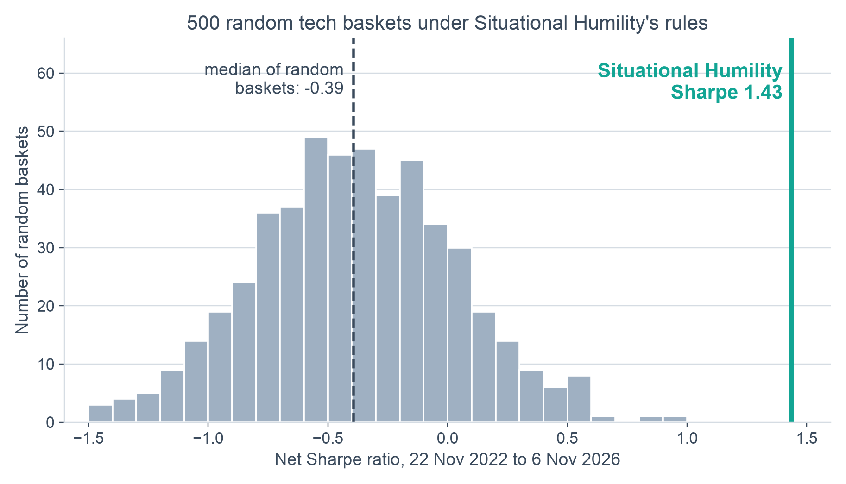
Test 1: the same rules on random tech stocks lose money
100th
percentile: our Sharpe beat all 500 random tech baskets
−0.39
median Sharpe of a random basket under the same rules
−5.9%
median yearly return of a random basket (ours: +25.1%)
500 random 18-stock baskets of Technology and Communication names, same rules, 10 bps costs. The rules alone have no edge: the 18 names carry the result, and they were picked with hindsight.
Tests use our offline engine through 6 Nov 2026, so every alternative is run the same way. On QuantConnect's dates it gives 25.0% a year (QuantConnect: 25.7%).
Situational Humility · AI ecosystem long/short · Midterm
15
Notes:
Now the part where we tried to break it. Our first question: is this the rules, or is it the names? We took Situational Humility's exact rules and ran them on 500 random baskets of tech and communication stocks, each with the same group structure, same costs, same dates. The typical random basket loses money: the median Sharpe is minus 0.39 and the median return is about minus 6 percent a year, while stocks overall went up. Situational Humility's real 18 names score 1.43, above every one of the 500. So Situational Humility clearly beats luck, but read it the other way too: the rules have no generic edge. The result depends on these specific names, and we chose them with hindsight. Our engine reproduces the QuantConnect run to within 0.7 points of return, so the comparison is fair.

Slide 16
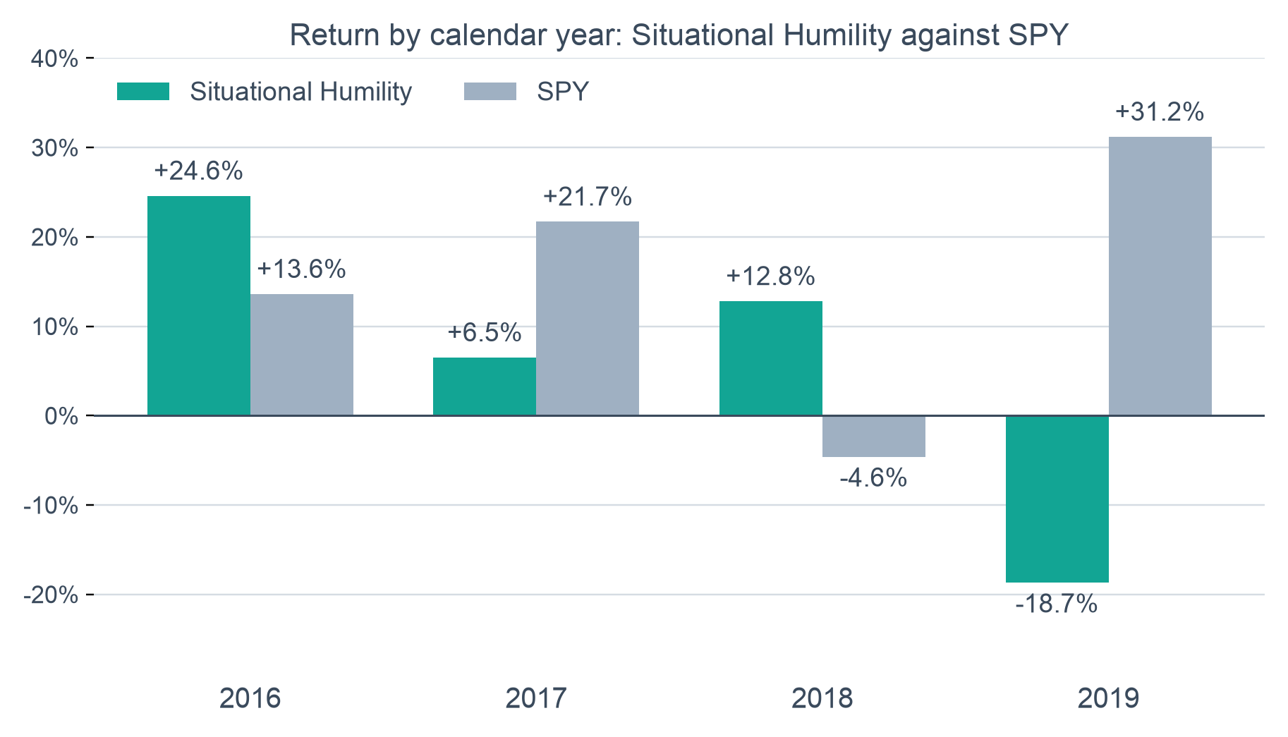
Test 2: pre-AI it lagged SPY, but held up in 2018
5.1%
Situational Humility return per year, 2016 to 2019 (SPY 14.7%)
0.44
Situational Humility Sharpe ratio (SPY 1.13)
−24.4%
Situational Humility worst drawdown (SPY −19.3%)
Our backtest engine, net of 10 bps costs, 4 Jan 2016 to 31 Dec 2019. It beat SPY in 2016 and 2018, and lost 18.7% in 2019 while SPY gained 31.2%.
Situational Humility · AI ecosystem long/short · Midterm
16
Notes:
Second test: what happens before the AI boom? We ran Situational Humility unchanged on 2016 to 2019. It returned about 5 percent a year against 14.7 for SPY, a Sharpe of 0.44 against 1.13, and a worse drawdown than SPY. That is consistent with the weaker pre-AI result on our caveats slide, which uses a longer window. But look at the year-by-year bars: in 2018, when SPY fell 4.6 percent, Situational Humility gained 12.8, and in the September to January sell-off it made 6.9 percent while SPY lost 6.1. Then in 2019 it gave it all back, minus 18.7 percent while SPY rose 31. We have not decomposed that 2019 loss into the two sleeves, so we do not claim to know the cause. We set the pass rules before running it: two of three passed, so the verdict is partial. Remember the 18 names are still hindsight picks; this window is out of cycle, not out of sample for the names.

Slide 17
Test 3: a one-line trend switch matches Situational Humility
 | Trend switch | Humility | Always on | SPY
Sharpe, 2022–26 | 1.87 | 1.43 | 1.82 | 1.18
Sharpe, 2016–19 | 1.28 | 0.44 | 1.41 | 1.13
Worst drawdown, 2022–26 | −20.8% | −15.1% | −31.9% | −18.8%
Worst drawdown, 2016–19 | −17.0% | −24.4% | −23.3% | −19.3%
Return per year, 2022–26 | 54.5% | 25.1% | 63.4% | 18.2%
Trading per year (turnover) | 6.9x | 20.7x | 1.0x | —
Trend switch: hold the 18 stocks equally while their basket is above its 100-day average, else cash. Always on: hold them all the time. Same engine and 10 bps costs for all. Only Situational Humility is hedged; the other two are long-only. Teal marks the best in each row.
Situational Humility · AI ecosystem long/short · Midterm
17
Notes:
Third test, and the one that surprised us most. We asked: what if you ignore all of Situational Humility's machinery, the regime sleeve, the memory spread, the SPY hedge, and just hold the same 18 stocks equally while their basket is above its 100-day average, and hold cash otherwise? That one-line rule has a higher Sharpe than Situational Humility in the AI era, 1.87 against 1.43, and in 2016 to 2019 too, 1.28 against 0.44, with about a third of the trading. It also cuts the drawdown from minus 32 percent for always holding to minus 21. Be fair about what this says. The simple switch is long-only, so it carries market risk; Situational Humility's selling point is that it is hedged, with a beta of 0.11, and it can go short. So the honest reading: Situational Humility does not add risk-adjusted return over a plain trend filter, it trades return for low market exposure. And simply holding the names did best of all in return, because the names are hindsight winners.

Slide 18
Test 4: it protects in sell-offs, then lags rebounds
 | Humility | Trend switch | Always on | SPY
Sep 2018 – Jan 2019 sell-off | +6.9% | −3.2% | −9.1% | −6.1%
Calendar year 2018 | +12.8% | +3.7% | −1.6% | −4.6%
Worst drawdown, 2020–21 (incl. COVID) | −18.5% | −23.1% | −29.7% | −33.7%
Worst drawdown, 2022–26 | −15.1% | −20.8% | −31.9% | −18.8%
Calendar year 2019 (a rebound) | −18.7% | +7.7% | +41.4% | +31.2%
Our backtest engine, net of 10 bps. What a plain trend filter lacks is Situational Humility's ability to go net short: it did so a week after the 2018 memory peak. The price of that protection is rebounds: in 2019 it lost 18.7% while SPY gained 31.2%.
Situational Humility · AI ecosystem long/short · Midterm
18
Notes:
This is the claim that matters for the whole idea: does it protect when the AI group falls? Mostly yes. In the September 2018 to January 2019 sell-off Situational Humility made 6.9 percent while SPY lost 6.1. Through the COVID crash window, 2020 to 2021, its worst drawdown was 18.5 percent against 33.7 for SPY. And in the AI era its worst drawdown, 15.1 percent, is the shallowest of the group, versus 31.9 for just holding the stocks. A plain trend switch gets part of this protection, you can see it in the third column, but Situational Humility does better in the sell-offs because it can go net short. The cost is in the last row: in the 2019 rebound it lost 18.7 percent while SPY gained 31. So the accurate summary is: it follows the trend up, it is ready for a regime change, and it pays for that in fast recoveries. Only the 2018-19 sell-off against SPY was a pre-registered test; the other rows are descriptive results we picked afterwards, so treat them as evidence, not proof.

Slide 19
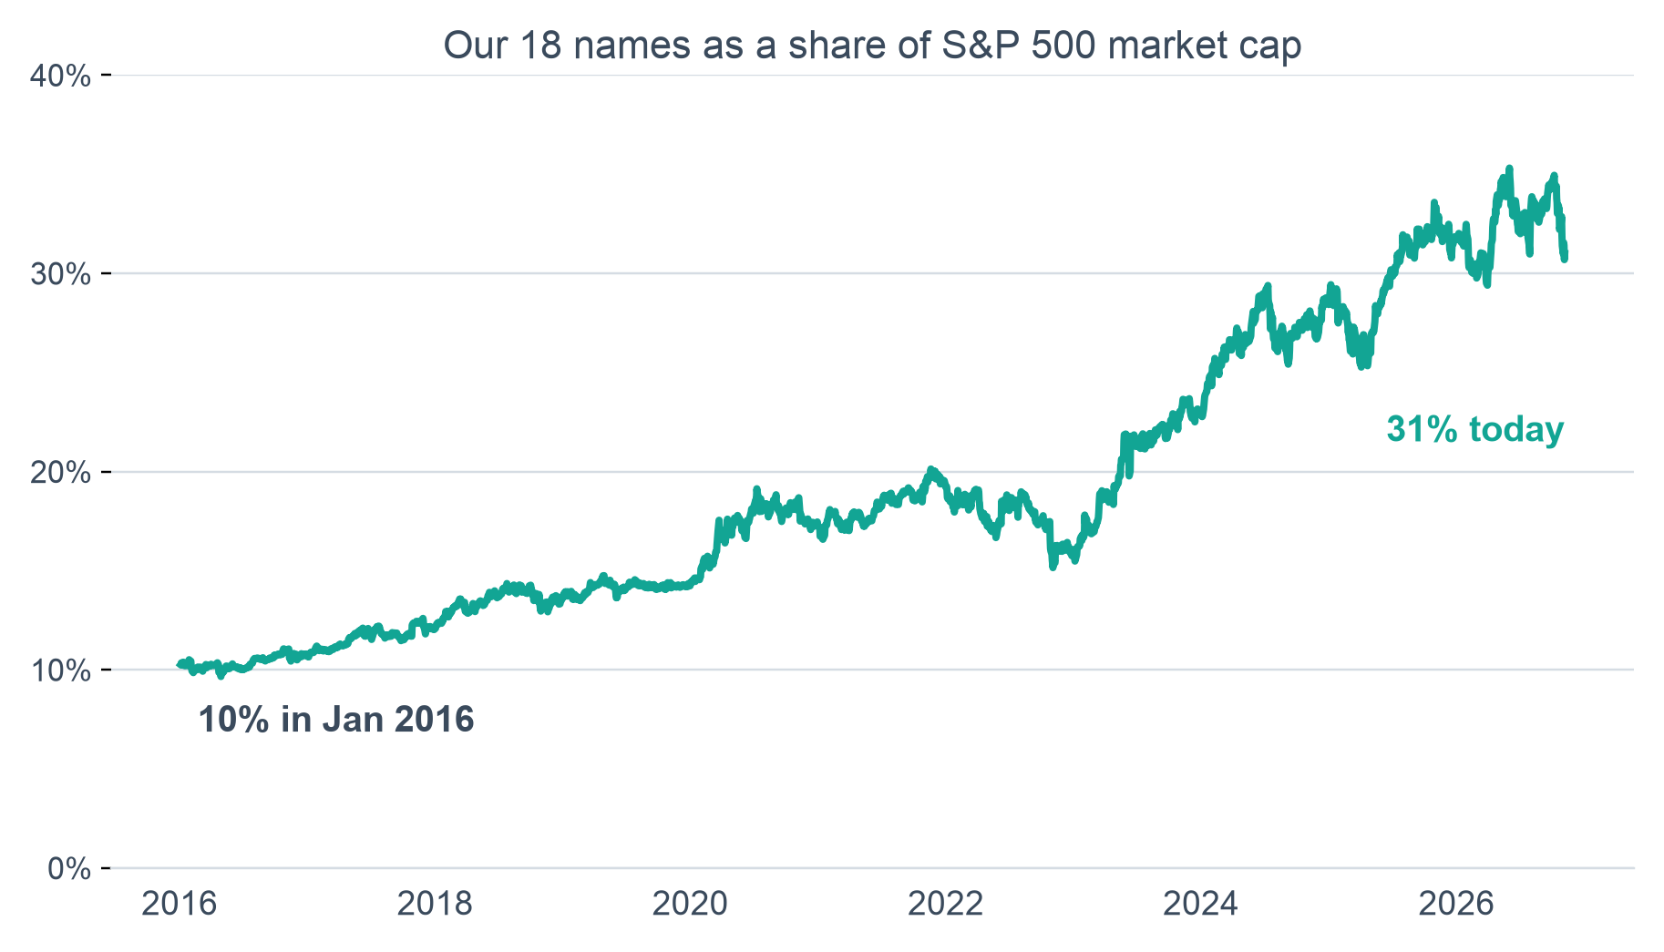
What did not help: volume and market-cap share
31%
of S&P 500 market cap today, up from about 10% in early 2016
No lead
Volume share did not predict the next 20 days beyond price
2 of 6
pass rules for adding market-cap share to the trend switch
Market cap = split-adjusted share count x price, today's S&P 500 members, 2016 to 6 Nov 2026. Shares of volume and of market cap largely track price (correlation about 0.6 with relative return), so neither beat a plain price trend.
Situational Humility · AI ecosystem long/short · Midterm
19
Notes:
Our hunch about a regime change was that these stocks keep growing as a share of the market, so we tried to turn that into a signal. The chart is the descriptive story and it is striking: the 18 names went from about 10 percent of S&P 500 market cap at the start of 2016 to about 31 percent now, after peaking near 35 percent in June. We tested two ways to trade it. First, share of trading volume as an early warning: we pre-registered the test, ran it once, and it did not predict the next 20 days beyond what price trend already says, and its rollovers flagged only 2 of 11 declines against 10 of 11 for a plain 100-day price switch. Second, adding market-cap share as a veto on the trend switch: 2 of 6 pass rules, worse in 2016 to 2019, so we left the strategy unchanged. The reason is that market-cap share is mostly relative strength, it moves with price. It is a good description of how big the AI trade became, but we could not turn it into a better signal.

Slide 20
What you should know before trusting it
1
Hindsight universe
All 18 stocks are survivors of the AI run-up.
2
Many tests
About 80 variants tried, so some of the result is luck. QuantConnect's probabilistic Sharpe is 39%.
3
Tuned windows
The 50- and 100-day settings were chosen after seeing 2022.
4
Weaker before AI
Offline, Situational Humility earned about 4% a year in 2011–2022, against 12% for SPY.
Situational Humility · AI ecosystem long/short · Midterm
20
Notes:
Five things you should know; the first four are on the slide. One: the stocks were chosen with hindsight. Two: about 80 rule variations were tested on this data, so some of the result will be luck. Three: the regime windows were tuned after seeing 2022. Four: before the AI era the same approach earned much less than SPY, about 4% a year against 12% in our offline test. Five: Situational Humility failed our own pre-declared test, because it had to make money in 2022. We are showing it because it is the best protection we found.

Slide 21
Why Situational Humility and not the alternatives
 | Humility (chosen) | Gated AI basket | Memory basket
Return per year, AI era | 25.7% | 62.9% | 71%*
Worst drawdown, AI era | 15.7% | 27.8% | 44%*
Beta to the market | 0.11 | 1.36 | 1.60*
2022 return, to Nov 21 (offline) | −6% | −23% | −28%
Can it go short? | Yes | No | No
AI era: 22 Nov 2022 to 7 Aug 2026. QuantConnect results for Situational Humility and the gated basket; * offline research, same dates.
The alternatives earn more because they are the AI trade at beta 1.4 to 1.6. Situational Humility is the one built to hold up if the group keeps falling.
Situational Humility · AI ecosystem long/short · Midterm
21
Notes:
We also built a long-only version that holds the stocks when the trend is up and SPY otherwise. It returned 63% a year, but with a beta of 1.4 it is the AI trade, not a hedge. The old memory basket returned more still, but with a 44% drawdown. We chose Situational Humility because, with the group already in a downtrend, we want the strategy that is built to be short and hedged and gave up the least in a bear. (Skip for an 8-minute talk.)

Slide 22
A long/short bet on the AI chain, sized to survive being wrong
Net short today
About 26% a year
The main risk
About half of capital, memory the most short.
In the backtest, with a 16% worst drawdown.
A sharp rebound in the first few weeks.
Situational Humility · AI ecosystem long/short · Midterm
22
Notes:
Situational Humility is a long/short strategy on the AI ecosystem. It is net short right now. It earned about 26% a year in the backtest with a shallow drawdown, and we have told you where it is weak. If the sell-off continues, it is positioned for it. If the group rebounds, the volatility target and the hedge are there to limit the damage. Take questions; use the backup slide if asked for the run-by-run numbers.

Slide 23
Backup: the five QuantConnect runs
Run | Window | Return / yr | Max drawdown | Beta | Orders
Q1 default | 22 Nov 2022 – 7 Aug 2026 | 25.7% | 15.7% | 0.11 | 2,635
Q2 +10 bps slippage | same | 23.3% | 16.1% | 0.11 | 2,636
Q3 1% order band | same | 24.1% | 15.8% | 0.10 | 3,348
Q4 first half | to 30 Jun 2024 | 21.3% | 9.9% | 0.56 | 944
Q5 second half | from 1 Jul 2024 | 29.1% | 15.7% | −0.10 | 1,742
SPY over the same dates: 21.5% (full window), 24.3% (first half), 19.5% (second half). Pass rules for all runs were written before the runs.
Situational Humility · AI ecosystem long/short · Midterm
23
Notes:
Backup only. Use if asked for run-by-run numbers.

