Slide 1

30-07-2024
Web scraping to gain company insights

Slide 2
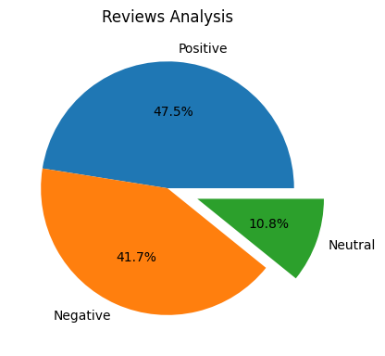
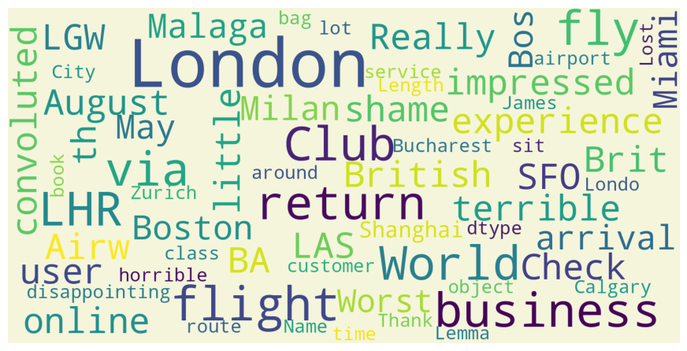
INSIGHTS FROM CUSTOMER REVIEWS
From cleaning 1000 reviews given by the customers, we obtained
Analysis:
Positive Reviews - 475
Negative Reviews - 417
Neutral Reviews – 108
Word cloud of keywords used in reviews:

