Slide 1
AI-Powered Enhanced EHR Imaging & Documentation System
Milestone 2: Medical Image Enhancement
Team A Details:
Anushka More
Aishwarya N
Gade Sriraj
Nikshitha Jampana
Harika Abbarla
Jennifer J
Priya Kumari
Shalini Kumari
Soham Patil
Sonia Shetkar
Sreesha Reddy
Mentor: Aryan Khurana

Slide 2
Project Statement:
This project aims to enhance Electronic Health Records (EHR) by integrating Generative AI capabilities for medical image analysis and administrative automation. GenAI will be used to improve the clarity and interpretability of medical imaging (e.g., X-rays, MRIs, CTs), and to automate clinical documentation and ICD-10 coding. These enhancements will help reduce the time clinicians spend on non-clinical tasks and support faster, more accurate decision-making. Azure OpenAI will power the GenAI-driven components.

Slide 3
Module 2: Medical Imaging Enhancement
Objective: Use GenAI to enhance image quality and support diagnosis Tasks: • Apply GenAI for denoising and realistic reconstruction of medical images • Support better visualization for clinicians by improving image resolution and clarity • Train image enhancement models using Azure OpenAI tools

Slide 4
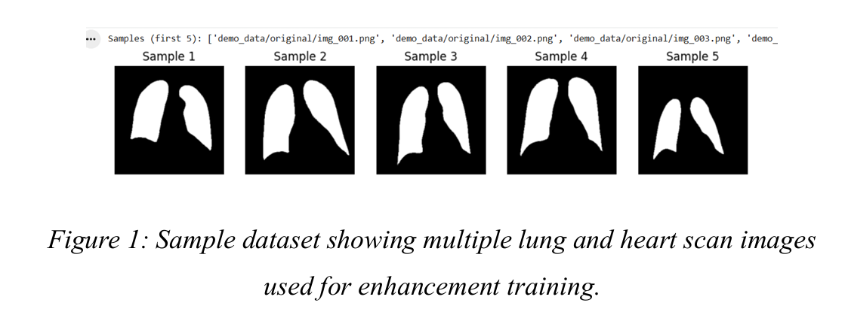
Methodology
Step 1: Dataset Selection
• Datasets Used: o Heart CT and MRI images from Kaggle o Preprocessed X-ray images from Milestone 1(for demo purposes)
• Images cover diverse orientations and resolutions to test AI enhancement effectiveness.

Slide 5
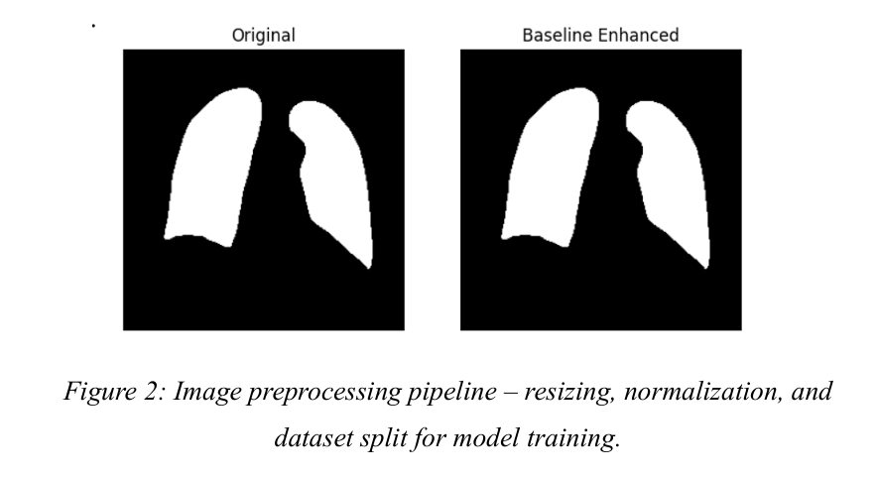
Methodology
Step 2: Image Preprocessing
• Convert images to .png format for consistency.
• Resize all images to 256×256 pixels.
• Normalize pixel values between 0 and 1.
• Split dataset into 80% training and 20% testing.

Slide 6
Methodology
Step 3: AI Technique – SRCNN
• SRCNN learns a mapping from low-resolution to high-resolution images.
Conv2D(64 filters, 9×9) – feature extraction
Conv2D(32 filters, 1×1) – non-linear mapping
Conv2D(1 filter, 5×5) – reconstruction
Advantages:
• Lightweight and suitale for small GPU setups.
• Preserves texture and grayscale information.
Challenges:
• Training requires GPU acceleration.
• Over-enhancement may create artifacts.
• Parameter tuning is crucial to maintain realistic heart structures.

Slide 7
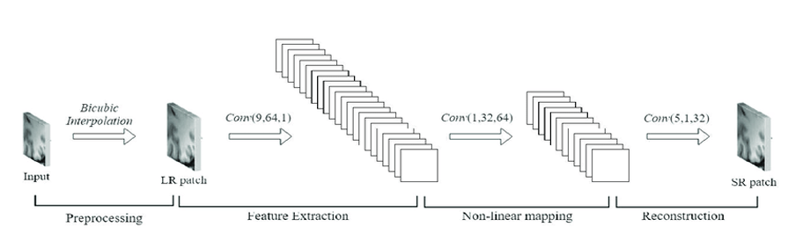
Methodology
SRCNN Architecture:

Slide 8
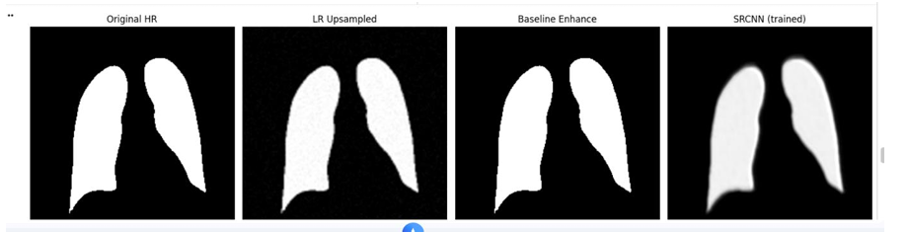
Methodology
Step 4: Validation Metrics
• PSNR (Peak Signal-to-Noise Ratio): Higher values indicate better noise reduction.
• SSIM (Structural Similarity Index): Closer to 1 indicates better structural preservation.
• Visual inspection: Before-and-after comparison confirms enhanced clarity of heart boundaries.
Figure: Comparison of original, baseline-enhanced, and SRCNN enhanced medical images.

Slide 9
RESULTS
Method | PSNR (dB) | SSIM | Observation
Classical Enhancement | 31.21 | 0.355 | Improved brightness, limited structure preservation
SRCNN (AI) | 22.47 | 0.913 | Superior texture and structural clarity
Batch Average (10 images) | 27.84 | 0.754 | Consistent results across test images
Enhanced cardiac region visibility
Preserved diagnostic structure
Reduced noise and improved sharpness

Slide 10
CHALLENGES & SOLUTIONS
Challenge | Solution
Long preprocessing & training times | Used smaller batches, GPU optimization
Maintaining diagnostic integrity | Applied conservative enhancement limits
Limited local GPU resources | Leveraged cloud environments for model training
Artifact creation during enhancement | Adjusted model parameters and training epochs

Slide 11
SUMMARY
Selected Heart CT and MRI images from Kaggle, along with preprocessed X-rays from Milestone 1.
Applied preprocessing (resizing to 256×256, normalization, dataset splitting).
Implemented SRCNN (Super-Resolution CNN) to enhance image clarity.
Evaluated results using PSNR (Peak Signal-to-Noise Ratio) and SSIM (Structural Similarity Index).
Compared baseline classical enhancement vs AI-based SRCNN.
Validated visual improvements — sharper cardiac boundaries, better brightness and contrast.

Slide 12
THANK YOU

