Slide 1
Patterns of engagement in a flipped undergraduate class: Antecedents and outcomes
Joshua M. Rosenberg¹, You-kyung Lee¹, Kristy A. Robinson¹, John Ranellucci², Cary J. Roseth¹, Lisa Linnenbrink-Garcia¹
¹Michigan State University, ²Hunter College
Notes:
\

Slide 2
Background
Lectures are a common feature of instruction (Mazur, 2009; Smith & Valentine, 2012)
The flipped class has become an increasingly common design
Outside-of-class, students view video-recordings of lectures
In-class, students participate in other activities

Slide 3
Need for study
Past research on impacts of flipping is quite limited
Participation in outside of class activities is key (Chen & Wu, 2015; He, Holton, Farkas, & Warschauer, 2016)

Slide 4
Intensive data and engagement
Digital sources of data can be used to study learning and engagement (D’Mello, Dieterle, & Duckworth, 2017; Gobert, Baker, & Wixon, 2015)
Trace measures, like students’ online lecture viewing, can be especially useful for measuring behavioral engagement (Azevedo, 2015)

Slide 5
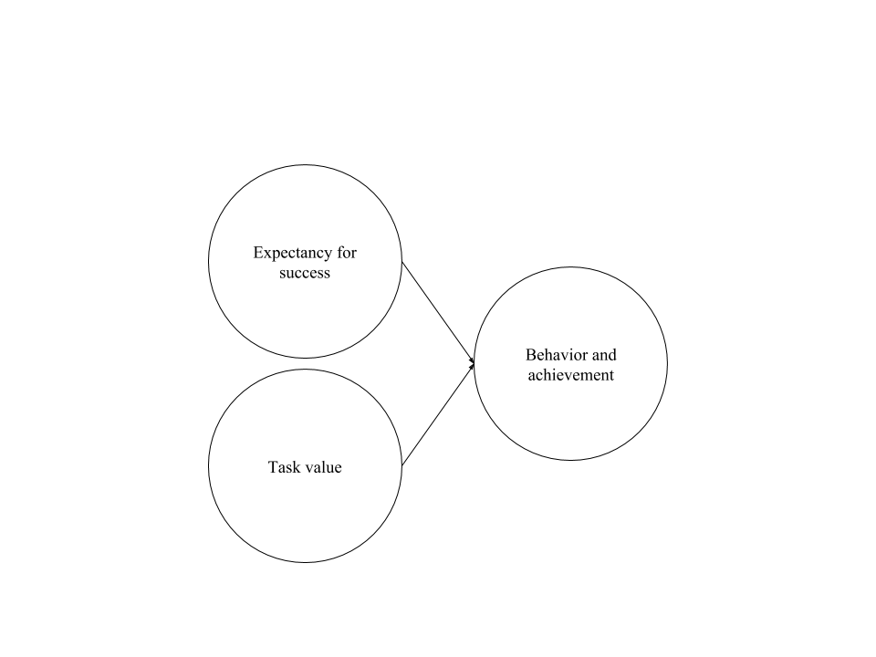
Theoretical framework: Expectancy-value theory
(Eccles, 1983; Wigfield & Eccles, 2000)
Notes:
Eccles and Wigfield’s (Eccles, 1983; Wigfield & Eccles, 2000) modern expectancy-value theory as the theoretical framework for studying students’ engagement in flipped classrooms
Generally, expectancies are stronger predictors of academic achievement and task values are stronger predictors of academic choices and engagement or persistence (Wigfield & Cambria, 2010). Furthermore, there is a growing body of evidence that perceived costs play an important role in both academic achievement and choice/persistence behaviors (Barron & Hulleman, 2015; Battle & Wigfield, 2003; Flake et al., 2015; Perez et al., 2014; Trautwein et al., 2012). Given the relative dearth of research on cost relative to the other task values and the potentially strong role that costs may play in students’ decisions to engage outside of class (e.g., by viewing the online lectures), we focused our analyses on expectancies and perceived effort costs.

Slide 6
Purpose of the present study
Explore students’ out-of-class engagement in the flipped classroom using longitudinal growth models
Investigate antecedents
Investigate outcomes

Slide 7
Research questions
What patterns of engagement outside-of-class do students in the flipped class exhibit?
What student characteristics predict their patterns of engagement?
How does students’ engagement predict achievement-related outcomes?

Slide 8
Participants and instructional context
272 undergraduates in a large introductory anatomy course
Students were assigned to view 58 videos over the semester
In-class activities largely consisted of small-group work

Slide 9
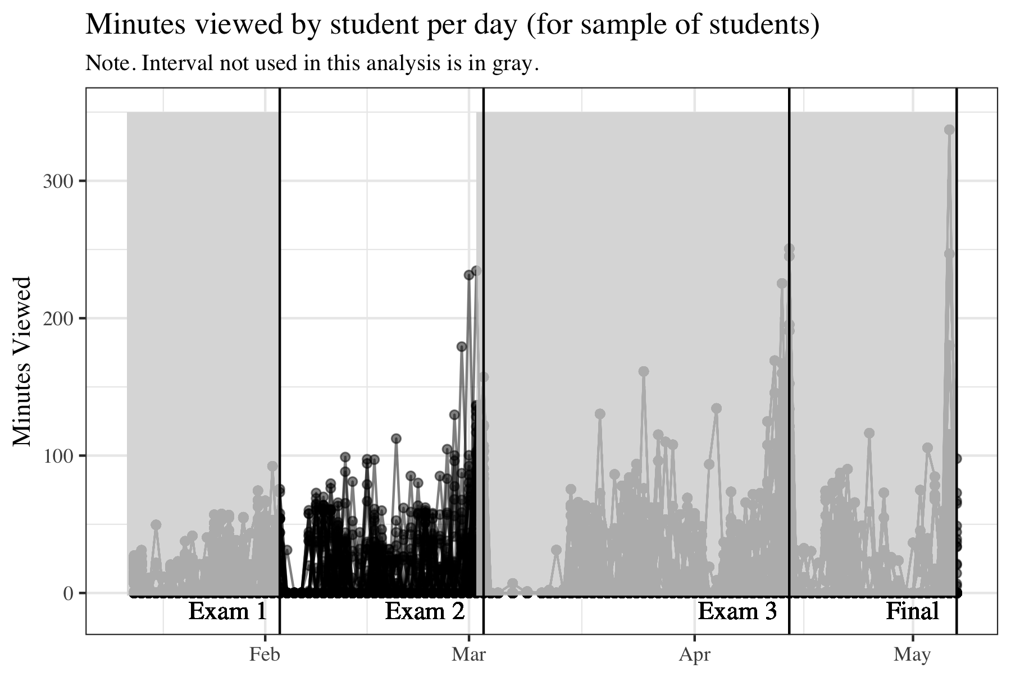
Final Grade

Slide 10
Self-report measure of students’ effort cost and perceived competence
Final Grade
Notes:
Motivation
Self-report measures of the two motivational predictors
Perceived competence (5 items; Midgley et al., 2000; alpha = .87 – sample items)
Effort cost (5 items; Conley, 2012; alpha = .61)
Administered several weeks into the semester

Slide 11
Log-trace measures of students’ behavioral engagement
Self-report measure of students’ effort cost and perceived competence
Final Grade

Slide 12
Log-trace measures of students’ behavioral engagement
Self-report measure of students’ effort cost and perceived competence
Final Grade

Slide 13
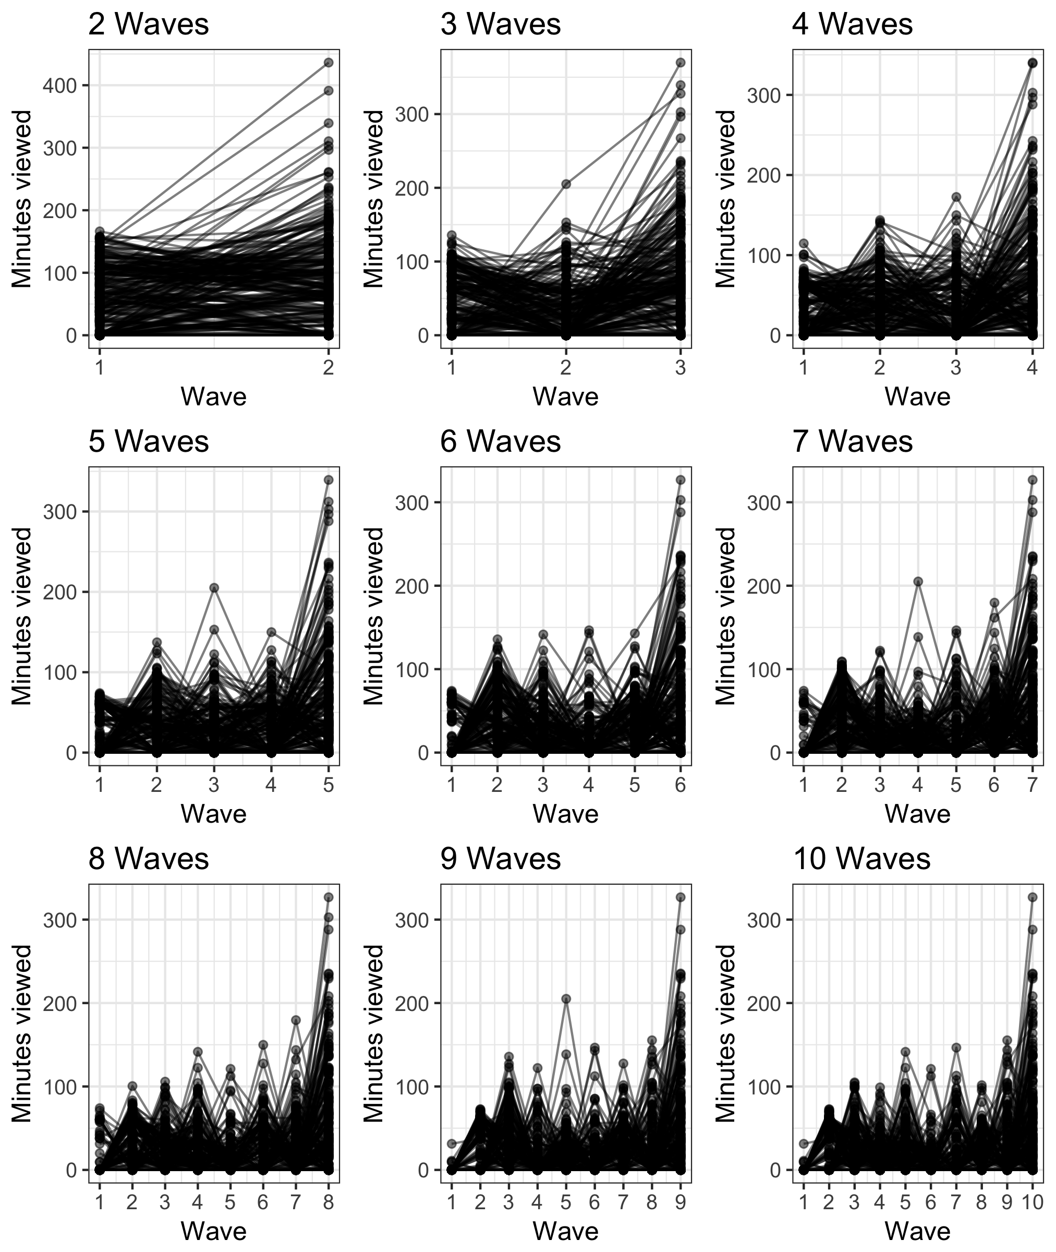
Different ways to process the data for the time between Exam 1 and Exam 2
Notes:
Students completed questionnaires assessing their motivation (perceived competence and perceived effort cost) as part of a larger study
The survey was administered several weeks into the semester and five days prior to the first exam
Exam 2 reflected the material learned in the first few weeks of class, and the final exam grade reflected the material learned throughout the semester. The final course grade included all semester exams and class assignments. The three outcomes were standardized (M = 0, SD = 1) to facilitate comparisons of results with respect to the three outcomes, however unstandardized scores were used to compute descriptive statistics and correlations.

Slide 14
Different ways to process the data for the time between Exam 1 and Exam 2
Notes:
Students completed questionnaires assessing their motivation (perceived competence and perceived effort cost) as part of a larger study
The survey was administered several weeks into the semester and five days prior to the first exam
Exam 2 reflected the material learned in the first few weeks of class, and the final exam grade reflected the material learned throughout the semester. The final course grade included all semester exams and class assignments. The three outcomes were standardized (M = 0, SD = 1) to facilitate comparisons of results with respect to the three outcomes, however unstandardized scores were used to compute descriptive statistics and correlations.

Slide 15
Data analysis
Model for RQ #1: Mixed effects (or multi-level) model predicting time viewed
Y_{time-viewed-i} = β ₀₀ + intercept-term_{i}* b β ₁₀ + linear-slope_{i}* β ₂₀ + quadratic-term_{i}* β ₃₀ + ε_{j}
β ₀₀ = β ₀₀ + person-specific-intercept-effect_{j}*µ₁
β ₁₀ = β ₁₀ + person-specific-linear-slope-effect_{j}*µ₂
β ₂₀ = β ₂₀ + person-specific-quadratic-term-effect_{j}*µ₃
Models RQ #2: Predicting student-specific effects
Models for RQ #3: Predicting outcomes using student-specific effects

Slide 16
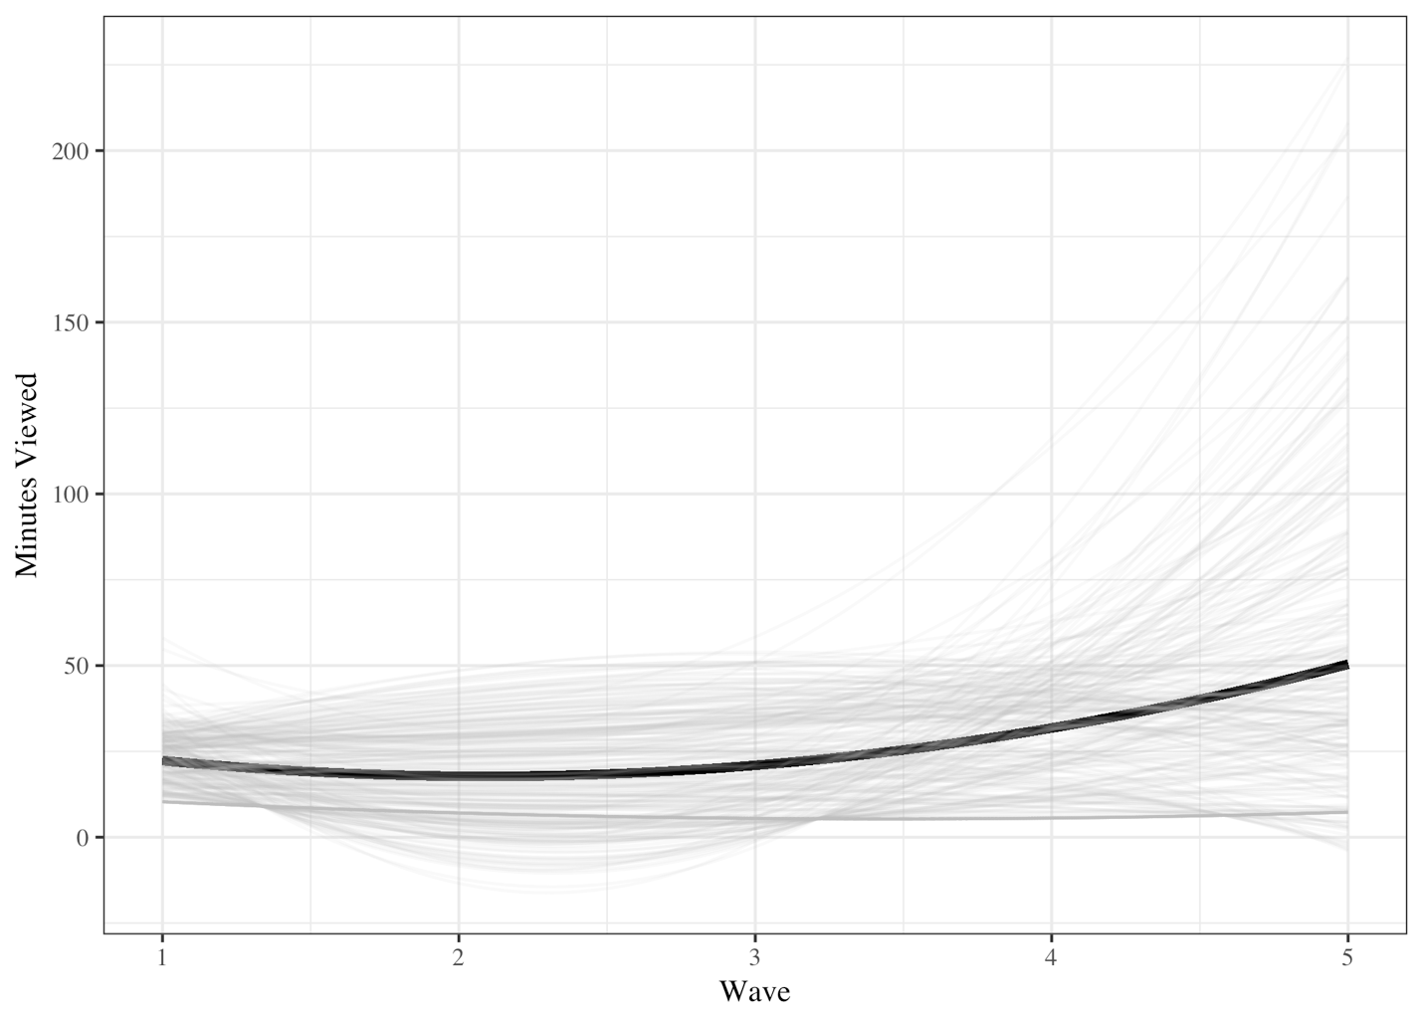
RQ #1 results: Predicting time viewed
Notes:
Be explicit about what each of the terms means
The intercept, linear term, and quadratic term is being estimated for each student
Add r^2

Slide 17
RQ #1 results: Predicting time viewed
Fixed effects | B (SE)
Intercept | 34.55 (4.08, p < .001)
Linear term | -16.09 (3.59, p < .001)
Quadratic term | 3.85 (0.66, p < .001)
Random effects | SD
Intercept | 34.83
Linear term | 39.80
Quadratic term | 8.34
Residual | 28.92
Correlation structure | Phi
First-order auto-regressive (AR1) | -0.33
Notes:
Be explicit about what each of the terms means
The intercept, linear term, and quadratic term is being estimated for each student
Add r^2

Slide 18
RQ #2 results: Predicting student-specific patterns
Predicting initial time viewed
Perceived competence: ns
Effort cost: ns
Predicting change in time viewed
Perceived competence: ns
Effort cost: B = -7.03 (3.77), p = .063
Predicting change in rate of time viewed
Perceived competence: ns
Effort cost: B = 1.37 (0.806), p = .088

Slide 19
RQ #3 results: Predicting students’ outcomes
Predicting Exam 2
Initial time viewed: B = 0.13 (0.038), p < .001
Change in time viewed: ns
Change in rate of time viewed: B = -1.03 (0.46), p = .027
Predicting Final Exam
Initial time viewed: B = 0.09 (0.038), p = .019
Change in time viewed: ns
Change in rate of time viewed: ns
Predicting Final Grade
Initial time viewed: B = 0.10 (0.03), p = .004
Change in time viewed: ns
Change in rate of time viewed: ns

Slide 20
Predicting time viewed
Viewing started at a moderately high level and exhibited linear and quadratic patterns of change
Statistically significant variability in patterns of viewing
New insight into outside of class engagement via online lecture viewing in the flipped classroom
Notes:
This study also has the potential to contribute to debates on the alignment of log-trace (and other “objective” or external measures) to “subjective,” self-report measures (Henrie et al. 2015; Henrie et al., advance online publication). Moreover, we found substantial individual variability in these trajectories, highlighting the importance of considering person-specific trajectories in our subsequent analyses.
While past research has shown this to be the case with self-report measures, this study is distinct in using a behavioral measure constructed from log-trace data. In this way, these findings align with research in learning analytics (Gerard et al., 2015; Gobert et al., 2015).

Slide 21
Antecedents of student-specific patterns
No statistically significant relations between antecedents (perceptions of competence and effort cost) and student-specific
Some relations between effort cost with students’ rate of viewing and change in rate of viewing were positive
But did not meet the criterion for statistical significance
Suggestive of further work on the role of cost given past research (e.g., Perez, Cromley, & Kaplan, 2014)
Notes:
This study also has the potential to contribute to debates on the alignment of log-trace (and other “objective” or external measures) to “subjective,” self-report measures (Henrie et al. 2015; Henrie et al., advance online publication). Moreover, we found substantial individual variability in these trajectories, highlighting the importance of considering person-specific trajectories in our subsequent analyses.

Slide 22
Predicting students’ outcomes
Consistent, positive relations between initial time viewed(i.e., students’ intercept terms) and achievement
Positive change in the rate of viewing (i.e., students’ quadratic terms) was negatively related to the proximal outcome, Exam 2
Increasing the rate at which one views is associated with lower achievement
May indicate “cramming” before an exam
Notes:
This study also has the potential to contribute to debates on the alignment of log-trace (and other “objective” or external measures) to “subjective,” self-report measures (Henrie et al. 2015; Henrie et al., advance online publication). Moreover, we found substantial individual variability in these trajectories, highlighting the importance of considering person-specific trajectories in our subsequent analyses.

Slide 23
Limitations of the study
Use of person-specific terms in other models (Houslay & Wilson, 2017)
Y_{time-viewed-i} = β ₀₀ + linear-term_{i}* b β ₁ + linear-slope_{i}* β ₂ + quadratic-term_{i}* β ₃ + e_{j}
β ₀₀ = β ₀₀ + person-specific-intercept-effect_{j}*µ₁
β ₁₀ = β ₁₀ + person-specific-linear-slope-effect_{j}*µ₂
β ₂₀ = β ₂₀ + person-specific-quadratic-term-effect_{j}*µ₃
Role of other dimensions of engagement (Fredericks, Blumenfeld, & Paris, 2004; Sinatra et al., 2015)
Consideration of students’ outside effort, loss of valued alternatives, and emotional cost (Flake, Barron, Hulleman, McCoach, & Welsh, 2015) in the flipped class

Slide 24
Future research
Explore other antecedents of engagement, especially other expectancy beliefs
Better understand utility of log-trace measures of engagement (e.g., Henrie, Bodily, Larsen, & Graham, 2015; Henrie, Bodily, Manwaring, & Graham, advance online publication)
Consider a one-step analytic approach

Slide 25
Implications for practice
Instructors may suggest to students benefits of a more consistent pattern of viewing videos
Support students’ autonomy and self-regulatory capabilities (i.e., M-Flip)
Consider students’ motivation and individual differences in reasons for enrolling in the flipped class

Slide 26
Questions & contact information
Thank you for your time
We welcome your questions and feedback on this study
Joshua M. Rosenberg (jrosen@msu.edu, http://jmichaelrosenberg.com) and You-kyung Lee, Kristy A. Robinson, John Ranellucci, Cary J. Roseth, Lisa Linnenbrink-Garcia

