Slide 1

This is the end!
Thank you for your attention.
Cheng-Jun Wang
wangchengjun@nju.edu.cn

Slide 2

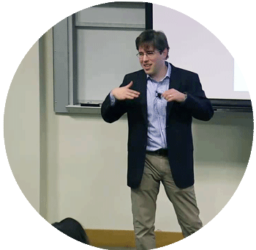

Bit by Bit is an invaluable resource for social scientists who want to harness the research potential of big data and a must-read for data scientists interested in applying the lessons of social science to tomorrow's technologies.
Matthew J. Salganik is professor of sociology at Princeton University
Cheng-Jun Wang
wangchengjun@nju.edu.cn

Slide 3
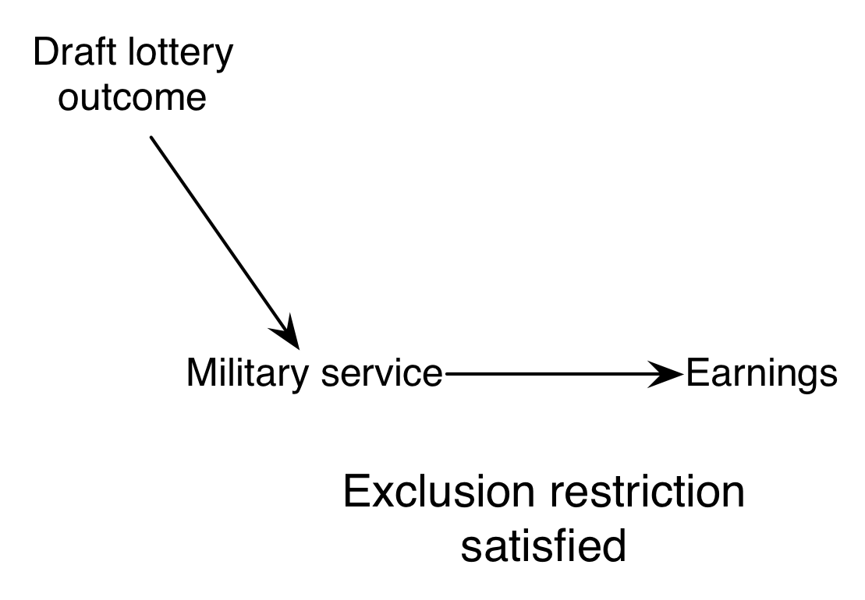
ITT_{Y} = ITT_{W} * CACE
ITT_{W}
CACE

Slide 4
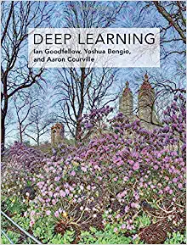
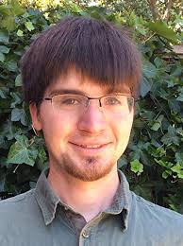
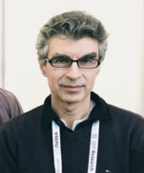
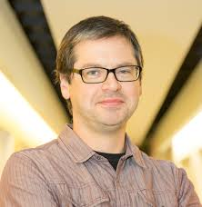
Deep Learning
Ian Goodfellow, Yoshua Bengio and Aaron Courville
2016 MIT Press
http://www.deeplearningbook.org

