Slide 1
Face Following Robot
A simple introduction
By Bozhidar Atanasov, 45257

Slide 2
The Aim
To create a robotic gimbal, which detects a specific type of object (in this case – a face) and tracks it
To tinker more with electronics, robotic vision and movement
To have some fun

Slide 3
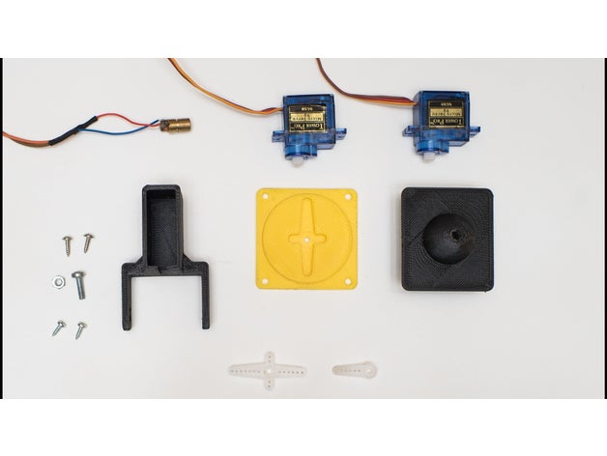
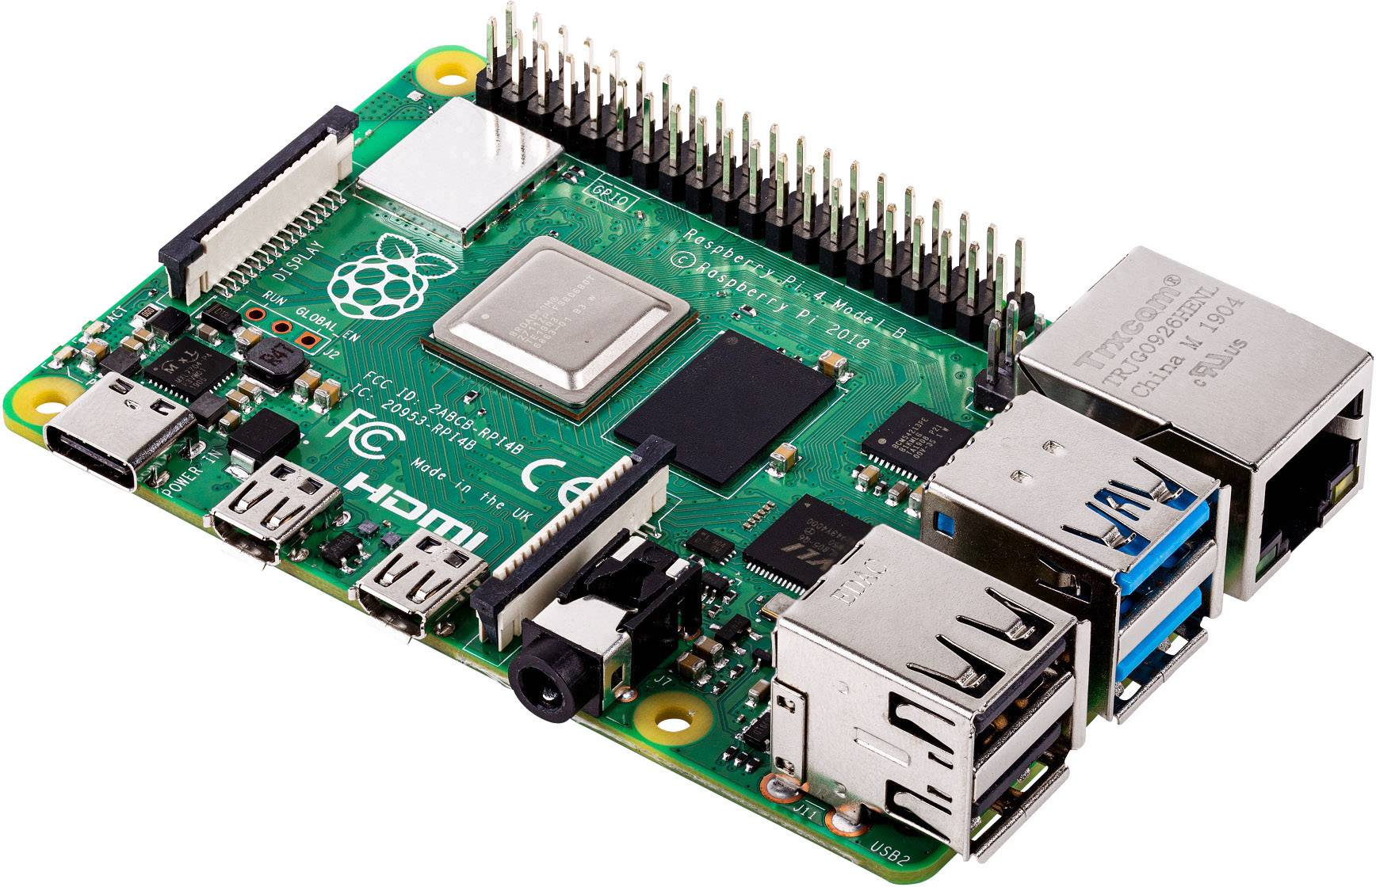
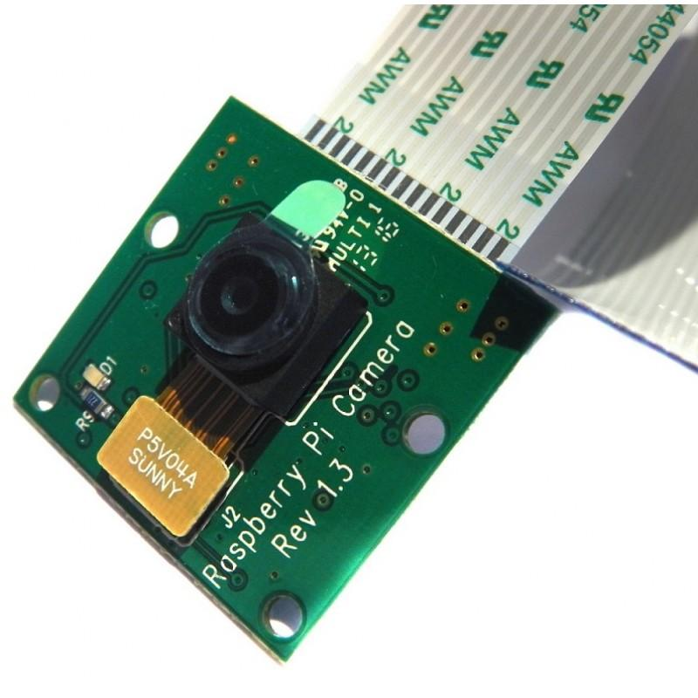
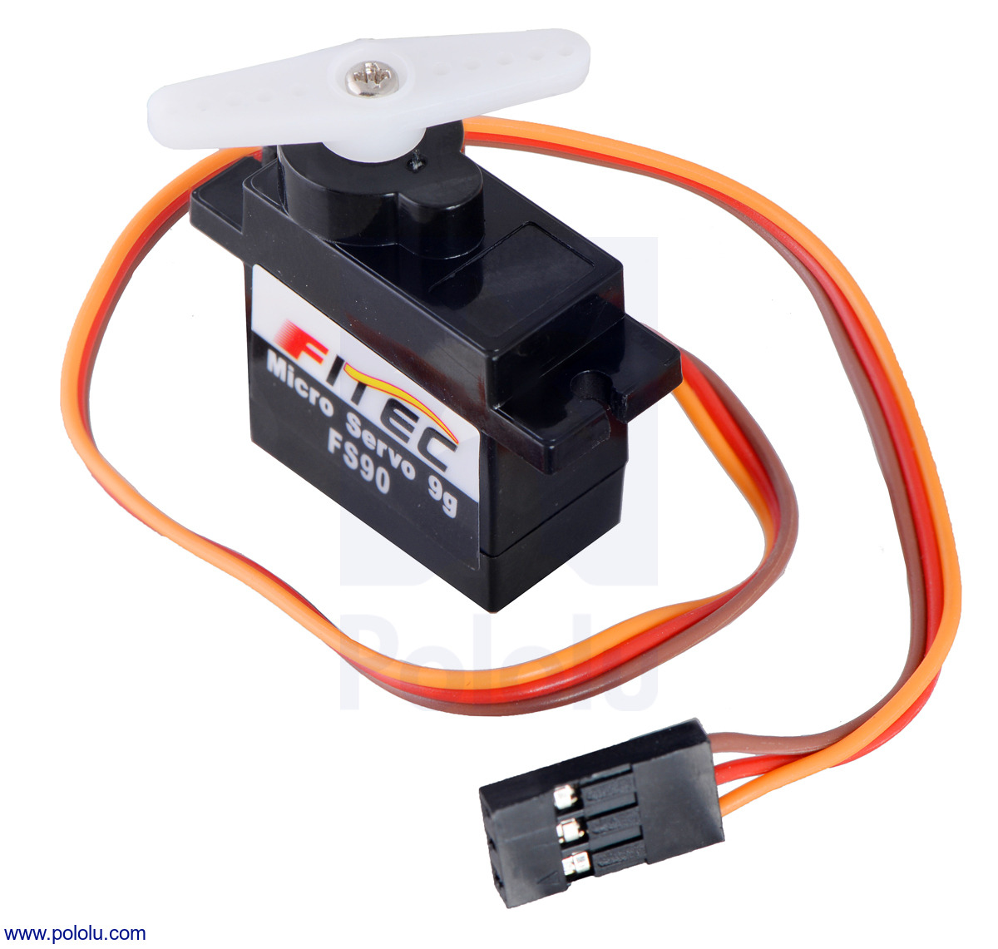
The hardware

Slide 4
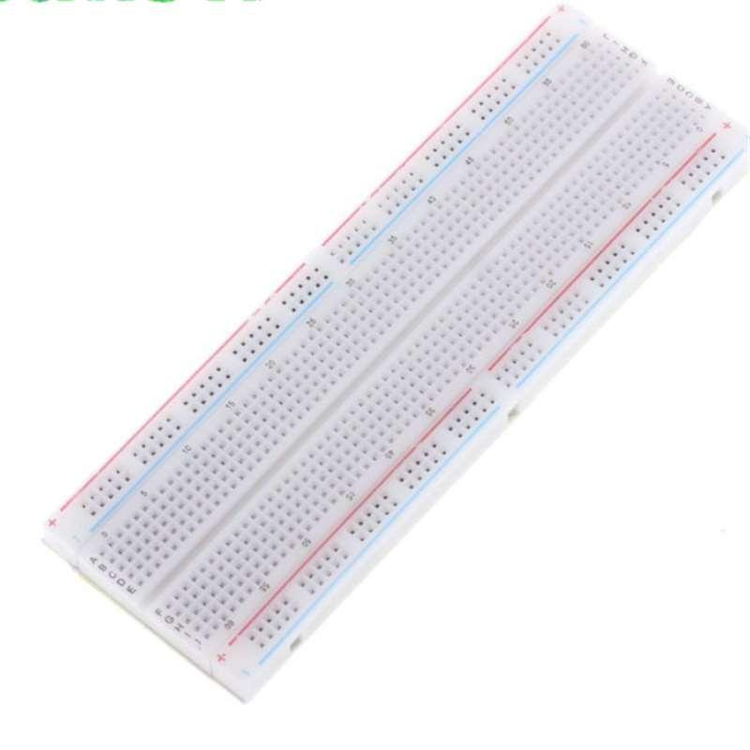
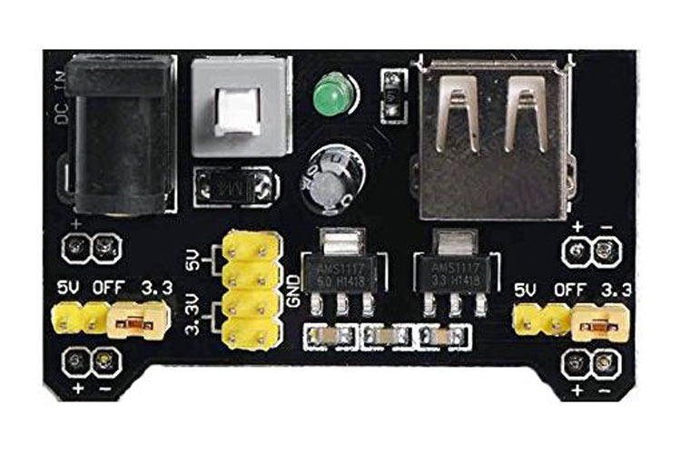

Slide 5
The software
Python3
  OpenCV (facial recognition)
  RPI.GPIO (servo movement)
  http module (not yet implemented) (streaming the camera feed to the browser, controlling the servos manually from the browser)

Slide 6
Implementation details
Haar Cascade Classifier – pretrained – uses kernels just like CNNs, but is applied to windows of the whole image and does not necessarily compute all kernels on every window.
Software PWM
Focus on writing code, which allows changing servo type

Slide 7
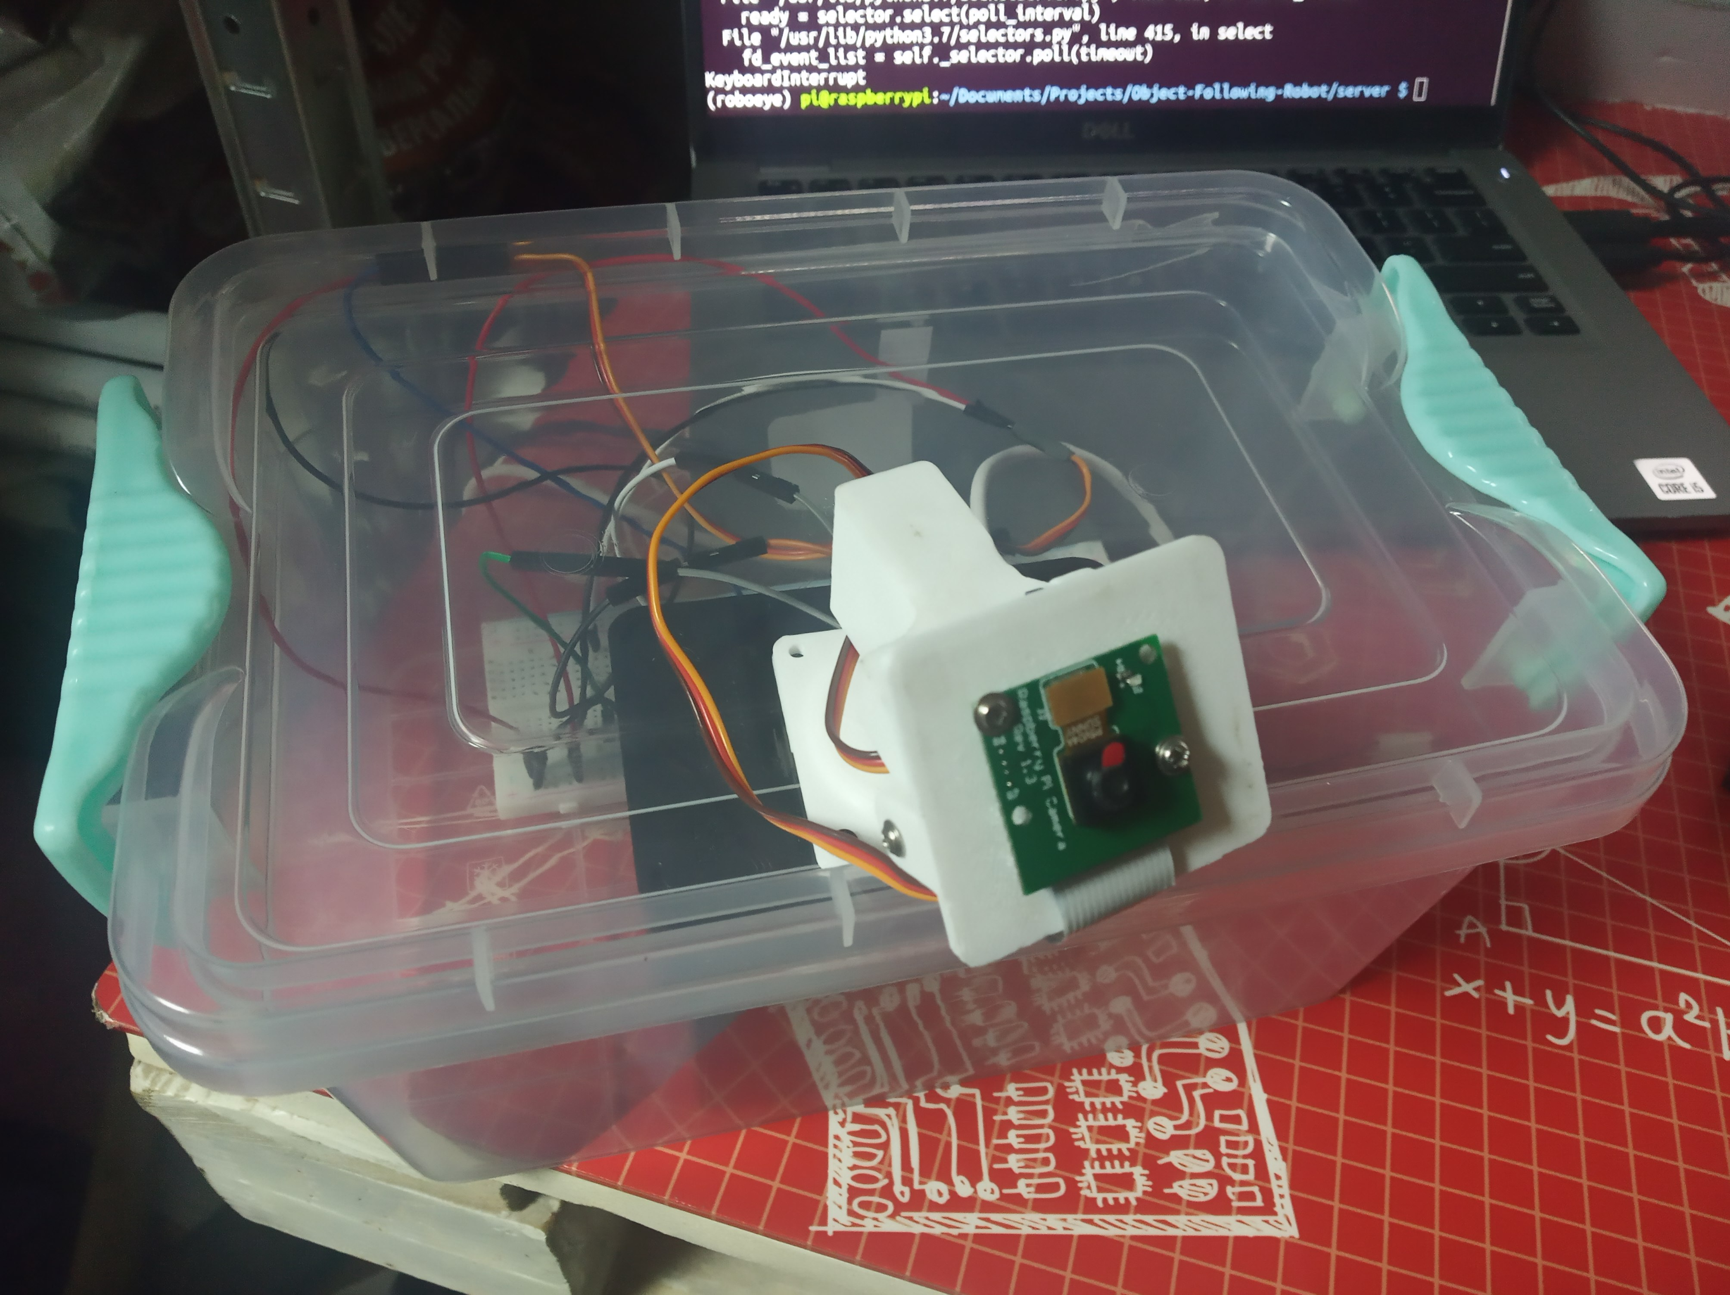
Final result

