Slide 1
Primary Source Projects in an Undergraduate Mathematics Classroom: A Pilot Case in a Topology Course
Kathleen Clark, Daniel Otero, & Nicholas Scoville
Thematic Working Group 12
CERME-10
Dublin, Ireland
2 February 2017

Slide 2
The TRIUMPHS Project
Transforming Instruction in Undergraduate Mathematics via Primary Historical Sources
Principle Investigators (Collaborators):
Janet H Barnett, Colorado State University Pueblo
Kathleen M Clark, Florida State University
Dominic Klyve, Central Washington University
Jerry M Lodder, New Mexico State University
Daniel Otero, Xavier University
Nicholas A Scoville, Ursinus College
Diana White, University of Colorado Denver
Graduate Students:
Cihan Can, Florida State University
Merve Karakis, Florida State University

Slide 3


The TRIUMPHS Project
Funded by the National Science Foundation
Five-year, $1.5 million, seven-institution effort in the United States
Funding Period: August 2015 – July 2020
This material is based upon work supported in part by the National Science Foundation under grant numbers 1523494, 1523561, 1523747, 1523753, 1523898, 1524065, and 1524098. Disclaimer: Any opinions, findings, and conclusions or recommendations expressed in this material are those of the author(s) and do not necessarily reflect the views of the National Science Foundation.

Slide 4
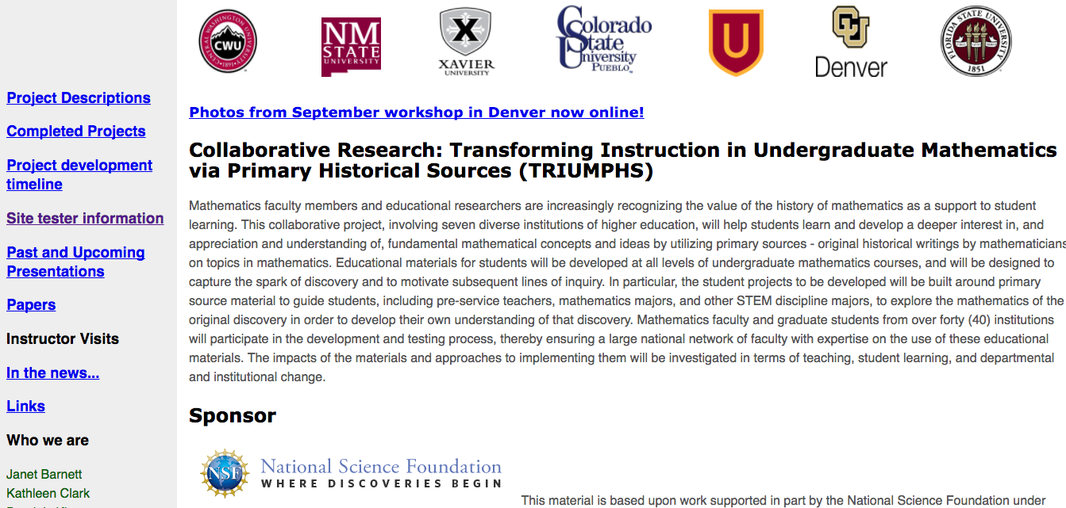
TRIUMPHS Project Website

Slide 5
Aims and Scope of TRIUMPHS
Aim: to design, develop, write, test/implement, evaluate, and disseminate classroom materials based on primary sources (“Primary Source Projects” = PSPs) for teaching undergraduate mathematics courses
Plan to create 25 full-length PSPs and 30 “mini” PSPs over the course of grant project
Scope of Topics: PSPs address topics ranging from pre-calculus / trigonometry and elementary statistics to abstract algebra, analysis, and topology

Slide 6
Aims and Scope, continued
The materials allow instructors to replace traditional classroom instruction with PSPs that directly engage students with the mathematics they are studying
Students read source texts, and through a series of exercises that are woven throughout the project, develop a fuller understanding of the mathematics they are studying

Slide 7
Full-Length PSPs (14)
A Genetic Context for Understanding the Trigonometric Functions
The Exigency of the Euclidean Parallel Postulate and the Pythagorean Theorem
Failure of the Euclidean Parallel Postulate and Distance in Hyperbolic Geometry
Richard Dedekind and the Creation of an Ideal: Early Developments in Ring Theory
Rigorous Debates over Debatable Rigor in Analysis (Darboux’s Monster Function)
Primes, Divisibility & Fermat Numbers
Bolzano's Definition of Continuity, his Bounded Set Theorem, and an Application to Continuous Functions
Investigating Difference Equations
Investigations Into d’Alembert’s Definition of Limit
An Introduction to a Rigorous Definition of Derivative
Investigations Into Bolzano’s Formulation of the Least Upper Bound Property
The Mean Value Theorem
Abel and Cauchy on a Rigorous Approach to Infinite Series
The Definite Integrals of Cauchy and Riemann

Slide 8
Mini-PSPs (9)
Babylonian Numeration
Why Be So Critical? Nineteenth Century Mathematics and the Origins of Analysis
Topology from Analysis: Making the Connection
Connecting Connectedness
The Cantor Set Before Cantor
Henri Lebesgue and the Integral Concept
Euler’s Rediscovery of e
Euler’s Derivatives of the Sine and Cosine Functions

Slide 9
Topology Course Pilot Case Study
Setting: Ursinus College
A small liberal arts, bachelor’s degree granting institution near Philadelphia, Pennsylvania
Topology Course: 8 students
full data profile for 5
Three mini-PSPs implemented
PSPs help to provide students with motivation for subtle and nuanced mathematical definitions (in contrast to what typically occurs in traditional classrooms) – and the texts used exhibit the rationale behind these definitions

Slide 10
Research Questions
As a result of engaging with PSPs, what changes do students report in their attitudes and beliefs about learning mathematics?
As a result of engaging with PSPs, do students report any change in their mathematical worldview, and if so, what is the predominant view change?
In what ways does the use of PSPs influence mathematics (or mathematics-related major) students’ beliefs and perceptions about mathematics?
As a result of engaging with PSPs, what do students report as challenges and benefits of learning from primary sources?
Notes:
(Note here: changed surveys in 2016 to better address question 3 & 4.)

Slide 11
Data Sources
Student Change
Pre- / Post-Course Survey
Post-PSP Survey(s) [began Fall 2016]
Student Work [from each PSP]
Student Interviews [planned to begin Spring 2017]
Daily video capture, small-group audio, additional student work, and pre- / post-interviews:
Evidence of students’ progress in “figuring out” (Sfard, 2014, p. 201) the meta-level rules that govern a new mathematical discourse [began Spring 2017]
The extent to which students’ (verbal / written / other) actions both during and after engagement with the PSPs provide evidence of their acceptance of a new discourse [began Spring 2017]

Slide 12
Of Interest for this Pilot
What student populations are being served in courses where PSPs are implemented / tested?
What do students discuss regarding learning of mathematics?
What do students observe about the use of PSPs in their undergraduate mathematics courses (in general; for their own learning)?
What are students views on mathematics (pre-/post)?

Slide 13
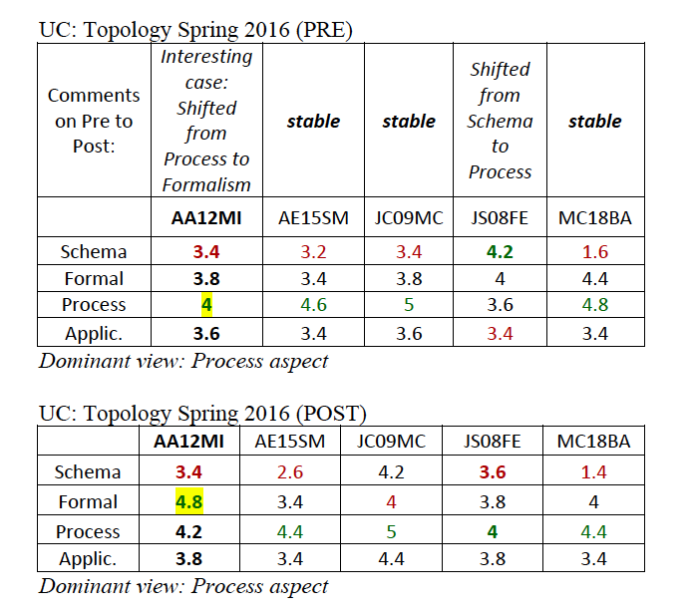
Notes:
Formalism and Schema same “static” view of math: intercorrelate highly (here solving problems of reality not a goal0
Application and process correlates significantly

Slide 14
Definitions of Törner’s Aspects
Formalism-aspect of mathematics: “mathematics is characterised by strictness, exactness, and precision on the terminological and language levels concerning thinking (“logical,” “objective,” and “flawless thinking”), argumentation, giving reasons and proof of statements as well as theoretical systematology (axiomatics and the strict deductive method)” (Törner, p. 126)

Slide 15
Aspects, continued
Application-aspect: “…of the immediate relevance to application or the practical use of mathematics. The pupils’ knowledge of mathematics is important to their future life: mathematics either helps to solve everyday tasks and problems or it is useful to one’s occupation. Apart from that, mathematics is of a general, fundamental use to society” (Törner, p. 127)

Slide 16
Aspects, continued
Process-aspect: “Mathematics is…a process and…an activity in thinking about problems and gaining knowledge. On the one hand, this cognitive process is about creating, inventing or re-inventing (re-discovering) mathematics. On the other hand, it also includes the comprehension of facts and understanding connections. This problem, the oriented cognitive process of understanding, decisively requires thinking and arguing in regard to content as well as sudden and new ideas, intuition and experimenting. This [aspect] expresses the dynamic view of mathematics” (Törner, pp. 127-128)

Slide 17
Aspects, continued
Schema-aspect: “…operationally define a view of mathematics which is seen as a “tool-box and bundle of formulas” and an idea oriented with algorithm and schemes. Mathematics is characterised by a collection of methods and rules which precisely determine how to solve a task. The consequence with dealing with mathematics is: doing mathematics consists of remembering and applying definitions, rules, formulas, facts and methods. Mathematics consists of learning (and teaching!), practising and the remembering and applying of routines, schemata, and applications” (Törner, p. 128)

Slide 18
Next Steps
Currently concentrating efforts to expand testing of projects in classrooms. We are:
Acquiring appropriate data to better inform the first four research questions (survey refinement; interviews)
Developing an intensive qualitative study on the role of PSPs in learning of meta-discursive rules
Spring 2017:
15 instructors
17 courses
10 states
~334 students involved in courses using projects; 259 consenting students

Slide 19
Thank you for your attention!
We look forward to your questions and subsequent discussion.
Contact Information:
otero@xavier.edu
nscoville@ursinus.edu
kclark@fsu.edu
TRIUMPHS Website:
http://webpages.ursinus.edu/nscoville/TRIUMPHS.html

Slide 20
The following slides are not…
…part of the presentation.

Slide 21
Three Key Project Activities
Develop and rigorously test classroom materials to teach standard topics in the university undergraduate mathematics curriculum through primary historical sources,
Train faculty to implement PSPs and promote their use as widely as possible through widespread dissemination via conference talks and training workshops, and
Study diverse aspects of their implementation and efficacy.

Slide 22
Evaluation-with-Research Study
Designed to provide both formative and summative evaluation of key project activities:
Student Change
Faculty Expertise
Development Cycle (development of PSPs)

Slide 23
Sites & Data Collection Thus Far
Fall 2015 | Spring 2016 | Fall 2016 | Spring 2017
Colorado 1 | Colorado 1 | Colorado 1 | Colorado 1
New Mexico 1 | Pennsylvania 1 | New Mexico 1 | Colorado 2 (2 courses)
 |  | Ohio 1 (2 instructors) | Colorado 3 (2 courses)
 |  | Tennessee 1 (2 sections) | Colorado 4
 |  |  | Alabama
 |  |  | Ohio 1
 |  |  | California 1
 |  |  | Wisconsin 1
 |  |  | Missouri
 |  |  | Kansas
 |  |  | Pennsylvania 2
 |  |  | Pennsylvania 3
 |  |  | New York 1
 |  |  | New York 2
 |  |  | Georgia (2 sections)

Slide 24
Meta-Discursive Rules (intensive pilot study, Fall 2016 – Spring 2017)
Research Questions
1. When studying number theoretic ideas focused on prime numbers using primary source projects, what is the evidence of students’ progress in “figuring out” (Sfard, 2014, p. 201) the meta-level rules that govern a new mathematical discourse?
2. To what extent do students’ (verbal / written / other) actions both during and after engagement with the primary source projects provide evidence of their acceptance of a new discourse?

