Slide 1
TRIUMPHS
Transforming Instruction in Undergraduate Mathematics via Primary Historical Sources

Slide 2
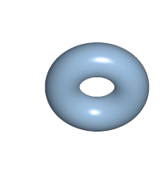

Slide 3
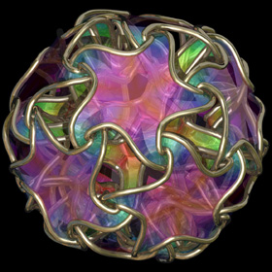
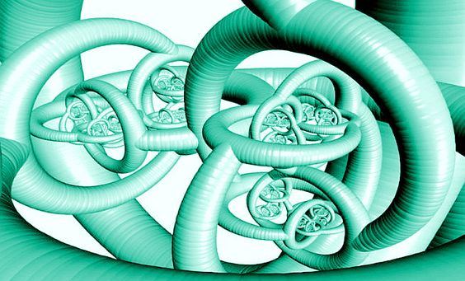
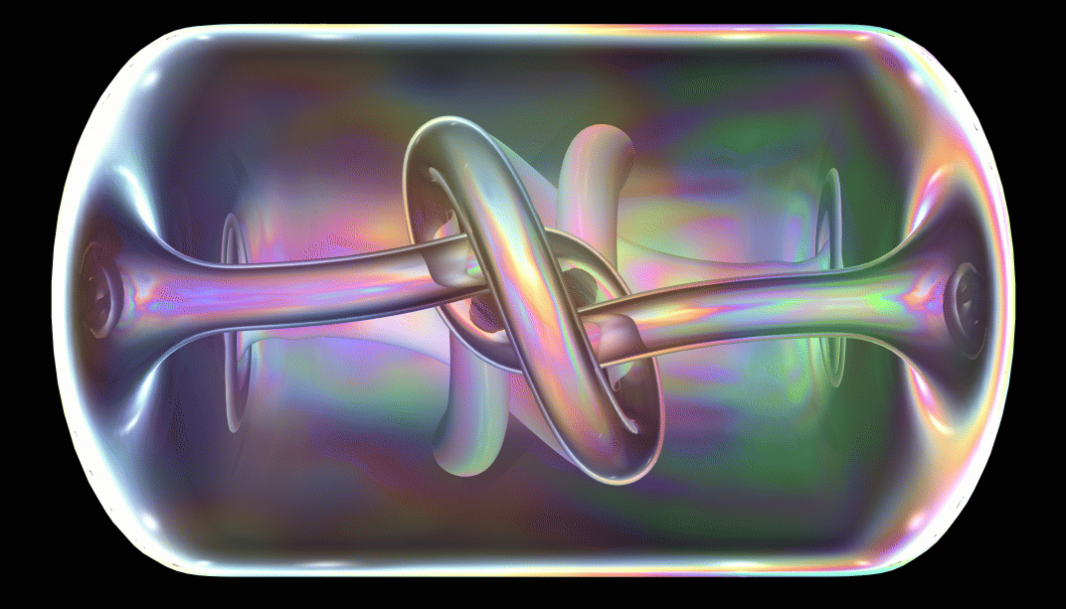

Slide 4
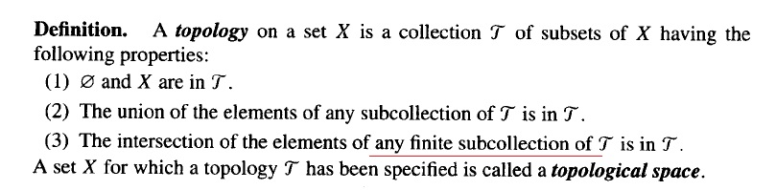

Slide 5
Where does it come from?

Slide 6
Where does it come from?
Why THIS definition?

Slide 7
Where does it come from?
Why THIS definition?
Why THESE nuances and subtleties?

Slide 8
Where does it come from?
Why THIS definition?
Why THESE nuances and subtleties?
Mathematics less clear and less motivated

Slide 9
The TRIUMPHS Project

Slide 10
The TRIUMPHS Project
Design

Slide 11
The TRIUMPHS Project
Design
Write

Slide 12
The TRIUMPHS Project
Design
Write
Implement

Slide 13
The TRIUMPHS Project
Design
Write
Implement
Test

Slide 14
The TRIUMPHS Project
Design
Write
Primary Source Projects
Implement
Test

Slide 15
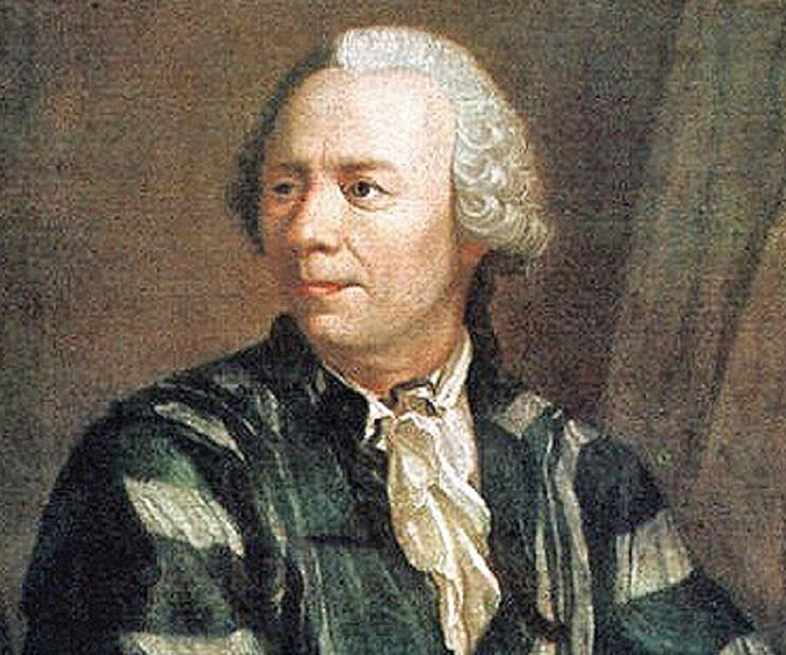

Slide 16
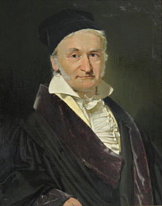

Slide 17
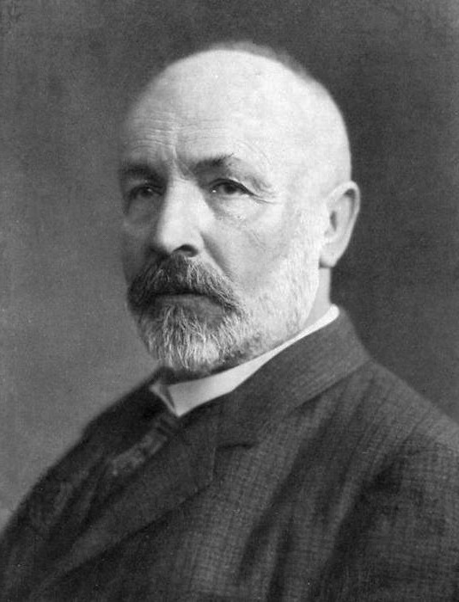

Slide 18
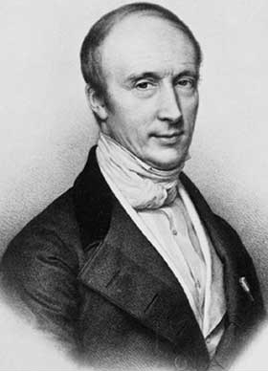

Slide 19
Problems and questions in the original context

Slide 20
Problems and questions in the original context
Motivation for modern ideas

Slide 21
Problems and questions in the original context
Motivation for modern ideas
Guided reading with exercises

Slide 22

Learn more at
www.webpages.ursinus.edu/nscoville/TRIUMPHS.html
This material is based upon work supported in part by the National Science Foundation under Grants No. 1523494, 1523561, 1523747, 1523753, 1523898, 1524065, and 1524098.
Any opinions, findings, and conclusions or recommendations expressed in this material are those of the authors and do not necessarily reflect the views of the National Science Foundation.

