Slide 1

The TRIUMPHS Project: Opportunities for History, Research, and Change in Undergraduate Mathematics Classrooms
Kathy Clark & Cihan Can
(Florida State University)
HPM – Americas Meeting
San Diego, CA
16 October 2016

Slide 2
Presentation Overview
Introduction to the TRIUMPHS Project
Overview of the Project Activities
Examples of Primary Source Projects
Evaluation with Research (EwR) Components
Additional Information & Resources

Slide 3
TRIUMPHS Project
TRIUMPHS: TRansforming Instruction in Undergraduate Mathematics via Primary Historical Sources
Janet H Barnett, Colorado State University Pueblo
Kathleen M Clark, Florida State University
Dominic Klyve, Central Washington University
Jerry M Lodder, New Mexico State University
Daniel Otero, Xavier University
Nicholas A Scoville, Ursinus College
Diana White, University of Colorado Denver

Slide 4
TRIUMPHS Project
Funded by the National Science Foundation
“Collaborative research project”
Five-year, $1.5 million, 7 institution effort in the United States
Began 1 August 2015
Project website: http://webpages.ursinus.edu/nscoville/TRIUMPHS.html

Slide 5
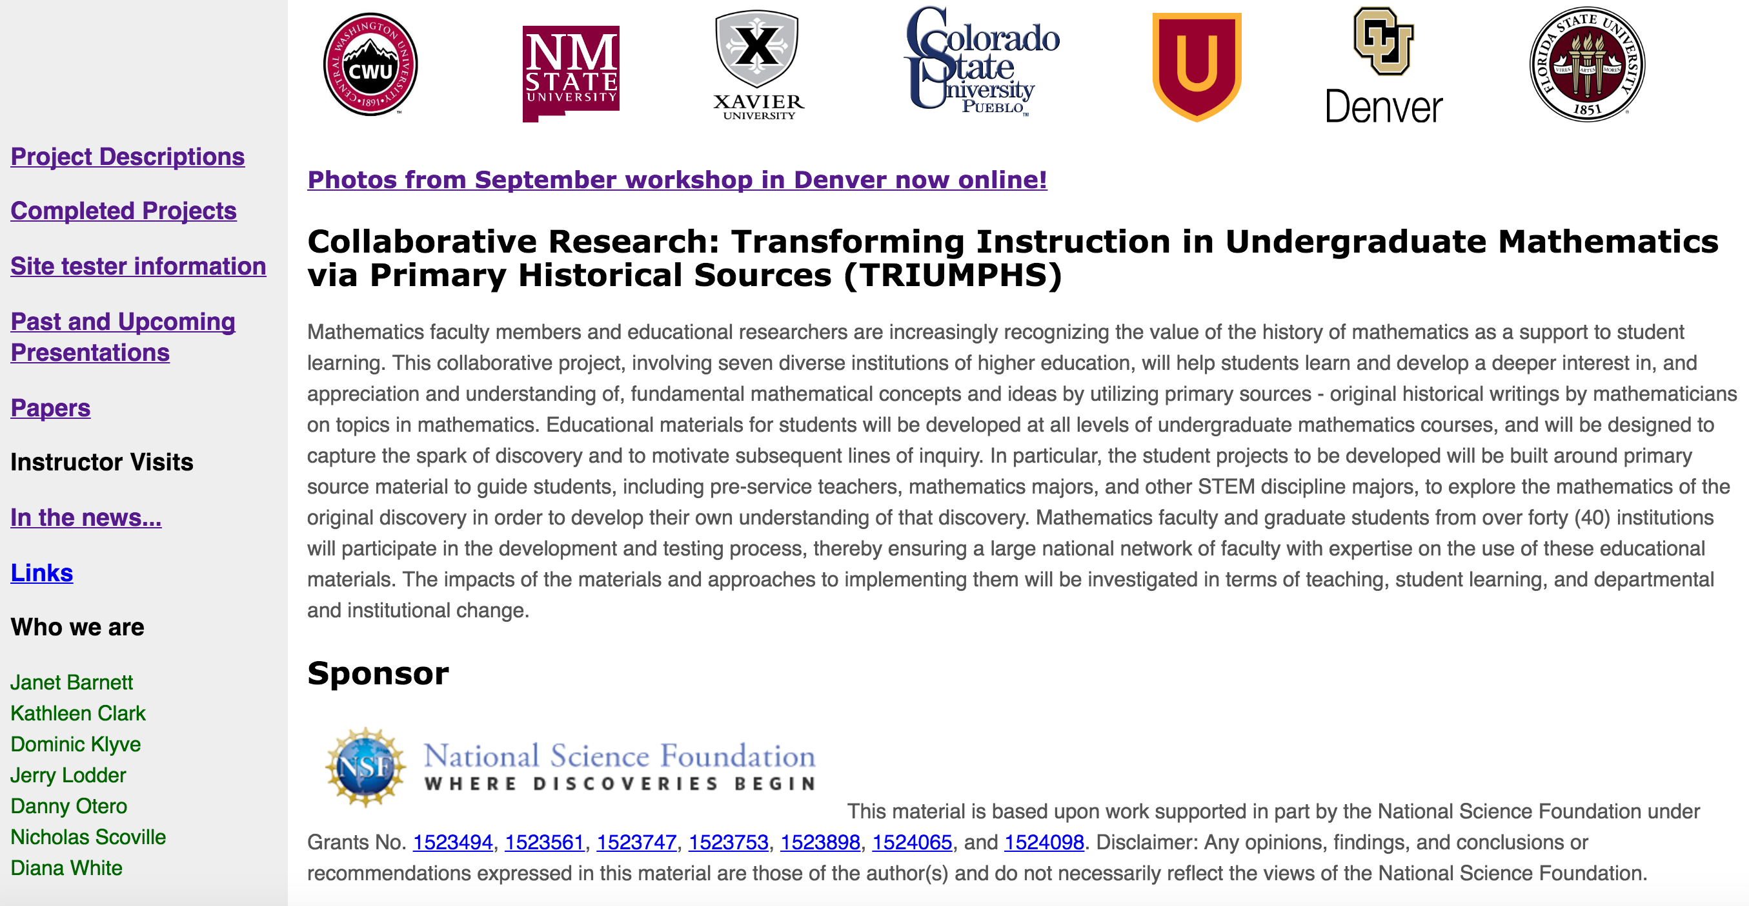
Project Website

Slide 6
TRIUMPHS Information
→ Project website with projects ready for use;
Site tester information;
Additional resources.

Slide 7
TRIUMPHS Project: Aims, Topics, & Materials
Aim: to develop, test/implement, and evaluate classroom materials based on primary sources (“Primary Source Projects”; PSPs) for teaching undergraduate mathematics courses
Plan to create 20 full-length PSPs and 30 “mini” PSPs over the course of grant project
Topics addressed by the PSPs range from pre-calculus and elementary statistics to abstract algebra, analysis, and topology

Slide 8
Aims, Topics, & Materials…
The materials allow instructors to replace standard classroom lectures with PSPs that directly engage students with the mathematics they are studying
Students read source texts, and through a series of exercises that are woven throughout the project, develop a fuller understanding of the mathematics they are studying

Slide 9
Full-Length PSPs
Full-Length PSPs
Understanding the Trigonometric Functions
Investigating Difference Equations
Pythagorean Theorem and Exigency of Parallel Postulate
Failure of the Parallel Postulate
Dedekind and the Creation of Ideals
Primes, Divisibility & Factoring
Bolzano's Definition of Continuity, his Bounded Set Theorem, and an Application to Continuous Functions
Rigorous Debates over Debatable Rigor in Analysis (Monster Functions!)
Construction of Figurate Numbers
Investigations Into d’Alembert’s Definition of Limit
An Introduction to a Rigorous Definition of Derivative
Investigations Into Bolzano’s Formulation of the Least Upper Bound Property
The Mean Value Theorem
Abel and Cauchy on a Rigorous Approach to Infinite Series
The Definite Integrals of Cauchy and Riemann

Slide 10
Mini-PSPs
Babylonian Numeration
Why be so critical? Origins of Analysis
Topology from Analysis: Making the Connection
Connecting connectedness
The Cantor set before Cantor
Henri Lebesgue and the Integral Concept
Euler’s Rediscovery of e

Slide 11
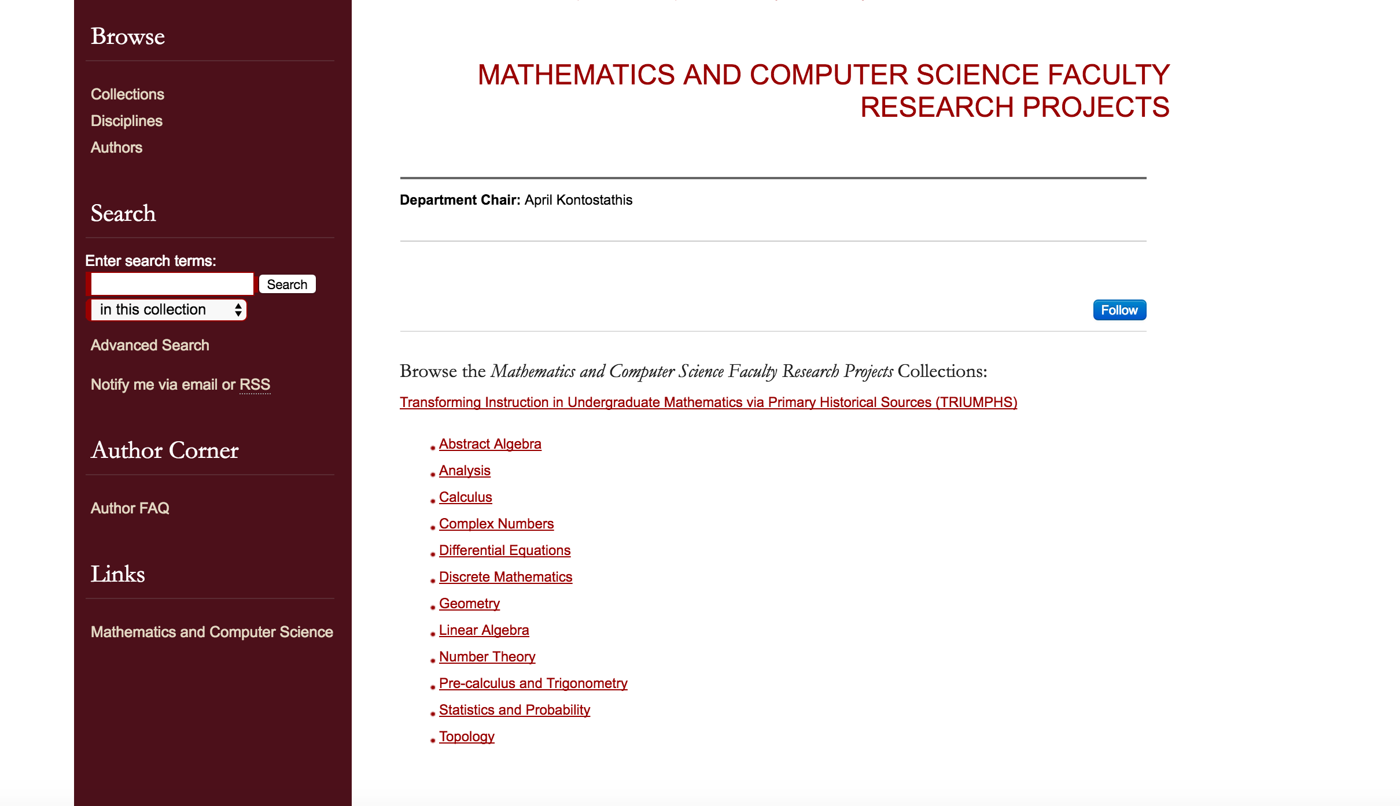
Project Depository

Slide 12
TRIUMPHS: Overall Plan
Develop and rigorously test classroom materials to teach standard topics in the university undergraduate mathematics curriculum through primary historical sources,
Train faculty to implement them, to promote their use as widely as possible through widespread dissemination via conference talks and training workshops, and
Study diverse aspects of their implementation and efficacy.

Slide 13
TRIUMPHS Project: Evaluation with Research
The Evaluation with Research (EwR) Component will provide formative and summative evaluation for TRIUMPHS to aid in the understanding of:
* How student mathematical world views evolve;
* How / in what ways do individual PSPs may promote student learning of the meta-discursive rules that govern mathematical practice; and
* How to support faculty in developing expertise implementing this instructional approach

Slide 14
Sample Research Questions
“Student Change” Piece
RQ1a: In what ways does the use of PSPs influence mathematics students’ beliefs and perceptions about mathematics?
RQ1b: In what ways does the use of PSPs influence mathematics education students’ beliefs and perceptions about mathematics?
RQ1c: In what ways does the use of PSPs influence other students’ (taking Calculus II and below) beliefs and perceptions about mathematics?

Slide 15
RQs, continued
RQ2a: What is the potential of a given PSP (specifically the original source material within the PSP) to promote the learning of meta-discursive rules in mathematics?
RQ2b: What is the potential of a given PSP to promote student reflection on meta-rules in conception formation?
[Sfard (2001): meta-rules include those rules that underlie the uniquely mathematical ways of defining and proving; rules that regulate and guide interpersonal exchange and self-communication; the way symbolic tools should be used in the given type of communication, etc.]
RQ3: In what ways does student engagement with PSPs influence student retention in mathematics?

Slide 16
RQs, continued
“Faculty Expertise” Piece
RQ4: What faculty characteristics may predict or explain which faculty and graduate students choose to attend training workshops and to implement PSPs?
RQ6: In what ways does the use of PSPs change instructors’ (and graduate teaching assistants’) approach to teaching other topics/courses?

Slide 17
Data Sources (Sample for “Student Change” piece)
Students | Instructor
Pre-Course Survey | Pre-Course Survey
PSP student work
Post-PSP Survey (for max of 2 per course) | Post-Implementation Report (per PSP)
Post-Course Survey | Post-Course Survey
** Student “matched set” requires each of the above. **
Note: Collect 10% -20% of participating students’ work.
(Interviews possible.) | (Interviews possible.)

Slide 18
TRIUMPHS Information
Project website with projects ready for use;
→ Site tester information;
Additional resources.

Slide 19
TRIUMPHS Information
Project website with projects ready for use;
Site tester information;
→ Additional resources.

Slide 20
Thank you!
Questions about being a site tester of a PSP? Contact Janet Barnett (janet.barnett@csupueblo.edu)
and Dominic Klyve (klyved@cwu.edu)
Please direct questions/comments on the EwR aspect of TRIUMPHS to:
Kathy Clark
kclark@fsu.edu

