Slide 1
Spotify Hit Prediction
Group 17 Stat 451
Alex Wong, Aradhya Gupta, Bobby Bui, Mia Patil, Xinwei Chen
Notes:
Alex
Hi everyone, we’re group 17 and today we’ll be sharing our Spotify Hit Prediction Project

Slide 2
Spotify Hits Predictor Dataset
The Spotify Hit Predictor Dataset contains Spotify songs that are classified as a hit or a flop Based on the following conditions:
The track, artist, or genre has appeared in Spotify’s ‘Today’s Top Hits’ list of the 10’s
The track has US as one of its markets
The track’s genre is considered mainstream
The dataset contains the following variables of interest per track:
Danceability, energy, key, loudness, mode, speechiness, acousticness, instrumentalness, liveness, valence, tempo, duration, chorus hit
Notes:
Mia
The dataset we used for our project is the Spotify Hit Predictor Dataset from Kaggle, specifically data from the 2010s. This dataset includes 6,398 songs that are classified as a hit or a flop based on the following conditions… each song contains the following variables of interest…

Slide 3

Research Question
Main Question
Can Spotify audio features predict whether a song becomes a hit?
What We Want to Learn
Identify what musical characteristics most influence popularity.
Why This Matters
Reveal whether pop-music success follows measurable patterns.
Notes:
Xinwei:
Our main question is whether Spotify’s audio features can actually predict if a song becomes a hit.
Based on the dataset, we want to identify what musical features most influence popularity
This question is interesting to us because it reveals whether pop music success might follow measurable patterns.

Slide 4
Variables of Interest
Danceability: How suitable a track is for dancing (0–1). Higher = more rhythmically regular and danceable.
Energy: How loud, fast, and noisy the song is. Higher = more energetic, loud, fast-paced.
Liveness: Probability that the track was performed to a live audience (0–1).
Loudness_scaled: Overall loudness in decibels (dB), typically between -60 and 0. Used standard scaler.
Tempo_scaled: Speed of the track in beats per minute (BPM). Used standard scaler.
Chorus_proportion: Estimated timestamp (in seconds) where the chorus begins/total length of song.
Notes:
Bobby
Just list the variables and move on to the next slide

Slide 5
Data Cleaning
Data Processing
Converted duration from milliseconds to seconds (duration_ms - duration_sec).
Standardized numeric features using z-scores:
tempo - tempo_scaled
loudness - loudness_scaled
Engineered a new feature:
chorus_proportion = time when chorus starts ÷ total duration
Selected modeling features:
danceability/energy/liveness/loudness_scaled/tempo_scaled/chorus_proportion
Checked for missing values in all selected columns using a function.
Confirmed no missing data: no rows removed.
Data Split
Split dataset into 80% training, 10% validation, 10% test, with stratification.
Notes:
Xinwei: For data cleaning, we started by converting the song duration from milliseconds to seconds to make sure we have clearer scale to work with. Next, we standardized two variables that naturally have large ranges (tempo and loudness) using a z-score, so the model treats all features on a similar scale.
We also created a new feature called chorus proportion to measure how early the chorus appears relative to the total length of the song. After that, we selected the core audio features we wanted to use in the model.
To make sure the dataset was usable, we checked each selected column for missing values using a small function that reports and removes any incomplete rows. In this case, we found no missing data, so nothing was dropped.
Once the dataset was clean, we split it into training, validation, and test sets using an 80-10-10 split with stratification to keep the ratios consistent across all parts of the data.

Slide 6
Methods: Model and Hyperparameter Selection
Train and compare multiple classification algorithms (SVM, Logistic Regression without LASSO, Logistic Regression with LASSO, KNN, Decision Tree) while testing different several different hyperparameters for each model.
Use proportion of predictions where y = 1 to flag potential class-imbalance/overfitting.
Evaluate each model using validation accuracy. Select model and hyperparameter combination which produces highest accuracy score on validation data.
Notes:
Alex - For Model and Hyperparameter Selection
Using grid search with cross validation
tested 5 different classifiers (SVM, LR w LASSO, LR w/o LASSO, KNN, Decision Tree, Random Forest) and different hyperparameters with respect to each classifier on our training data.
We tested all model and hyperparameter combos and selected one which produced the validation highest accuracy score and took note of the number of predicted y values. This was Random Forest.

Slide 7
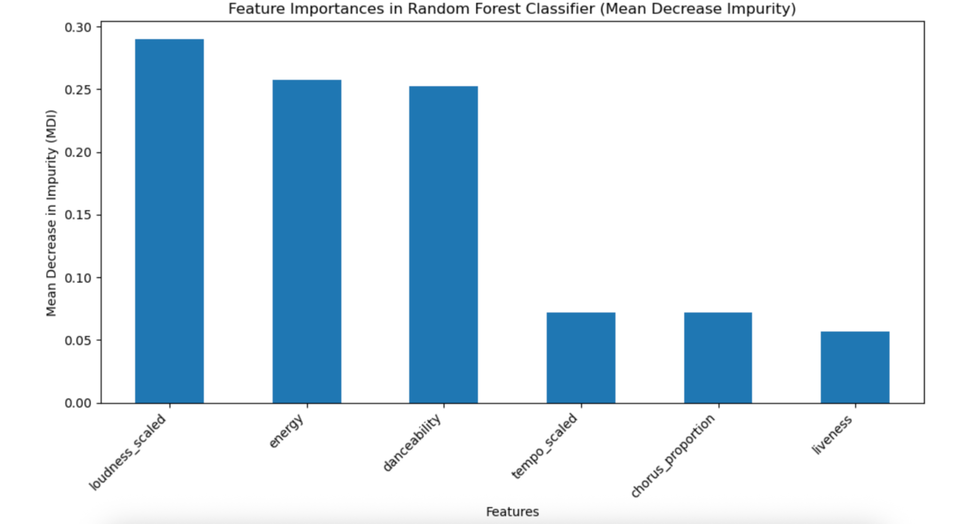
Random Forest
Random Forest has the highest validation accuracy: 0.772
Proportion of predictions where y=1: 0.5766
Plot shows feature importance using mean decrease impurity.
Notes:
Bobby: Validation accuracy of random forest is 0.772
All of our models have accuracies within the 0.7-0.8 range but random forest is the highest of them all.
Proportion of predictions where y=1 for RF is 0.5766
Used mean decrease in impurity to measure feature importance in out random forest. Calculated on our best model.
MDI: the Random Forest internal measure of how much a feature improves splits in decision trees.
Higher values = the feature contributes more to predicting hit vs. flop.
Loudness, energy, and danceability score high, which means these three variables have a larger effect on the model.
Tempo_scaled and Chorus_proportion matter moderately, and Liveness has the least predictive power

Slide 8
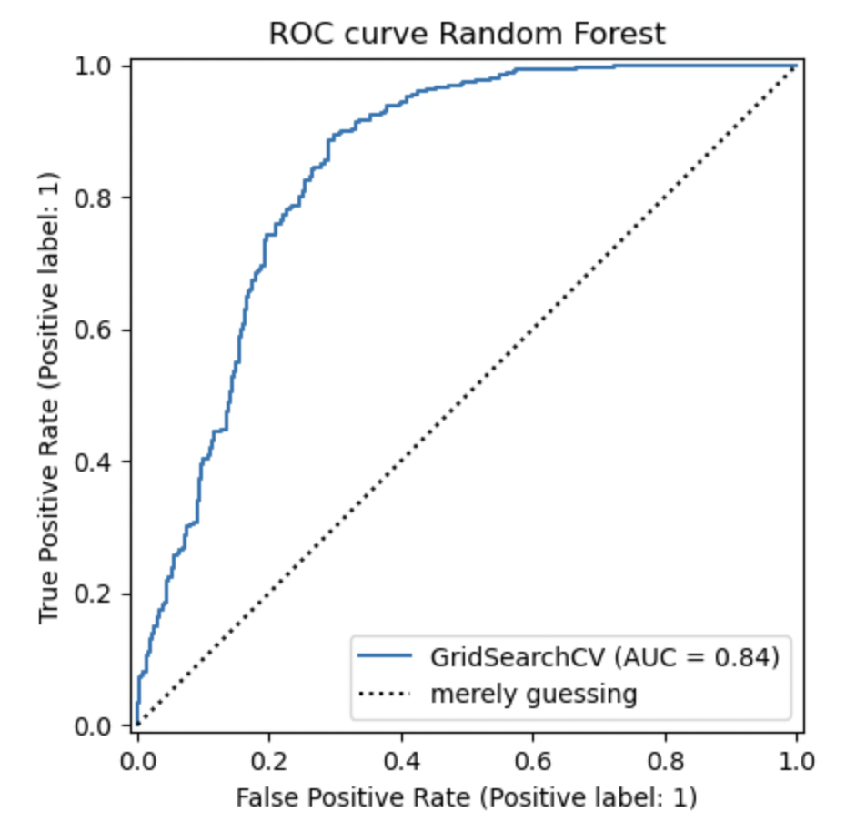
The Area Under the Curve (AUC) for our Random Forest is 0.84
This means if we randomly pick one hit and one flop, there’s about an 84% chance the model assigns a higher score to the hit than to the flop.
This indicates strong ranking performance, meaning the model is good at ordering songs from “more likely to be a hit” to “less likely”.
Notes:
Aradhya
We wanted to see how well our best model (Random Forest, tuned via GridSearchCV) separates hits from flops across all classification thresholds, not just at 0.5 that is why we looked at the ROC curve
Even if we moved the classification threshold up or down this curve shows the Random Forest would still maintain a strong trade-off between catching real hits and not mislabeling too many flops.

Slide 9
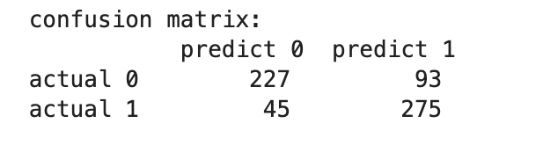
Confusion Matrix of Best Model (Random Forest)
The model correctly identifies 275 hits and 227 flops
Most errors are false positives (93 cases):
The model predicted a flop song as a hit.
This means some flops resemble hits in their audio features.
There were 45 false negatives:
Real hits the model missed.
These tracks may have unusual characteristics not typical of most hits.
The model is better at identifying actual hits (TP = 275) than flops.
Combined with the AUC = 0.84, this shows the model distinguishes hits vs. flops well, but some borderline cases remain ambiguous.
Notes:
Aradhya
This confusion matrix helps us understand what kinds of mistakes the model is making, not just how often it’s correct.
The rows show the true labels and the columns show what the model predicted
The model correctly identifies 275 hits and 227 flops.Most errors are false positives.
The important takeaway is that the model is noticeably stronger at catching actual hits (it gets about 86% of them right) than at confidently rejecting flops
Overall, this confusion matrix reinforces our main conclusion: Spotify audio features contain clear signals that help predict hit songs

Slide 10
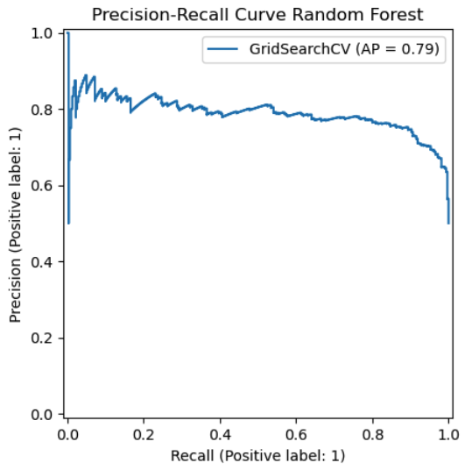
Average Precision = 0.79
Model achieves 80% recall with 80% precision
Precision drops when targeting 90%+ recall because of hits with atypical audio features
Notes:
Mia
Our precision recall curve shows how well our model balances two important questions: 1) Of all songs predicted as hits, how many were actually hits? (this is measuring the precision) And 2) Of all actual hits, how many do we catch? (this measures the recall).
Our model scored an average precision of 0.79/1.0 which is a strong performance. As we can see in the middle section, at a certain threshold the model achieves ~80% precision with 80% recall. This shows that our model manages both false positive and false negative errors well at that threshold.
The sharp drop at the end of the curve occurs when we try to catch every single hit (90% or greater) because the model lowers its thresholds to predict more songs as hits which logically includes more false positives. This is expected for songs that are genuinely difficult to predict because they don’t have typical audio features of hits.

Slide 11

Weaknesses/Limitations
Did not consider additional variables beyond the 6 selected.
Selected Spotify dataset is for the 10s. (Songs released starting from 1/1/2010, ending 12/31/2019). It is possible that music tastes have changed, causing the model to not be generalizable/applicable to today’s music charts.
The Spotify dataset limited to song metrics. It is possible that data beyond song metrics may have been highly predictive of hit/flop
Ex: number of tour shows, number of grammys awarded
Notes:
Alex:
We didn’t consider variables beyond the 6 selected, our data was limited to the 2010s and the model may not be generalizable to today, our dataset was limited to song metrics and include other features that may have been predictive of a song becoming a hit.

Slide 12
Thanks!
Questions?
Notes:
Alex
Thank you for listening!

Slide 13
