Slide 1
STORE ALL BARBADOS · PERFORMANCE REPORTING
Full house. Digital money.
Word of mouth pays the rent.
What the June 2026 data says about where Store All grows next — told in four acts, from the dashboard: occupancy, payments, acquisition and the customer.
01
02
03
04
OCCUPANCY
PAYMENTS
ACQUISITION
CUSTOMER
We are sold out — 6 units left across 996.
86% of payers are already digital; autopay is stuck.
Referrals carry the value; the phone carries the volume.
Local, residential, location-led — never price-led.
Central · South · Lears — SiteLink rent roll, receipts, inquiry tracking & marketing summary · June 2026 month-end
Store All Barbados — Data Story · July 2026 · Title
01

Slide 2
01
ACT 01 · OCCUPANCY
We are sold out.
June 2026 month-end · 976 of 982 rentable units occupied across three sites (99.4%)
RENTABLE OCCUPANCY
UNITS LEFT TO SELL
MONTHLY RENT ROLL
NET ABSORPTION · JUNE
99.4%
6
$274k
+21
976 of 982 rentable units filled — 98.0% of all 996 (14 out of service)
vacant rentable units in the whole portfolio: 4 Central · 1 South · 1 Lears
96.6% of the $283k gross potential — near-zero discounting
34 move-ins vs 13 move-outs — vacated units refill immediately
OCCUPANCY BY SITE — SHARE OF RENTABLE UNITS
Churn at the ceiling
Central
99.1%
A small negative month is tenants swapping, not demand falling: every unit vacated in June was re-let within the month. Economic occupancy of 96.6% means we collect close to full list price — we are not buying this occupancy with discounts.
The portfolio has been at this ceiling all year. That is the story of this deck: the constraint is no longer demand — it is space.
457 of 461 rentable · 4 vacant — The Pine, St. Michael
South
99.6%
264 of 265 rentable · 1 vacant — Gibbons, Christ Church
Lears
99.6%
255 of 256 rentable · 1 vacant — 14 more units out of service
Store All Barbados — Data Story · July 2026 · SiteLink rent roll · June month-end; Lears position as of 2 July 2026
02

Slide 3
01
ACT 01 · OCCUPANCY
Demand keeps arriving. Supply doesn't.
SiteLink inquiry tracking · leads placed January–June 2026, all three sites
SIX MONTHS OF DEMAND VS WHAT WE CAN SELL TODAY
We need supply.
Inquiries · Jan–Jun
361
Growth is capped by capacity, not by the market. At 99.4% full, revenue can only move through rate — volume is gone until we add space.
Every act that follows — payments, referrals, the website — makes the machine more efficient. But only new units let it grow. Expansion is decision #1.
Converted to move-ins
138
Rentable units vacant today
6
361 inquiries chased 6 available units. Lears — the newest site — absorbed +15 net units in June alone and is now effectively full. The 38% inquiry→move-in rate is demand we largely turn away.
The ask: commit to a supply decision — expand Lears or open site #4.
Where the catchment data says it will fill is Act 04.
Store All Barbados — Data Story · July 2026 · SiteLink inquiry tracking Jan–Jun 2026 · rent roll June month-end
03

Slide 4
02
ACT 02 · PAYMENTS
The money is already digital.
June 2026 receipts, all sites · bank-app transfers reclassified July 2026 — they were never cash
PAYERS WHO PAY ELECTRONICALLY
REVENUE COLLECTED DIGITALLY
BIGGEST SINGLE MONEY CHANNEL
STILL PAYING CASH
86%
82.6%
$106k
71 units
699 of 812 units paying in June — autopay, bank app, website or card
$279k of $338k June receipts
CIBC bank-app transfers — 31% of collections, ahead of autopay
just 9% of collections ($30k) — cash is the tail, not the norm
HOW THE 812 JUNE PAYERS PAID — UNITS BY TIER
34%
42%
10%
14%
Autopay (Plug & Pay) 274 units · $89k/mo
Online / bank app 343 units · $149k/mo
Manual card 82 units · $41k/mo
Cash / cheque 113 units · $59k/mo
What changed: July's reclassification revealed that “Money Order” and “Internet” receipts were CIBC and Republic bank-app transfers, and “Bank Transfer” was the website's Pay Now. The cash-heavy picture was a labelling illusion — customers moved to digital years ago. The gap left is not digital vs cash — it is automatic vs manual, which is the next slide.
Store All Barbados — Data Story · July 2026 · SiteLink receipts June 2026 · 812 of 976 occupied units transacted in the window
04

Slide 5
02
ACT 02 · PAYMENTS
Autopay is stuck. 425 units are one click away.
Plug & Pay share of 978 occupied units, January–June 2026 · June receipts by conversion tier
AUTOPAY ADOPTION — SIX FLAT MONTHS
THE CONVERSION LADDER — JUNE PAYERS BY DISTANCE FROM AUTOPAY
On autopay today
274
27.4%
27.7%
28.3%
28.6%
28.5%
28.0%
Plug & Pay — the destination
One click away
425
343 bank-app / Pay Now + 82 manual card — already digital, just manual
The hard tail
113
Jan
Feb
Mar
Apr
May
Jun
cash & cheque — needs an ACH offer at renewal, not a nudge
+0.6pp in six months. Organic growth will not shift the mix — it needs a push.
Convert the one-click tier and autopay reaches ~72% of occupied units.
The ask: run the switch campaign
One targeted message to the 343 bank-app & Pay Now payers (“make it recurring”), a tick-box prompt for the 82 manual card payers at their next payment, and an ACH offer to cash & cheque at renewal. Every converted unit removes a monthly manual touch and cuts late-payment risk.
Store All Barbados — Data Story · July 2026 · SiteLink receipts Jan–Jun 2026 · autopay share of occupied units
05

Slide 6
03
ACT 03 · ACQUISITION — HOW THEY FOUND US
Word of mouth is the value engine.
SiteLink marketing category · 974 occupied tenants · lifetime value = cumulative rent per tenant, $12.5M total
HOW THE CURRENT BASE FOUND STORE ALL — 974 TENANTS
33%
22%
16%
9%
6%
11%
Internet 326 · 33%
Referral 217 · 22%
Prev tenant 160 · 16%
Drive-by 84 · 9%
Y. Pages 60 · 6%
Facebook 6 · 1%
Other 103 · 11%
Unknown 18 · 2%
LIFETIME VALUE PER TENANT, BY SOURCE
Referrals punch above their weight
Referral
$14,637
Referral + previous tenant are 39% of tenants but 41% of all lifetime value — $5.2M. A referred tenant is worth $14.6k, 52% more than an internet-sourced one.
And we currently pay nothing for it. The ask: formalise it — a referral credit for existing tenants and a win-back offer at move-out.
Previous tenant
$12,485
Drive-by
$11,979
Internet
$9,637
Yellow Pages tops the table at ~$21k/tenant but is a shrinking legacy book of 60 long-tenured commercial accounts. Internet brings the most tenants — at the lowest value per head.
Store All Barbados — Data Story · July 2026 · SiteLink marketing summary (sMktCat) · occupied base + cumulative rent value
06

Slide 7
03
ACT 03 · ACQUISITION — HOW THEY REACHED US
They find us online — then they phone.
SiteLink enquiry channel · 979 occupied units · contact channel, distinct from the marketing source
CONTACTED US BY PHONE
FOUND US ON THE INTERNET
EVER BOOKED VIA THE WEBSITE
WEB BOOKINGS, LAST 12 MONTHS
61%
34%
1.7%
1 of 270
602 of 979 tenants — the phone is the front door at every site
332 tenants incl. Facebook — discovery is already digital
17 tenants in the entire base — most predate 2020
one web move-in out of 270 recent — the funnel is broken
CONTACT CHANNEL MIX — 979 OCCUPIED UNITS
A brochure, not a funnel
Phone
602 · 61%
A third of tenants discover us online — then pick up the phone to book. Discovery is digital; booking is analog. That gap is the website.
The ask: rebuild it as a booking channel — live availability, prices, “Reserve now” — and own local search (Google Business Profile, click-to-call). Its Pay Now already collects $41k/mo; the front of the site should work as hard as the back.
Not recorded
165 · 17%
Walk-in
148 · 15%
Email
47 · 5%
Web
17 · 2%
Store All Barbados — Data Story · July 2026 · SiteLink InquirySource · occupied base; recent = move-ins in the last 12 months
07

Slide 8
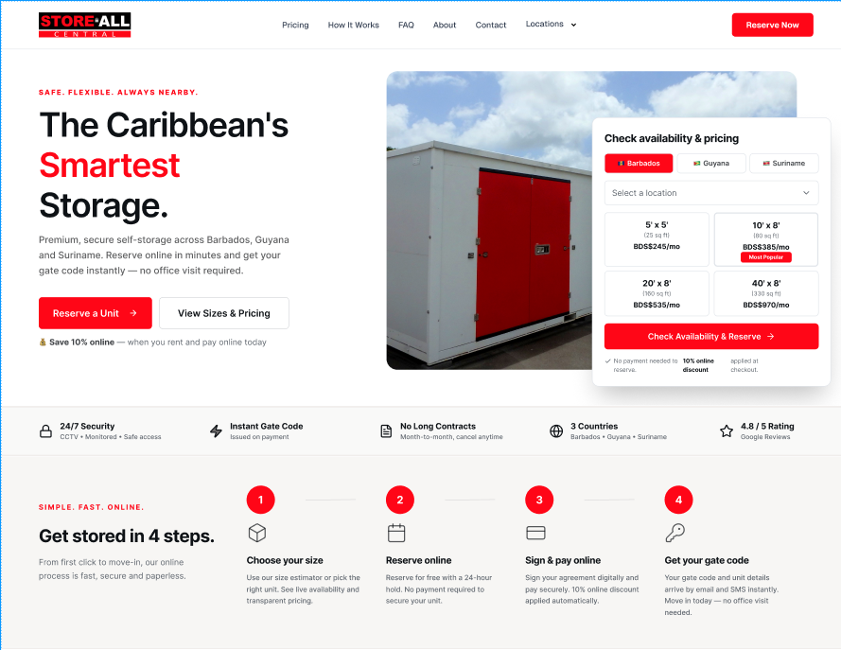
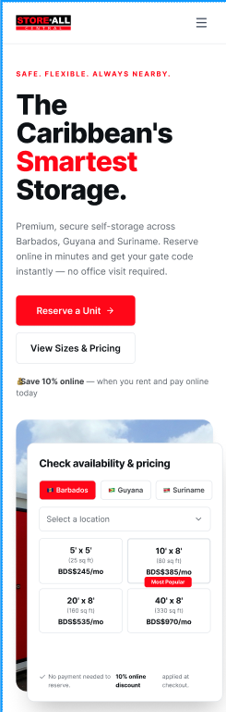
03
ACT 03 · THE NEW WEBSITE — STATUS
The fix is in flight: first mockups are in.
Store All Central homepage — desktop & mobile design mockups · received this week
WHAT THIS ALREADY FIXES
Live pricing & availability
the “check availability” widget Act 03 asked for
Reserve Now, online
reserve in minutes, gate code on payment — no office visit
10% online discount
a built-in reason to book (and pay) on the web
4-step online move-in
size → reserve → sign & pay → gate code
Three countries, one site
Barbados · Guyana · Suriname location picker
Designed so far: Homepage, Locations, FAQ, Contact, About. The online-reservation flow designs land early next week.
Store All Barbados — Data Story · July 2026 · Developer design mockups · client Figma share due tomorrow
08

Slide 9
03
ACT 03 · THE NEW WEBSITE — STATUS
Design is nearly done; the reservation flow is in build.
Developer status · week of 6 July 2026
DESIGN TRACK
DEVELOPMENT TRACK
DONE
Core pages designed
DONE
SiteLink API key
Homepage · Locations · FAQ · Contact · About
delivered — integration work unblocked
IN PROGRESS
Client Figma share
DONE
PlugnPay test account
completed designs shared with us by tomorrow
secured from PlugnPay support — payments testable
IN PROGRESS
Reservation-flow designs
IN PROGRESS
API integration
early next week — being validated against the live API first
website functionality build underway
OURS
Internal design review
NEXT
Working reservation flow
our team reviews mockups + reservation flow, returns feedback
basic end-to-end version by the end of next week
The ball comes to us this week
The only step on our side of the net: review the Figma designs and the reservation flow, then return one consolidated round of feedback. The July 24 build date holds only if that feedback doesn't sit — book the internal review session now.
Store All Barbados — Data Story · July 2026 · Developer status email · design + development tracks
09

Slide 10
03
ACT 03 · THE NEW WEBSITE — STATUS
Build done July 24. Live the week of August 10.
Phase 1 = 8 weeks from end of May · on track · go-live moved off month-end to the second week of August
THIS WEEK
NEXT WEEK
JUL 24
EARLY AUG
WEEK OF AUG 10
Figma review &
reservation designs
Working reservation
flow (end of week)
Phase 1 build
complete — on track
Review, content
& UAT window
GO-LIVE
PHASE 1 — WHAT GOES LIVE IN AUGUST
PHASE 2 — STARTS AFTER PHASE 1
Redesigned homepage and ancillary pages (Locations, FAQ, About, Contact), live unit availability, online reservation and online payment — the booking funnel this deck's Act 03 called for, with a 10% book-online incentive.
Account management — tenant self-service on top of the booking funnel. Some of it may be ready by go-live. Decision for us now: the developer asked which Phase 2 pages to build first — tell them this week.
Store All Barbados — Data Story · July 2026 · Developer phase breakdown (Google Doc) + status email · timeline as of 6 July 2026
10

Slide 11
04
ACT 04 · CUSTOMER PROFILE
Here for location — never for price.
Local households in transition · SiteLink marketing summary · 978 active tenants, all sites
CHOSE US FOR LOCATION
RESIDENTIAL CUSTOMERS
STORE FURNITURE / HOUSEHOLD
LIVE WITHIN ~5 MILES
67%
76%
64%
43%
657 tenants — versus 2 (0.2%) for price. Convenience, not cost
747 households vs 231 commercial accounts
629 tenants — life-event storage dominates the mix
and 13% overseas — the diaspora, concentrated at Central
WHY THEY STORE
WHY THEY CHOSE US
Back to Act 01
Excess / declutter
338 · 35%
Location
69%
Demand is local, residential and location-led — people store because life changed, near where they live.
So the growth lever is proximity and visibility, not discounting — and it is exactly why new supply in the right catchment will fill.
Moving
249 · 26%
Features
19%
Business needs
231 · 24%
Management
8%
Renovating
53 · 6%
Other
5%
Other
88 · 9%
Price
0%
Store All Barbados — Data Story · July 2026 · SiteLink marketing summary · shares of tenants with the field recorded
11

Slide 12
THE STORY, IN ONE SLIDE
What the data asks of us
Secure new supply
Sold out at 99.4% with 361 inquiries chasing 6 units. Volume growth is gone until we add space — expand Lears or commit to site #4.
01
EXPANSION
Convert the one-click 425
Autopay is stuck at 28% (+0.6pp in 6 months). 425 units already pay digitally but manually — run the recurring-billing switch campaign.
02
THIS QUARTER
Pay for word of mouth
Referrals + returning tenants: 39% of tenants, 41% of $12.5M lifetime value, $14.6k per referred tenant. Launch referral credits & move-out win-back.
03
REFERRAL CREDIT
Land the new website
The rebuild is in flight: mockups in, reservation flow next week, Phase 1 build done Jul 24. Review designs fast and pick Phase 2 priorities.
04
LIVE WK OF AUG 10
Store All Barbados — Data Story · July 2026 · Full detail in the Data Dashboard — occupancy, payments, acquisition, lead funnel & profile
12

