Slide 1
Human Activity Recognition Project
NAME : Veeri Dheeraj
REG NO : 12012614
SECTION : K20UP
COURSE NAME : CSE 441 (INDUSTRY INTERNSHIP PROJECT)/ CSE 448 (INDUSTRY CO – OP PROJECT-II )
MENTOR NAME : Ajay Sharma

Slide 2

Introduction
Human activity recognition (HAR) is the process of identifying specific activities or actions performed by individuals using data collected from various sensors.
This field has gained significant attention due to its applications in healthcare, sports analytics, surveillance, and human-computer interaction.
The aim of this project is to develop a robust HAR system using machine learning techniques to accurately classify different human activities based on sensor data.

Slide 3

Project Objective
The primary goal of this project is to develop a robust and accurate machine learning model capable of precisely recognizing a wide range of human activities. This will enable advanced applications and insights in areas such as healthcare monitoring, security surveillance, and smart home automation.
1
Accurate Activity Detection
2
Real-Time Processing
3
Scalable and Adaptable
Leverage machine learning algorithms to reliably identify a diverse set of human activities.
Implement the model to perform activity recognition in real-time, enabling immediate response and decision-making.
Design the solution to be scalable and adaptable to handle diverse data sources and user scenarios.

Slide 4
Dataset Description
The project utilizes a comprehensive dataset collected from multiple sensors, including video cameras. The dataset covers a wide range of human activities, such as walking, running, jumping, sitting, and more, performed by a diverse set of participants in various environments.
Video Recordings
UCF50 Dataset
Synchronized video footage captures the visual representations of the human activities, enabling multimodal analysis.
The UCF50 dataset consists of sensor data collected from wearable devices worn by participants. The sensors include accelerometers, gyroscopes, and magnetometers. The data was collected during various activities performed by participants.

Slide 5



Preprocessing of Data
The video data requires thorough preprocessing to ensure it is in a suitable format for machine learning models. This includes steps such as frames extraction, feature extraction, and normalization.
Frames Extraction
Video dataset is divided into equal number of frames for feature extraction.
Feature Engineering
Extracting relevant features from the sensor and video data to capture the characteristics of human activities.
Normalization
Scaling and normalizing the data to ensure optimal model performance.

Slide 6


Machine Learning Algorithms
The project leverages a variety of state-of-the-art machine learning algorithms to build the activity recognition model, including deep learning techniques and traditional supervised learning methods.
Deep Learning
CNN+LSTM
Convolutional Neural Networks (CNNs) and Long Short-Term Memory (LSTMs) are employed to capture the spatiotemporal patterns in the sensor and video data.
The combined CNN+LSTM algorithm is used to capture spatial and temporal features in the input data.

Slide 7
Result
The developed machine learning models demonstrate impressive accuracy in recognizing a wide range of human activities, with the ability to classify activities in real-time. The results highlight the effectiveness of the chosen algorithms and the quality of the dataset.
Matrices
Value
Precision
0.87
Recall
0.84
F1 Score
0.861
Loss
0.4
Accuracy
0.86

Slide 8
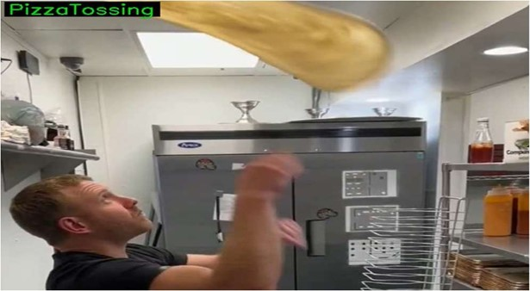
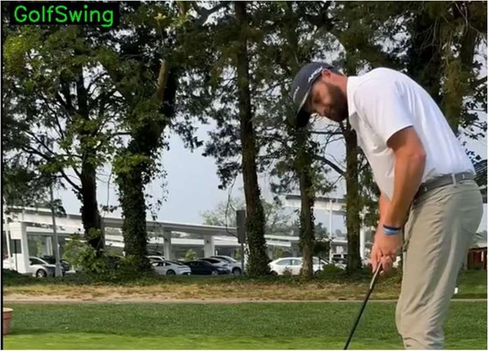
Prediction
With our developed machine learning models, we can accurately predict human activities in real-time. Our algorithms have shown high accuracy in activities like pizza tossing, golf swing. This enables us to provide valuable insights and enhance decision-making in various domains.

Slide 9
Applications
The human activity recognition capabilities developed in this project have numerous real-world applications across various industries, enabling innovative solutions and improving quality of life.
Healthcare Monitoring
Smart Home Automation
Security and Surveillance
Detect and analyze patient activities to improve rehabilitation programs, monitor elderly individuals, and provide personalized health recommendations.
Enable intelligent home environments that can automatically adjust lighting, temperature, and other settings based on recognized user activities.
Enhance security systems by detecting suspicious behaviors and activities, improving situational awareness and response times.

Slide 10

Conclusion and Future Work
This project has demonstrated the power of machine learning in accurately recognizing a diverse range of human activities. The developed models show promising results and open up new possibilities for innovative applications across various domains.
Expand Dataset
Multimodal Integration
Collect and incorporate a larger and more diverse dataset to improve model generalization and robustness.
Explore the integration of additional sensor modalities, such as visual, audio, and physiological data, to enhance activity recognition capabilities.
Edge Computing
Optimize the models for deployment on edge devices, enabling real-time, low-latency activity recognition in various applications.

Slide 11


