Slide 1


Human Activity Detection
upGrad
NAME : Dheeraj, Vamshidhar, Imran, Anvith
REG NO : 12012614, 12018126, 12020309, 12017102
SECTION : K20UP
COURSE NAME : CSE 441 (INDUSTRY INTERNSHIP PROJECT)/ CSE 448 (INDUSTRY CO – OP PROJECT-II )
MENTOR NAME : Ajay Sharma

Slide 2
introduction
upGrad
Human activity recognition (HAR) is the process of identifying specific activities or actions performed by individuals using data collected from various sensors.
This field has gained significant attention due to its applications in healthcare, sports analytics, surveillance, and human-computer interaction.
The aim of this project is to develop a robust HAR system using machine learning techniques to accurately classify different human activities based on sensor data.

Slide 3
ABOUT THE PROJECT
upGrad
The domain of this project lies at the intersection of machine learning, wearable technology, and human-computer interaction. It finds applications in healthcare (e.g., monitoring elderly individuals), sports analytics (e.g., analyzing athletes' movements), surveillance (e.g., detecting suspicious activities), and human-computer interaction (e.g., gesture-based control).
The dataset used in this project is the UCF50 dataset, which is a publicly available dataset consisting of sensor data collected from wearable devices worn by participants performing various activities. The dataset includes measurements from accelerometers, gyroscopes, and magnetometers, along with corresponding labels for each activity.

Slide 4
dAta PREPARATION
upGrad
Data collected from UCF50 dataset
UCF50 dataset consists of sensor data collected from wearable devices worn by participants
Sensors include accelerometers, gyroscopes, and magnetometers
Data collected during various activities performed by participants.
Long Short-Term Memory (LSTM) model selected for human activity recognition
LSTM is a type of recurrent neural network (RNN) well-suited for sequential data
Capable of capturing temporal dependencies in the sensor data
Suitable for modeling time-series data with long-range dependencies

Slide 5
STEPS OF Project
upGrad
The steps carried out throughout your project-
Data collection
Data preprocessing
Training using LSTM
Downloading video from YouTube
Saving the model
Recognition of video

Slide 6
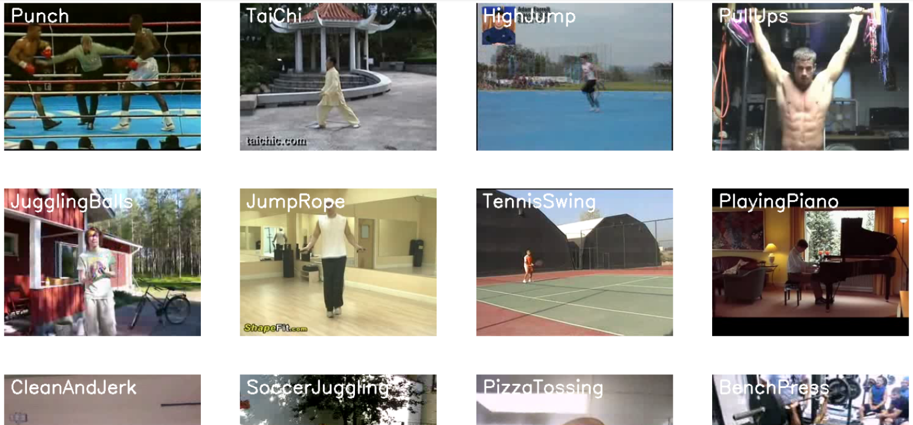
dAtaset overview
upGrad
Number of Classes: 50
Total Number of Videos:
50 classes * 150 videos/class = 7500 videos
Description: The dataset contains videos capturing various human activities, with each video
belonging to one of the 50 distinct classes. These activities encompass a wide range of daily
human actions and behaviors, covering diverse scenarios and contexts.

Slide 7
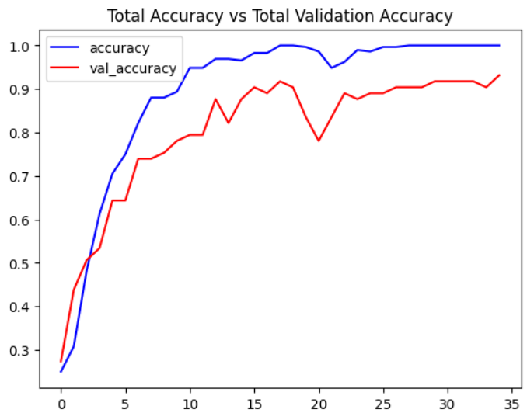
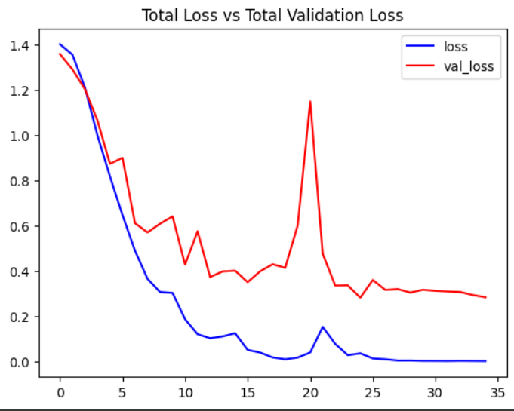
dAta VISUALIZATION
upGrad
These graphs represents the validation accuracy and validations loss and the validation accuracy. Which is used to represent whether the model is overfit. When the model is overfit we use Early Stopping method for this process.

Slide 8
insights
upGrad
Diverse Dataset: The dataset containing videos of human activities across 50 classes offers a diverse range of scenarios and actions. This diversity enables the development of robust models capable of recognizing various activities in real-world settings.
Balanced Classes: The balanced distribution of videos across the 50 classes ensures that the model is trained on an equal number of samples from each activity category. This balance is essential for preventing bias towards specific activities during training and evaluation.
Real-world Applications: The project's focus on human activity recognition from video data has numerous real-world applications, including surveillance, sports analytics, healthcare monitoring, and human-computer interaction.
Future Directions: The project provides a foundation for exploring advanced techniques in activity recognition, including multi-modal fusion, attention mechanisms, and transfer learning. Furthermore, ongoing research in human behavior analysis, video understanding, and explainable AI offers exciting avenues for future exploration and innovation in this field.

Slide 9
conclusion
upGrad
In conclusion, this project focused on the development of a robust human activity recognition system using a diverse dataset containing videos of human activities across 50 classes. Through meticulous data collection, preprocessing, and model training, we have achieved significant insights and advancements in the field of activity recognition from video data.
The diverse dataset provided a rich source of information, enabling the development of models capable of recognizing various activities in real-world settings. By ensuring a balanced distribution of videos across the 50 classes, we mitigated bias and facilitated fair evaluation of model performance across different activity categories.
This project has contributed valuable insights, methodologies, and models for human activity recognition from video data, paving the way for further advancements in computer vision, deep learning, and artificial intelligence. The knowledge gained from this project can be leveraged for future research, development, and applications aimed at understanding and interpreting human behavior in video streams.

Slide 10
thank you
upGrad

