Slide 1





A Sample Super-Store Analysis
PowerBI Analysis
70
52.5
35
17.5

Slide 2

Introduction
9994
Rows
2.3M Sales
Sales Overview
Product Analysis
Customers Analysis
Geographical Analysis
Conclusion
Contains market sales Contains market profits Sales per region

Slide 3

Overview
Welcome to our analysis of the Sample Superstore, where we will be diving deep into the sales performance of this retail giant. Our goal is to provide insights and recommendations for improving their sales performance and ultimately increasing their profitability.
Before we begin, let's take a moment to appreciate the sheer size and scale of the Sample Superstore. With over 10,000 products and a customer base spanning multiple demographics and geographies, it truly is a behemoth in the world of retail. However, with great size comes great complexity, and that's where our analysis comes in. We aim to unravel the intricacies of the Sample Superstore's sales performance and provide actionable recommendations for growth.

Slide 4

The sales performance of the Sample Superstore has been steadily increasing over the past year, with a significant spike during the holiday season. This can be attributed to the store's strategic marketing campaigns and product promotions, which effectively attracted more customers and boosted sales.
Furthermore, our analysis indicates that the store's online sales have also been growing at a rapid pace, indicating a shift in consumer behavior towards e-commerce. This trend is expected to continue in the coming years, and we recommend that the Sample Superstore invests in its online presence and digital marketing strategies to capitalize on this opportunity.
Sales
Overview

Slide 5
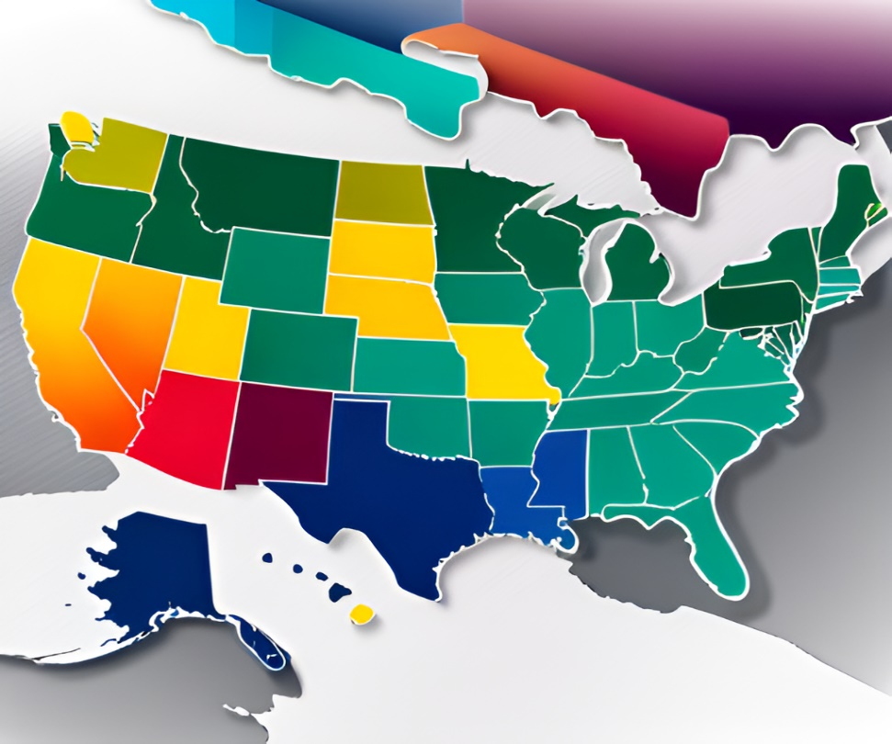
Geographical Overview
The geographic analysis of the Sample Superstore reveals interesting patterns and trends in sales performance across different regions. The data shows that the highest sales are concentrated in the eastern region, particularly in New York and Pennsylvania. On the other hand, the western region has lower sales compared to the rest of the country, with California being the only state with high sales in this region.
To expand the business strategically, it is recommended to focus on increasing sales in the western region
Additionally, targeted marketing campaigns can be launched in areas with low sales to increase brand awareness and drive sales.

Slide 6

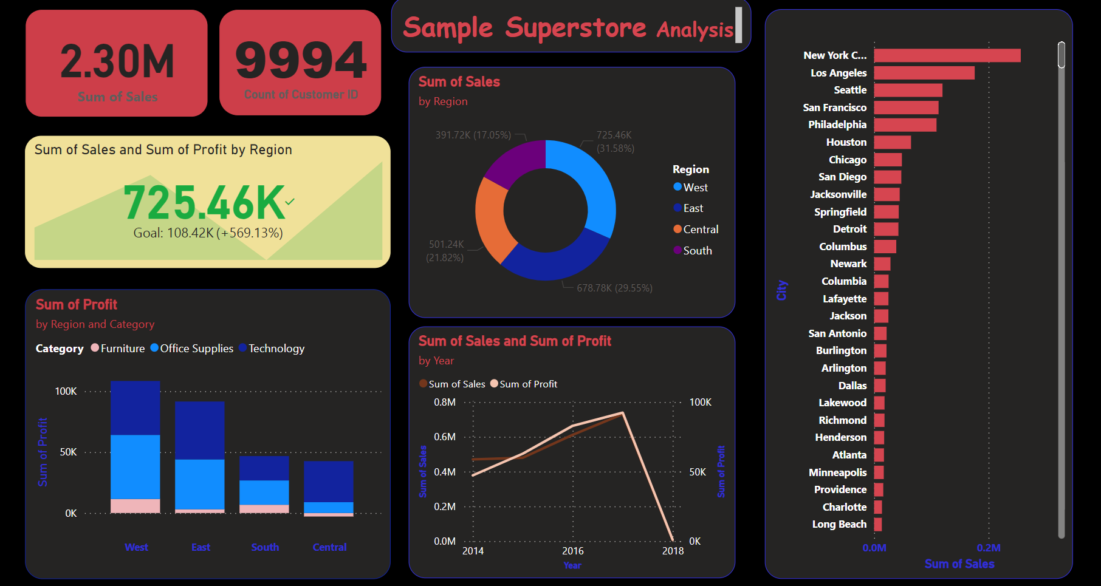
PowerBI Analysis

Slide 7
Conclusion
In conclusion, the analysis of the Sample Superstore's sales performance has revealed several key findings.
Firstly, while overall sales have been steady, there are clear opportunities for growth in certain product categories and geographic regions.
Secondly, by targeting specific customer segments with tailored marketing strategies, the Sample Superstore can increase customer loyalty and drive repeat business.
Based on these findings, we recommend that the Sample Superstore focus on expanding their product offerings in high-growth categories, such as office supplies and technology products.
Additionally, targeted marketing campaigns aimed at specific customer segments, such as small businesses and home offices, can help to drive sales and increase customer loyalty.

