Slide 1

Hackathon
Babson CODE

Slide 2
Dave's Drinks is a morning refreshment shop serving Coffee, Hot Chocolate and Tea. It is open 7am - 3pm , 7 days a week. It records sales, costs, and tracks employee attendance in 15 minute increments, so if the time is 7:30AM, the data is from 7:30AM - 7:45AM. There is always a manager working, they show up 30 minutes before open and stay 30 minutes after close. June makes $32 per hour and Walter makes $30 per hour. Each regular employee makes $15 per hour. Coffee costs $1.5 to make and sells for $5. Hot Chocolate costs $1 to make and sells for $4. Tea costs $0.50 to make and sells for $3. This data represents a week of activity at the store. The only cost not included is the lease cost which is $500 per week.
Deliverables
Find the stores revenue, ingredient costs, labors costs, and net income
How many time slots are understaffed (less than 3 non-manager employees)?
Find what employee is stealing
Create one line chart for each day with three lines (one for each drinks sales)
What trends are there in the sales?
Create a presentation with one slide per deliverable with your answers

Slide 3
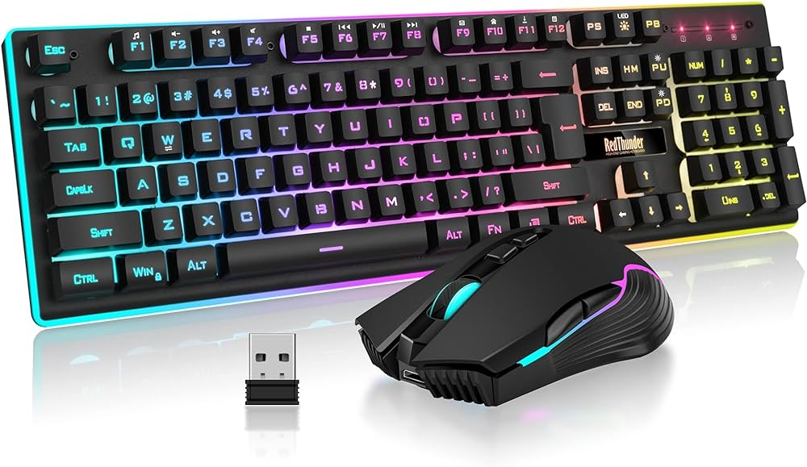
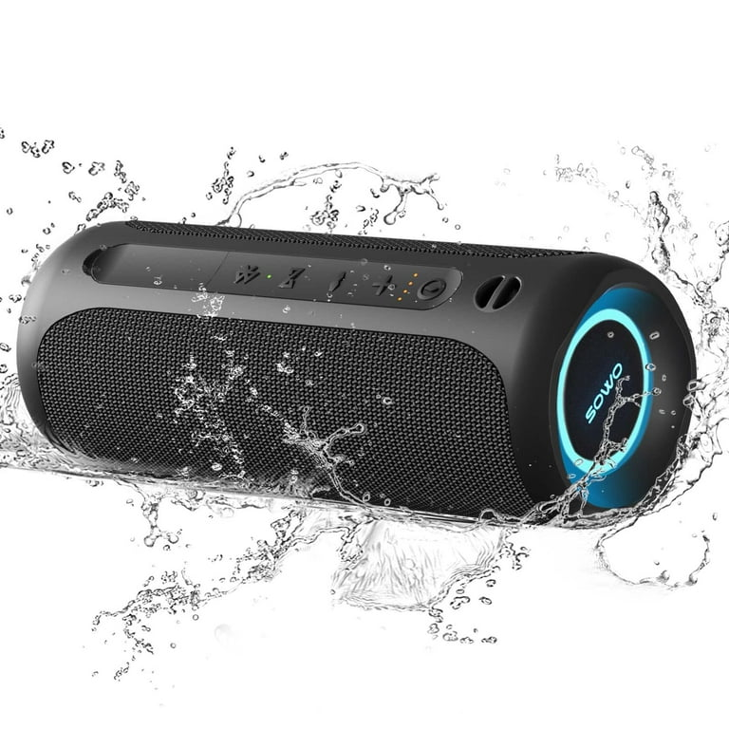
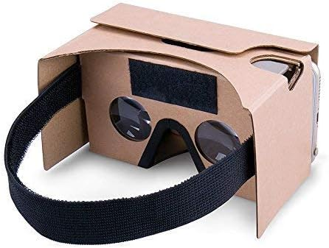
Prizes!

Slide 4
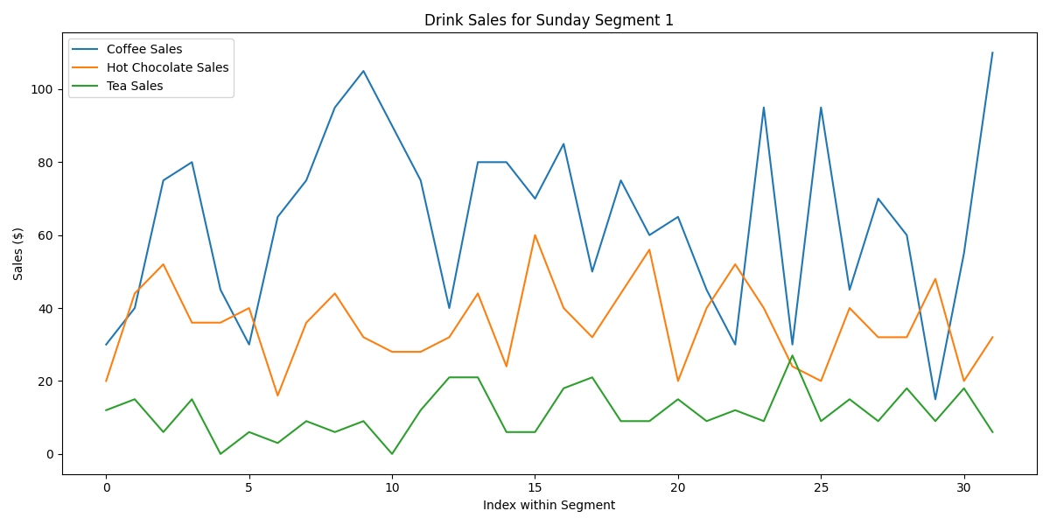
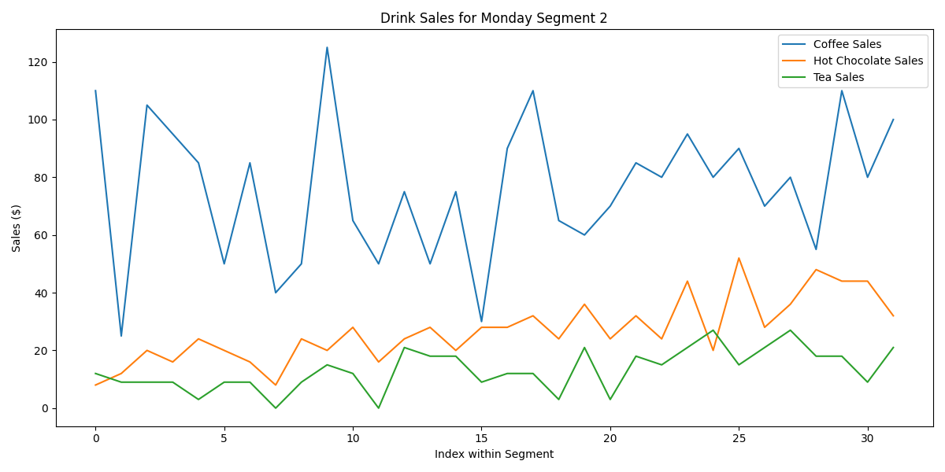
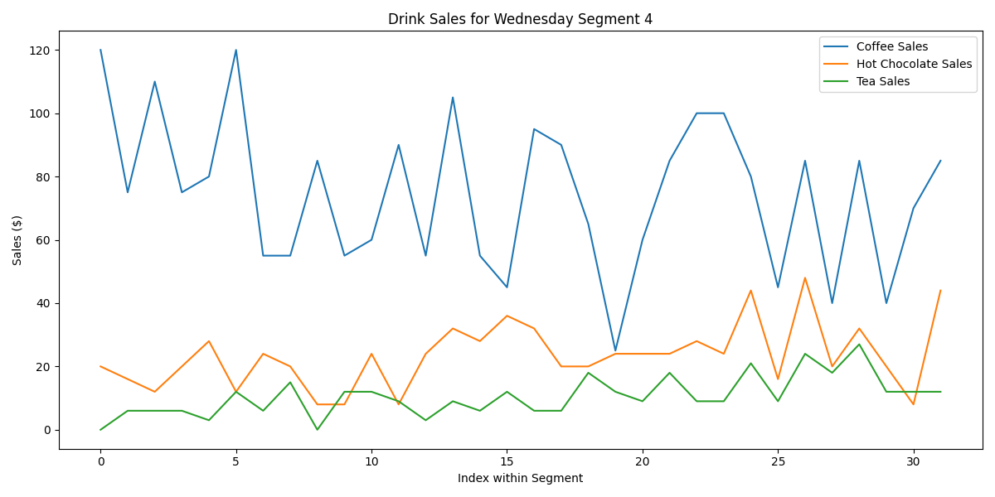
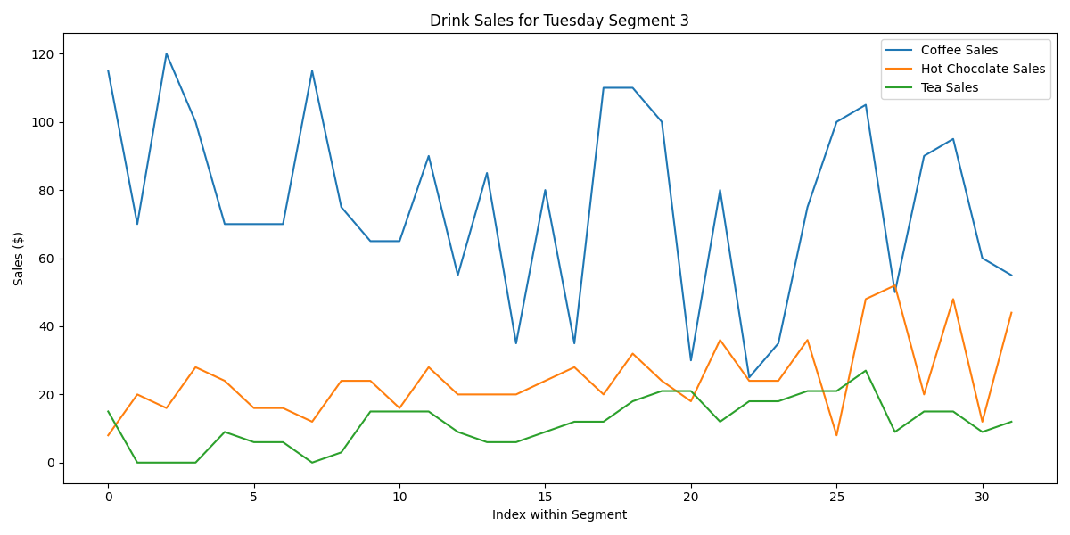
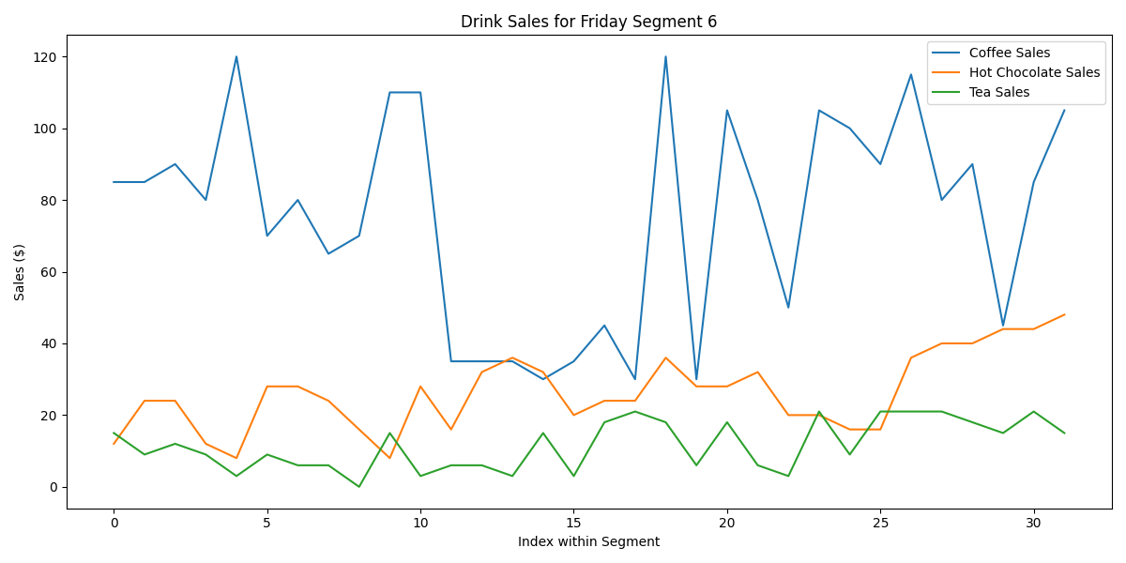
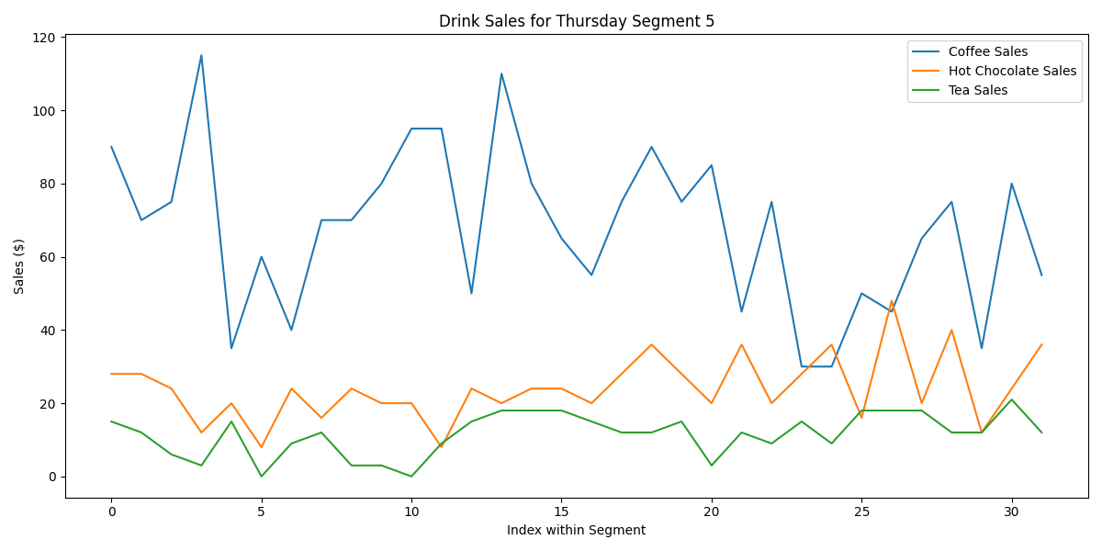
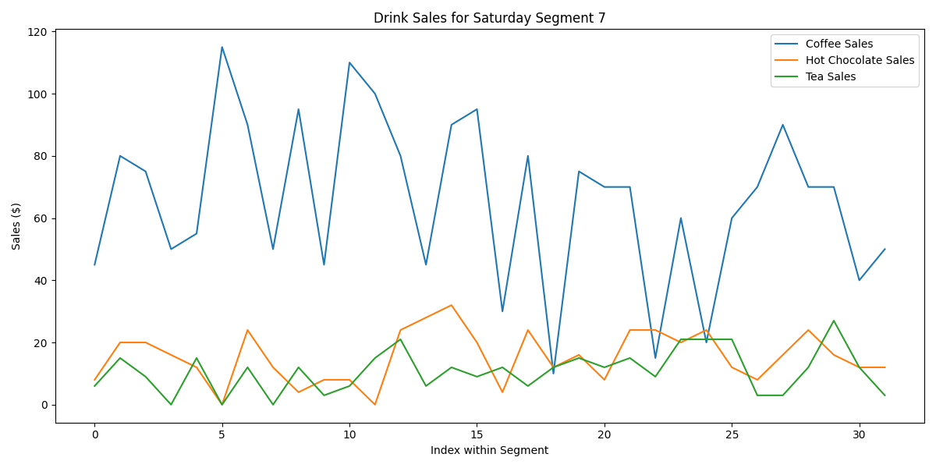
Sales | $24,485.00
Ingredients | $6,734.50
Labor | $4,726.75
Costs | $11,461.25
Net Income | $13,023.75
27 Understaffed days
Robber: Jerry!
Trends:
Coffee > Hot Chocolate > Tea

