Slide 1

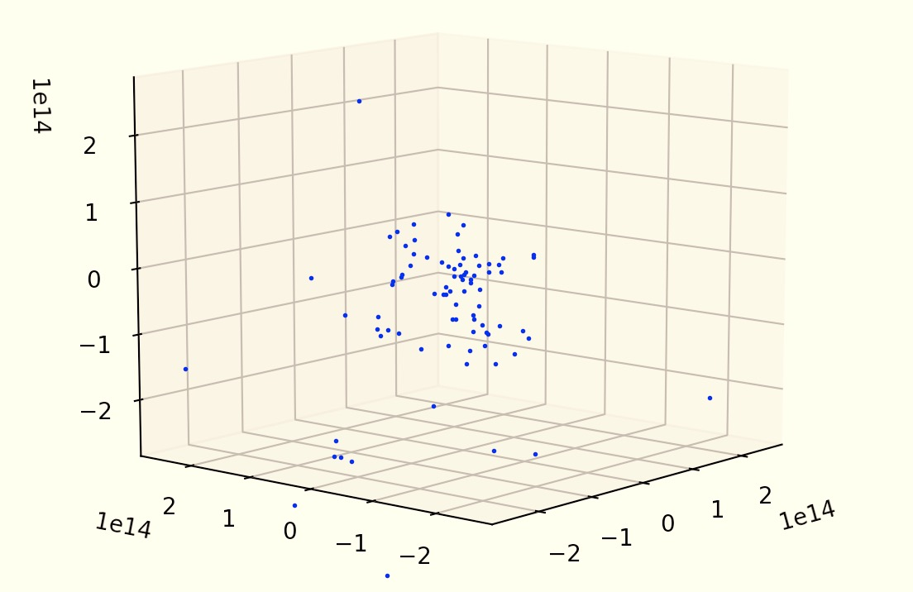
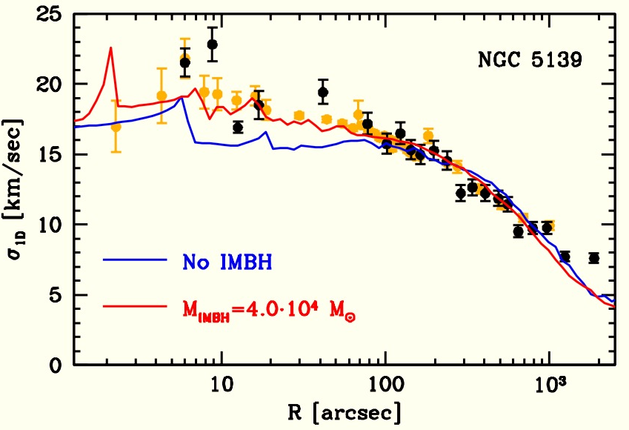
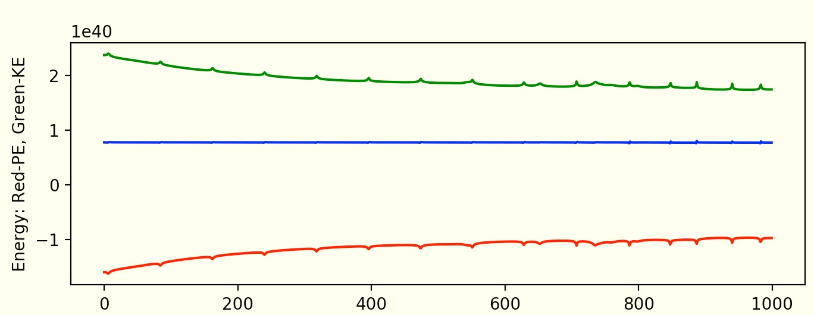

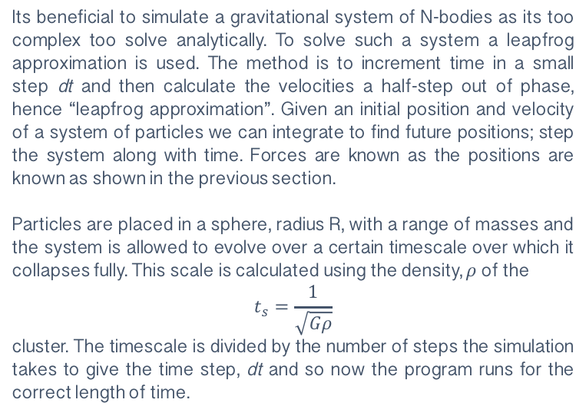
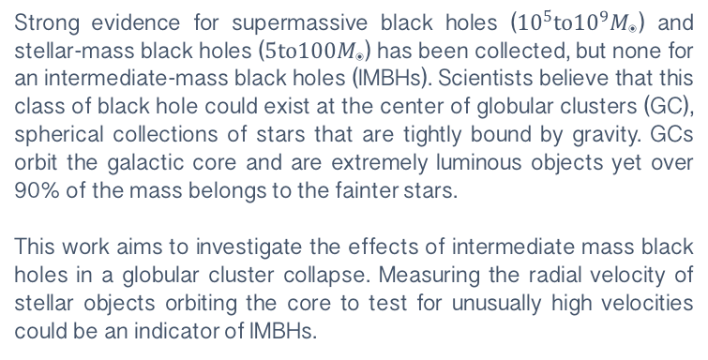
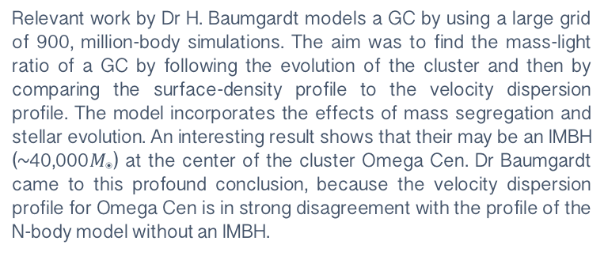
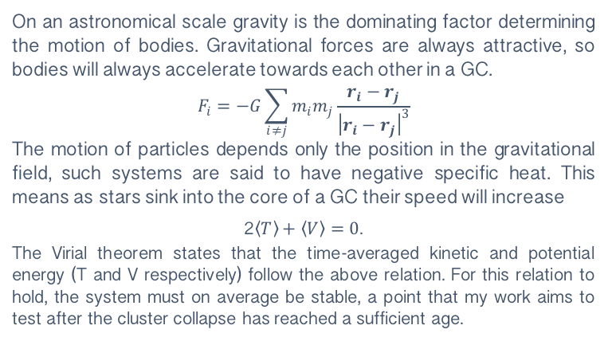
DO GLOBULAR CLUSTERS CONTAIN INTERMEDIATE MASS BLACK HOLES?
BOBBY HEMMING
INTRODUCTION
Strong evidence for supermassive black holes (${10}^{5}to{10}^{9}M_{◉}$) and stellar-mass black holes (${5to100M}_{◉}$) has been collected, but none for an intermediate-mass black holes (IMBHs). Scientists believe that this class of black hole could exist at the center of globular clusters (GC), spherical collections of stars that are tightly bound by gravity. GCs orbit the galactic core and are extremely luminous objects yet over 90% of the mass belongs to the fainter stars.
This work aims to investigate the effects of intermediate mass black holes in a globular cluster collapse. Measuring the radial velocity of stellar objects orbiting the core to test for unusually high velocities could be an indicator of IMBHs.
km
km
km
Fig. 2 100-Body Simulation, age 20 million years, my GC collapse from initial radius 6 parsec, mass~300$M_{◉}$, containing an IMBH~100$M_{◉}$
PAST WORK
METHOD
Relevant work by Dr H. Baumgardt models a GC by using a large grid of 900, million-body simulations. The aim was to find the mass-light ratio of a GC by following the evolution of the cluster and then by comparing the surface-density profile to the velocity dispersion profile. The model incorporates the effects of mass segregation and stellar evolution. An interesting result shows that their may be an IMBH (~40,000$M_{◉}$) at the center of the cluster Omega Cen. Dr Baumgardt came to this profound conclusion, because the velocity dispersion profile for Omega Cen is in strong disagreement with the profile of the N-body model without an IMBH.
Its beneficial to simulate a gravitational system of N-bodies as its too complex too solve analytically. To solve such a system a leapfrog approximation is used. The method is to increment time in a small step dt and then calculate the velocities a half-step out of phase, hence “leapfrog approximation”. Given an initial position and velocity of a system of particles we can integrate to find future positions; step the system along with time. Forces are known as the positions are known as shown in the previous section.
Particles are placed in a sphere, radius R, with a range of masses and the system is allowed to evolve over a certain timescale over which it collapses fully. This scale is calculated using the density, $ρ$ of the
$$t_{s}=\frac{1}{\sqrt{Gρ}}$$
cluster. The timescale is divided by the number of steps the simulation takes to give the time step, dt and so now the program runs for the correct length of time.
RESULTS
Fig. 3 Result showing the kinetic and potential energy, in Joules as the cluster collapses
Fig. 1 Velocity Dispersion Profile of Omega Cen, (Dr. H Baumgardt 2016), can clearly see the disagreement of model with no IMBH and observed data
RELEVANT PHYSICS
On an astronomical scale gravity is the dominating factor determining the motion of bodies. Gravitational forces are always attractive, so bodies will always accelerate towards each other in a GC.
$$F_{i}=−G\sum_{i≠j}{m_{i}m_{j}\frac{r_{i}−r_{j}}{{\left|r_{i}−r_{j}\right|}^{3}}}$$
The motion of particles depends only the position in the gravitational field, such systems are said to have negative specific heat. This means as stars sink into the core of a GC their speed will increase
2$\left\langle T\right\rangle +\left\langle V\right\rangle =0$.
The Virial theorem states that the time-averaged kinetic and potential energy (T and V respectively) follow the above relation. For this relation to hold, the system must on average be stable, a point that my work aims to test after the cluster collapse has reached a sufficient age.
The results aim to verify the virial theorem holds for collapses with different initial conditions; with two, one, and no IMBHs and then compare the velocity dispersion profiles of all. The energy is conserved to within 2%.
REFERENCES
[1] Dr H Baumgardt et al. N-body modeling of globular clusters: Masses, mass-to-light ratios and intermediate-mass black holes, (2016).
[2] Long Wang et al. The DRAGON simulations: globular cluster evolution with a million stars , (2016).
[3] M. Trenti et al. Primordial Binaries and IMBHs in globular clusters, (2017).
[4] G. A. Drukier et al. Can High-Velocity Stars Reveal Black Hole in Globular Clusters? (2003).

