Slide 1
Do Globular Clusters contain Black Holes?
Bobby Hemming

Slide 2
Contents
Introduction:
What is a globular cluster?
Black Holes?
Relevant Physics
Computational approaches
My Research and Report:
Aim
Method
Results
Summary
Past Research:
Quick History
Dr. H. Baumgardt, 2016
Long Wang et al. 2016
References

Slide 3
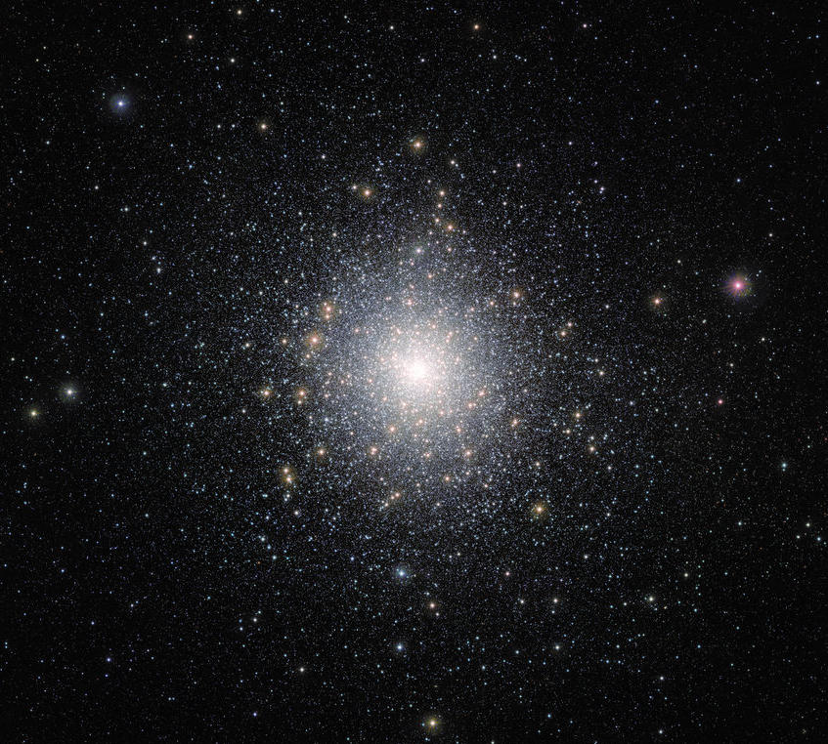
What is a Globular Cluster?
Collection of stars
On average 10,000 solar masses
Very luminous objects
Do we know there Origin?
Composition
Fig.1 Globular Cluster 47 Tucanae (from Kayhan Gültekin, Nature Journal 542, February 2017)

Slide 4
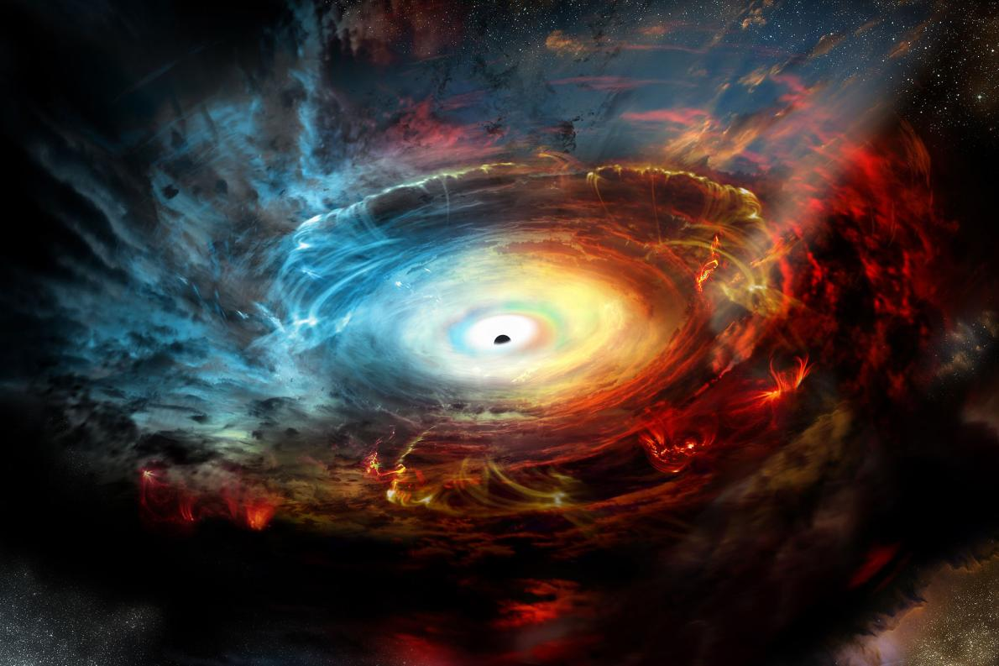
Black Holes?
Scientists think intermediate-mass black holes at center of a cluster?
Measurements of fast moving stars
Interesting idea: two black holes in one globular cluster
Fig.2 Illustration of a super-massive Black Hole at a galactic core (Photograph by NRAO, AUI, NSF)

Slide 5
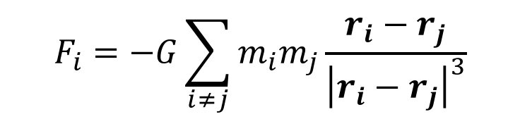

Relevant Physics
Force between gravitational bodies:
Gravity is always an attractive force
Negative Specific Heat – energy is lost, the temperature increases
$$F_{i}=−G\sum_{i≠j}{m_{i}m_{j}\frac{r_{i}−r_{j}}{{\left|r_{i}−r_{j}\right|}^{3}}}$$
$$v=\sqrt{\frac{GM}{r}}$$

Slide 6
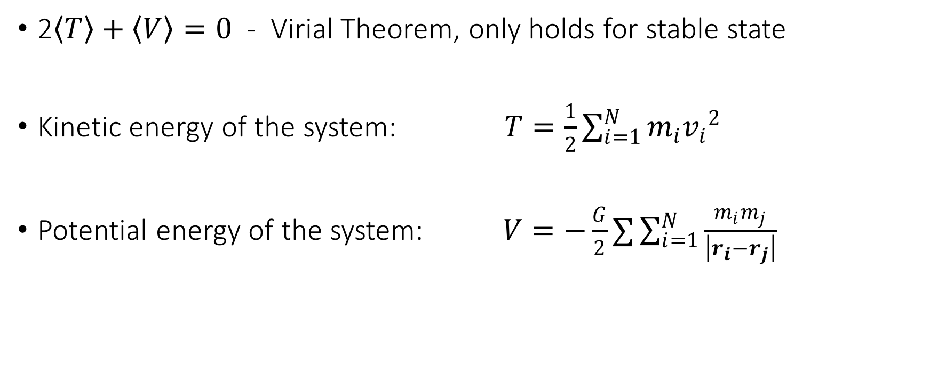
Virial Theorem
2$\left\langle T\right\rangle +\left\langle V\right\rangle =0$ - Virial Theorem, only holds for stable state
Kinetic energy of the system: $T=\frac{1}{2}\sum_{i=1}^{N}{m_{i}{v_{i}}^{2}}$
Potential energy of the system: $V=−\frac{G}{2}∑\sum_{i=1}^{N}{\frac{m_{i}m_{j}}{\left|r_{i}−r_{j}\right|}}$

Slide 7
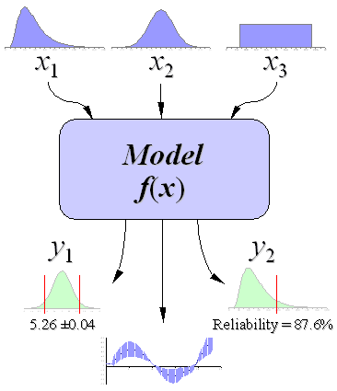
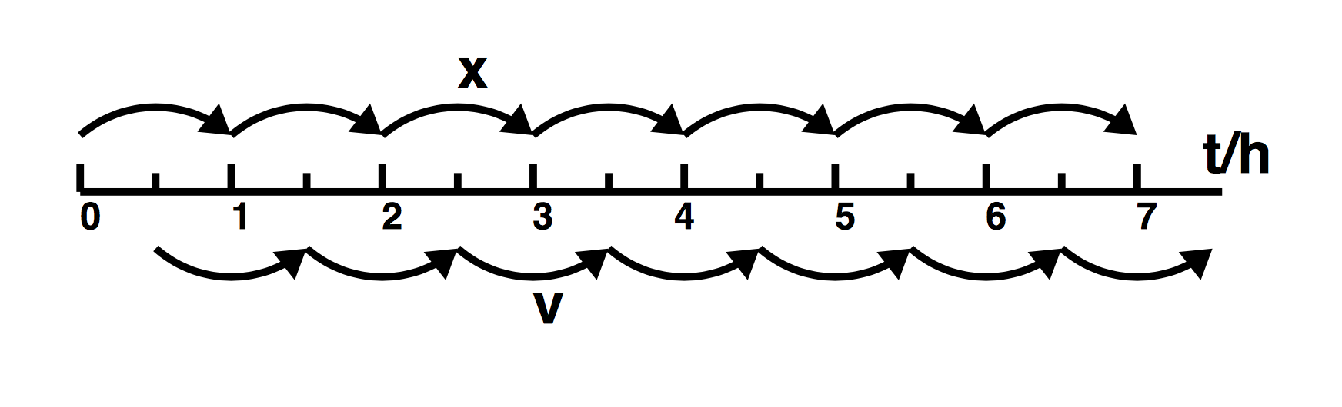
Computational Solutions
Leap-Frog approximation
Monte-Carlo Simulation
Fig.3 Structure of the leapfrog method (Peter Young, April 2013)
Fig.4 Monte Carlo Simulation Basics, (J.W Wittwer, From Vertex42.com)

Slide 8
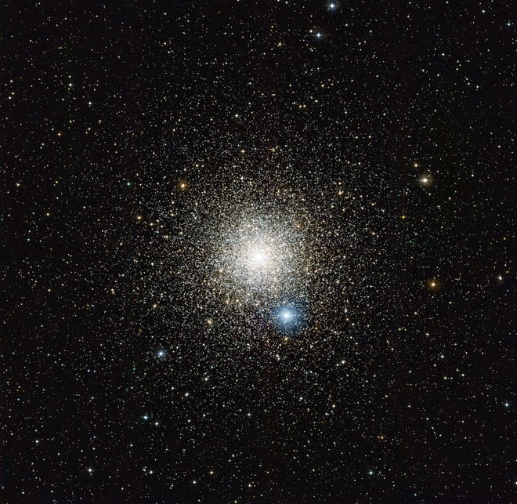
Quick History
First observed Globular cluster, Messier 22
Simulation stepping stones:
10k bodies (Spurzem & Aaseth, 1996)
100k bodies (Baumgardt & Makino, 2003)
485k bodies (Heggie, 2014)
Fig.5 Messier (from ESO’s La Silla Observatory in Chile, 2012)

Slide 9
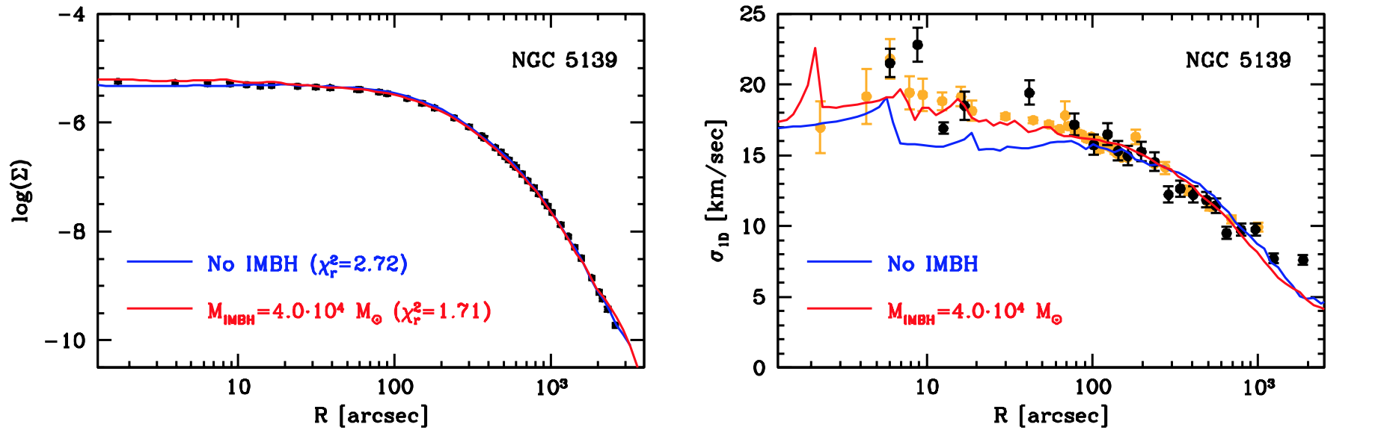
Dr. H. Baumgardt, N-body modeling of Globular Cluster
Model follows the evolution of clusters
Interesting find: Intermediate black holes?
Large grid 900 N-body simulation of clusters
To find the mass to light ratios of cluster
Fig. 6 Surface density profiles & velocity dispersion of the globular clusters (from Dr. H. Baumgardt 2016)

Slide 10
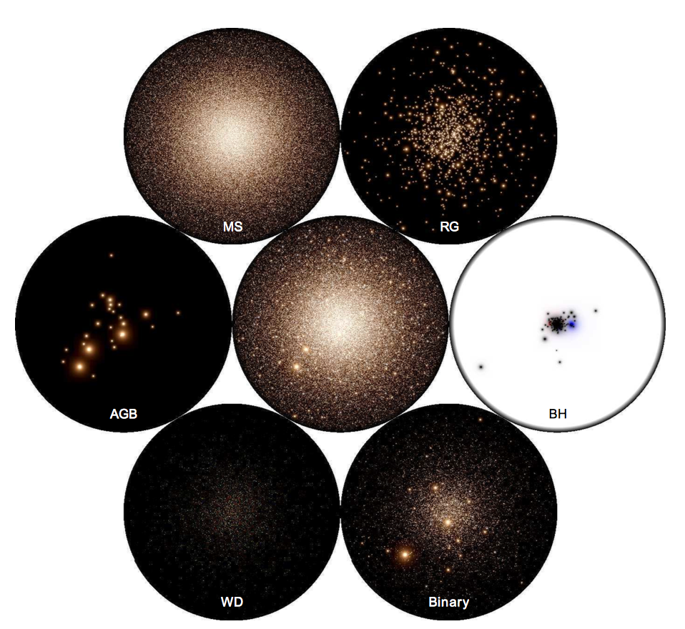
Long Wang et al. DRAGON Simulations
GC evolution with 1 million stars
Follows 4 globular clusters
NBODY6++GPU code
Multiple Black holes at the core possible
Fig.7 Snapshot of models at 12 Gyr (from Long Wang et al. 2016)

Slide 11
My Report: Globular Clusters & IMBHs
Aim:
Compare 3 different Globular Clusters
Vary the initial conditions
Method:
N randomly placed particles in a sphere
Use leapfrog approximation
Results:
Compare the Virial equilibrium radius
the time it takes to reach this steady state
The velocity dispersion of particles in the core
Fig.8 500 Body simulation (from Martin Woodward, Nbody Simulation)

Slide 12
Summary
Background information
Physics behind Globular Cluster & Black Holes
Research by others that is relevant to my extension
My Report – what will I be doing?

Slide 13
References
Long Wang et al. Dragon Simulations, 2016
Dr. H. Baumgardt, N-body modeling of Globular Cluster, 2016
Michael Richmond, Using the virial theorem
M. Trenti et al. Primordial Binaries and IMBHs in globular clusters, 2017
G. A. Drukier et al. Can High-Velocity Stars Reveal Black Hole in Globular Clusters?, 2003

Slide 14
GCs were first discovered in 1665 by Abraham Isle, and stars were first resolved in GCs (M4) by Charles Messier in 1764. Important simulations of clusters begin in 1996 by Spazem & Aarseth with a 10,000 body simulation.
. Their origin is poorly understood, but show approximately the same stage of stellar evolution, suggesting they were formed at approximately the same age.

