Slide 2
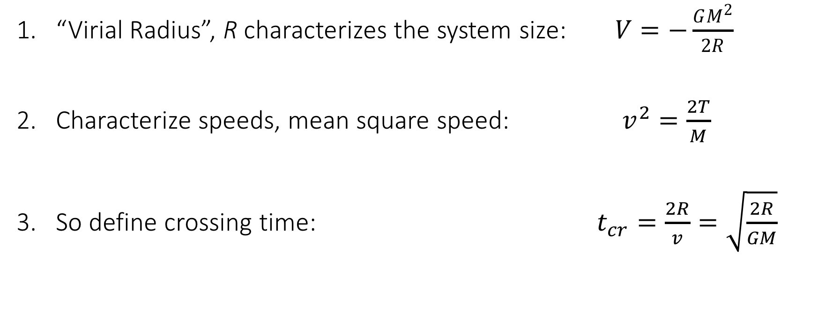
Crossing Time
“Virial Radius”, R characterizes the system size: $V=−\frac{GM^{2}}{2R}$
Characterize speeds, mean square speed: $v^{2}=\frac{2T}{M}$
So define crossing time: $t_{cr}=\frac{2R}{v}=\sqrt{\frac{2R}{GM}}$

Slide 3

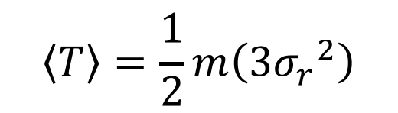
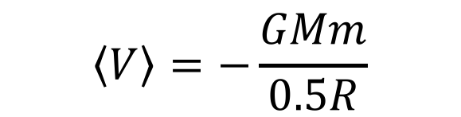
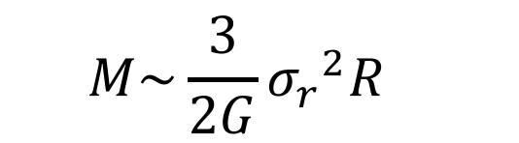
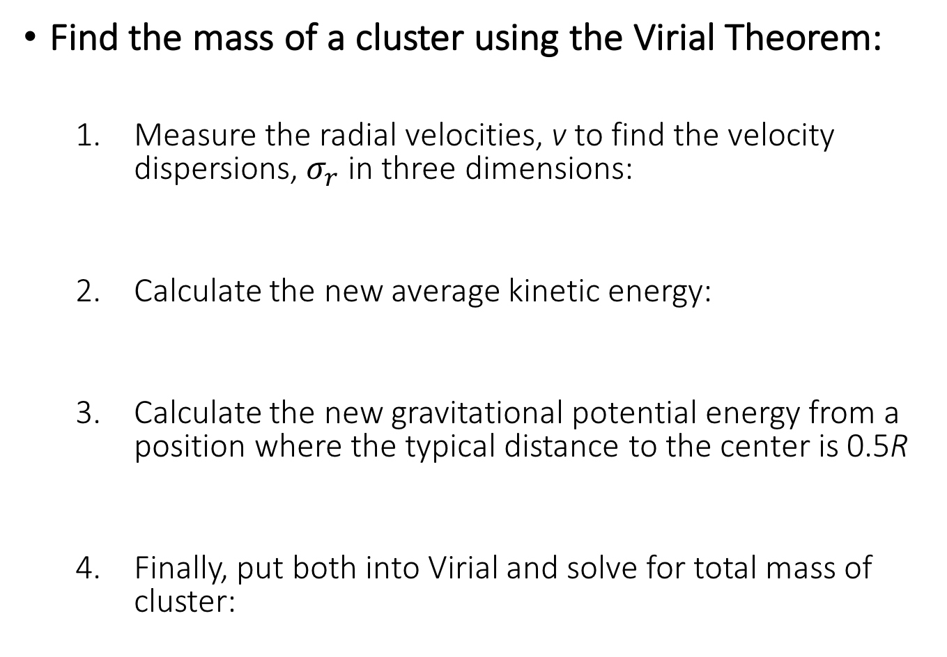
Globular Cluster Mass
Find the mass of a cluster using the Virial Theorem:
Measure the radial velocities, v to find the velocity dispersions,${ σ}_{r}$ in three dimensions:
Calculate the new average kinetic energy:
Calculate the new gravitational potential energy from a position where the typical distance to the center is 0.5R
Finally, put both into Virial and solve for total mass of cluster:
$$v^{2}=3{σ_{r}}^{2}$$
$$\left\langle T\right\rangle =\frac{1}{2}m\left(3{σ_{r}}^{2}\right)$$
$$\left\langle V\right\rangle =−\frac{GMm}{0.5R}$$
$$M\sim \frac{3}{2G}{σ_{r}}^{2}R$$

