Slide 1

Bacchus Winery Case Study
CSD310 – Database Development & Use
Professor Susan Sampson
BLUE TEAM:
Robert Breutzmann
Carolina Rodriguez
Sara White

Slide 2

Group Introduction
We are part of Team Blue and for our case study we decided to choose the Bacchus Winery Case. Our team members are Robert, Sara and Carolina.
Robert contributed the business rules, the initial ERD, and prepared a report for how many hours each employee worked during the last quarter.
Sara contributed updates to the initial ERD and database, while preparing a report on supplies delivery time and any gap between expected delivery.
Carolina contributed updates to the business rules and initial ERD and prepared a report on which distributor orders which wine, which wine sold, and which didn’t.
Together we prepared this presentation and took note on the assumptions we made during this project.

Slide 3

Case Study Overview
The case study involves helping Bacchus Winery with their operations team by creating a database system to track suppliers, wine production, inventory, distribution and employee hours. The owners need accurate reports on supply deliveries, wine sales and employee work time to make sure their winery is running according to budget.
Our objective was to design a database structure, create exact reports and ensure data is clear for new decisions.

Slide 4

Key Database Requirements
List Business Rules Identified that the database needs to solve.

Slide 5
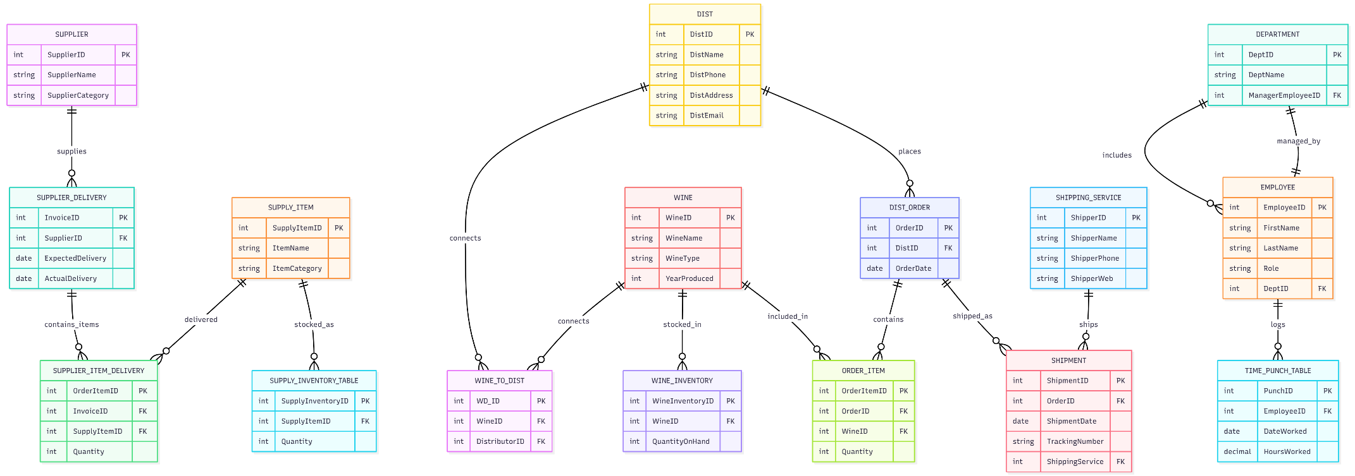
Finalized ERD

Slide 6
Reports selected for generation
Report to show difference in expected delivery of supplies and actual delivery of supplies.
Report to show what wines the distributors are selling more or less of over time.
Report to show average number of hours worked each week by employees over a period of time.

Slide 7
Report 1: Expected vs Actual Supply Delivery
SQL Code/Description

Slide 8
Report 2: Wine Purchases and Who distributes which.
SQL Code/Description

Slide 9
Report 3: Employee Hours per week over the last period
SQL Code/Description

Slide 10
Assumptions Made
List all assumptions made during the process of making the ERD and business rules.
(Such as the shipments vs orders relationships.)
The wines “age” differently. Without the information for the year the wine was produced, we would have incomplete data and be unable to know which year is not selling and which is. Based on the report on the wines that haven’t sold, we can locate Chardonnay 2024, 2025 and Chablis 2024, 2025 are not fan favorites from our distributors.

Slide 11
Challenges and Resolutoins
List any hurdles during the ERD creation.
Any issues the team resolved?
Any lessons learned?

Slide 12
Thanks for watching our presentation!

