Slide 1

Bacchus Winery Case Study
CSD310 – Database Development & Use
Professor Sue Sampson
BLUE TEAM:
Robert Breutzmann
Carolina Rodriguez
Sara White

Slide 2

Group Introduction
We are part of Team Blue and for our case study we decided to choose the Bacchus Winery Case. Our team members are Robert, Sara and Carolina.
Robert contributed the business rules, the initial ERD, and prepared a report for how many hours each employee worked during 4 quarters and a yearly average.
Sara contributed updates to the initial ERD and database, while preparing a report on supplies delivery time and any gap between expected delivery.
Carolina contributed updates to the business rules and initial ERD and prepared a report on which distributor orders which wine, which wine sold, and which didn’t.
Together we prepared this presentation and took note on the assumptions we made during this project.

Slide 3

Case Study Overview
The case study involves helping Bacchus Winery with their operations team by creating a database system to track suppliers, wine production, inventory, distribution and employee hours. The owners need accurate reports on supply deliveries, wine sales and employee work time to make sure their winery is running according to budget.
Our objective was to design a database structure, create exact reports and ensure data is clear for new decisions.

Slide 4

Key Database Requirements
Business Rules:
Suppliers provide materials used in wine production, including bottles, corks, labels, boxes, vats, and tubing.
Each distributor may carry multiple types of wine produced by Bacchus Winery.
Each distributor may carry multiple production years (batches) of each wine type.
A distributor may place multiple orders with Bacchus Winery.
Each department may employ multiple employees.
Each employee may work multiple days and hours, tracked over time.
Bacchus Winery produces four types of wine: Merlot, Cabernet, Chablis, and Chardonnay.
Each wine type may have multiple batches, distinguished by the year produced.

Slide 5
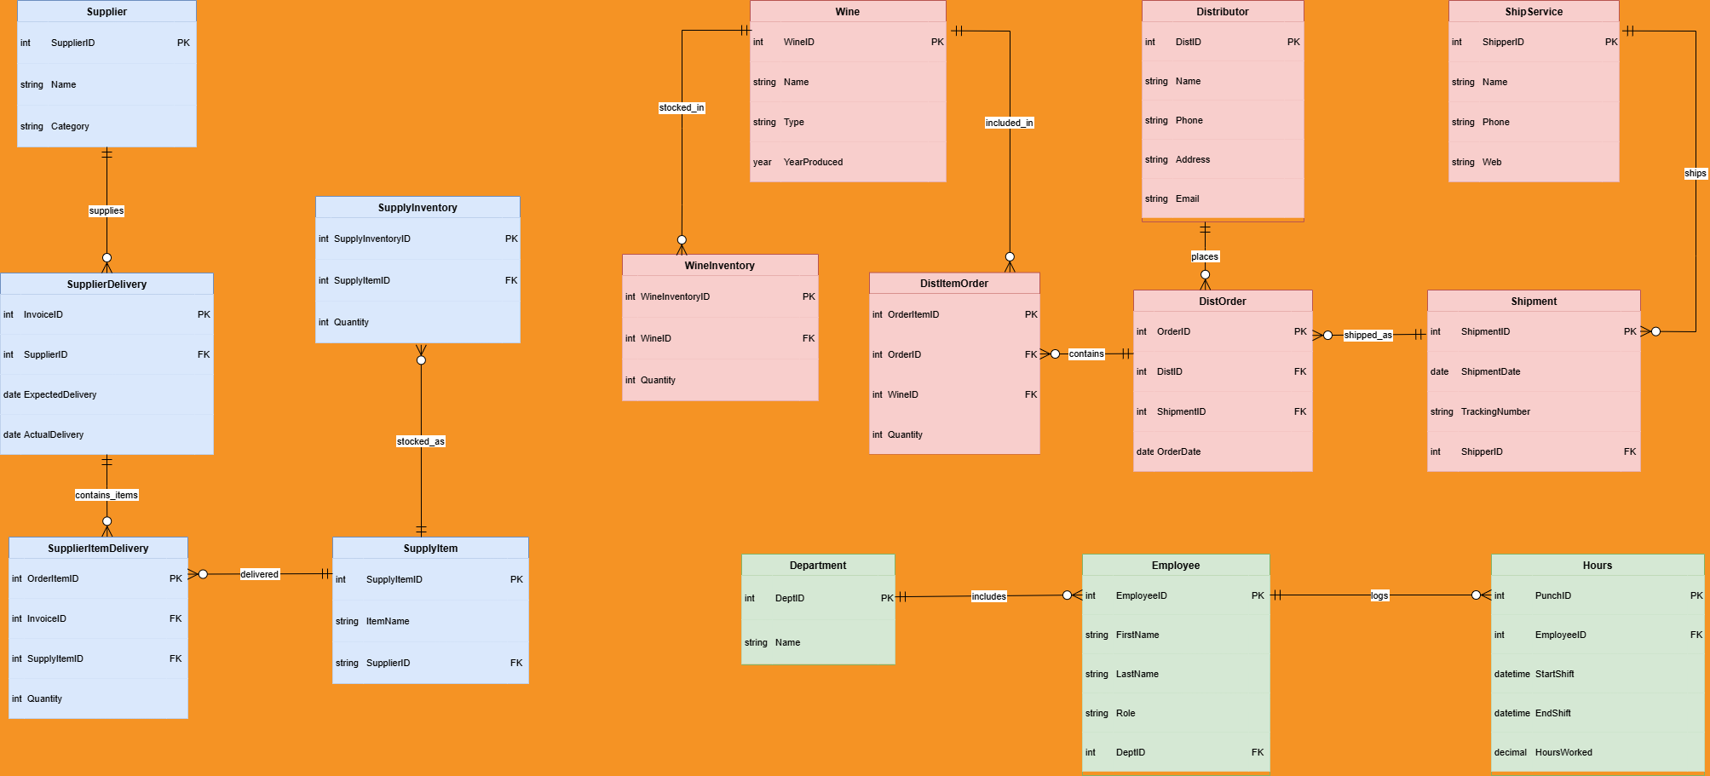
Finalized ERD

Slide 6
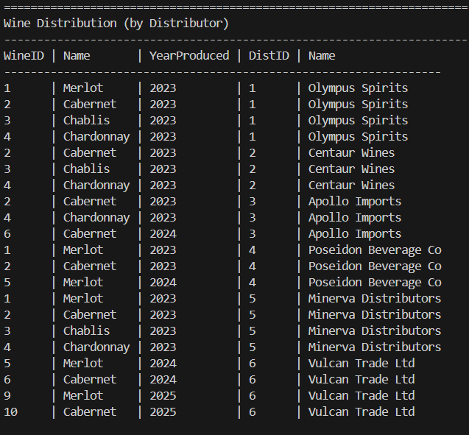
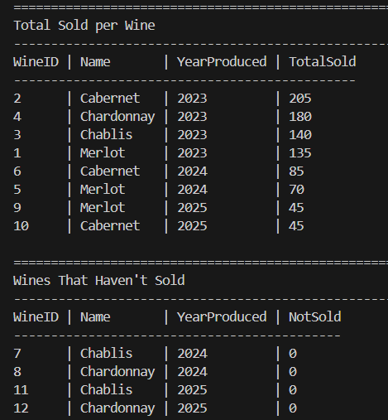
Reports selected for generation (1 of 3)
This report provides data in three tables: the first table shows the wines carried by the distributors, the second shows the total amount sold for each type of wine, and the third table shows which wines haven’t sold at all.
Use case: Bacchus Winery can use this report for quick insight into which of their wines are best sellers.

Slide 7
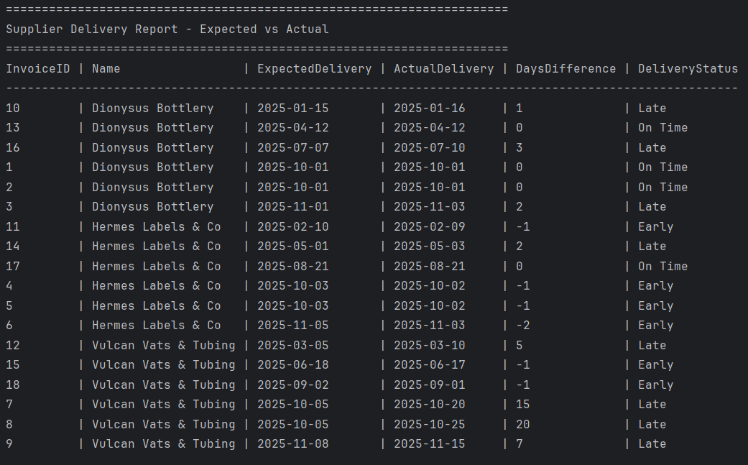
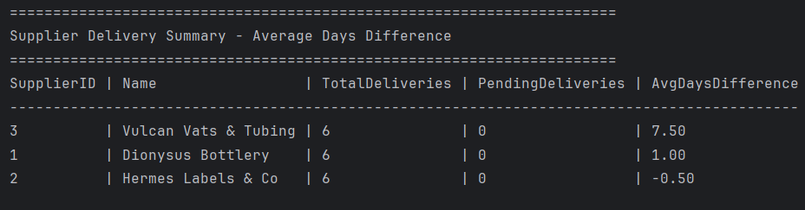
Reports selected for generation (2 of 3)
This report highlights any differences between expected and actual delivery dates from suppliers. The DaysDifference column shows how many days the delivery is off from the anticipated delivery date, and the DeliveryStatus column states whether the delivery was early or on time. A second table shows the average days difference from the expected delivery date for a simpler report.
Use case: Bacchus Winery can use this report to get a quick snapshot into which suppliers are routinely late with deliveries and which suppliers are early or on-time. This could help plan for expected delays with supplies necessary to package and distribute their wines.

Slide 8
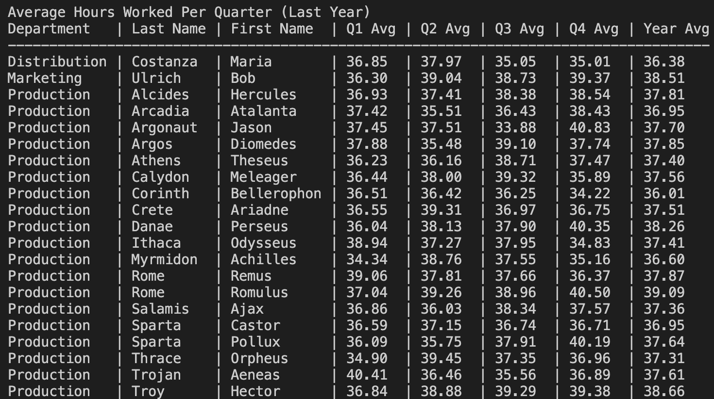
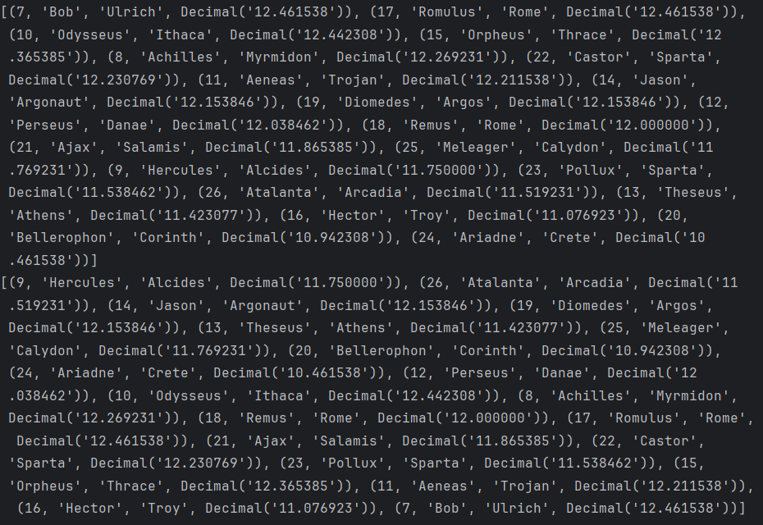
Reports selected for generation (3 of 3)
This report was generated to show the average number of hours worked per quarter for each employee. This report uses a dataset for each quarter and a yearly average.
Two outputs are produced: the first is a list of each employee’s ID, followed by their name and average hours worked; The other report shows the average hours worked per week over each quarter for the last year for all hourly employees with their department.
Use case: Bacchus Winery can use this report to budget for payroll, monitor department productivity, and gain business insight based on the hours expended for each department.

Slide 9
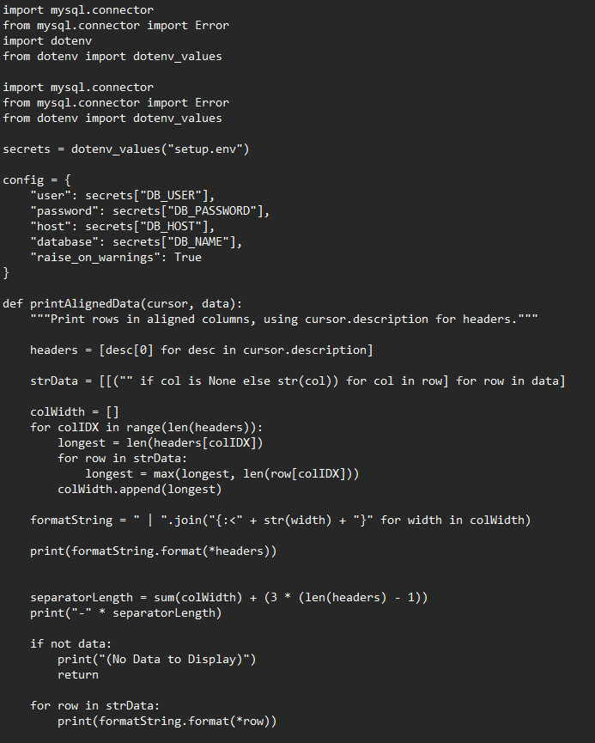
Report Generation: Python Code
Our reports were generated and formatted with this initial block of code which securely loads the database credentials utilizing the dotenv Python library. This reads sensitive information, like usernames and passwords, from the locally stored setup.env.
The config dictionary stores the settings necessary to connect to MySQL. The printAlignedData() function extracts the column headers from cursor.description, converts the data to strings and then formats the data for readability.
The following slides will contain screenshots of the code unique to each report.

Slide 10
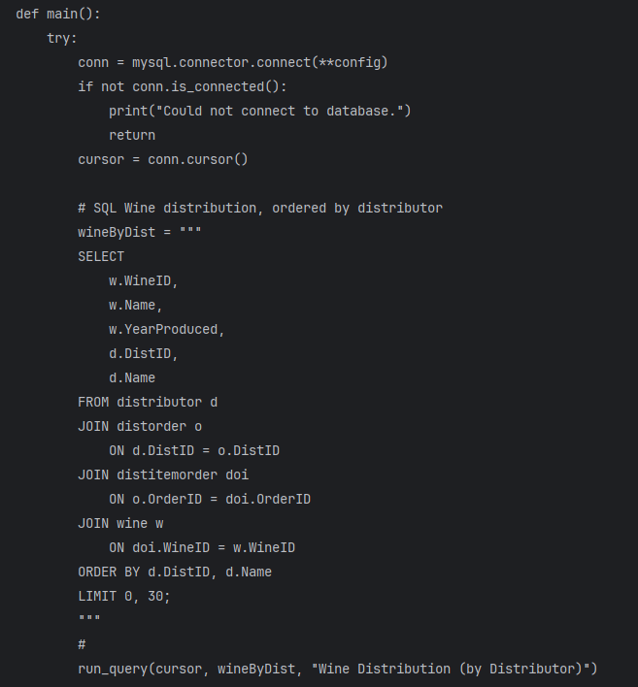
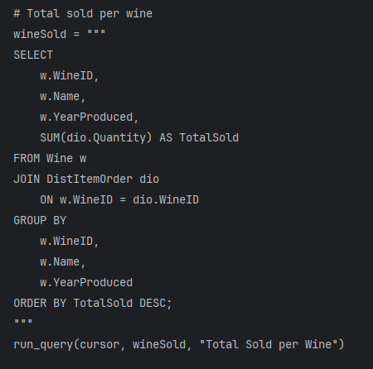
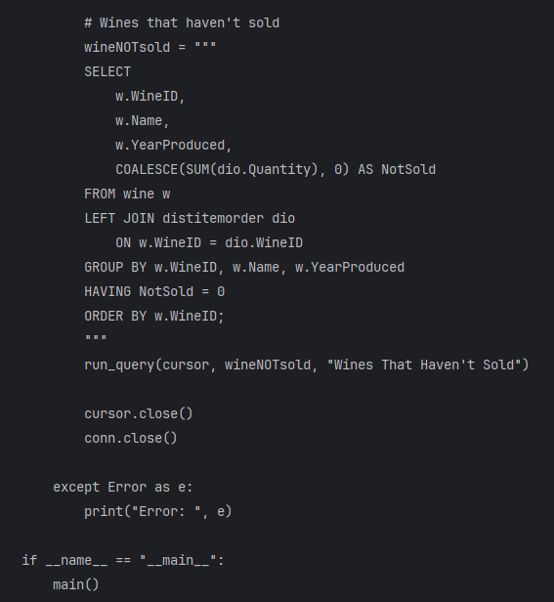
Wines Carried by Distributors and Bestsellers: Python Code

Slide 11
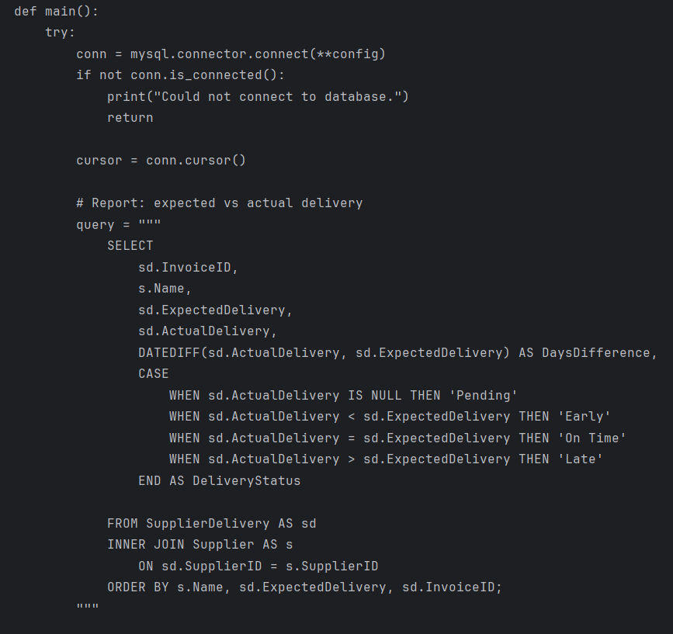
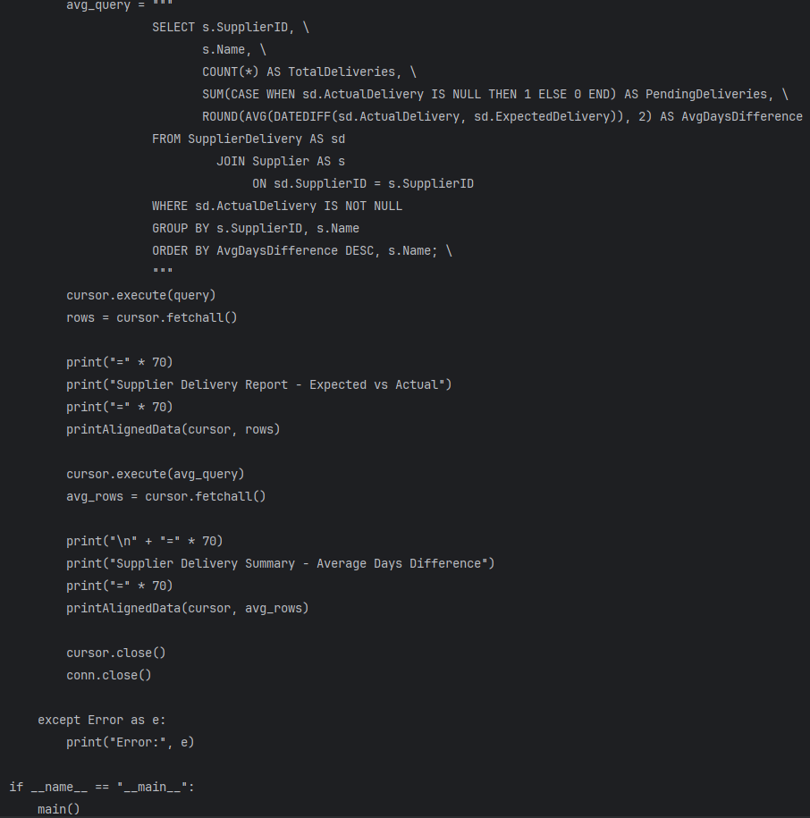
Expected vs Actual Supply Delivery:
Python Code

Slide 12
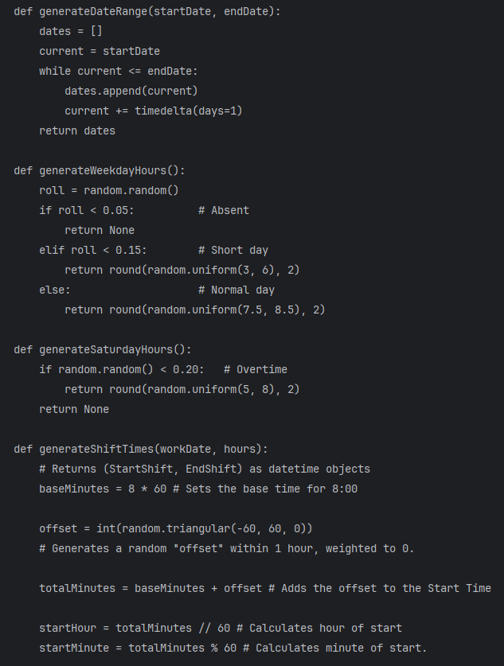
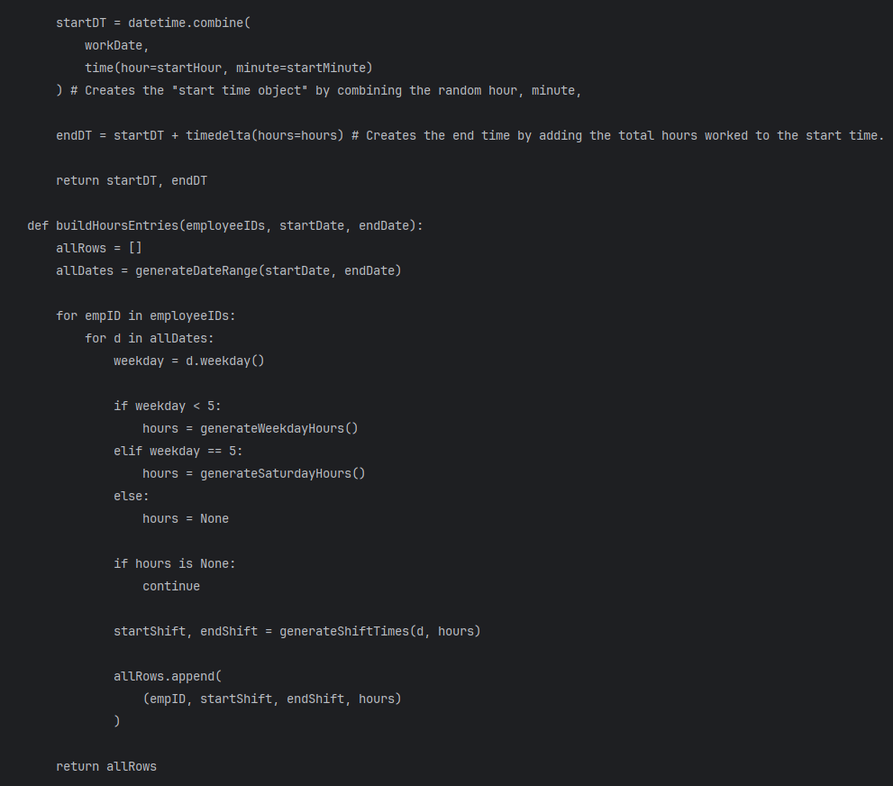
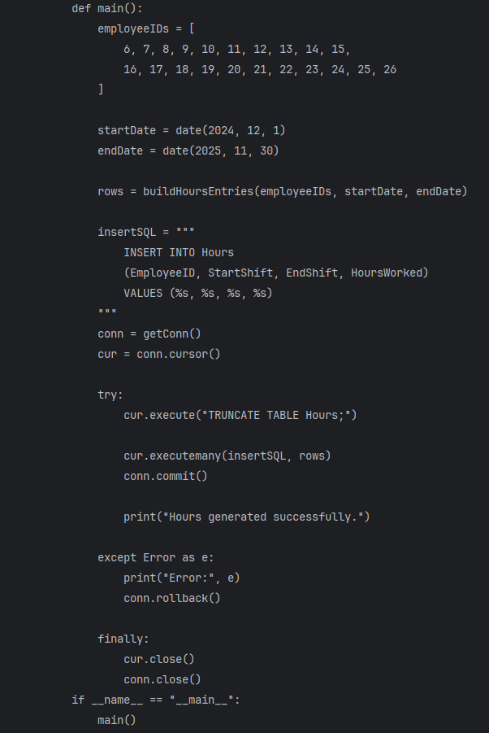
Average Quarterly Hours for Employees: Python Code (1 of 2)

Slide 13
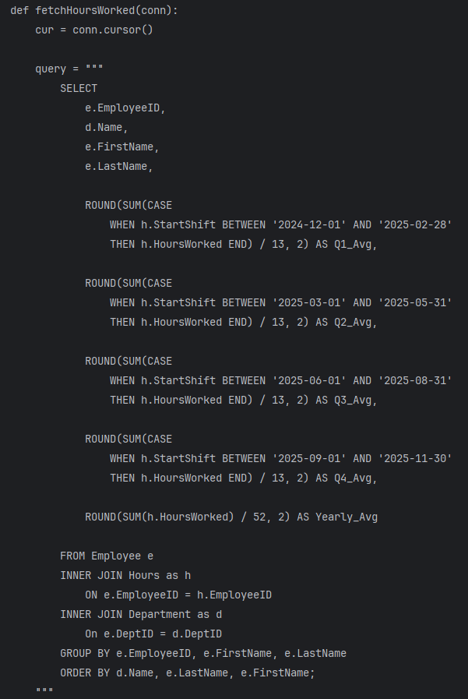
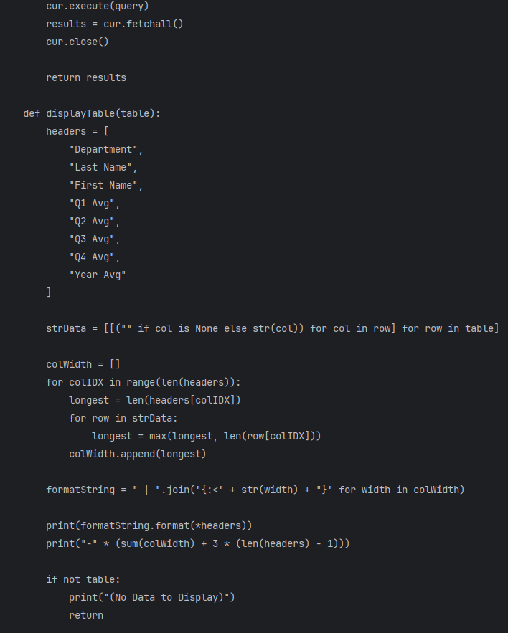
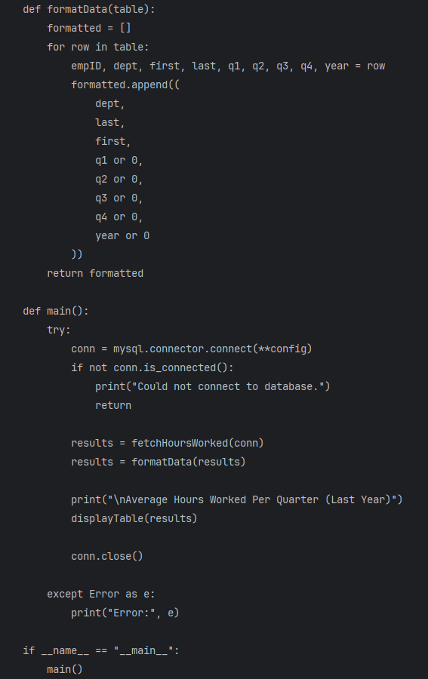
Average Quarterly Hours for Employees: Python Code (2 of 2)

Slide 14
Assumptions:
We considered designing a table to keep inventory for the grapes produced by Bacchus Winery, but for the purpose of this case study, we assumed they already have their inventory in place for their grapes that they grow.
We assumed Bacchus Winery would want to keep detailed inventory of wine-making supplies and monitor the timeliness of deliveries from suppliers. Therefore, we created a Supplier table to store supplier information, a SupplierDelivery table to track the expected vs. actual delivery dates, and SupplierItemDelivery table to track orders with invoices and item information. The SupplyItem table contains the specific information on each item that's referenced by the other tables, and the SupplyInventory tracks the quantity of those items on hand.
The Wine Distribution portion of the ERD is similarly structured and keeps track of the distributors' information, the wines produced by Bacchus Winery (like the name, year produced, and type of wine) and the current wine inventory of Bacchus Winery. Information, like the year the wine was produced, is useful in determining which specific batches of a type of wine are selling better than others.
The Wine Distribution tables are connected to the distributors' orders and the shipment information for those orders. While our reports don't utilize the ShipService table, we felt it was useful to include that table for a fully realized database. For example, we assumed Bacchus Winery might want to monitor which shipping services deliver faster with less issues (like lost or damaged packages).

Slide 15
Challenges and Resolutions
It was challenging to think of a winery's business model from all angles and accurately represent it with our database. We initially didn’t account for the need to track the inventory of individual components for a wine business, like bottles, corks, tubing, etc., and had to revise our database design and ERD to include a table to track those items. Other tables, like the ones tracking deliveries from suppliers and the shipments to distributors, were difficult to conceptualize in the beginning because there are so many steps in the supply chain and distribution process.
We thought it would be challenging to find a time that worked for all of us to meet and work on the project together, since we all have busy lives and jobs (and none of us are on the same schedule), however, we were able to meet consistently and communicate with ease.

Slide 16
Thanks for watching our presentation!

Slide 17
References
Comeau, A. (2017). MySQL explained. OSTraining.
GeeksforGeeks. (n.d.). SQL CASE statement. https://www.geeksforgeeks.org/sql/sql-case-statement/
W3Resource. (n.d.). SQL join tables with GROUP BY and ORDER BY. https://www.w3resource.com/sql/joins/joining-with-group-by-and-order-by.php
W3Schools. (n.d.). MySQL LIMIT clause. https://www.w3schools.com/mysql/mysql_limit.asp
Image credit:
Ivantsov, V. (n.d.). Elegant wine still life with grapes [Photograph]. https://www.pexels.com/photo/elegant-wine-still-life-with-grapes-34815861/
Sample data generation:
OpenAI. (2025). ChatGPT (Feb 2025 version) [Large language model]. https://chat.openai.com/

