Slide 1
Moffat Bay Marina
QA Presentation · Blue Team · CSD 460 Capstone
1

Slide 2
Meet Blue Team
Section 1 · Introduction of Team
Slide owner: Robert
Section divider for the team introductions. Assembled from everyone’s About the Developer slides.
2

Slide 3

About the Developer: Robert Breutzmann
Front-End Duties
Back-End Duties
Extra Duties
Registration Page
Book a Slip
My Fleets
Login Popup
Edit User Info
Team Leader
Database Manager
Robert works at Target Distribution as a Warehouse Worker and Inventory Control and Quality Assurance Specialist. When he is not working on his coursework or at work moving inventory through the warehouse, he is a coach for his son’s Flag Football, Soccer, and Baseball teams; Dungeon Master for a group of Dungeons and Dragons adventurers; as well as a husband and father of two boys.
Robert took on the leadership role in this group project partly because of his past management experience, but mostly because he does most of his work on Mondays and created the repo for it without really looking too much at what that meant, and rather than re-creating the repo under someone else, the team decided to let it be.
3

Slide 4
About the Developer: Miguel Fernandez
Slide owner: Miguel
Your name, a photo or avatar, a brief description of yourself, and what you contributed to the project (pages, roles, and testing).
4

Slide 5
About the Developer: Carolina Rodriguez
Slide owner: Carolina
Your name, a photo or avatar, a brief description of yourself, and what you contributed to the project (pages, roles, and testing).
5

Slide 6
About the Developer: Sara White
Slide owner: Sara
Your name, a photo or avatar, a brief description of yourself, and what you contributed to the project (pages, roles, and testing).
6

Slide 7
Sample Prototypes
Section 2 · From wireframe to finished page
7

Slide 8
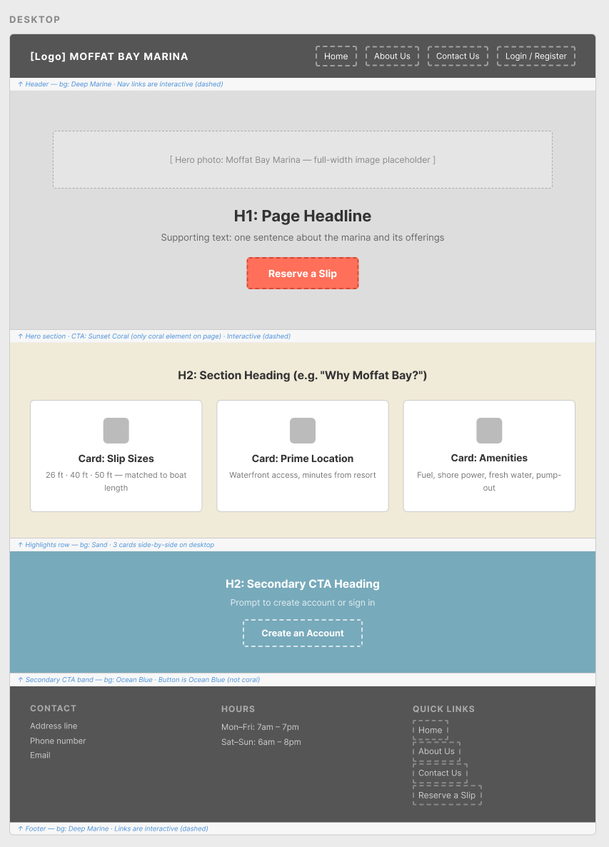
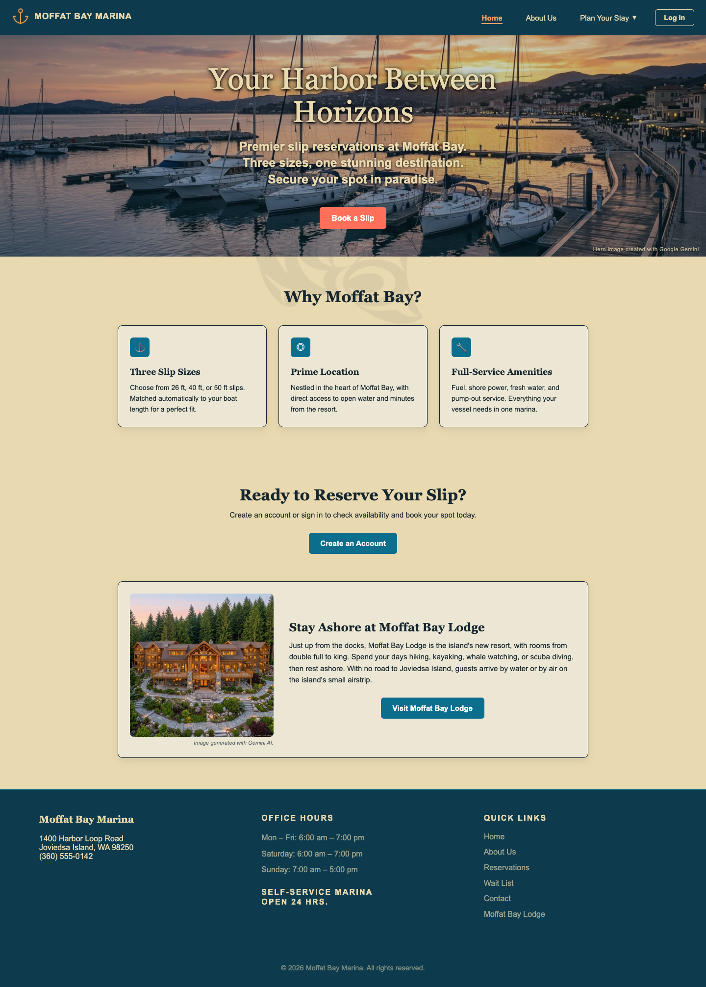
Wireframe to Finished Page: Landing Page
Reserve a Slip -> Book a Slip
Moffat Bay Lodge Link
Page Background
Hero Photos/Credit
This change was made to match a site wide decision on language
The cards were made translucent and the blue secondary background was removed from the reserve your slip section so that the Salmon image required by the client could be embedded in the background of the site and be partly visible through the cards.
Decided to add a link (currently broken until connected with another groups Moffat Bay Lodge websites) linking directly to the Lodge. Since they are under the same umbrella, they would certainly advertise for each other.
All the images on the site were crafted with Google Gemini to avoid any copyright constraints. A credit is given on every photo, including the hero images to Gemini for creating the photo.
8

Slide 9
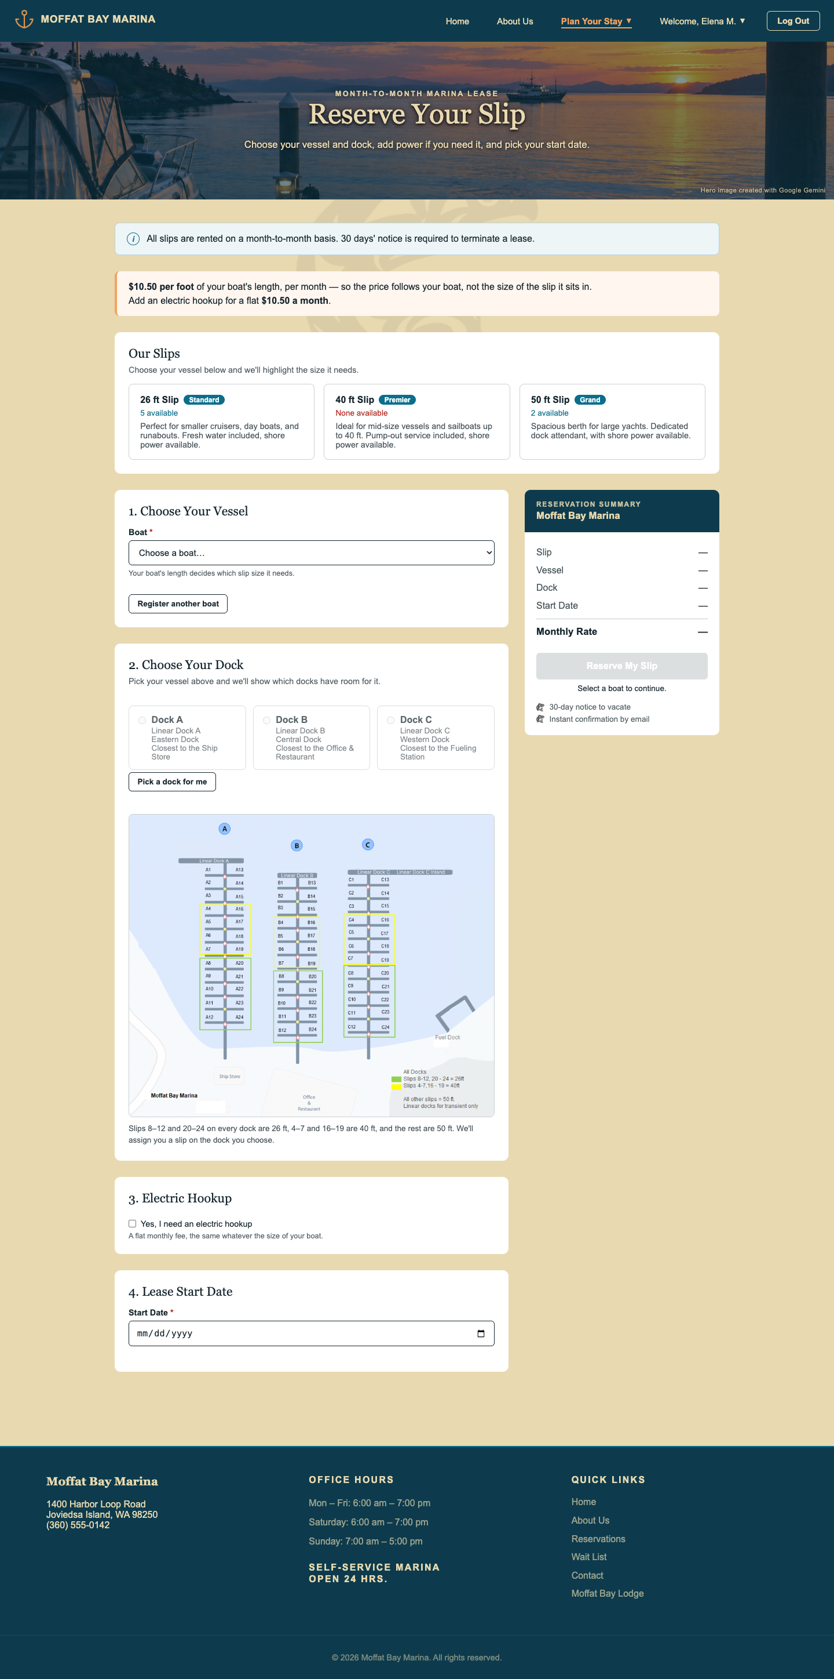
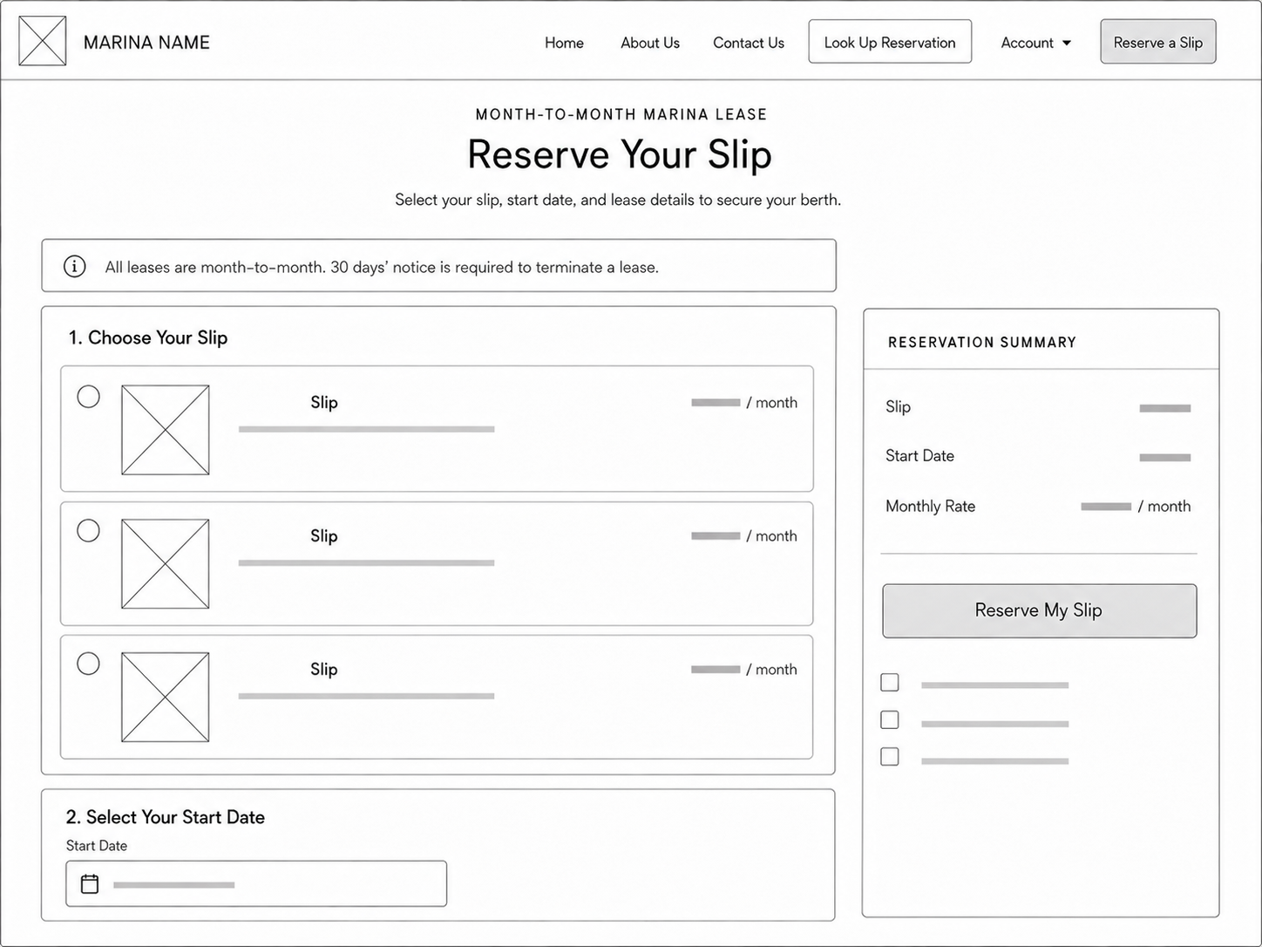
Wireframe to Finished Page: Book a Slip
Our Slips Change
Choose Your Boat
Electrical Hookup
Summary Relatively Unchanged
Marina Map
The ‘Our Slips’ portion was changed to not allow the user to select a slip size, since it will be auto assigned when you select your boat to fit the size. If no size is available, you will be directed to the waitlist.
This was added so that a signed in customer (which is required) must add their boat to book the slip. A button to add a boat to their account brings a popup that allows them to add a boat to their account.
The Marina Map/Choose your Dock section shows the dock and a description, allowing the user to select from the available docks for the boat size they selected depending on the user's preference.
During the wireframing, we thought electrical hookup was a part of every reservation. We discovered the error here and added the option to include or not.
The only things that changed on the summary was adding the electrical hookup fee.
9

Slide 10
How the Design Changed Along the Way
Look and Feel Kept
The color pallet, the overall design shapes, and the general feel of the layout did not change where it did not need to.
Built around the real data
Forms grew to match the database: full address, country, boat details, etc. Also, the marina facts were scattered in the wireframes and we settled on a single source of truth.
The Boat Drives the Booking
Instead of picking a slip, customers pick their boat and the site matches the size to a slip. The customer then can select which dock based on what is open.
Accounts Replaced Lookups
Instead of Looking Up Reservations, we decided that to see reservations required a user to be signed in, and then replaced the Look Up Reservation page with a My Reservations page. The look up tool became a filtering tool instead.
Client Changes
A few client changes were made along the way. The site required us to remove the Contact Us page and instead put the Contact Us information and form on the About Us page. They also require raising the rates of slips and electrical hookups by 5%. Later, they required us to do beta tests and to incorporate a salmon image into the landing page, which we incorporated into every page as an embedded background to the sandy color.
Shaped by Testing
Beta Testers led to auto sign-in after registering, a “Forgot Password?” link, clearer date and form messages, and a warning for boats over 50ft. Also, Developer and Peer tests led to revamping some ideas and pushing each other to fill some gaps in what the pages covered. The menus were also made more concise, making a User Profile menu, allowing the user to edit their profile, access their My Fleet page, or access their Reservations.
10

Slide 11
Database Design
Section 3 · The ERD
Slide owner: Miguel
Section divider for the database design slides.
11

Slide 12
The Full ERD
Slide owner: Miguel
The complete, current ERD, with a short orientation to how the tables are grouped.
12

Slide 13
Customer
Slide owner: Miguel
The Customer table: what it stores, and how it connects to everything else (reservations, boat ownership, and the wait list).
13

Slide 14
Reservation
Slide owner: Miguel
The Reservation table: what it stores, and how it connects to everything else (the customer, the boat, the slip, and termination notices).
14

Slide 15
Boats and Ownership
Slide owner: Miguel
The Boat and BoatOwnership tables: what they store, and how ownership links boats to customers over time.
15

Slide 16
Docks, Slips and Slip Sizes
Slide owner: Miguel
The Dock, Slip and SlipSize tables: how the marina’s slip inventory is modeled, and how it feeds reservations and the wait list.
16

Slide 17
Wait List and Termination Notices
Slide owner: Miguel
The WaitList and TerminationNotice tables: what each one tracks, and which tables they connect to.
17

Slide 18
Supporting Tables
Slide owner: Miguel
The standalone and supporting tables (Contact, Employee, Rate, DatabaseVersion): what each is for, in a line or two.
18

Slide 19
Business Rules That Shaped the Schema
Slide owner: Miguel
Two or three business rules that directly drove a design decision in the database, and what that decision was.
19

Slide 20
Testing and Results
Section 4 · Five tests and their results
Slide owner: Carolina
Section divider for the testing slides.
20

Slide 21
How We Tested
Slide owner: Carolina
How the team planned, ran, and peer-checked its tests across the project.
21

Slide 22
Test 1: Page Name, What It Checks
Slide owner: Carolina
One test: the page it came from, what it checks, the steps in short form, the expected result, the actual result (Pass or Fail), and a screenshot.
22

Slide 23
Test 2: Page Name, What It Checks
Slide owner: Carolina
One test: the page it came from, what it checks, the steps in short form, the expected result, the actual result (Pass or Fail), and a screenshot.
23

Slide 24
Test 3: Page Name, What It Checks
Slide owner: Carolina
One test: the page it came from, what it checks, the steps in short form, the expected result, the actual result (Pass or Fail), and a screenshot.
24

Slide 25
Test 4: Page Name, What It Checks
Slide owner: Carolina
One test: the page it came from, what it checks, the steps in short form, the expected result, the actual result (Pass or Fail), and a screenshot.
25

Slide 26
Test 5: Page Name, What It Checks
Slide owner: Carolina
One test: the page it came from, what it checks, the steps in short form, the expected result, the actual result (Pass or Fail), and a screenshot.
26

Slide 27
What Testing Caught
Slide owner: Carolina
A test that failed at first: what went wrong and how it was fixed. Delete this slide if nothing failed.
27

Slide 28
Lessons Learned
Section 5 · What each of us learned
Slide owner: Robert
Section divider for everyone’s Things I Learned slides.
28

Slide 29
Things I Learned: Robert Breutzmann
The Division of Labor is Harder than it Looks
Dividing Up the Pages would have worked better if each of us had a job for every page
Working as a Team is a Completely Different Experience than Working Alone
To be fair, I already knew this. But trying to divide up the work on developing a webpage among 4 developers proved to be a much greater challenge than I had originally given credit. Certain things I thought were simple ended up not being simple and created a greater workload on certain team members.
My gut on how to divide the work was to have one person do the database layer, one person the logic layer, and one person the UI layer (Front End), and then the final person be the peer tester for all the tests. I thought that the DB layer was going to be too easy and not enough work for one person, so I ended up pivoting from that and combining it with the logic layer. This made the back-end heavy pages, like Registration and Reservation VERY heavy work and I should have stuck with my gut.
When working on projects by myself, there's no pressure when I fell behind. I could just catch up later. But for the group project, if I didn't get my part pushed on time, it affected everyone else. So, the pressure for deadlines wasn’t “have this done by the end of the week.” but instead “have this done with enough time for everyone else to be able to complete their work by the end of the week.” Which is even more difficult when the 4 of us have completely different schedules.
29

Slide 30
Things I Learned: Miguel Fernandez
Slide owner: Miguel
Two or three things you learned on this project.
30

Slide 31
Things I Learned: Carolina Rodriguez
Slide owner: Carolina
Two or three things you learned on this project.
31

Slide 32
Things I Learned: Sara White
Slide owner: Sara
Two or three things you learned on this project.
32

Slide 33
Thank You
Questions?
Slide owner: Robert
Closing slide: thank the audience and invite questions.
33

