Slide 1
Moffat Bay Marina
QA Presentation · Blue Team · CSD 460 Capstone
Slide owner: Robert
Title slide: project name, team name, course, and date.
1

Slide 2
Meet Blue Team
Section 1 · Introduction of Team
Slide owner: Robert
Section divider for the team introductions. Assembled from everyone’s About the Developer slides.
2

Slide 3
About the Developer: Robert Breutzmann
Slide owner: Robert
Your name, a photo or avatar, a brief description of yourself, and what you contributed to the project (pages, roles, and testing).
3

Slide 4
About the Developer: Miguel Fernandez
Slide owner: Miguel
Your name, a photo or avatar, a brief description of yourself, and what you contributed to the project (pages, roles, and testing).
4

Slide 5
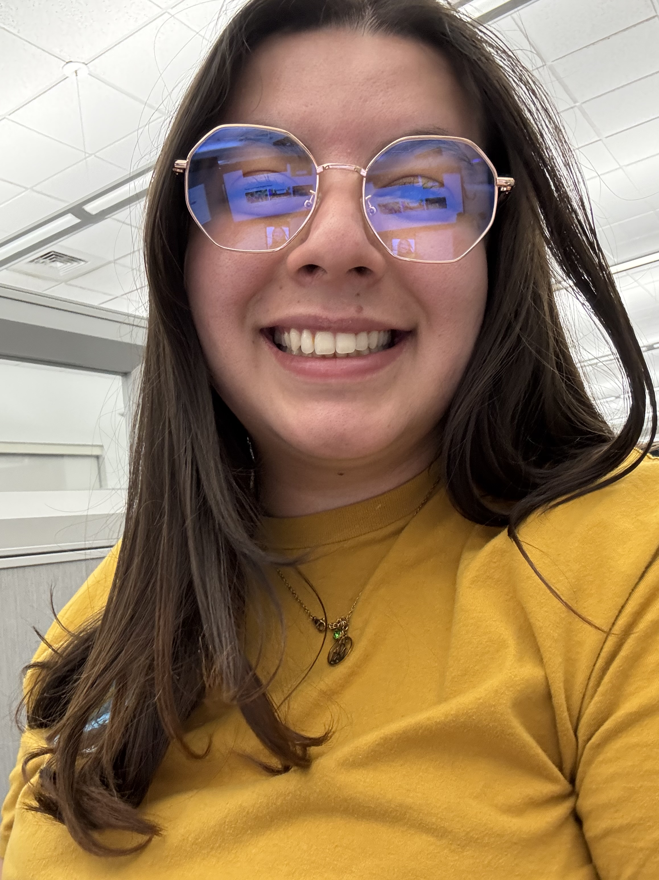
About the Developer: Carolina Rodriguez
Hi there! You can call me Caro for short 😊. I’m a Software Development student learning how the different parts of software development work together, from front-end design to back-end development, databases, and testing.
Throughout this project, I contributed in a lot of different areas. Early on, I helped create three personas and worked on the wireframes for the Reservation, Reservation Summary, and Look Up Reservation pages. I also contributed to the ERD, especially the Reservation and TerminationNotice tables, along with their SQL and business rules.
For development, I designed the main section of the Landing Page, worked on the back end of the Registration Page, and helped with the front end of the Reservation Summary page. I also worked on the back end of the Look Up Reservation page and My Fleet.
Testing was another big part of my contribution. I completed developer testing for the About Us page, peer testing for the Reservation and Reservation Summary pages, developer testing for my own pages, and peer testing for the back-end tests of the Edit User Info page. I also worked on the testing section of this presentation, Slides 20–27.
I’m excited to keep learning and building on what I gained from this project. 😊
5

Slide 6
About the Developer: Sara White
Slide owner: Sara
Your name, a photo or avatar, a brief description of yourself, and what you contributed to the project (pages, roles, and testing).
6

Slide 7
Sample Prototypes
Section 2 · From wireframe to finished page
Slide owner: Robert
Section divider for the prototype comparisons.
7

Slide 8
Wireframe to Finished Page (1)
Slide owner: Robert
A Module 2 wireframe or mockup side by side with a screenshot of the finished page, plus a line on what carried through and what changed.
8

Slide 9
Wireframe to Finished Page (2)
Slide owner: Robert
A second wireframe-to-finished-page comparison, using a different page from the first.
9

Slide 10
How the Design Changed Along the Way
Slide owner: Robert
The main ways the finished site differs from the original prototypes, and why each change was made.
10

Slide 11
Database Design
Section 3 · The ERD
Slide owner: Miguel
Section divider for the database design slides.
11

Slide 12
The Full ERD
Slide owner: Miguel
The complete, current ERD, with a short orientation to how the tables are grouped.
12

Slide 13
Customer
Slide owner: Miguel
The Customer table: what it stores, and how it connects to everything else (reservations, boat ownership, and the wait list).
13

Slide 14
Reservation
Slide owner: Miguel
The Reservation table: what it stores, and how it connects to everything else (the customer, the boat, the slip, and termination notices).
14

Slide 15
Boats and Ownership
Slide owner: Miguel
The Boat and BoatOwnership tables: what they store, and how ownership links boats to customers over time.
15

Slide 16
Docks, Slips and Slip Sizes
Slide owner: Miguel
The Dock, Slip and SlipSize tables: how the marina’s slip inventory is modeled, and how it feeds reservations and the wait list.
16

Slide 17
Wait List and Termination Notices
Slide owner: Miguel
The WaitList and TerminationNotice tables: what each one tracks, and which tables they connect to.
17

Slide 18
Supporting Tables
Slide owner: Miguel
The standalone and supporting tables (Contact, Employee, Rate, DatabaseVersion): what each is for, in a line or two.
18

Slide 19
Business Rules That Shaped the Schema
Slide owner: Miguel
Two or three business rules that directly drove a design decision in the database, and what that decision was.
19

Slide 20
Testing and Results
Functional testing across Modules
Slide Owner from pages 20-27 : Carolina
Developer testing, Peer Testing, Data Verification and UI Validation
20

Slide 21
How We Tested
Plan:
Test objectives, steps and expected results
Developer Test:
Initial Pass/Fail testing
Peer Test:
Teammate verification
Evidence:
Screenshots
Summary: Throughout the project, every major page had its own functional test plan. The developer tested the feature first, and then a teammate repeated the same steps as the peer tester. Each week, the roles switched depending on which feature was being tested. Every test included the steps to follow, the expected results, the Pass/Fail outcome, and screenshots from the peer tester. For backend features, we also ran MySQL queries to confirm that the database matched what the user saw on the page.
21

Slide 22
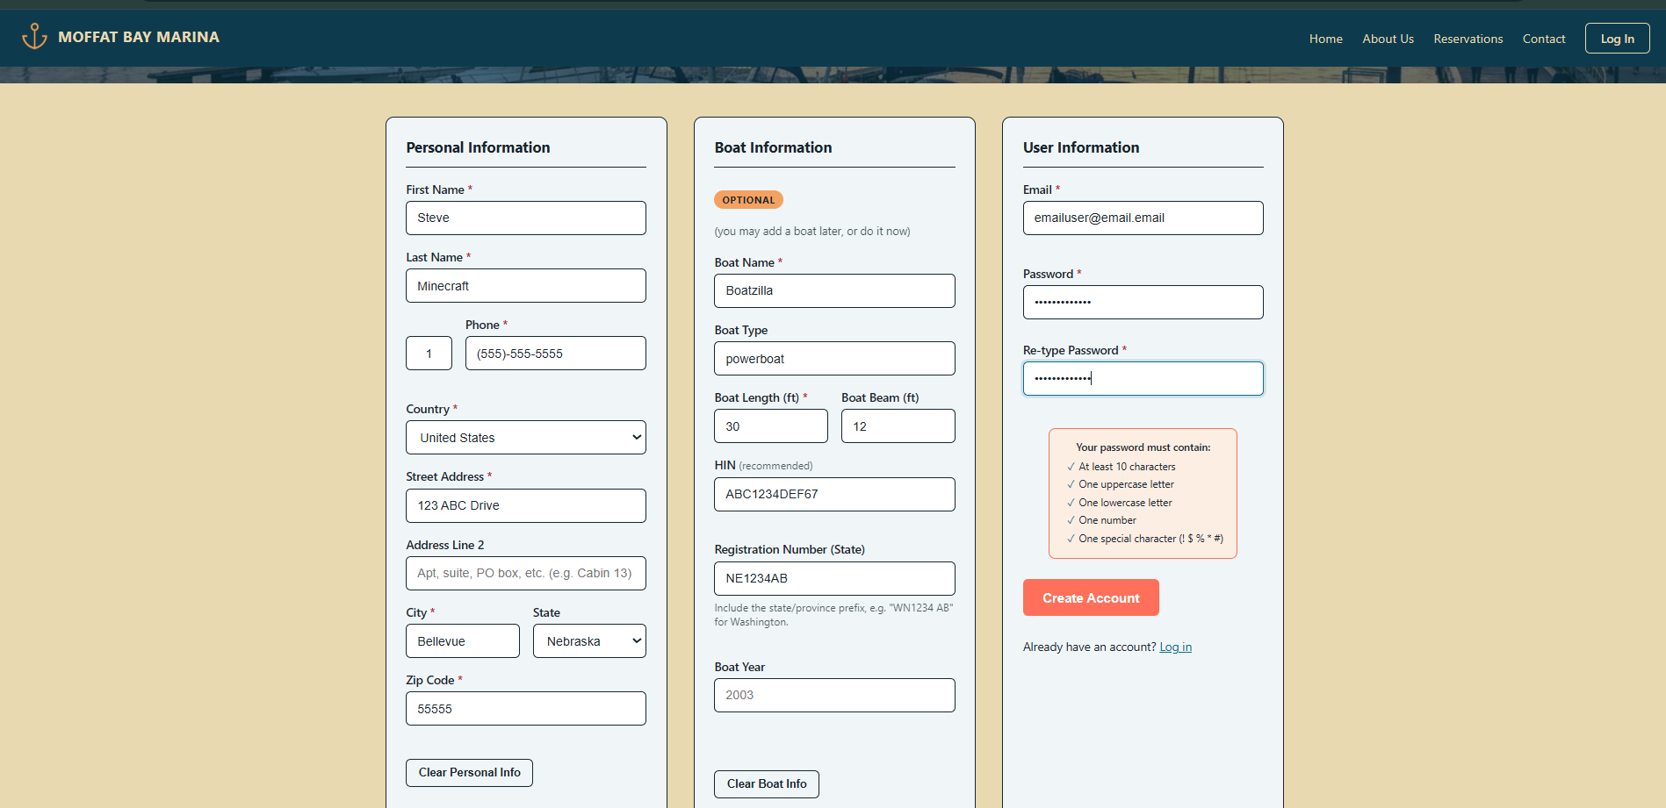
Test 1: Registration- Account Creation
What we tested: A new customer could complete the registration form, create an account, register a boat, and have the information written correctly to the database. The Registration test plan specifically covered both the live password checklist and account creation in the database.
Test process:
Enter personal information, phone number, address, and country.
Enter boat information, including the registration number.
Enter a valid email and password.
Verify that the Create Account button becomes available.
Submit the registration.
Query MySQL for the new Customer and Boat records.
Expected result:
The account should be created successfully, the customer should be redirected after registration, and the database should contain the new customer and boat.
Actual result:
Passed - The database check confirmed the Customer and Boat rows were created, and the peer tester also verified that a BoatOwnership row linked the new customer to the boat.
22

Slide 23
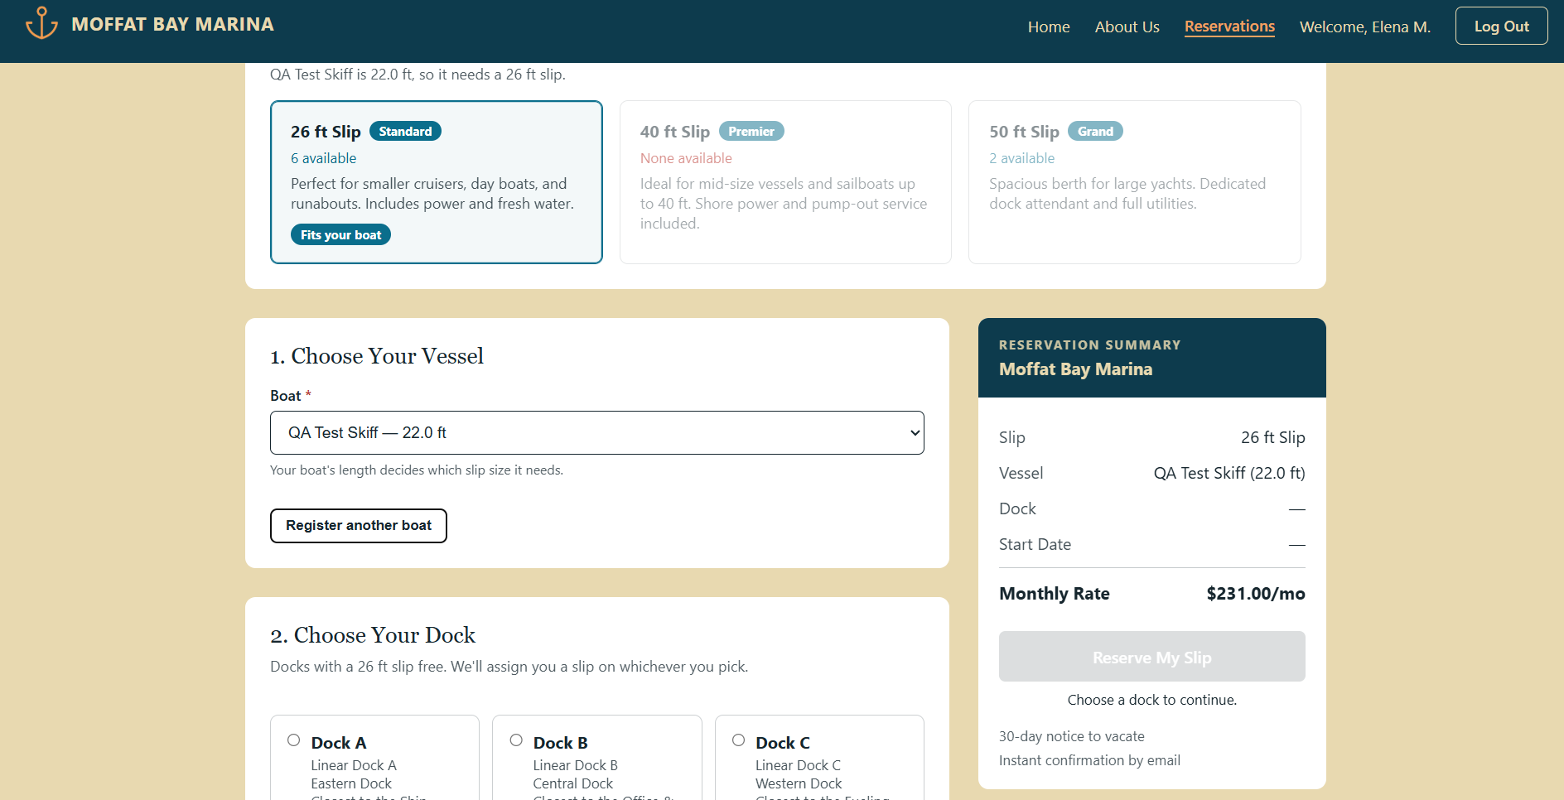
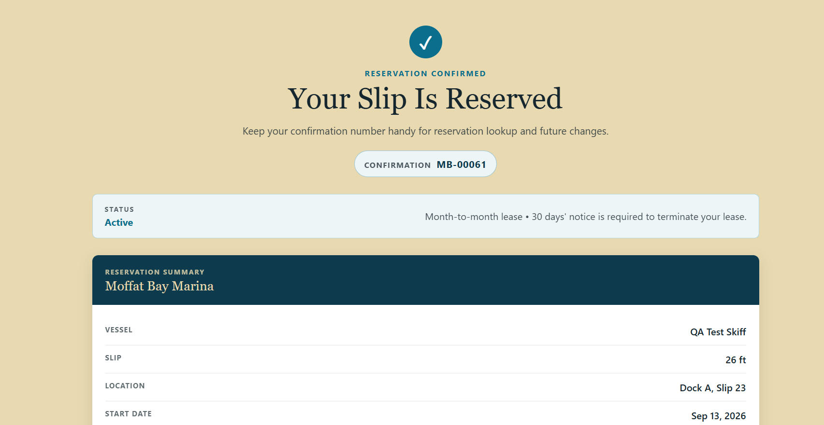
Test 2: Reservation- Booking Through Reservation Summary
What we tested: A customer could select a boat and available slip, complete a reservation, see the same information on Reservation Summary, and have the booking written correctly to MySQL.
Slide owner: Carolina
One test: the page it came from, what it checks, the steps in short form, the expected result, the actual result (Pass or Fail), and a screenshot.
Test process:
Sign in and open Book a Slip.
Select the test vessel.
Verify the correct slip size is matched to the boat.
Select Dock A, electric hookup, and a start date.
Confirm the Reservation Summary updates to the selected values.
Click Reserve My Slip.
Verify the Reservation Summary page shows the same boat, dock, date, hookup, and rate.
Expected result:
The information shown while setting a reservation should match the final Reservation Summary.
Actual result:
Passed - The test verified the new boat, current BoatOwnership, and an Active Reservation record in MySQL. The reservation rate also matched the total shown on the Reservation Summary page.
23

Slide 24
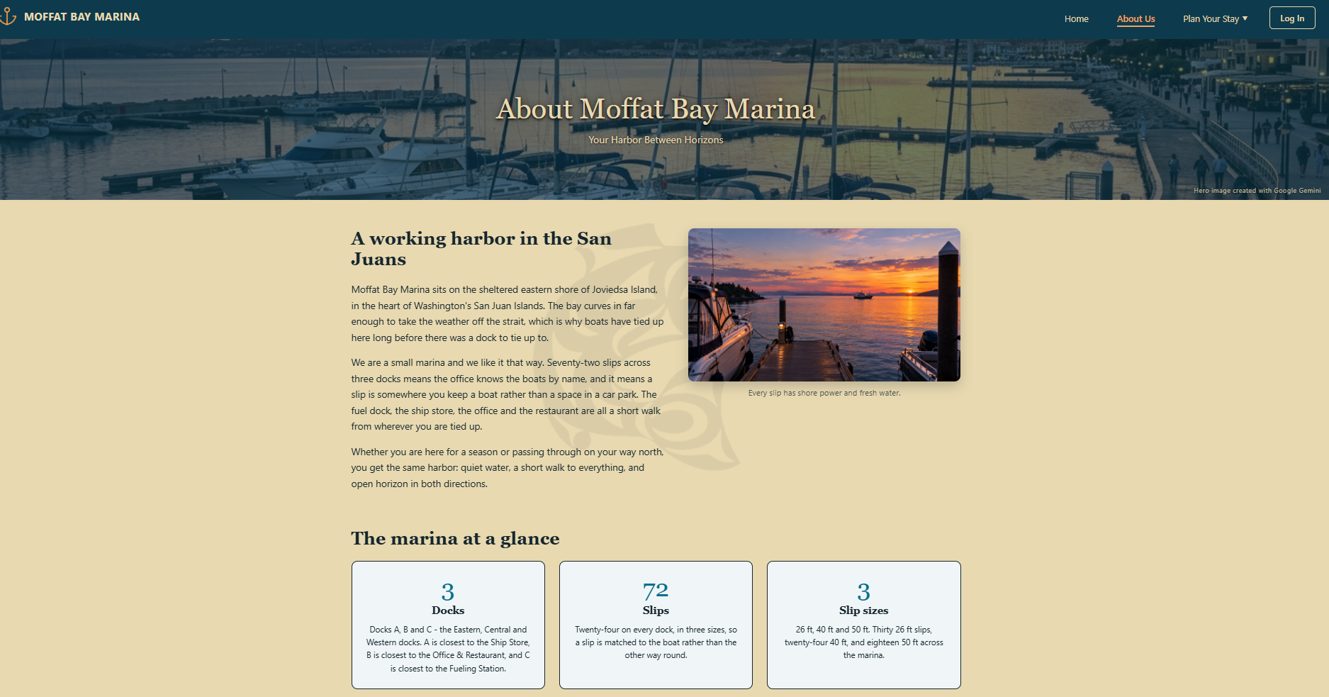
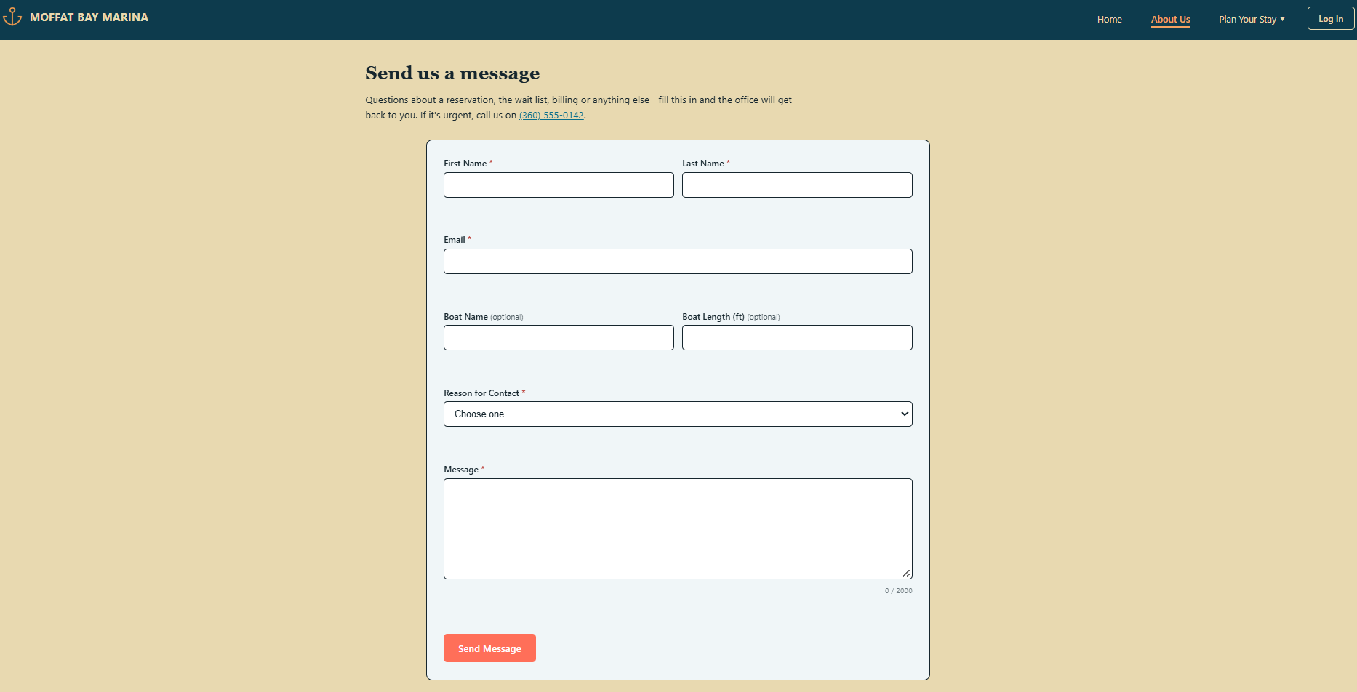
Test 3: About Us – Navigation and Page Display
What we tested: Verified that the About Us page loaded correctly, could be accessed while signed out, displayed its content and images properly, and allowed users to navigate to and from other pages.
Slide owner: Carolina
One test: the page it came from, what it checks, the steps in short form, the expected result, the actual result (Pass or Fail), and a screenshot.
Test process:
Open the About Us page.
Verify the header, footer, text, and images are consistent.
Use the logo to return to the landing page.
Navigate from About Us to another page such as Reservation.
Use the browser Back button and verify it returns to About Us.
Verify the page includes a Contact Us section.
Expected result:
The page should be publicly accessible, display all content and images correctly, include the Contact Us section, and allow users to navigate to and from the page without issues.
Actual result:
Passed- The About Us page remained publicly accessible, the contact information was consistent, and navigation worked without issues.
25

Slide 25
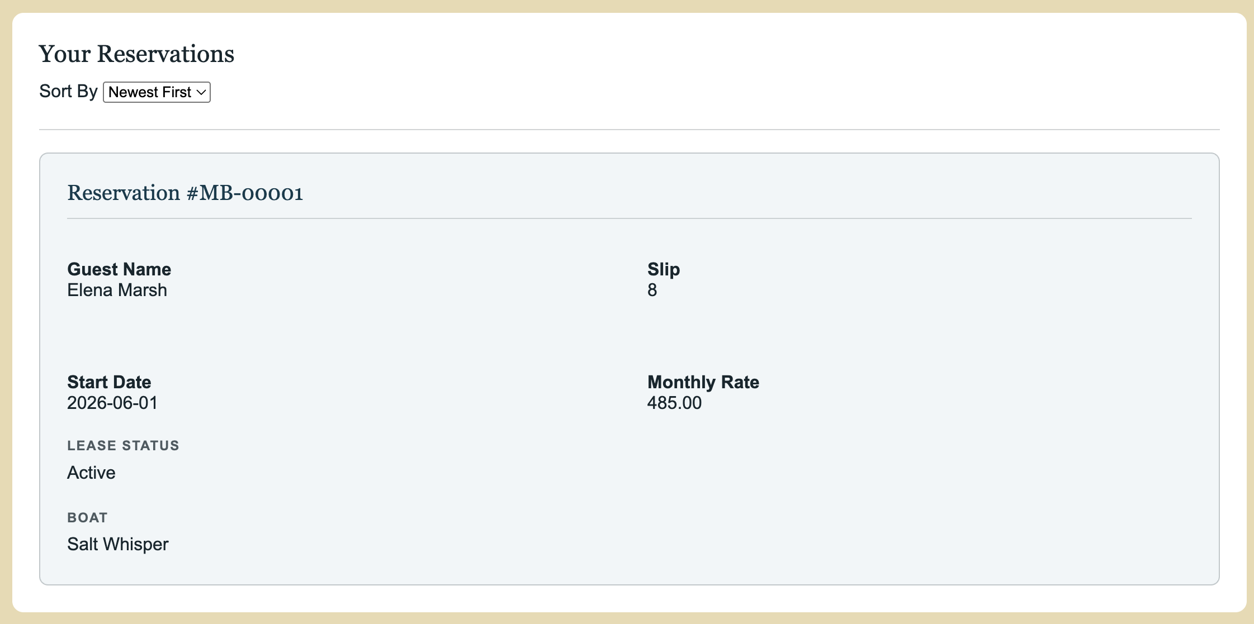
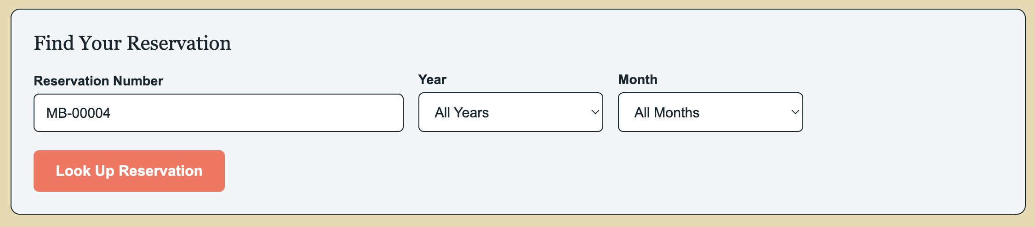
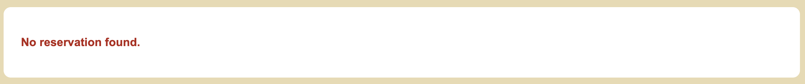
Test 4: Look Up Reservation- Customer Reservation
What we tested: Verified that the Look Up Reservation backend returns reservations only when they belong to the signed-in customer.
Test process:
Sign in as Elena Marsh.
Search for Elena’s reservation MB-00001.
Verify that the correct reservation details are returned.
Search for reservation MB-00004, which belongs to another customer.
Confirm that the backend uses the signed-in customer’s session ID when searching.
Verify that the other customer’s reservation is not displayed.
Expected result:
Elena should be able to retrieve her own reservation, but a reservation belonging to another customer should return “No reservation found.”
Actual result:
Passed - The lookup returned the signed-in customer’s reservation details correctly while using the session customer ID to block access to another customer’s reservation, returning “No reservation found.”
24

Slide 26
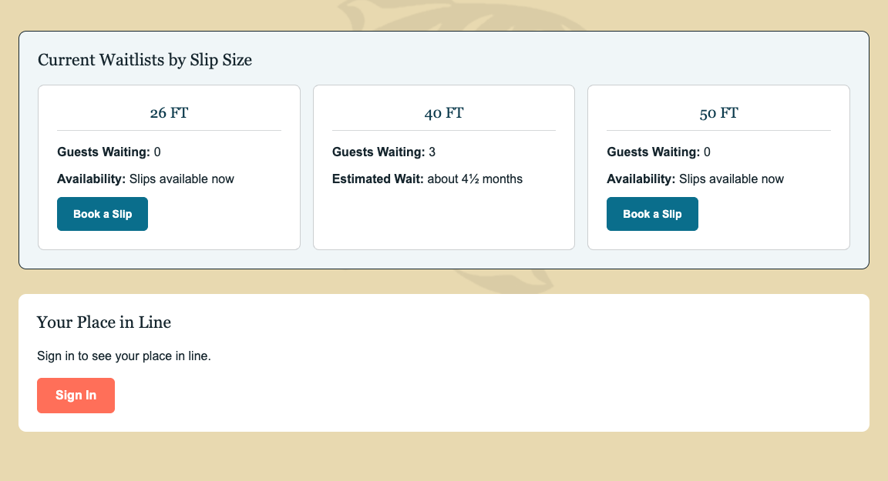
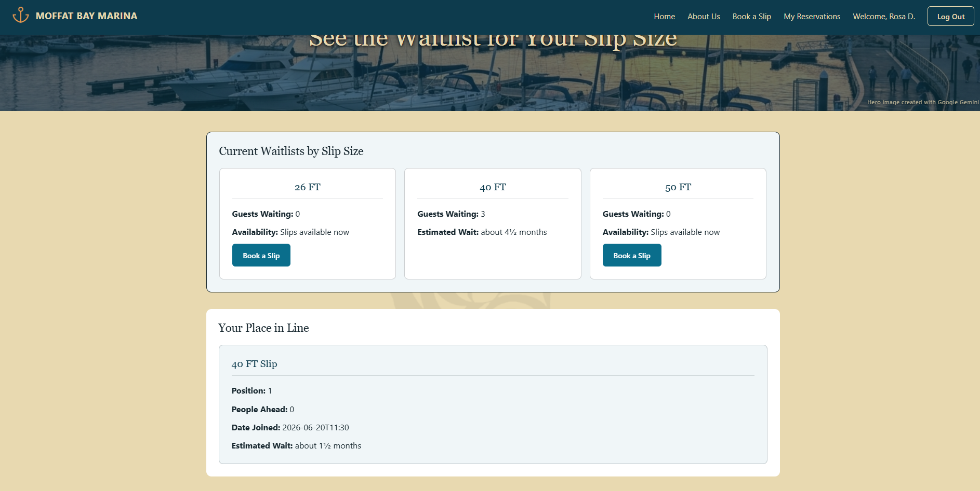
Test 5: Wait List – Counts, Position, and Join Flow
What we tested: Verified that the Wait List displayed public slip-size information, showed the signed-in customer’s position in line, and updated both the public count and personal position after joining.
Slide owner: Carolina
One test: the page it came from, what it checks, the steps in short form, the expected result, the actual result (Pass or Fail), and a screenshot.
Test process:
Open the Wait List while signed out.
Verify all slip sizes display with the correct number of guests waiting.
Sign in and verify the customer’s position and number of people ahead.
Join the wait list from the Reservation page.
Confirm the public wait-list count increases and the customer’s position updates.
Expected result:
The public wait-list counts should match the database, signed-in customers should see only their own position, and joining the wait list should immediately update the page.
Actual result:
Passed - The public wait-list counts matched the database, signed-in customers saw the correct position and number of people ahead, and joining the wait list created a new Waiting record and updated the page correctly.
26

Slide 27
What Testing Caught
Testing helped us catch user feedback, navigation, responsive-design, and integration issues before the final version.
Registration | Reservation | About Us | Waitlist
Issue Found – Registration completed but there was no clear success confirmation after re-direct. Result / Fix- Testing identified the need for a clearer user feedback. | Issue Found- It was not always clear why a boat could not be booked. Result /Fix- A helper message was added to explain that the boat already had a reservation. | Issue Found- Peer testing found visual issues with the hero banner and spacing on smaller screens. Result / Fix- Responsive layout issues were identified for cleanup. | Issue Found- Testing showed the wait-list flow needed to route through the correct page. Result /Fix- The flow was corrected so updated counts and customer position loaded correctly.
27

Slide 28
Lessons Learned
Section 5 · What each of us learned
Slide owner: Robert
Section divider for everyone’s Things I Learned slides.
28

Slide 29
Things I Learned: Robert Breutzmann
Slide owner: Robert
Two or three things you learned on this project.
29

Slide 30
Things I Learned: Miguel Fernandez
Slide owner: Miguel
Two or three things you learned on this project.
30

Slide 31
Things I Learned: Carolina Rodriguez
Three things I learned were:
Teamwork and Communication
  Communication really does make a big difference. It ended up being one of the biggest factors in keeping the project on track. Since we were all focused on different pieces, checking in with each other helped us avoid confusion and work through problems faster.
Project Structure
  Staying organized made the project a lot easier to manage. Having our files, page responsibilities, database work, and testing separated helped the workload remain balanced between each other.
Testing
  I learned how helpful it is to have someone else test your work. Sometimes you get so used to what you built that you miss small issues, and also peer feedback helped us catch those things before the final version.
31

Slide 32
Things I Learned: Sara White
Slide owner: Sara
Two or three things you learned on this project.
32

Slide 33
Thank You
Questions?
Slide owner: Robert
Closing slide: thank the audience and invite questions.
33

