Slide 1


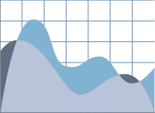
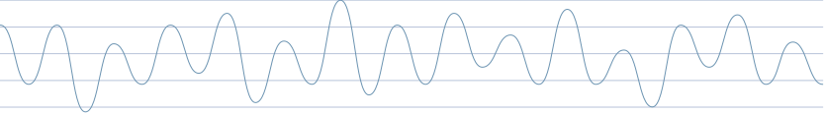



Canadian Household Personal Finance Analysis 2022
Shimeng Wang Simone.wang@mail.utoronto.ca
Yiming Li, goat.li@mail.utoronto.ca
Yuanzhe Li, yzb.li@mail.utoronto.ca
Ruiqi Zhang ruiqirae.zhang@mail.utoronto.ca

Slide 2


Introduction
This analysis examines the financial health of 16,208 Canadian households based on 2022 survey data. The study reveals significant wealth accumulation patterns, debt structures, and demographic correlations across age groups, education levels, and geographic regions.
Key Findings:
Median household net worth: 902,500
Mean after-tax income: 101,812
Home ownership is the primary driver of wealth inequality
University graduates hold 44% of households and show highest net worth
66% of households demonstrate good financial health through full credit card payments
Notes:
Effect of friendship, family, close social connections on different measures of health or wellbeing.

Slide 3

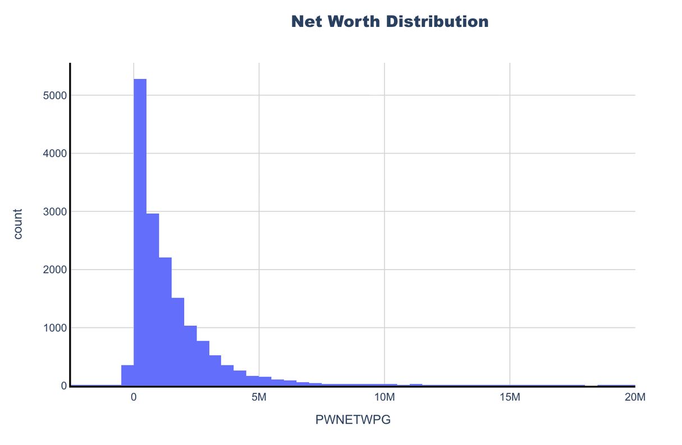

  Source: Personal Finance Case Dataset (2022)
  Sample Size: 16,241 households → 16,208 after outlier removal
  Coverage: All 10 Canadian provinces
Age Range: Under 25 to 80+
Variables (19 total):
  Financial: Income, assets, debt, net worth
  Demographic: Education, family type, employment status
  Data Quality:
  No missing values
  100% completeness across all variables
Dataset Overview

Slide 4

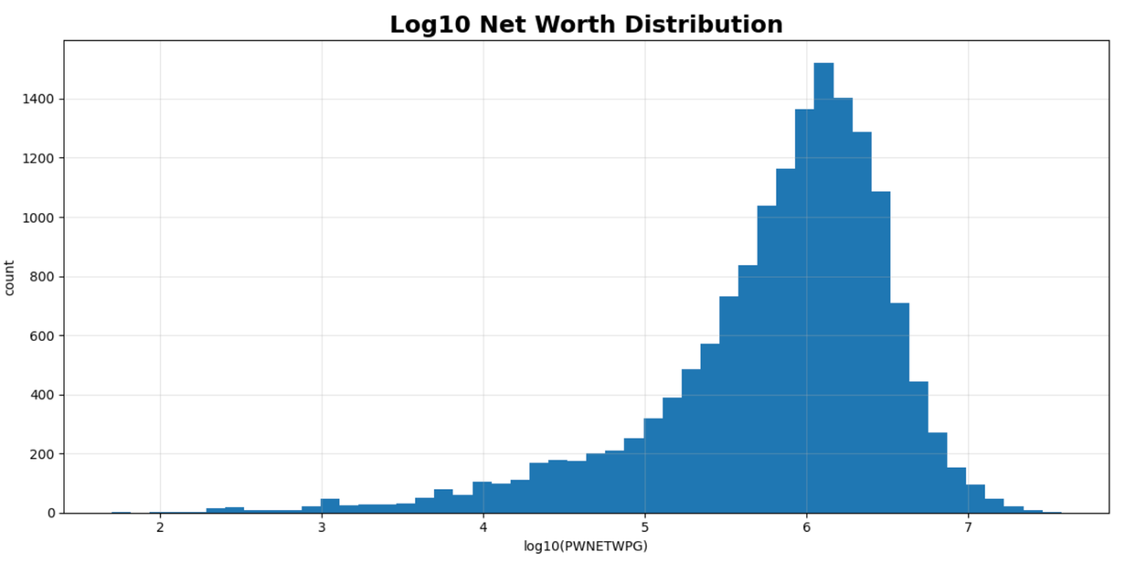

Net Worth by Age Group
The analysis of net worth across age groups reveals clear life-cycle wealth accumulation patterns.
Key Observations:
  Life-Cycle Accumulation:
Net worth rises steadily during working years, with the fastest growth in mid-career.
  Peak then Preserve:
Wealth peaks before retirement and remains high afterward, followed by a gradual decline at older ages.
  Early-Age Outlier:
Younger households show unexpectedly high net worth, likely driven by family support rather than earned income.

Slide 5
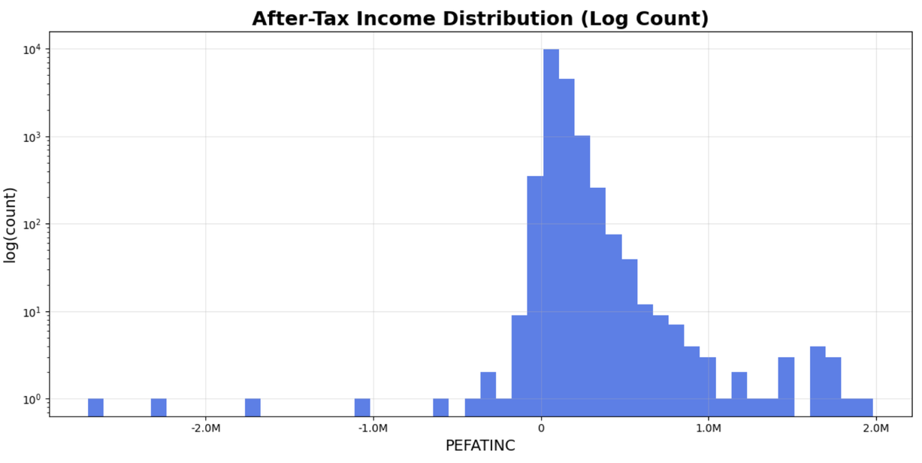
Income Distribution Analysis
Household after-tax income shows a different distribution pattern compared to net worth reflecting current earning capacity rather than accumulated wealth.
  Right-Skewed Earnings:
Household income is highly skewed, with a small share of high earners driving inequality.
  Income ≠ Wealth:
Many moderate-income households still build substantial wealth through homeownership and long-term saving.
  Income Volatility:
Negative incomes reflect business losses, highlighting the risk and variability of entrepreneurial earnings.

Slide 6
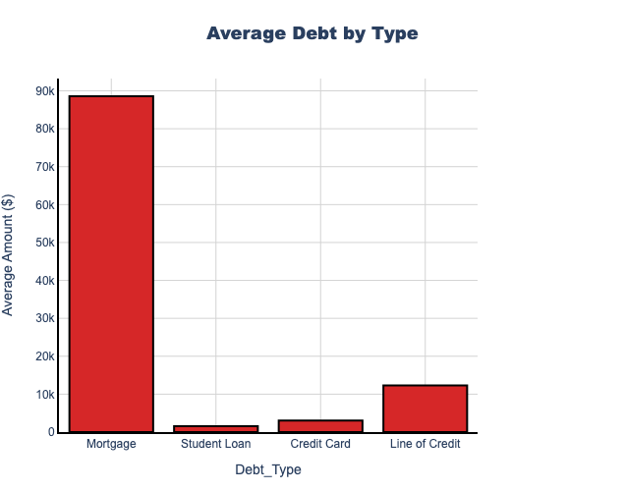
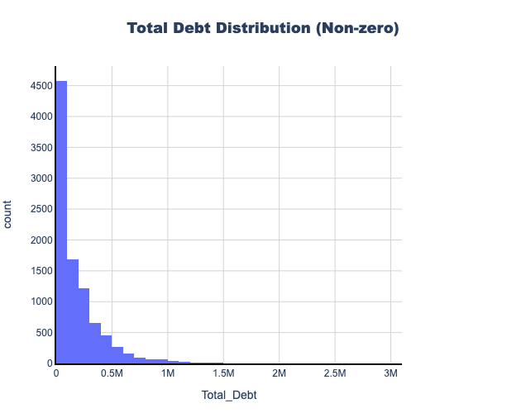
Housing Debt Concentration & Structural Risk
Canadian households carry various types of debt, with mortgages dominating the debt landscape.
  Mortgages = 84% of total household debt
  Line of credit is second largest category
  Debt distribution is highly right-skewed
Household financial risk is concentrated in housing leverage.

Slide 7
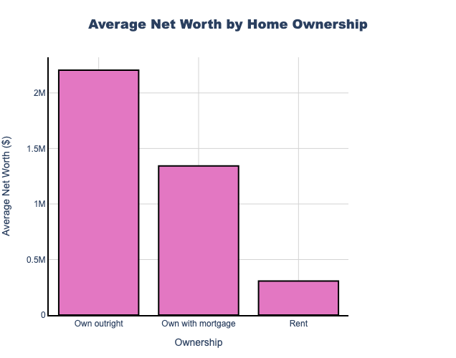
Home Ownership & Wealth
  Own outright: 2.2M
  Own with mortgage: 1.34M
  Rent: 307K
  Households owning outright have 7.2× the net worth of renters.
  Even households with mortgages hold 4.4× the wealth of renters.
Home ownership status emerges as a critical factor differentiating household wealth.

Slide 8
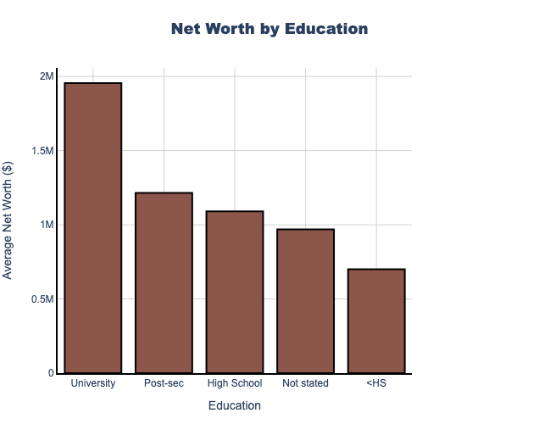

Education Premium
  University graduates show the highest average net worth.
  Post-secondary education also provides advantage over high school.
  Education impact compounds over time.
Education strengthens long-term financial resilience.

Slide 9
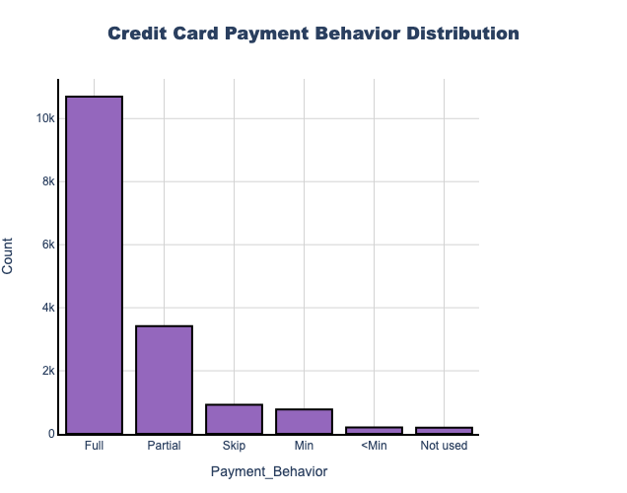
Credit Card Payment Behavior
Payment distribution
Full payment: 66%
Partial/minimum: 26%
Skip/below minimum: 7%
Financial Health Assessment:
  Full payers indicate strong monthly cash flow and lower interest burden.
  Partial/minimum payers suggest revolving debt and rising repayment costs.
  Skip/below minimum is a direct signal of short-term financial stress.

Slide 10
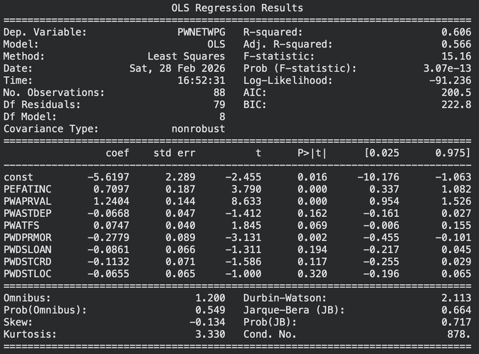
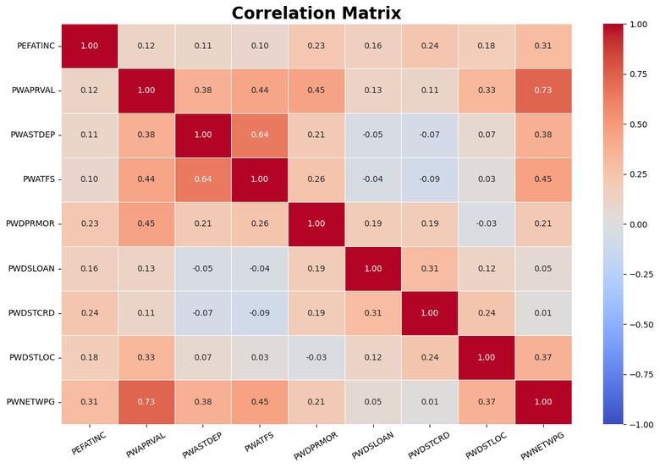
Correlation Analysis
Examining relationships between financial variables reveals key drivers of household wealth.
The constant can be seen as an indicator of average life standard
-5.61
net book value is 0
= - net worth
>0 imposible?
= 0 welfare state
<0 what’s shown in dataset
Net Worth Drivers
Strong positive correlation with:
  property value
  bank deposits
  TFSA balance
  (income)
Asset Correlations:
  Home value (strongly) mortgage debt - expected
  Liquid assets bank deposits + TFSA correlate with each other and net worth

Slide 11
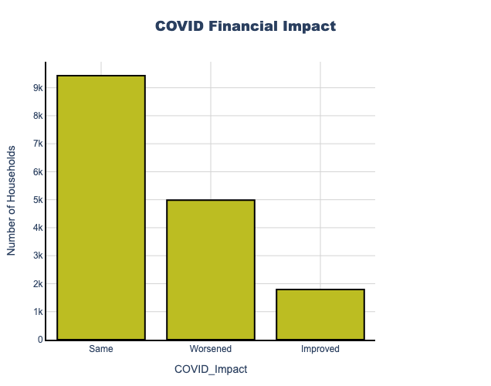
COVID-19 Financial Impact
The COVID-19 pandemic had varied financial impacts across households.
COVID Impact Distribution:
  Stayed the same: 9,432 households 58.2%
  Worsened: 4,982 households 30.7%
  Improved: 1,794 households 11.1%
COVID Impact Analysis:
1. Majority Stable:58% no change
household savings & government support programs CERB, etc. were effective.
2. Negative Impact:31% worsening
Low-income households
Service sector workers
Small business owners
etc.
3. Positive Impact:11% improvement
Increased savings rates
Investment market gains
Government transfers
4. Net Worth Correlation:
"stayed same" status had the highest average net worth 1.62M
Notes:
COVID Impact Analysis:
1. Majority Stable:58% of households reported no change in their financial situation, suggesting strong household balance sheets and government support programs CERB, etc. were effective.
2. Negative Impact:31% experienced financial worsening, likely affecting:
Low-income households
Service sector workers
Small business owners
Those with job losses or reduced hours
3. Positive Impact:11% experienced financial improvement, benefiting from:
Reduced expenses commuting, dining out
Increased savings rates
Investment market gains
Government transfers
4. Net Worth Correlation:Households with "stayed same" status had the highest average net worth 1.62M, suggesting financial resilience is linked to wealth.
Long-term Implications:
Widening wealth gap between resilient and vulnerable households
Increased savings rates for some households
Potential permanent shifts in work and spending patterns
Government policy evaluation point for future crises

Slide 12
Financial Health Indicators
Financial Health Distribution:
66% ---- strong ---- full credit card payments
26% ---- moderate ---- partial or minimum payments
7% ---- financial stress ----skip payments.
key indicators of household financial health.
  Net worth > median vs < 25%th
  Renting vs Owning
  Education level
  Diversified asset vs Limited diversification
  Employment full-time vs Part-time/unemployed
  Multiple vs Single earners in household
Notes:
Based on the comprehensive analysis, we can identify key indicators of household financial health.
Positive Indicators:
Net worth above median 902,500
Full credit card payment each month
Home ownership with or without mortgage
University or post-secondary education
Diversified asset holdings home + liquid investments + registered accounts
Stable employment full-time work
Multiple earners in household
Risk Indicators:
Net worth below 25th percentile 289,250
Carrying credit card balances month-to-month
Renting vs. owning
No post-secondary education
Limited asset diversification
Part-time or no employment
Single earner household
Financial Health Distribution:
Based on payment behavior, approximately 66% of households demonstrate strong financial health full credit card payments, 26% show moderate risk partial or minimum payments, and 7% show signs of financial stress skip or below-minimum payments.

Slide 13
Policy Implications and Recommendations
  Savings Incentives
    Promote TFSA / RRSP contributions
    Matching programs / tax incentives
    Automatic enrollment in workplace plans
  COVID-19 Recovery
    31% experienced financial decline
    Targeted support: low-income, service sector
    Stronger social safety nets
  Wealth Inequality
    Large gap: median vs 75th percentile wealth
    Progressive taxation
    Redistribution measures
  Homeownership Support
    7.2× wealth gap: owners vs renters
    Down payment assistance
    First-time buyer programs
    Affordable housing expansion
  Financial Education
    Strong education–wealth link
    Financial literacy programs
    Target: young adults,
lower-education households
  Debt Management
    26% carry balances / pay minimum
    Debt counseling & financial planning
    Regulation of predatory lending
Notes:
Policy Implications and Recommendations
The analysis reveals several areas where policy interventions could improve household financial outcomes.
Homeownership Support:
The 7.2x wealth gap between owners and renters suggests supporting homeownership could reduce wealth inequality
Consider down payment assistance, first-time buyer programs, and affordable housing initiatives
Financial Education:
Strong correlation between education and net worth suggests value in financial literacy programs
Target programs at young adults and lower-education households
Debt Management:
26% of households carry credit card balances or make minimum payments
Promote debt counseling and financial planning services
Consider regulation on predatory lending practices
Savings Incentives:
Encourage TFSA and RRSP contributions through matching programs or tax incentives
Promote automatic enrollment in workplace savings plans
COVID-19 Recovery:
31% of households experienced financial worsening during pandemic
Targeted support for vulnerable households low-income, service sector
Strengthen social safety nets for future crises
Addressing Wealth Inequality:
The wide gap between median and 75th percentile net worth 905K vs 1.95M indicates concentration of wealth
Consider progressive taxation and wealth redistribution policies

Slide 14
Conclusion
This comprehensive analysis of 16,208 Canadian households reveals several critical insights
  Wealth Accumulation is Time-Dependent:Net worth peaks at ages 55-64, demonstrating the importance of long-term saving and investing strategies starting early in life.
  Home Ownership is a Wealth Multiplier:Homeowners have 4-7x the net worth of renters, making housing policy central to addressing wealth inequality.
  Education Provides Clear Advantages:University graduates show higher net worth and financial resilience, supporting the value of accessible post-secondary education.
  Financial Behavior Matters:Credit card payment patterns correlate with overall financial health, suggesting money management skills are as important as income.
  Wealth Inequality is Significant:The distribution of net worth shows substantial inequality, with the top quartile holding significantly more wealth than the median household.
  COVID-19 Impacts Varied Widely:While most households were financially resilient, 31% experienced worsening conditions, highlighting vulnerability in certain demographics.
FutureResearch Directions
  Longitudinal analysis to track wealth accumulation over time
  Intergenerational wealth transfer patterns
  Impact of rising interest rates on household debt sustainability
  Regional and urban-rural comparisons
  Gender and immigration status analysis with additional data
Methodology Notes
  Data cleaned to remove extreme outliers net worth 20M, income 1M
  All monetary values reported in Canadian dollars
  Analysis based on 2022 survey data
  Sample designed to be representative of Canadian households
This analysis provides a foundation for understanding household financial health in Canada and can inform policy decisions, financial product development, and individual financial planning strategies.

Slide 15
Thank you !

