Slide 1


The gem5 architecture simulator
WIFI PW: hotel 900
A tutorial for HPCA ‘23, presented by the Bobby R. Bruce

Slide 2

Today’s Agenda
WIFI PW: hotel 900
Introduction (8:30 to 9:00)
What is gem5?
What can gem5 be used for?
Nomenclature
Obtaining and building gem5
”Hello World” in gem5 (9:00 to 9:30)
Running a “Hello World” binary in SE Mode
How does gem5 work?
Discrete Event Simulation
SimObejects
Speeding things up (10:50 to 11:20)
What can we do?
Checkpoints
Simpoints and Looppoints
The GPU Model (11:20 to 12:05)
Wrap-up (12:05-12:15)
Tutorial on Looppoints in the afternoon (Outremont 1)
gem5 standard library (9:30 to 10:50)
What is it?
Where is it?
Gem5 Resources
Coffee Break at somepoint.
Understanding the stats.
Creating a traffic generator.
Creating a FS simulation.
The Simulator Module

Slide 3
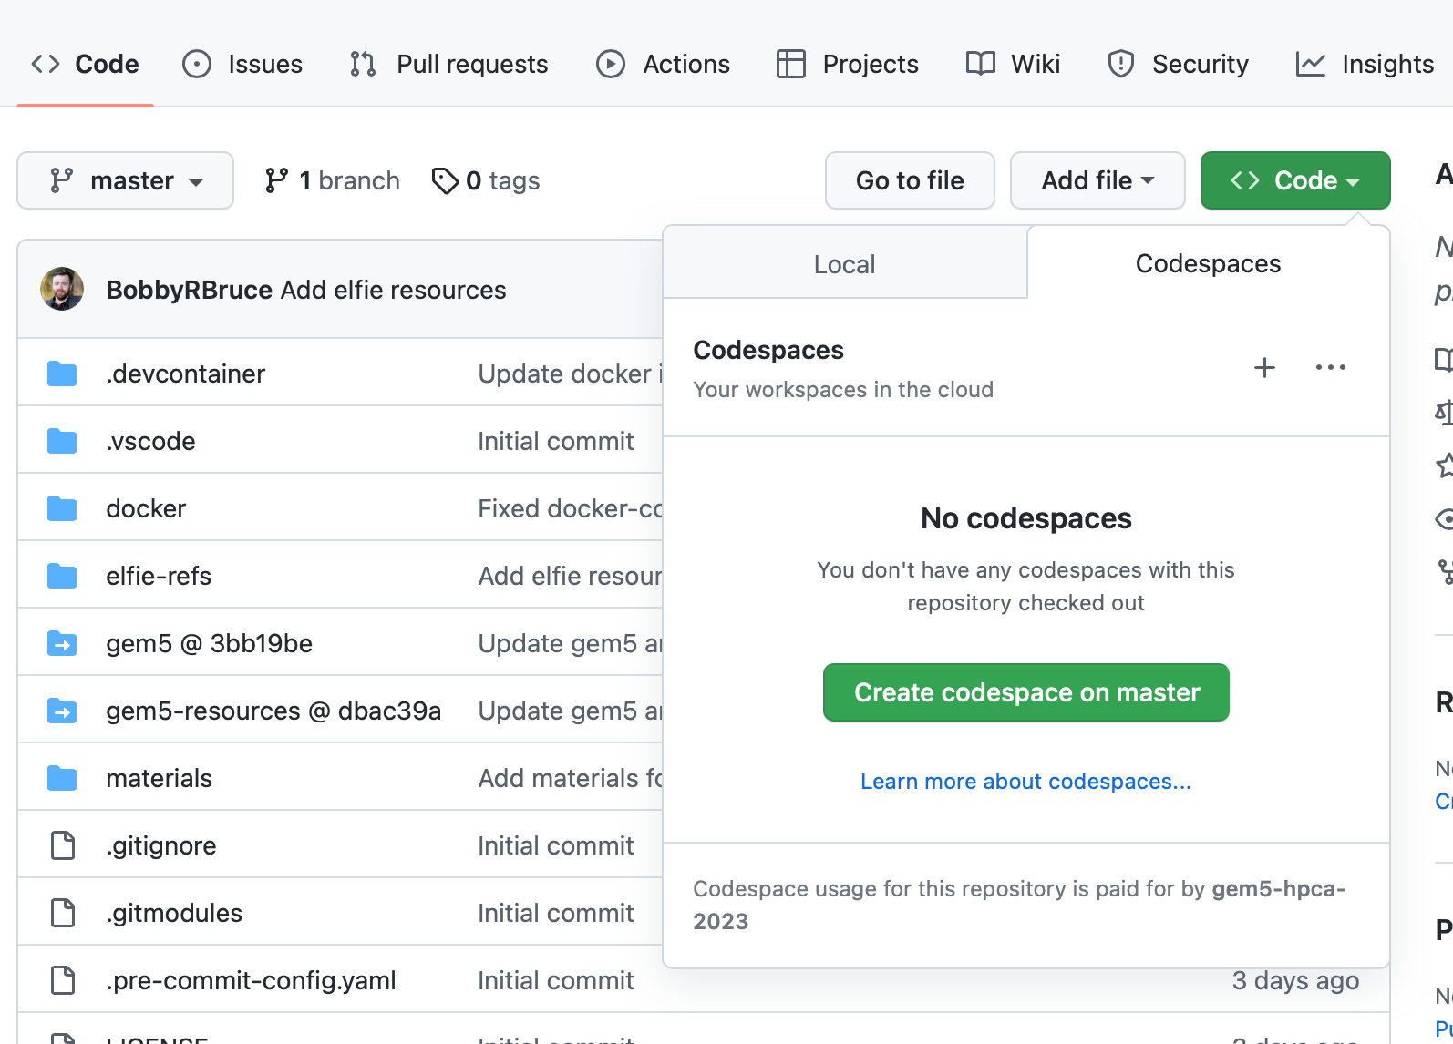
GitHub Codespaces
WIFI PW: hotel 900
https://github.com/gem5-hpca-2023/gem5-tutorial-codespace
“Code” -> “Codespaces” -> “Create Codespace on master”
This will take a minute to load a Visual Studio Code environment in your web-browser.

Slide 4
GitHub Codespaces
“materials” contains everything you need.
The “ALL/gem5.fast” binary comes pre-built and installed as “gem5”
This is completely open source. Feel free to pull a copy.

Slide 5
What is gem5?
The gem5 architecture simulator provides a platform for evaluating computer systems by modeling the behavior of the underlying hardware. It enables researchers to simulate the performance and behavior of complex computer systems, including the CPU, memory system, and interconnects. This makes it possible to study the performance of different microarchitectural and architectural choices, as well as the effects of different workloads, without having to build and test real systems.
By ChatGPT

Slide 6



A little bit of history
The GEMS simulator
Provided a detailed memory system.
^{(~2000)}
The m5 Simulator
“A tool for simulating systems”
(~2002)
(2011)
6

Slide 7
A true public infrastructure project
Open Source
Free (like beer)
Massively Collaborative
7

Slide 8
Who uses gem5, and why?
Education
Academic Research and public research labs
Industrial R&D
8

Slide 9
Education
Problem: Students need to learn to design hardware but don’t have a multi-billion-dollar factory
9

Slide 10
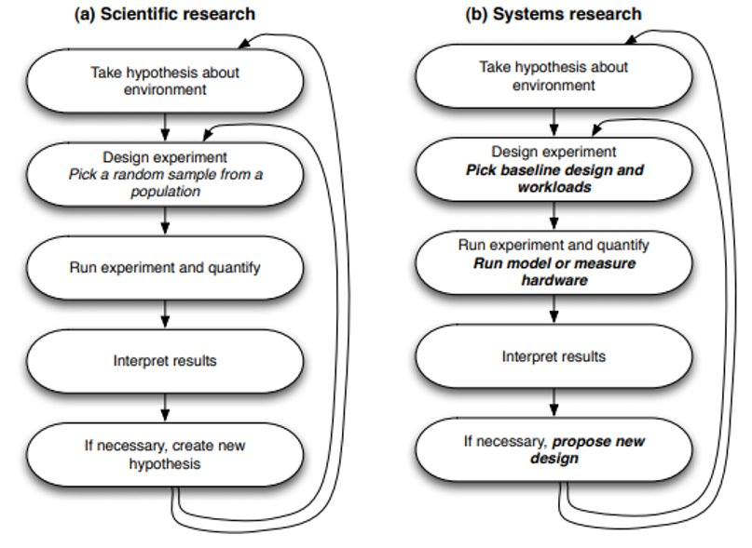
Research
10

Slide 11
Researchers
We recently surveyed the top architecture conferences and found:
70% of all computer architecture research utilizes simulation.
The gem5 simulator is by-far the most popular.
Room for improvement: Most users still “roll their own” simulation software. Only 20% use gem5 directly. We want to go above 50% by 2027.
11

Slide 12
Industry
?
Really, we don’t know exactly. We don’t track users and industrial users seldom make themselves known.
12

Slide 13



Industry
Big players we know use it
13

Slide 14
What languages do we use?
Your simulation configuration is written in Python which interacts with the core CPP simulator.
Python
CPP
In this tutorial we’ll be working solely at the level of Python.
Adding CPP code is necessary for extending gem5’s capabilities.
14

Slide 15
Nomenclature
Your system
Host: the actual hardware you’re using
Simulator: Runs on the host Exposes hardware to the guest
Guest: Code running on simulated hardware OS running on gem5 is guest OS gem5 is simulating hardware
Simulator’s code: Runs natively executes/emulates the guest code
Guest’s code: (or benchmark, workload, etc.) Runs on gem5, not on the host.
App
App
Operating Sys.
Host
Hardware
Simulation
Workload
App
App
Guest
Operating Sys.
gem5
Host
Hardware

Slide 16
Nomenclature
Your system
Host: the actual hardware you’re using
Simulator: Runs on the host Exposes hardware to the guest
Simulator’s performance: Time to run the simulation on host Wallclock time as you perceive it
Simulated performance: Time predicted by the simulator Time for guest code to run on simulator
App
App
Operating Sys.
Host
Hardware
Simulation
Workload
App
App
Guest
Operating Sys.
gem5
Host
Hardware

Slide 17
Let’s hit the ground running
This example will show:
How someone obtains gem5.
How you build it.
Running a very basic ”Hello World” simulation.
17

Slide 18
Downloading/building gem5
> git clone https://gem5.googlesource.com/public/gem5
> cd gem5 > scons build/ALL/gem5.opt –j<number of threads>
stable: The default branch for gem5. Updated at stable releases. develop is updated more frequently (>1 per day)
18

Slide 19
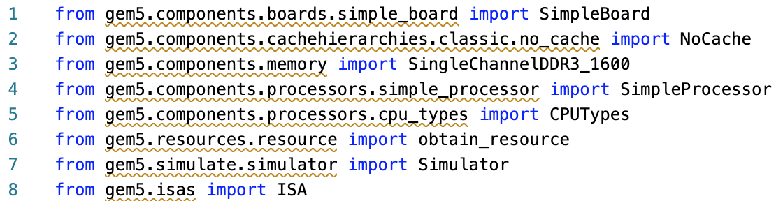
Write a “hello world!” configuration (in Python!)
Open “materials/hello-world.py”.
We have provided the imports:
19

Slide 20
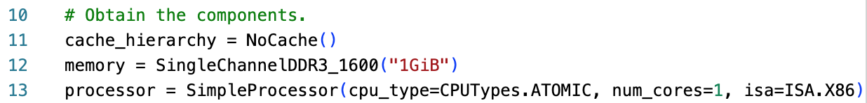
“hello world!”: Obtaining the components

Slide 21
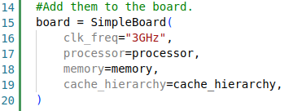
“hello world!”: Adding to the board!

Slide 22
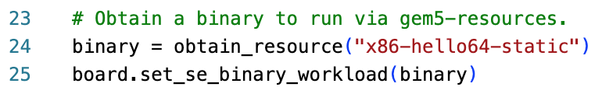
“hello world!”: Obtain the resource

Slide 23

“hello world!”: Load the board to the simulator

Slide 24
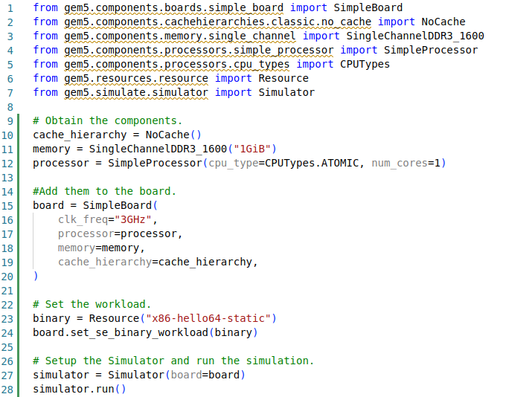
“hello world!”: In full
A full example can be found in “materials/complete/hello-world.py”

Slide 25
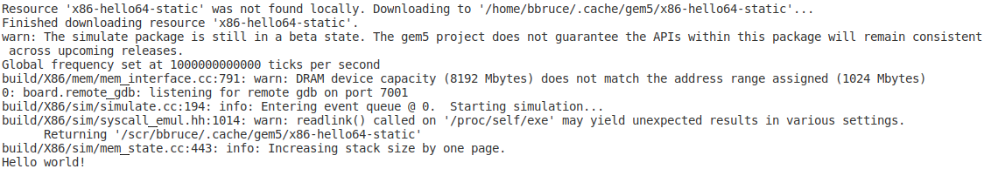
“hello world”: Let’s run it!
> gem5 materials/hello-world.py

Slide 26
Wait, what just happened?
1-Core, No Cache Hierarchy, 1GiB memory
Demonstrated the core library APIs
We just did a “Hello World!”
Using “SE Mode”

Slide 27
Ok, but how does it work?
Modern systems are very complex, and the design of gem5 simulations reflects this.
However, at its core, the simulator builds on a relatively simple model.

Slide 28

At its core: it’s a discrete event simulator
Event at head dequeued
Event executed
More events queued
gem5 is a discrete event simulator
Event Queue
Event - 52
Event - 50
Event - 50
Event - 55
Event - 20
Event - 11
Event - 10

Slide 29
At its core: it’s a discrete event simulator
Event at head dequeued
Event executed
More events queued
gem5 is a discrete event simulator
Event Queue
Event - 51
Event - 55
Event - 52
Event - 50
Event - 50
Event - 20
Event - 11

Slide 30
Discrete event simulation example
Fetch first inst
Miss in L1, send to DRAM
Put in read Q
Get data from DRAM
Cache recvs data
Fetch next inst
Send req to cache
Processor decodes instruction
Processor executes instruction
TIME
L1 tag latency
To DRAM latency
DRAM read latency
Response latency
One cycle

Slide 31
Discrete event simulation
"Time" needs a unit In gem5, we use a unit called "Tick"
Need to convert a simulation "tick" to user-understandable time E.g., seconds
This is the global simulation tick rate Usually this is 1 ps per tick or 10¹² ticks per second

Slide 32
Ok, but how do you schedule these events?
While some are incredibly complex, at their core they only do two things:
SimObject
Schedule events and process events.
2. Talk to other SimObjects.

Slide 33
It’s hard to scale this…
gem5
Config file
When done without the library you must define every part of your simulation.
This allows for maximum flexibility but can mean creating 100s of lines of Python to create even a basic simulation.

Slide 34
The solution: The gem5 standard library
gem5
stdlib
Config file
The stdlib is a library which allows for users to quickly create systems with pre-built components.
The stdlib's module architecture allows for components (e.g. a memory system or a cache hierarchy setup) to be quickly swapped in and out without radical redesign.

Slide 35
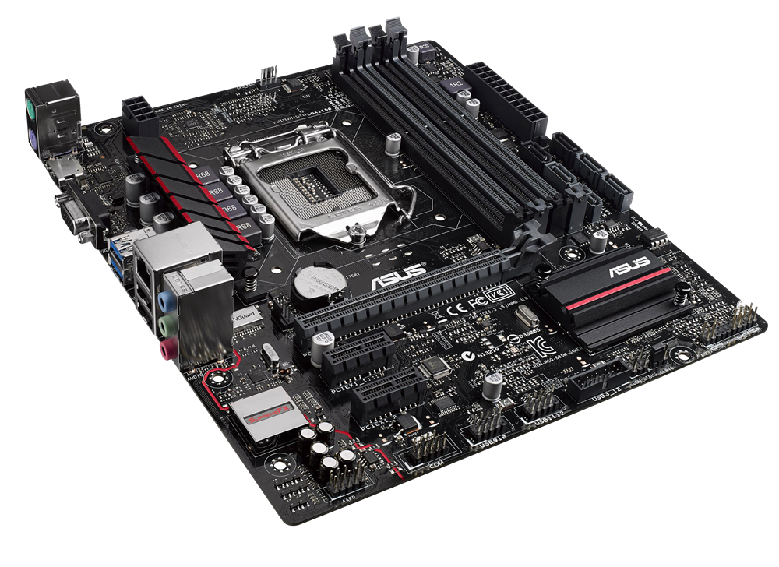
The stdlib modular metaphor
Processor
Simple Processor
Memory
SwitchableProcessor
Cache Hierarchy
SingleChannelDDR3_1600
No Cache
...
PrivateL1PrivateL2
SingleChannelDDR4_2400
MesiTwoLevel
Board
...
...

Slide 36
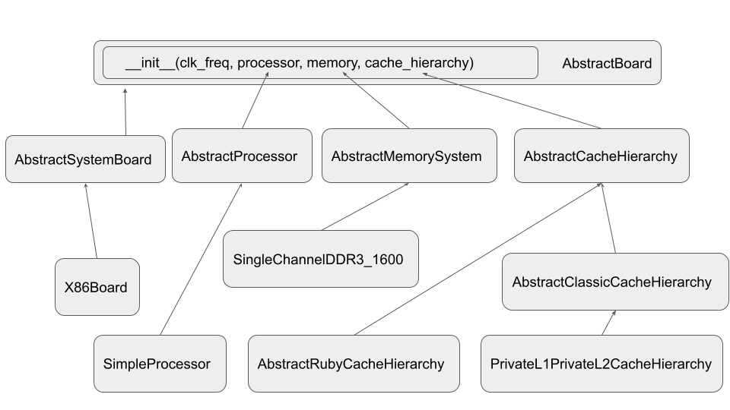
The modular architecture

Slide 37
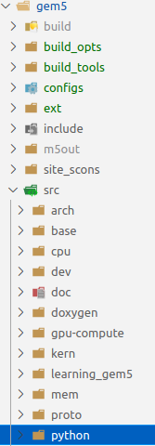
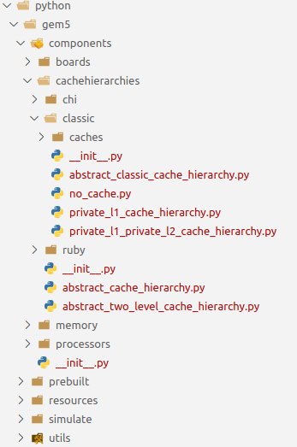
Where to find stuff: The directory structure

Slide 38
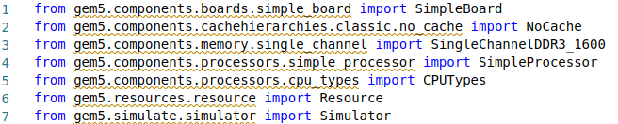
Where to find stuff : Importing in a script

Slide 39
Let’s go back and loop at our script again

Slide 40
gem5 Resources
gem5 resources is a repository providing sources for artifacts that are known to be compatible with gem5.
These resources are not necessary for the compilation or running gem5 but may aid users in running simulations. E.g.: disk images, kernels, applications, cross-compilers, etc.
Resources are held on gem5's Google Cloud Bucket, and sources for these resources are found at: https://gem5.googlesource.com/public/gem5-resources/
The stdlib can be used to automatically obtain and use these resources.
https://resources.gem5.org/resources.json

Slide 41
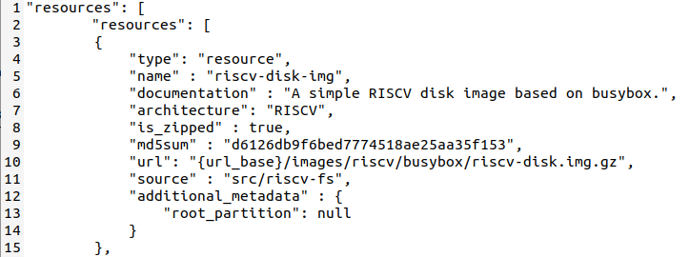
Looking up gem5 Resources
https://resources.gem5.org/resources.json
This is all machine-reachable for now. We're working on a web-portal.

Slide 42
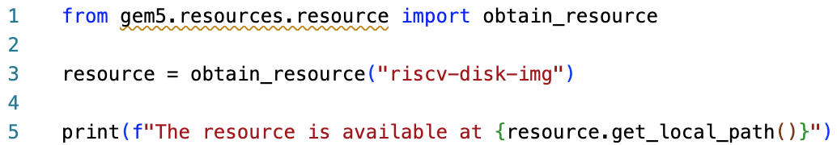
Obtaining Resources in the stdlib
This complete script can be found in “materials/obtain-resources.py”
> gem5 materials/obtain-resources.py

Slide 43
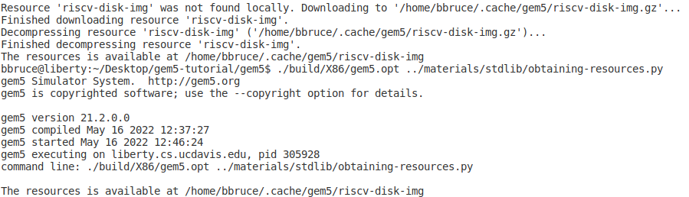
Obtaining Resources in the stdlib
The stdlib will use the cached resources if already downloaded.

Slide 44

Using a Custom Resource
You don't need to use the gem5 resources
You can specify a local resources (e.g., your own disk image)

Slide 45
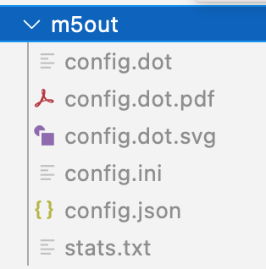
More detailed output
Look into the more the ”gem5/m5out” directory
The “config” files detail your system configuration (various formats, ”config.ini” most human-readable.
The stats.txt shows the various simulation statistics.
In Full-System simulations the terminal output can be found in this directory.

Slide 46
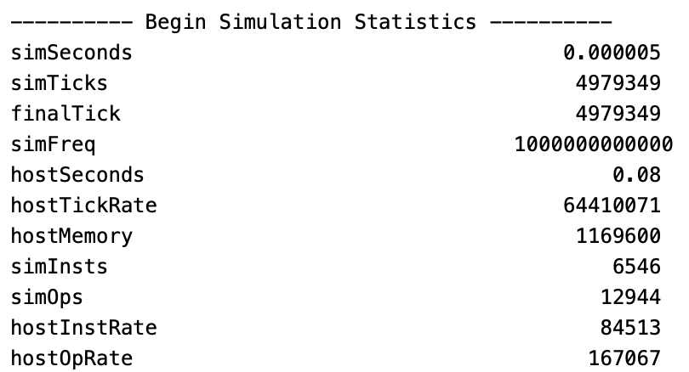
More detailed output
Look into the more the ”gem5/m5out/stats.txt” file

Slide 47
Modifying our design!
Remember: gem5 is modular!
In general, you can replace components with components of the same type.
Let’s convert our basic “hello world” board into a Traffic generator board.

Slide 48
Traffic Generator
Generator
Memory System

Slide 49
The ‘TestBoard’
Generator
Memory System
TestBoard
And gem5 does the rest!

Slide 50
Let’s build one!
Go to “materials/traffic-generator.py”
Here we have imports, and some boilerplate code to run the simulation. You’re code will go in-between.

Slide 51
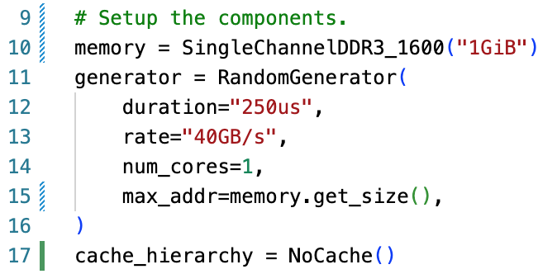
Traffic generator: Setup our components

Slide 52
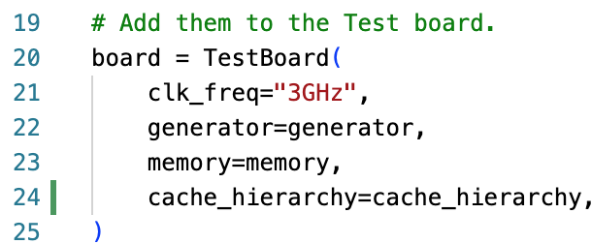
Traffic generator: Connect them to the TestBoard

Slide 53
Running the traffic generator.
> gem5 materials/traffic-generator.py
This should be quite fast. What have we done?
This does not require a workload or even a real processor
Generated traffic to evaluate a memory component
Users would typically consult the stats.txt

Slide 54
Let’s add a ‘fun’ memory system
2nd generation High Bandwidth Memory stack
Complete version can be found in “materials/complete/traffic-generator-hbm2stack.py”

Slide 55
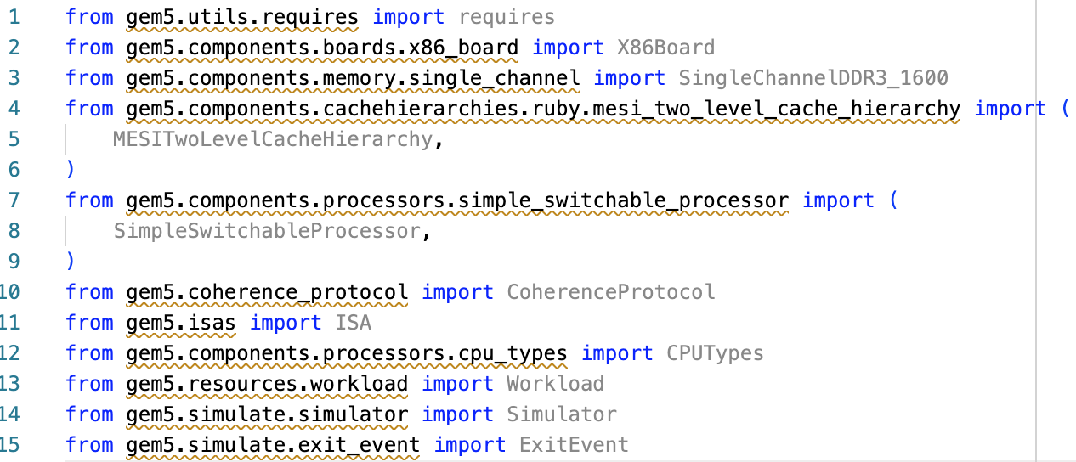
More complex designs: An X86 full system simulation in the stdlib
Move to "materials/x86-full-system.py. You should see the following provided for you:

Slide 56

Adding the 'requires' function
This adds a check for the gem5 binary parsing the script. In this case:
1. The binary supports the X86 ISA.
2. The binary supports the MESI Two Level coherence protocol.

Slide 57
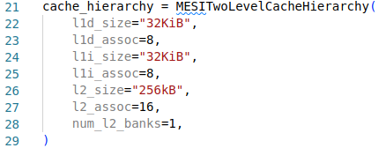
Extending the gem5 library

Slide 58
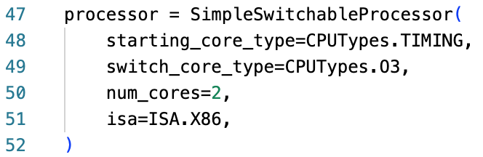
Extending the gem5 library
The SimpleSwitchingProcessor allows for different types of cores to be swapped during a simulation with `processor.switch()`.
This can be useful when wanting to switch to and from a detailed form of simulation. (Timing = less detailed but fast; O3 = detailed but slow).

Slide 59
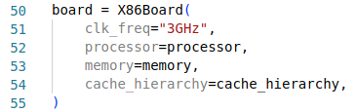
Extending the gem5 library
As usual, we add the components to the board, in this case an `X86Board`.

Slide 60
Extending the gem5 library

Slide 61
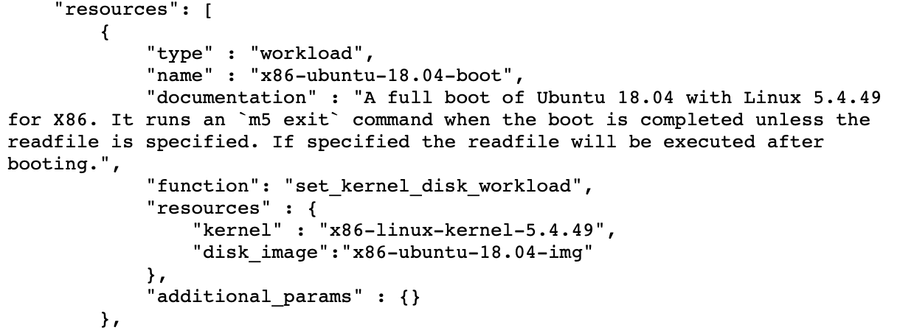
Extending the gem5 library
http://resources.gem5.org/resources.json

Slide 62
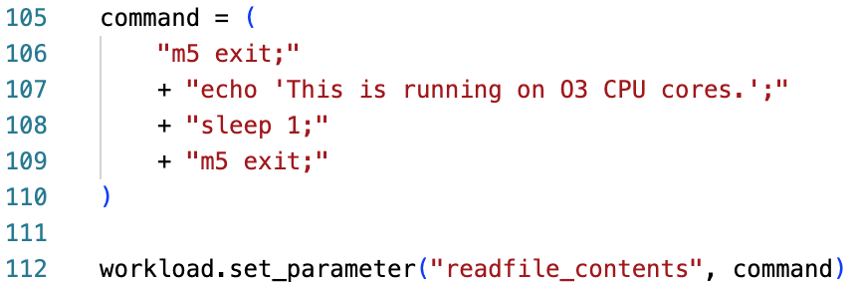
Extending the gem5 library

Slide 63

Extending the gem5 library

Slide 64



Exit Events
Note: This is module is still considered to be in Beta. The API may change in future versions of gem5
During a simulation you can have "Exit Events".
In this example there are two. These return the simulation to the Python Script.

Slide 65
The Simulation Loop
“simulate.run()”
Simulation
X
Exit Event
“simulate.run()”
Simulation
Exit Event

Slide 66
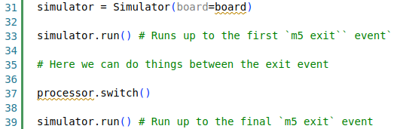
The Simulator Module handles the loop!
Here we can run up to an exit event, do things, and then continue the run.
In this case we want to switch the CPU cores.

Slide 67
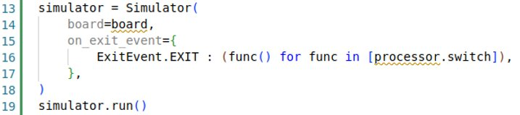
The Simulator Module: We can do better
ExitEvent.EXIT
ExitEvent.CHECKPOINT
ExitEvent.FAIL
ExitEvent.SWITCHCPU
ExitEvent.WORKBEGIN
ExitEvent.WORKEND
ExitEvent.USER_INTERRUPT
ExitEvent.MAX_TICK
Here we can specify exactly what to do on each exit event type via Python generators.
The Simulator had default behavior for these events, but they can be overridden.

Slide 68
Your done! You can now run your full-system simulation
Warning: This will take a long time to complete execution.

Slide 69
Simulation’s major pitfall: It’s slloooww
>> 100k seconds on the host
Simulating 1 Second

Slide 70
Fortunately, there are some work arounds
Key idea: You don’t need to simulate everything perfectly, or at all.
Simulation Fidelity
Simulation Time

Slide 71
Some techniques we provide
CPU Models
KVM Mode
SE Mode
Checkpoints
Simpoints

Slide 72
Simpoints/Looppoints
There’s a tutorial on Looppoints this afternoon in Outremont 1
Discuss: What is a Simpointing?

Slide 73
Simpoints
Open “materials/simpoints-checkpoint.py”

Slide 74
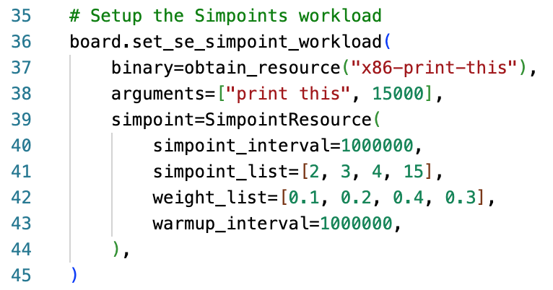
Simpoints

Slide 75
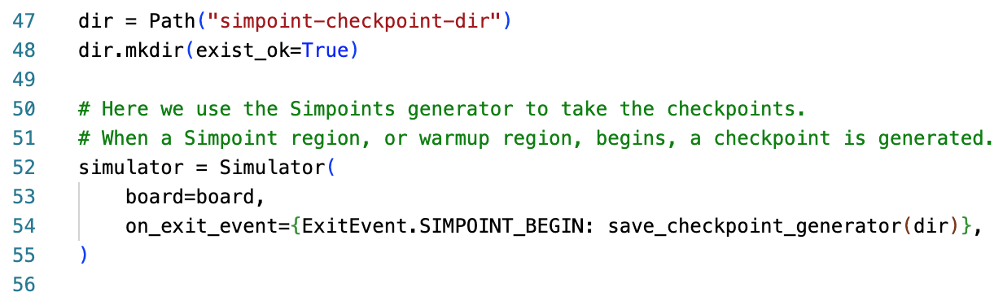
Simpoints

Slide 76
Simpoints
> gem5 materials/simpoint-checkpoint.py
Generates checkpoints at each warmup/Simpoint region start

Slide 77
Simpoints: Restoring
> gem5 materials/simpoints-restore.py

Slide 78
The gem5 GPU Model

Slide 79

Caveats
gem5 is a tool, not a panacea
Most models are not validated against “real” hardware
See “Architectural Simulators Considered Harmful”
There are bugs!

Slide 80

Getting (more) help
Main gem5 website: http://gem5.org/
More like this:
https://www.gem5.org/documentation/ learning_gem5/introduction/
Mailing lists: http://gem5.org/Mailing_Lists
gem5-users: General user questions (you probably want this one)
gem5-dev: Mostly code reviews and high-level dev talk
gem5 slack: https://join.slack.com/t/gem5-workspace/shared_invite/zt-1c8go4yjo-LNb7l~BZ0FagwmVxX08y9g

Slide 81
References
Martin et al. 2005. Multifacet’s general execution-driven multiprocessor simulator (GEMS) toolset. ACM SIGARCH Computer Architecture News. https://doi.org/10.1145/1105734.1105747
Binkert et al. 2006. The M5 simulator: Modeling Networked Systems. IEEE Micro. https://doi.org/10.1109/MM.2006.82
Binkert, et al. 2011. The gem5 simulator. SIGARCH Comput. Archit. News 39 http://dx.doi.org/10.1145/2024716.2024718
Lowe-Power et al 2021. The gem5 Simulator: Version 20.0+. ArXiv Preprint ArXiv:2007.03152, 2021. https://doi.org/10.48550/arXiv.2007.03152

