Slide 1
A gem5 Implementation of the Codelet Model
Dawson Fox, Jose Monsalve Diaz, Xiaoming Li

Slide 2
Outline
High level objective with novel innovation
Pushing architecture-agnostic hardware modules from the PXM (which is usually software)
Dedicated hardware unit for organization and scheduling of data movement
Scratchpad memory, hardware FIFOs to improve performance hindered by cache protocols
Motivating example: what’s wrong with the state of the art?
DARTS flow
Tasking Models
Difficulties with data movement in traditional memory hierarchies
The prototype we want to implement (with a diagram)
CodeletInterface for CUs
SU for codelet / memory codelet scheduling
MCU for fast data transformation
Notes:
Either address it or disable it

Slide 3
Implementation Objectives

Slide 4
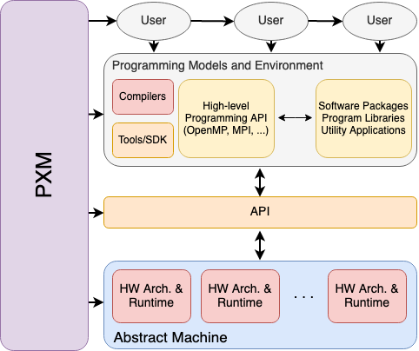
Objective: HW Implementation of PXMs
Program Execution Models (PXMs)
“formal specification of the application program interface (API) of the computer system”
System-wide agreement between hardware and software
Holistic organization of execution throughout system stack

Slide 5
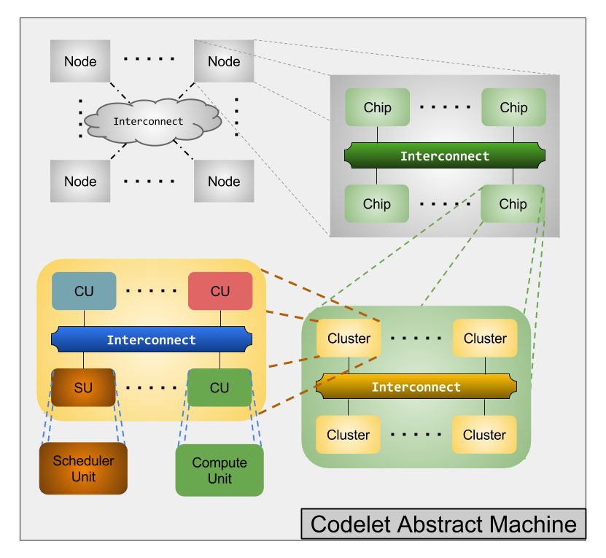
Objective: HW Implementation of Sequential Codelet Model
Codelets are bits of sequentially-executed, non-preemptive, side-effect free code
Sequentially written programs containing Codelets and control flow instructions
Intended to be fine-grained with strong input/output definitions
The Scheduler Unit (SU) schedules Codelets to Compute Units (CU) as dependencies are fulfilled
Notes:
Expect people to wonder how Codelets are different from threads – emphasize this point so they understand better. ****Make sure to point out the benefits of nonpreemptive and side effect. Maybe give very broad idea of tasking then introduce how codelets are different

Slide 6
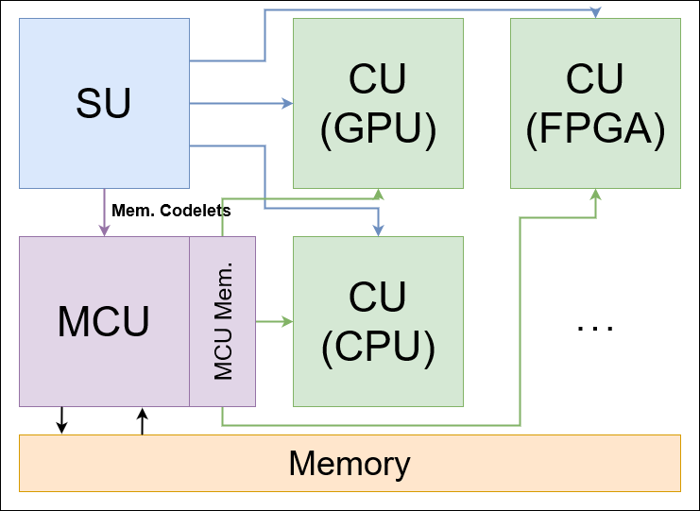
Objective: Implement the MCU
Memory Codelet Unit (MCU) - dedicated execution unit for Memory Codelets
Fast-data-transform programmable PNM hardware unit
Mem. Codelets decouple memory access from computation
Perform data movements and preprocessing/recode operations
Leverage gem5 to explore heterogeneity
Notes:
Be more consistent with the figures throughout. Maybe use this figure to refer back to later to tie the implementation to the function of each unit. Change this figure to show memory controller or take out MMU. Make clear external memory vs local memory for the MCU in this diagram

Slide 7
Motivating Examples: Why bother with this implementation?
Notes:
Mention that traditionally PXMs are implemented only in software

Slide 8
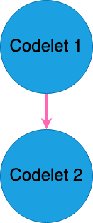
Motivating Example 1: DARTS Signaling Overhead
myTP->toSignal->decDep()
if(sync_.decCounter())
{
if(myTP_)
myTP_->incRef();
if(myThread.threadMCsched)
{
if(myThread.threadMCsched->getLocal())
{
if(myThread.threadMCsched->pushLocal(this))
return;
}
}
myThread.threadTPsched->pushCodelet(this);
}
Problems?

Slide 9
Motivating Example 1: DARTS Signaling Overhead
myTP->toSignal->decDep()
if(sync_.decCounter())
{
if(myTP_)
myTP_->incRef();
if(myThread.threadMCsched)
{
if(myThread.threadMCsched->getLocal())
{
if(myThread.threadMCsched->pushLocal(this))
return;
}
}
myThread.threadTPsched->pushCodelet(this);
}
Pointer
Dereferencing
Notes:
Get rid of bulleted points, make figure of codelet signalling another codelet. Simplify names in code to save space. Use multiple slides of the code with syntax highlighting varying to augment the explanation of the code flow
Layers of references
References may or may not be valid, causing multiple levels of branches
Data referred to may be located anywhere in the memory hierarchy of the system
Software implementation causes overhead of varying times

Slide 10
Motivating Example 1: DARTS Signaling Overhead
myTP->toSignal->decDep()
if(sync_.decCounter())
{
if(myTP_)
myTP_->incRef();
if(myThread.threadMCsched)
{
if(myThread.threadMCsched->getLocal())
{
if(myThread.threadMCsched->pushLocal(this))
return;
}
}
myThread.threadTPsched->pushCodelet(this);
}
Multiple branches
Notes:
Get rid of bulleted points, make figure of codelet signalling another codelet. Simplify names in code to save space. Use multiple slides of the code with syntax highlighting varying to augment the explanation of the code flow
Layers of references
References may or may not be valid, causing multiple levels of branches
Data referred to may be located anywhere in the memory hierarchy of the system
Software implementation causes overhead of varying times

Slide 11
Motivating Example 1: DARTS Signaling Overhead
myTP->toSignal->decDep()
if(sync_.decCounter())
{
if(myTP_)
myTP_->incRef();
if(myThread.threadMCsched)
{
if(myThread.threadMCsched->getLocal())
{
if(myThread.threadMCsched->pushLocal(this))
return;
}
}
myThread.threadTPsched->pushCodelet(this);
}
Multiple function calls
Notes:
Get rid of bulleted points, make figure of codelet signalling another codelet. Simplify names in code to save space. Use multiple slides of the code with syntax highlighting varying to augment the explanation of the code flow
Layers of references
References may or may not be valid, causing multiple levels of branches
Data referred to may be located anywhere in the memory hierarchy of the system
Software implementation causes overhead of varying times

Slide 12
Motivating Example 2: Tasking Models
Software only
Very heavy implementations:
OpenMP LLVM kmp_tasking.cpp: > 4000 lines of code
No direct hardware support
Victim of the target architecture
Notes:
These points are not specific to OpenMP just software implementations. Focus on tasking runtimes more generally to not confuse people, can use OpenMP as specific example

Slide 13
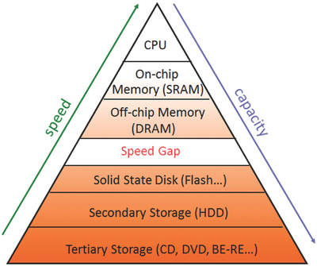
Motivating Example 3: Traditional Memory Hierarchy
Data’s physical location in the system is ambiguous
Data movement inherently tied to cache protocols
Penalties for cache invalidation
Issues with streaming
Software FIFOs equally ambiguous
Incurs software-based synchronization overheads (locks & atomic mem. accesses)
Tied to cache line size
Bandwidth / latency bound applications
Where’s the data?

Slide 14
The gem5 Codelet Model Implementation
Notes:
At each slide, make very clear to start with what each module actually does

Slide 15
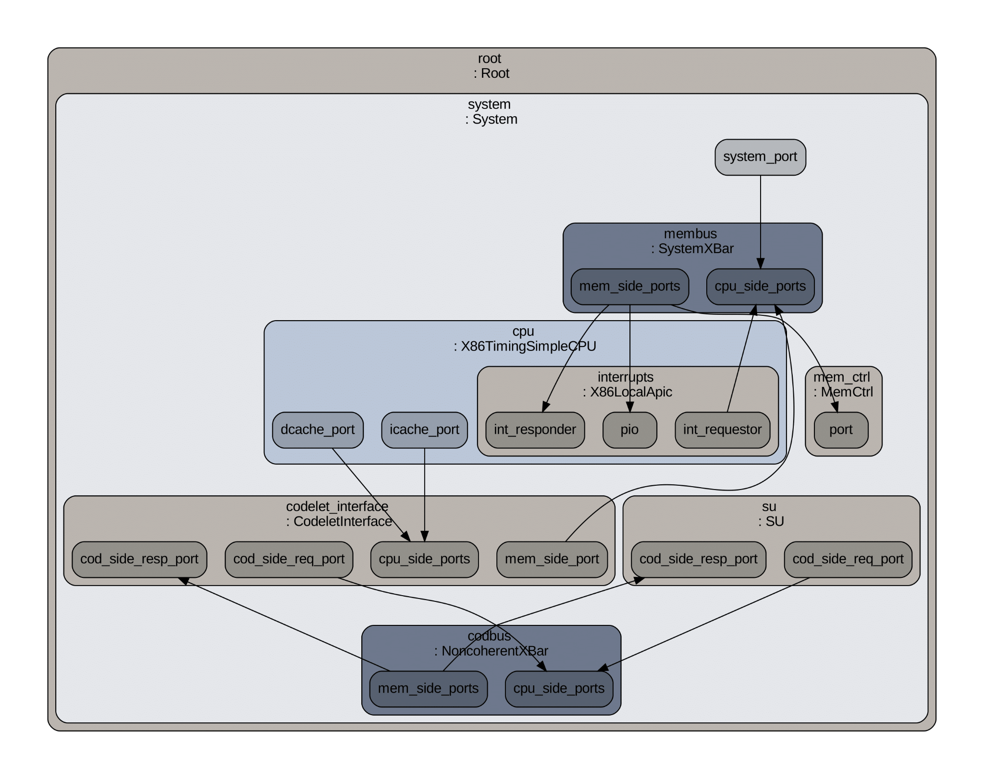
Notes:
Put dot file plot here since gem5 workshop, then highlight difference objects in it as you go through the sim objects to explain them

Slide 16
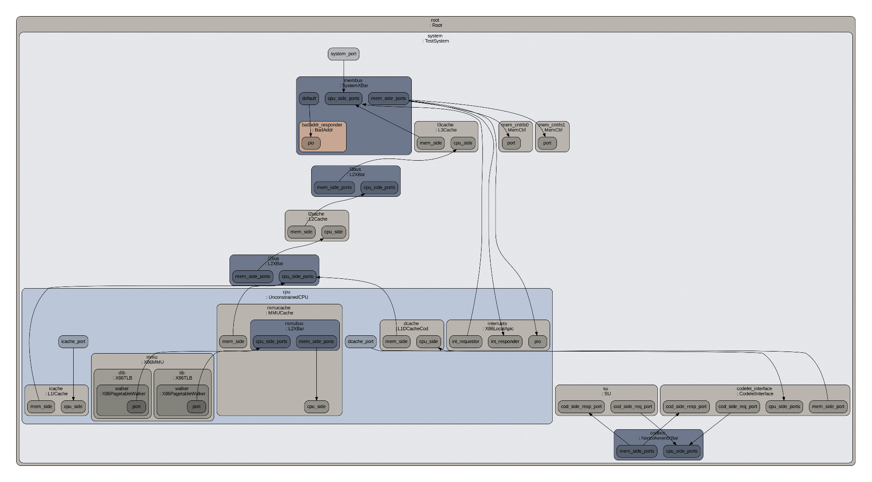

Slide 17
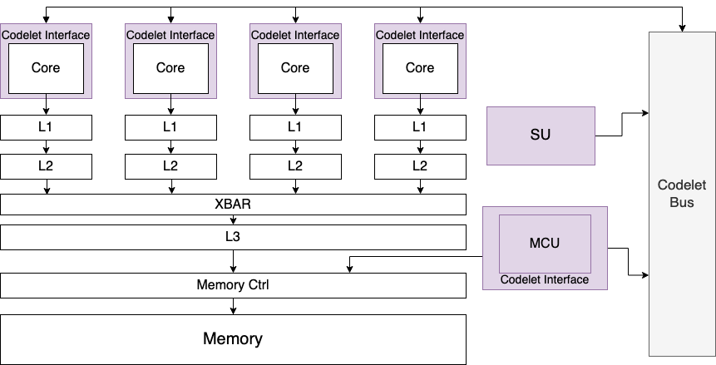
High level diagram of a target Codelet-based system

Slide 18
High level diagram of a target Codelet-based system

Slide 19
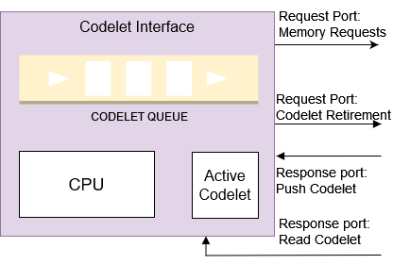
Codelet Interface
Turn the CPU into a Codelet CU
FIFO Codelet Queue
Codelets pushed to queue by SU
Round robin scheduling
Active Codelet is tail of queue
Active Codelet
Read by CPU
Changed when CPU sends retire request
Retire request forwarded to SU
Non-Codelet requests forwarded to memory subsystem
Notes:
Tie back to the other PXM diagram so the function in the machine is obvious. Edit diagram to show that it wraps around the CPU

Slide 20
High level diagram of a target Codelet-based system

Slide 21
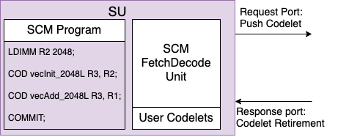
Scheduling Unit (SU)
Manages Codelet dependencies and schedules Codelets to CUs
Loads User Codelets
Mapping between Codelet name and fire function
Loads SCM Program
User program written in SCM-style, Codelet-based code
SCM Fetch-Decode
Fetching and decoding SCM insts.
Schedules execute insts. (Codelets)

Slide 22
How to Use the System
User provides:
SCM Program
Code defining Codelets
Fire functions
Codelet name:fire function mapping
User compiles Codelet-defining code into CU runtime
CU runtime automatically pops Codelets when available and retires them when finished

Slide 23
Continuing Implementation & Future Work

Slide 24
High level diagram of a target Codelet-based system

Slide 25
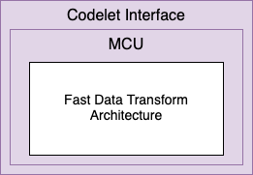
Memory Codelet Unit (MCU)
Special CU to Execute Memory Codelets
Executes Memory Codelets
Emphasis on smart data movement, prefetching, streaming
Preprocessing / recode operations, Extract-Transform-Load
Fast Data Transform arch.
Fast branching
Low latency data transformation
Parallel computation
Local scratchpad mem. and streaming

Slide 26
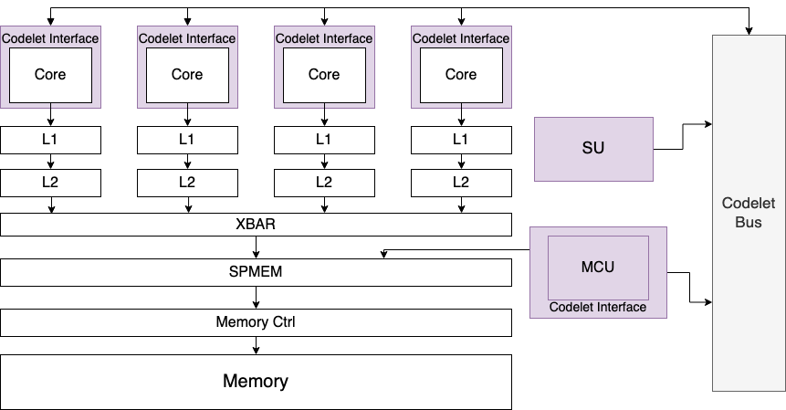
High level diagram of a target Codelet-based system

Slide 27
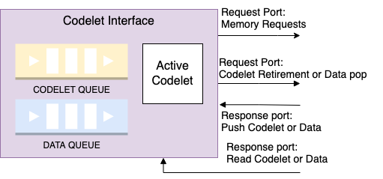
Data Queues
Hardware FIFOs to allow for Streaming Codelets
Streaming Codelets:
Stream data from memory or different Streaming Codelet during execution
Different dependency requirements
Queue abstraction
Runtime can decide to use HW queue if available; else SW queue
Possible data queue implementation in Codelet Interface

Slide 28
Conclusion
Implementation of hardware features of PXMs
Relatively architecture agnostic (support heterogeneity)
Provide alternative memory system structures and smarter ways to prefetch, stream, etc.
Reduce overhead of PXM
Merge with Intel Skylake gem5 configuration
Add MCU, scratchpad memory, data queues
Dawson Fox Jose Monsalve Diaz Xiaoming Li
dawsfox@udel.edu / dfox@anl.gov – jmonsalvediaz@anl.gov – xli@udel.edu

Slide 29
References and Additional Information
gem5 Codelet Model implementation: https://github.com/dawsfox/gem5_cod/tree/codelet
More on streaming in the Codelet Model:
Siddhisanket Raskar. 2021. Dataflow software pipelining for codelet model using hardware-software co-design. Ph. D. Dissertation. University of Delaware.
More on Memory Codelets:
https://doi.org/10.48550/arXiv.2302.00115 On Memory Codelets: Prefetching, Recoding, Moving and Streaming Data
More on DARTS / the Codelet Model:
J. Suettlerlein, S. Zuckerman, and G. R. Gao, “An implementation of the codelet model,” in Euro-Par 2013 Parallel Processing, F. Wolf, B. Mohr, and D. an Mey, Eds. Berlin, Heidelberg: Springer Berlin Heidelberg, 2013, pp. 633–644.
More on PXMs:
J. Dennis, “A parallel program execution model supporting modular software construction,” in 3rd Working Conf. on Massively Parallel Programming Models, Nov. 1997, pp. 50–60.

Slide 30
High level diagram of a target Codelet-based system

