Slide 1
Analyzing the Benefits of More Complex Cache Replacement Policies in Moderns GPU LLCs
Jarvis (Yuxiao) Jia and Matthew D. Sinclair
University of Wisconsin-Madison
jia44@wisc.edu sinclair@cs.wisc.edu

Slide 2
Background: m5 + GEMS = gem5
Ruby: more sophisticated & adaptable
More in-depth coherence support
Classic: quick, simpler option
Often easier to configure
Only basic MOESI coherence protocol
 | Ruby | Classic
Replacement policies | LRU, PseudoLRU | Random, LRU, TreePLRU, BIP, LIP, MRU, LFU, FIFO, Second-Chance, NRU, RRIP, BRRIP
Coherence protocols | MI_example, MESI_Two_Level, MOESI_CMP_directory, MOESI_CMP_token, MOESI_hammer, MESI Three Level, CHI, … | MOESI (snooping protocol)
Problem: Ruby cannot use state-of-the-art replacement policies in Classic
2

Slide 3
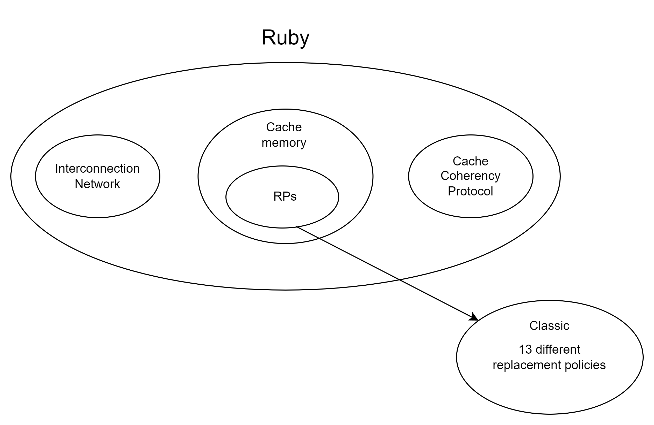
Merging Replacement Policy Support
Merged the cache replacement policies from Classic to Ruby
Users can use any of the replacement policies in either model
How to validate correctness of replacement policies?
3

Slide 4
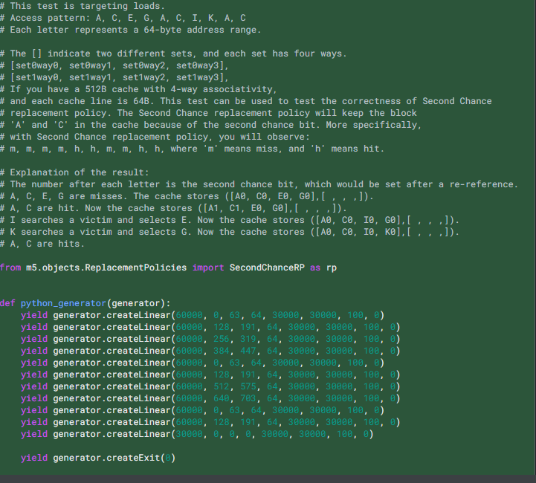
Edge case example for SecondChance RP
4

Slide 5
Access Pattern: A, C, E, G, A, C, I, K, A, C
Way1 Way2 Way3 Way4
5

Slide 6
Access Pattern: A, C, E, G, A, C, I, K, A, C
Way1 Way2 Way3 Way4
A
0
Miss
6

Slide 7
Access Pattern: A, C, E, G, A, C, I, K, A, C
Way1 Way2 Way3 Way4
A | C
0
0
Miss
7

Slide 8
Access Pattern: A, C, E, G, A, C, I, K, A, C
Way1 Way2 Way3 Way4
A | C | E
0
0
0
Miss
8

Slide 9
Access Pattern: A, C, E, G, A, C, I, K, A, C
Way1 Way2 Way3 Way4
A | C | E | G
0
0
0
0
Miss
9

Slide 10
Access Pattern: A, C, E, G, A, C, I, K, A, C
Way1 Way2 Way3 Way4
A | C | E | G
1
0
0
0
Hit
10

Slide 11
Access Pattern: A, C, E, G, A, C, I, K, A, C
Way1 Way2 Way3 Way4
A | C | E | G
1
1
0
0
Hit
11

Slide 12
Access Pattern: A, C, E, G, A, C, I, K, A, C
Way1 Way2 Way3 Way4
A | C | I | G
0
0
0
0
Miss
12

Slide 13
Access Pattern: A, C, E, G, A, C, I, K, A, C
Way1 Way2 Way3 Way4
A | C | I | K
0
0
0
0
Miss
13

Slide 14
Access Pattern: A, C, E, G, A, C, I, K, A, C
Way1 Way2 Way3 Way4
A | C | I | K
1
0
0
0
Hit
14

Slide 15
Access Pattern: A, C, E, G, A, C, I, K, A, C
Way1 Way2 Way3 Way4
A | C | I | K
1
1
0
0
Result: M, M, M, M, H, H, M, M, H, H
15

Slide 16
Turns Out The Replacement Policies Had Bugs!
Replacement Policy-specific Bugs (i.e., both Classic and Ruby)
20881: MRU initialized replacement incorrectly
20882: SecondChance initialized new entries incorrectly
65952: FIFO incorrect if multiple new entries in same cycle
Integration with Ruby-specific Bugs (i.e., only in Ruby)
21099: Ruby called cacheProbe twice in in_ports, causing RP info to be incorrect
62232, 63191, 64371: Ruby updated RP info twice per miss, causing LFU, RRIP, and others to behave incorrectly (MI_example, MESI_Two_Level)
This problem may be in other Ruby protocols too
Current Status: RPs have edge case tests integrated
Correctness testing performed as part of gem5 regression testing
16

Slide 17
How Can We Use These Modern RPs in Ruby?
Prior work has not examined more complex RPs in GPUs
Conventional wisdom: LRU sufficient for GPUs
Traditional GPGPU workloads have streaming access patterns
GPGPU caches traditionally < 64B of space, on average, per thread
Thus, unlikely data will remain in caches long enough for RP to matter
Modern GPUs used for an increasingly wide range of applications
These workloads reuse data more frequently
And modern GPUs have increasingly large LLCs
Added support to use these RPs in gem5’s GPU LLC
17

Slide 18
Methodology
System Setup:
Vega 20 GPU (60 Compute Units, 16KB L1 D$ per CU)
L1 latency: 143, L2 latency: 260, Scalar cache latency: 167
Latencies based on Daniel & Vishnu’s GAP work
Metrics:
Vary L2 (LLC) cache sizes: [256KB, 512MB] (powers of two)
L2 Replacement Policies: FIFO, LFU, LIP, LRU, MRU, NRU, SRRIP, SecondChance, TreePLRU
Write-back and Write-through L2
Study of mix of streaming and non-streaming workloads:
Pannotia, Rodinia
Microbenchmarks to better trace access patterns
Show a subset of these results today for brevity
18

Slide 19
NW (Needleman–Wunsch) WT LLC Execution Time
LFU, MRU generally worse than others – Hurt temporal locality
Little difference between rest of policies until WS fits in LLC
19

Slide 20
NW (Needleman–Wunsch) WT LLC Hit Rate
LLC Hit Rates confirm performance trends
20

Slide 21
NW (Needleman–Wunsch) WB LLC Execution Time
In general WB LLC caches outperform WT LLC caches – reuse opportunities
Average around 6% less execution time than WT
21

Slide 22
NW (Needleman–Wunsch) WB LLC Hit Rate
Same RP trends for WT caches (just hit rates vary)
Higher average hit rate than WT
22

Slide 23
Overall Result Takeaways
MRU and LFU generally perform worse than other RPs
WB/WT choice seems much more important than RP choice (besides not using MRU/LFU)
Performance affected less by RPs as cache size grows, fixed once WS fits in LLC
Surprising how little RP seems to impact performance
Hypothesis: GPU Ruby protocols have similar RP update problems as Ruby CPU protocols
Next Step: targeted microbenchmarks with known access patterns
23

Slide 24
Conclusion
Classic model has more complex RP support in gem5
However, Ruby only supported LRU variants
We improved gem5’s publicly available RP support
Merged RPs – Ruby can now use Classic’s advanced RPs
Integrated RP edge case testing into gem5’s regression testing
Added support to use these RPs into GPU
Current Results:
MRU and LFU fail to exploit temporal locality (bad choices for GPU)
Other RPs provide similar performance to one another
WB vs. WT LLC seems to matter a lot more than RP choice
Next Steps:
Use targeted microbenchmarks to debug GPU LLC RP behavior
Integrate RP into known good GPU models
24

